Slide 1
Final Year Project (Midterm) July2026-December2026

Slide 2
INGRES-Text2SQL: A Multilingual Natural-Language Interface to India's Groundwater Assessment Data
Supervisor(s): <Name, Designation>
Team Member(s):
<Name (Roll No.)>
<Name (Roll No.)>
Department of Computer Science and Engineering

Slide 3
Introduction & Motivation
Groundwater supplies most of India's irrigation; CGWB assesses ~7,000 blocks / mandals / taluks every cycle (recharge, extraction, stage of extraction, Safe to Over-Exploited category)
Results are published through INGRES (CGWB + IIT Hyderabad): a GIS portal with maps and tables, English only
Real users ask questions like "Ludhiana ke kitne blocks over-exploited hain?" or "Which Punjab blocks moved from Critical to Over-Exploited since 2022?"
Text-to-SQL can answer these, but research is English-centric: no benchmark or system covers Indian scripts, Hinglish or ambiguous Indian place names
This project: a multilingual (English, Hindi, Hinglish, Tamil) Text-to-SQL system over official INGRES data, studied as research with a benchmark, baselines and ablations

Slide 4
Problem Statement
Design, build and evaluate a natural-language interface that converts questions about India's groundwater assessments, written in English, Hindi, romanised Hinglish or Tamil, into correct and safe SQL over the official INGRES data, and returns answers whose numbers are grounded in the query result.
Measure, by execution accuracy on a purpose-built benchmark, how much each component contributes:
schema linking across scripts - geographic entity resolution - tokenizer adaptation
numeric grounding verification - agentic decomposition for multi-step questions
Handle code-mixed and noisy input and historical comparisons across assessment cycles with methodology caveats

Slide 5
Objectives
O1 Validated, reproducible database of official INGRES assessments for 5 cycles ✔ done
O2 INGRES-Bench: multilingual Text-to-SQL benchmark with leakage-free splits and a hard test set ✔ done
O3 Baselines: keyword/template, BM25, multilingual embeddings, frontier LLM (in progress)
O4 Learned multilingual schema linker with hard negatives (recall@k, MRR per language)
O5 Hierarchical geographic entity resolver for misspelled, transliterated and ambiguous names
O6 Tokenizer fertility and code-mixing study: link to accuracy; compare translation vs direct vs vocabulary adaptation
O7 Numeric grounding verifier: every number in an answer traced to the SQL result (pass / regenerate / abstain)
O8 Single-shot vs agentic decomposition: accuracy, SQL calls, latency, cost

Slide 6
Literature Survey
Work | Approach | Limitation for our setting
Spider (Yu et al., EMNLP 2018) | Cross-domain Text-to-SQL benchmark, 200 databases | English only
BIRD (Li et al., NeurIPS 2023) | Large benchmark with dirty values, external knowledge | English only
RAT-SQL (ACL 2020), RESDSQL (AAAI 2023) | Schema-aware encoders; decoupled schema linking | Trained on English questions
DIN-SQL (NeurIPS 2023), DAIL-SQL (PVLDB 2024) | LLM prompting, decomposition, self-correction | English only; decomposes every question
MAC-SQL (COLING 2025), CHESS (2024) | Multi-agent / pipeline LLM systems | Cost; per-question-type benefit not isolated
CSpider (EMNLP 2019), MultiSpider (AAAI 2023) | Translated multilingual Text-to-SQL | No Indian scripts, no code-mixing
Petrov et al. (NeurIPS 2023), Rust et al. (ACL 2021) | Tokenizer fertility / unfairness across languages | Not linked to Text-to-SQL accuracy
GLUECoS (ACL 2020), CMI (LREC 2016) | Code-switched NLP benchmark; code-mixing index | No semantic parsing task
FActScore (EMNLP 2023), hallucination survey | Measuring unsupported facts in generated text | Not for numbers derived from SQL

Slide 7
Existing Systems & Comparison
Parameter | INGRES portal | English Text-to-SQL | Multilingual (MultiSpider) | Proposed
Natural-language questions | No | Yes | Yes | Yes
Indian languages / scripts | No | No | No | Hindi, Tamil
Hinglish (romanised code-mixed) | No | No | No | Yes
Ambiguous place names | Manual navigation | Not addressed | Not addressed | Gazetteer + context resolver
Cross-year comparison with caveats | Manual | No | No | Crosswalk + caveats
Numbers verified against data | N/A | Rarely | No | Grounding verifier
Public benchmark / evaluation | N/A | Yes | Yes | INGRES-Bench
Official government data | Yes | No | No | Yes
Public INGRES chatbot prototypes we inspected do not document their data source or report any evaluation.

Slide 8
Research Gap
No multilingual benchmark on Indian public data: no Text-to-SQL benchmark covers Hindi, Hinglish or a Dravidian language
Cross-script schema linking fails: our baselines show BM25 recall@3 of ~0.01 for Hindi and Tamil script vs 0.45 for English
Ambiguous, inconsistently spelled places: 169 unit names are shared across states ('Ramnagar' x10); INGRES itself respells units across cycles (NOWGAON to NOWGONG)
Unsafe cross-year joins: INGRES re-issues unit IDs, and some states changed the unit type (Tamil Nadu firka to taluk)
Unverified numbers in LLM answers, which is unacceptable for policy data
The benefit of agents is not isolated by question type; they add cost and latency
How we address them: INGRES-Bench, learned schema linker, entity resolver, crosswalk + caveats, grounding verifier, targeted agent

Slide 9
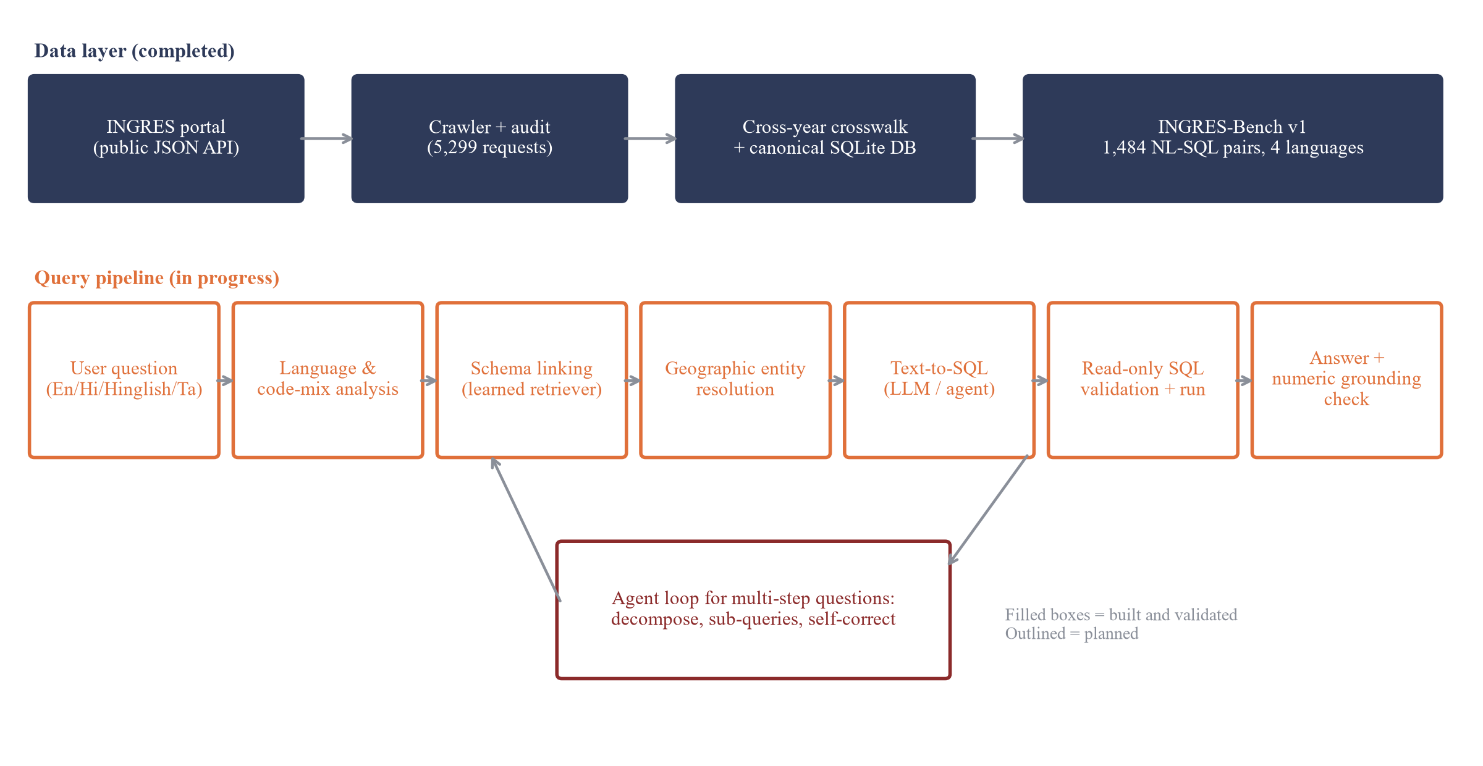
Proposed Methodology

Slide 10
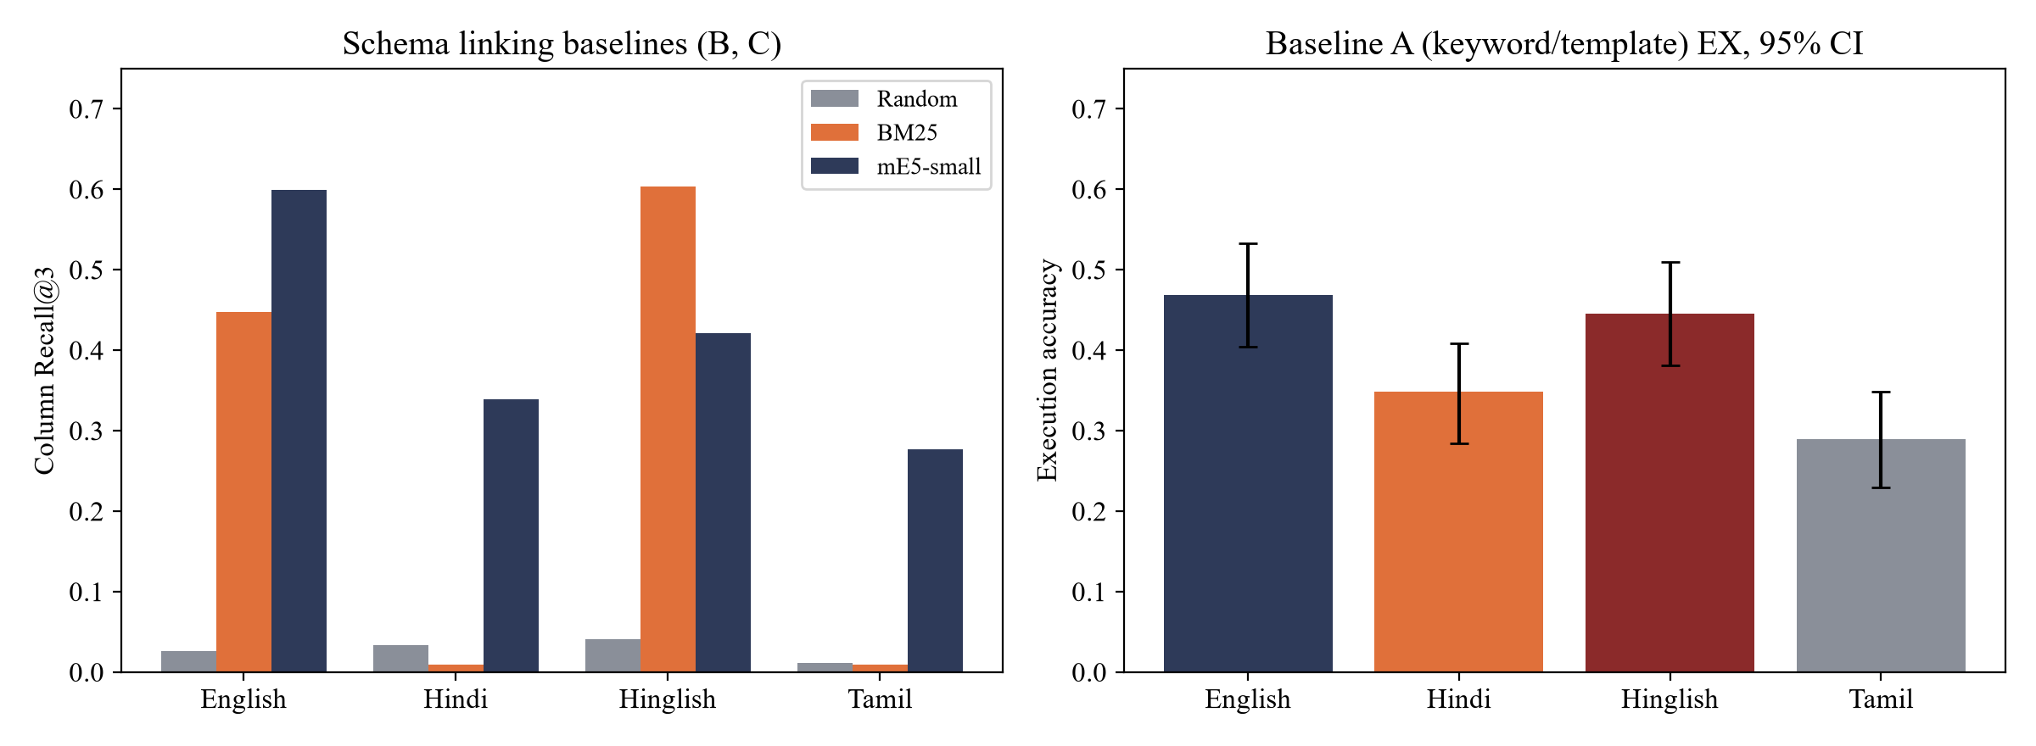
Work Completed (Mid-term)
Data access: found INGRES's public JSON endpoint; crawled 5,299 responses with 0 failures
Database: 5 cycles (GWRA 2020, 2022-2025); national totals match PIB figures within 0.1% (automated test)
Crosswalk: links units across cycles despite re-issued IDs; fuzzy links 37/40 correct on manual check
INGRES-Bench v1: 371 items x 4 languages = 1,484 NL-SQL pairs; 0 QC failures on 8 checks
Baselines: keyword/template EX 38.8%; schema recall@3: BM25 0.267, mE5 0.409 (random 0.028)
Safety: read-only SQL executor; 13 injection / write tests pass
Code: github.com/WAkshat/NLP-INGRES

Slide 11
Feasibility & Expected Outcomes
Technical: data access verified; 22 MB SQLite DB; CPU for retrieval, RTX 5060 (8 GB) for fine-tuning
Tools: Python, SQLite, pandas, scikit-learn, sentence-transformers, multilingual-e5, Gemini API, Git/GitHub
Economic: open-source tools, public data, free-tier LLM with on-disk caching; zero cost
Operational / schedule: fully scripted, reproducible pipeline; riskiest phases (data, benchmark) already done
Expected outcomes
Validated INGRES database and data-access report (achieved)
INGRES-Bench: first multilingual, code-mixed Text-to-SQL benchmark on Indian government data (achieved)
Measured contribution of each component via ablations, including negative results
Working read-only prototype with SQL, result, grounded answer and cross-year caveats

Slide 12
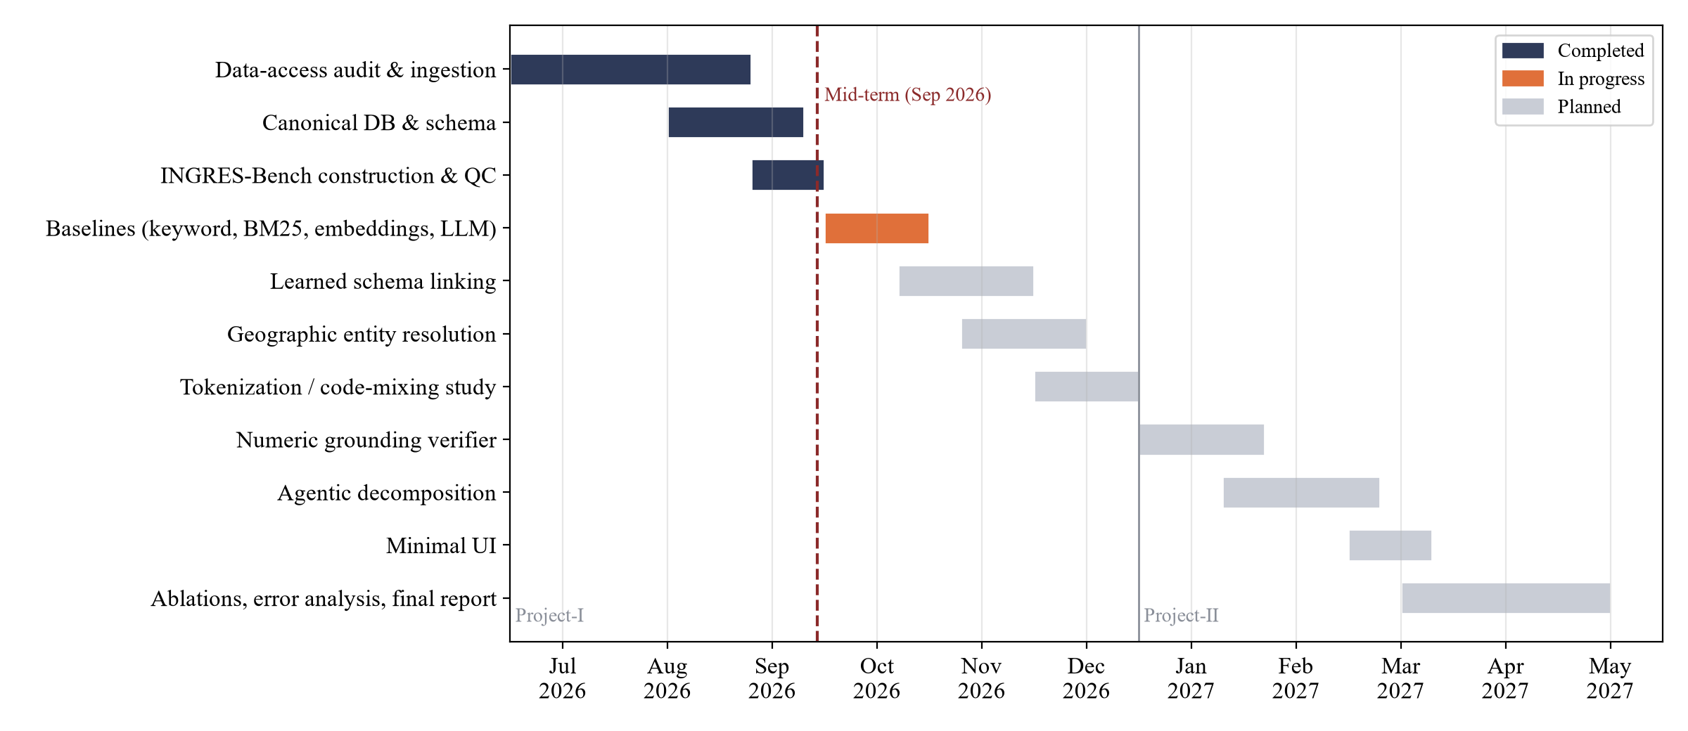
Project Timeline (Gantt Chart)

Slide 13
Responsibility Chart
Task | <Member 1> | <Member 2> | <Member 3> | <Member 4>
Data access, crawling and audit | R | A | C | I
Canonical database and crosswalk | R | C | A | I
INGRES-Bench construction and QC | A | R | R | C
Baselines and evaluation harness | C | R | A | R
Schema linking and tokenization study | C | A | R | C
Entity resolution and numeric grounding | R | C | C | A
Agent, UI and documentation | A | C | C | R
R = responsible, A = accountable, C = consulted, I = informed

Slide 14
References
Yu et al., Spider, EMNLP 2018 | Li et al., BIRD, NeurIPS 2023 | Wang et al., RAT-SQL, ACL 2020
Pourreza & Rafiei, DIN-SQL, NeurIPS 2023 | Gao et al., DAIL-SQL, PVLDB 17(5) 2024 | Li et al., RESDSQL, AAAI 2023
Min et al., CSpider, EMNLP-IJCNLP 2019 | Dou et al., MultiSpider, AAAI 2023
Wang et al., MAC-SQL, COLING 2025 | Talaei et al., CHESS, arXiv:2405.16755
Petrov et al., Tokenizer unfairness, NeurIPS 2023 | Rust et al., How good is your tokenizer?, ACL 2021
Khanuja et al., GLUECoS, ACL 2020 | Gambäck & Das, Code-switching level, LREC 2016
Gala et al., IndicTrans2, TMLR 2023 | Wang et al., Multilingual E5, arXiv:2402.05672
Robertson & Zaragoza, BM25 and beyond, FnTIR 2009 | Min et al., FActScore, EMNLP 2023 | Ji et al., ACM CSUR 2023
CGWB, GEC-2015 report (2017) | PIB releases on Dynamic Ground Water Resources 2022-2025 | INGRES portal, ingres.iith.ac.in

Slide 15
Annexure I
Front page of plagiarism report provided by guide

Slide 16
Annexure II
Screenshot of mentor’s mail /comments by Guide

