Slide 1
DPPHA 30560
Data Visualization
Week 2 : Labels, axes and design
Intro to the web

Slide 2
Features of a chart
Title
Subhed
Axes
Data
Key / Annotation
Source

Slide 3
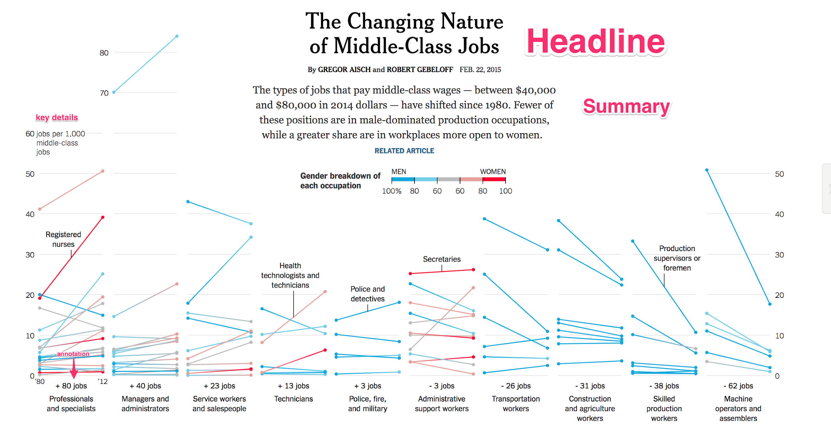
Features of a chart
Notes:
What do you notice about how the key elements of this chart are organized in terms of visual emphasis?

Slide 4
Hierarchy
IMPORTANT (hed)
Less important (subhed, labels)
Key detail (axis labels)
Detail (NOTE OR LEGEND)
Notes:
It’s a concept that we’re going to come back to alot in class. Remember that. Today we’re going to focus on axes

Slide 5
Axes:
“Visible when you need them. Invisible when you don’t.”

Slide 6

Why do we need them?
To help readers navigate through the chart

Slide 7
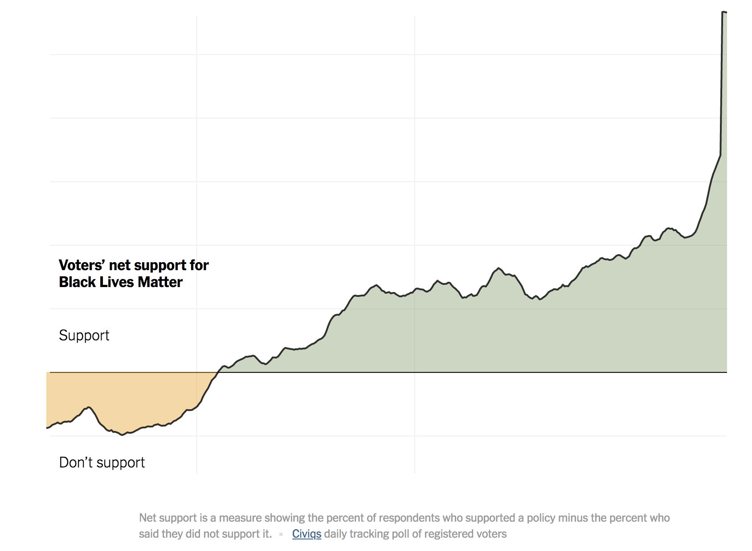
Notes:
What are we seeing? What is this chart saying?
https://www.nytimes.com/interactive/2020/06/10/upshot/black-lives-matter-attitudes.html

Slide 8
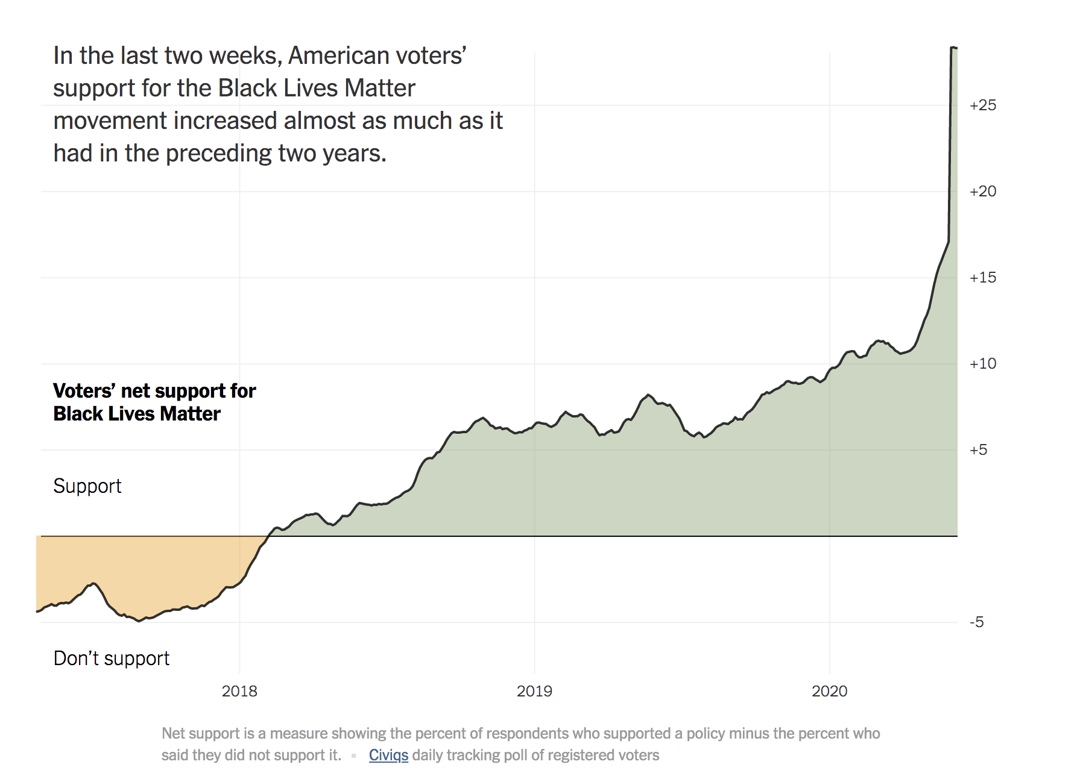
Notes:
What is it saying now?

Slide 9
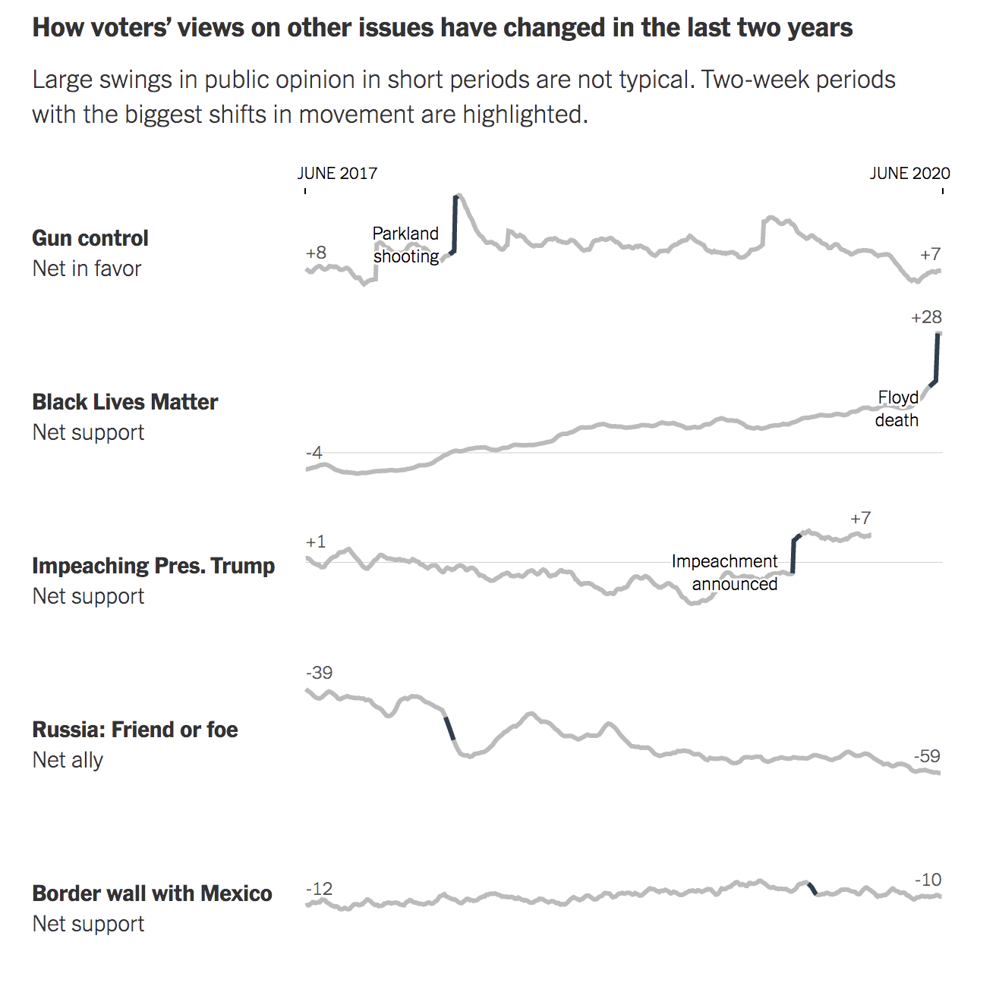
But sometimes you don’t need them
Notes:
Sometimes you don’t need the axis. In the very same article.

Slide 10
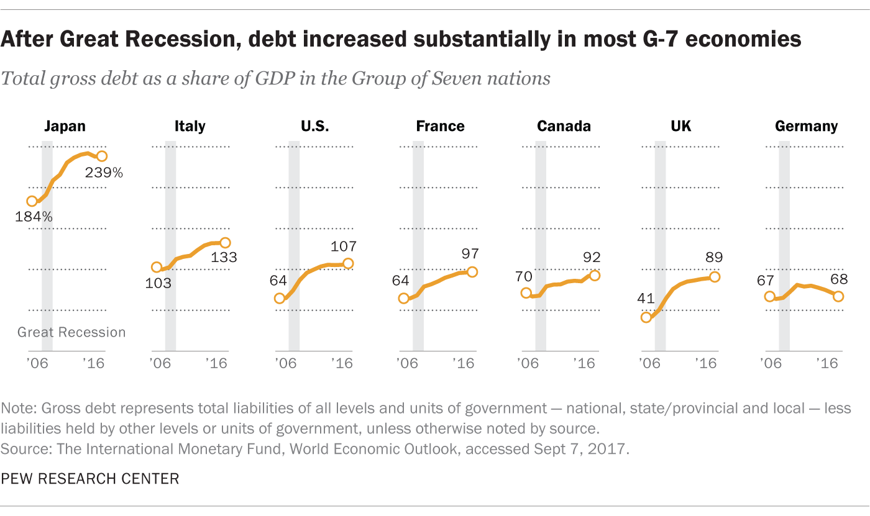
Notes:
Or you need the ticks but not labels

Slide 11
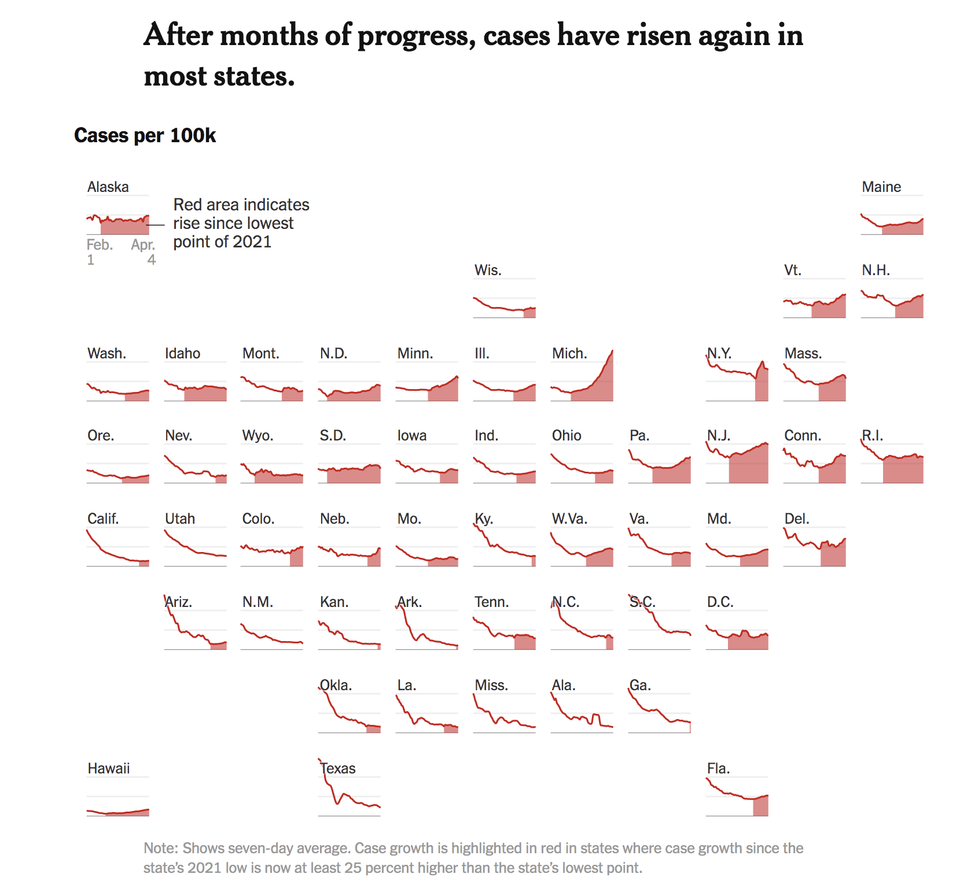
Notes:
Go back to our idea of hierarchy. We want to display the idea. The data. But we don’t want to increase visual load. More numbers, more words = more load.

Slide 12
A few tips on Y Axes
Use just enough to get by
Use units that make sense
Write out units explicitly, on the line if you can
The more numbers you have on screen, the less of need you have for axis
Line doesn’t have to extend across

Slide 13

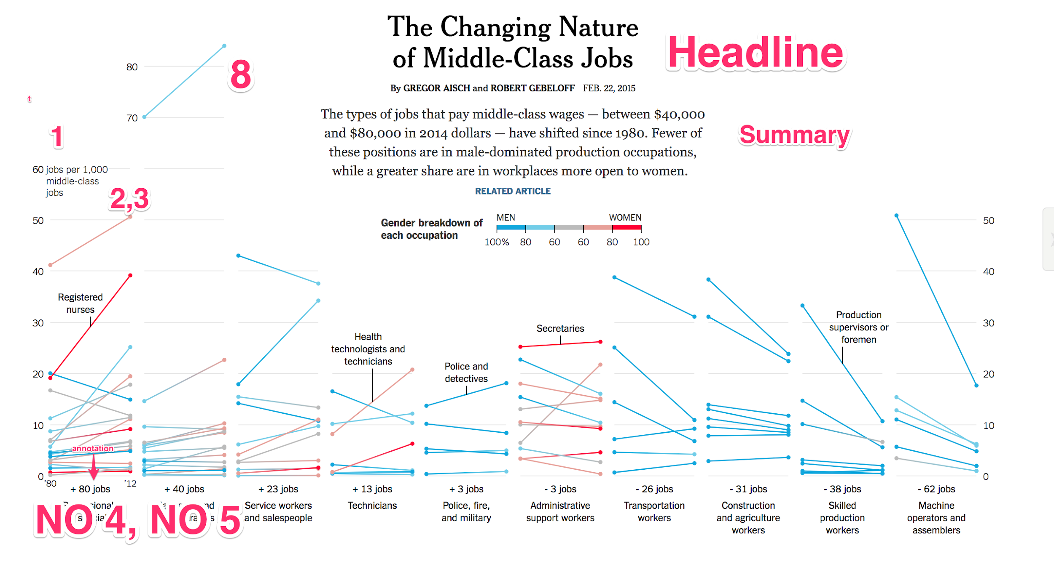

Slide 14
Baselines
Darken zero baselines.
Do not need to label zero baselines.
Almost always zero-base data.
If you don’t try to find some other relevant baseline
You can even use two baselines, zero and some other relevant metric!

Slide 15
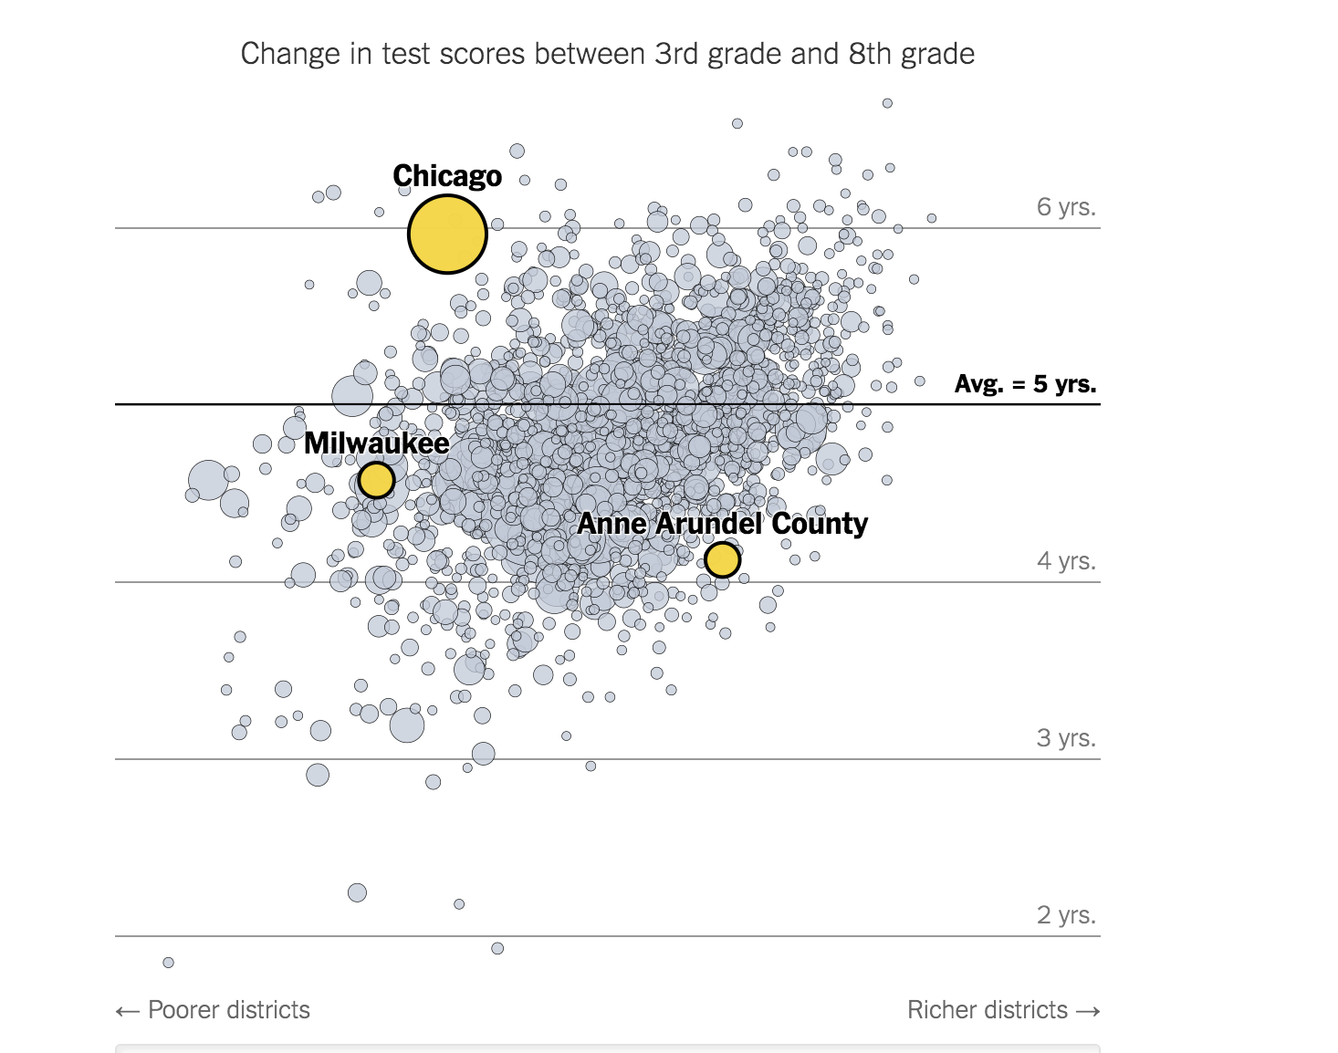

Slide 16
Rules on X Axes
You don’t need that many.
Dates don’t need to be evenly spaced. They just need to mean something.
Ticks should be short (or no length at all). Except for scatters, then they can be long
If it’s bar charts with discrete values, then you need to label everything.
Small multiple charts usually only need 2 dates

Slide 17
Notes:
Or you need the ticks but not labels

Slide 18
Axes labels
If label or axes are going to be complicated, try gesturing directionally.

Slide 20
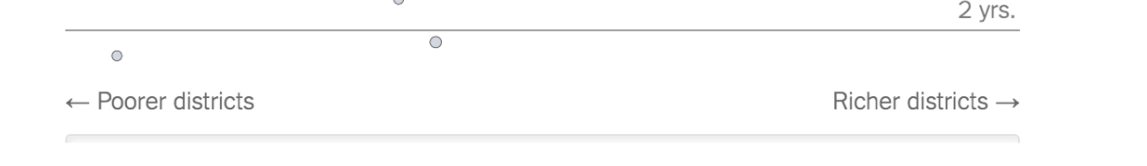

Slide 21
Tick marks
Grey is your friend on a white background
Make them thin: .5px to 1px max!
You can also make them a dotted line.
Should sit behind the data.
Unless it’s a dark foreground, then white strokes are your friend

Slide 23
Other axes-like elements
Use light backgrounds when you have a lots of empty space. It will help grid out the shape of the chart.
Unless you’re using white space as rhetorical device
Annotate important dates with vertical annotations

Slide 24
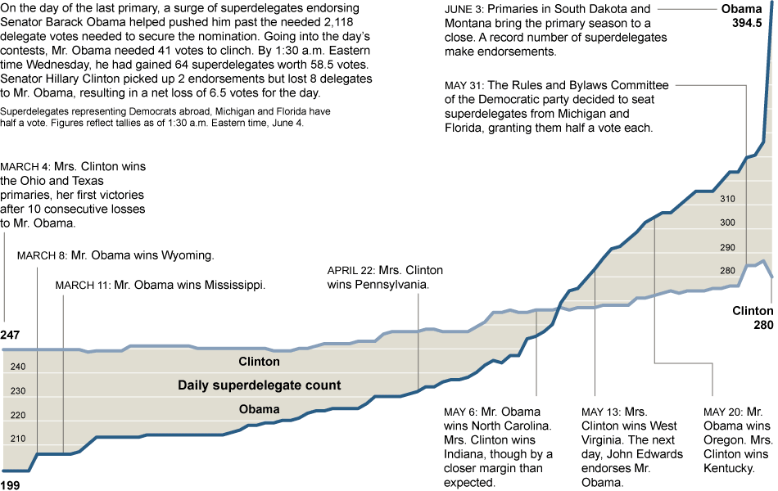
Notes:
https://archive.nytimes.com/www.nytimes.com/interactive/2008/06/03/us/politics/20080603_SUPERS_GRAPHIC.html

Slide 25
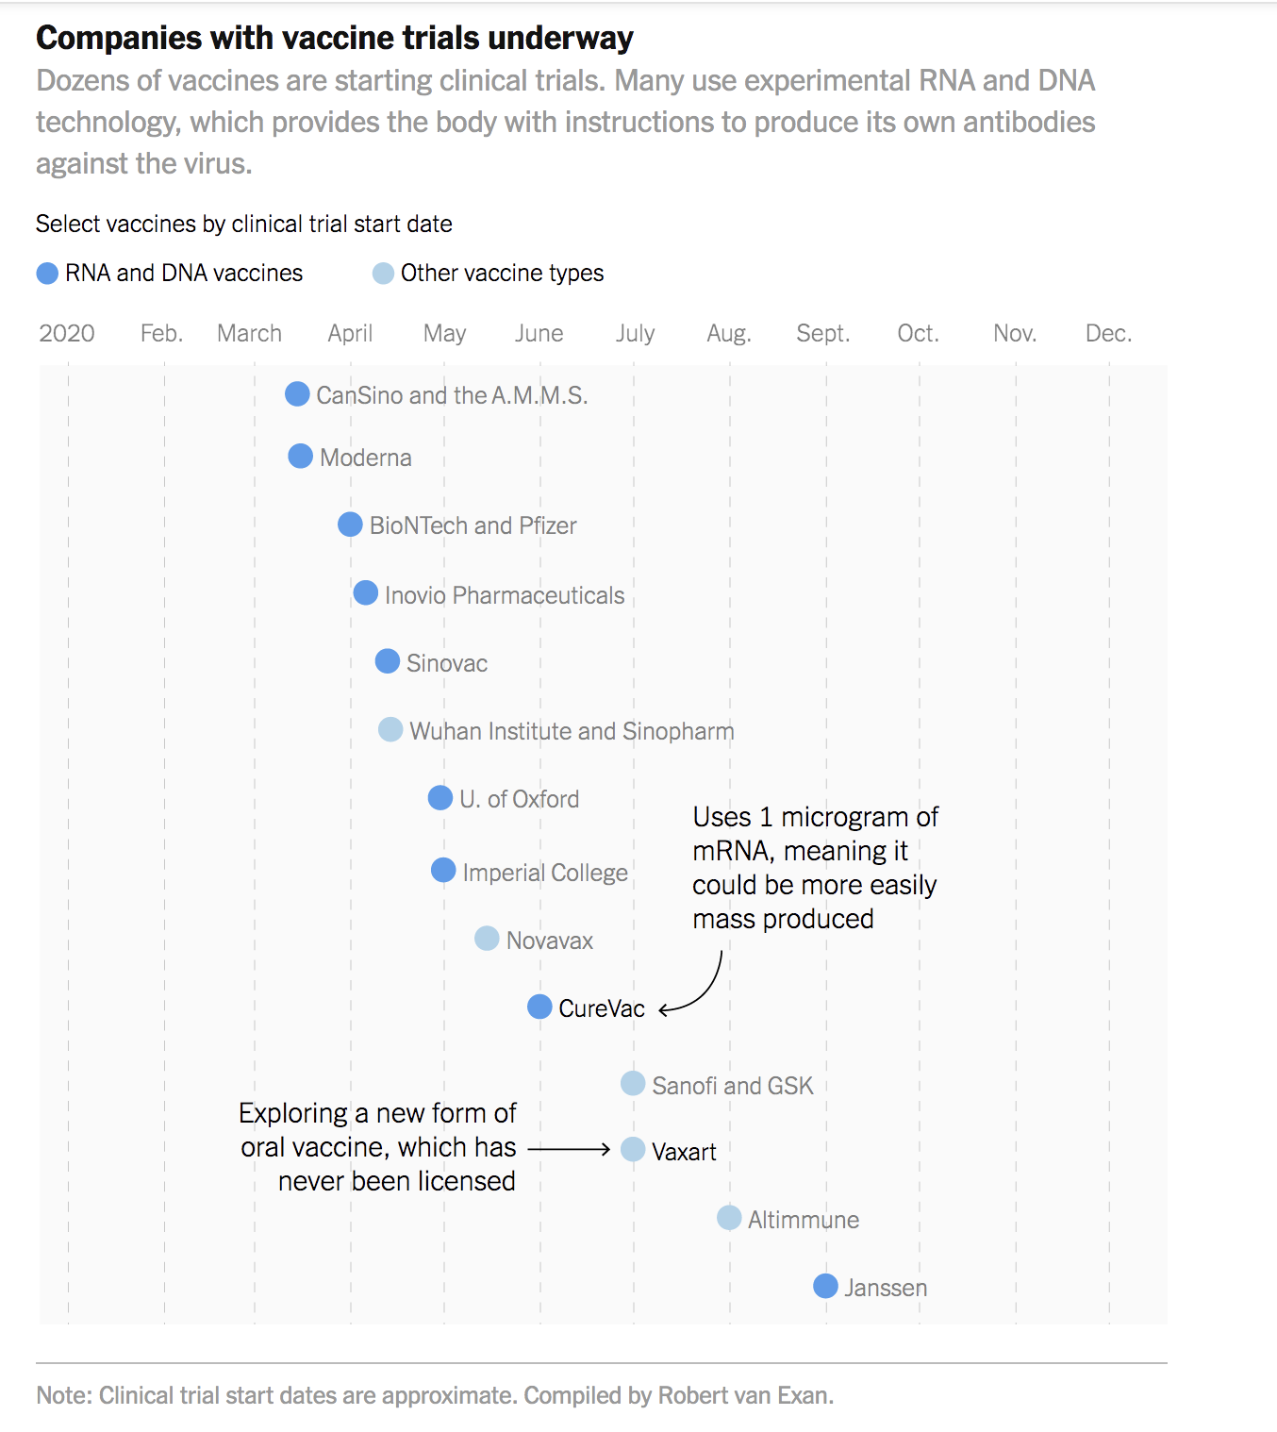

Slide 26
One cool trick
https://www.nytimes.com/interactive/2020/06/10/upshot/black-lives-matter-attitudes.html

Slide 27
Inkscape DEMO

