Slide 1
DPPHA 30560
Data Visualization
Week 3 :
Intro to the web

Slide 2
Understanding your web tools

Slide 3
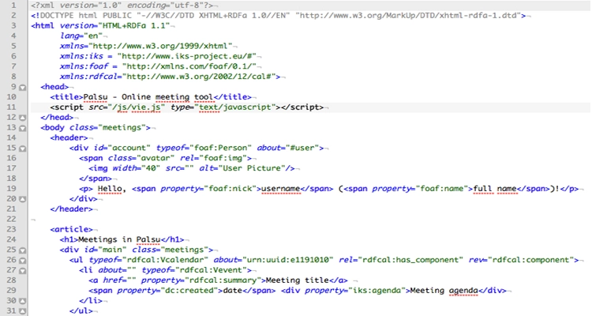
HTML
The bones of your page
Defines the structure of how stuff works on your page

Slide 4
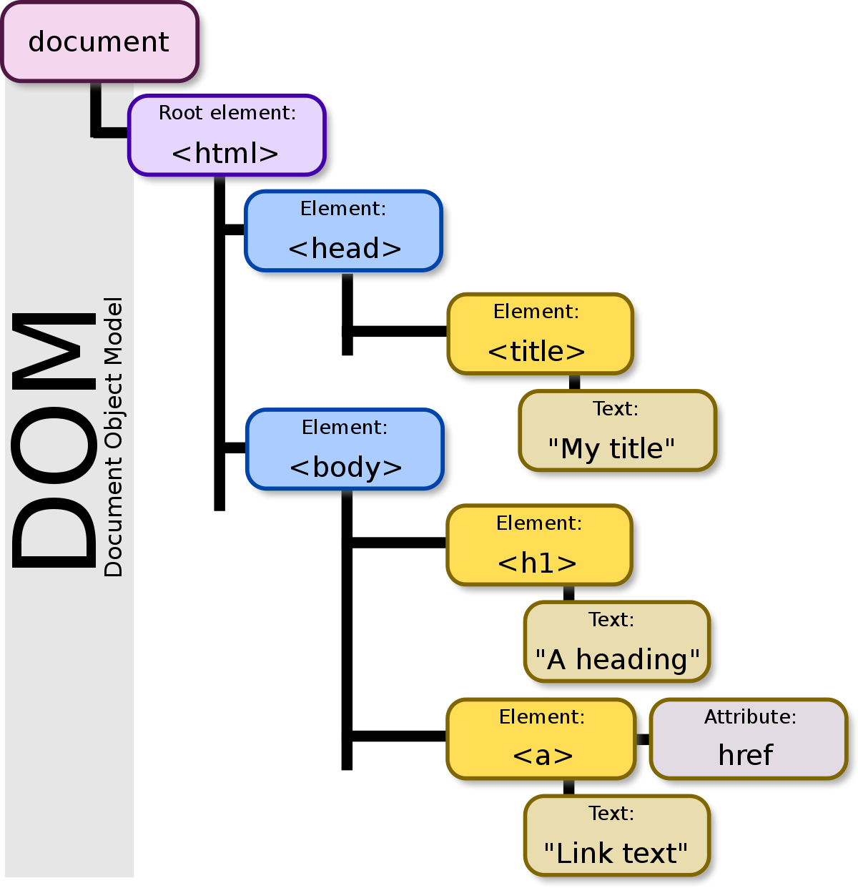
Notes:
This is important! It allows you to navigate the elements on the page.

Slide 5
HTML
https://www.geeksforgeeks.org/dom-document-object-model/
https://developer.mozilla.org/en-US/docs/Web/API/Document_Object_Model/Introduction
https://eloquentjavascript.net/14_dom.html

Slide 6
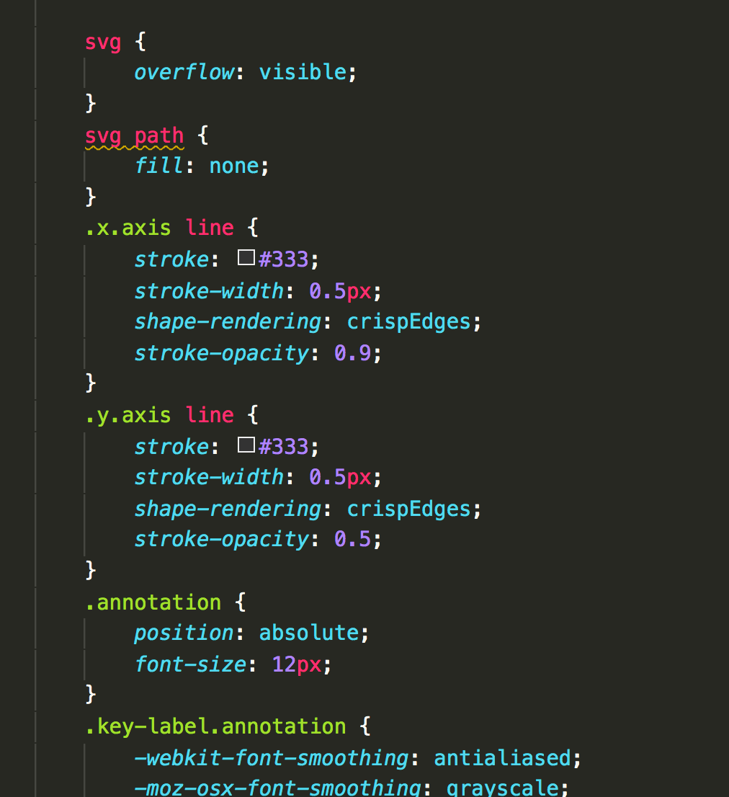
CSS
The skin. Defines how things look.

Slide 7
CSS
https://www.w3schools.com/css/css_intro.asp
https://css-tricks.com/how-css-selectors-work/

Slide 8
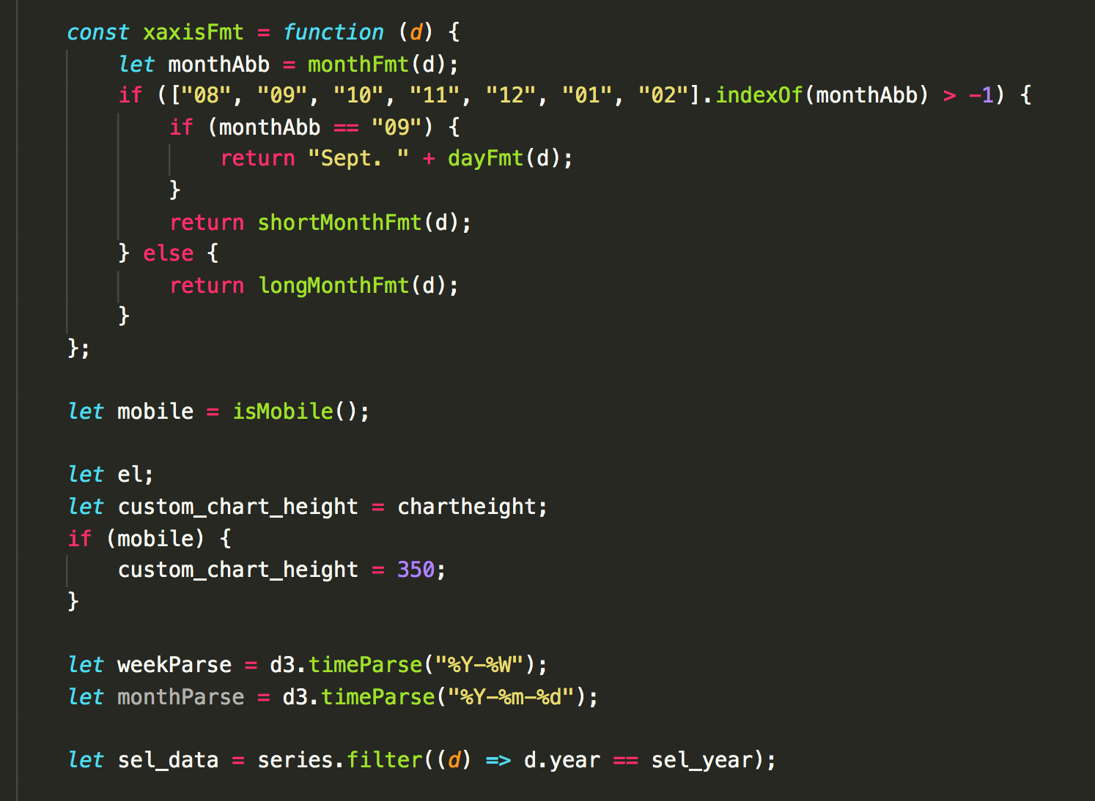
Javascript
The muscle.
Get things to work.

Slide 9
Javascript
https://developer.mozilla.org/en-US/docs/Web/JavaScript/A_re-introduction_to_JavaScript
https://eloquentjavascript.net/00_intro.html

Slide 10
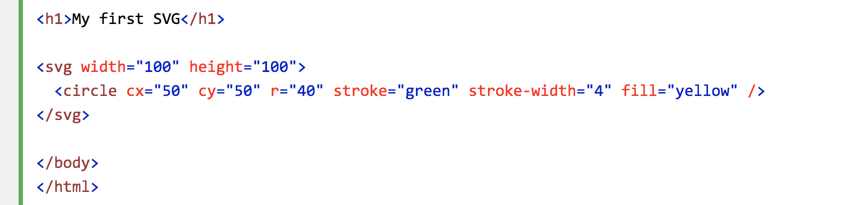
SVG
The chart components on your page

Slide 11
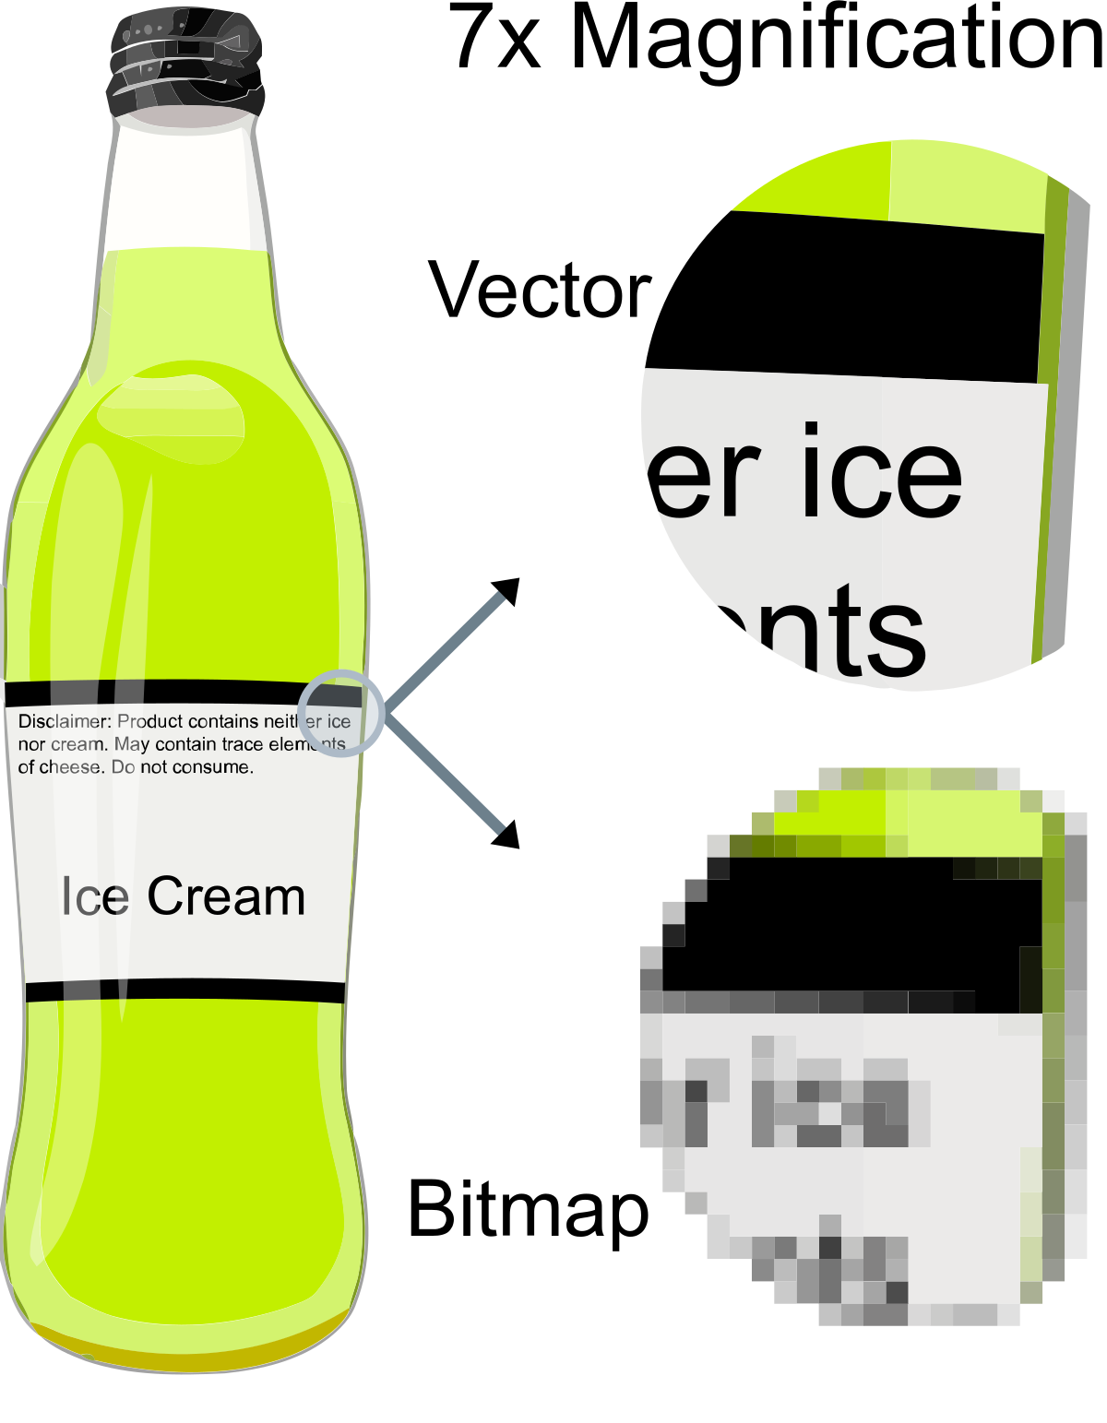
Vector graphics
Uses math to dictate imagery.

Slide 12
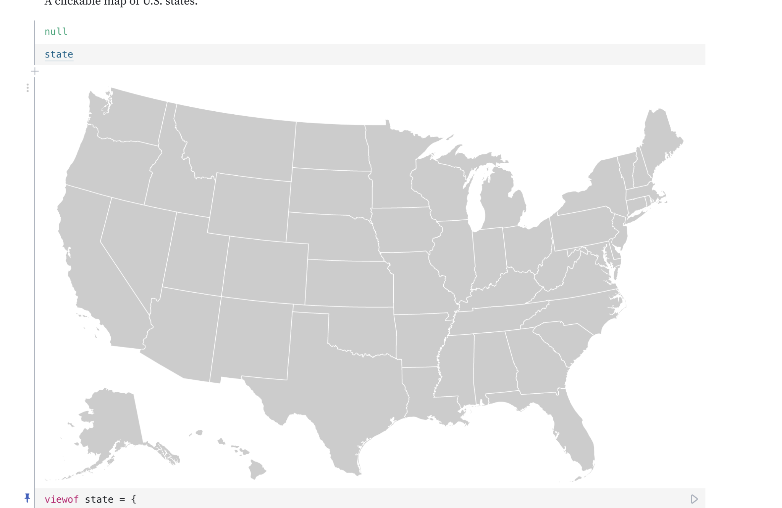
Notes:
https://observablehq.com/@mbostock/u-s-state-map

Slide 13
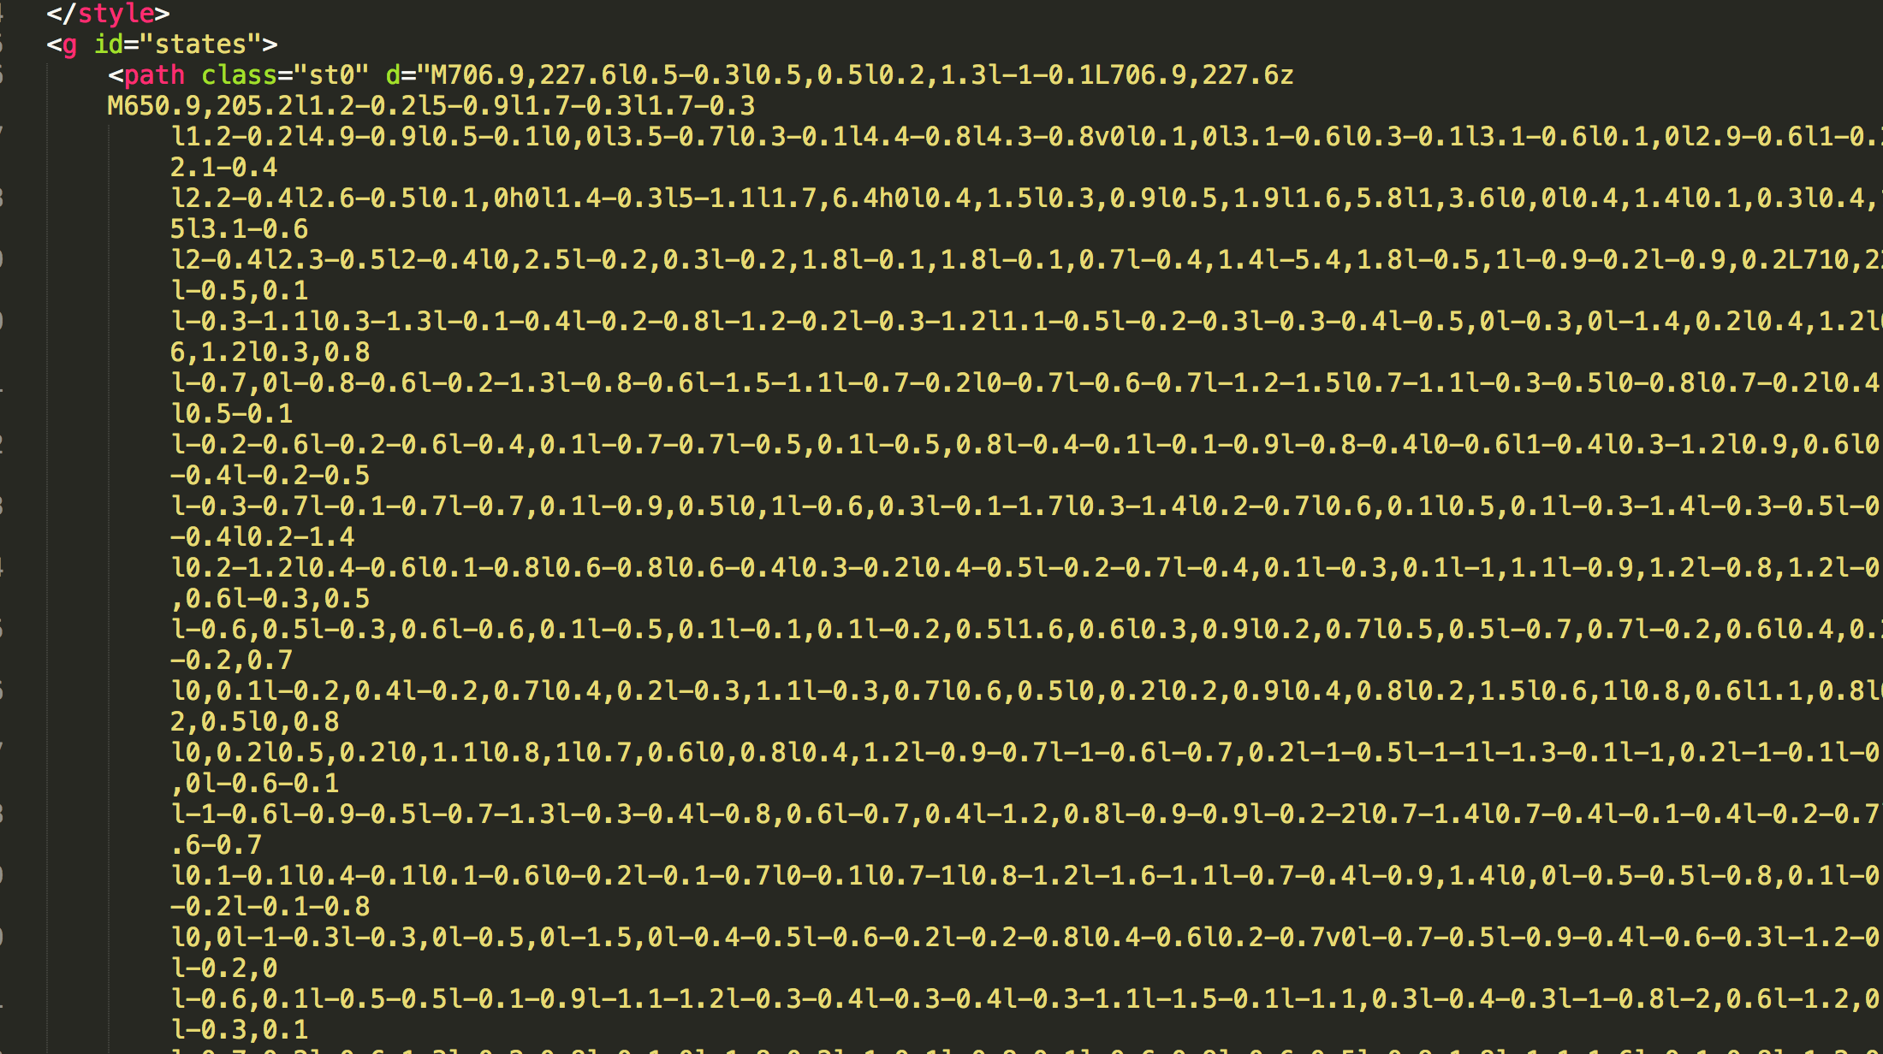

Slide 14
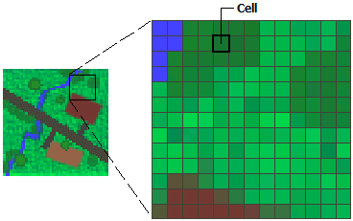
Raster image
Jpegs
Tiffs
Photography

Slide 15

D3
A library within Javascript.
Made by a former NYT staffer, Mike Bostock
https://d3js.org/
Its success is probably why you’re here in this classroom
Why is it so useful?
It is designed to leverage the components of the web to make charts
For more:
Bostock introduction to D3 at W3Conf in 2011: https://www.youtube.com/watch?v=ZDcwvIlcTB8
10 years later! https://observablehq.com/@mbostock/10-years-of-open-source-visualization
https://observablehq.com/@d3/learn-d3
Notes:
=

Slide 16
How to use webtools
Inspector
Mousing over elements
$0.__data__
Logging
console.log()
Network

Slide 17
Stealing data, copying charts
https://www.nytimes.com/interactive/2020/11/06/upshot/suburbs-shifted-left-president.html
https://bl.ocks.org/

