Slide 1
JUPITER Paraguay
Workforce and Wage Bill Analytics
Galileu Kim

Slide 2
Workforce

Slide 3
Overview
This presentation focuses on workforce and wage bill analytics for the justice sector of Paraguay, focusing on the Supreme Court of Justice.
The data spans from January 2016 through December 2025.
On average, there are 13-15 thousand workers in the Justice sector.
While most of our analysis treats the sector as a whole, some of the analysis focuses on specific occupation groups: juez de paz, juez de primera instancia y miembro de tribunal.

Slide 4
Main findings
The headcount in the justice sector has remained stable over time.
Wages, in real terms, have declined. This decline has been driven primarily by a lack of adjustment in base salaries.
The wage bill has remained stable. This stability is due to the offsetting effects of declining wages and growing headcount.
There are gender disparities in employment and wages. In general, women receive lower wages, likely because their employment is concentrated in lower-paying occupations (e.g., juez de paz).

Slide 5
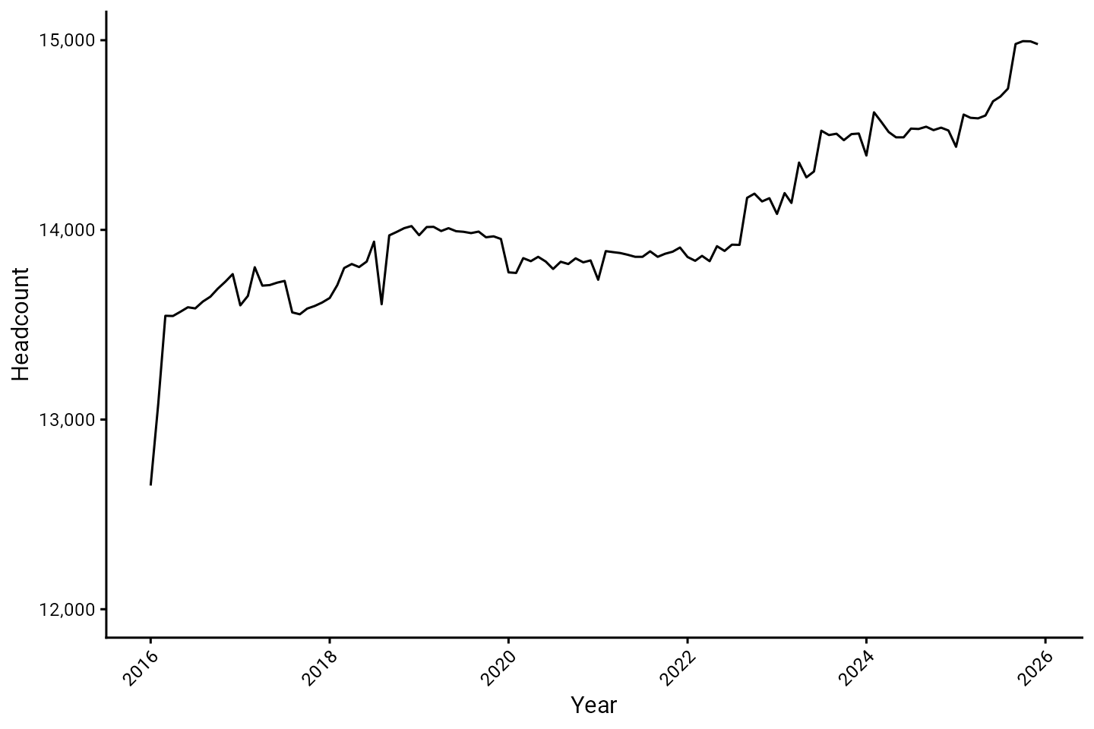
Headcount

Slide 6
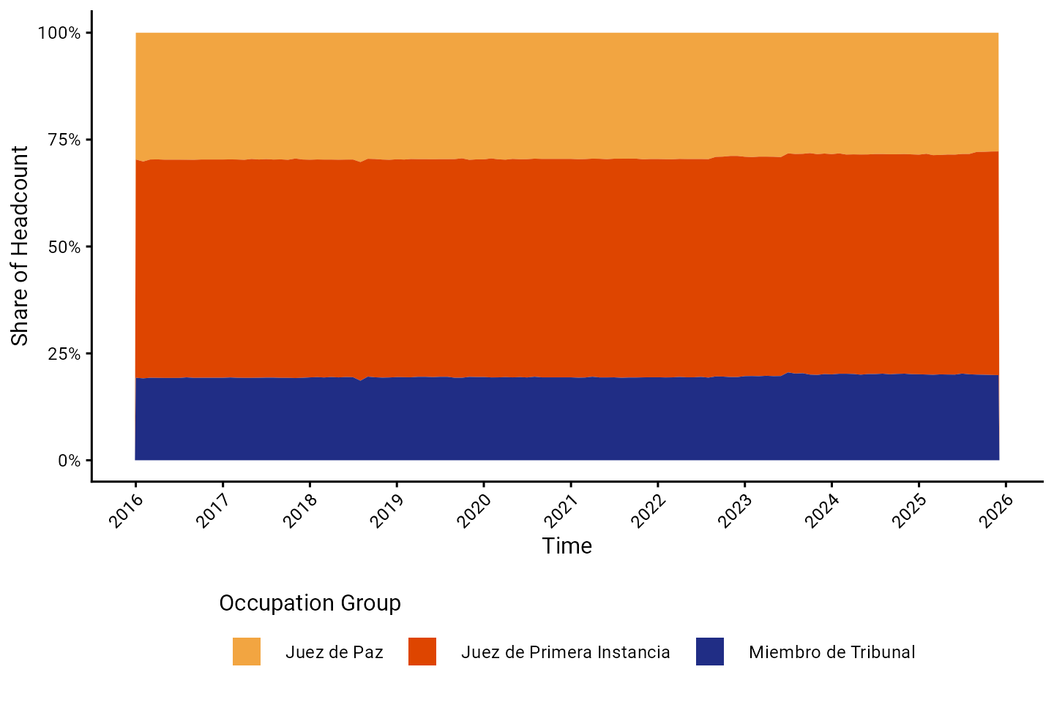
Headcount by occupation group

Slide 7
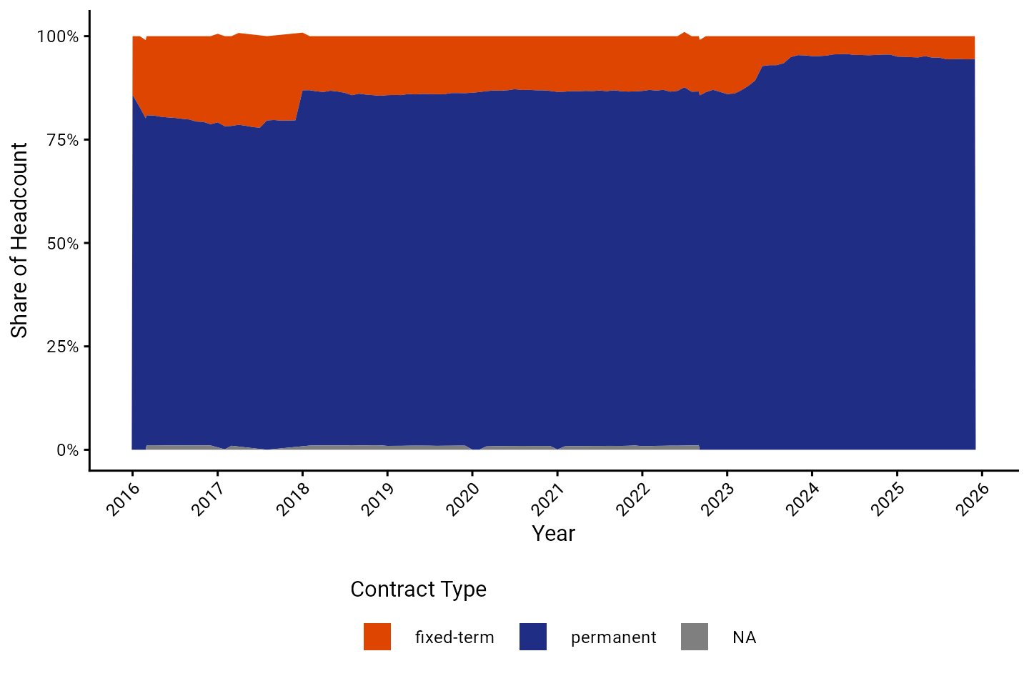
Headcount by contract type

Slide 8
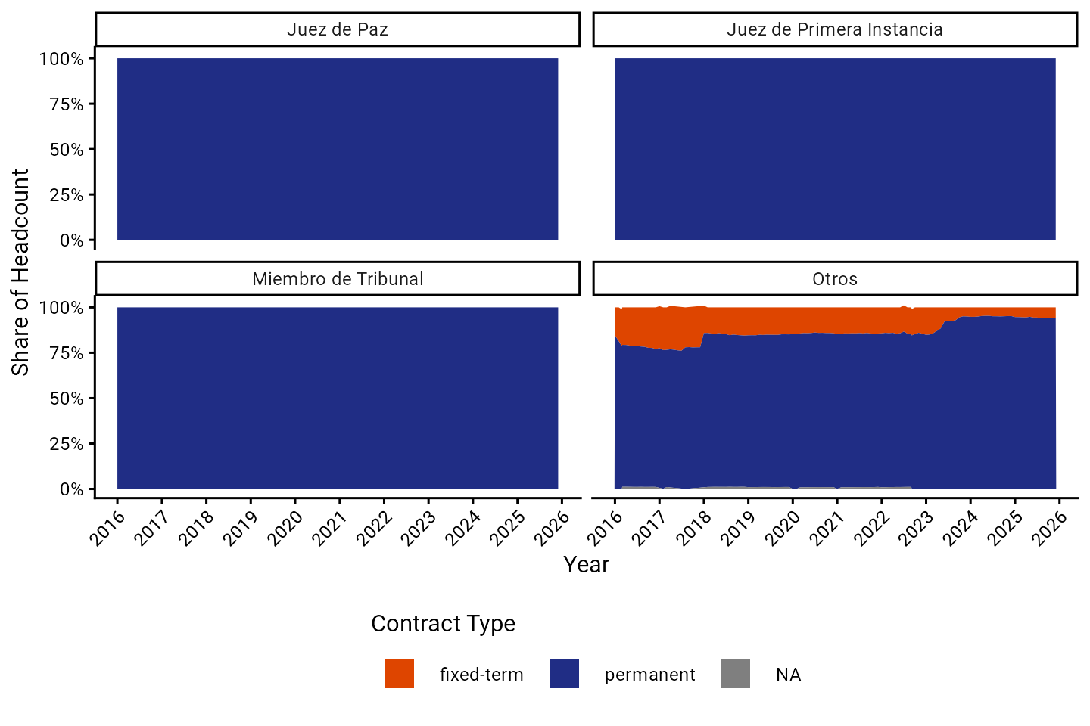
Headcount by contract type and occupation group

Slide 9
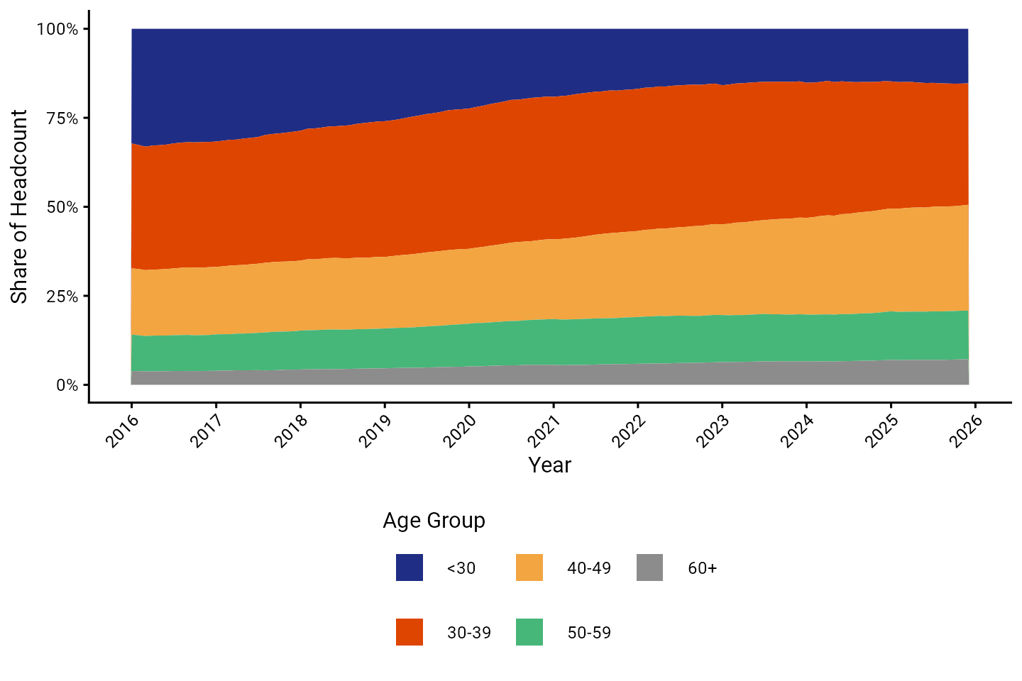
Headcount by age group

Slide 10
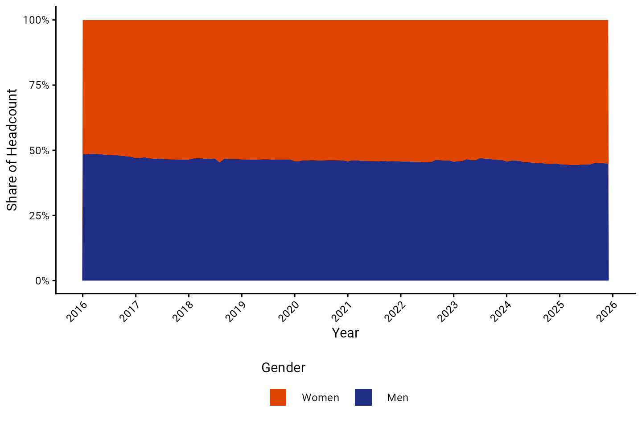
Headcount by gender

Slide 11
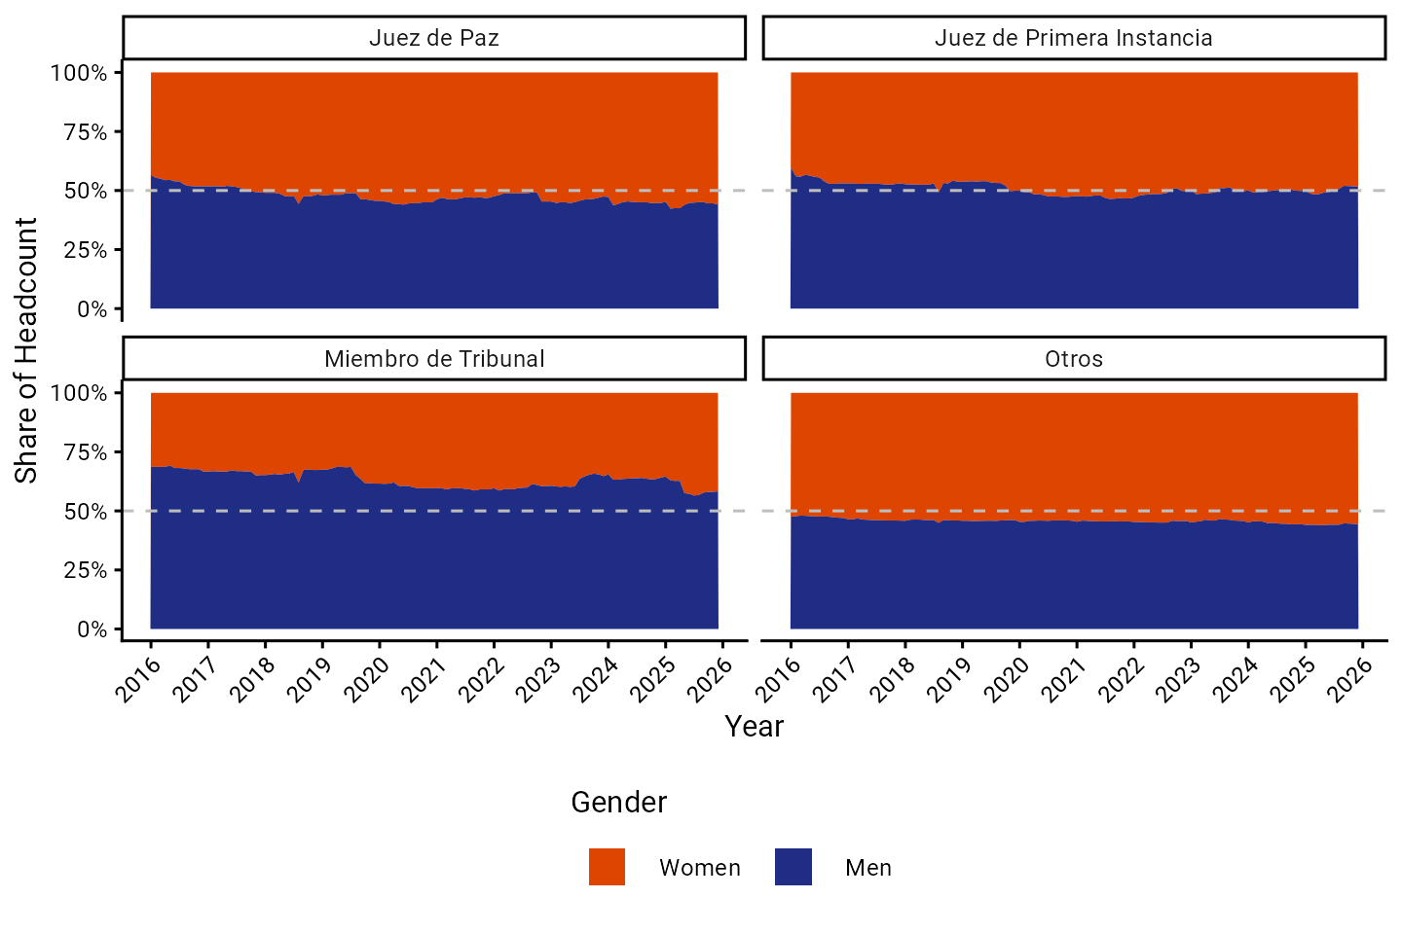
Gender composition by occupation group

Slide 12
Movements

Slide 13
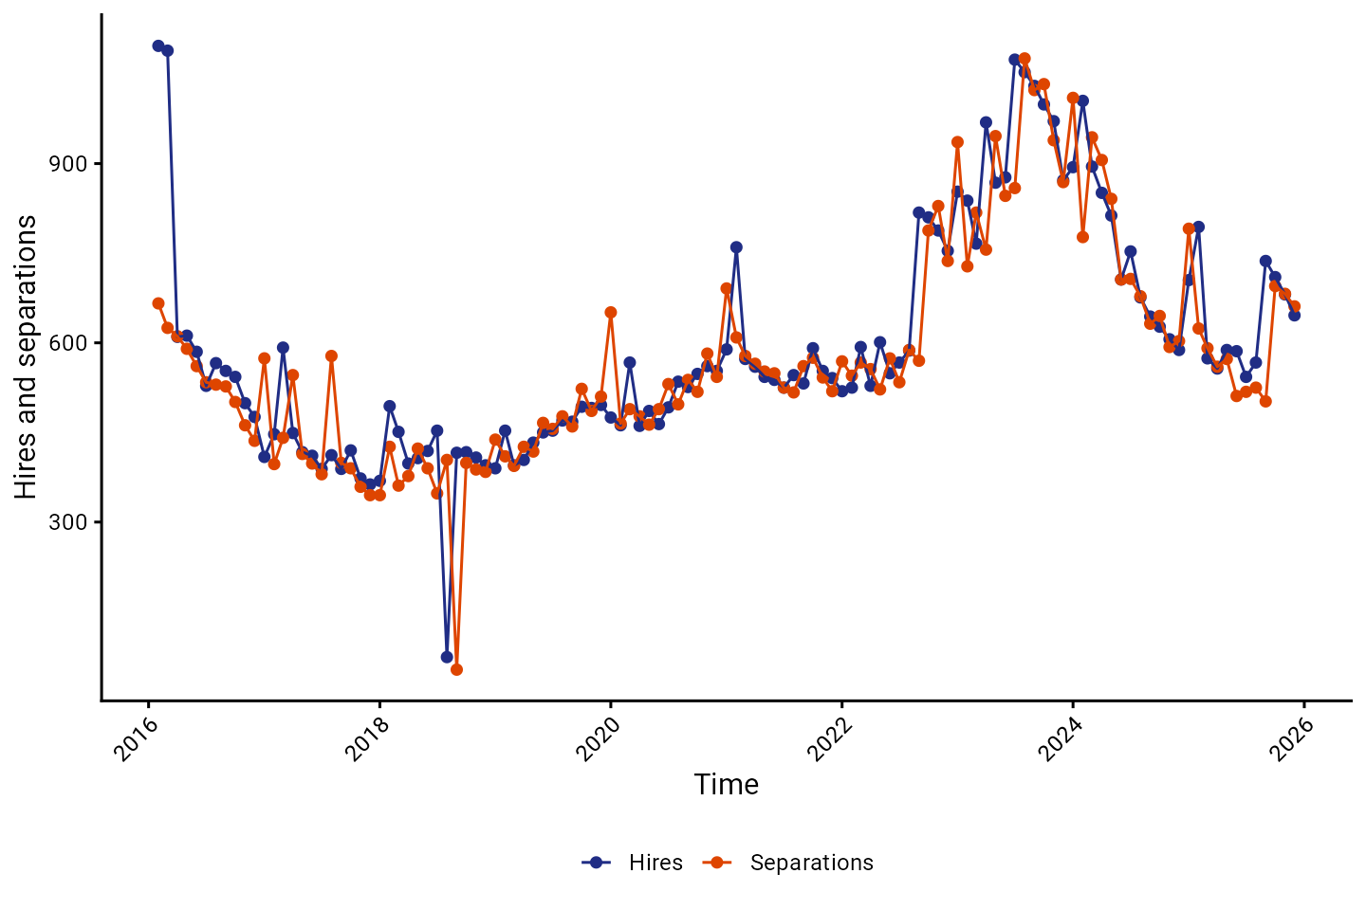
Hires and separations

Slide 14
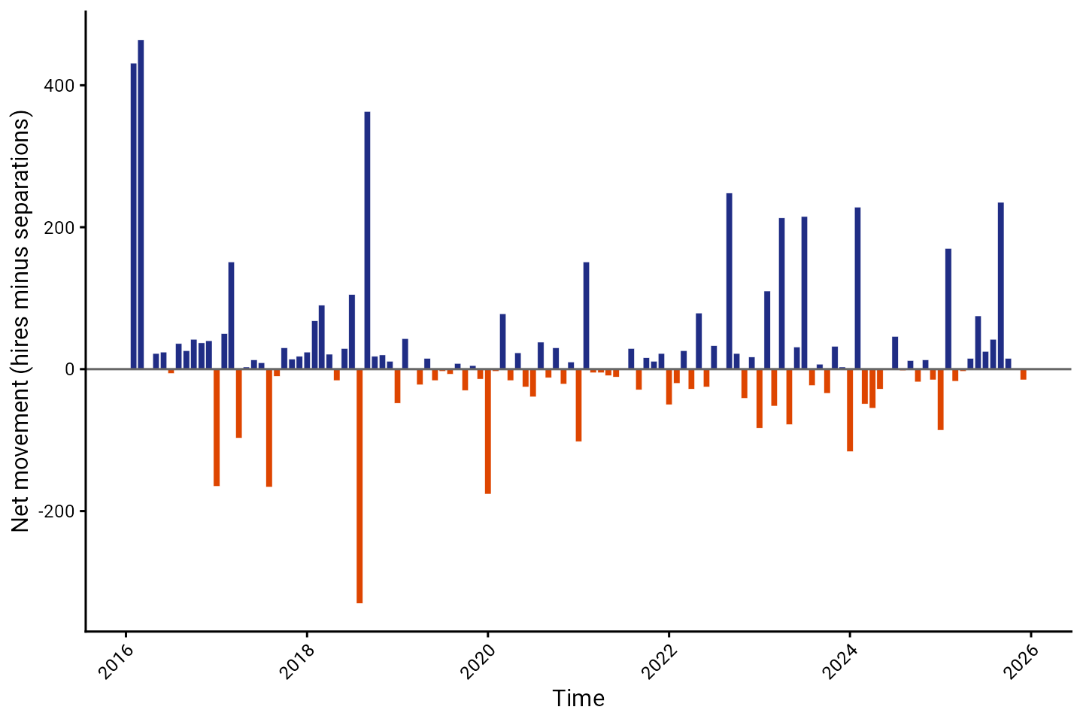
Net movements

Slide 15
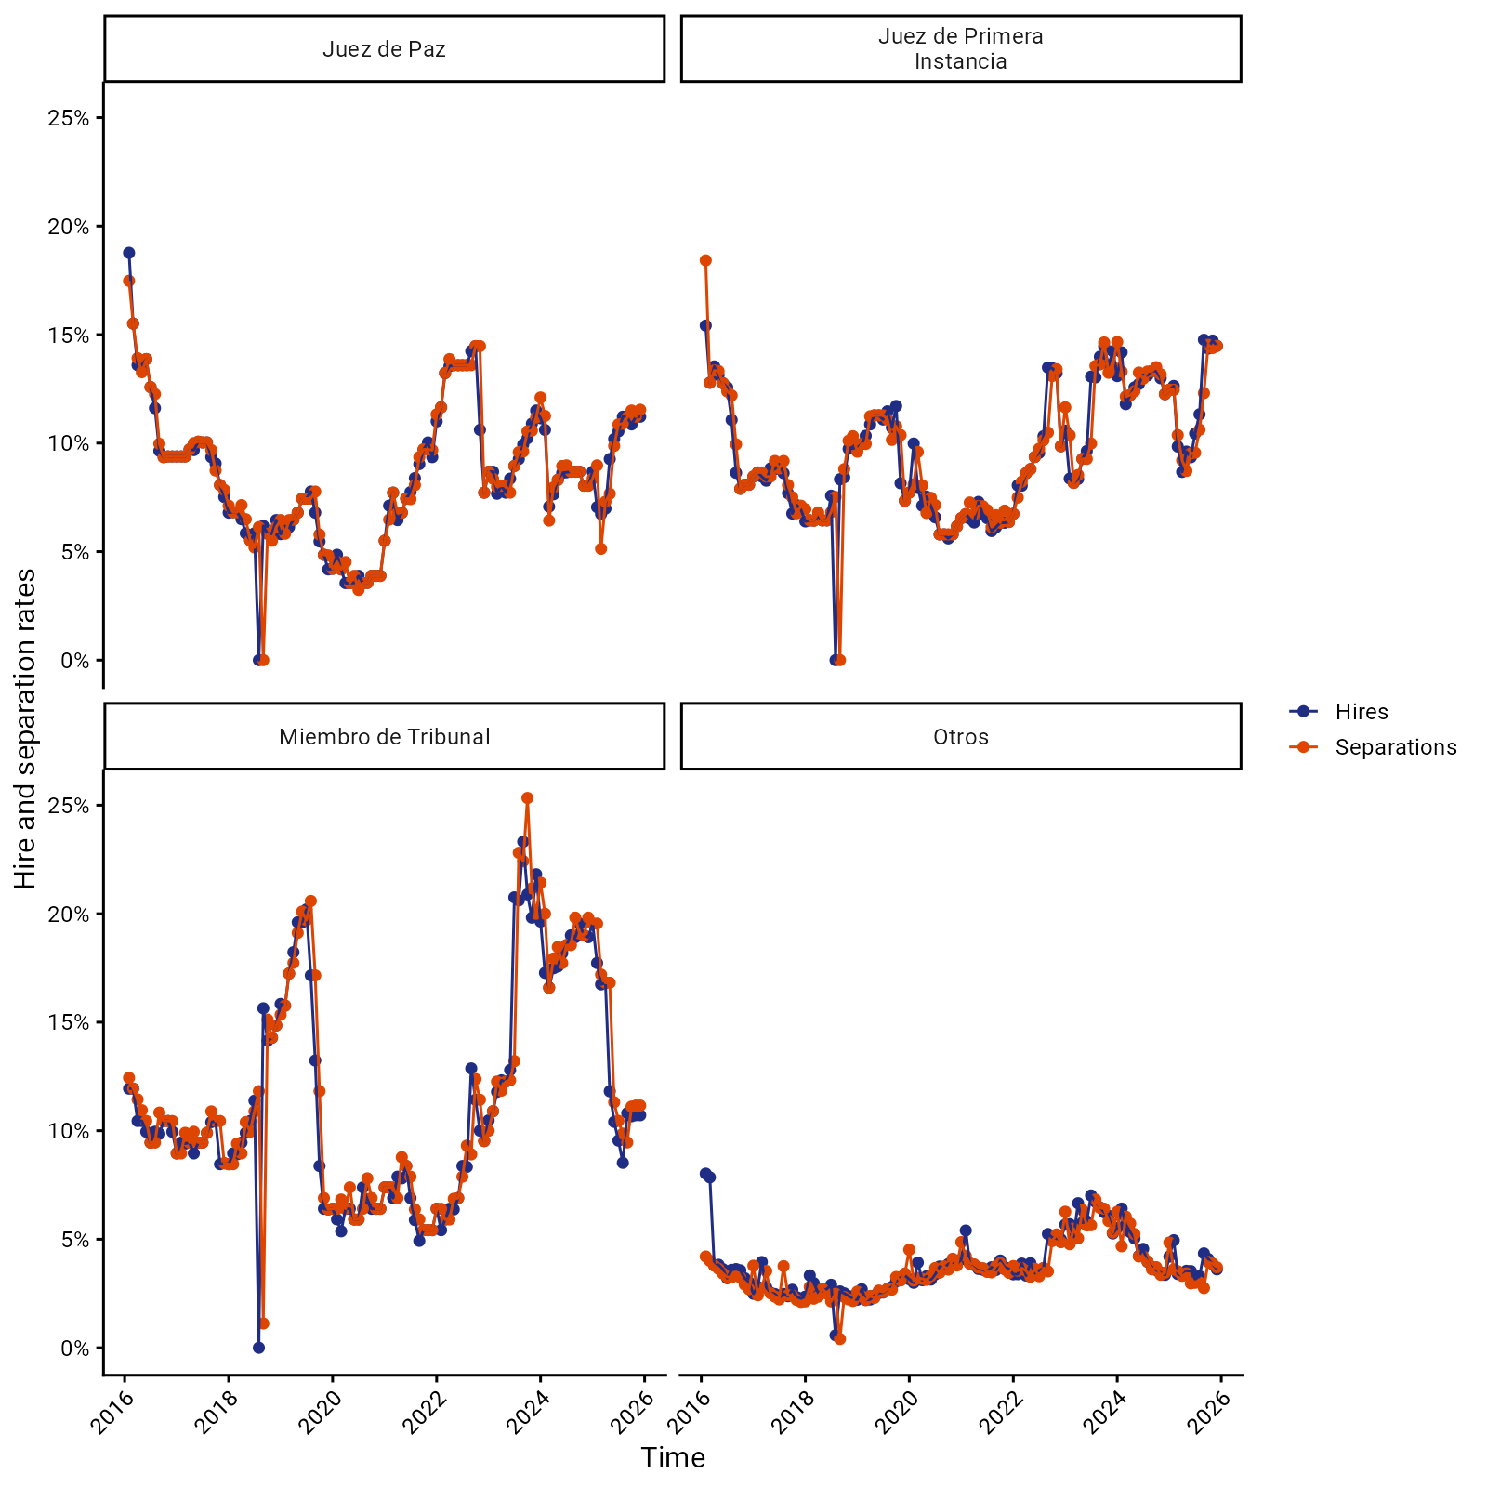
Hires and separations by occupation group

Slide 16
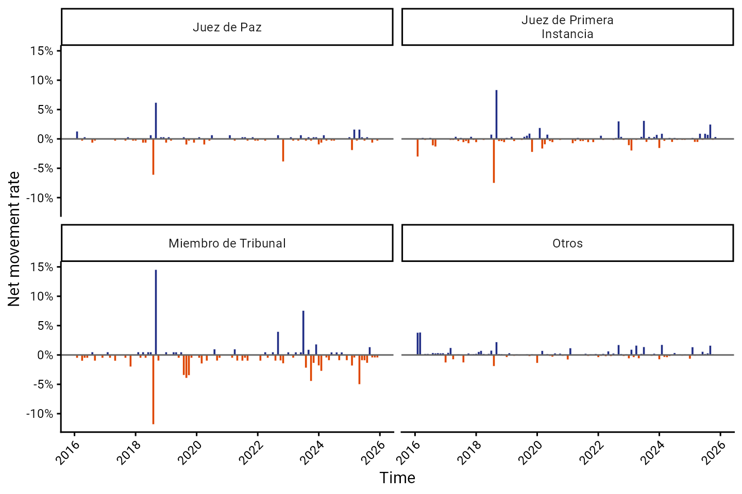
Net movements by occupation group

Slide 17
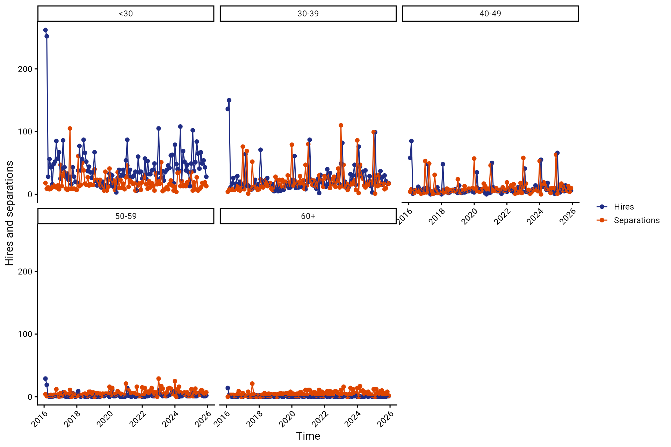
Hires and separations by age group

Slide 18
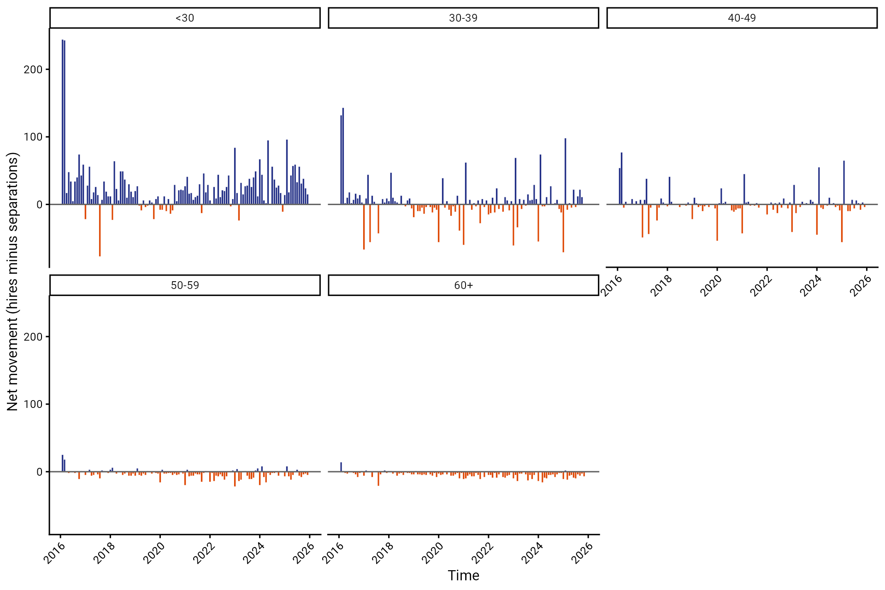
Net movements by age group

Slide 19
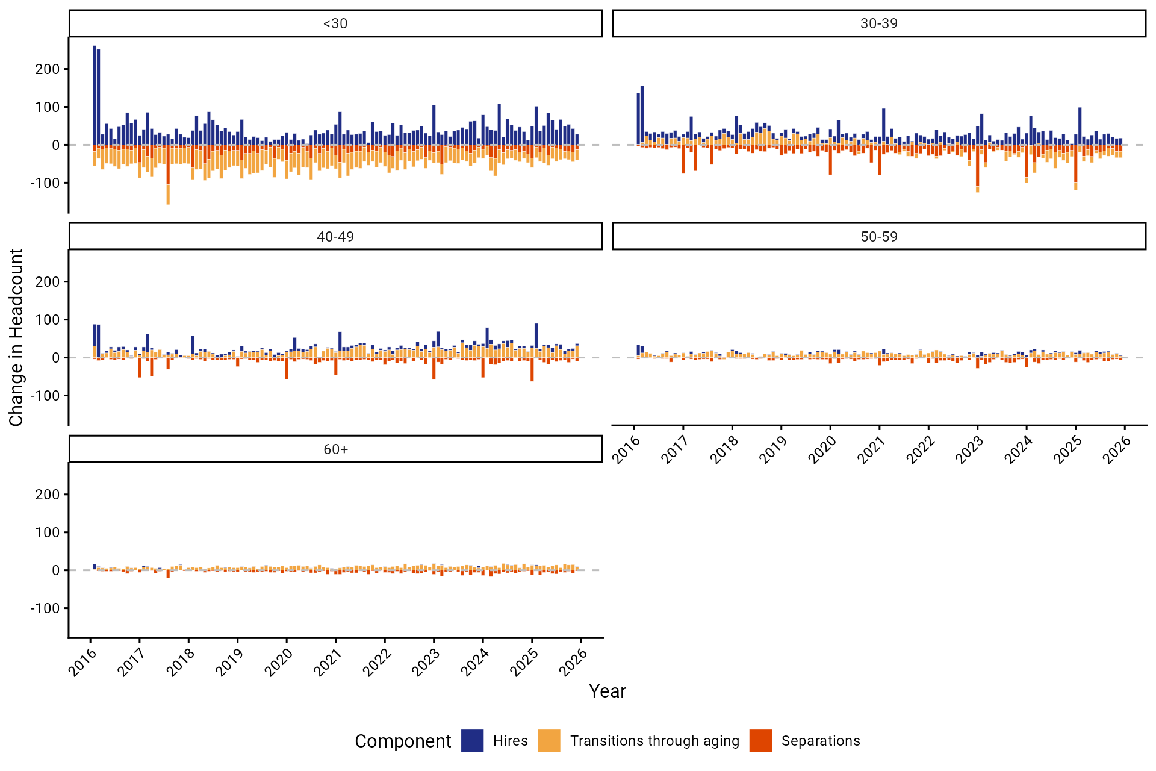
Decomposition of headcount change by age group

Slide 20
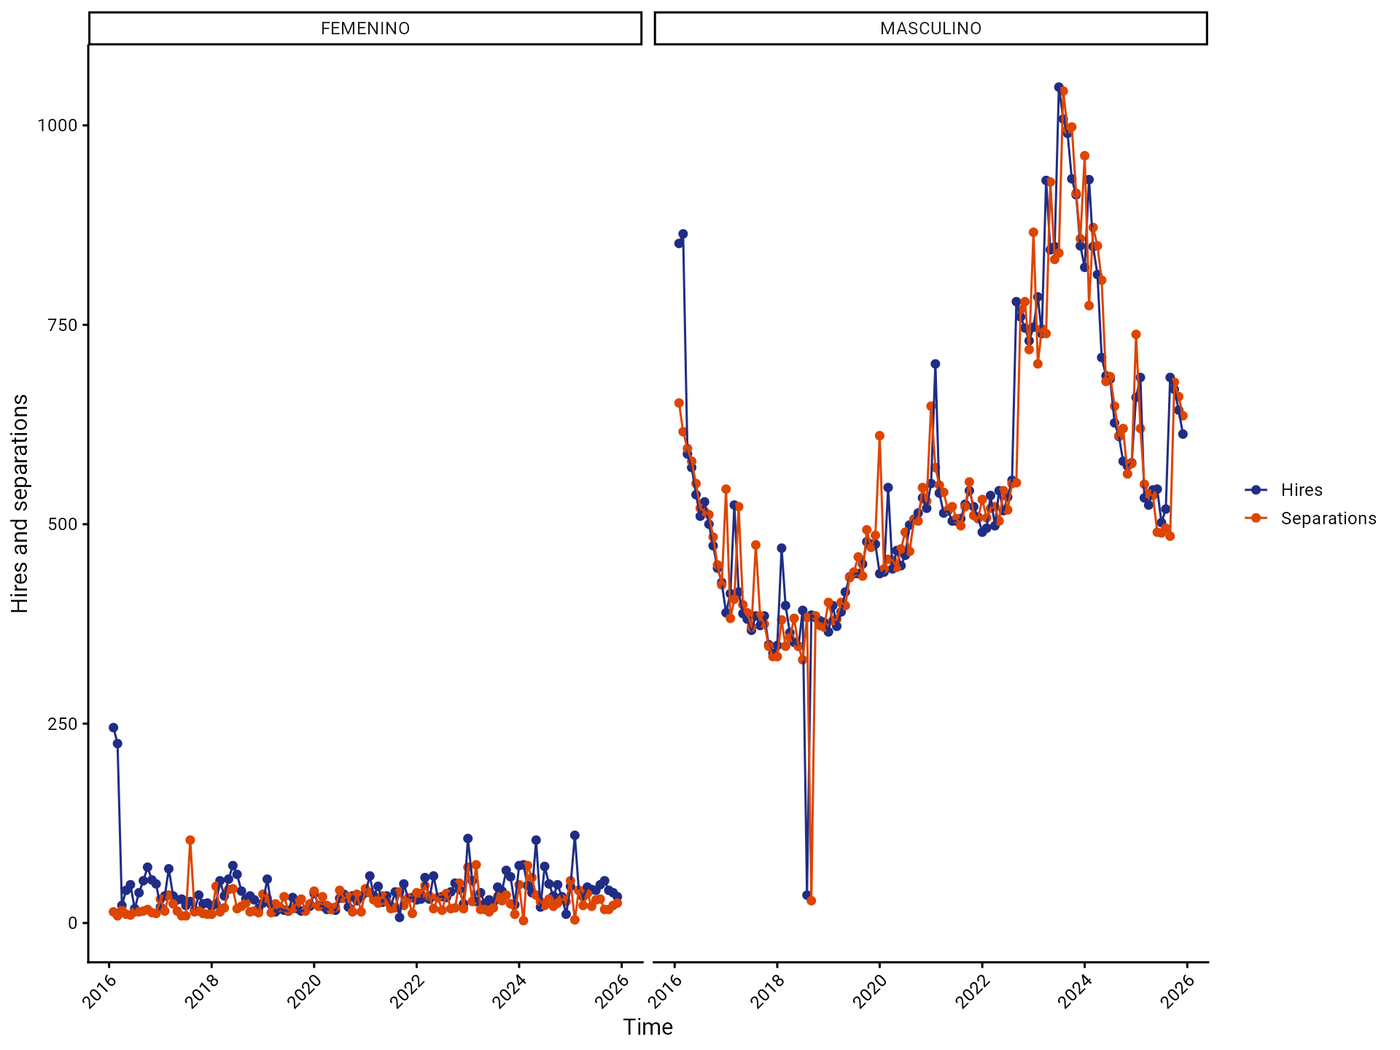
Hires and separations by gender

Slide 21
Transitions

Slide 22
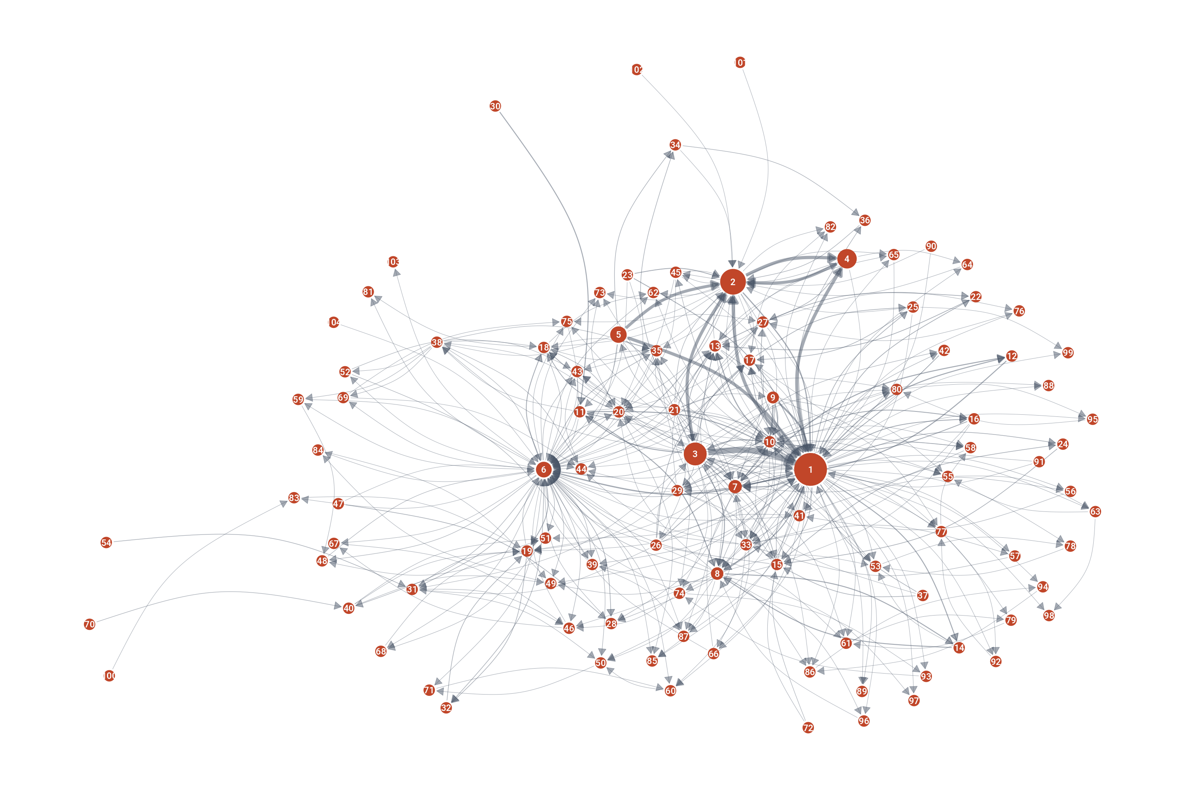
Transitions across occupations

Slide 23
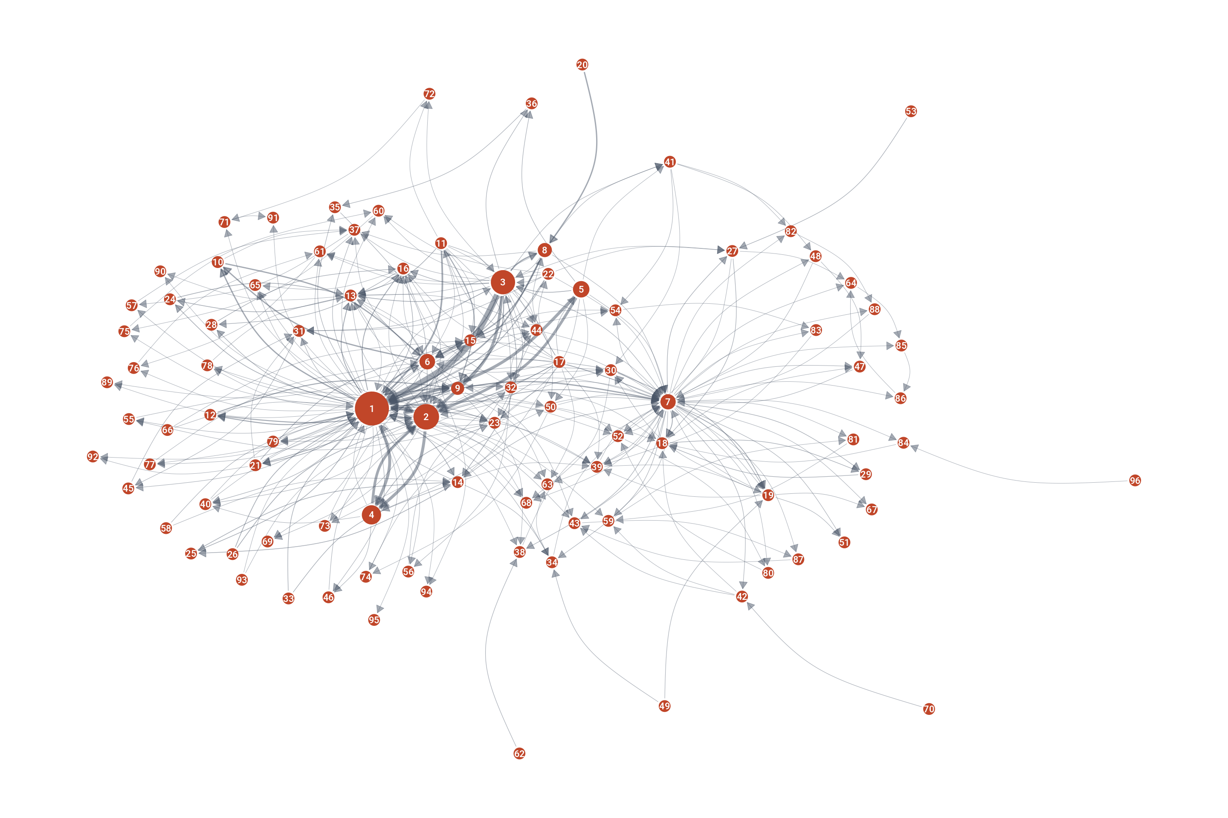
Transitions across occupations: women

Slide 24
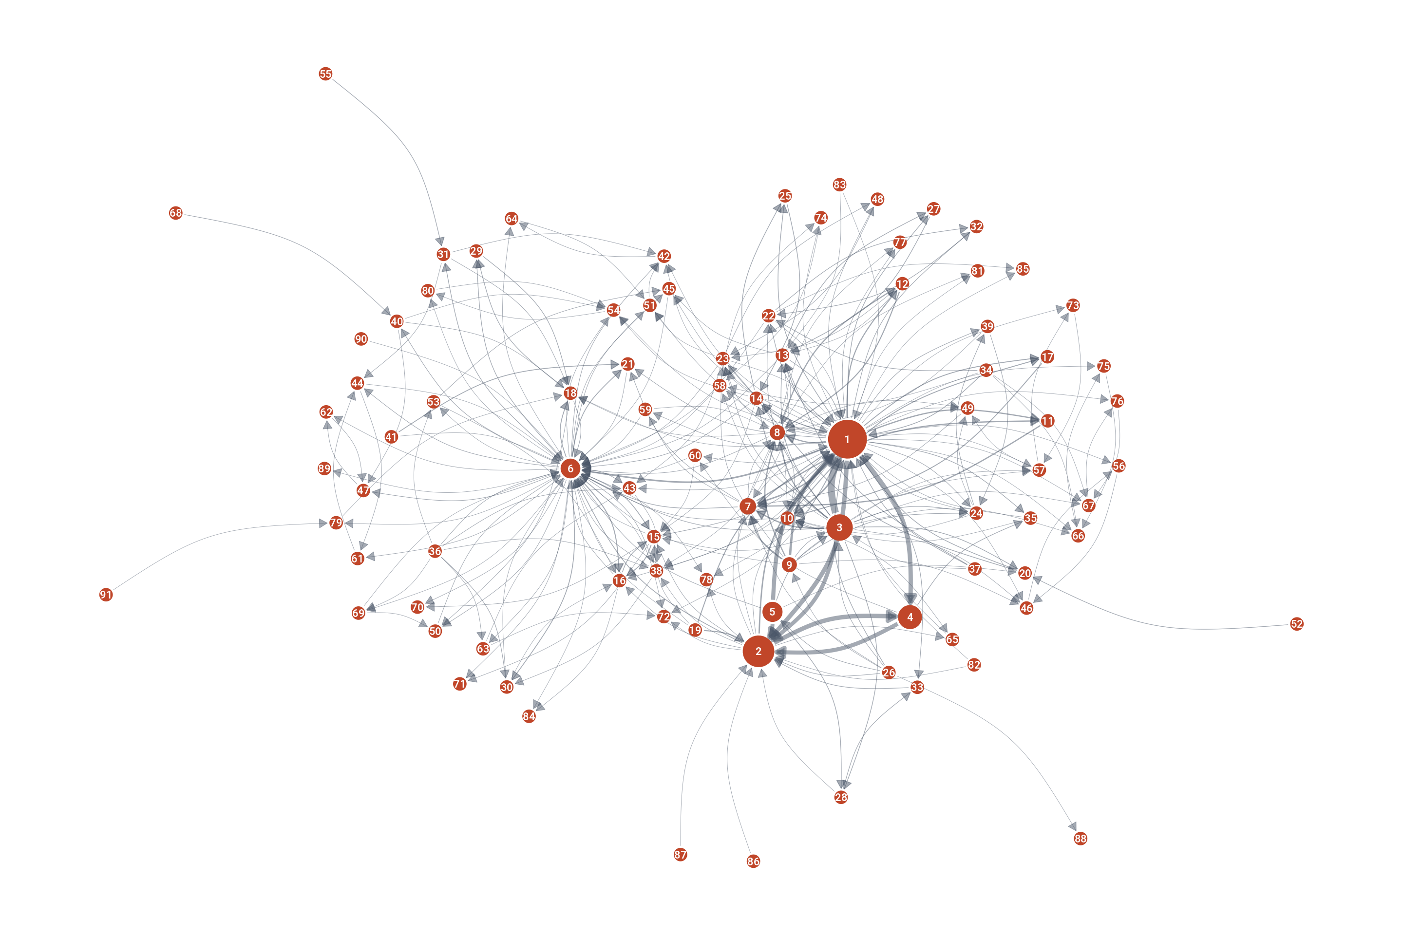
Transitions across occupations: men

Slide 25
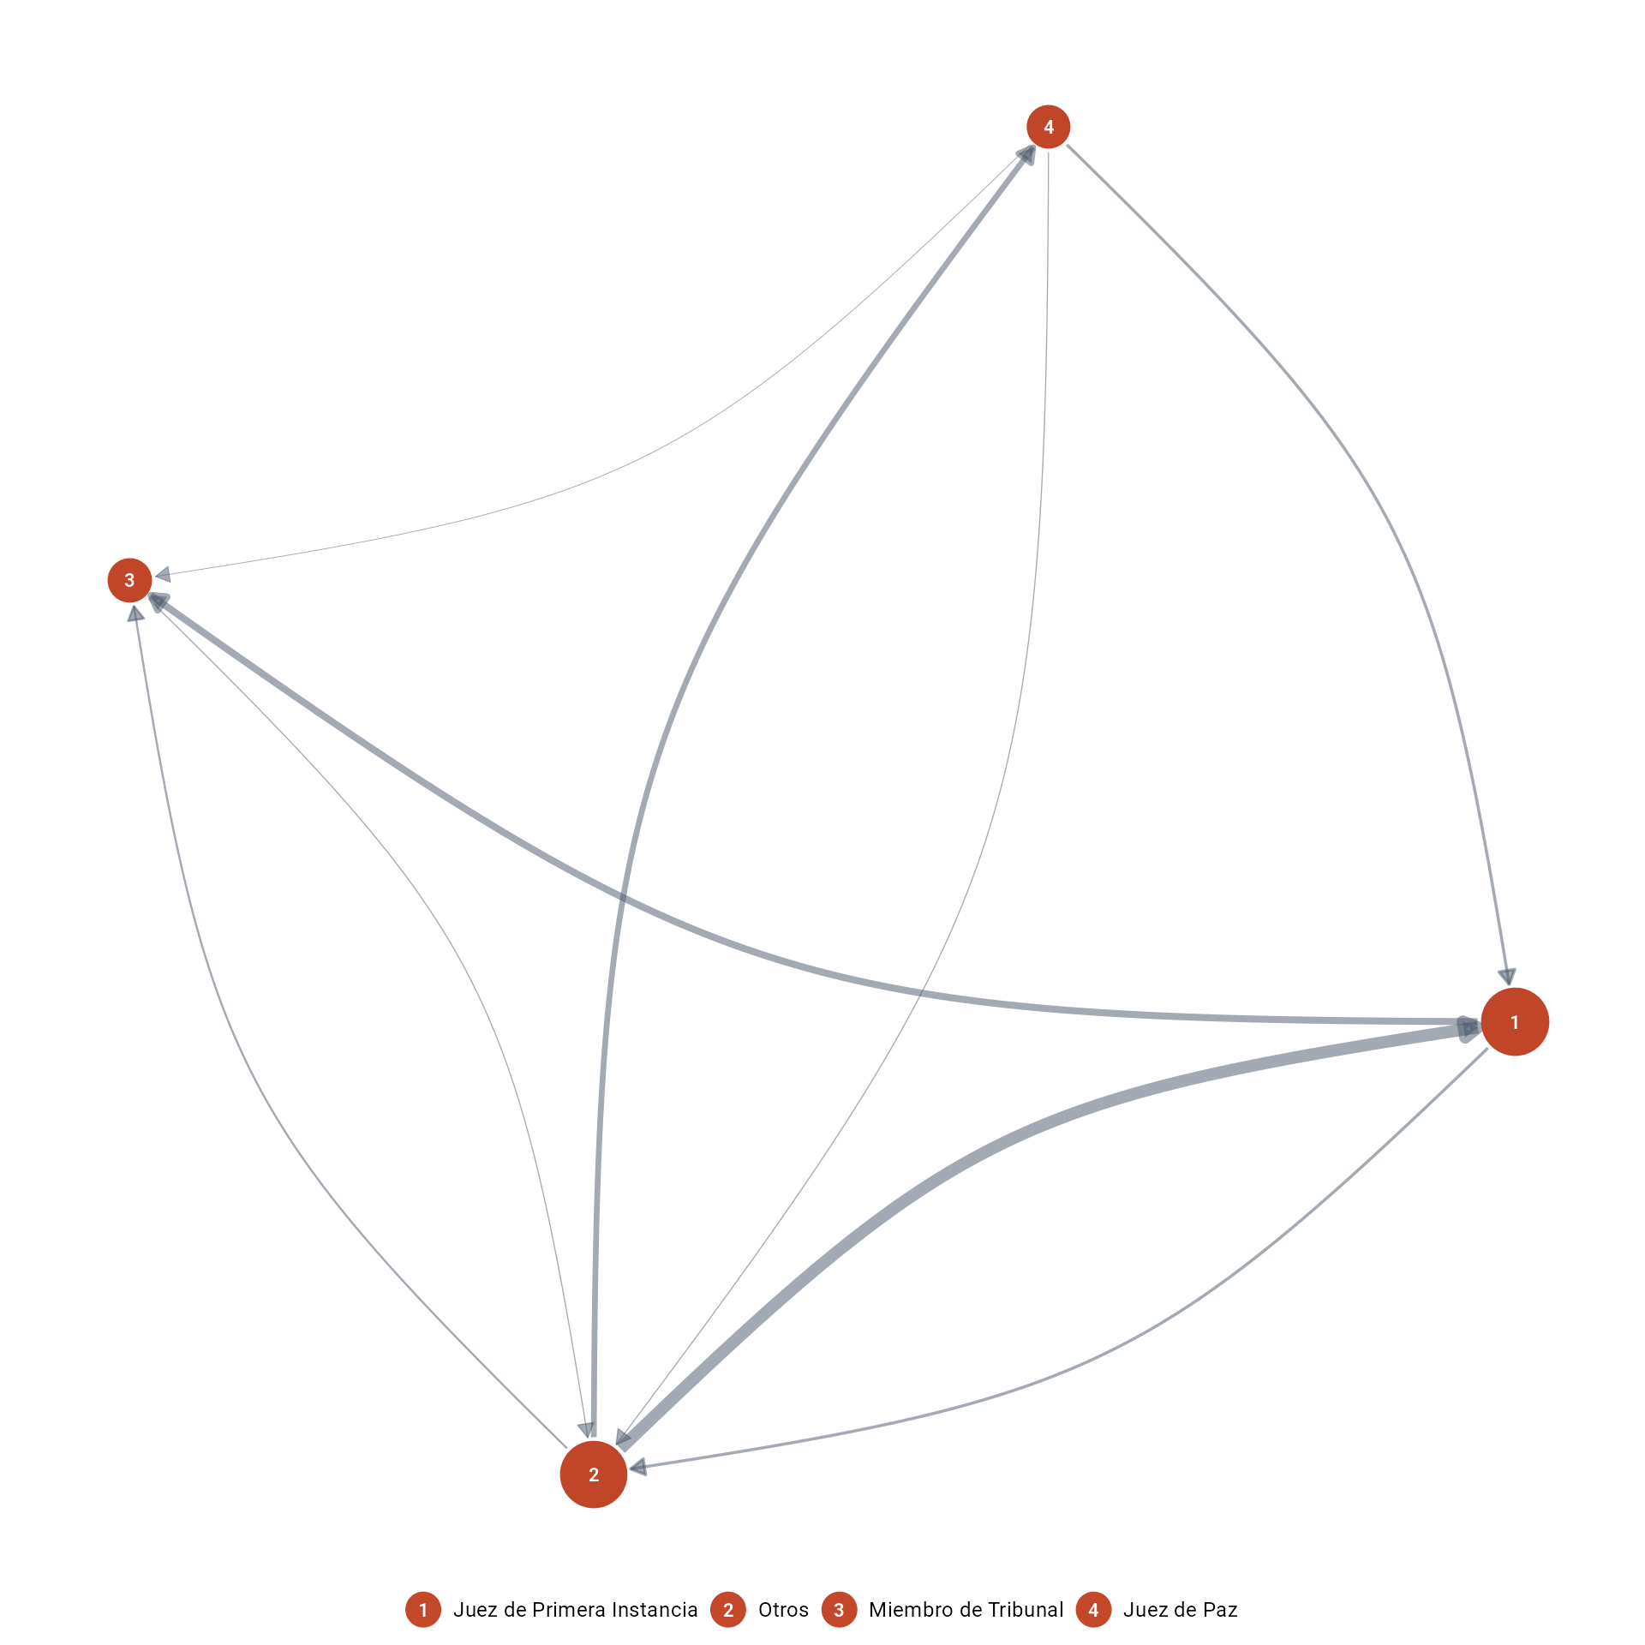
Transitions across occupation groups

Slide 26
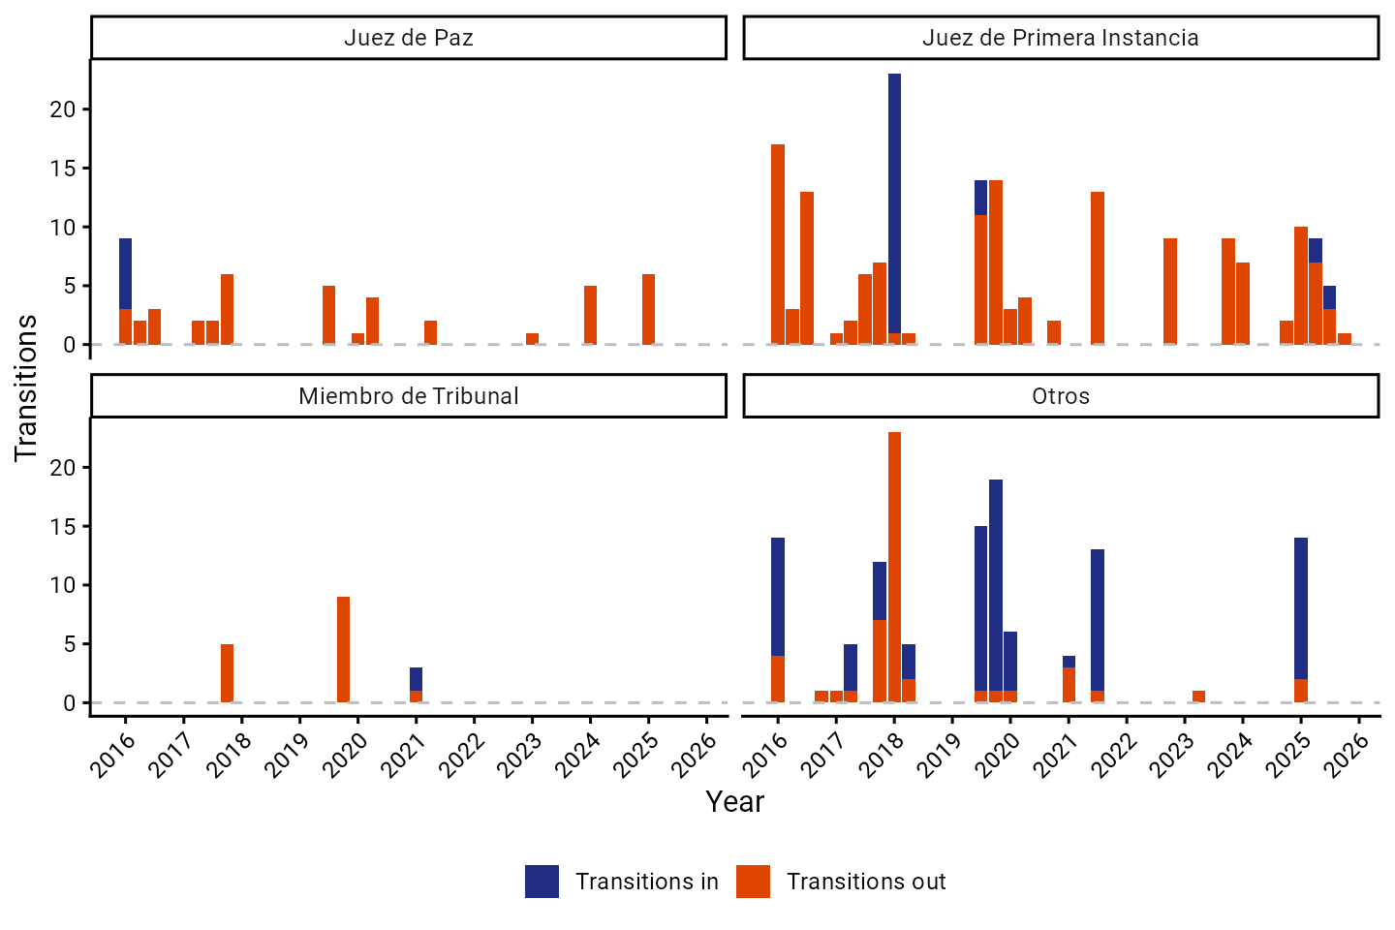
Transitions in and out of occupation groups

Slide 27
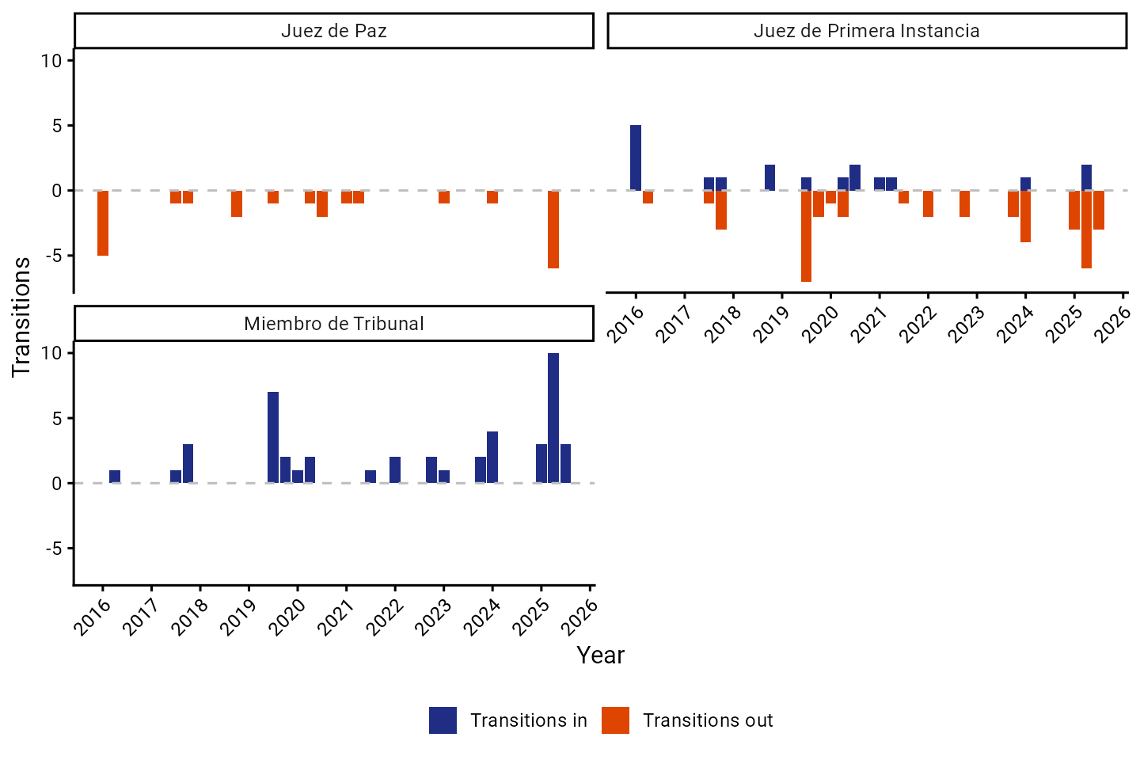
Transitions in and out of occupation groups: by gender

Slide 28
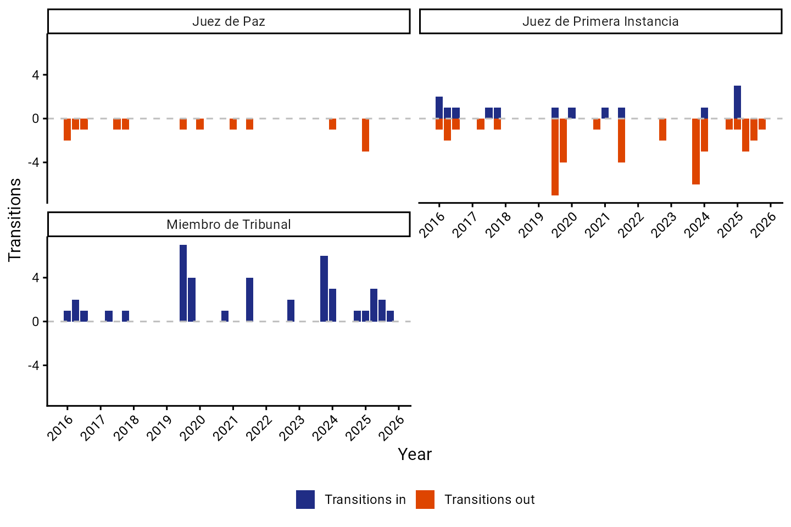

Slide 29
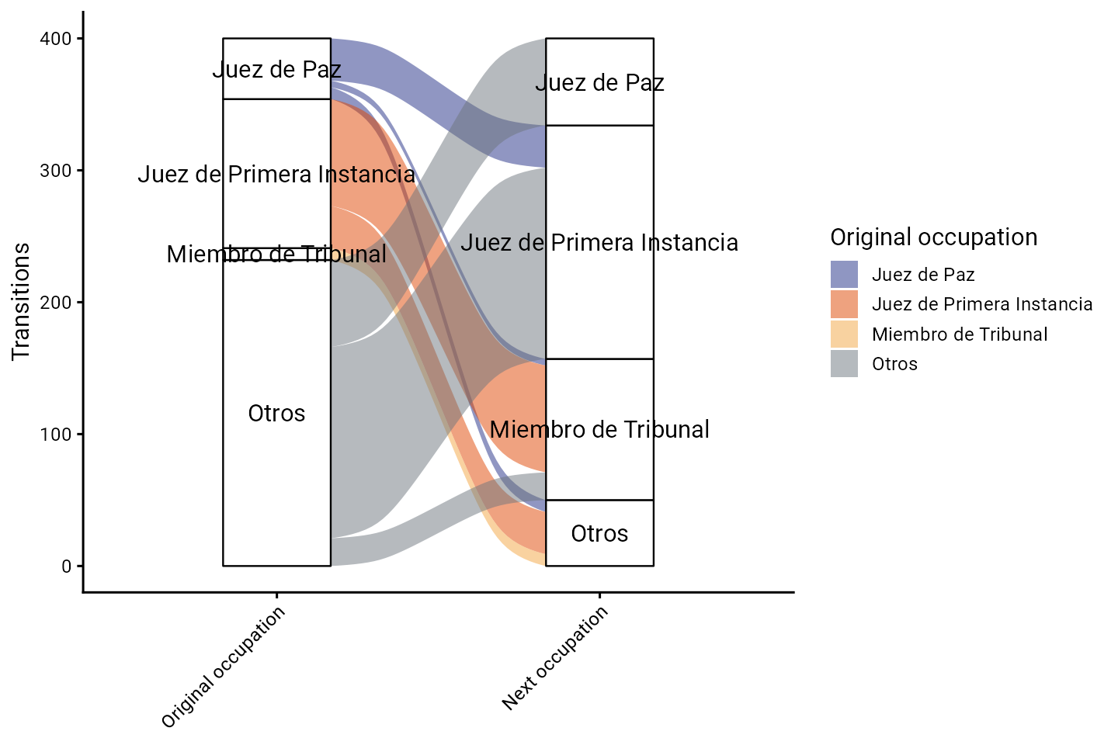
Transitions between occupation groups

Slide 30
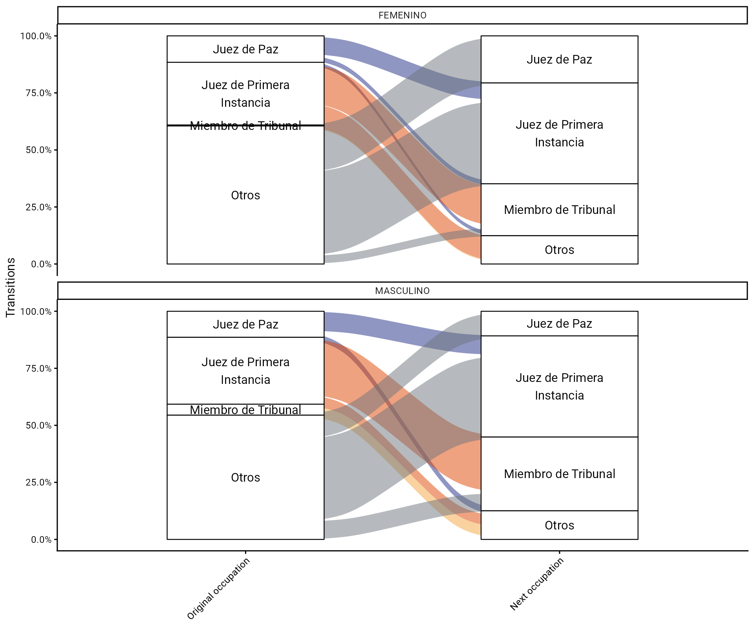
Transitions between occupation groups by gender

Slide 31
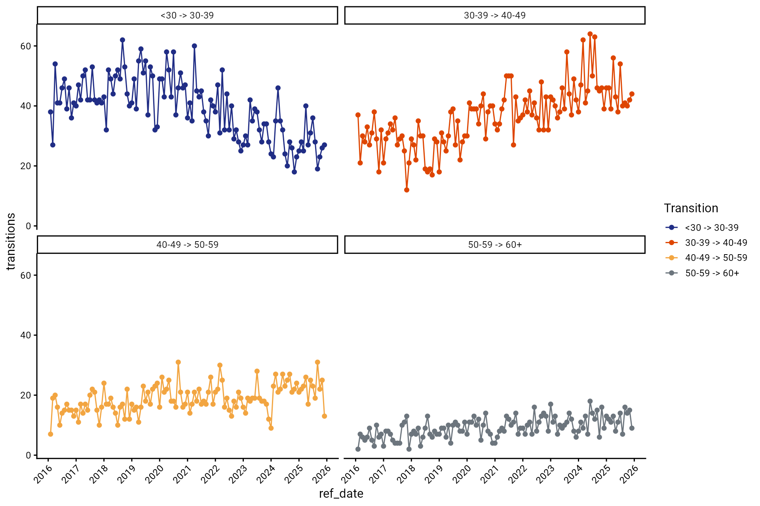
Transitions across age groups

Slide 32
Wage bill

Slide 33
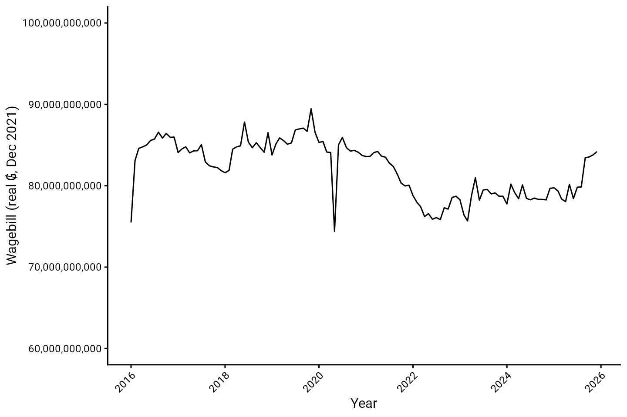
Wage bill

Slide 34
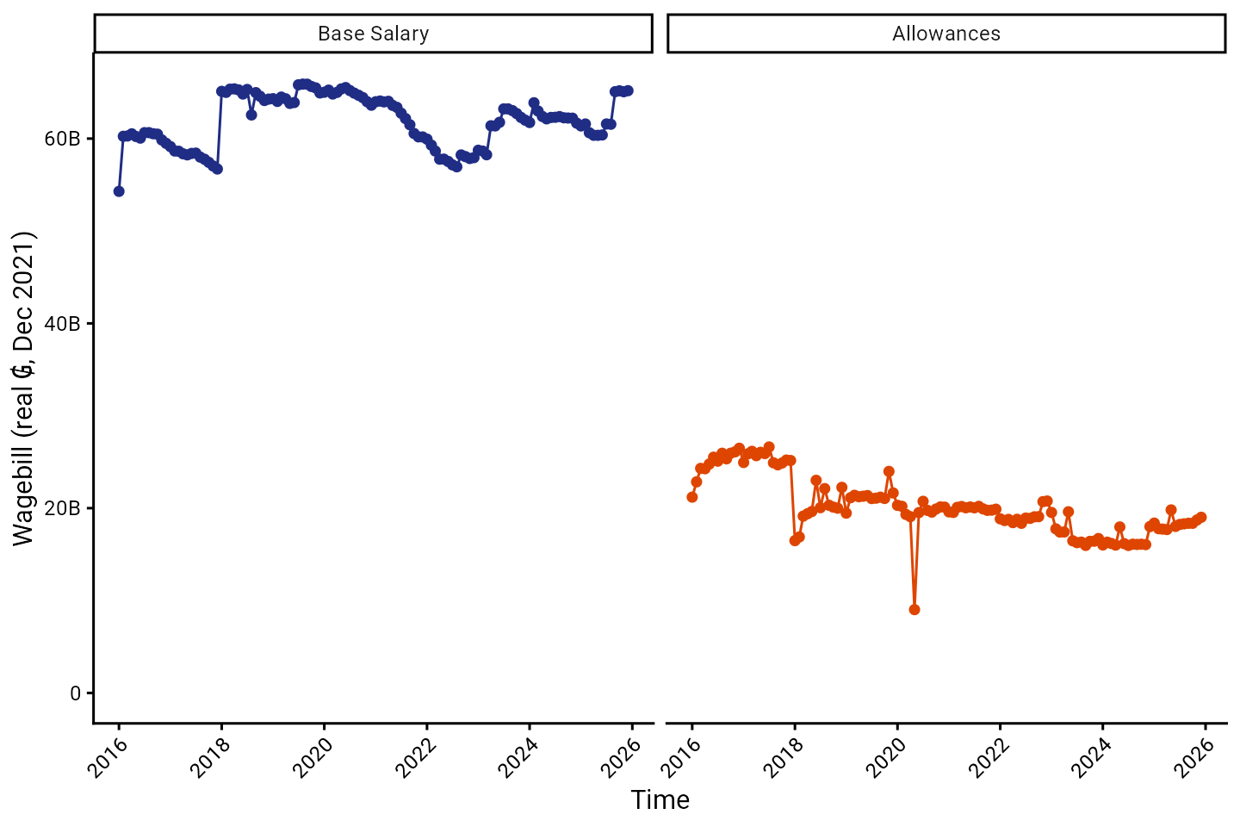
Wage bill by salary component

Slide 35
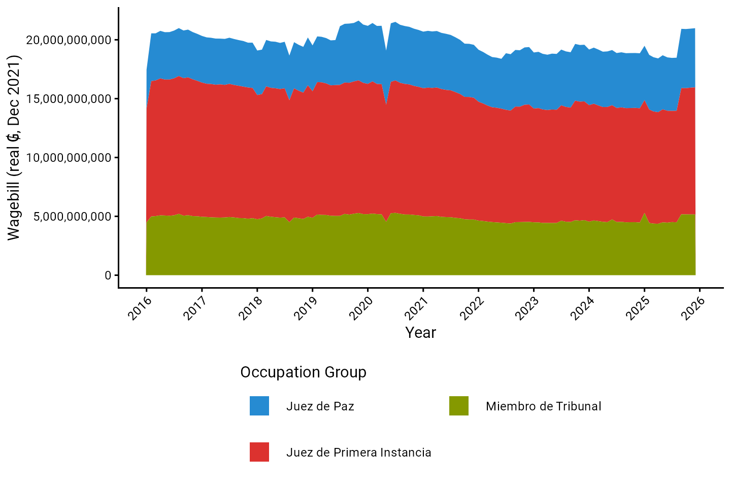
Wage bill by occupation group

Slide 36
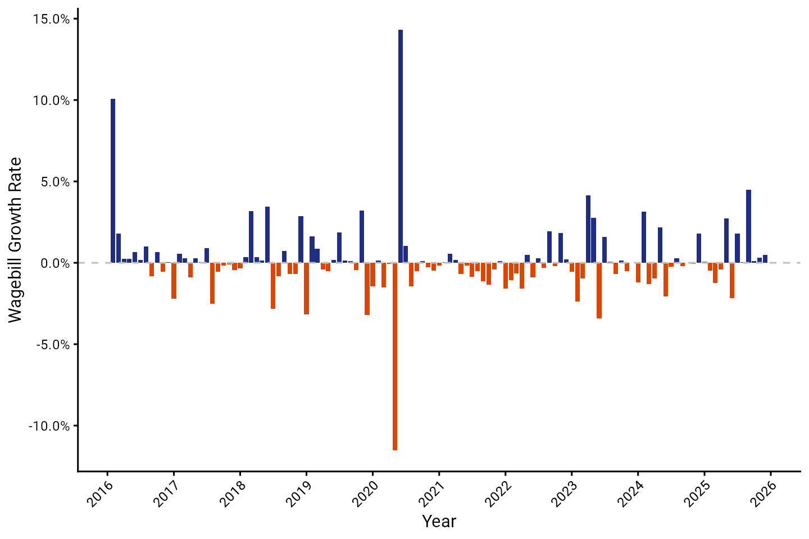
Wage bill growth

Slide 37
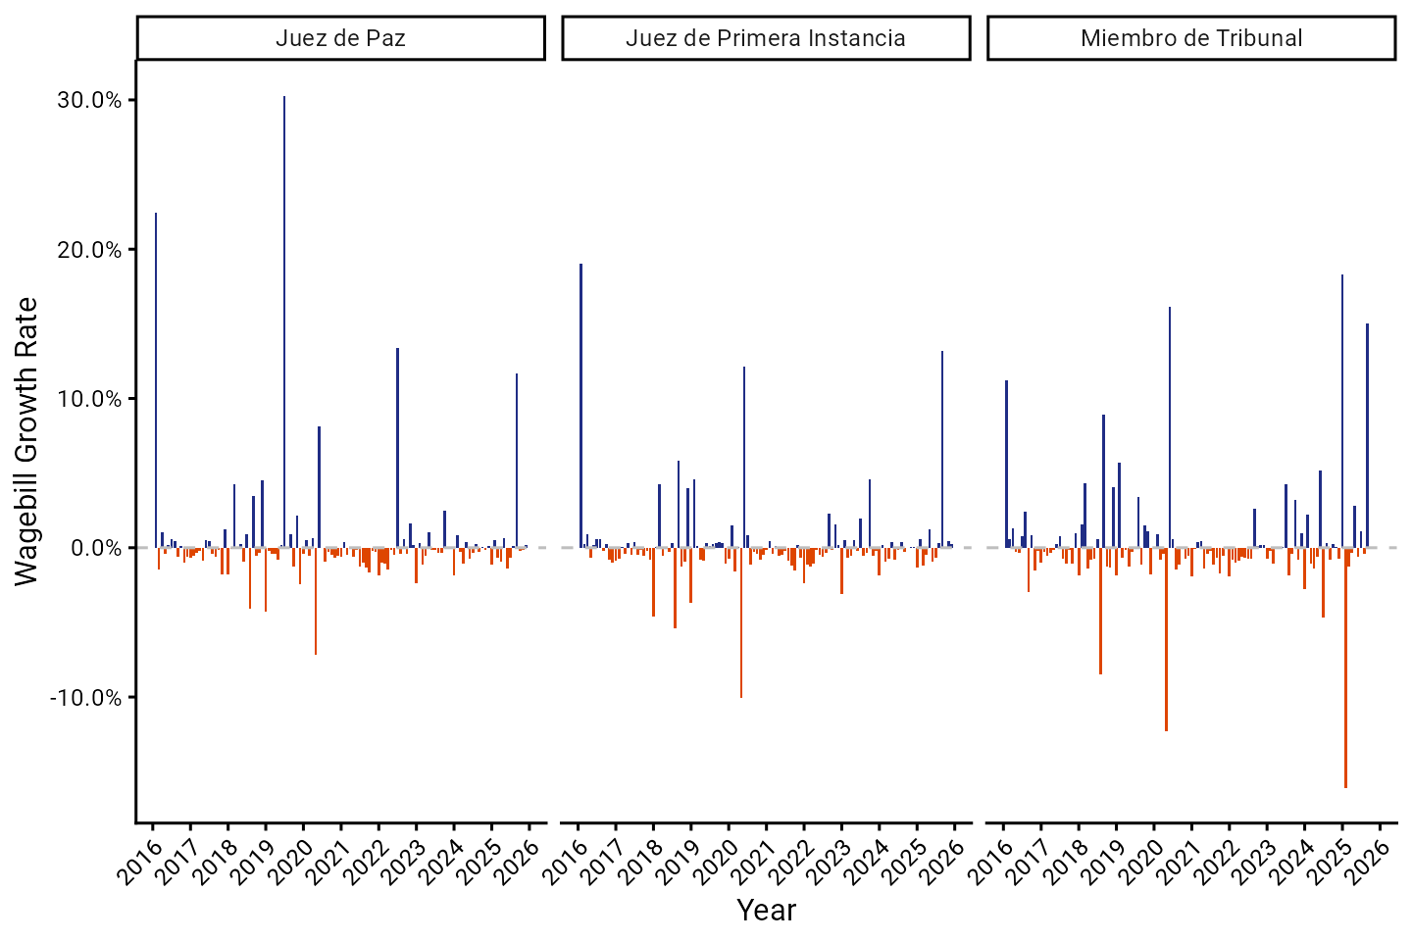
Wage bill growth by occupation group

Slide 38
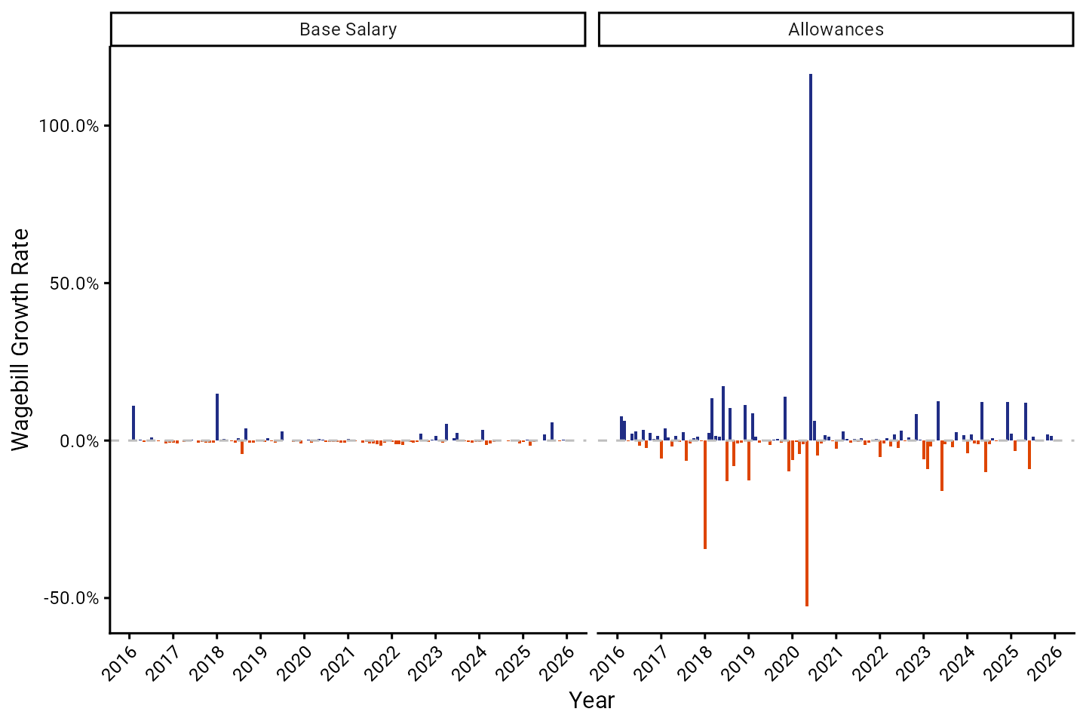
Wage bill growth by salary component

Slide 39
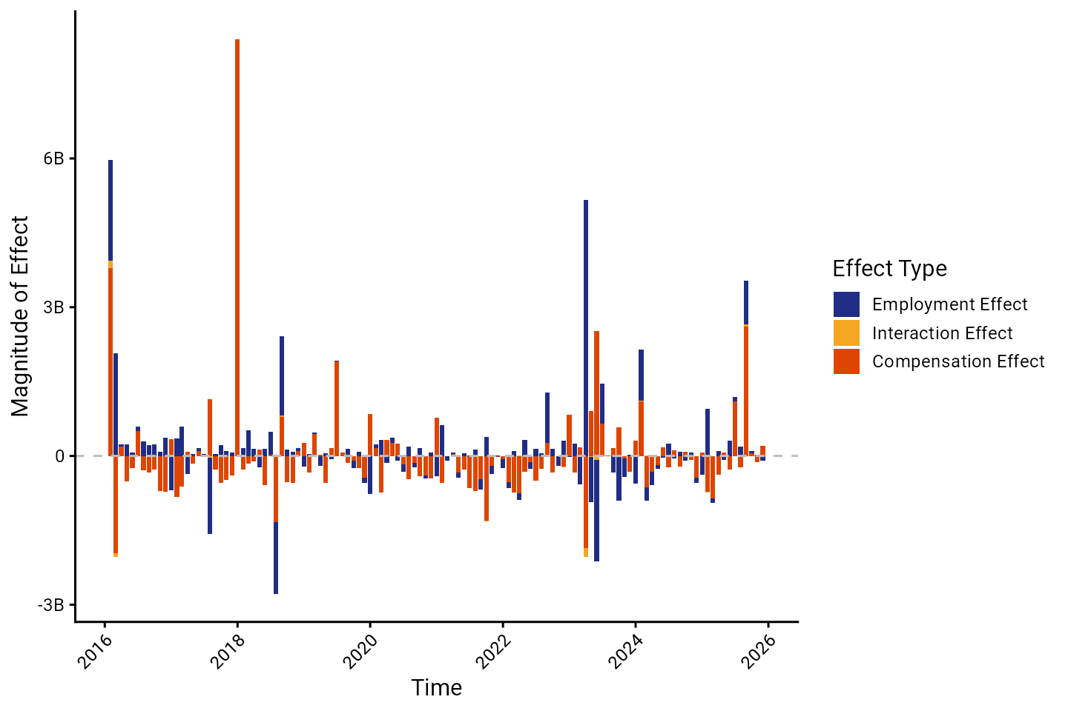
Decomposition of wage bill growth

Slide 40
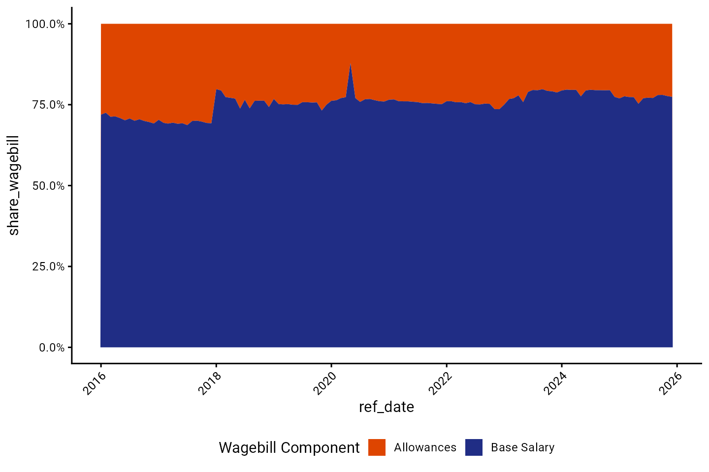
Wage bill share by salary component

Slide 41
Compensation

Slide 42
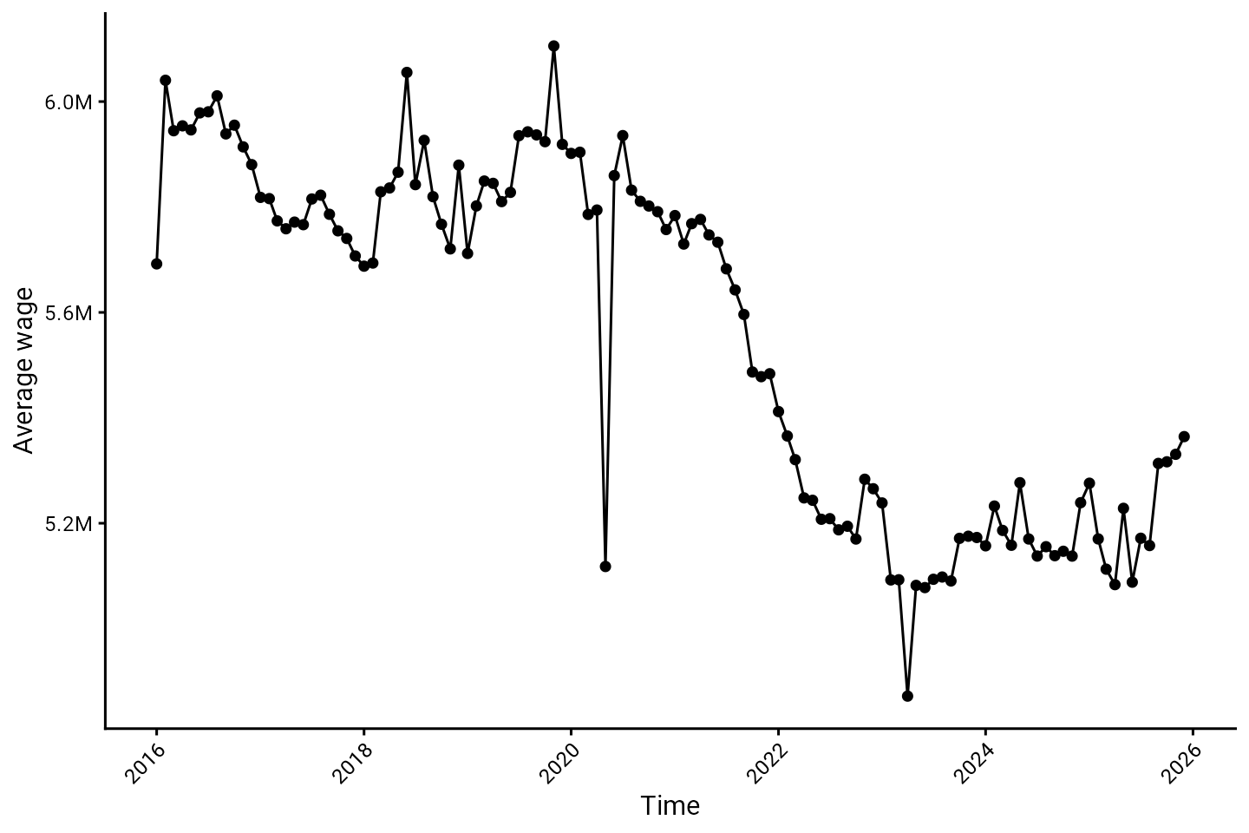
Average wage

Slide 43
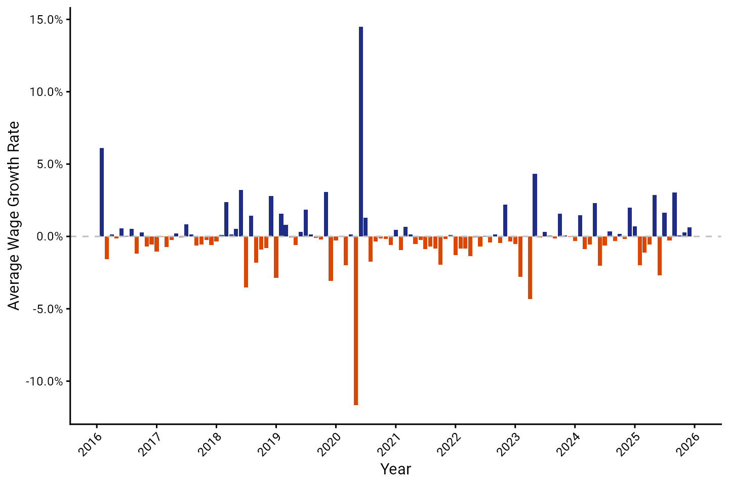
Average wage growth

Slide 44
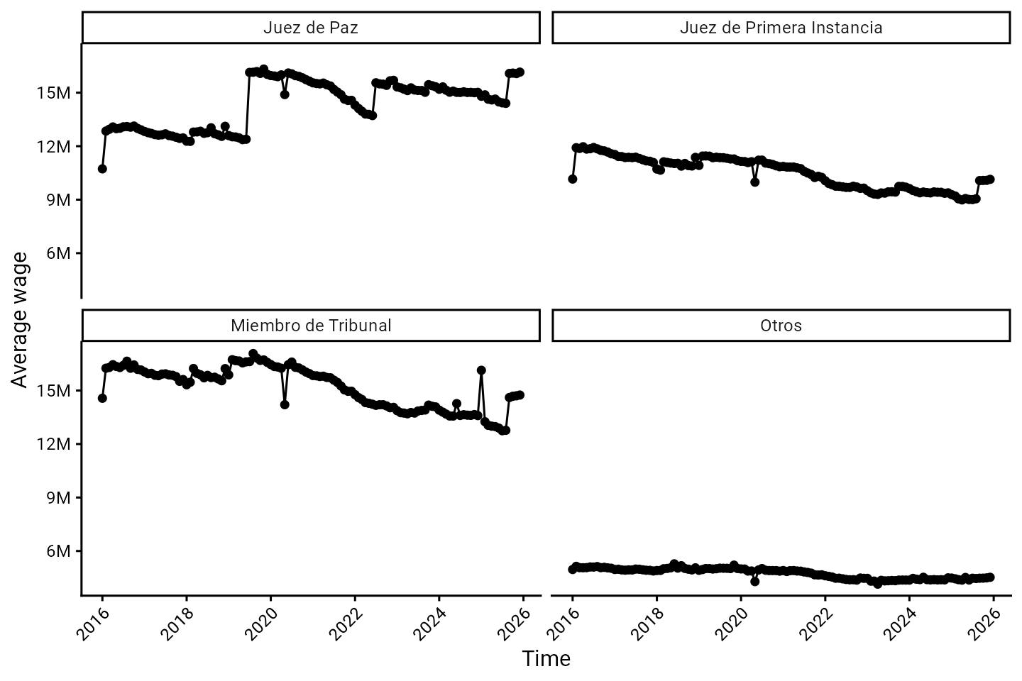
Average wage by occupation group

Slide 45
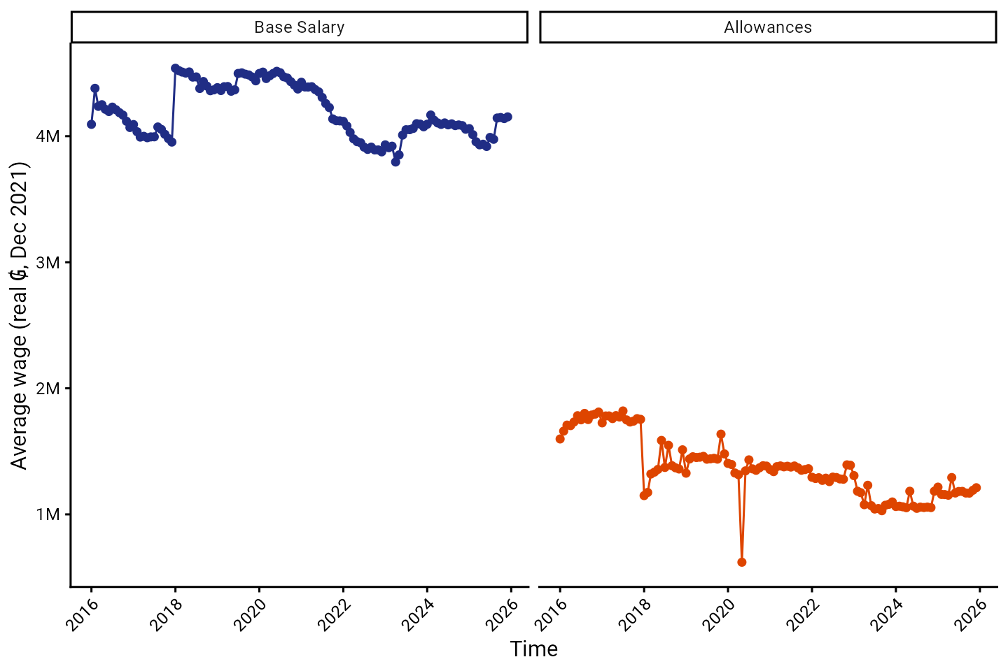
Average wage by salary component

Slide 46
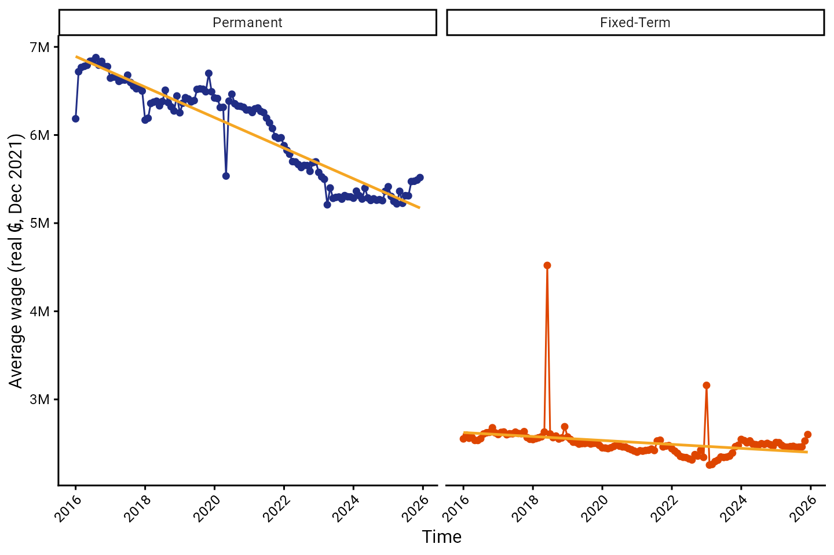
Average wage by contract type

Slide 47
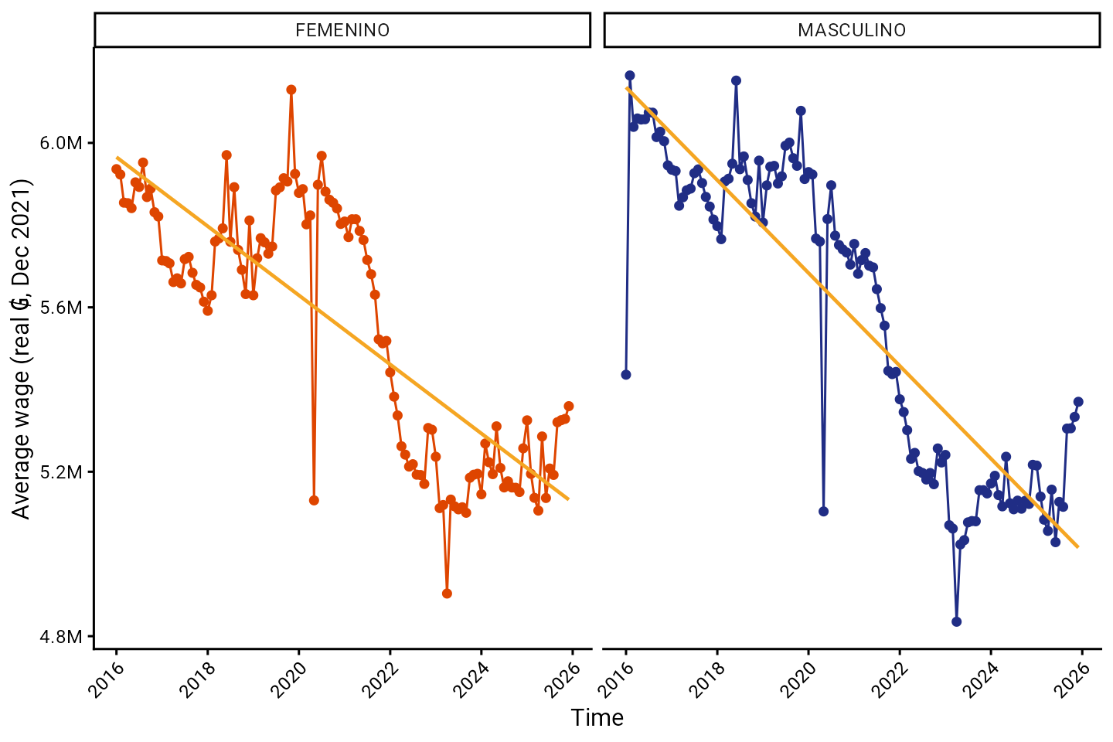
Average wage by gender

Slide 48
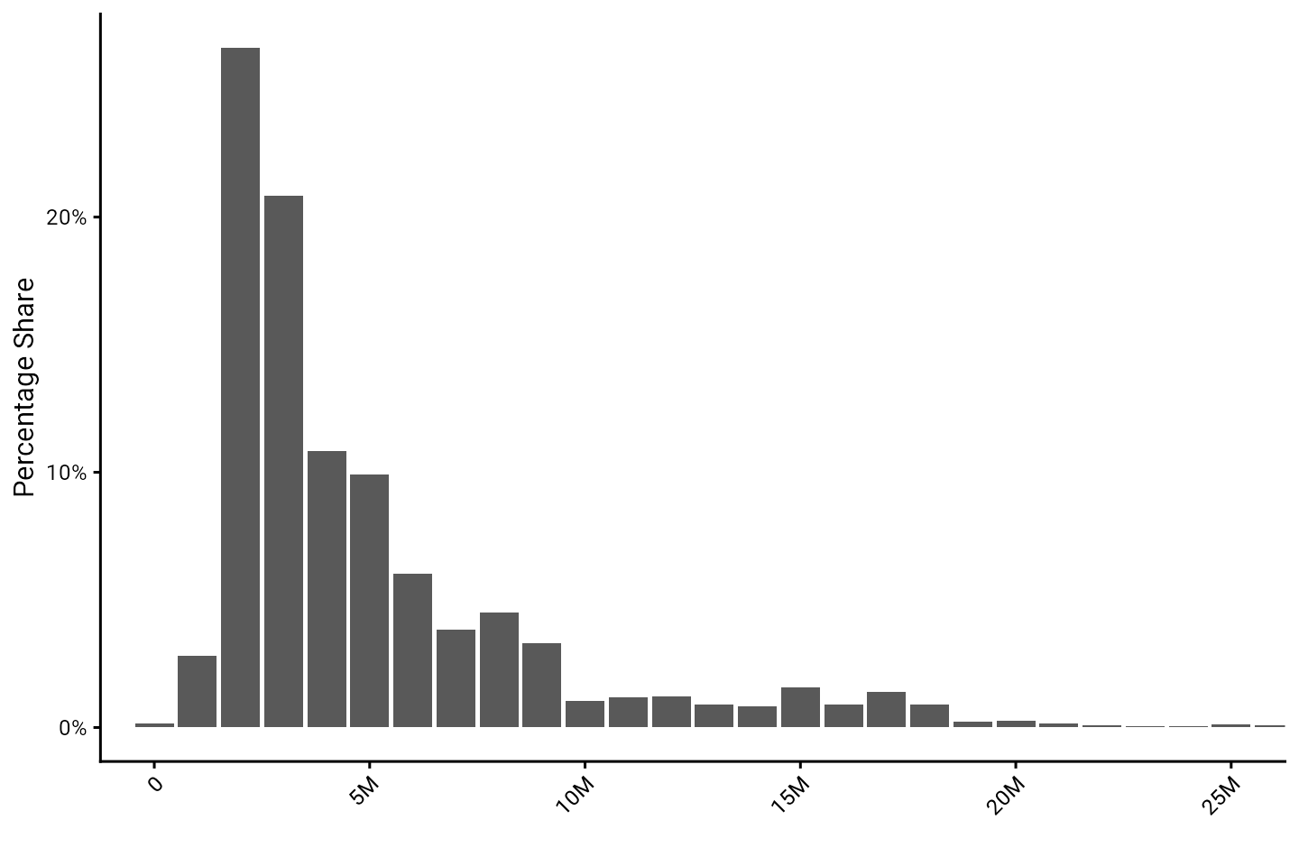
Wage distribution

Slide 49
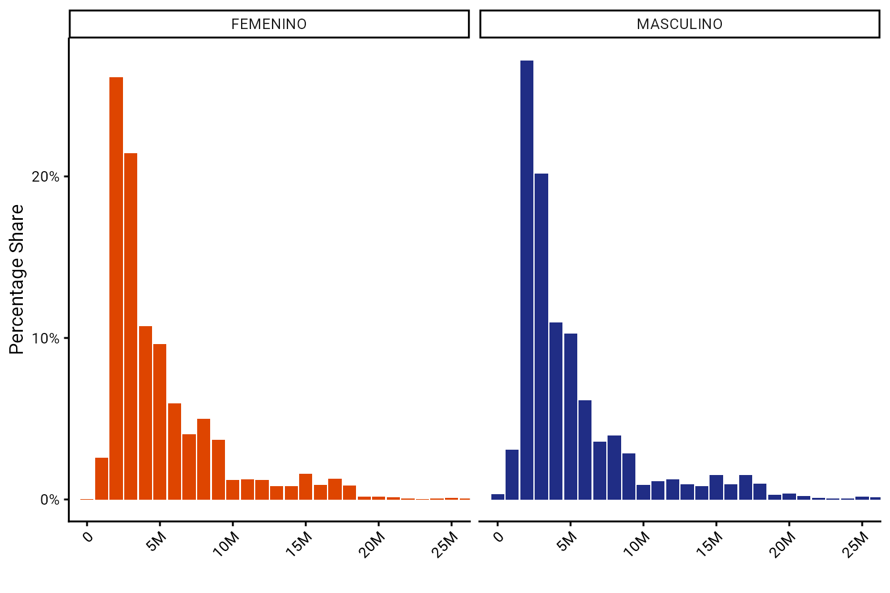
Wage distribution by gender

