Slide 1
Chapter 4: Regulatory Institutions
Proposed revisions for QER

Slide 2
Goal of this meeting
Present new data analysis for Chapter 4 on Regulatory Institutions.
Gather feedback and revise analysis to incorporate to the chapter.
Discuss next steps until QER.

Slide 3
Comments received after DRM
To address this problem of overly narrow focus [on telecoms], the team needs to gather and analyze data on regulatory institutions other than telecoms and use this to apply the conceptual framework of the report to this broader set of regulatory institutions. One promising direction is to use the B-Ready data, which is only briefly mentioned in the revised report. This data contains many indicators that could be mapped to the governance and organizational dimensions and used to apply the conceptual framework to a wider set of regulatory institutions. There also is a lot of work on regulation in Asya and Mario’s teams in TIC. The public institutions report team should reach out to explore how to incorporate some of this work into the report.

Slide 4
B-Ready Data
Goal: correlate governance dimensions with private sector outcomes such as competition.
Outcome:
Market competition: (a) number of firms that compete in the market, (b) market share of largest competitor, (c) changes in competition, (d) ability to change prices without losing customers, among others.
Governance dimensions:
Independence: competition authority has (a) operational independence, (b) an established procedure for selection and dismissal of board members, (c) term limits for board members, (d) cooling off periods, (e) conflict of interest rules.
Transparency: (a) issuance of guidance documents on horizontal and vertical agreements, (b) organization of workshops to disseminate competition authority, (c) online publication of decisions and exemptions.
Organizational dimension:
Information systems: (a) existence of business registries, (b) registry updates, (c) data coverage on financial services, among others.

Slide 5
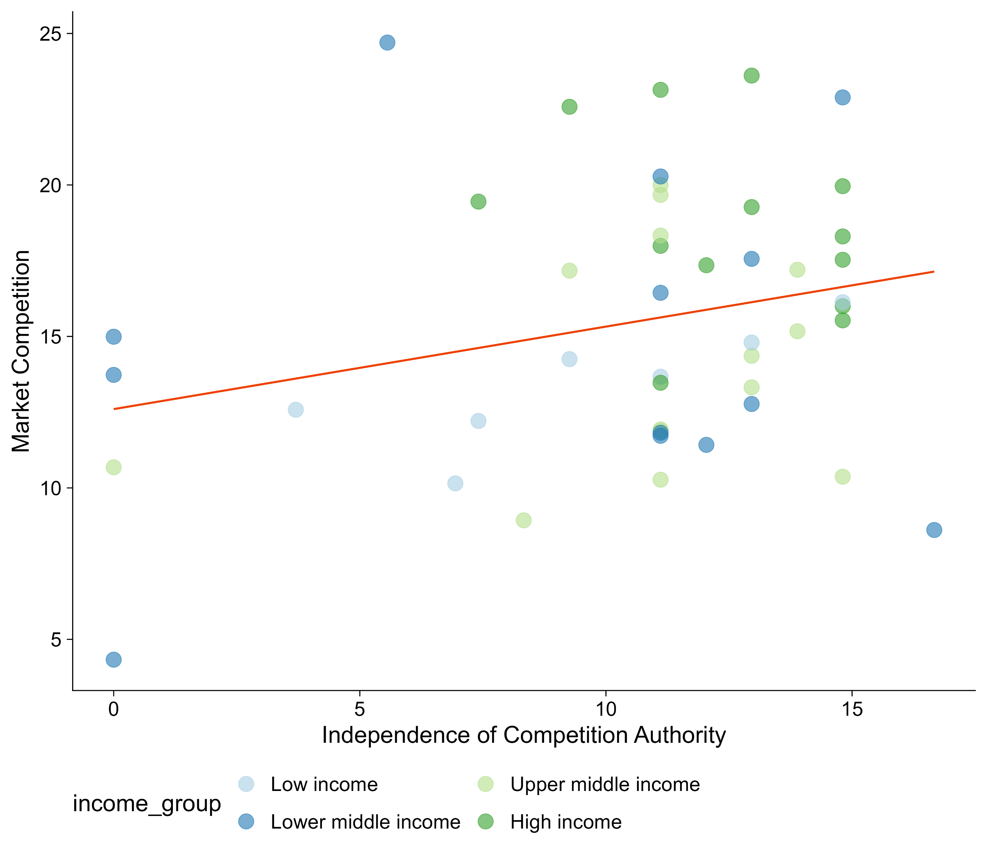
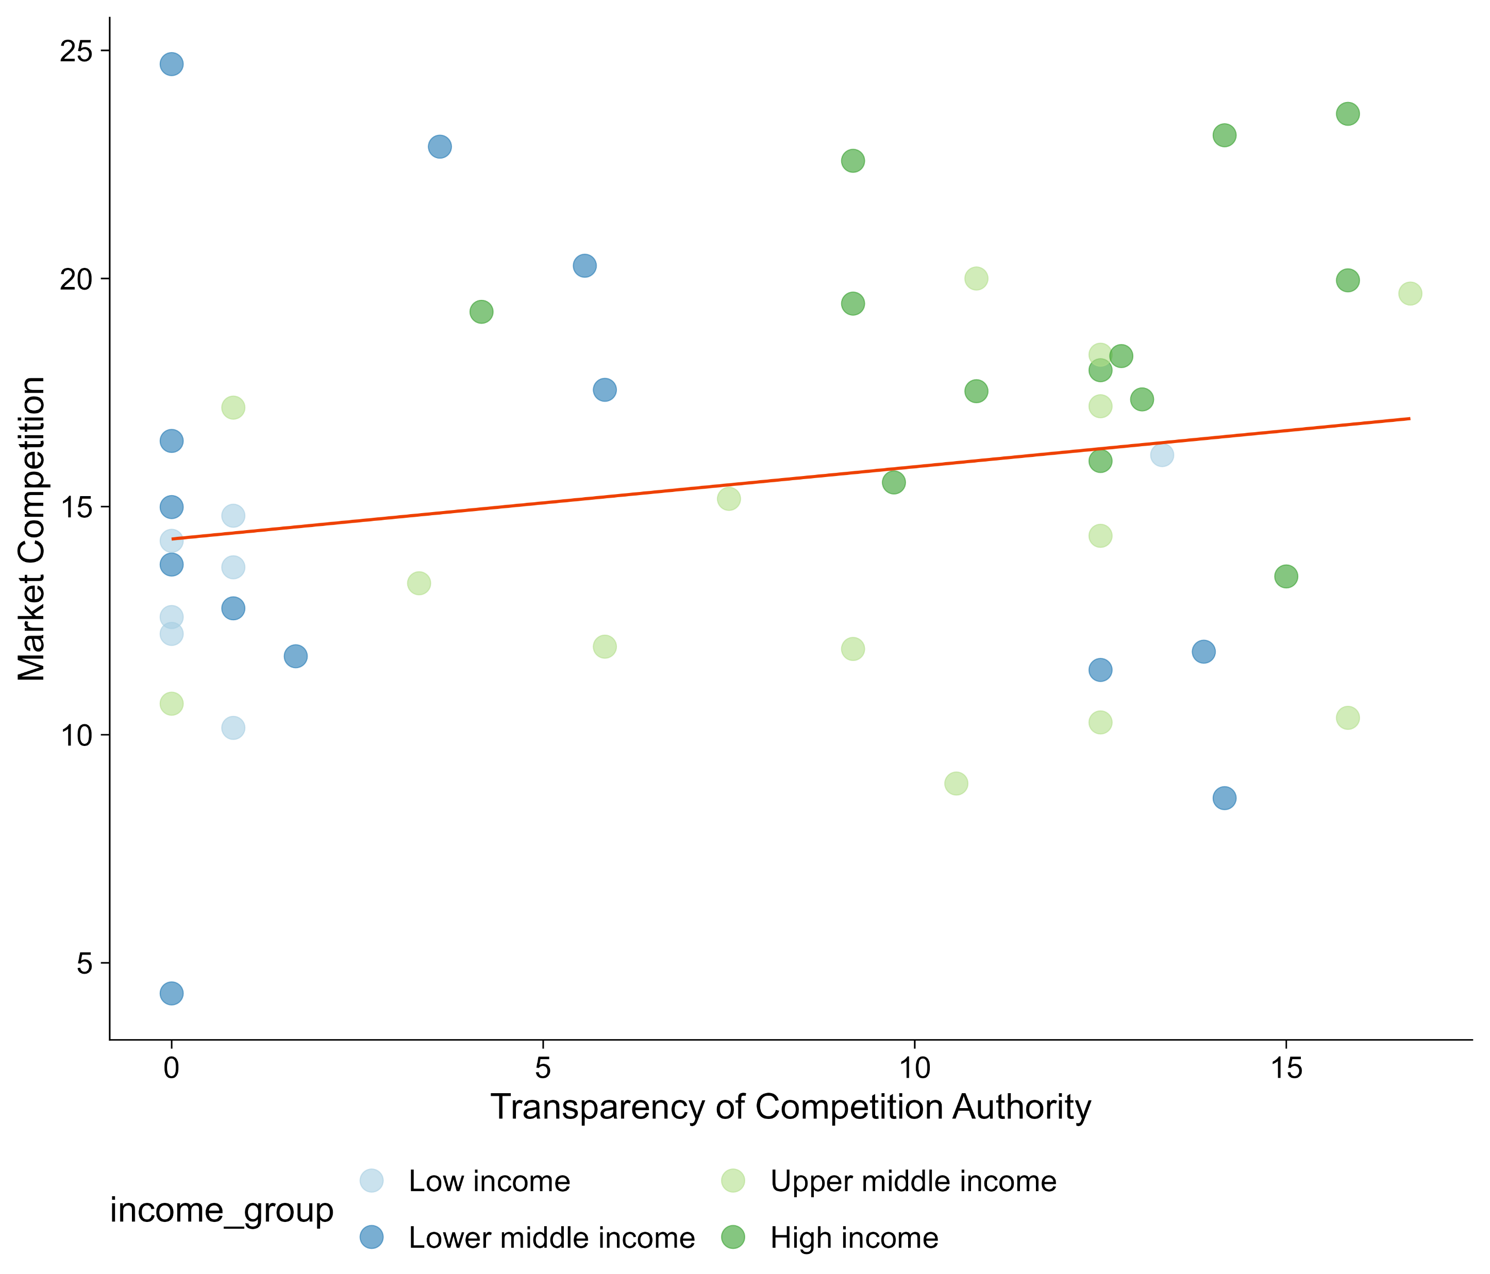
Better governance of competition authority correlates with higher market competition
Notes:
Better off graphing independence and transparency for the sample. We thought about putting the outcome but it didn’t work.
One point for independence, the other one for transparency, same country?

Slide 6
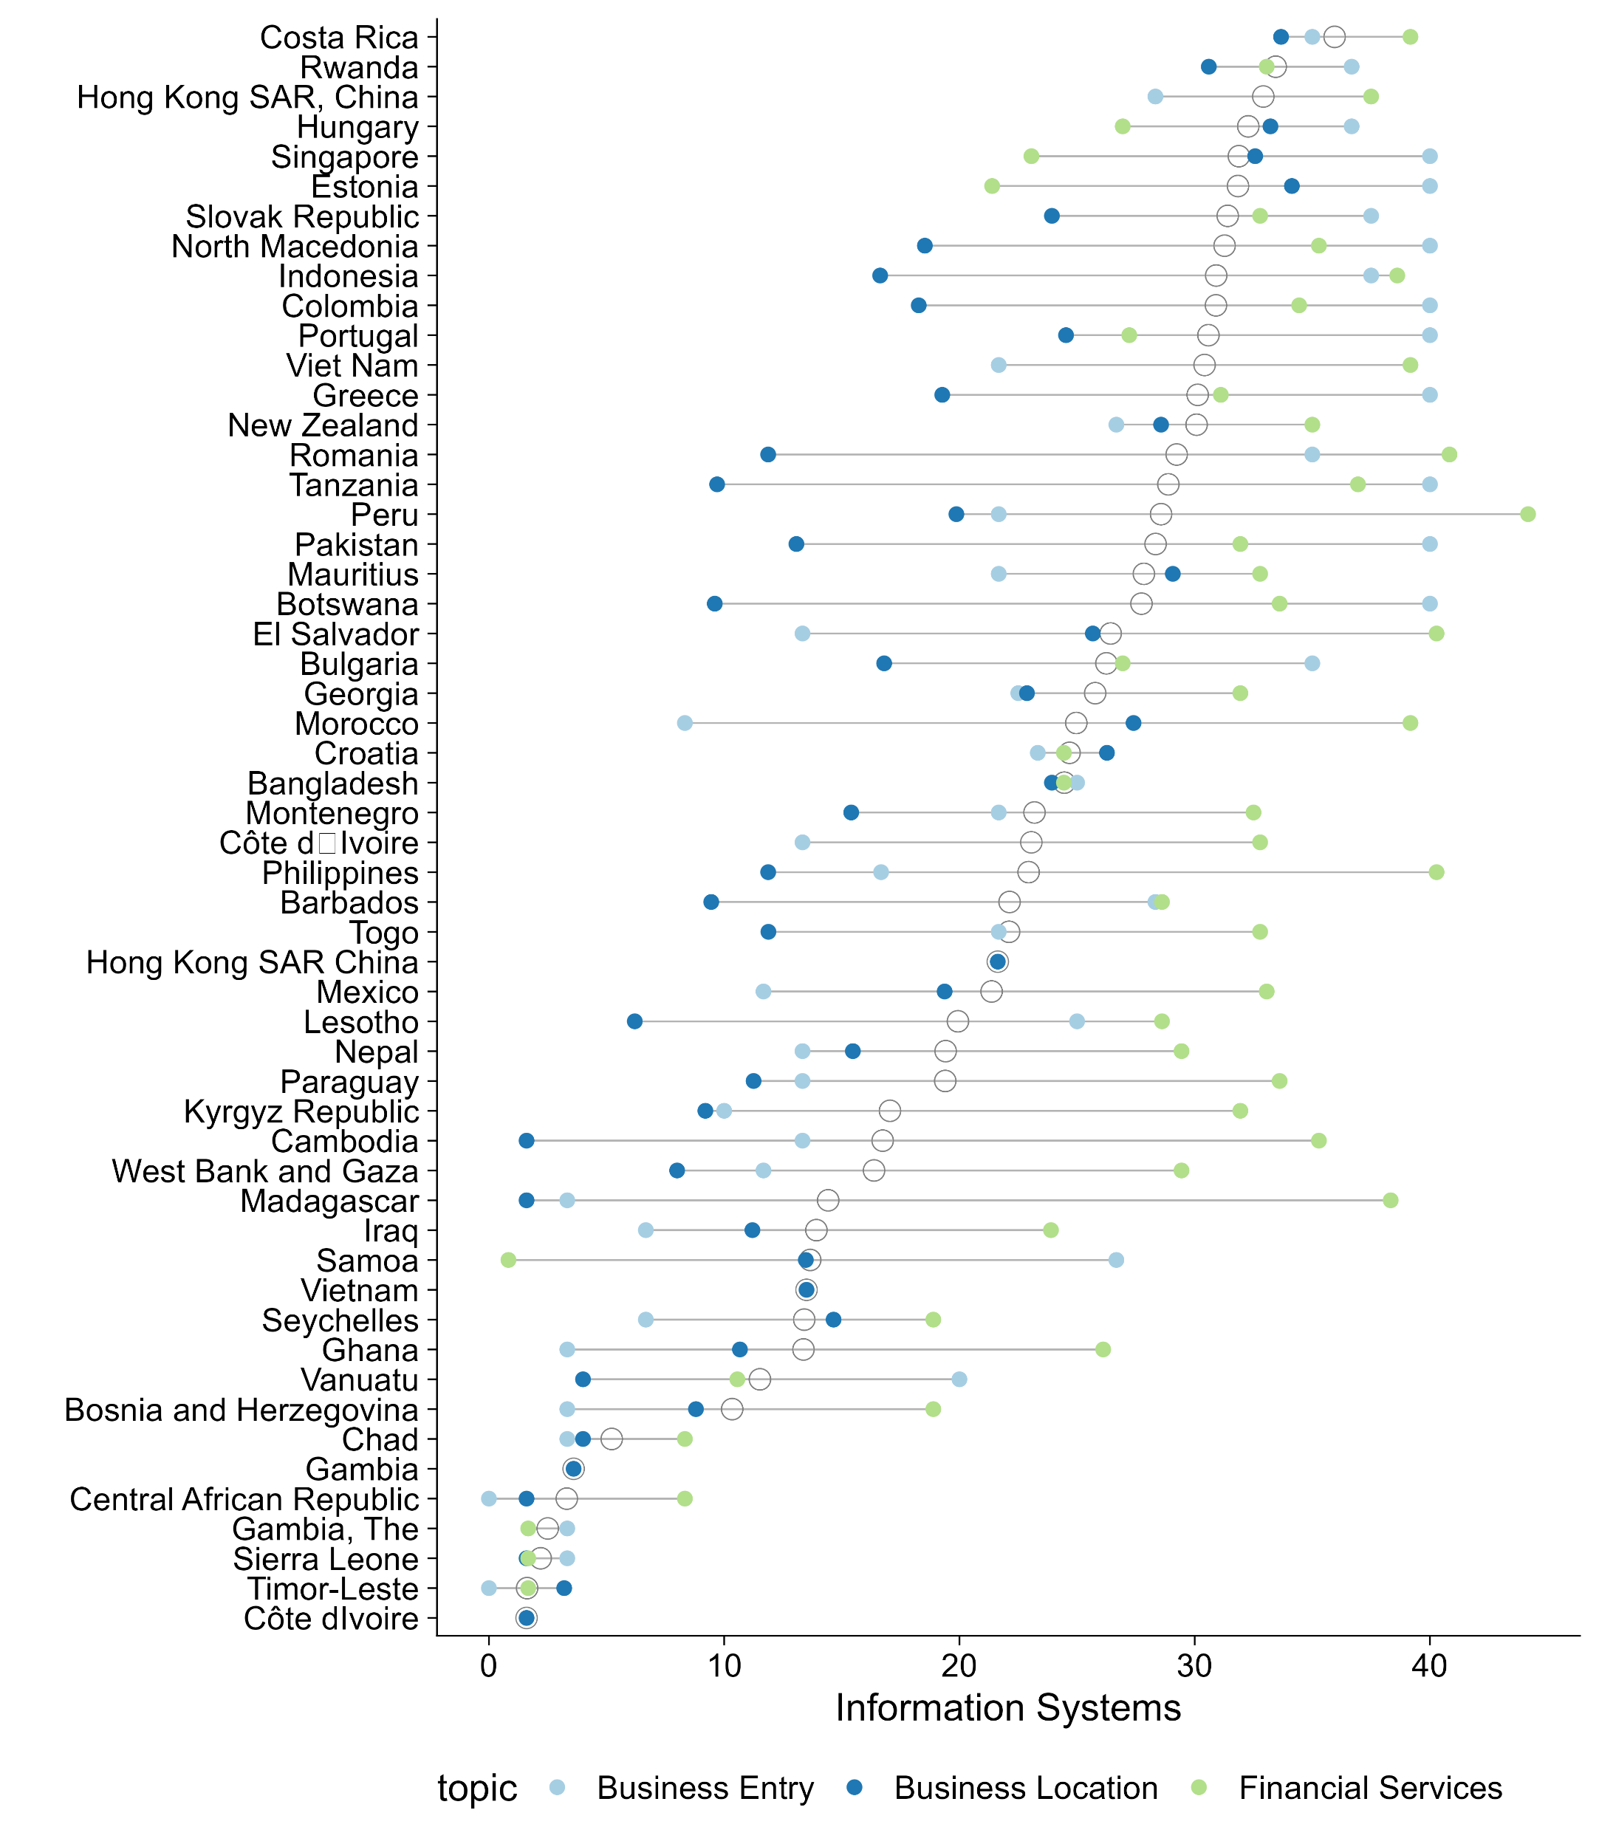
Information systems vary across B-Ready topics
Notes:
Figure out if these are on the same scale: are there ceiling effects? Are they the same score?

Slide 7
OECD Governance of Sector Regulators
Goal: measure institutional variation (within country) on the governance of sector regulators.
The OECD Governance of Sector Regulators (GSR) is a self-reported questionnaire answered by OECD+ countries. Mix of de jure and de facto practices.
Accountability: this dimension covers the mechanisms to hold the regulator to account on its performance and decision making. This concerns the regulator’s accountability vis-à-vis the executive, legislature, regulated entities, users and society.
Independence: this dimension looks at the degree to which regulators can operate independently, free from undue influence from government and regulated entities. The independence dimension covers three sub-dimensions: relationship with the executive, staff and budget.

Slide 8
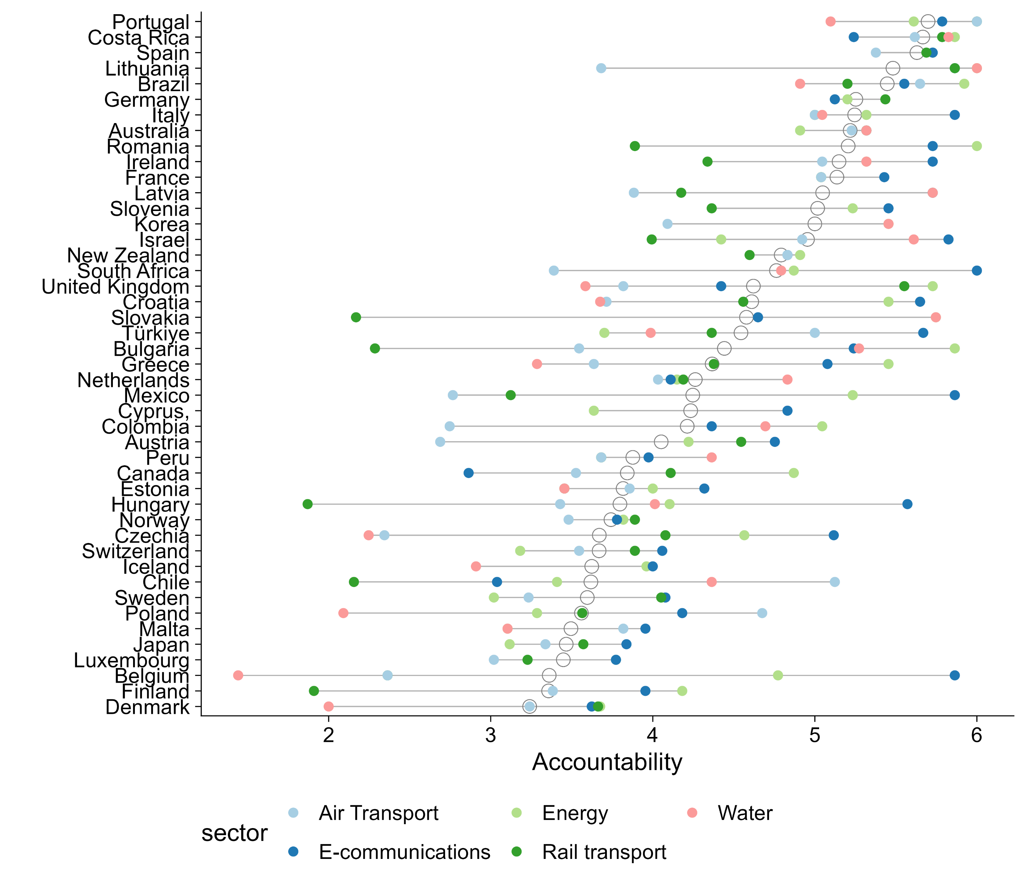
OECD GSR: Accountability

Slide 9
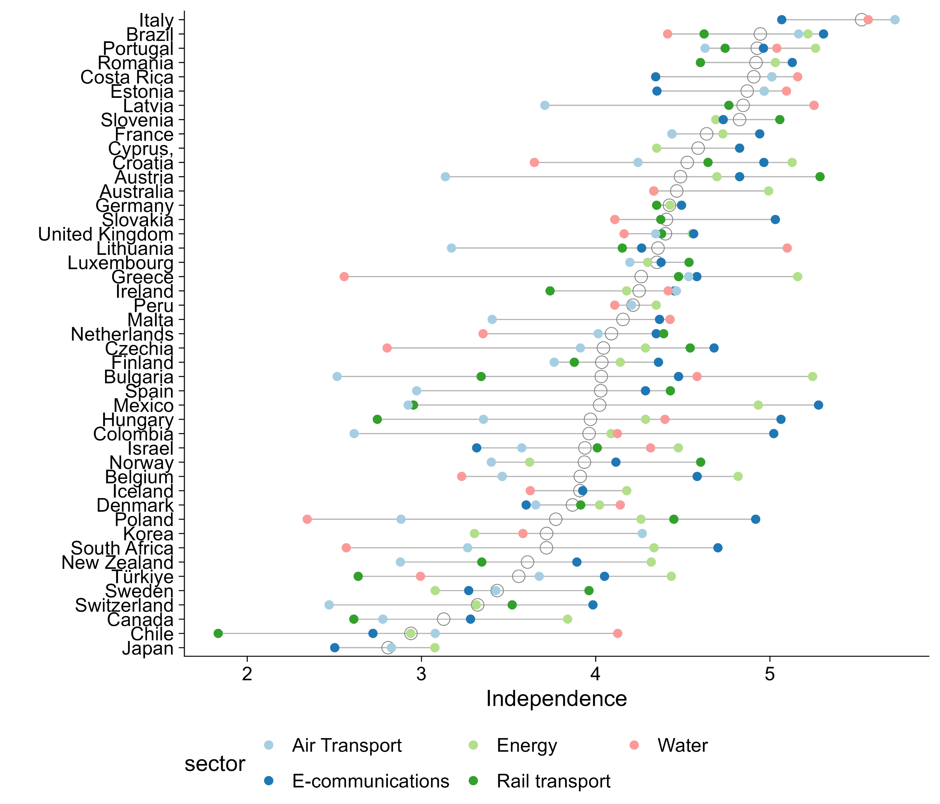
OECD GSR: Independence

Slide 10
International Telecoms Union
Goal: link governance dimensions (independence) to outcomes (investment).
Literature links independence of regulators with decreased regulatory uncertainty, incentivizing investments.
Independence: the team has created an index of seven indicators of independence of ICT regulators, including who has the authority to appoint (e.g., parliament or the regulatory board), laws that codify grounds for dismissal, among others.
Each indicator is coded as 0 or 1, validated by the Markets, Competition, and Technology team.
Maximum score of 7, lowest of 0. We rescale it to 0-1.

Slide 11
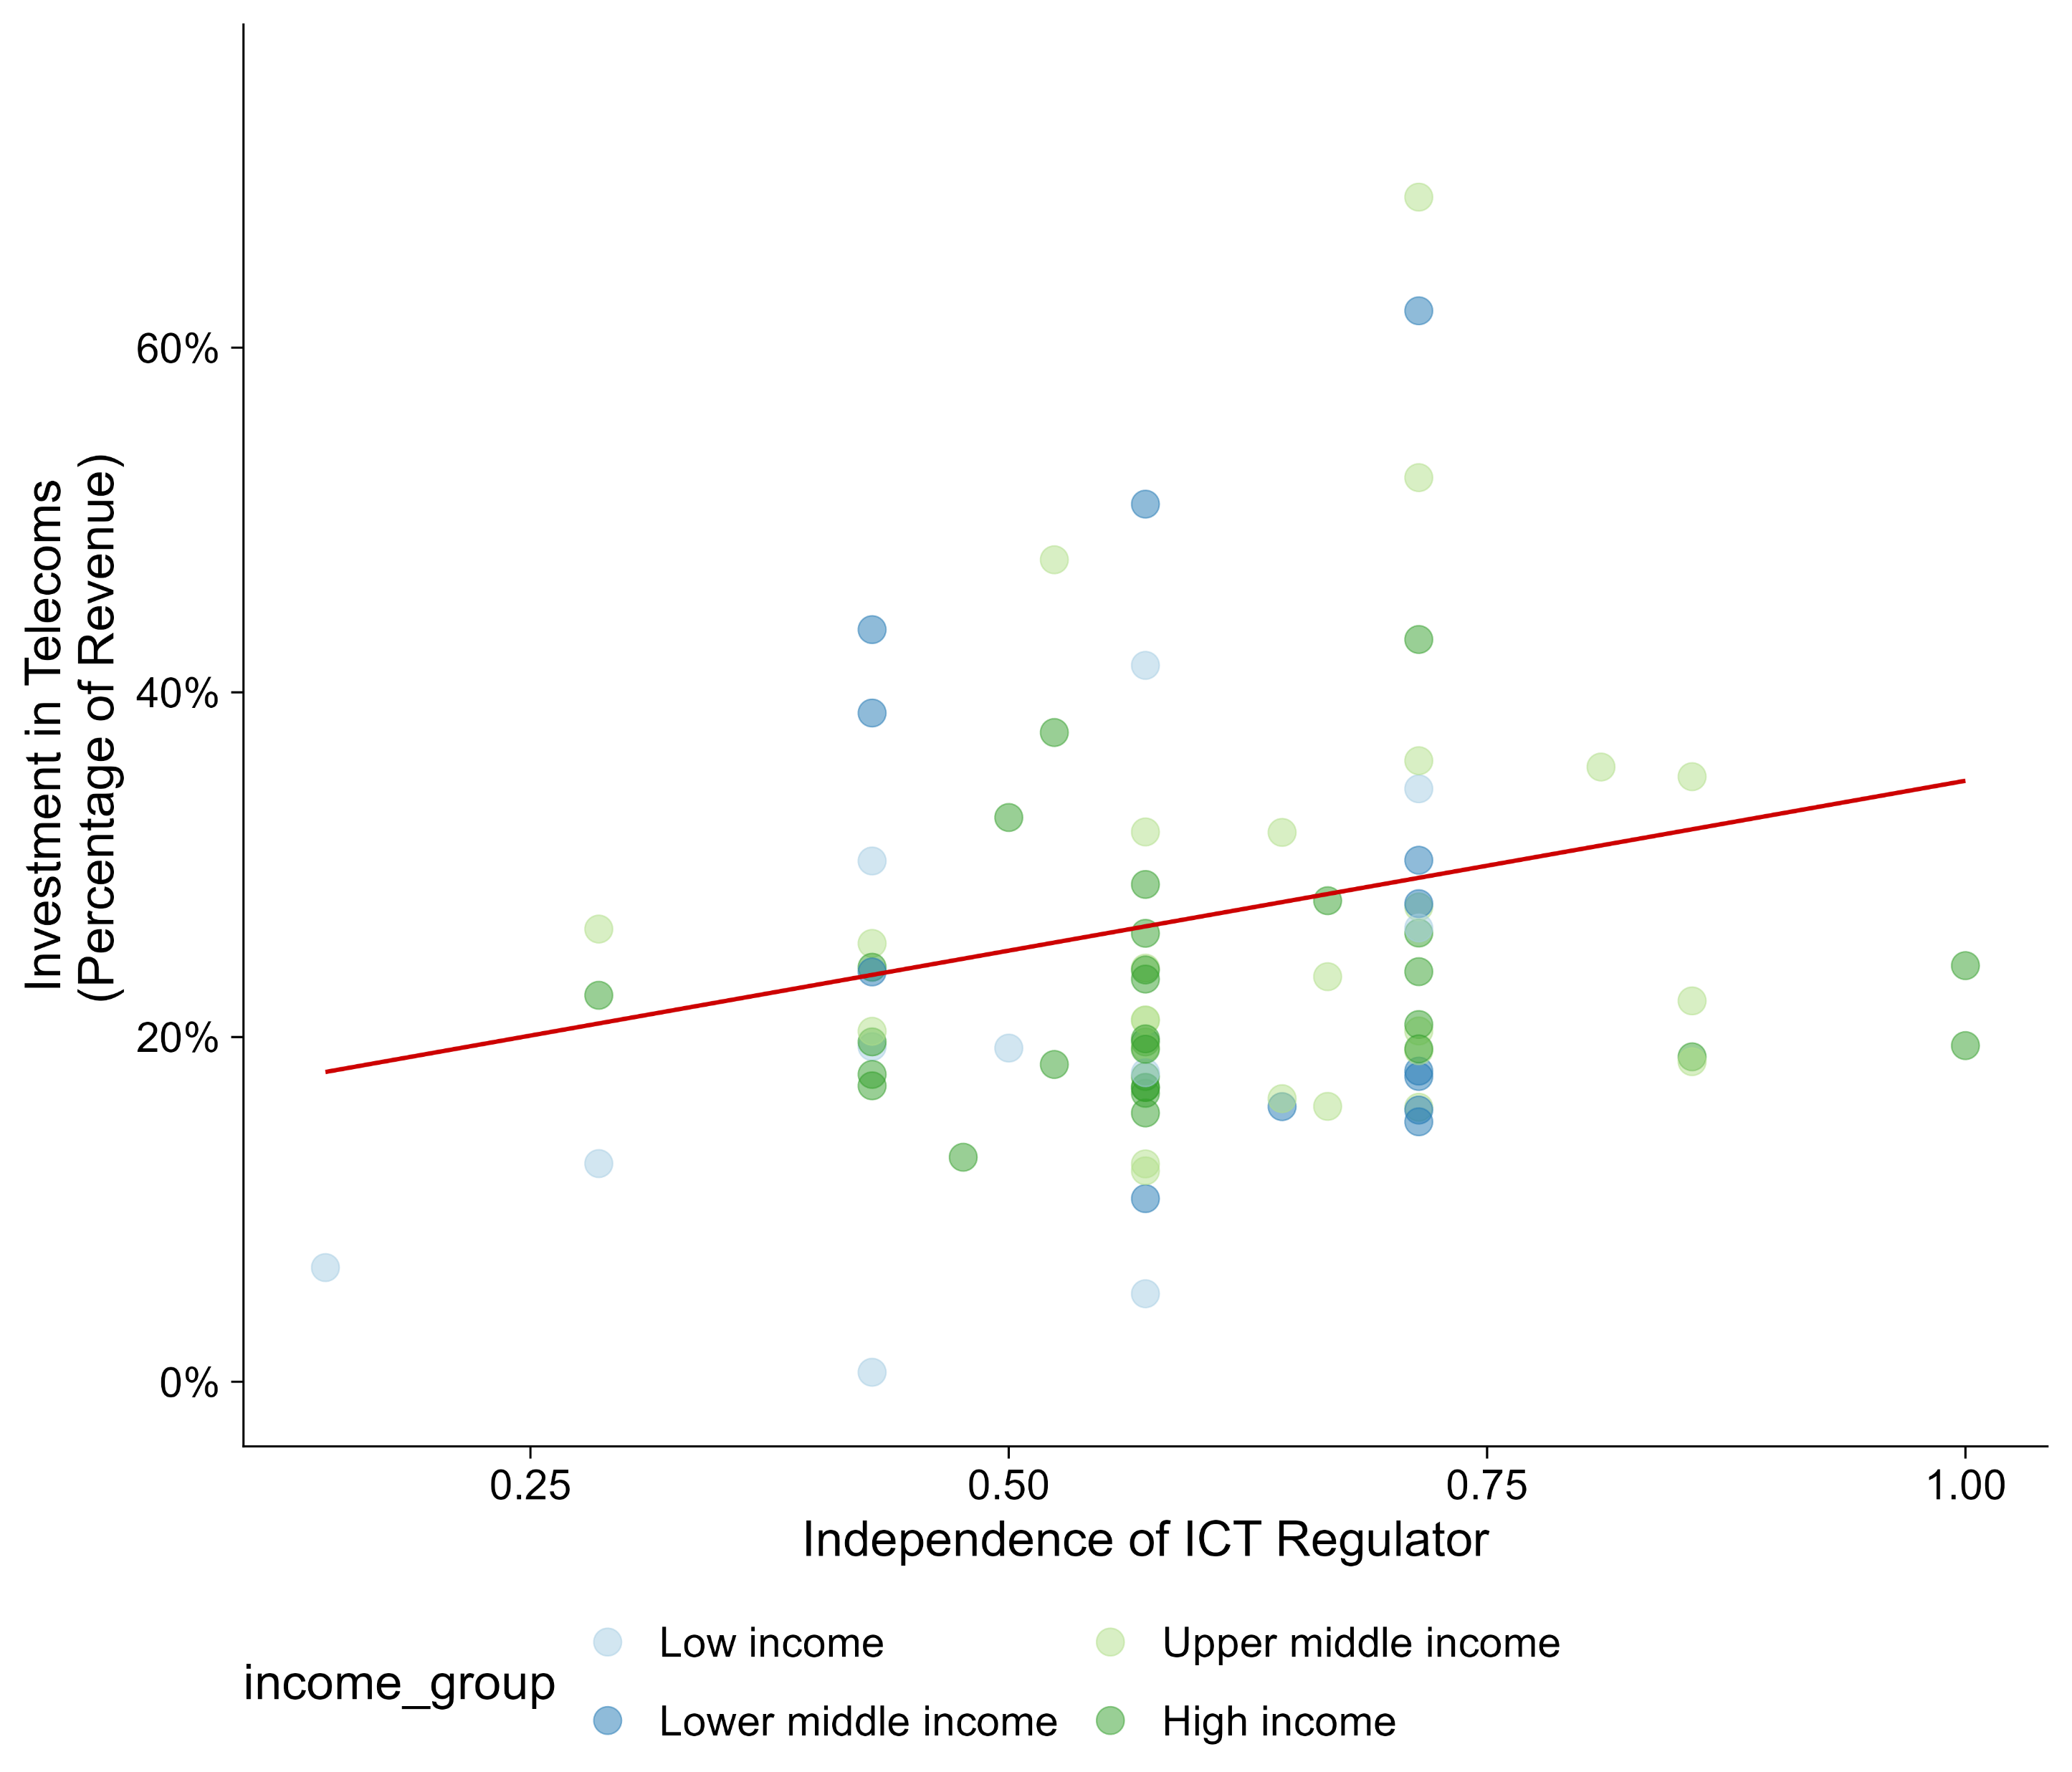
Higher independence of ICT Regulator associated with greater investments
Notes:
Let’s unpack independence into organizational (e.g., personnel and management).

Slide 12
CPSDs and CEMs (now CGJRs)
The added references to CPSDs and CEMs (now CGJRs) is not very convincing. The discussion is skewed towards CPSDs and simply notes that CPSDs say that regulation is important – this is true but not particularly convincing and does not connect with the governance and organizational dimensions. The team should consider more carefully what insights can be taken from CPSDs, CGJRs, and PMRs that relate specifically to the conceptual framework of the report.

Slide 13
Revisions proposed
The team has opted to add references to CPSDs and CGJRs in Chapter 2.
This allowed for a broader framing on the role of public institutions for enabling private sector development, instead of a narrower focus on regulatory institutions.
Example on Infrastructure:
The effective management of financial resources fundamentally shapes the ability of public institutions to deliver physical infrastructure like electricity, roads, and infrastructural nodes in supply chains. For instance, the CGJR for Moldova emphasizes the need to improve the low quality of infrastructure. The country CPSD finds that roads in particular have received insufficient investment. Not only is the State Road fund insufficiently capitalized, but it also fails to provide a predictable source of funding for road maintenance. One of the recommendations is to establish multiyear payment mechanisms to enable output- and performance-based contracts to improve road maintenance and operation. As one of Europe’s poorest countries, it may be difficult for Moldova to allocate more funding to road maintenance; even so, changing how existing funds are managed can improve outcomes.

