Slide 1
Hybrid Soft Computing
M11259003 吳柏呈

Slide 2
Outline
PSO參數設定
GA參數設定
訓練結果&模型測試

Slide 3
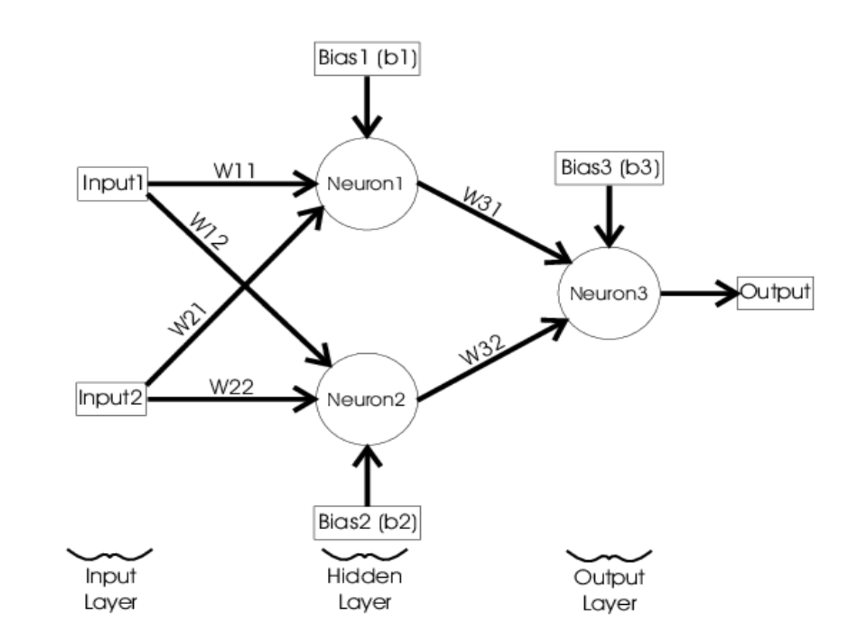

PSO參數設定
The dimension of a particle : 9
$w_{11} , w_{12}{ , w}_{21} , w_{22}$​ is weights of the hidden layer
$w_{31}{ , w}_{32}$ is weights of the output layer
$b_{1} , b_{2} , b_{3}$is bias

Slide 4
PSO參數設定
Number of particles | Max iterations | c1 | c2 | w_max | w_min | dimension of a particle
100 | 90 | 1 | 1 | 0.5 | 0.3 | 9
終止條件:
在 PSO 中，終止條件是最大迭代次數(max_iter)，即在這裡設為 90 次。當迭代次數達到 90 次時，PSO 會停止搜尋。
Inertial weight線性遞減 $w\left(t\right)= w_{max} − \frac{w_{max} − w_{min}}{t_{max}} ×t$
速度更新公式 : $v_{id}^{k+1}= ωv_{id}^{k}+ c_{1}r_{1}\left(p_{id,pbest}^{k}−x_{id}^{k}\right)+c_{2}r_{2}\left(p_{d,gbest}^{k}−x_{id}^{k}\right)$
位置更新公式 : $x_{id}^{k+1}= x_{id}^{k}+v_{id}^{k+1}$

Slide 5
GA參數設定
在GA中，每個個體(染色體)也有9維，與PSO相同。
GA 的終止條件是max_generations ,在這裡設為100次。當進化過程達到 100 代時，GA 會停止搜尋。
Parent Selection : Roulette Wheel Selection ,我們選取了fitness前10的染色體來進行隨機選擇2個。
Crossover Operator/s : Single-point Crossover , 機率 : 100%
Mutation Operator/s : 0.1(10%)

Slide 6
GA參數設定
dim | population_size | max_generations | Crossover_rate | mutation_rate
9 | 50 | 90 | 1.0 | 0.1

Slide 7
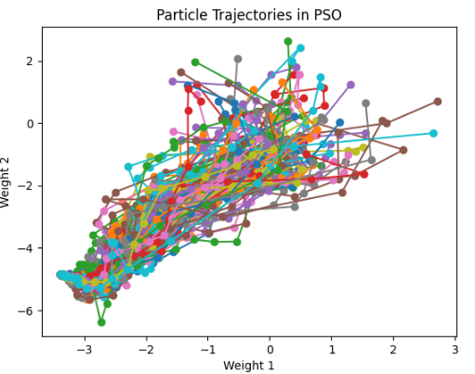
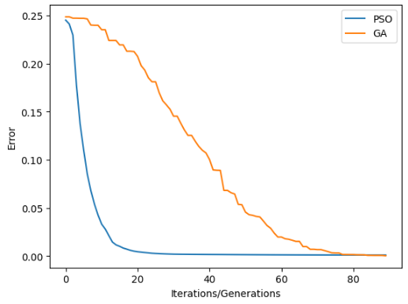
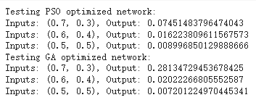
訓練結果
Number of particles | Max iterations | c1 | c2 | w_max | w_min | dimension of a particle
100 | 90 | 1 | 1 | 0.5 | 0.3 | 9
population_size | max_generations | Crossover_rate | mutation_rate | dim
50 | 90 | 1.0 | 0.01 | 9

Slide 8
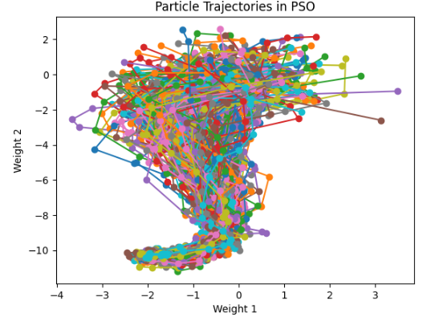
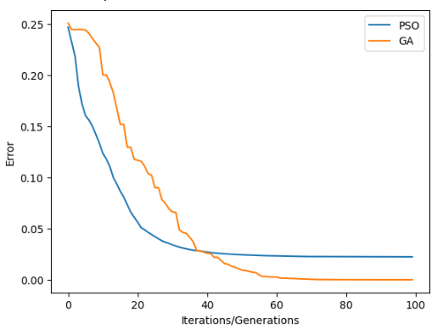
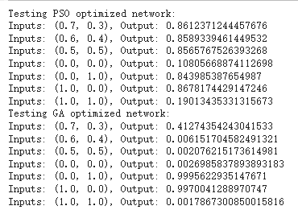
訓練結果
Number of particles | Max iterations | c1 | c2 | w_max | w_min | dimension of a particle
200 | 100 | 1 | 1 | 0.5 | 0.3 | 9
population_size | max_generations | Crossover_rate | mutation_rate | dim
50 | 100 | 1.0 | 0.01 | 9

Slide 9
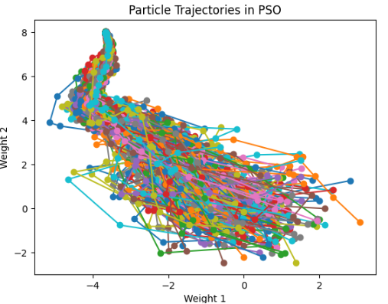
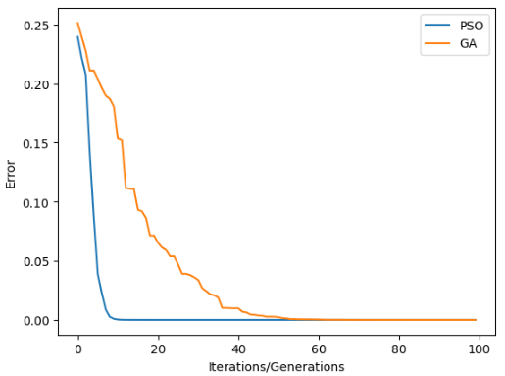
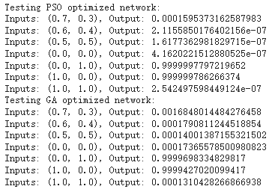
訓練結果
Number of particles | Max iterations | c1 | c2 | w_max | w_min | dimension of a particle
200 | 100 | 1 | 1 | 0.5 | 0.3 | 9
population_size | max_generations | Crossover_rate | mutation_rate | dim
50 | 100 | 1.0 | 0.01 | 9

Slide 10
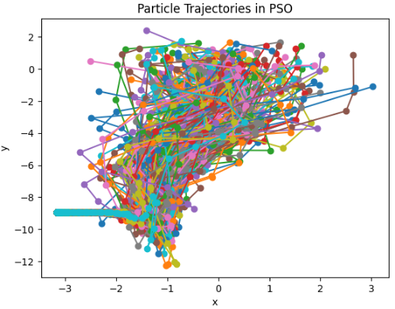
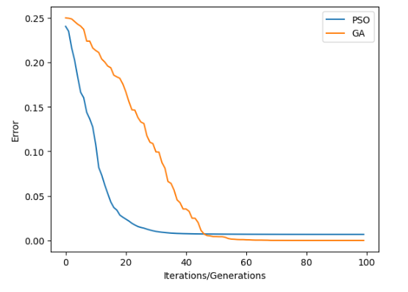
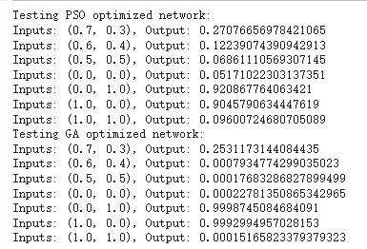
訓練結果
Number of particles | Max iterations | c1 | c2 | w_max | w_min | dimension of a particle
200 | 100 | 1 | 1 | 0.5 | 0.3 | 9
population_size | max_generations | Crossover_rate | mutation_rate | dim
50 | 100 | 1.0 | 0.1 | 9

Slide 11
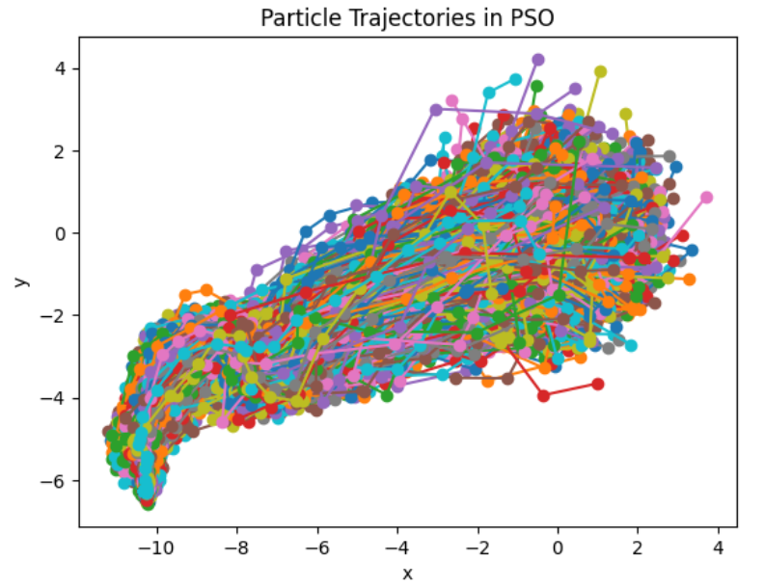
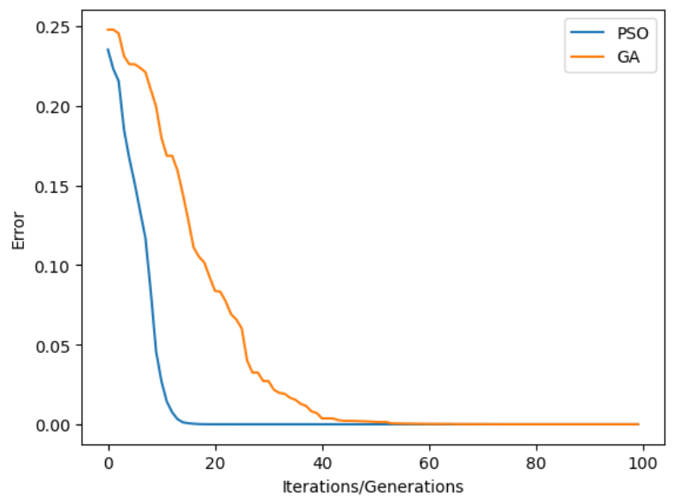
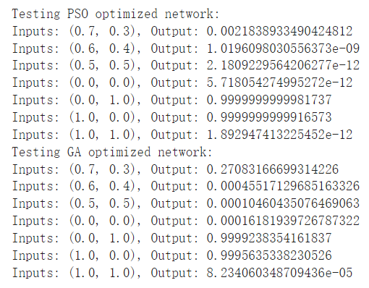
訓練結果
Number of particles | Max iterations | c1 | c2 | w_max | w_min | dimension of a particle
4000 | 100 | 1 | 1 | 0.5 | 0.3 | 9
population_size | max_generations | Crossover_rate | mutation_rate | dim
50 | 100 | 1.0 | 0.1 | 9

