Slide 1


Diagnostic system for diabetes retinopathy
Milestone 1 meeting
Member：
BEINING WANG
CHENYU HUANG
ZHENGYU ZHOU
PEIJIN CHEN
Date: 2025.04.20

Slide 2
1
Overview of project objectives and requirement design
CONTENTS
2
Gantt chart and progress analysis, team member division analysis
3
Detailed step demonstration

Slide 3
Overview of project objectives and requirement design
PART 1

Slide 4
Goal
Problem
Develop an automatic diagnosis system for diabetes retinopathy (DR) based on neural networkUsing deep learning techniques to construct a neural network model.
1. The efficiency of manual screening is low
2. Lack of medical resources
3. Low popularity of fundus examination
Technology
programming language Python
Deep Learning Framework: PyTorch
Data processing tools: OpenCV
Model Training Platform: Cloud GPU Server

Slide 5
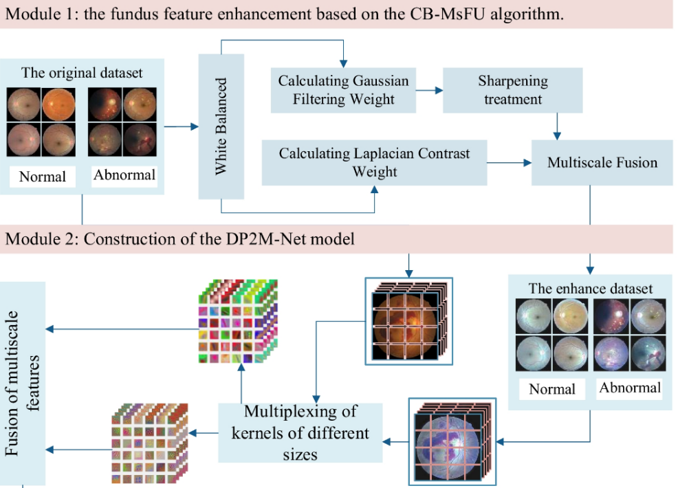

1、The system is capable of receiving fundus images uploaded by doctors or patients and automatically analyzing them to classify them. Standardize the input image, further remove noise, perform pixel level annotation, brightness adjustment, etc.
2、Judge whether there is diabetes retinopathy, further divide the severity of the disease, and identify the diagnosis results. Choose a suitable deep learning model (such as ResNet) and train the model to identify retinal lesions. It is possible to grade lesions and develop lesion grading algorithms.

Slide 6
3 User Interface
Used to view patient test results, lesion grading, and treatment recommendations, supporting image upload, result viewing. Automatically generate reports and reference treatment methods to help doctors quickly understand the patient's condition and develop treatment plans.
4 Non functional requirements
4.1 System response time
4.2 Support high concurrency user access
4.3 Security（All patient data must be encrypted）

Slide 7
Gantt chart and progress analysis, team member division analysis
PART 2

Slide 8
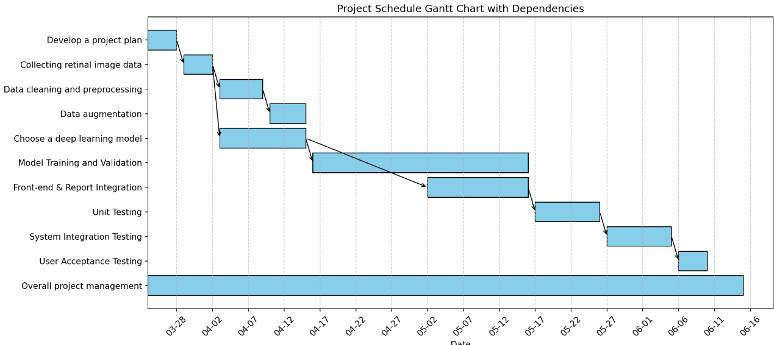

Slide 9
Name | Responsibility（about 30 working hours/person until 4.20)
BEINING WANG | Supervise and manage the overall progress, conduct model training and data processing
CHENYU HUANG | Conduct paper research and data preprocessing，host system testing
ZHENGYU ZHOU | Based on previous papers and dataset structures, optimize the model and analyze the results
PEIJIN CHEN | Complete the writing of front-end and back-end interfaces and API documentation

Slide 10
PART 3
Detailed step demonstration

Slide 11
Dataset Collecting
Dataset | Task | Images
DRIVE | Vessel segmentation | 40
IDRID | Segmentation & Grading | 81
FGADR | Segmentation | 1842
DDR | Segmentation & Grading | 757
Tongji-DR | Segmentation | 492
Nankai-DR | Segmentation | 762

Slide 12
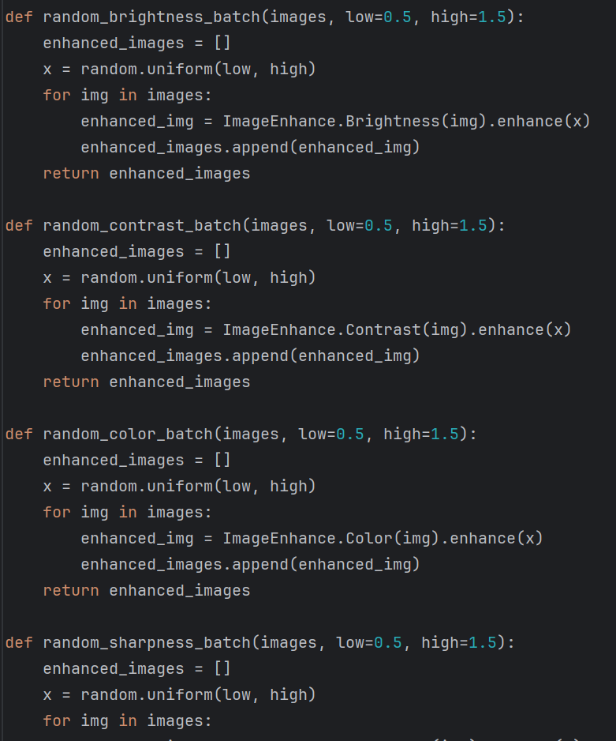
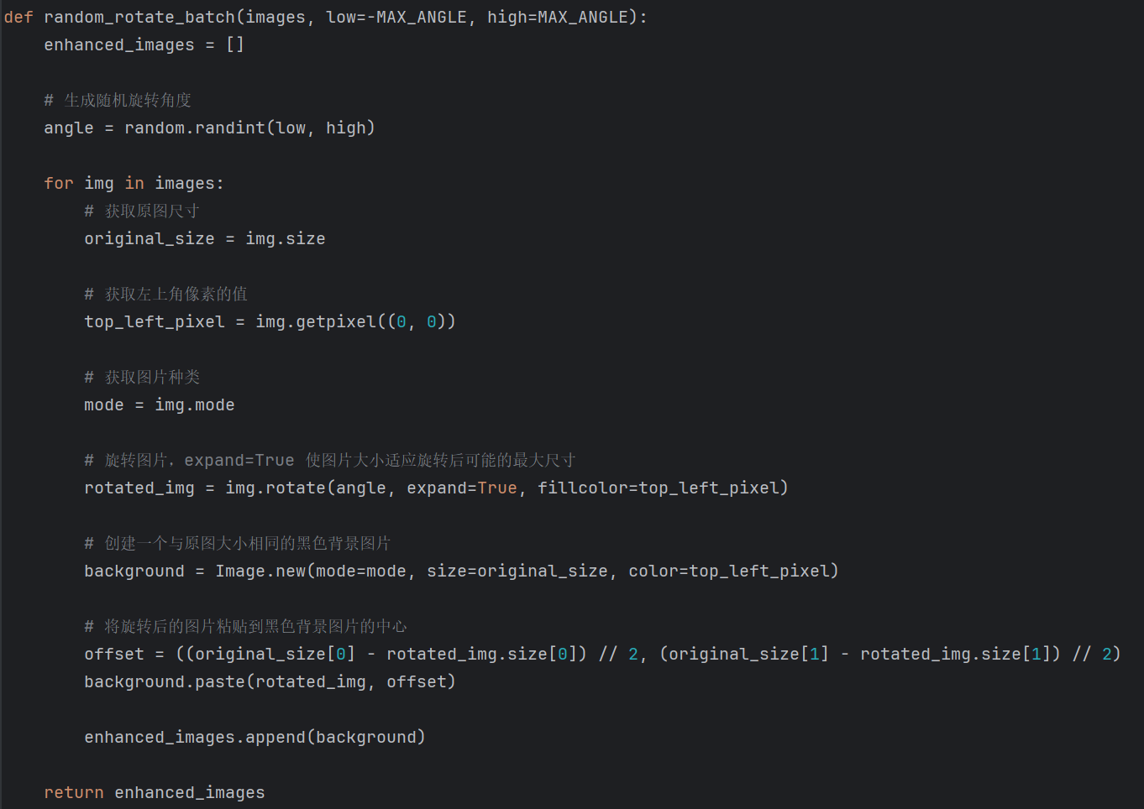
Data preprocessing and augmentation

Slide 13
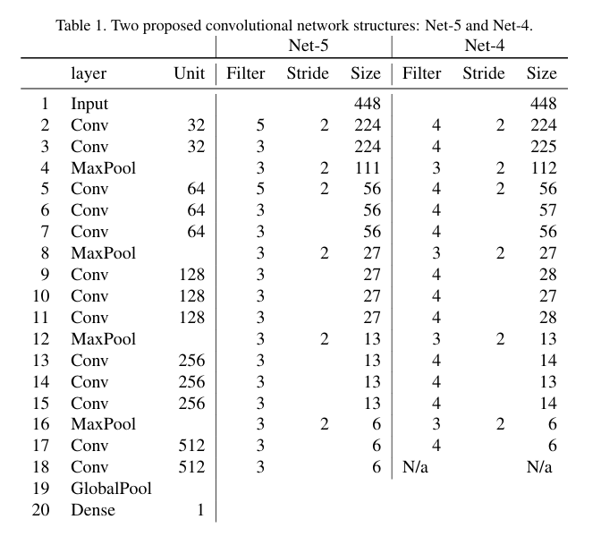
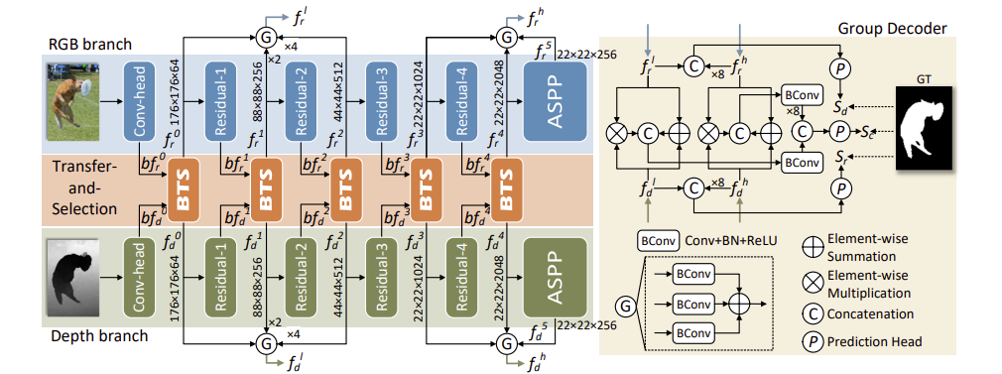
Paper research
Diabetic Retinopathy Detection via Deep Convolutional Networks for Discriminative Localization and Visual Explanation
BTS neural network
https://arxiv.org/pdf/2104.01784.pdf

Slide 14
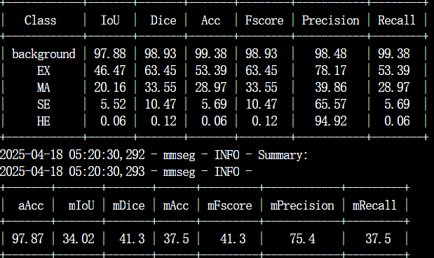
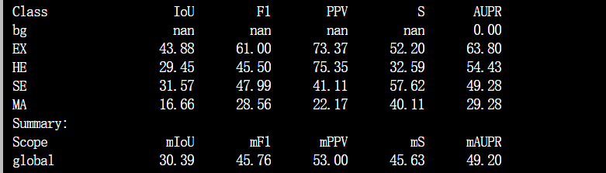
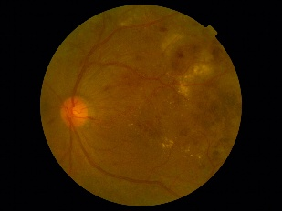
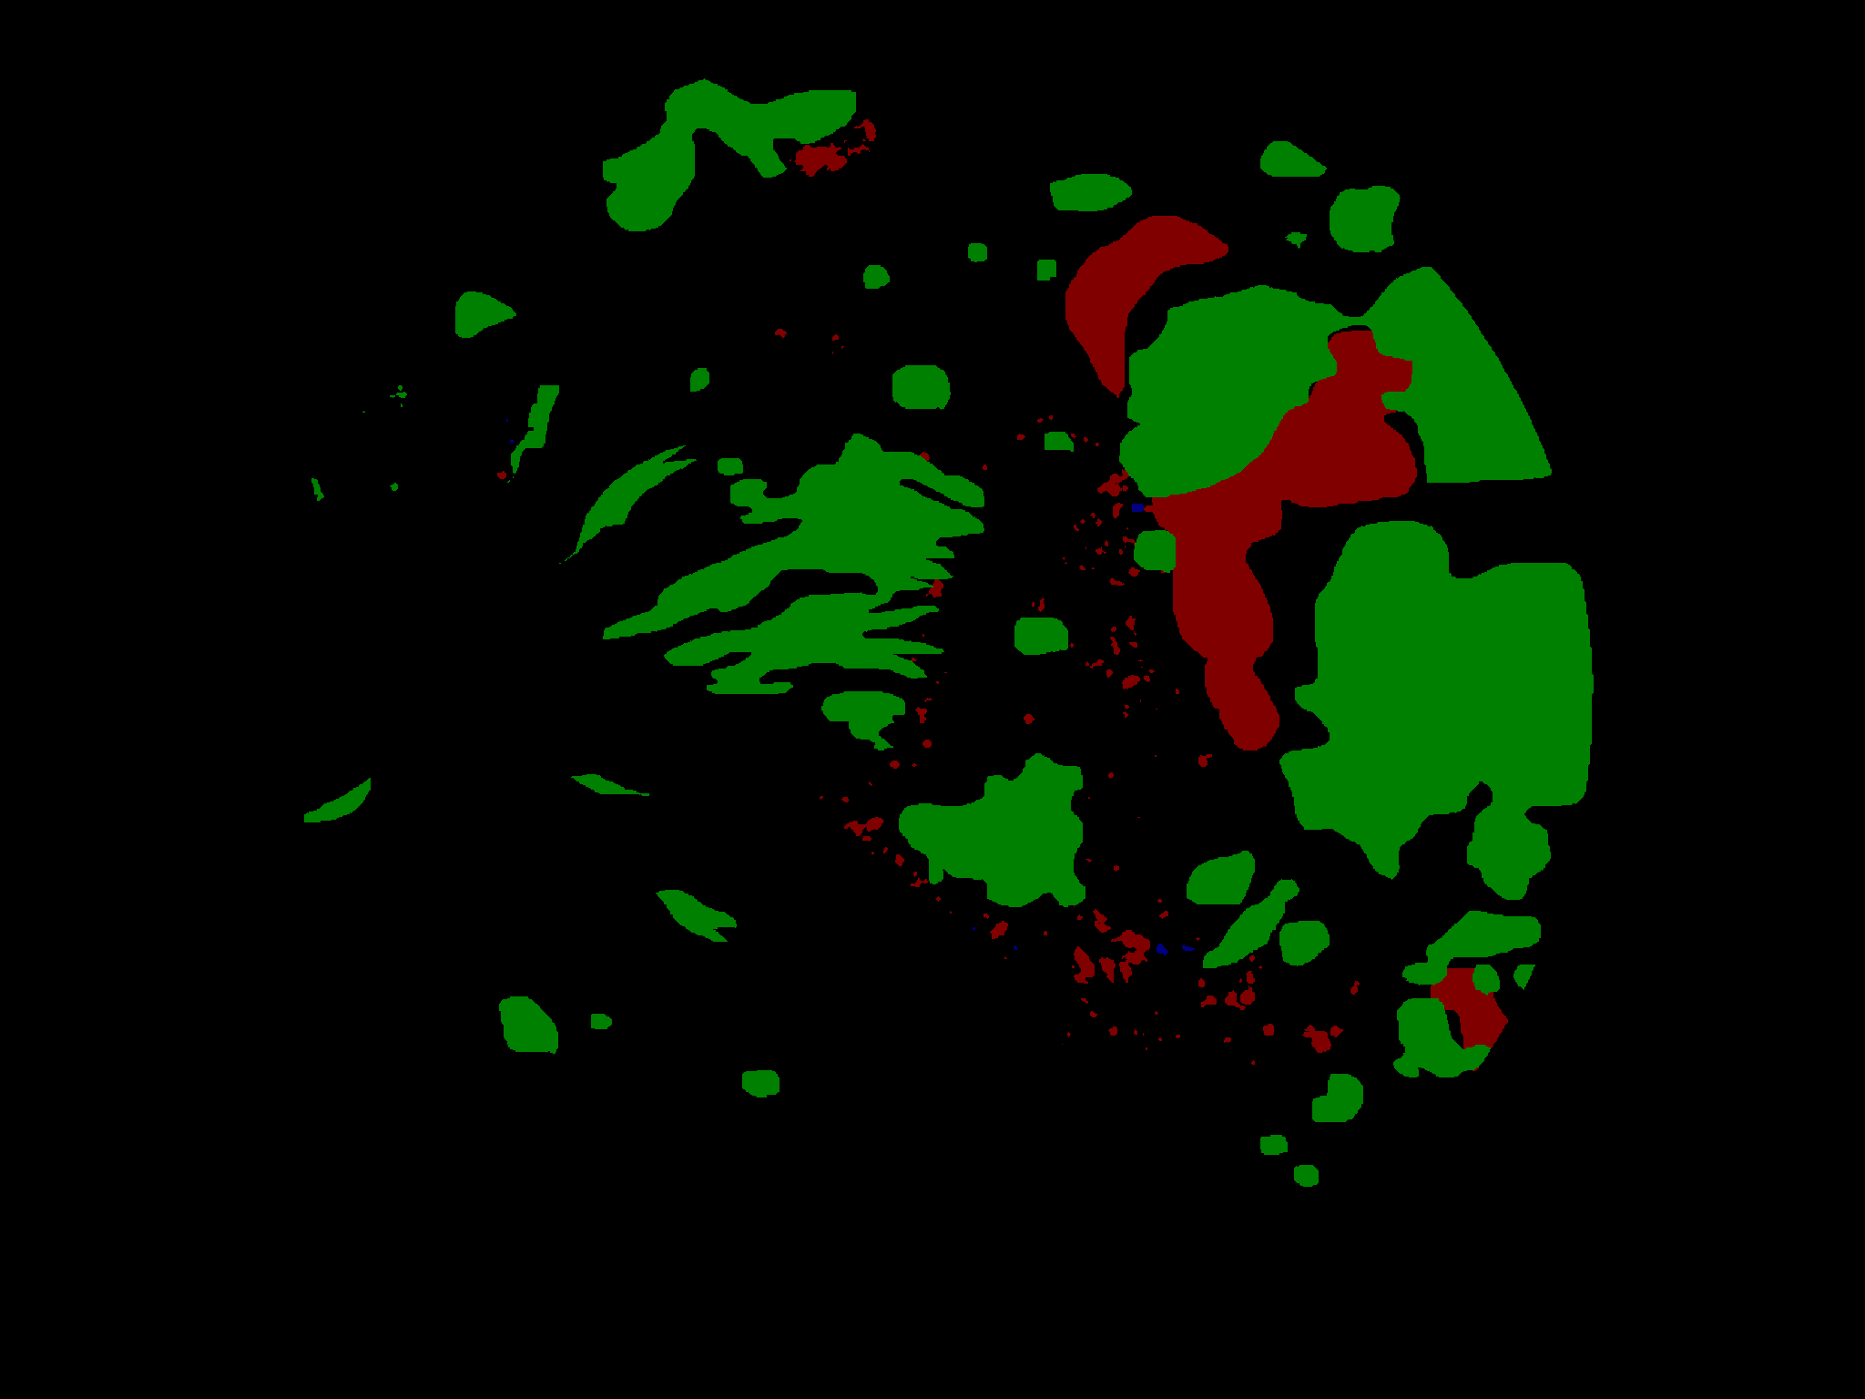
Model reproduction (using IDRiD and DDR dataset)
https://github.com/xqh180110910537/HACDR-Net
https://github.com/CVIU-CSU/M2MRF-Lesion-Segmentation?tab=readme-ov-file

Slide 15
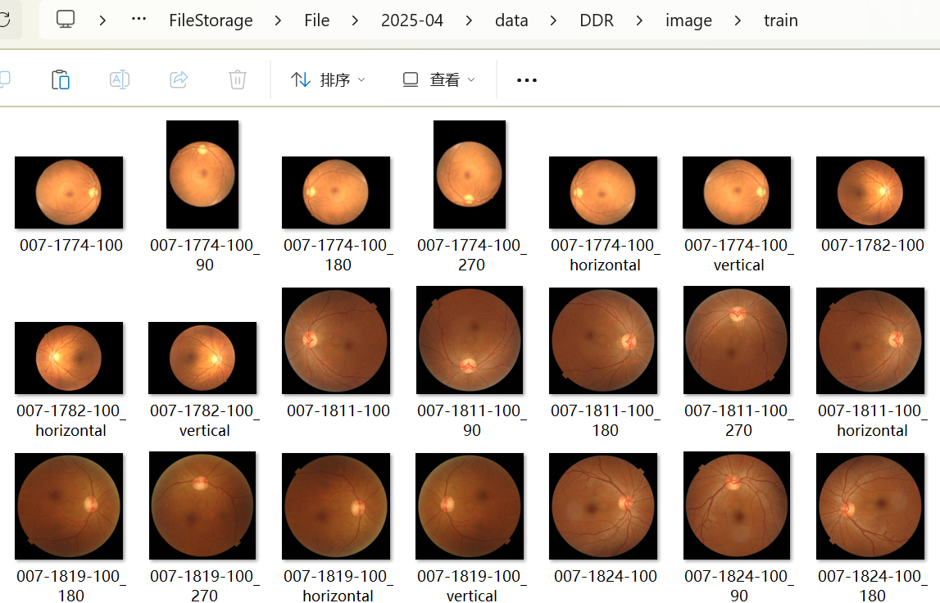
Model Optimization - Input Dataset
1、class imbalance problem
2、The correlation between single channel and multi-channel and training results

Slide 16
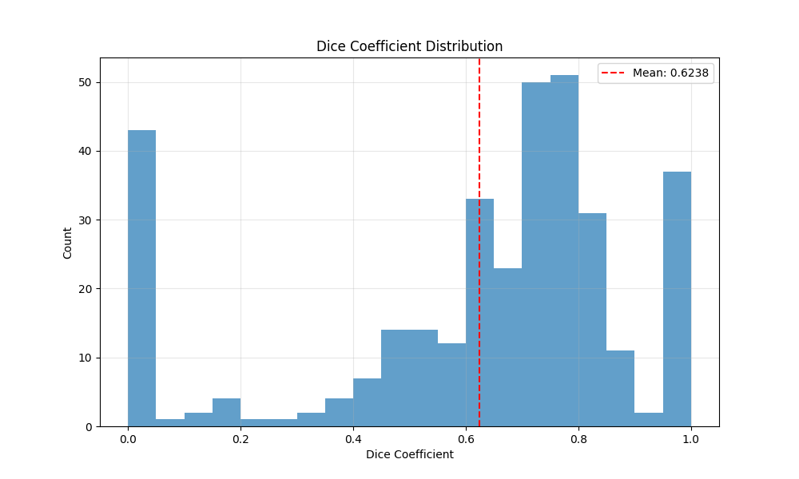
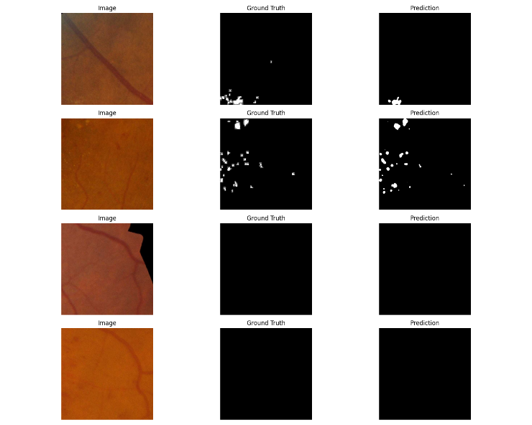
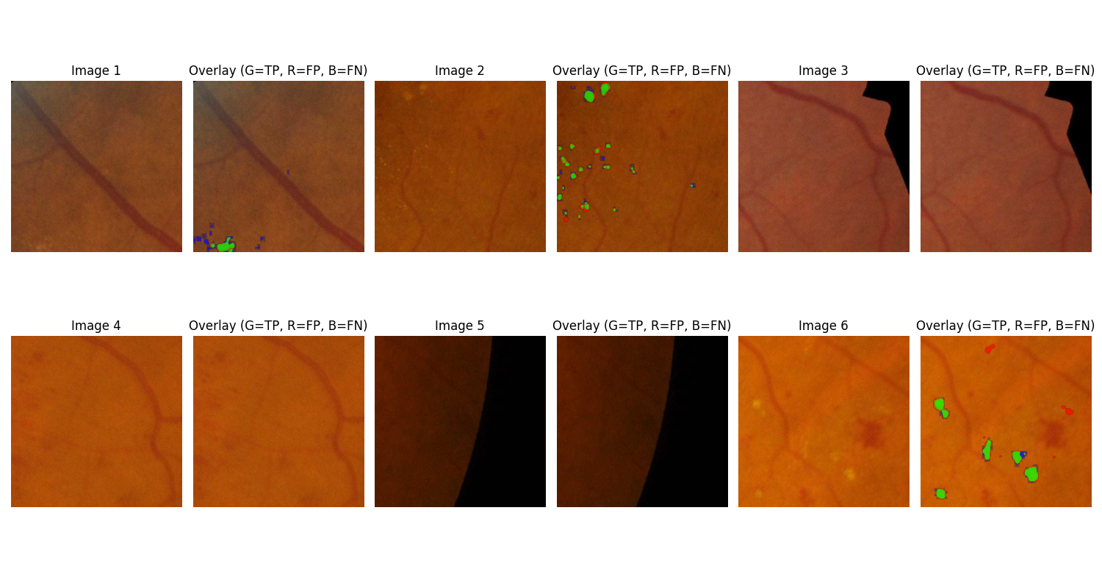
Model Optimization – U-net++
Test set evaluation results:
Sample size: 1372
Average Dice coefficient: 0.6238
Average precision: 0.6835
Average recall rate: 0.7075
fiveAverage F1 score: 0.6325

Slide 17
THANKS!

