Slide 1
Architecture Of Risk
Project build-3

Slide 2
Modules

Slide 3
Modules in risk Project
src: where the raw code
main: where the original code and resource file located
java: raw code
driver: the entrance of the project
mapeditor: code implement the map editor function
model: data and function in this project, observable
Strategy: include all the strategies used in the game
view: code to show graph based on data, observer
Controller: the mediator between model and view,
when player interact with view, help to call the model function
validate: code to verify a map’s validity
common: code that other modules can use together
exception: define exceptions in the project
resource: where the maps are saved
test: where the test are saved

Slide 4
Design Patterns

Slide 5
Observer Pattern
View
Model
Observer
Observable Classes
(For UI related data only)
PhaseView
Notify: current phase, action and other info
Phase
WorldDomainView
Notify: all the player’s info
PlayersWorldDomination
Set data
Functional model classes
CardExchangeView
Notify: cards info
Cards
CountryView
(for each country)
Notify: countries info
Country
FileInfoMenuView
Notify: selected file info
FileInfoMenu
NumPlayerMenuView
Notify: selected player info
NumPlayerMenu
Note: Project flow chart (in next page) will present the Notify—update flows.

Slide 6
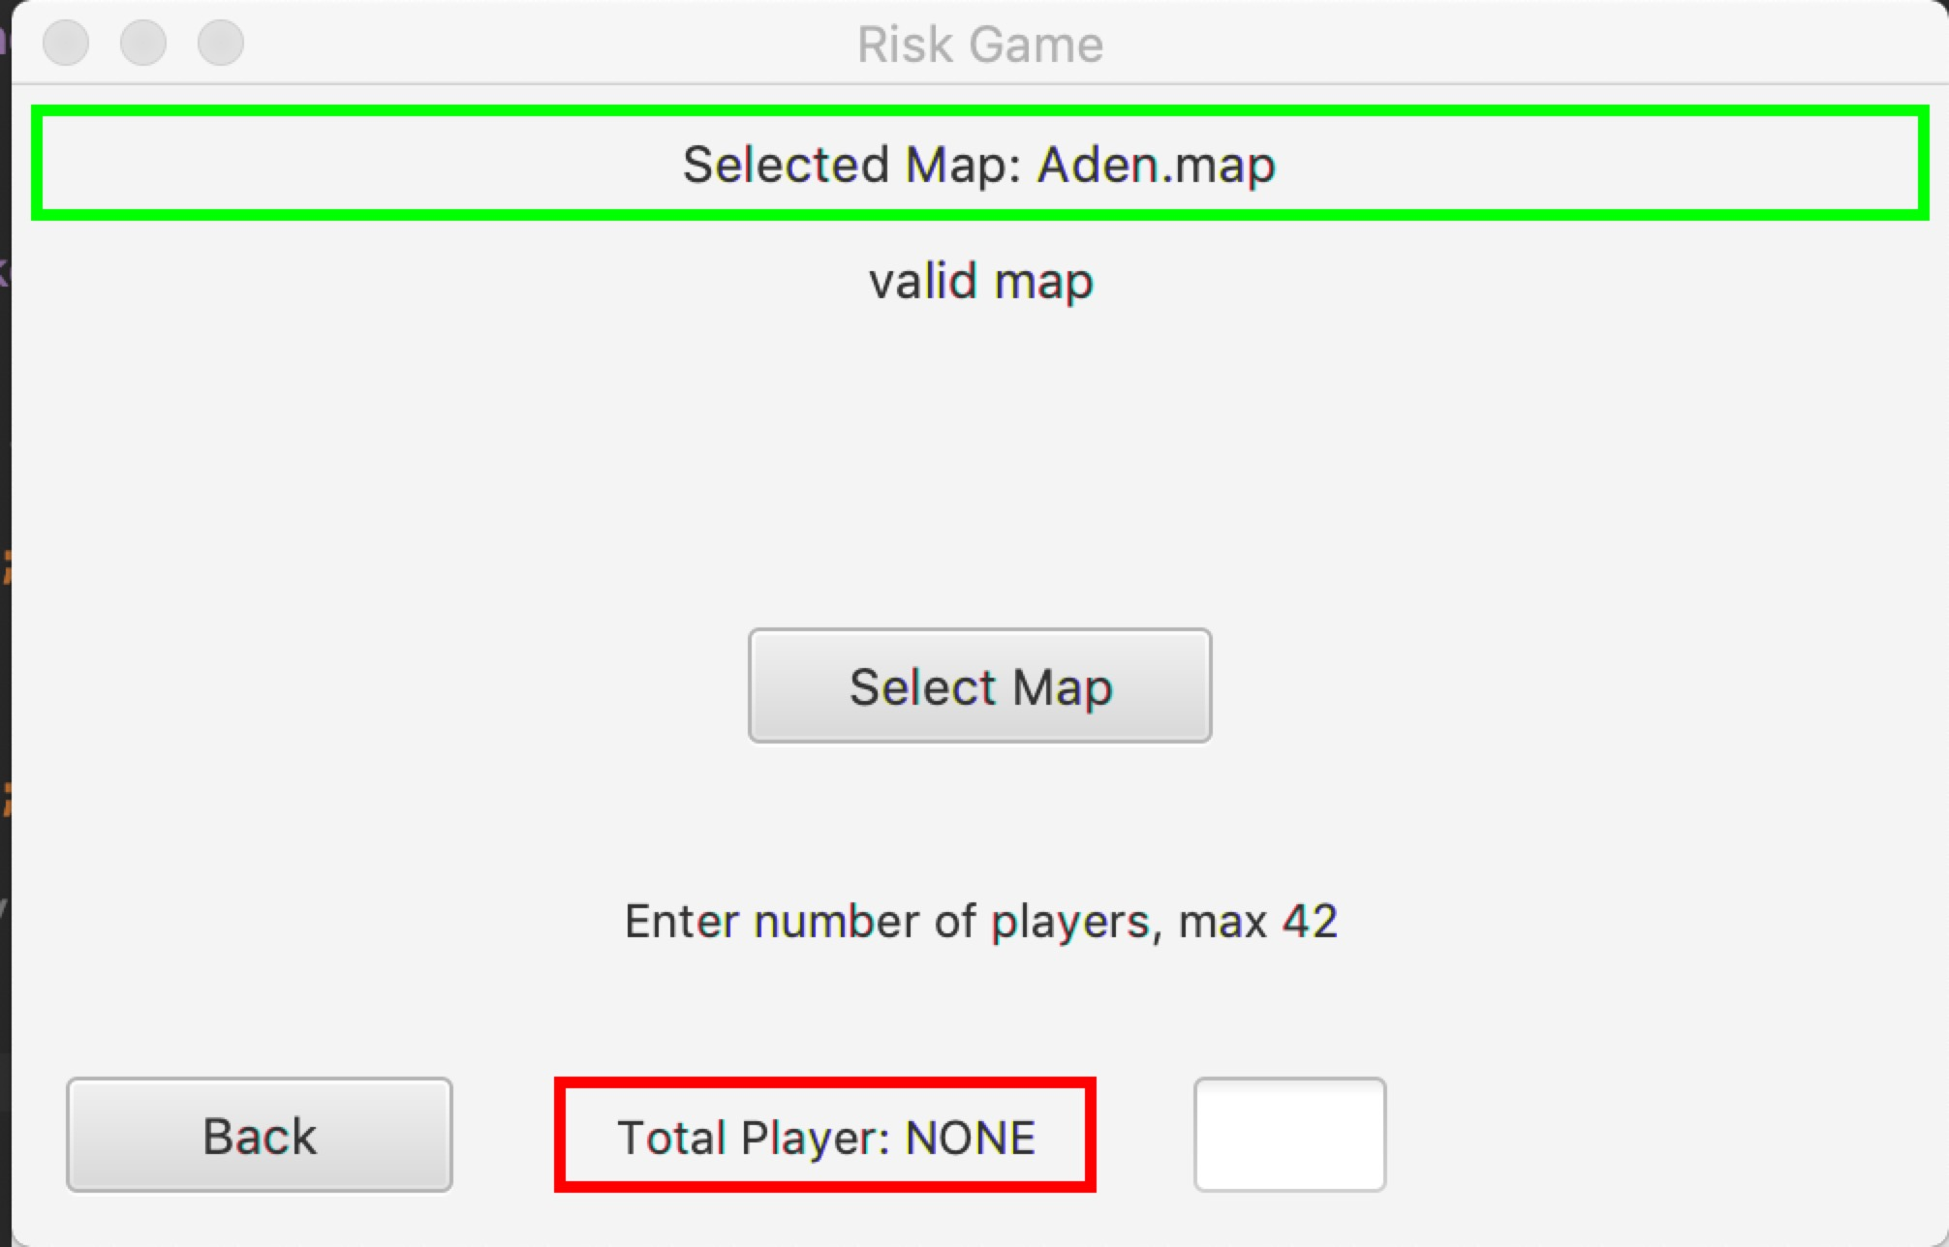
Observer Pattern
Notify: selected file info
FileInfoMenu
FileInfoMenuView
Notify: selected player info
NumPlayerMenu
NumPlayerMenuView

Slide 7
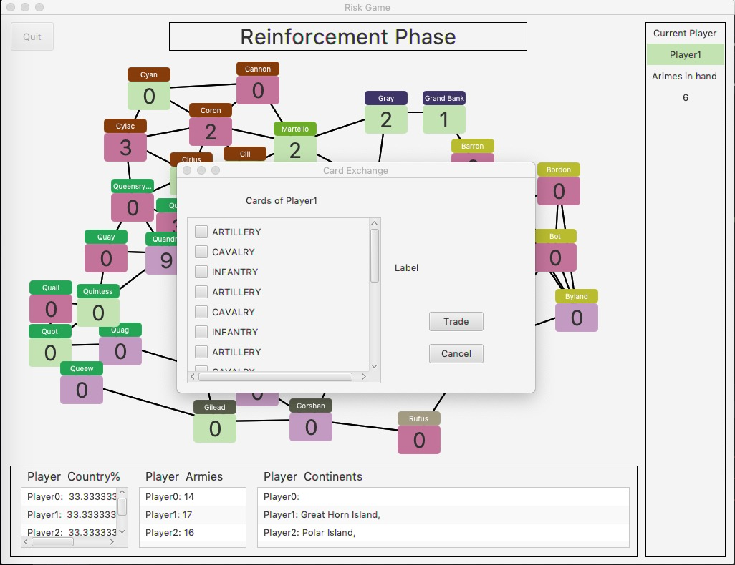
Observer Pattern
PhaseView
Notify: current phase, action and other info
Phase
Notify: cards’ info
Cards
CardExchangeView
Notify: countries’ info
Country(for each country)
CountryView
Notify: all the player’s info
PlayersWorldDomination
WorldDomainView

Slide 8
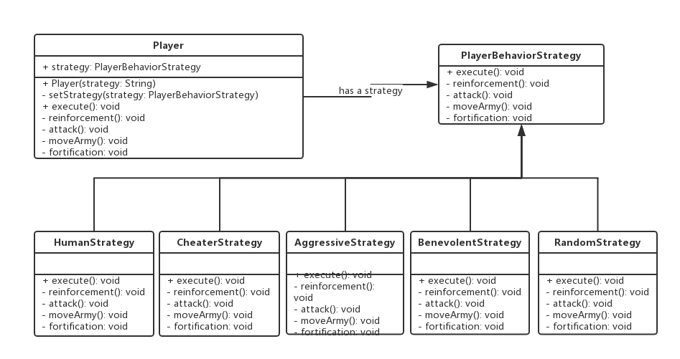
Strategy Pattern

Slide 9
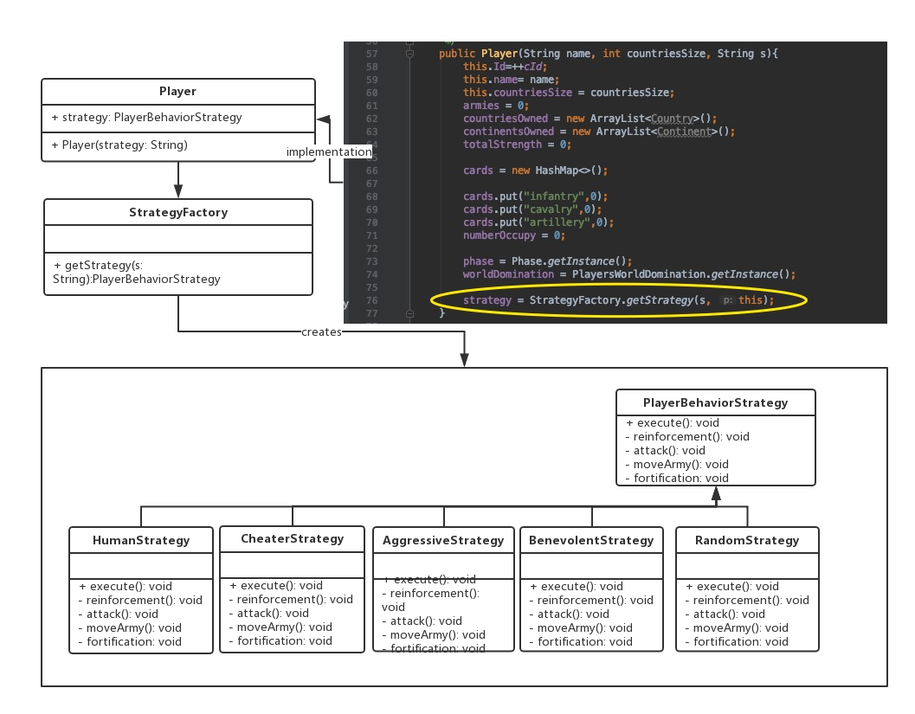
Factory Pattern

Slide 10
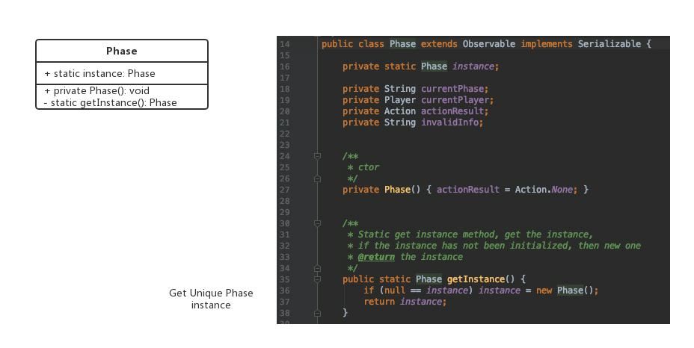
Singleton Pattern
In this project, we want ensures following class has only one instance, and provides a global point of access to it:
Phase+View, PlayersWorldDomination+View, CountryView, CardView, Map,Menu class use the singleton pattern.

Slide 11
MVC and Communication between them

Slide 12
Communication between View, Controller and Model
(see the big picture in the same folder)

