Slide 1
Architecture Of Risk
Project build-1

Slide 2
Modules in risk Project
resource: where the maps are saved
src: where the raw code
driver: the entrance of the project
mapeditor: code implement the map editor function
model: data and function in this project, observable
view: code to show graph based on data, observer
validate: code to verify a map’s validity
common: code that other modules can use together
exception: define exceptions in the project
test: where the test are saved

Slide 3
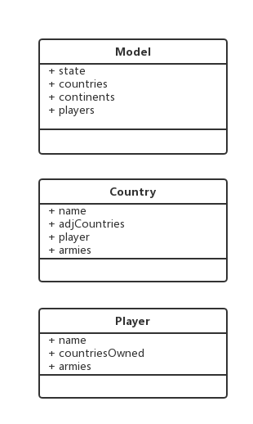
Observer Pattern
Model View
World Map
Country
View
Country
View
Notify
Country
View
Country
View
Notify
User View
Observer
Notify
Observable

Slide 4
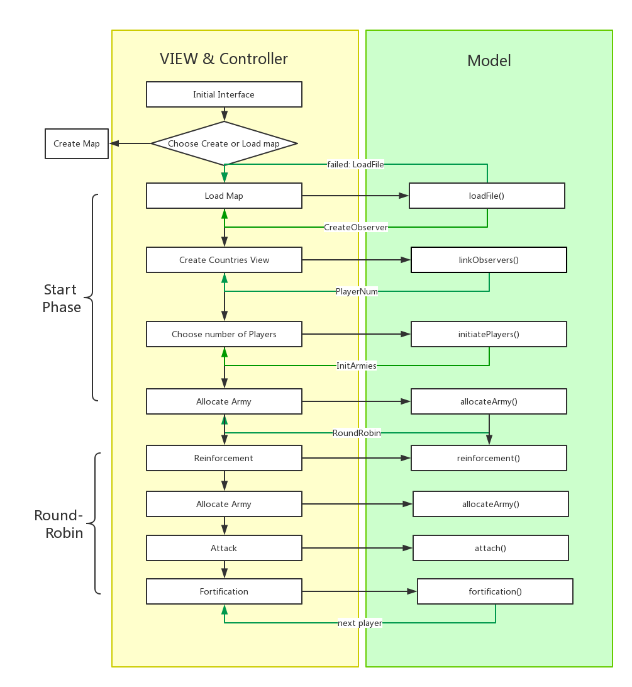
Communication between View and Model
https://www.evernote.com/shard/s397/sh/38298596-3e36-4e47-80f3-5166042a1883/c038706b292c49aeb53f905026bfb72d

