Slide 1
Target | Nontarget
- Low-throughput | - High-throughput
- Low-dimensional (few variables) | - High-dimensional (many parameters in parallel
- High accuracy | - Often low accuracy, lots of noise
- Simple data analysis of experiments | - Often not interpretable without statistics
- Preset of m/z and retention time | - No requirement of preset values

Slide 2
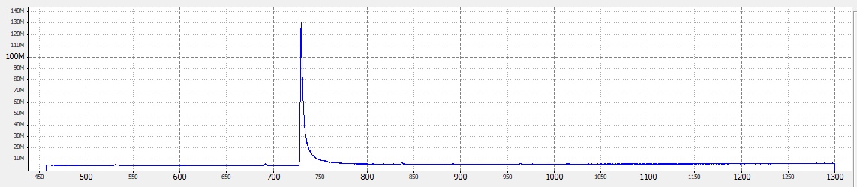
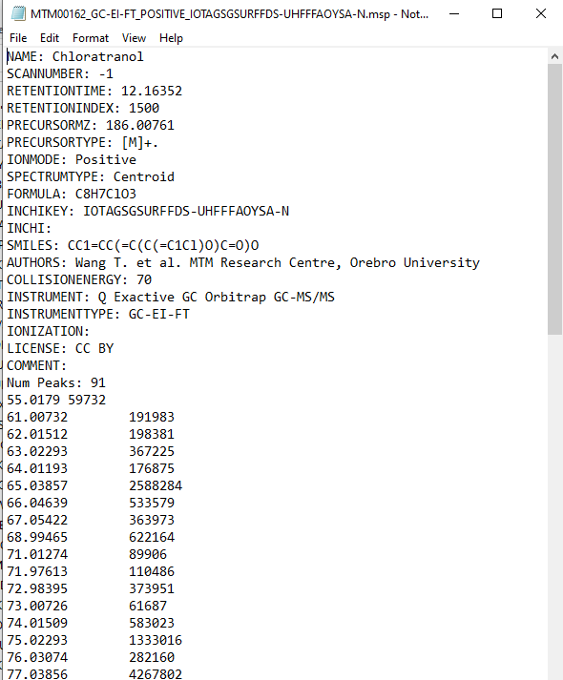
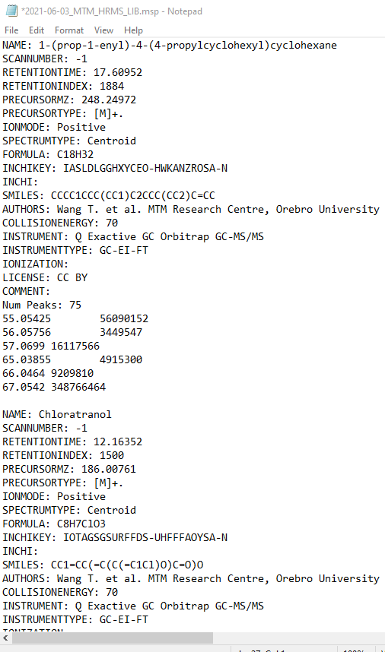
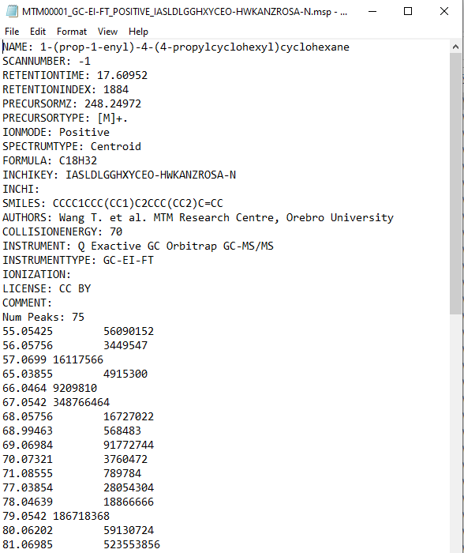
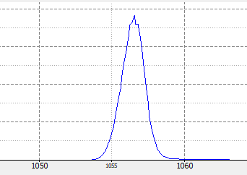
Metainfo
Combined msp file
GC-HRMS analysis of chloroatranol standard
Accurate m/z
Suspect screening
library
Intensity
Individual msp files
GC-HRMS analysis of LCM-4 standard

Slide 3
Library: combined msp file
LC-HRMS negative mode:
PFOS standard
Metainfo
Accurate m/z
Intensity
Suspect screening
LC-HRMS negative mode: PFOA

Slide 4
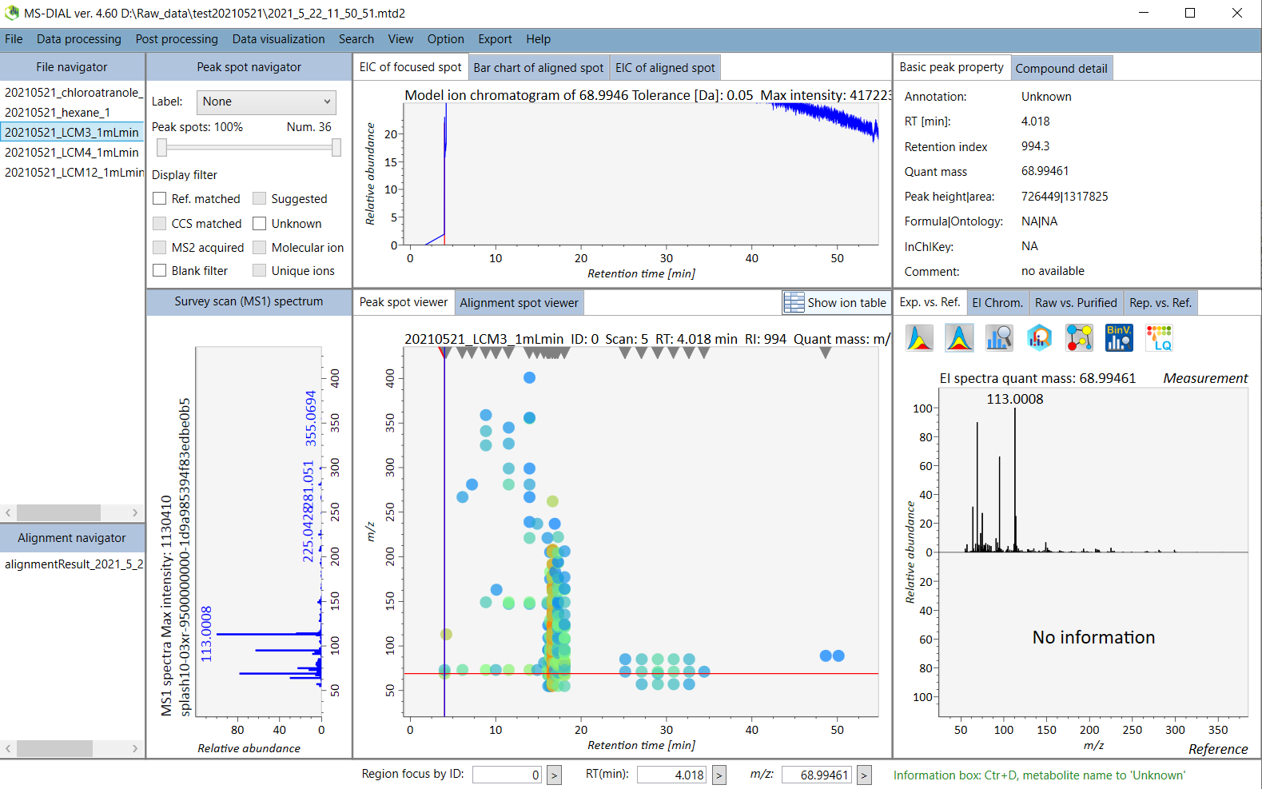
1
2
3

Slide 5
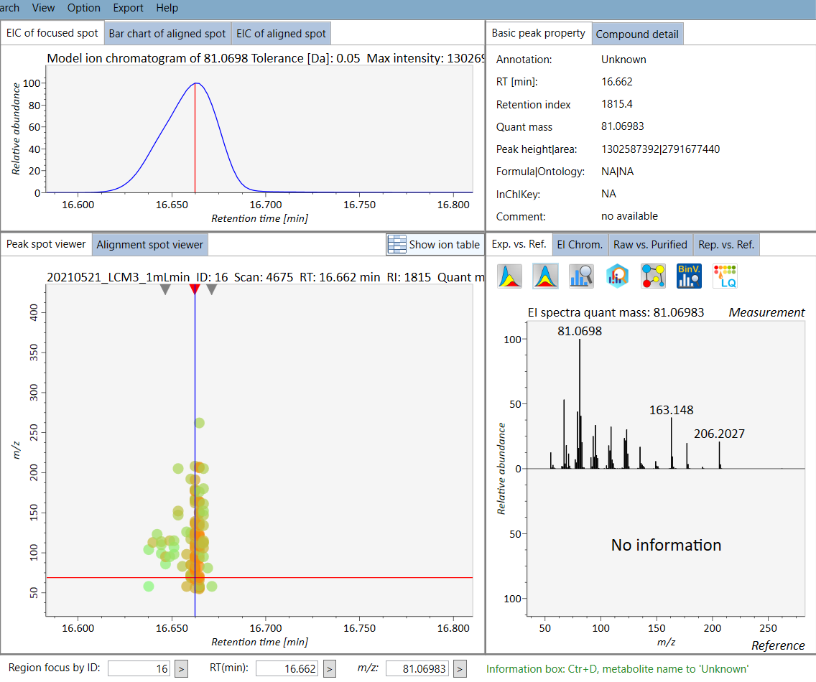
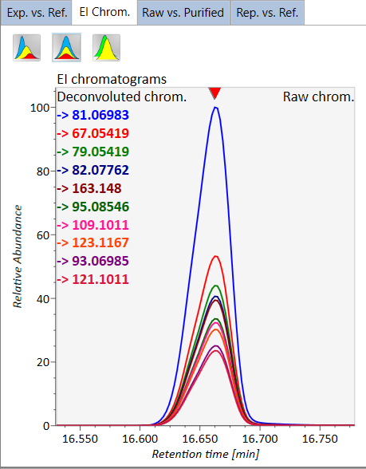
5
7
8
10
9
4
6

Slide 6
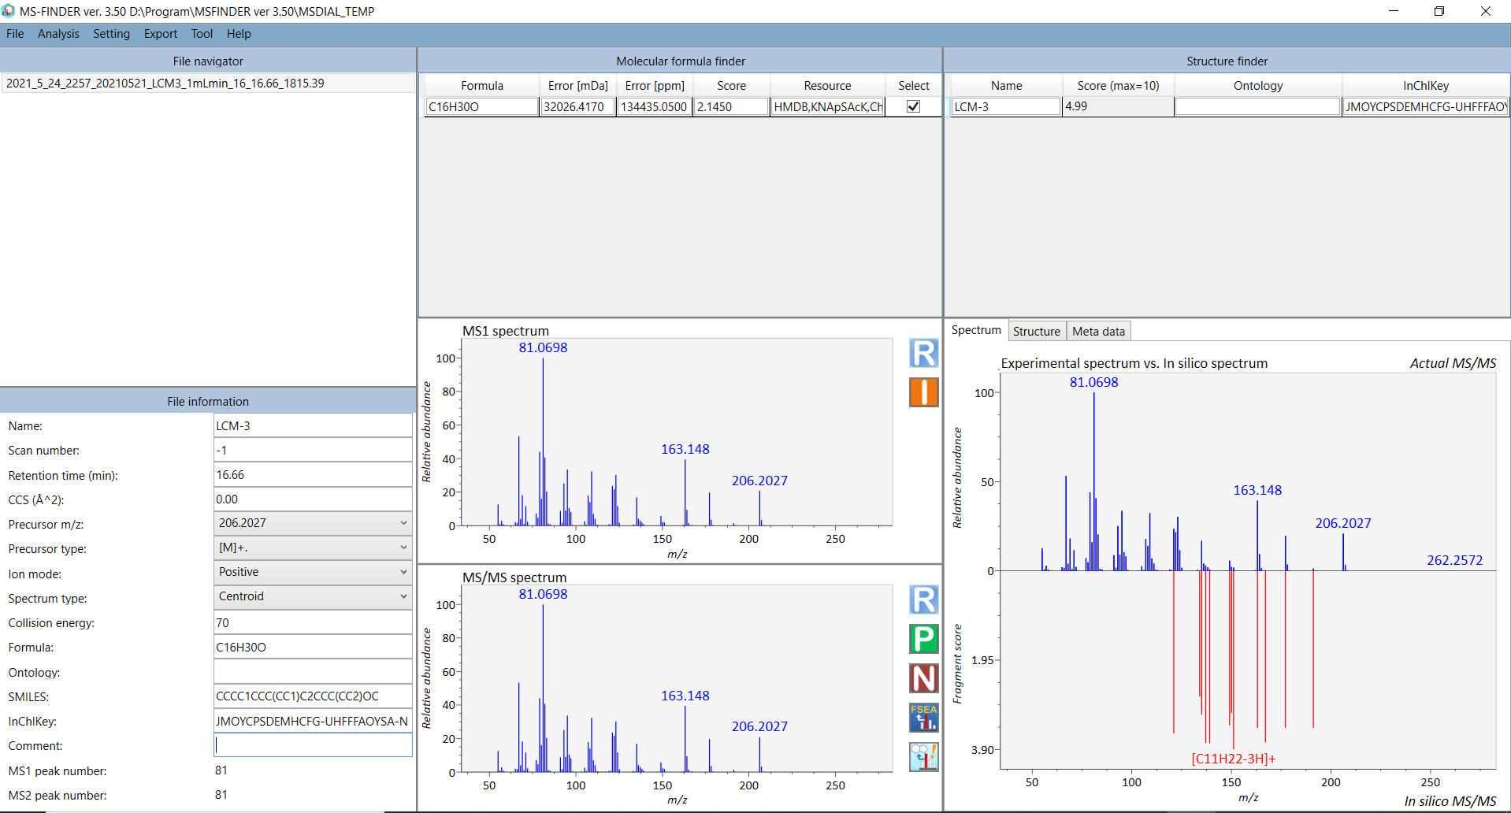
11
13
10
12

Slide 7
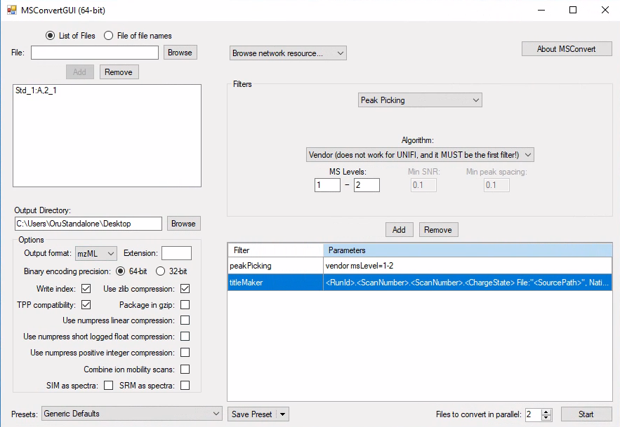
LC-HRMS spec lib
1.
3.
2.
4.

Slide 8
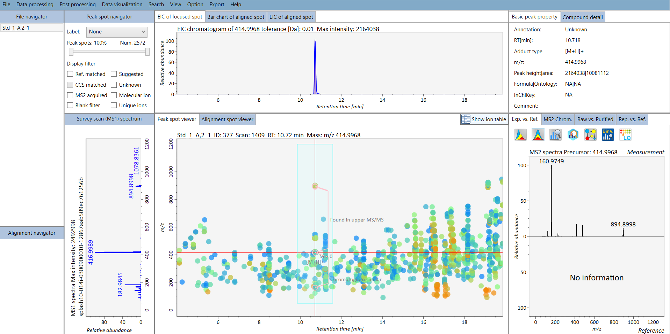
LC-HRMS spec lib MSDIAL

