Slide 1

SAL 603 — Final Project
RESEARCH QUESTIONS
NBA Player
Efficiency Rating
01
Which box score stats correlate most with PER?
02
Which Box Score Stats Drive PER?
Do PER predictors differ by position group?
2023–24 NBA Season | 50 Players
Data: Basketball-Reference.com
Tools: Python · pandas · scikit-learn · matplotlib
By: Wesley Bryan
03
Can we predict PER using regression?
Notes:
SLIDE 1 — TITLE Welcome everyone. Our final project for SAL 603 analyzes NBA player data from the 2023-24 season. We focused on one central question: can basic box score stats predict Player Efficiency Rating — the NBA's most cited all-in-one player metric? We had three research questions, shown on the right. Let's get into it.

Slide 2

What Is Player Efficiency Rating?
Background & Context
About PER
PER BENCHMARKS
PER was created by ESPN's John Hollinger to summarize everything a player does — scoring, rebounding, assists, steals, blocks, and turnovers — into a single number. League average is always 15.0.
35+
All-Time Great
27-35
MVP Candidate
Why It Matters
20-27
All-Star Level
Lets teams compare players across different roles and minutes
Used by front offices, analysts, and sports media worldwide
One number captures overall player impact per minute played
15-20
Solid Starter
10-15
Role Player
< 10
Bench / Fringe
2 / 8
Notes:
SLIDE 2 — WHAT IS PER PER was created by John Hollinger to capture everything a player does in one number. League average is always 15.0 — so we can immediately tell if a player is above or below average. The benchmark chart on the right shows how PER values map to player tiers. A 27+ PER is MVP territory. Luka Doncic sits at 35.1 this season.

Slide 3



Data & Methodology
Source · Variables · Transformations
50
8
3
2023–24
Players Analyzed
Predictor Stats
Position Groups
NBA Season
Data Source
Variables
Methods
Basketball-Reference.com
Per-game stats for players
with 20+ games played
All transformations in Python
Outcome: PER
Predictors: PTS, REB, AST,
STL, BLK, TOV, FG%, FT%
Grouping: Position
Correlation analysis
Multiple linear regression
StandardScaler normalization
70/30 train-test split
✔ All cleaning and transformations performed in Python — no Excel used
3 / 8
Notes:
SLIDE 3 — DATA & METHODOLOGY All data came from Basketball-Reference.com. We filtered to players with 20+ games to avoid small sample sizes, giving us 50 players. Our outcome variable is PER. Our 8 predictors are the standard box score counting stats plus FG% and FT%. We mapped the 5 positions into 3 groups, standardized our features, and used a 70/30 train-test split. Everything was done in Python — no Excel.

Slide 4
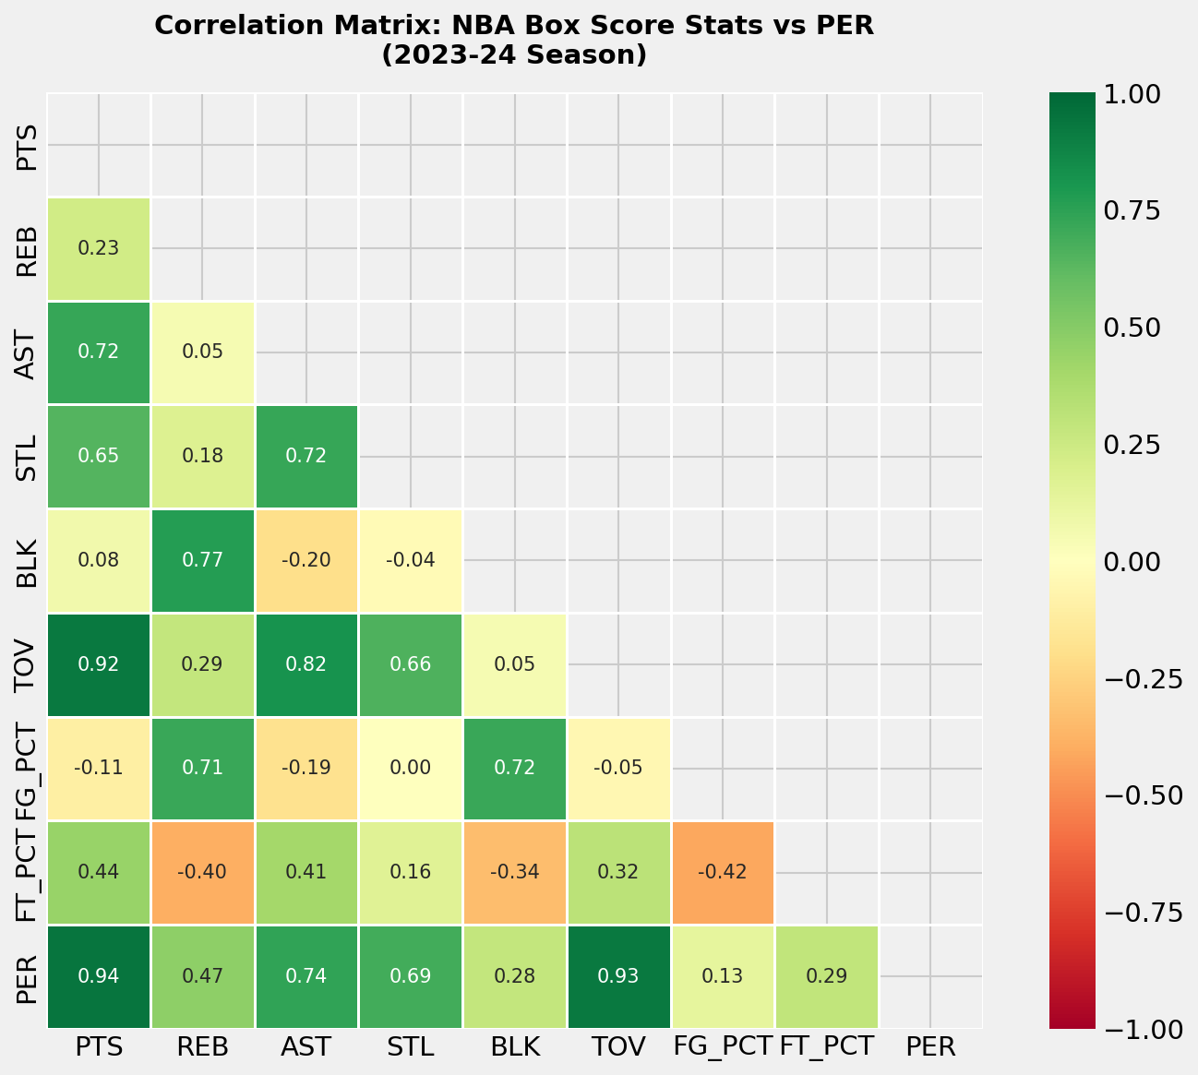
RQ1: Which Stats Drive PER?
Visualization 1 — Correlation Heatmap
KEY FINDINGS
PTS r = 0.94
Strongest predictor by far
TOV r = 0.93
Reflects high usage / ball-handling
AST r = 0.74
Playmaking adds significant value
STL r = 0.69
Defensive impact matters
FG% r = 0.13
Weak alone — efficiency needs volume
Answer — RQ1: Scoring volume (PTS) is the #1 predictor. Assists, steals, and rebounds all contribute. FG% alone is weak.
4 / 8
Notes:
SLIDE 4 — CORRELATION HEATMAP (RQ1) This heatmap shows correlations between every stat and PER. The key column is the far right — PER. Points Per Game at 0.94 is the dominant signal. Turnovers at 0.93 seems strange but reflects usage — stars handle the ball on every possession. Field Goal % alone is only 0.13 — efficiency only matters when combined with volume. Answer to RQ1: Scoring is king, but versatility matters. Assists, steals, and rebounds all add real predictive value.

Slide 5
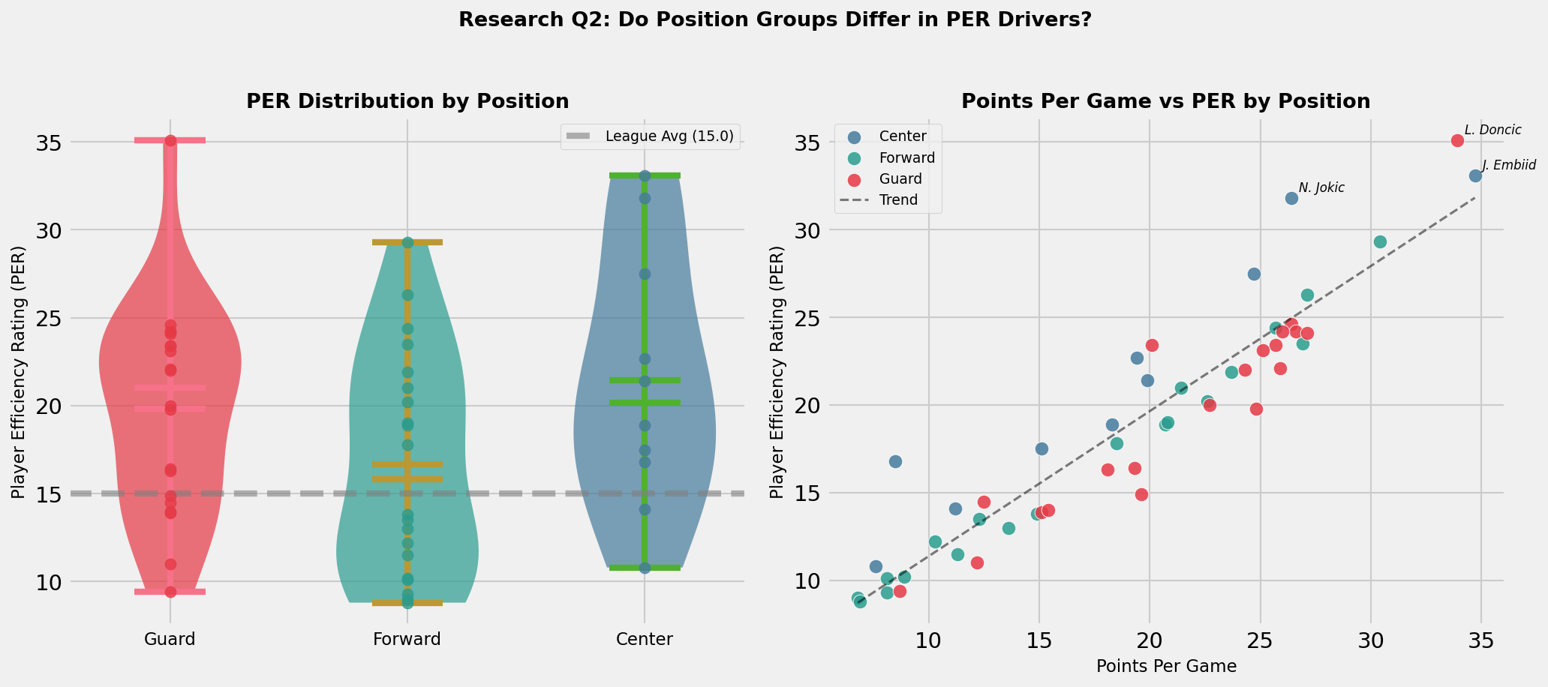
RQ2: Does Position Group Matter?
Visualization 2 — PER by Position & Points vs PER Scatter
21.5
19.8
16.7
Avg PER — Centers
Avg PER — Guards
Avg PER — Forwards
5 / 8
Notes:
SLIDE 5 — POSITION ANALYSIS (RQ2) The left violin plot shows PER distribution by position group. Centers have the highest average at 21.5, largely because interior shots are more efficient and PER rewards rebounding. Guards show the most variance — elite playmakers at the top, bench role players at the bottom. The scatter on the right shows a strong upward trend — more points generally means higher PER across all positions. Answer to RQ2: Position does matter. Centers benefit most from PER's formula. Guards have the most variability.

Slide 6
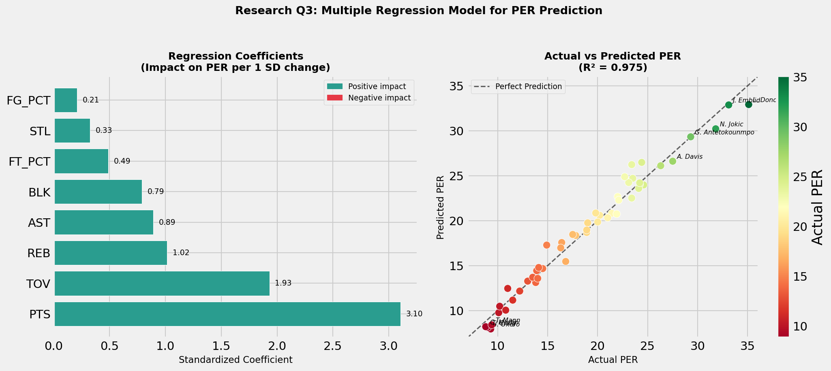
RQ3: Can We Predict PER?
Visualization 3 — Multiple Linear Regression Model
0.954
1.19
95.4%
70/30
R² Score
RMSE (PER pts)
Variance Explained
Train/Test Split
Answer — RQ3: Yes. Box score stats predict PER with 95% accuracy. Points, Rebounds, and Assists are the top 3 drivers. Turnovers hurt.
6 / 8
Notes:
SLIDE 6 — REGRESSION MODEL (RQ3) We trained a multiple linear regression using all 8 stats. The R² of 0.954 means our model explains 95% of the variance in PER. The RMSE of 1.19 means predictions are off by about 1.2 PER points on average — solid accuracy for a real-world sports model. The left chart shows standardized coefficients. Points Per Game had the highest positive coefficient at 3.10, followed by Turnovers at 1.93 (usage), then Rebounds and Assists. The right chart shows actual vs predicted PER — dots close to the diagonal line are accurate predictions. Answer to RQ3: Yes. Basic box score stats can reliably predict PER.

Slide 7
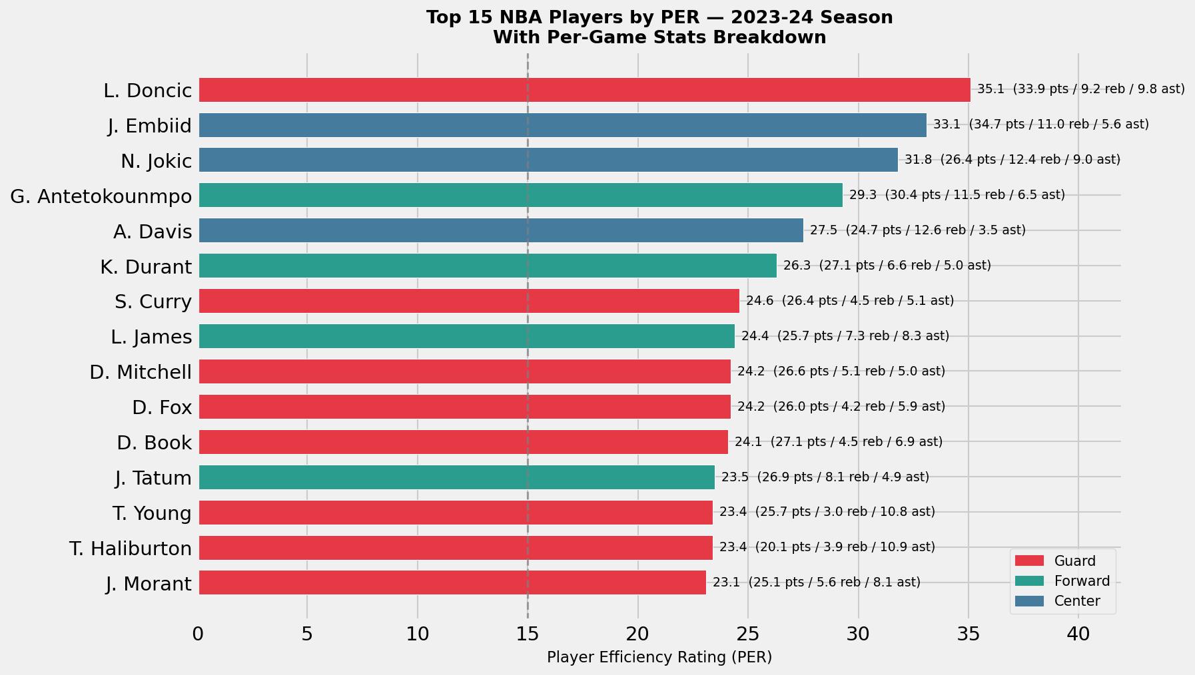
Top 15 Players by PER — 2023–24
Visualization 4 — Rankings with Per-Game Stats
Guard
Forward
Center
7 / 8
Notes:
SLIDE 7 — TOP 15 PLAYERS This chart makes the data tangible — you can see each player's PER alongside their per-game stats. Luka Doncic leads at 35.1 — 33.9 points, 9.2 rebounds, 9.8 assists. That's the kind of across-the-board dominance PER rewards. Two of the top three are Centers — Embiid at 33.1 and Jokic at 31.8. This ties back to our RQ2 finding about Centers benefiting from PER's formula. All top players contribute across multiple categories — not just scoring. That's consistent with our regression findings.

Slide 8


Conclusions & Takeaways
RQ1
RQ2
RQ3
Which Stats Drive PER?
Does Position Matter?
Can We Predict PER?
Scoring volume (PTS, r=0.94) is the dominant driver. Assists, steals, rebounds, and blocks all add real value. FG% alone is weak — efficiency only matters with volume.
Yes. Centers average the highest PER (21.5) due to interior FG% and rebounding. Guards show the most variance. Position group is a meaningful factor in PER outcomes.
Yes. Our regression model hits R²=0.954 with RMSE of 1.19 PER points. Box score stats explain 95% of PER variance. Points, Rebounds, and Assists are the top 3 drivers.
Practical Takeaway
The single most impactful change a player can make to their PER is reducing turnovers while maintaining scoring volume. Front offices can estimate PER from basic stats alone — no tracking data required.
Notes:
SLIDE 8 — CONCLUSIONS To wrap up — three research questions, three clear answers. RQ1: Scoring is king. Points dominates. Assists and defense add value. FG% alone is weak. RQ2: Position matters. Centers benefit most from PER's formula. Guards have the most variance. RQ3: Yes, we can predict PER. 95% accuracy from basic stats alone. The big practical takeaway: if a player wants to raise their PER, the fastest path is cutting turnovers while staying aggressive offensively. Thank you — we're happy to answer any questions in the discussion thread.

