Slide 1
Intro to Soldering
Making electrical connections that last
ENGR 101 · Engineering Exploration · Introduction to Soldering Micro Badge
Notes:
Goal: students leave able to set up a station safely, make a good through-hole joint, and tell a good joint from a bad one. The badge activity is the SparkFun Basic Flashlight Soldering Kit.

Slide 2

Warm-up: which joint would you trust?
Find the best-looking joint and the worst one. What exactly is different about them?
1
Pass around soldered boards
Is solder a glue, or something else? What makes you think so?
2
Small groups, 5 minutes. Then we share out as a class.
Why would the iron need to be hotter than the solder's melting point?
3
Notes:
Use a few finished flashlight boards plus a 'reject' board with cold joints, blobs and a bridge. Let students name the differences (shiny vs. dull, cone vs. ball, touching neighbors). Write their words on the board; the 'good vs. bad joints' slide gives them the official names later.

Slide 3



What is soldering?
Joining metal parts with a lower-melting metal (solder) to make a strong electrical connection.
Heat the parts
Solder flows
It bonds
The iron heats the pad and the component lead together
Melted solder is pulled toward heat and wraps the joint
Solder bonds with the copper as it cools, so it's not glue
The golden rule: heat the joint, not the solder. If you melt solder onto a cold part, it won't stick.
Notes:
Return to warm-up question 2: solder isn't glue. It forms a metallic bond with the copper. That's why a joint needs heat, cleanliness, and flux, and why dripping melted solder onto a cold joint gives a weak 'cold joint'.

Slide 4

Watch first
Watch for:
Where the iron touches the joint
Which side the solder is fed from
How long each joint takes
What a finished joint looks like
Soldering Crash Course (click to open)
Notes:
Give students the 'watch for' list BEFORE the video so they watch actively. Pair-share after: how many seconds per joint? (Usually 2–5.)

Slide 5
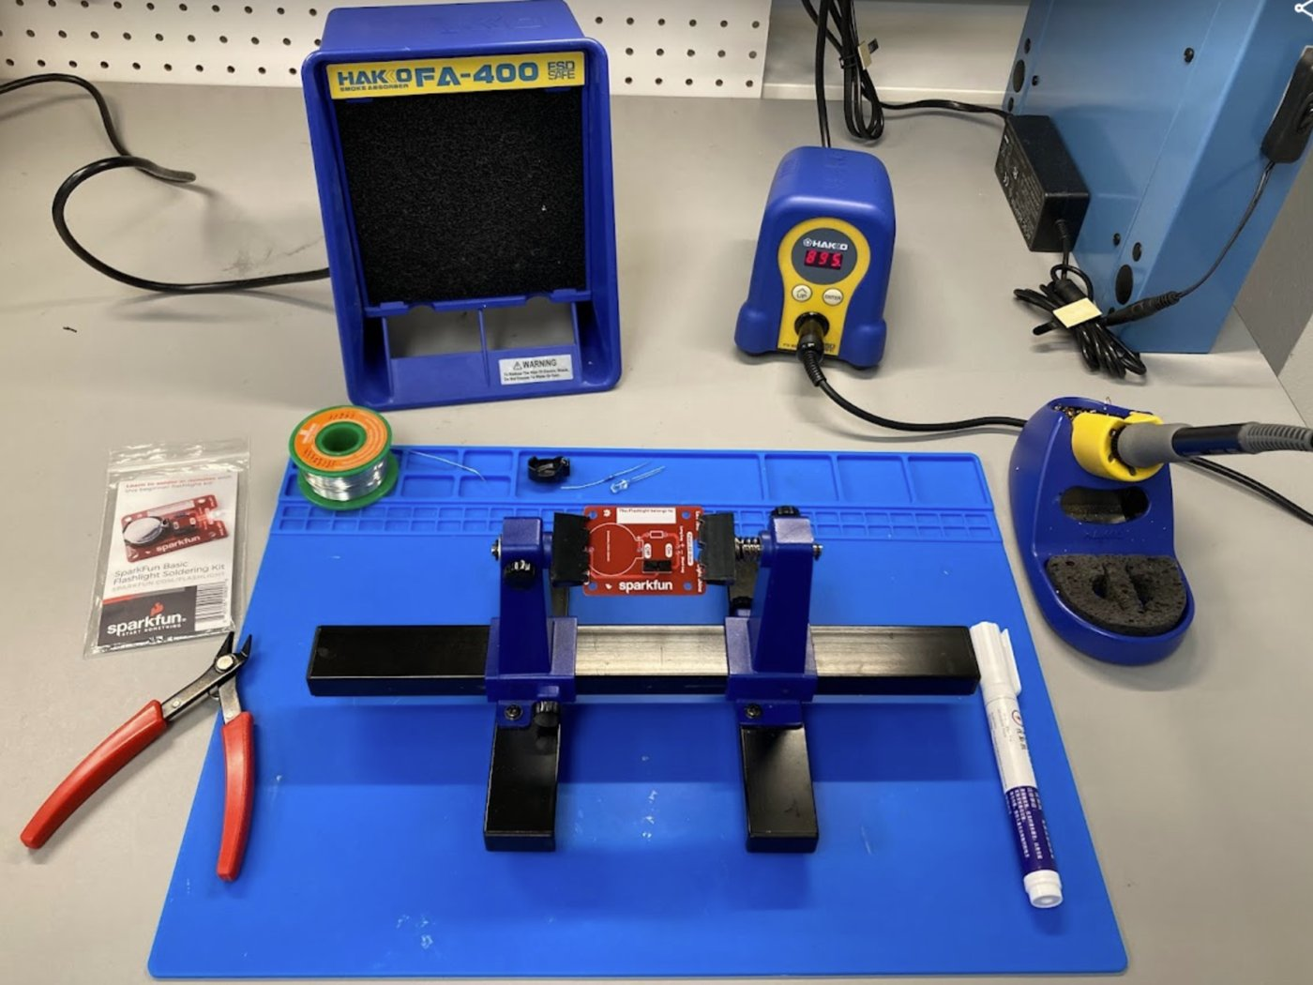

Your soldering station
Equipment is in CAS 113 and CAS 117
Soldering iron + stand
Fume absorber
Support equipment (holds your work)
Solder + flux
Wire strippers + flush cutters
Safety glasses
Notes:
Point to each item on a real station. Next slide covers what each one does.

Slide 6
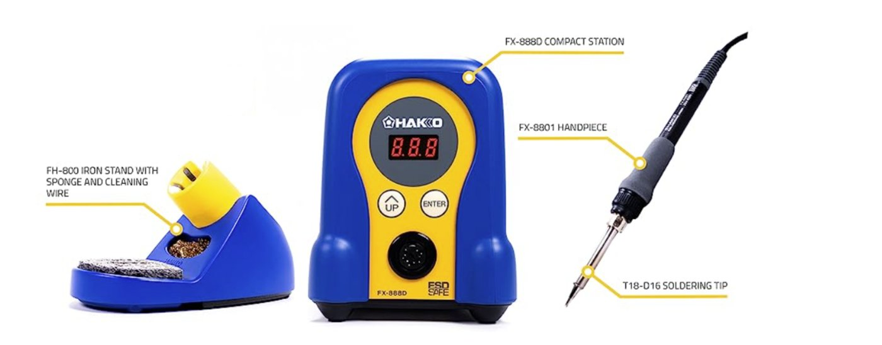
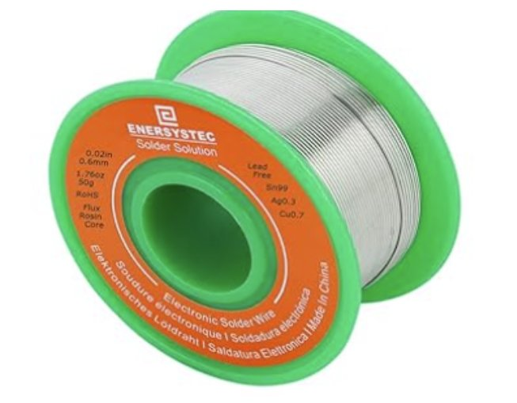
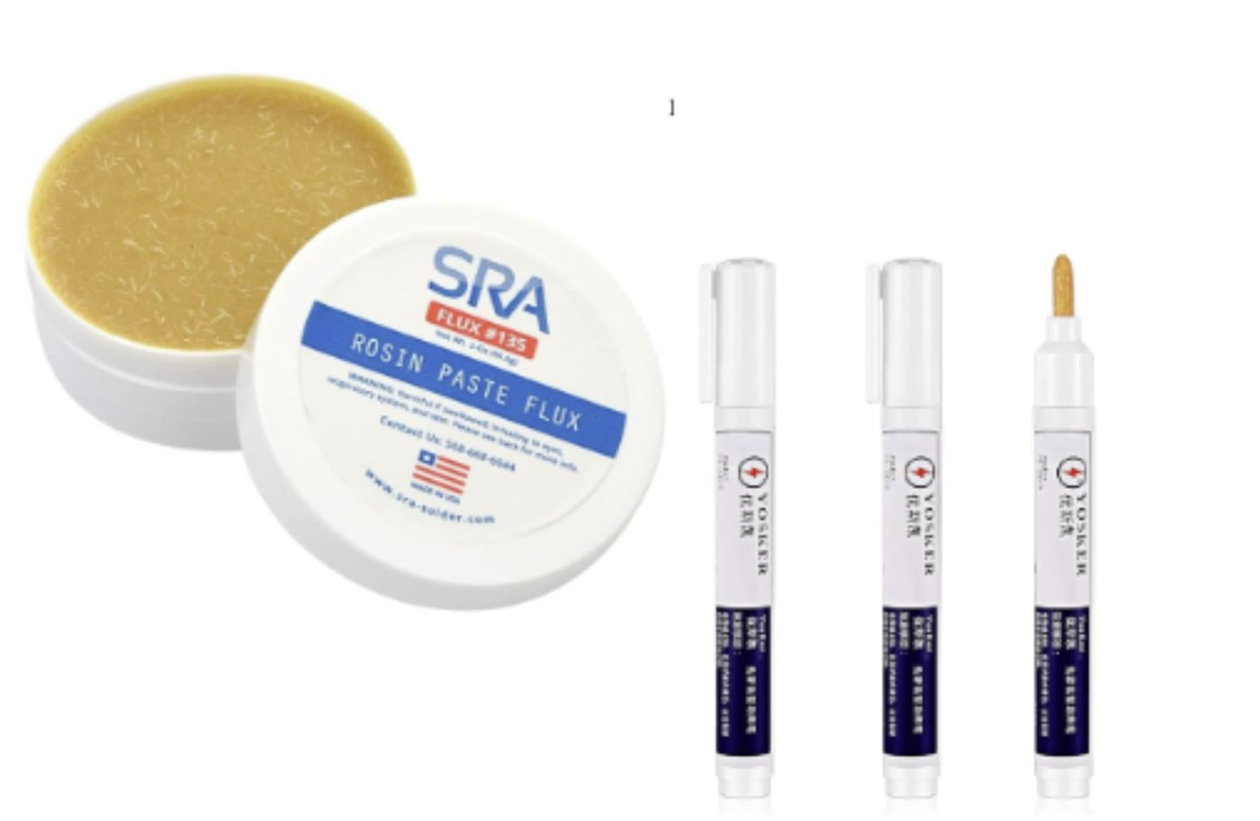
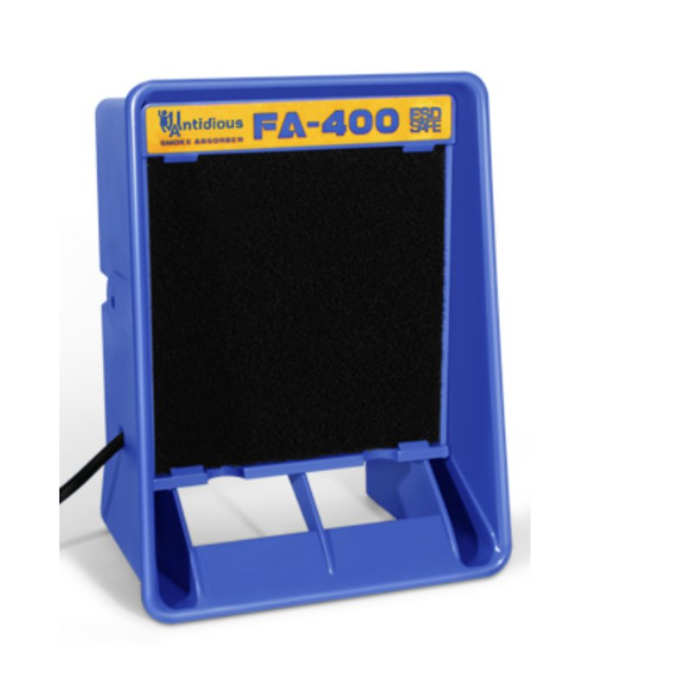
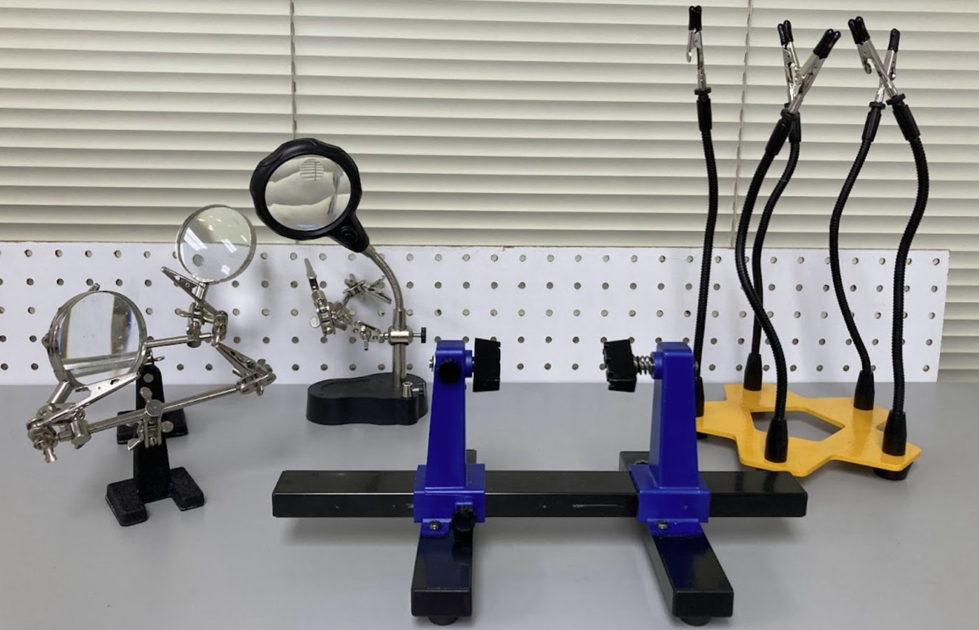
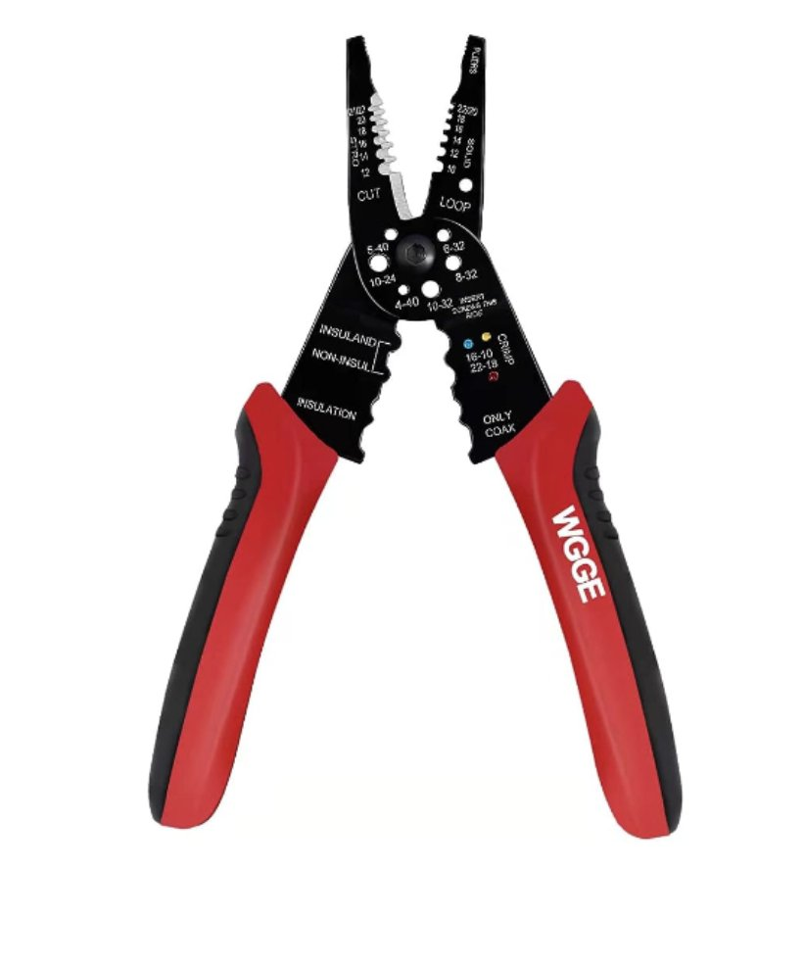
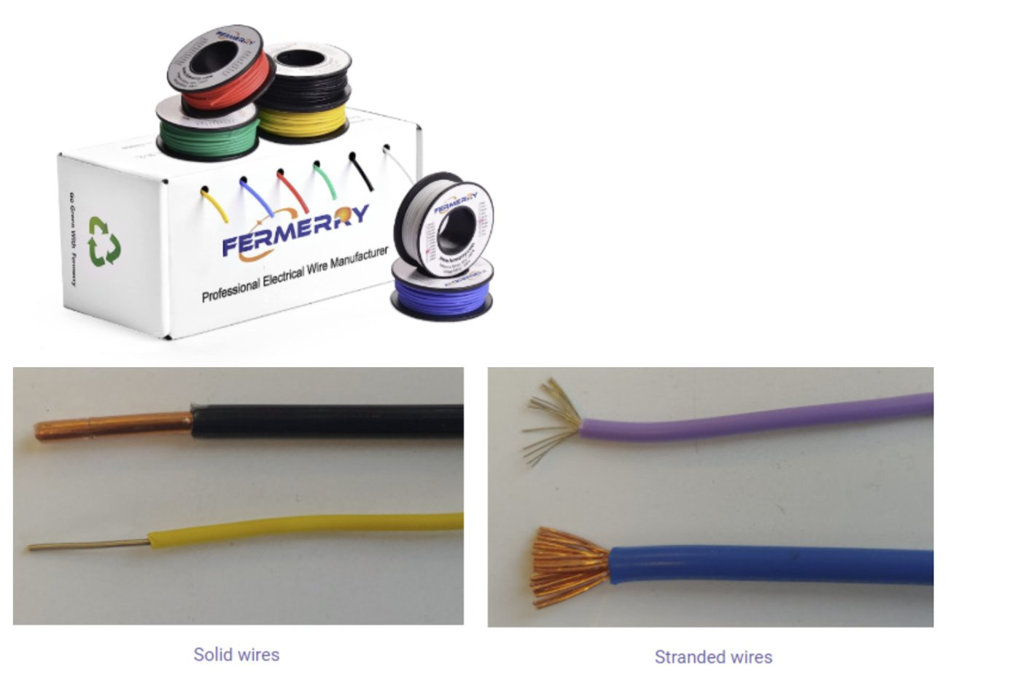
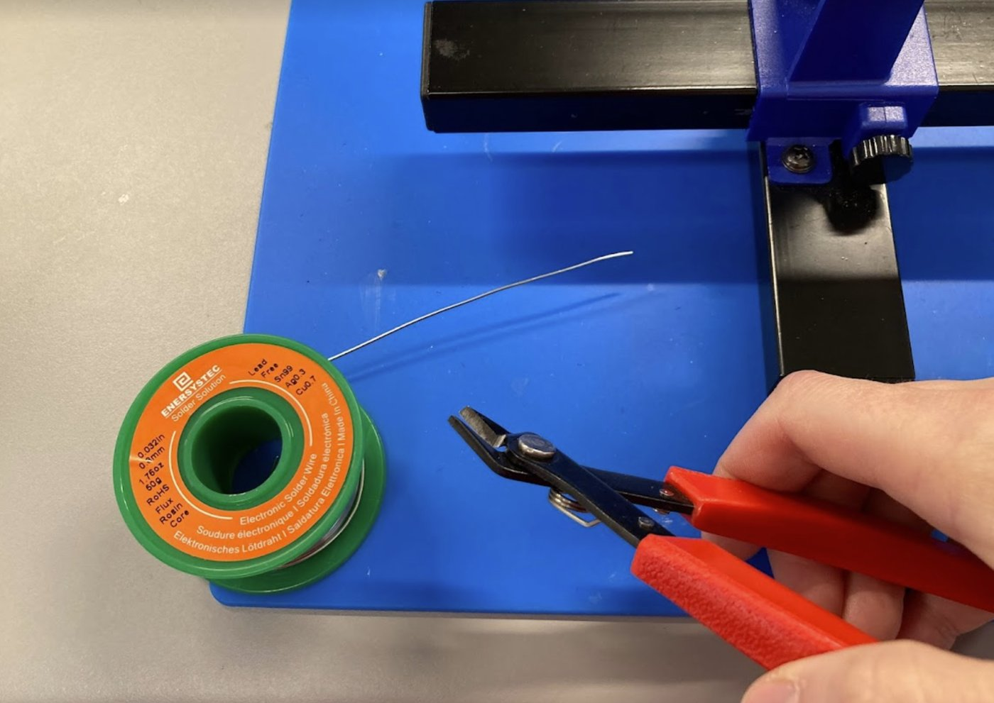
Tools & materials
Soldering iron
Solder
Flux
Fume absorber
Heated tip melts solder; station sets temperature
Metal alloy wire that forms the bond
Cleans oxidation so solder sticks
Filters fumes away from your face
Support tools
Wire strippers
Wire
Flush cutters
Hold your work so your hands are free
Remove insulation, matched to wire gauge
Solid (one strand) or stranded (many)
Cut solder and trim component leads
Notes:
Quick 'stand up and find it' race: each group finds every item on its station. Note that wire strippers aren't for cutting wire; use flush cutters.

Slide 7
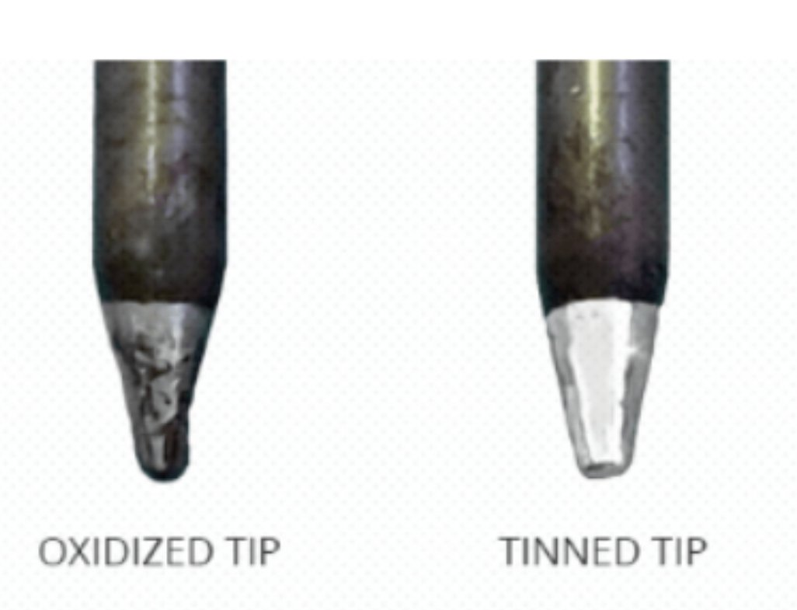

Why clean and shiny matters
Hot metal oxidizes fast
A dark oxide layer forms on hot copper in seconds
Oxide blocks solder
Solder beads up on it instead of flowing and bonding
Flux + tinning fix it
Flux cleans the joint; a thin solder coat protects the tip
Which tip will melt solder better?
Notes:
Ask the question at the bottom before revealing the right side. An oxidized tip can't transfer heat. This is why we clean and tin (Step 3) and why flux matters (Steps 2 and 4).

Slide 8





Soldering safety
The tip is several hundred °C
Iron always goes back in the stand. Never catch a falling iron. Let it drop.
Safety glasses at all times
Solder can spatter, and clipped leads fly.
Fume absorber on
Keep the smoke away from your face. Don't lean over the joint.
Wash your hands after
Solder and flux residue: no food or drinks at the station.
Clear, tidy workspace
No loose sleeves or cords near the tip. Nothing flammable nearby.
Off and unplugged when done
Burned? Cool water right away and tell the instructor.
Notes:
Condensed from the original safety page (the full text is still good for the Canvas page). Check our solder type: if it's leaded, stress handwashing. Point out the first aid kit and the electrical-rated extinguisher.

Slide 9



The big picture: four steps
STEP 1
STEP 2
STEP 3
STEP 4
Prep station
Prep parts
Clean & tin
Solder & inspect
Iron on, sponge wet, fume absorber on, parts secured
Strip, join, and flux wires (or insert components)
Clean the tip until shiny, then coat it with solder
Heat the joint, feed solder, check it, trim
Badge activity: SparkFun Basic Flashlight Soldering Kit
Notes:
Roadmap for the rest of the deck. Each step slide has a gold tag in the corner.

Slide 10
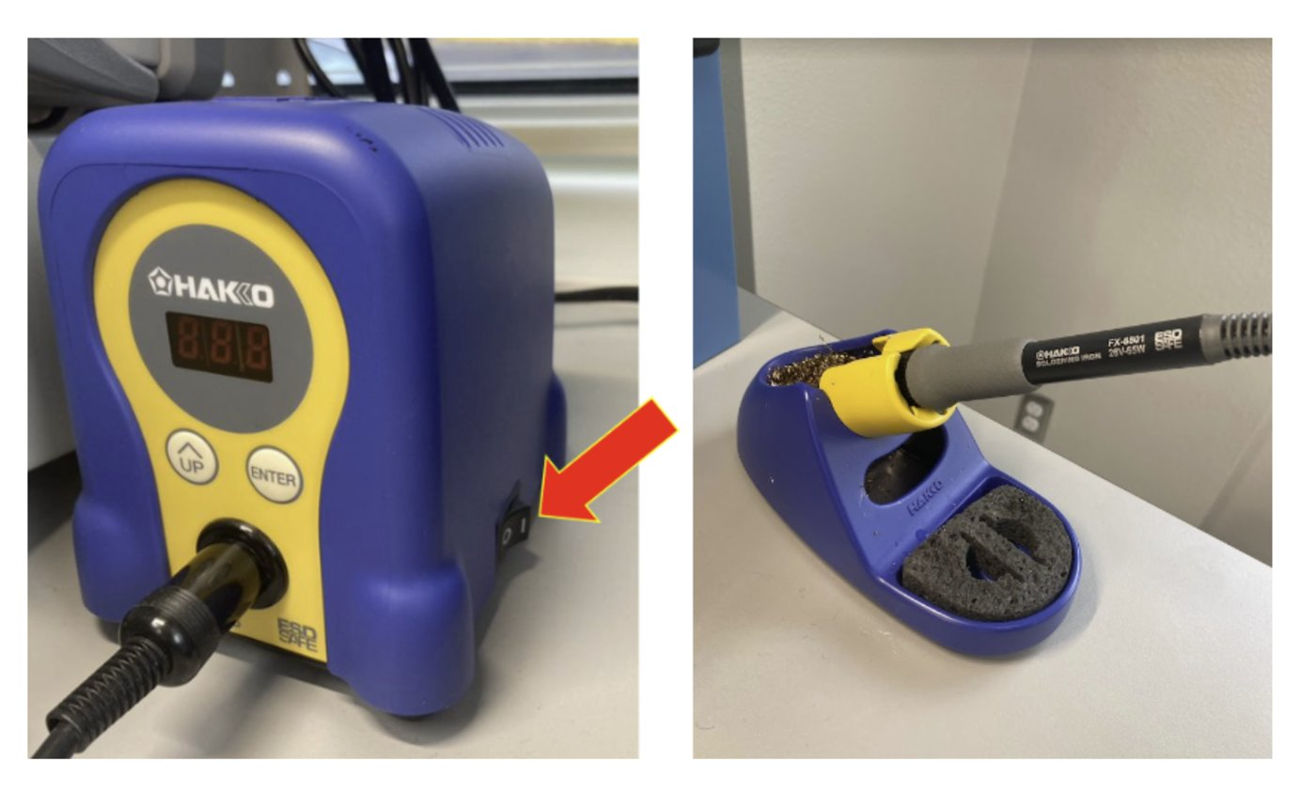
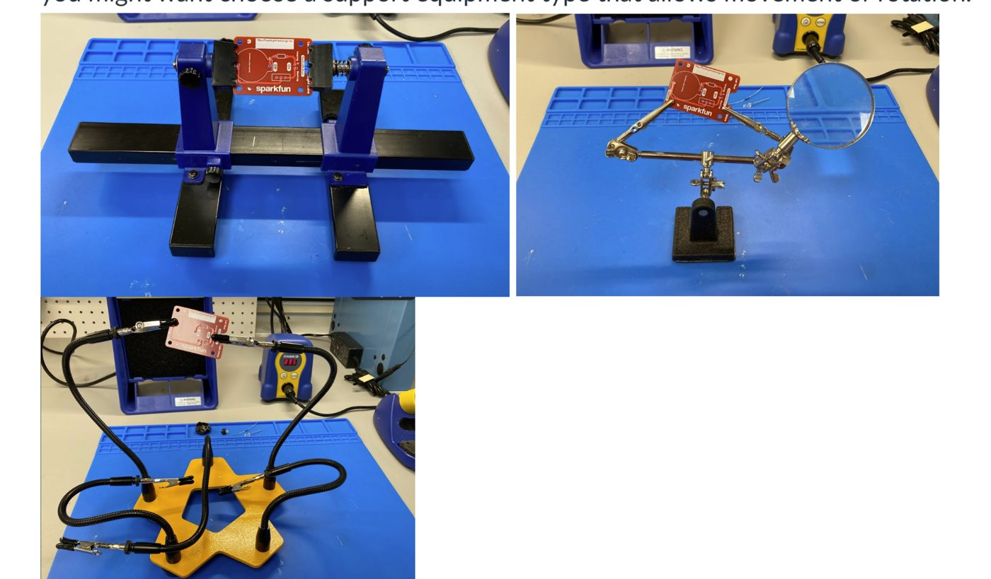
Prep your soldering iron
STEP 1 · PREP
A
Plug in and set the temperature
Iron in its stand before turning it on. Unsure of the temperature? Ask.
B
Soak the sponge
Use the area's water container. Damp, not dripping.
C
Turn on the fume absorber
Switch is on the back
D
Gather materials while it heats
Safety glasses, flux, solder, support equipment, parts
E
Secure your project
In support equipment that lets you move or rotate it
Notes:
Common miss: setting the iron down on the bench while it heats. It goes in the stand, always.

Slide 11
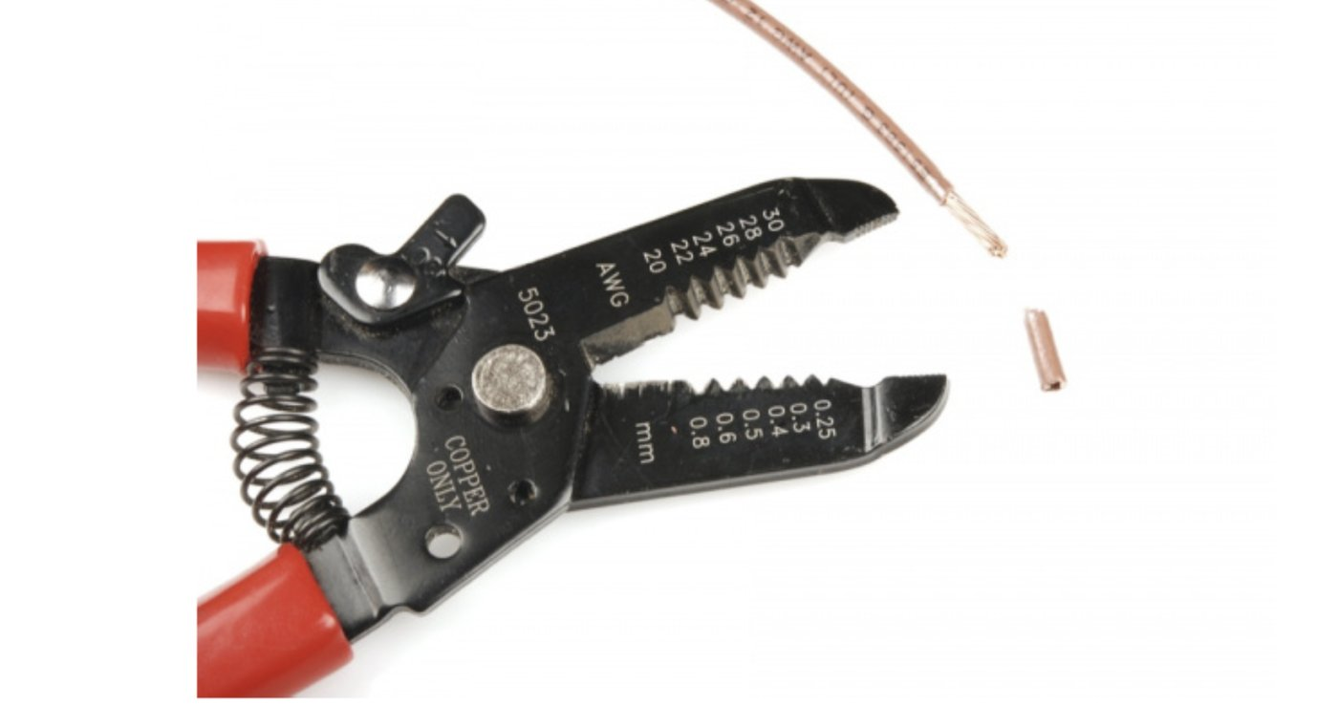
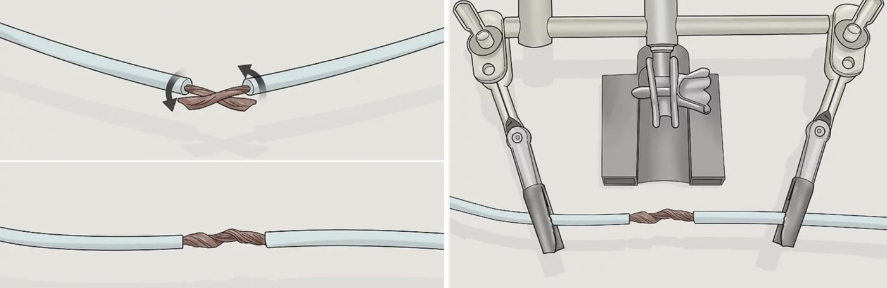
Prep your wires
STEP 2 · PARTS
A
Strip the wire
Match the gauge on the stripper, close, pull the insulation off. About 1/2 inch exposed.
B
Join the wires
Secure them in support equipment and twist the strands together
C
Apply flux
A small amount on the areas to be soldered
Flashlight kit: you don't need to prep wires beyond removing the protective paper ends.
Notes:
Too little exposed wire is hard to solder; too much leaves bare wire that can short. Wrong gauge on the stripper cuts strands. Have students check for nicked strands.

Slide 12
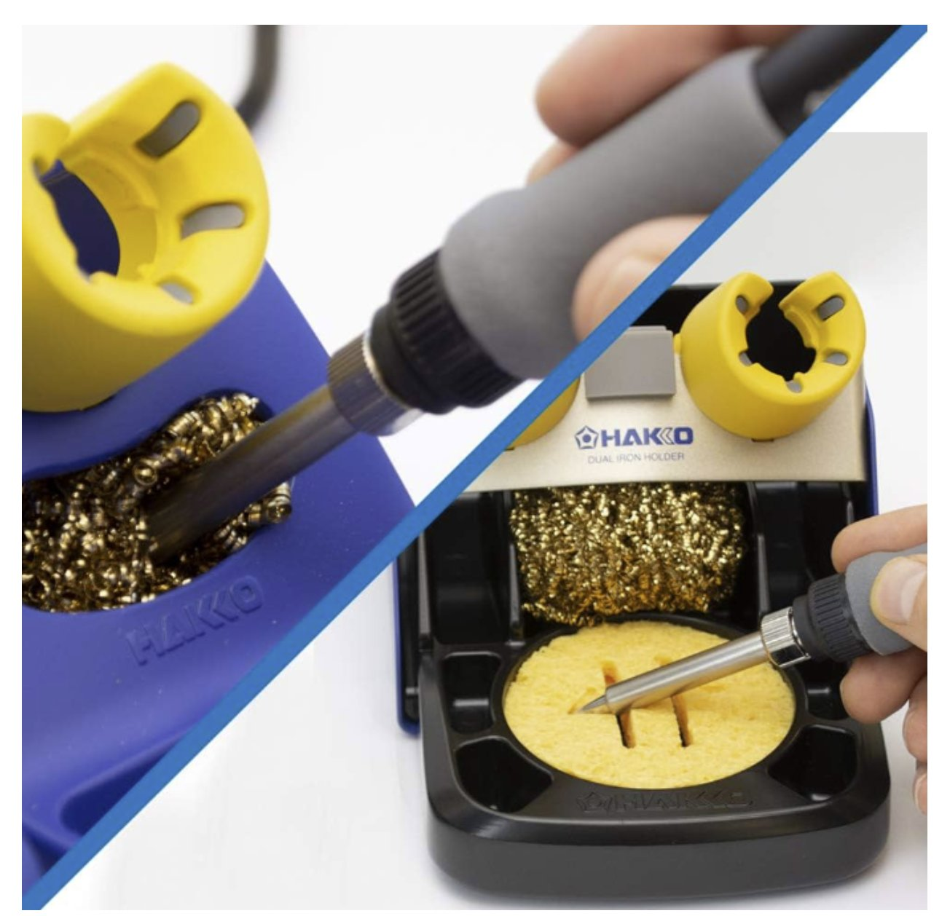
Clean and tin the tip
STEP 3 · TIN
A · Check
B · Clean
C · Tin
Dark and crusty = oxidized. Shiny silver = ready. Not sure? Ask!
Once hot, wipe on the damp sponge or brass cleaner until shiny
Melt a little solder onto the tip: a thin, even, shiny coat
Tin before and after every session, and as you go on long jobs. It makes tips last much longer.
Notes:
Tinning helps heat move from the tip into the joint. A bare, dry tip barely transfers heat, which is why students 'can't get the solder to melt'.

Slide 13
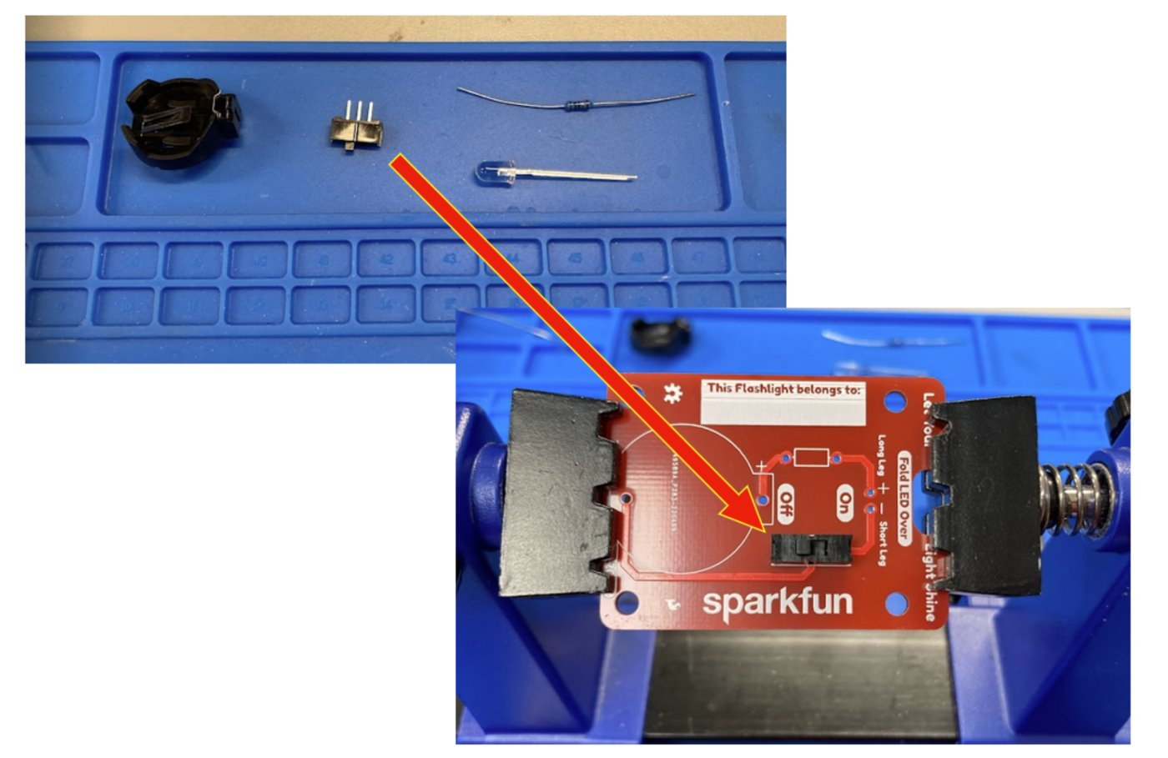
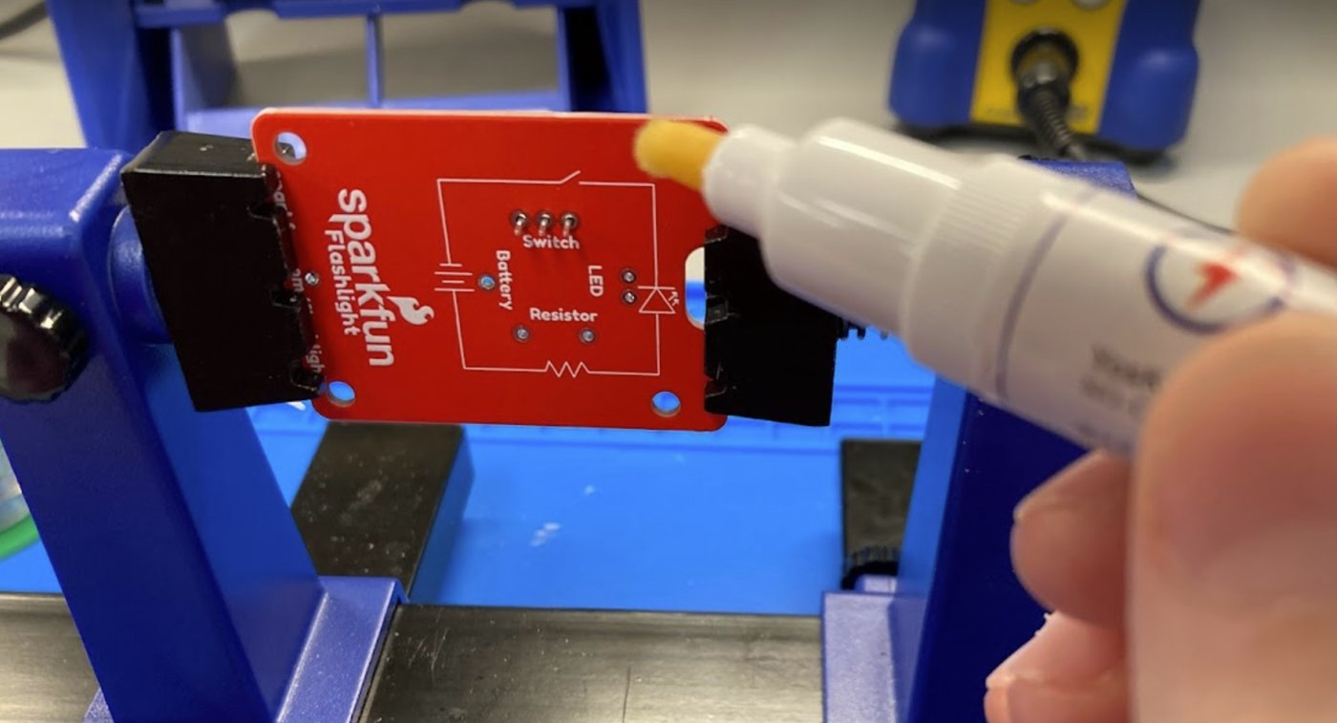
Get ready to solder
STEP 4 · SOLDER
A · Cut a piece of solder
B · Insert the component
C · Apply flux to the joint
A short length is easier to control than the spool
Leads through the holes from the printed side; bend them slightly to hold
A small dab on the pad and lead
Notes:
Check component orientation BEFORE soldering. LEDs have a long leg (+) and short leg (−). Desoldering is much harder than checking twice.

Slide 14
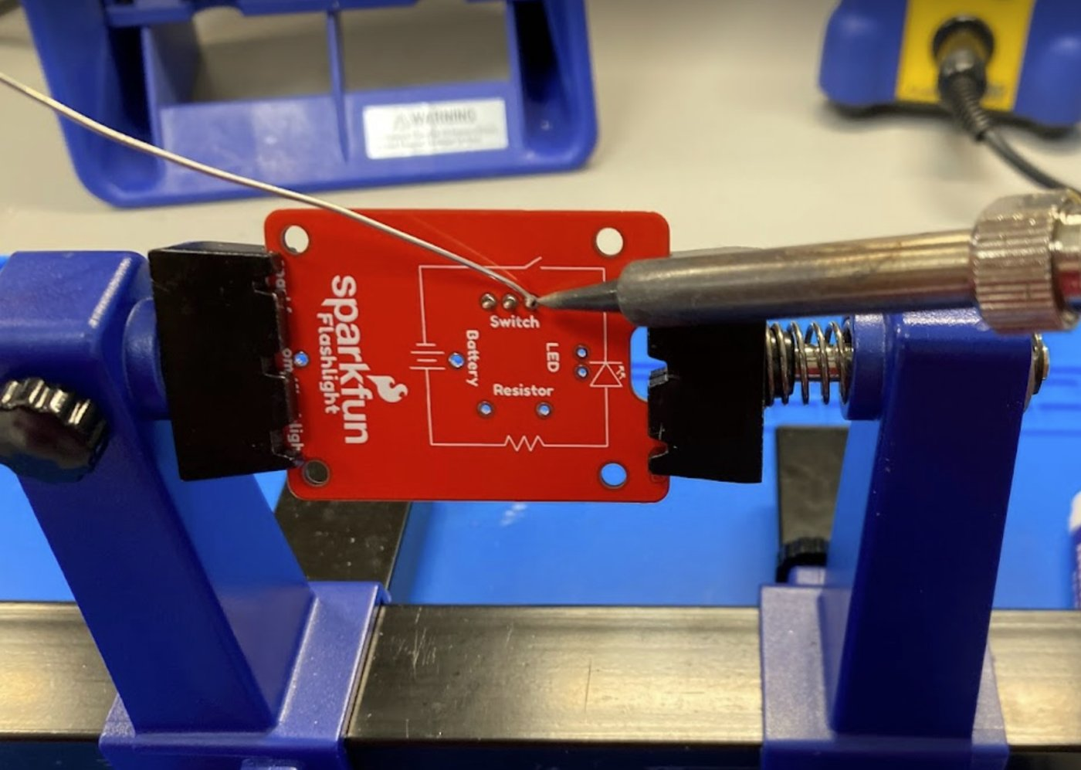
Make the joint
STEP 4 · SOLDER
1
Heat Touch the tip to the pad AND the lead at the same time
1–2 s
2
Feed Touch solder to the joint, opposite the iron, not to the tip
1–2 s
3
Remove solder Pull the solder away once it flows around the lead
4
Remove iron Then lift the iron straight away
Hold still Don't move the part while it cools
2–3 s
~3–5 seconds per joint. Much longer can lift the pad off the board.
5
Notes:
Demo under a document camera, narrating each step out loud with a count. Then have students practice on a scrap board or wire pair before touching the flashlight kit. Order matters: solder away first, iron second.

Slide 15
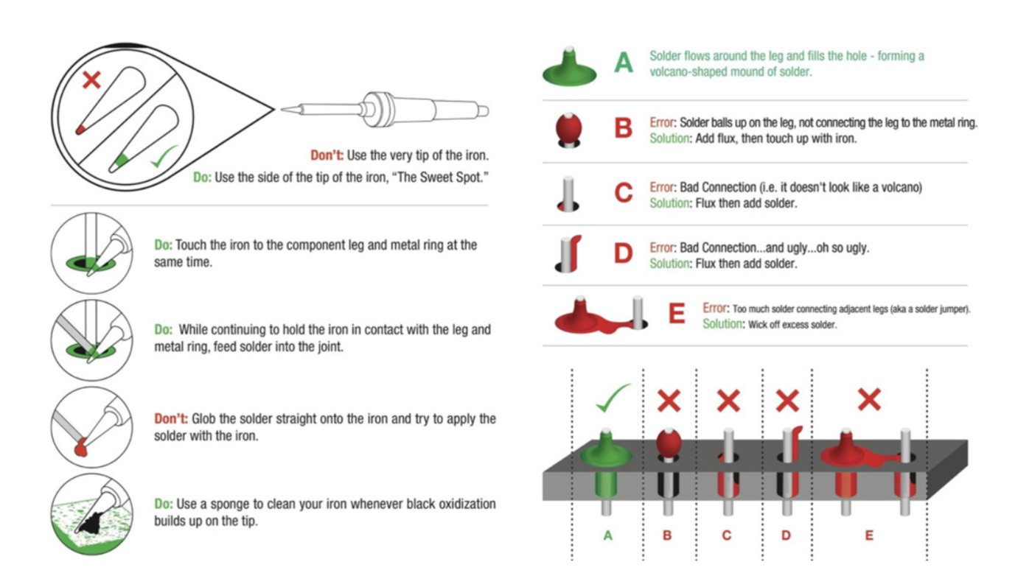
Good joint or bad joint?
STEP 4 · INSPECT
Good joint
Shiny, smooth, cone- or volcano-shaped, wraps the lead and covers the pad
Dull or grainy: Moved while cooling, or cold
Ball or blob: Too much solder, or the pad wasn't heated
Bridge: Solder connects two pads that shouldn't touch
Swap boards with a partner: inspect every joint and name each problem you find.
Notes:
Return to the warm-up: match the students' own words to these names. Peer inspection builds the habit of checking work, and it's how quality inspection works in industry.

Slide 16
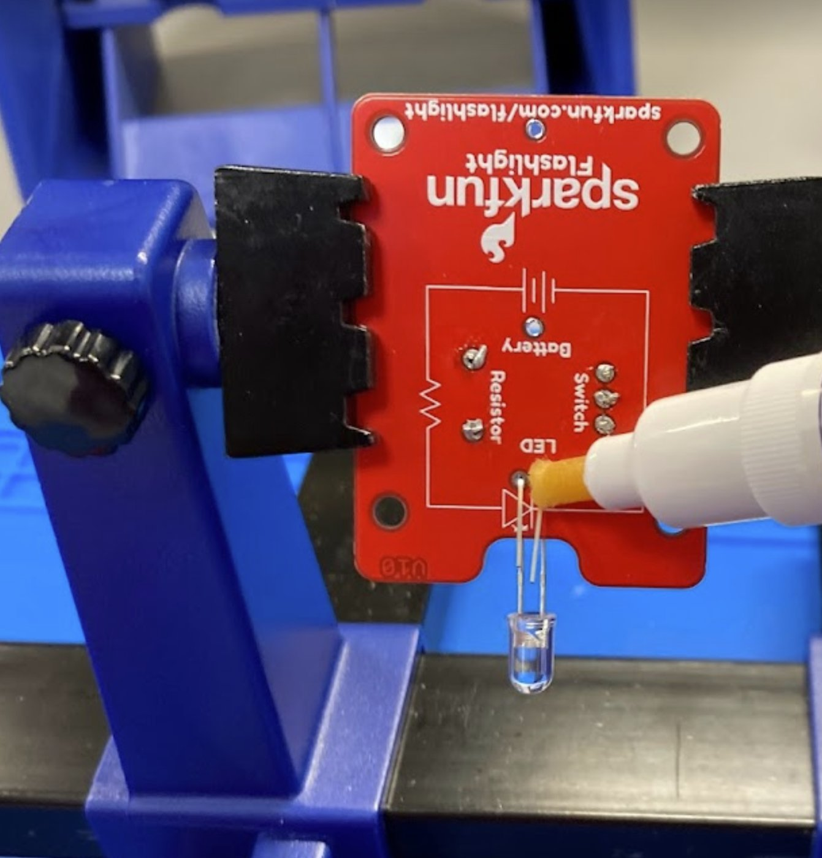
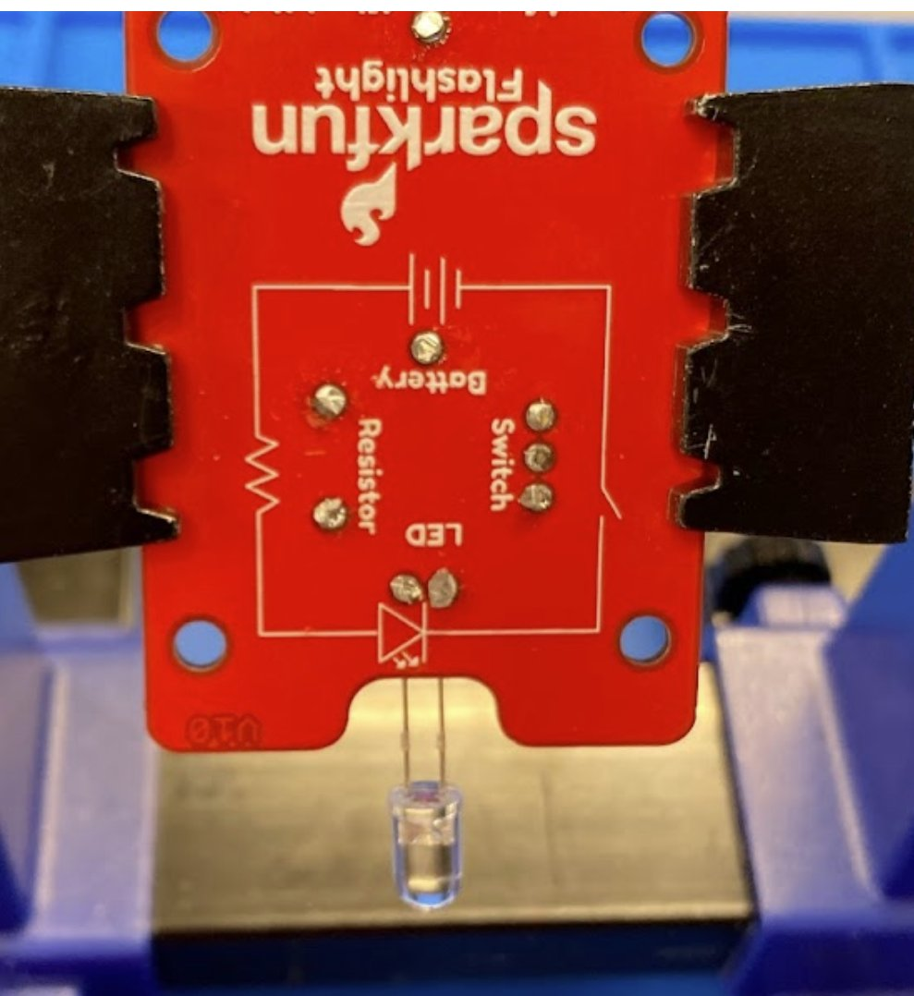
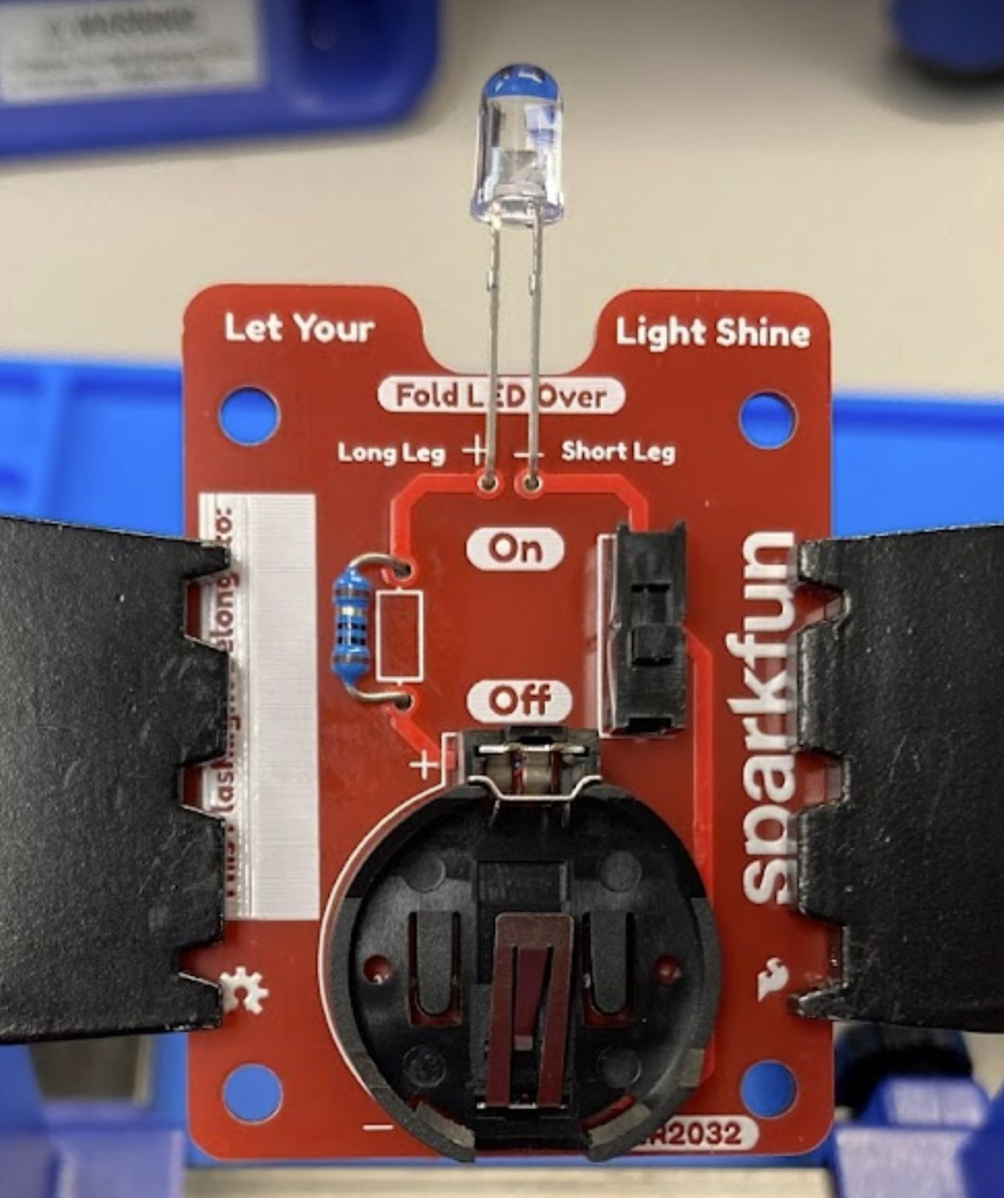
Trim, repeat, and finish
STEP 4 · FINISH
Solder each joint
Trim leads just above the joint
Finished flashlight!
Full kit directions: SparkFun Flashlight Kit tutorial
Notes:
Trim with flush cutters, pointing the leads down and away from faces. Safety glasses on, because clipped leads fly.

Slide 17
When things go wrong
What you see | Likely cause | Try this
Solder won't melt or melts slowly | Tip oxidized or not tinned | Clean on the sponge, then re-tin
Solder balls up and won't stick | Joint not heated, or dirty | Add flux; heat pad + lead first, then feed solder
Dull, grainy joint | Moved while cooling (cold joint) | Add flux and reheat until it flows
Two pads joined (bridge) | Too much solder | Reheat and drag the iron away; ask about solder wick
Pad lifted off the board | Heated too long | Stop and ask the instructor
Notes:
Most problems trace back to two things: a dirty tip, or heating the solder instead of the joint.

Slide 18

Shut down your station
Tin the tip
Iron off + unplugged
Fume absorber off
Clean up
Wash your hands
A fresh coat protects it while it's off
Back in the stand to cool
Switch on the back
Clipped leads, solder bits, tools back
Before eating or touching your face
Leave the station the way you'd want to find it. The next person's first job shouldn't be cleaning up yours.
Notes:
Do a quick station check before students leave: iron off, sponge damp, area clear.

Slide 19
Engineers iterate
Heat
Exit ticket
Describe your worst joint today. What did it look like, and what do you think caused it?
What did you change on your next joint, and did it work?
Where else might you need to solder: in your major, a hobby, or a job?
Rework
Feed
Inspect
Notes:
Question 1 forces a specific joint, not 'it went fine.' Question 3 connects to discipline exploration (EE, ME, aerospace, robotics, repair).

