Slide 1
From Onshape to Laser Cut
Laser cutting on the WCC Trotec Rayjet 300
ENGR 101 · Engineering Exploration · How Engineers Make Things
Notes:
Goal: every student leaves knowing the full path from a flat part in Onshape to a laser-cut piece off the Rayjet 300, and why each step matters. Students should have a simple flat part (or a provided practice part) ready in Onshape.

Slide 2

Warm-up: how was this made?
Look closely at a cut edge. What color is it, and what does it smell like? What does that tell you about how it was cut?
1
Pass around a laser-cut part
Find a spot that was marked or engraved but NOT cut through. How is it different?
2
Small groups, 5 minutes. Then we share out as a class.
If this started as a flat sheet, how did it become 3D? What holds it together?
3
Notes:
A finger-joint box or a tab-and-slot model with some engraving works best. Let them discover the browned/burnt edge (the laser burns and vaporizes, it doesn't saw), cut vs. engrave, and that slots and tabs turn flat parts into 3D shapes. Collect observations on the board and come back to them on the design slides.

Slide 3





How a laser cutter works
A focused beam of infrared light heats a tiny spot until the material burns away or vaporizes
CO₂ laser tube
Mirrors
Lens
Material
Ventilation
Makes an invisible infrared beam
Bounce the beam to the cutting head
Focuses it to a tiny, hot spot
Burns or vaporizes along the path
Pulls smoke and fumes out
Vector cut
Vector score
Raster engrave
Kerf
Follows a line all the way through
Follows a line, but only marks the surface
Scans back and forth like a printer to fill an area
The width of material the beam burns away
Notes:
Ask: the 3D printer ADDS material — which of our three manufacturing categories is this? (Subtractive.) Point out that the beam is infrared, so you can't see it — what you see through the lid is the material glowing and burning. That's why the lid stays closed.

Slide 4



Cut, score, or engrave?
Cut
Score
Engrave
Goes all the way through. Separates your part from the sheet.
A single fast, light pass along a line. Marks the surface only.
Fills an area by scanning line after line. Slowest of the three.
Use for: Outlines, holes, slots
Use for: Fold lines, outlines, labels
Use for: Logos, text, photos, textures
The laser doesn't know your intent. It decides what to do from the color of each line in your file.
Notes:
Score and cut are both 'vector' jobs that follow lines. Engrave is a 'raster' job, like an inkjet printer going back and forth. This sets up the color-coding slide in the CorelDRAW section.

Slide 5
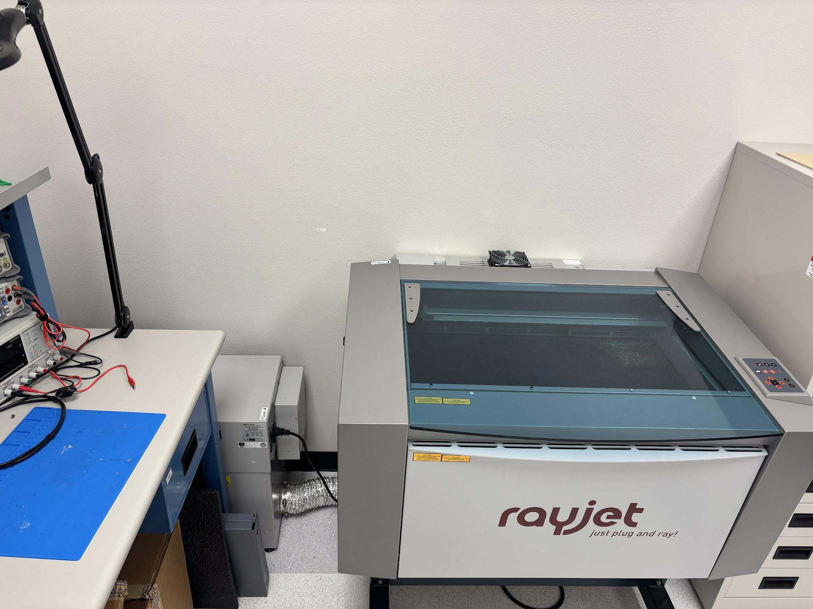


Meet the WCC laser cutter
TROTEC Rayjet 300
A CO₂ laser. The beam is infrared and invisible
Bed size 29" × 17"
Your material and document can't be bigger than this
CAS 117
WCC Engineering Lab: the machine available for student use
Rayjet Manager
Trotec software that receives your job from CorelDRAW
Notes:
Add our machine's wattage from the label on the back. Rayjet 300s were sold at several power levels, and that sets how thick we can cut.

Slide 6
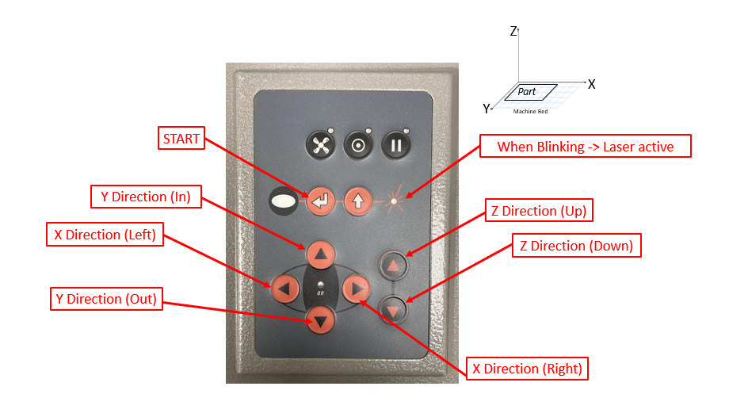
The control panel
On the right side of the machine is a control panel you can use to control positioning of the actual laser.
X / Y arrows
Move the laser head left/right and in/out
Z arrows
Move the bed up and down
START
Runs the job once it's set up
Blinking light
The laser is active
Notes:
Have students locate each button on the real machine before they touch anything. Stress that the Z arrows move the BED, not the laser head. This matters for calibration.

Slide 7


What can go in the laser?
OK with approval
Never
Plywood (thin, laser-grade)
MDF
Cast acrylic
Cardboard, chipboard, paper
Natural leather, cork, felt
PVC / vinyl: releases chlorine gas
Polycarbonate (Lexan): burns, doesn't cut
ABS, HDPE: melt and catch fire
Fiberglass, coated carbon fiber
Metal: reflects the beam, won't cut
Anything you can't identify
Notes:
Ask: how would you know if a mystery plastic sheet was PVC? (You often can't. That's why the rule is 'no ID, no cut.') Cast vs. extruded acrylic: both cut, but cast engraves frosty white and extruded engraves clear. Edit the OK list to match what our lab stocks.

Slide 8


The big picture
Prepare machine
Prepare design
1
Turn on ventilation fan
1
Export Onshape Drawing as a DXF
2
Turn on machine
2
Open Rayjet Manager + CorelDRAW
3
Let machine startup
3
Import DXF, set document size
4
Calibrate machine (Z-direction)
4
Customize lines: cut, etch, engrave
5
Position laser starting point
5
Print to Rayjet Manager → run
Before you laser cut… have you completed a drawing of your design? If not, go do that before taking up the CAS 117 computer.
Notes:
This is the roadmap for the rest of the deck. Each step slide has a gold tag in the corner (MACHINE or DESIGN plus the step number) so students can track where they are. The drawing check keeps the lab computer free for students who are ready to cut.

Slide 9






Design for laser cutting
PLAN YOUR PART
Think in flat parts
Measure the sheet
Account for kerf
Every part is a 2D outline. Build 3D by slotting flat parts together.
“1/8 in” plywood is rarely exactly 3.175 mm. Use calipers.
The beam removes ~0.2 mm, so slots come out a little loose.
Space parts apart
Features ≥ thickness
Watch for islands
Leave 2–3 mm between parts so the edges don't burn through.
Tabs, bridges, and holes thinner than the sheet are fragile or burn away.
The middle of an O or A falls out when cut. Engrave text, or use a stencil font.
Notes:
Tip for Onshape: make a variable like #thickness = the measured value, and use it for every slot width. When the sheet changes, change one number. Connect back to the warm-up: what held the passed-around part together?

Slide 10
Turning flat into 3D
PLAN YOUR PART
Tab & slot
Finger joint
Living hinge
Decide as a group: Your plywood measures 3.0 mm. How wide should the slot be for a snug fit? Why might a slot drawn at exactly 3.0 mm come out loose? How could you find out before cutting your real part?
Notes:
Small groups → share out. Answers to draw out: kerf widens every slot by about one beam width, so a 3.0 mm slot ends up around 3.1–3.2 mm. Draw the slot slightly smaller, or the tab slightly bigger. The best answer to the last question is a test comb: a small strip of slots at 2.8, 2.9, 3.0, 3.1 mm. It's cheap, fast, and how real engineers dial in tolerance. A living hinge is a pattern of offset cuts that makes rigid plywood bend.

Slide 11
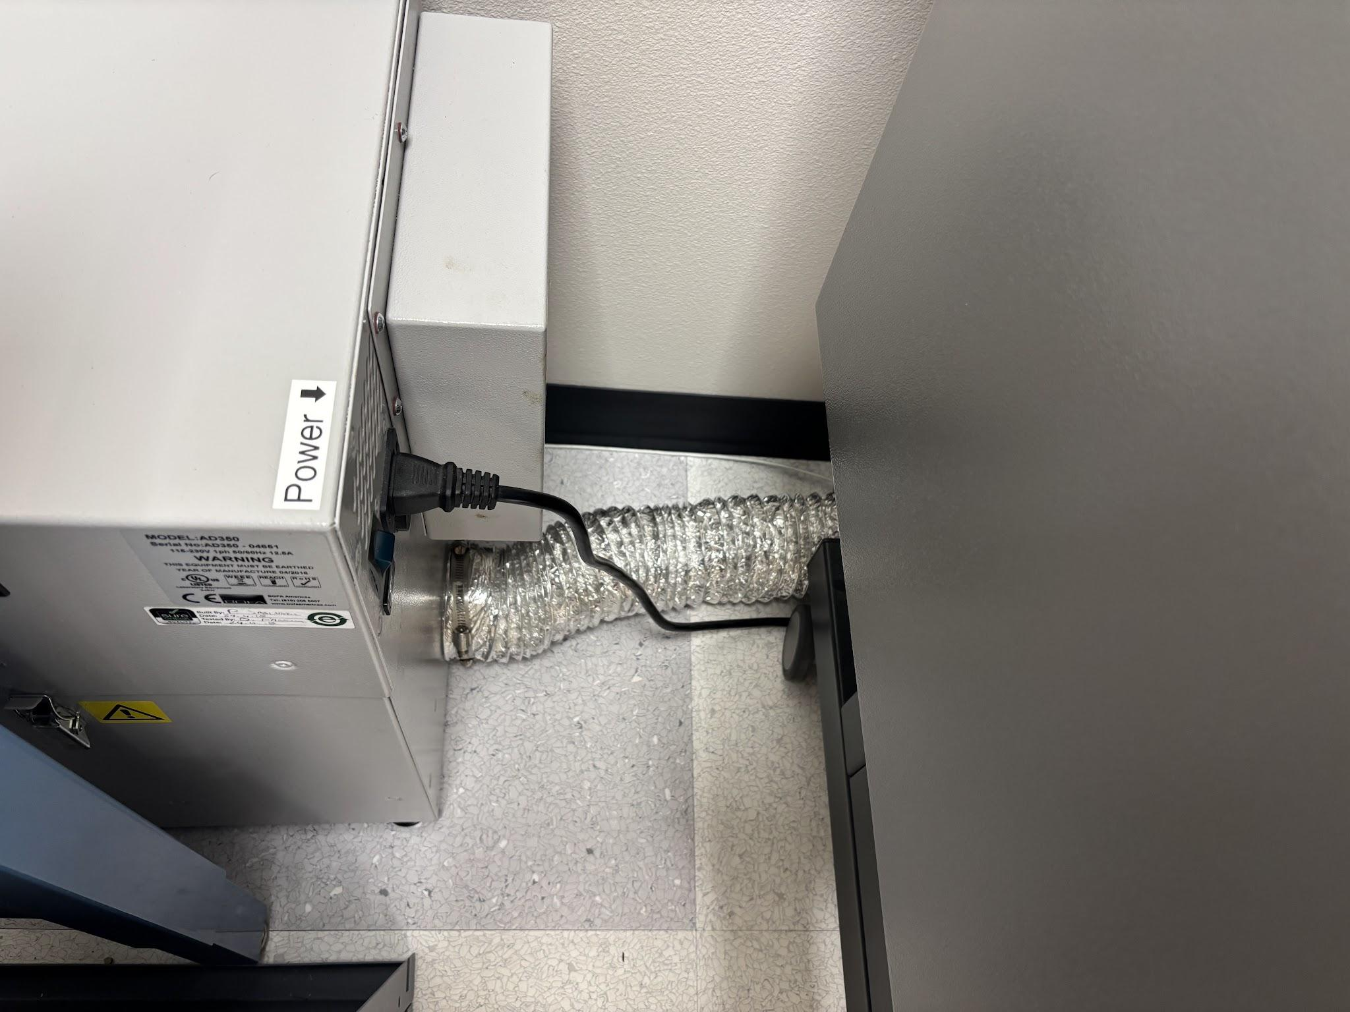
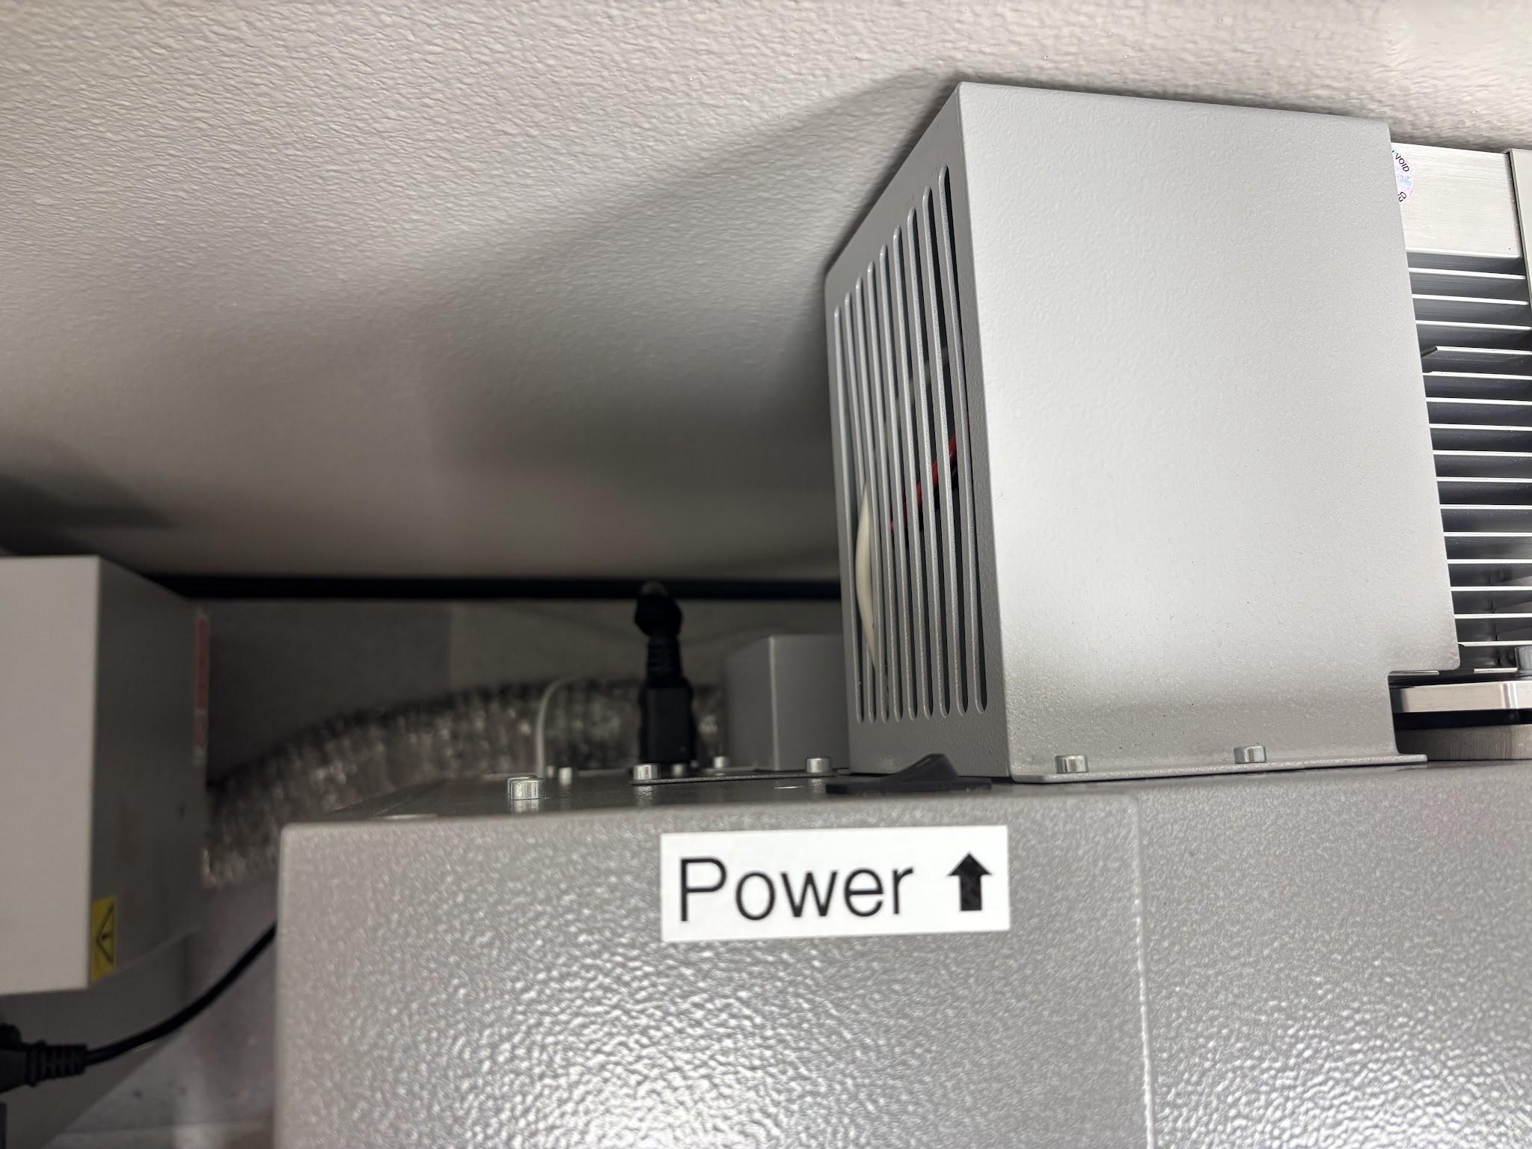
Turn on the fan and the machine
MACHINE · 1–2
1. Turn on Ventilation Fan
2. Turn on Laser Cutting Machine
Fan unit next to the machine. No fan, no laser.
Switch on the back, labeled Power ⬆
Notes:
Fan first, every time: smoke left in the machine damages the lens and gets into the room. Walk students to both switches the first time.

Slide 12
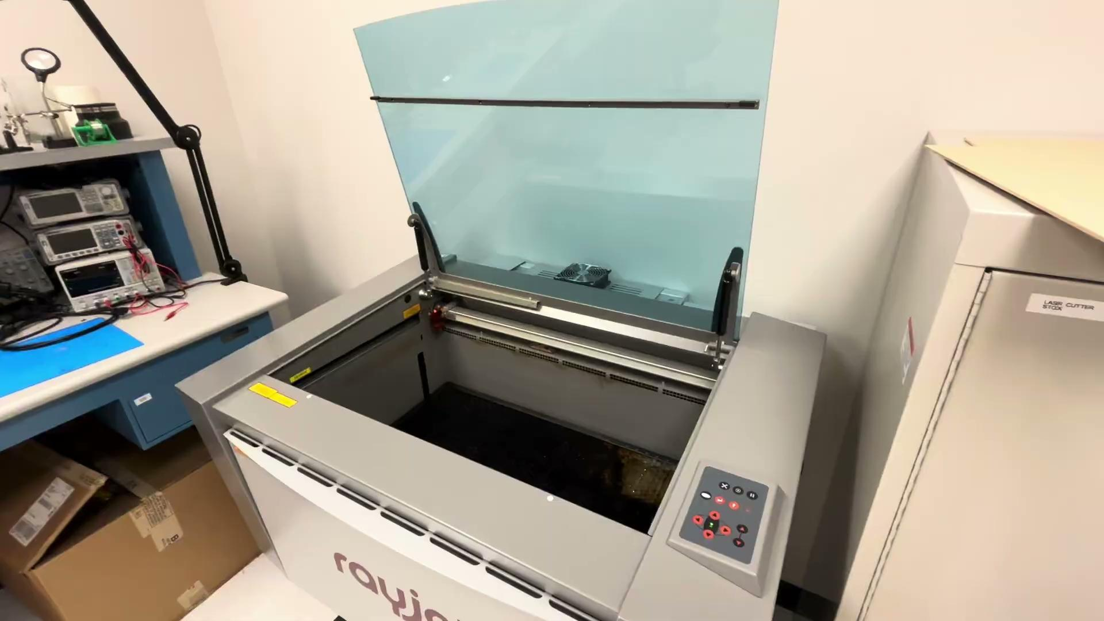
Let the machine start up
MACHINE · 3
1
Lid needs to be closed
2
The machine will lower its bed then move the laser head
3
The machine will beep 3 times then do a final beep
4
After the final beep, you can continue to calibrate the machine
Listen for:
→ go
Notes:
Hands off the controls until the final beep. The machine is homing itself (finding its zero position), and pressing buttons now can confuse it.

Slide 13
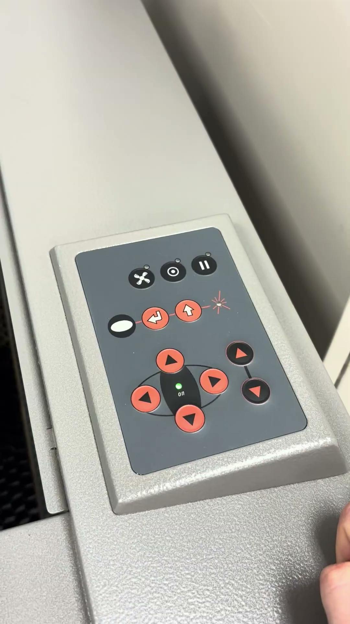

Calibrate the machine (Z-direction)
MACHINE · 4a–b
a
Place material on machine bed
Flat, and inside the 29" × 17" bed
b
Bring the bed UP about 1 inch from your material
Using the control panel, bring the bed UP (in the z direction) about 1 inch away from your material on the bed
DO NOT CRASH LASER INTO BED or MATERIAL
Go slowly with the Z arrows and watch the gap the whole time.
Notes:
Why calibrate? The lens focuses the beam to its smallest, hottest point at one exact distance. Different materials are different thicknesses, so the bed height has to be set for every new material.

Slide 14
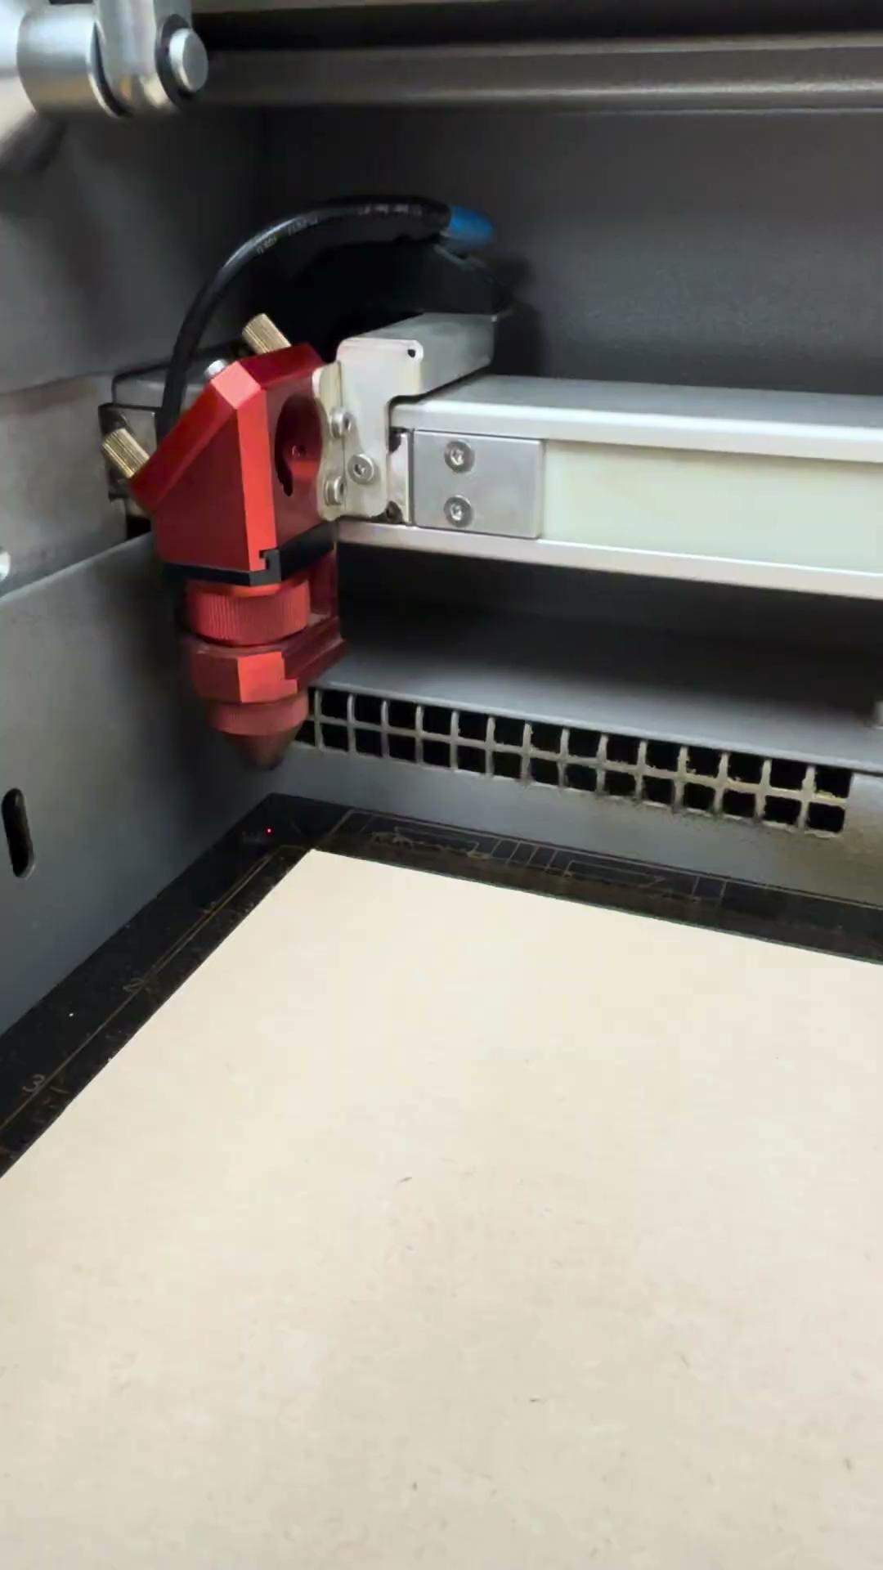
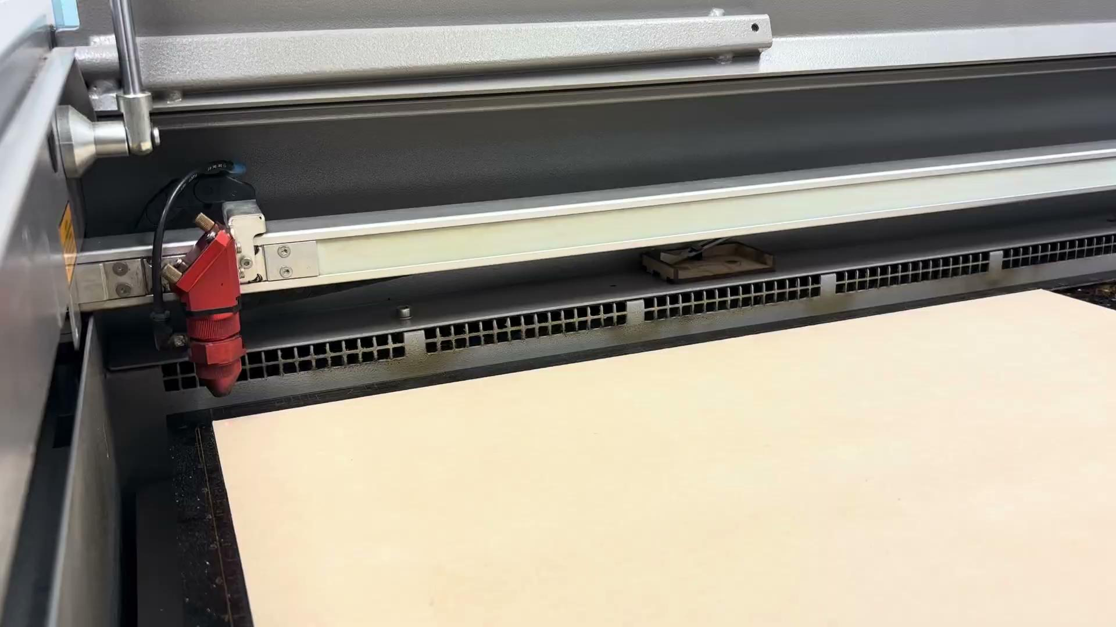
Calibrate with the calibration tool
MACHINE · 4c–d
c
Place calibration tool on end of laser
d
SLOWLY raise the bed
Using the control panel, SLOWLY bring the bed up (in z) so that the calibration tool barely meets your material and falls off
e
Put the tool back
Place calibration tool in its spot on the machine edge once done using
When the tool tips off, the lens is at the right height.
Notes:
If the tool falls the moment the bed moves, you came up too fast. Lower the bed a little and try again. Losing or damaging the calibration tool means nobody can calibrate, which is why it always goes back in its spot.

Slide 15
Position the laser starting point
MACHINE · 5
1
Use the X / Y arrows
Move the laser head over the top-left corner of your material
2
Leave a small margin
Stay a little in from the edge so the cut lands on the material
3
Check it fits
Your design has to fit between this point and the far edges of the sheet
Next: prepare your design on the CAS 117 computer.
Notes:
CHECK: this step was blank in the original deck. Confirm it matches how we position jobs (head position vs. placing the job in Rayjet Manager) and edit as needed.

Slide 16
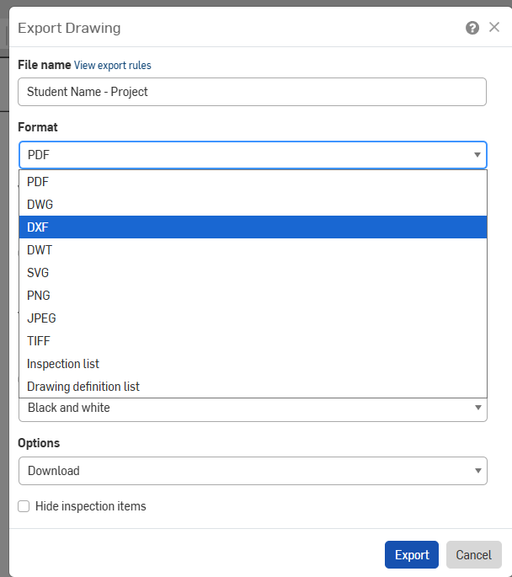
Export your Drawing as a DXF
DESIGN · 1
1
Open your Drawing tab
Your flat part, drawn at 1:1 scale
2
Right-click the tab → Export…
3
File name: Student Name - Project
4
Format: DXF
Then Download
Scale must be 1:1
If the drawing isn't 1:1, the laser cuts the wrong size.
Notes:
Check the drawing's sheet scale is 1:1 before exporting. Drawings also export the border, title block and dimensions. Students delete those in CorelDRAW (or the laser will try to cut them).

Slide 17
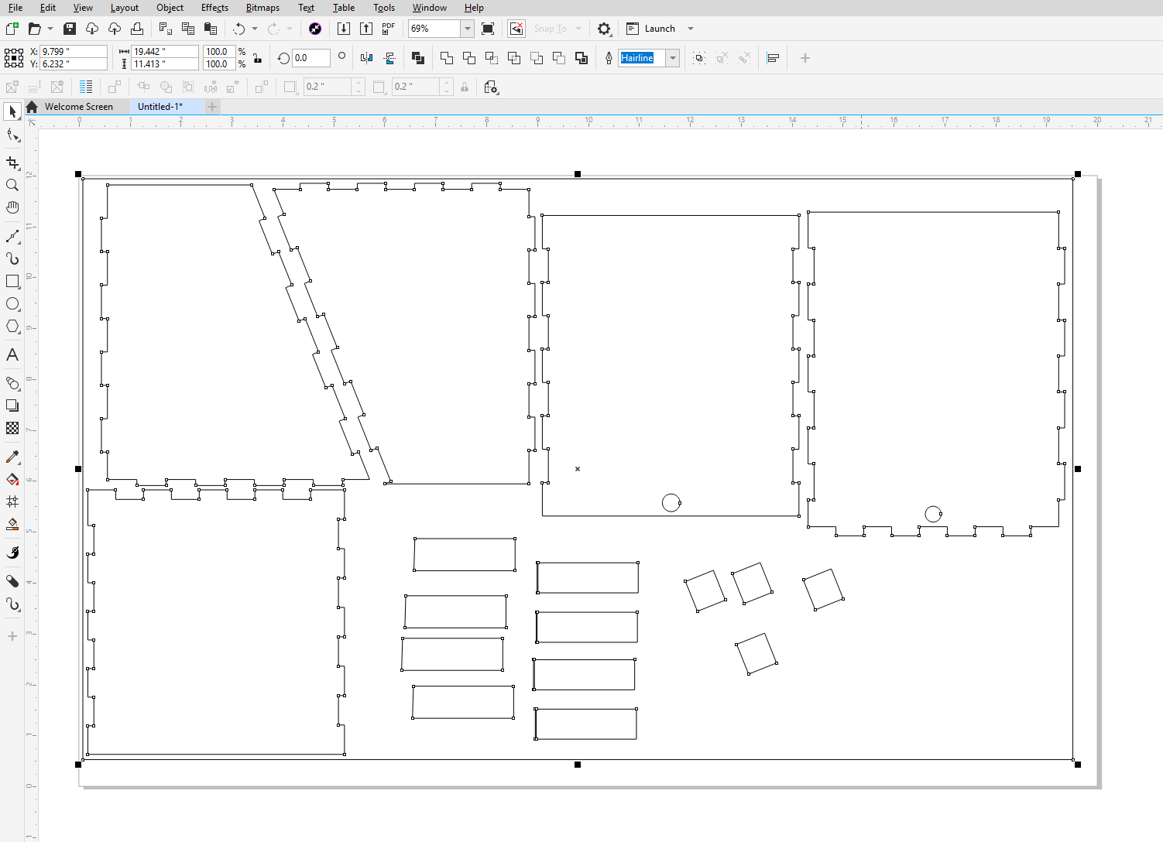
Open the software and import
DESIGN · 2–6
2
Open Rayjet Manager
3
Open CorelDRAW
4
Create new CorelDRAW document
File → New
5
Set document size = your material
Choose a template or custom (max 29" × 17")
6
Import your Onshape DXF
File → Import. Check the size matches Onshape
Notes:
Common mistakes: wrong import scale (click the part and compare W and H in the toolbar with Onshape), and leftover border, title block or dimension lines from the drawing. Delete anything that shouldn't be cut.

Slide 18
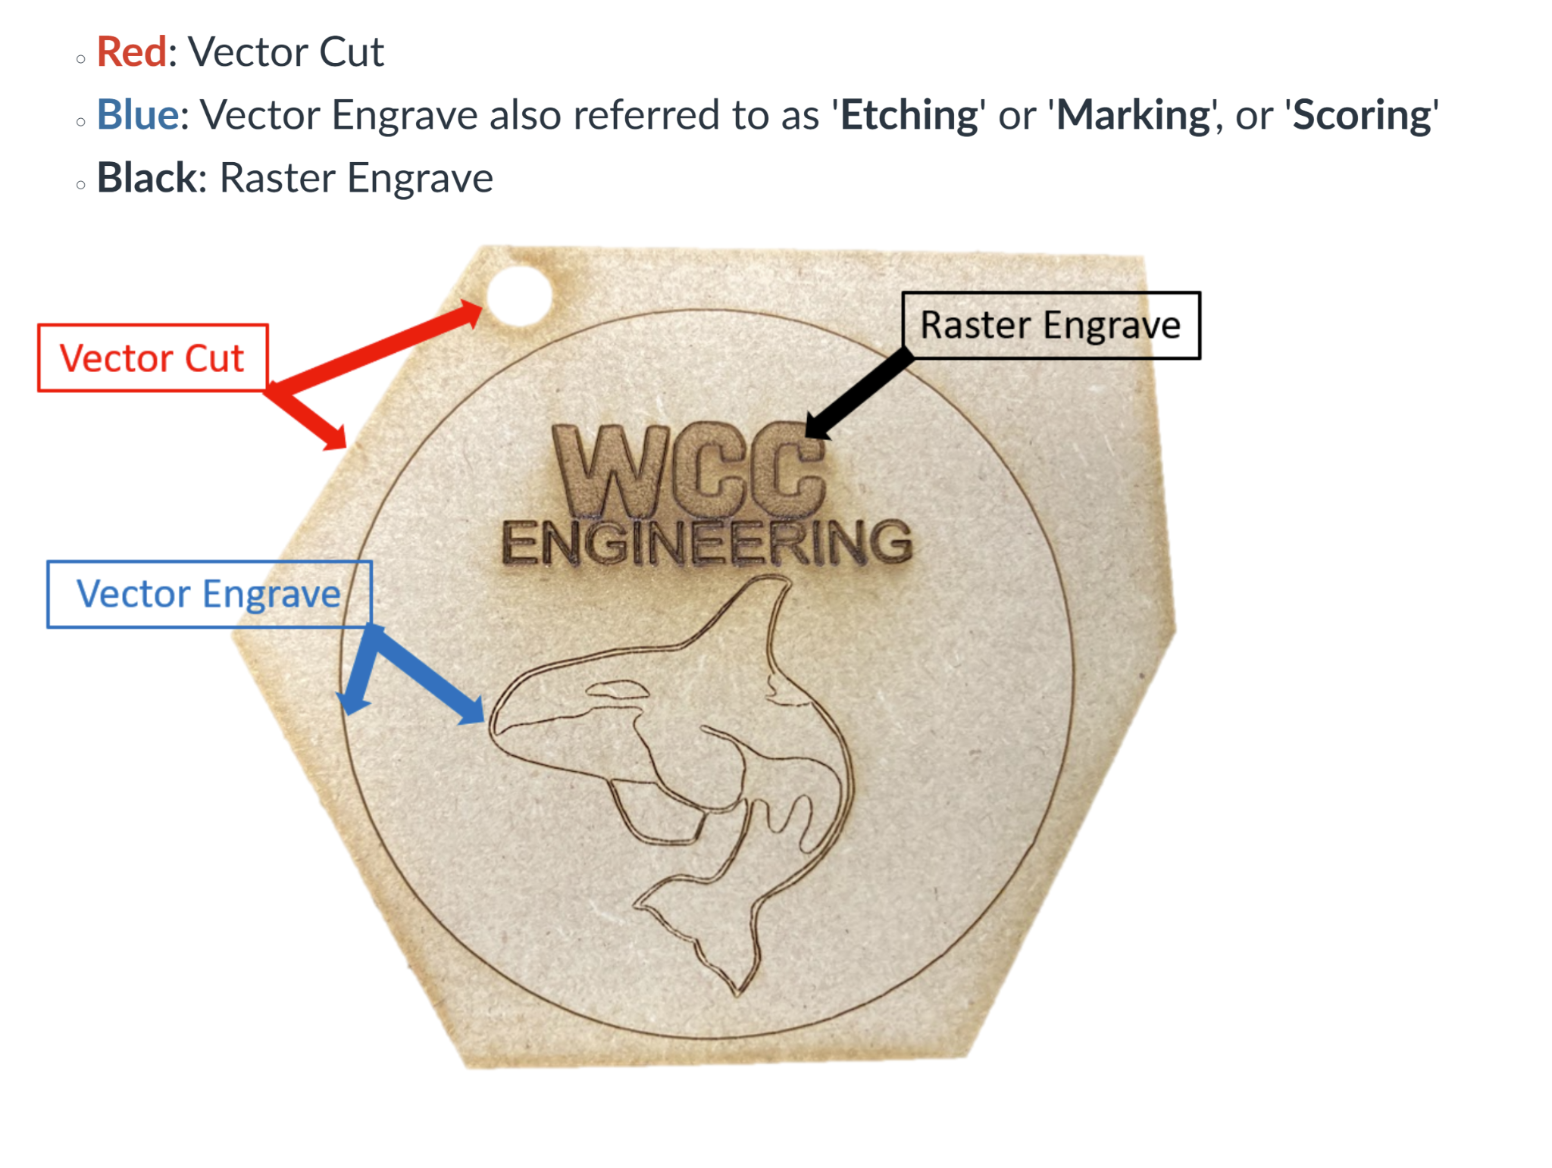
Customize lines to engrave, etch, or cut
DESIGN · 7
Red: Vector Cut
Cuts all the way through
Blue: Vector Engrave
Also called ‘Etching’, ‘Marking’, or ‘Scoring’
Black: Raster Engrave
Fills in an area, like text or a logo
The laser engraves first and cuts last, so parts don't shift before the engraving is done.
Notes:
Use the orca keychain sample: have students point to one example of each process on the real part.

Slide 19
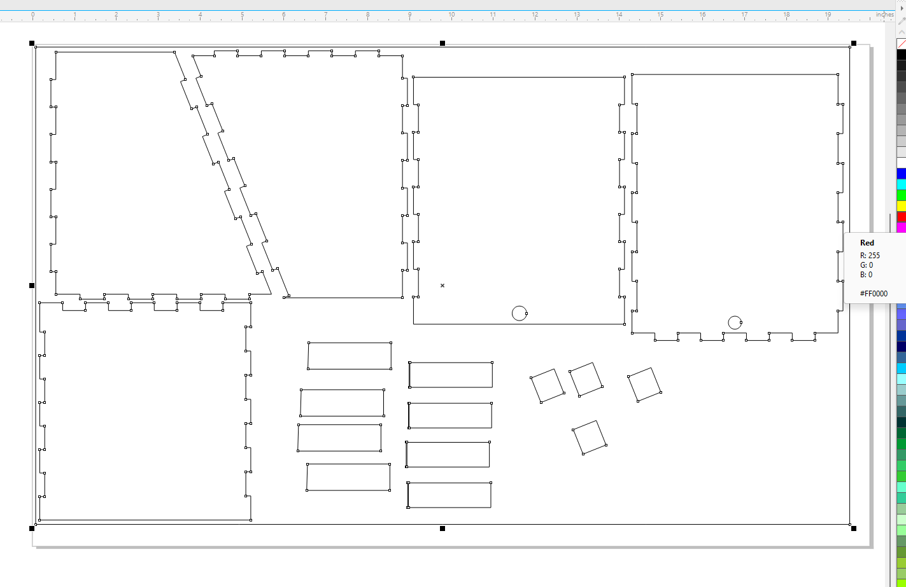
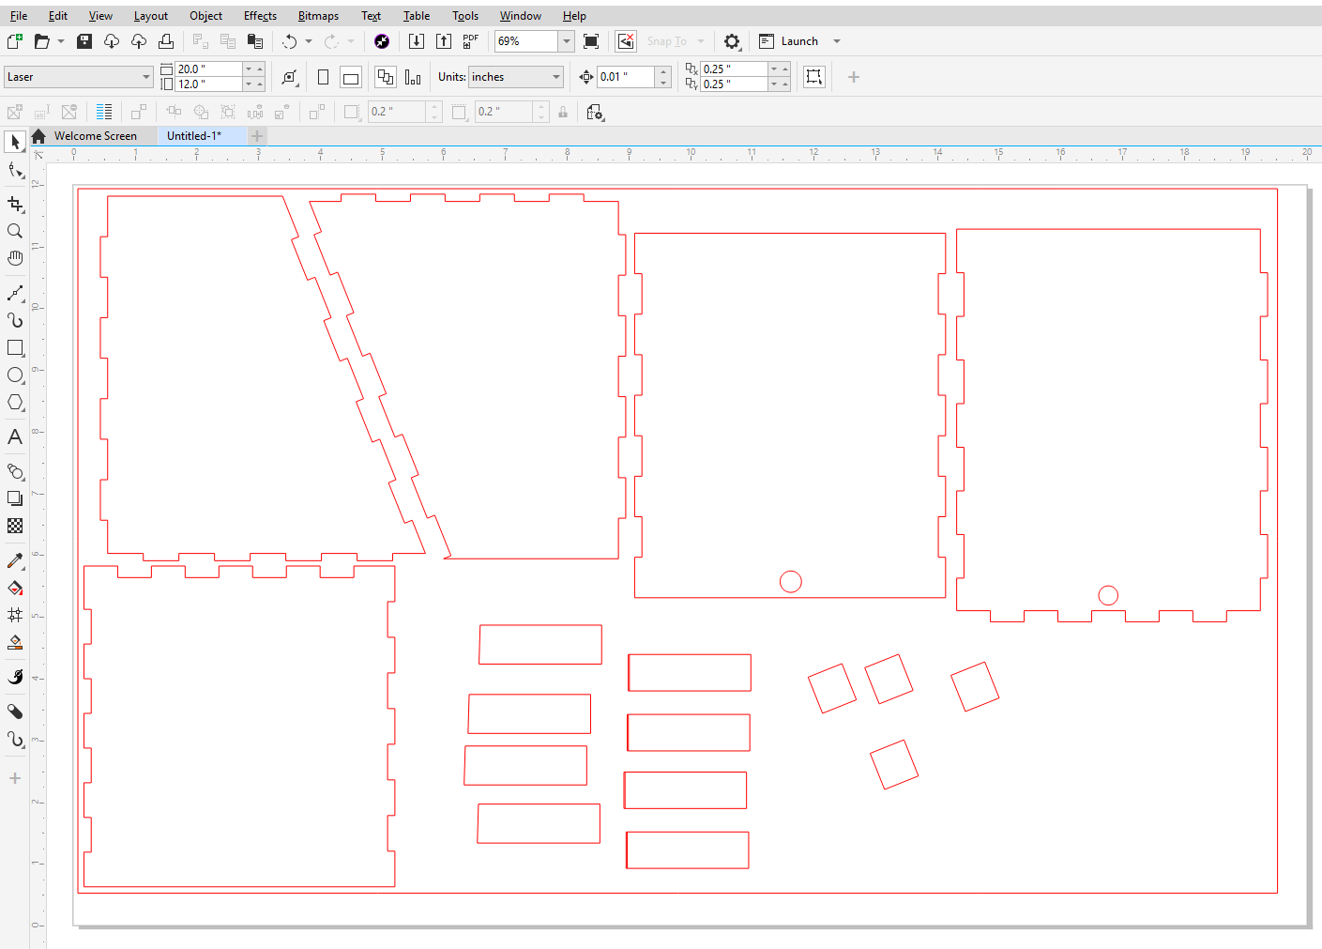
Setting the line color
DESIGN · 7
Select All or Select lines to be CUT and right click on RED
Before: black lines
After: red lines = cut
Right-click a swatch = line color. Left-click = fill color.
Notes:
Repeat for blue (vector engrave) lines and black-filled (raster engrave) areas. Check with the zoom tool: a line that's almost red, or a thick outline, may be engraved instead of cut.

Slide 20

Print to Rayjet Manager
DESIGN · 8–9
8) File ‘Print’
9) Rayjet Manager
Check the preview
Set the material
Sends your design to the Rayjet Manager Software
Go to the Rayjet Manager Software. Your job shows up there
All your parts there, and the right size?
Loads the power and speed for each color
Then send the job to the laser. Nothing fires until you press START on the control panel with the lid closed, so do the final checklist first.
Notes:
CHECK: the original deck stops at 'Go to the Rayjet Manager Software'. The last two cards and the banner are general Rayjet Manager steps. Edit them to match our exact clicks (material selection, positioning, sending the job).

Slide 21

Before you press START
RUN THE JOB
Ventilation fan is ON
Material lies flat on the bed (no warp)
Never walk away
Z calibrated with the calibration tool on THIS material
Small flames at the cut point are normal. A flame that keeps burning after the head moves on is not. Stay with the laser for the whole job. If something catches fire, press pause, keep the lid closed, and get the instructor.
Calibration tool is back in its spot
Lid closed, then press START
Notes:
Show students where the fire extinguisher is, and the pause/stop button on the control panel.

Slide 22
The settings that matter
RUN THE JOB
Setting | What it controls | Cutting | Engraving
Power | How much energy the beam delivers | High: get through the sheet | Lower: just mark the surface
Speed | How fast the head moves | Slow: more time to burn through | Fast: light, even marking
Frequency (PPI / Hz) | Pulses per inch along the path | Low for wood (less charring) | Usually material default
Passes | How many times it repeats the path | 1, or 2 for thick sheets | 1
Start from the material settings in Rayjet Manager, and test on a scrap before you change anything.
Notes:
Power and speed trade off against each other: the energy hitting each spot depends on both. Mini-experiment: engrave a small grid of squares on scrap at different power and speed combos and compare darkness. It's a great introduction to designing an experiment.

Slide 23



After the cut
AFTER
Wait for smoke
Test before moving
Remove parts
Clean up
Fit & measure
Let the ventilation fan clear it before you open the lid
Gently press a part. Not through? Rerun without moving the sheet
Lift them out. Watch for sharp acrylic edges
Pull out scraps and small pieces from the tray
Calipers vs. Onshape. How snug are the slots?
Your cut is data. Too loose or too tight? You just measured the kerf. Use it in your next design.
Notes:
Once the sheet moves, you can't line up a second pass again, which is why students check before removing anything. Have students record designed vs. measured slot width and calculate their kerf.

Slide 24
When things go wrong
What you see | Likely cause | Try this
Didn't cut all the way through | Z not calibrated, warped sheet, or low power | Re-calibrate Z; flatten the sheet; extra pass before moving it
Line was engraved, not cut | Line too thick or not exactly red | Re-select the lines and right-click the RED swatch
Part is the wrong size | Drawing not 1:1, or DXF imported at wrong units | Set the drawing to 1:1; check W and H in CorelDRAW
Border or dimensions got cut | Drawing extras left in the file | Delete them in CorelDRAW before printing
Slots too loose | Kerf not accounted for | Shrink slot width by about one kerf; cut a test comb
Notes:
Keep a bin of failed cuts as teaching examples. Iteration is normal.

Slide 25



Lab safety & norms
Fire is the #1 risk
Never leave the laser running unattended, not even for a minute.
Approved materials only
No ID, no cut. PVC and vinyl release toxic gas.
Ventilation fan always on
No fan, no laser. Smoke damages the lens and your lungs.
Lid stays closed
The beam is invisible. Never open the lid or bypass it mid-job.
Know where things are
Fire extinguisher, the pause button, and who to tell.
Log your job
Name, material, settings, and how it turned out.
Notes:
Physically point out the extinguisher and the Stop button. Edit the log item to match our actual log.

Slide 26
Engineers iterate
Design
Exit ticket
What slot width did you design, and what did it measure after cutting? What does that tell you about the kerf?
Name one thing you'd change in your file before your next cut, and what you expect to happen.
When would you choose the laser cutter over the 3D printer, and when the opposite?
Redesign
Cut
Measure
Notes:
Question 3 ties this lesson to the 3D printing one: laser = fast, flat, sheet goods, great for boxes and panels; printer = slow but true 3D shapes. Optional extension: redesign with your measured kerf and recut.

