Slide 1

Chapter 16:
Exceptions, Templates, and the Standard Template Library (STL)

Slide 2
6.1
Exceptions

Slide 3

Exceptions
Indicate that something unexpected has occurred or been detected
Allow program to deal with the problem in a controlled manner
Can be as simple or complex as program design requires

Slide 4
Exceptions - Terminology
Exception: object or value that signals an error
Throw an exception: send a signal that an error has occurred
Catch/Handle an exception: process the exception; interpret the signal

Slide 5
Exceptions – Key Words
throw – followed by an argument, is used to throw an exception
try – followed by a block { }, is used to invoke code that throws an exception
catch – followed by a block { }, is used to detect and process exceptions thrown in preceding try block. Takes a parameter that matches the type thrown.

Slide 6
Exceptions – Flow of Control
A function that throws an exception is called from within a try block
If the function throws an exception, the function terminates and the try block is immediately exited. A catch block to process the exception is searched for in the source code immediately following the try block.
If a catch block is found that matches the exception thrown, it is executed. If no catch block that matches the exception is found, the program terminates.

Slide 7
Exceptions – Example (1)
// function that throws an exception
int totalDays(int days, int weeks)
{
if ((days < 0) || (days > 7))
throw "invalid number of days";
// the argument to throw is the
// character string
else
return (7 * weeks + days);
}

Slide 8
Exceptions – Example (2)
try // block that calls function
{
totDays = totalDays(days, weeks);
cout << "Total days: " << days;
}
catch (char *msg) // interpret // exception
{
cout << "Error: " << msg;
}

Slide 9
Exceptions – What Happens
try block is entered. totalDays function is called
If 1st parameter is between 0 and 7, total number of days is returned and catch block is skipped over (no exception thrown)
If exception is thrown, function and try block are exited, catch blocks are scanned for 1st one that matches the data type of the thrown exception. catch block executes

Slide 10
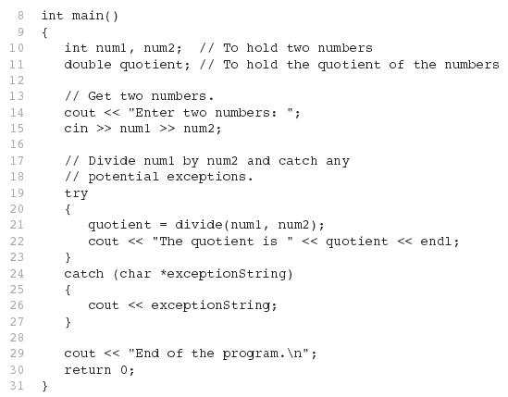
From Program 16-1

Slide 11
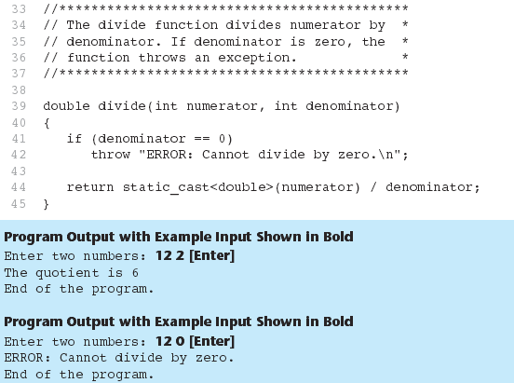
From Program 16-1

Slide 12
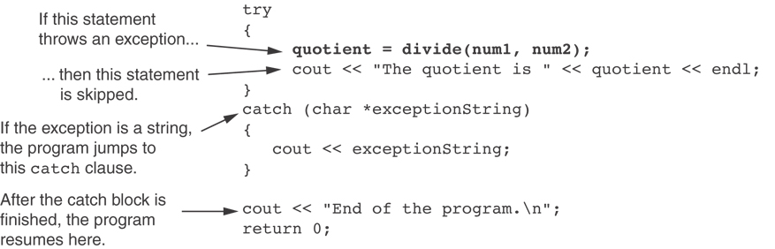
What Happens in theTry/Catch Construct

Slide 13
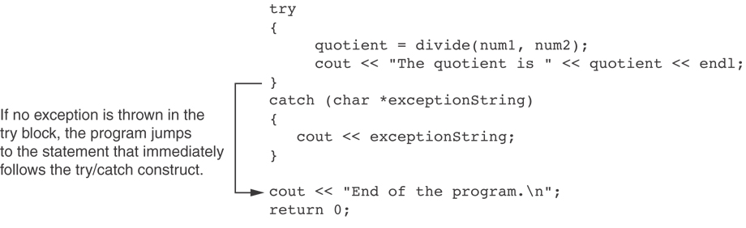
What if no exception is thrown?

Slide 14
Exceptions - Notes
Predefined functions such as new may throw exceptions
The value that is thrown does not need to be used in catch block.
  in this case, no name is needed in catch parameter definition
  catch block parameter definition does need the type of exception being caught

Slide 15
Exception Not Caught?
An exception will not be caught if
  it is thrown from outside of a try block
  there is no catch block that matches the data type of the thrown exception
If an exception is not caught, the program will terminate

Slide 16
Exceptions and Objects
An exception class can be defined in a class and thrown as an exception by a member function
An exception class may have:
  no members: used only to signal an error
  members: pass error data to catch block
A class can have more than one exception class

Slide 17
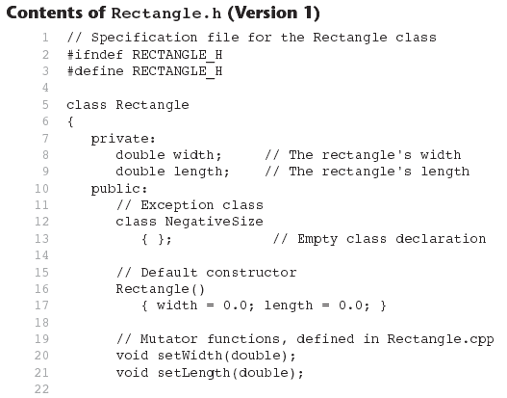

Slide 18
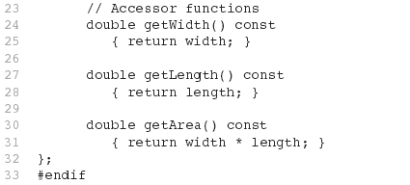
Contents of Rectangle.h (Version1) (Continued)

Slide 19
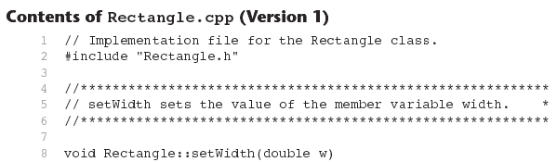
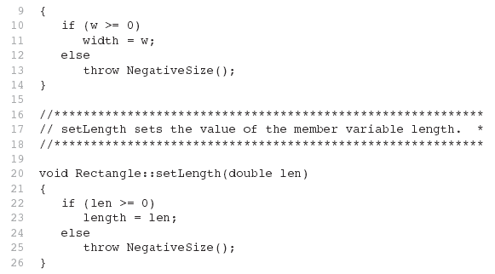

Slide 20
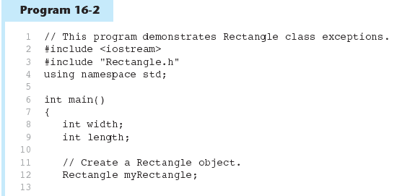

Slide 21
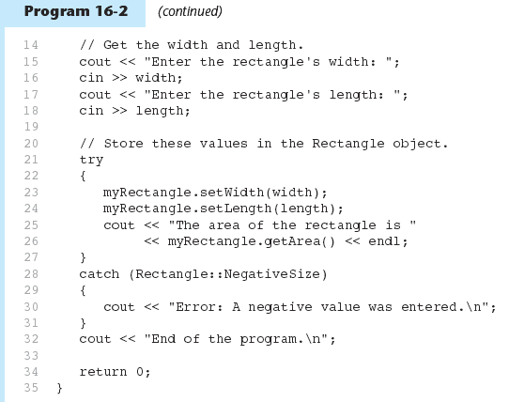

Slide 22
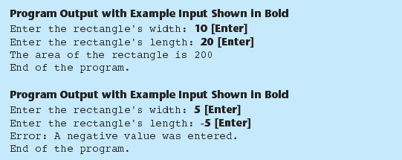
Program 16-2 (Continued)

Slide 23
What Happens After catch Block?
Once an exception is thrown, the program cannot return to throw point. The function executing throw terminates (does not return), other calling functions in try block terminate, resulting in unwinding the stack
If objects were created in the try block and an exception is thrown, they are destroyed.

Slide 24
Nested try Blocks
try/catch blocks can occur within an enclosing try block
Exceptions caught at an inner level can be passed up to a catch block at an outer level:
  catch ( )
  {
  ...
  throw; // pass exception up
  } // to next level

Slide 25
16.2
Function Templates

Slide 26
Function Templates
Function template: a pattern for a function that can work with many data types
When written, parameters are left for the data types
When called, compiler generates code for specific data types in function call

Slide 27
Function Template Example
template
prefix
  template <class T>
  T times10(T num)
  {
  return 10 * num;
  }
generic
data type
type
parameter
What gets generated when times10 is called with an int: | What gets generated when times10 is called with a double:
int times10(int num) { return 10 * num; } | double times10(double num) { return 10 * num; }

Slide 28
Function Template Example
  template <class T>
  T times10(T num)
  {
  return 10 * num;
  }
Call a template function in the usual manner:
  int ival = 3;
  double dval = 2.55;
  cout << times10(ival); // displays 30
  cout << times10(dval); // displays 25.5

Slide 29
Function Template Notes
Can define a template to use multiple data types:
template<class T1, class T2>
Example:
  template<class T1, class T2> // T1 and T2 will be
  double mpg(T1 miles, T2 gallons) // replaced in the
  { // called function
  return miles / gallons // with the data
  } // types of the
  // arguments

Slide 30
Function Template Notes
Function templates can be overloaded Each template must have a unique parameter list
  template <class T>
  T sumAll(T num) ...
  template <class T1, class T2>
  T1 sumall(T1 num1, T2 num2) ...

Slide 31
Function Template Notes
All data types specified in template prefix must be used in template definition
Function calls must pass parameters for all data types specified in the template prefix
Like regular functions, function templates must be defined before being called

Slide 32
Function Template Notes
A function template is a pattern
No actual code is generated until the function named in the template is called
A function template uses no memory
When passing a class object to a function template, ensure that all operators in the template are defined or overloaded in the class definition

Slide 33
16.3
Where to Start When Defining Templates

Slide 34
Where to Start
When Defining Templates
Templates are often appropriate for multiple functions that perform the same task with different parameter data types
Develop function using usual data types first, then convert to a template:
  add template prefix
  convert data type names in the function to a type parameter (i.e., a T type) in the template

Slide 35
16.4
Class Templates

Slide 36
Class Templates
Classes can also be represented by templates. When a class object is created, type information is supplied to define the type of data members of the class.
Unlike functions, classes are instantiated by supplying the type name (int, double, string, etc.) at object definition

Slide 37
Class Template Example
  template <class T>
  class grade
  {
  private:
  T score;
  public:
  grade(T);
  void setGrade(T);
  T getGrade()
  };

Slide 38
Class Template Example
Pass type information to class template when defining objects:
  grade<int> testList[20];
  grade<double> quizList[20];
Use as ordinary objects once defined

Slide 39
Class Templates and Inheritance
Class templates can inherit from other class templates:
  template <class T>
  class Rectangle
  { ... };
  template <class T>
  class Square : public Rectangle<T>
  { ... };
Must use type parameter T everywhere base class name is used in derived class

Slide 40
16.5
Introduction to the Standard Template Library

Slide 41
Introduction to the Standard Template Library
Standard Template Library (STL): a library containing templates for frequently used data structures and algorithms
Not supported by many older compilers

Slide 42
Standard Template Library
Two important types of data structures in the STL:
  containers: classes that stores data and imposes some organization on it
  iterators: like pointers; mechanisms for accessing elements in a container

Slide 43
Containers
Two types of container classes in STL:
  sequence containers: organize and access data sequentially, as in an array. These include vector, dequeue, and list
  associative containers: use keys to allow data elements to be quickly accessed. These include set, multiset, map, and multimap

Slide 44
Iterators
Generalization of pointers, used to access information in containers
Four types:
  forward (uses ++)
  bidirectional (uses ++ and -- )
  random-access
  input (can be used with cin and istream objects)
  output (can be used with cout and ostream objects)

Slide 45
Algorithms
STL contains algorithms implemented as function templates to perform operations on containers.
Requires algorithm header file
algorithm includes
binary_search | count
for_each | find
find_if | max_element
min_element | random_shuffle
sort | and others

