Slide 1
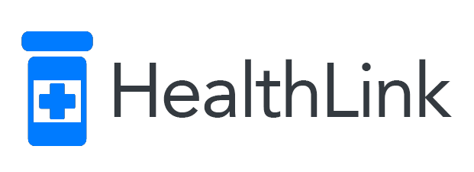
Robert Cordwell Brian Ng Jessica Richards
Provably valid blockchain prescription management through Exonum and WELL integrations.

Slide 2
Why?
Prescriptions provably valid
Provable single fill
Prevents abuse
Pill mills auditable
Pharmacies auditable
Patients can be audited
Increased patient anonymity

Slide 3
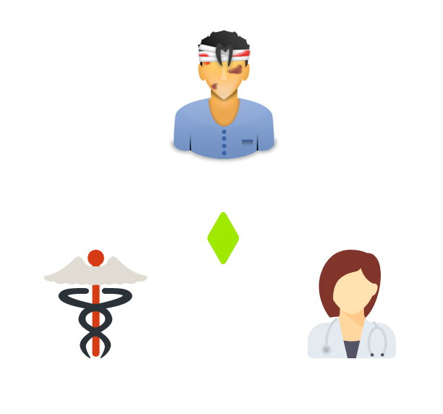
Anonymous Middleman Protocol
Patients:
Public key not associated with identity unless in-person authentication with provider or insurer.
Prescriptions collected by codephrase
Enabled by a private blockchain
Pharmacies:
Public key associated with business identity.
Doctors:
Public key associated with identity and M.D. license.

Slide 4
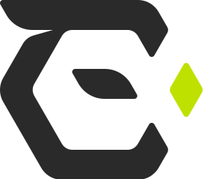
Exonum?
Database-like storage on blockchain
Time dependent transactions
Turing-complete smart contracts
Private blockchain
Capped transaction fees

Slide 5
Blockchain protocols
 | Relational database | Solidity | Exonum
Decentralized, time-dependent transactions | X | O | O
Turing-complete smart contracts | X | O | O
Private blockchain in Rust | X | X | O
Capped transaction fees | O | X | O

Slide 6
The 4 Handshakes
PHYSICIAN VISIT
Patient sees doctor, gives private key for medical history
Doctor provides diagnosis and prescription

Slide 7
The 4 Handshakes
2. PRESCRIPTION REQUEST
Patient creates request order from pharmacist
Picks codephrase for authentication

Slide 8
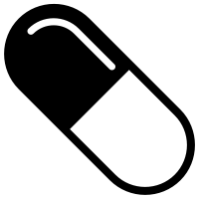
The 4 Handshakes
3. FILL ORDER
Pharmacy fills order and confirms for pickup

Slide 9
The 4 Handshakes
4. PICKUP
Patient and pharmacy confirm prescription pickup

Slide 10
Four Handshakes
Doctor gives patient prescription
Patient shares his public key
Doctor can look up patient history
Patient creates a request order from pharmacy
Picks a codephrase to give the pharmacist
Pharmacy fills order & confirms
Patient confirms receipt of medication

Slide 11
Single prescription invariant
Fill = pills waiting for pickup
Fill order creation requires open prescription
No open prescription => code bounces
Enforced time dependence crucial!
Pharmacist asks for codephrase
Optional salting prevents rainbow attacks
Pharmacy can cancel fill if necessary
Completion

Slide 12
Auditability
All transactions are part of the public domain
Anyone can see prescriptions by doctor
Doctors may anonymize by having an entire clinic under one umbrella
Anyone can see prescriptions by pharmacy
State can track if employees stealing pills

Slide 13
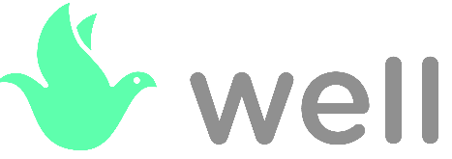
WELL Integration
Extensible contract = payment tokens required
Existing network of doctors means market advantage
Unique selling point
No similar product exists
Blockchain eliminates need for coordination

