Slide 1
AMPing up prescriptions

Slide 2
Why?
Prescriptions provably valid
Provable single fill
Prevents abuse
Pill mills auditable
Pharmacies auditable
Patients can be audited
Total patient anonymity

Slide 3
Anonymous Middleman Protocol
Doctor and pharmacy public keys public
Can’t practice without an MD
Patient public key is semi-private
Insurance may intervene
Only your doctor knows your name
Prescriptions collected with codephrase
Impossible without Exonum or similar

Slide 4
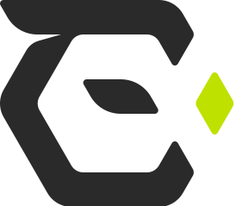
Exonum?
Database-like storage on blockchain
Time dependent transactions
Turing-complete smart contracts
Private blockchain
Capped transaction fees

Slide 5
Four Handshakes
Doctor gives patient prescription
Patient shares his public key
Doctor can look up patient history
Patient creates a request order from pharmacy
Picks a codephrase to give the pharmacist
Pharmacy fills order & confirms
Patient confirms receipt of medication

Slide 6
Single prescription invariant
Fill = pills waiting for pickup
Fill order creation requires open prescription
No open prescription => code bounces
Enforced time dependence crucial!
Pharmacist asks for codephrase
Optional salting prevents rainbow attacks
Pharmacy can cancel fill if necessary
Completion

Slide 7
Auditability
All transactions are part of the public domain
Anyone can see prescriptions by doctor
Doctors may anonymize by having an entire clinic under one umbrella
Anyone can see prescriptions by pharmacy
State can track if employees stealing pills

Slide 8
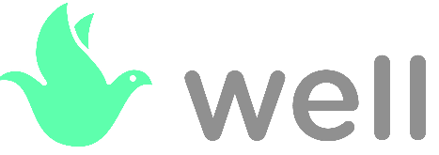
WELL Integration
Extensible contract = payment tokens required
Existing network of doctors means market advantage
Unique selling point
No similar product exists
Blockchain eliminates need for coordination

