Slide 1
Project – Create a Multiple Linear Regression Model for General Motors (GM) Data set
Chandani W

Slide 2
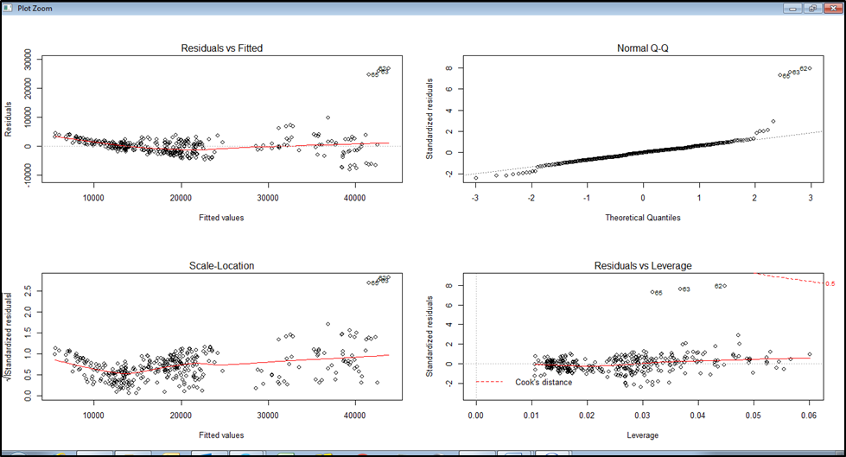
Initial Model
gmmod <- lm(Price~.,data = gmdstrain)
> summary(gmmod)
Call:
lm(formula = Price ~ ., data = gmdstrain)
Residuals:
Min 1Q Median 3Q Max
-8220.9 -1753.0 -72.9 1259.9 26928.5
Coefficients:
Estimate Std. Error t value Pr(>|t|)
(Intercept) 2.539e+04 2.190e+03 11.595 < 2e-16 ***
Mileage -1.985e-01 2.260e-02 -8.782 < 2e-16 ***
MakeChevrolet -1.667e+04 8.916e+02 -18.695 < 2e-16 ***
MakePontiac -1.802e+04 8.501e+02 -21.200 < 2e-16 ***
Cylinder -1.984e+03 6.009e+02 -3.301 0.00106 **
Liter 7.350e+03 6.884e+02 10.677 < 2e-16 ***
Cruise 1.559e+02 4.958e+02 0.314 0.75335
Sound 3.517e+02 4.575e+02 0.769 0.44256
Leather 1.014e+02 5.055e+02 0.201 0.84108
---
Signif. codes: 0 ‘***’ 0.001 ‘**’ 0.01 ‘*’ 0.05 ‘.’ 0.1 ‘ ’ 1
Residual standard error: 3470 on 341 degrees of freedom
Multiple R-squared: 0.8786, Adjusted R-squared: 0.8757
F-statistic: 308.4 on 8 and 341 DF, p-value: < 2.2e-16

Slide 3
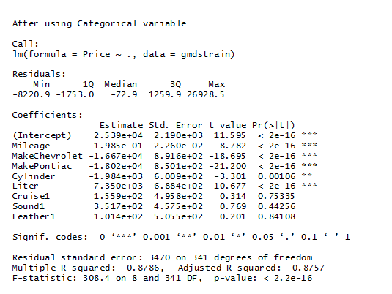
Using Categorical Variable
gmds$Cruise=as.factor(gmds$Cruise)
gmds$Sound=as.factor(gmds$Sound)
gmds$Leather=as.factor(gmds$Leather)
Not much improvement found in Model after using Cruise , Leather & Sound as categorical variable.

Slide 4
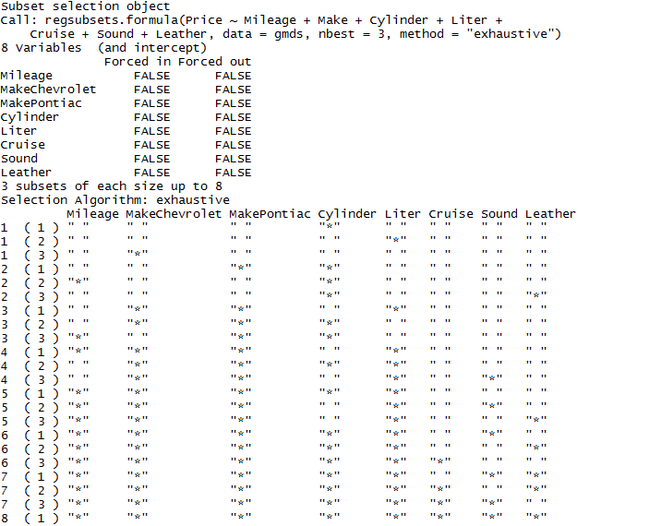
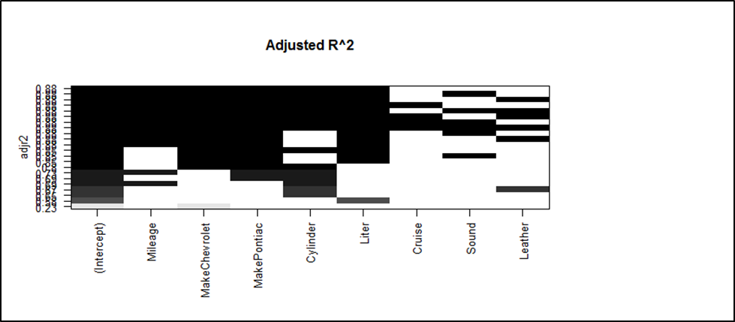
Using Leaps() function
Variable Cruise, Sound & leather are found to be less influential variable. Hence discarding them.

Slide 5
Model After removing Cruise, Leather & Sound variable:
Model has to be transformed.
Outliers are found.

Slide 6
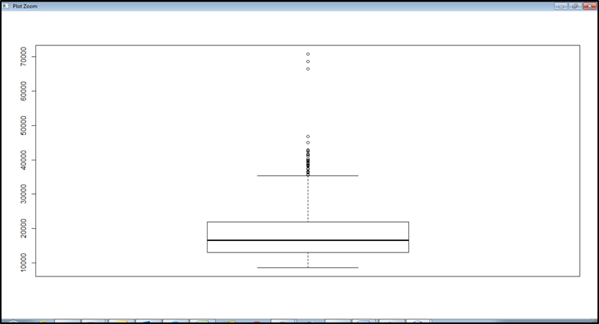
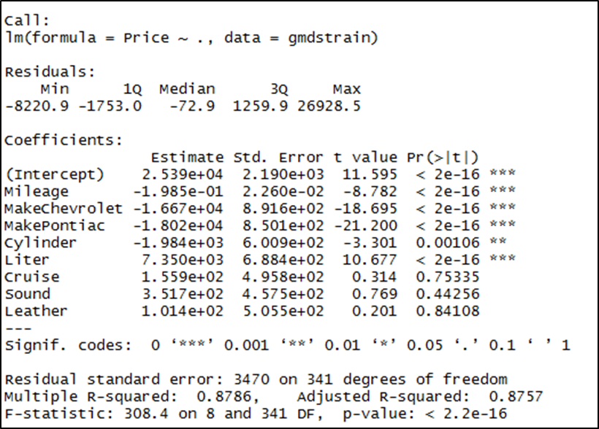
After Removing Outliers:

Slide 7
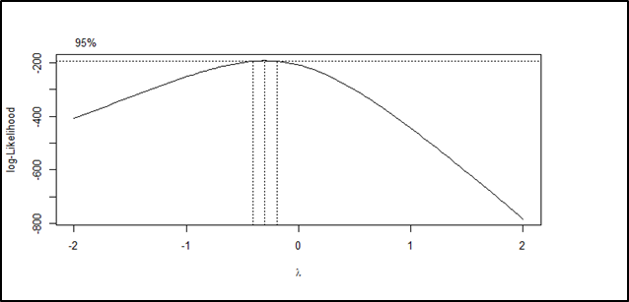
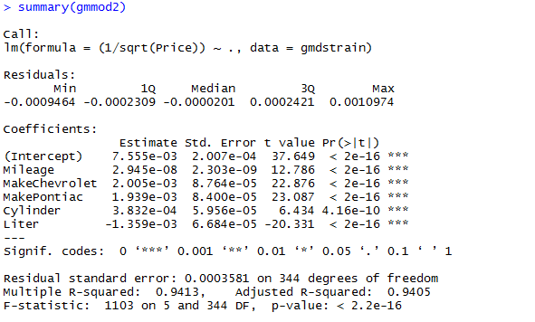
Boxcox Tranformation
library(MASS)
boxcox(lm(Price~.,data = gmdstrain),lambda = seq(-2,2,by=.1))
As the lamda lies between 0 & -1,using 1/Sqrt for transformation
gmmod2<-lm((1/sqrt(Price))~.,
data=gmdstrain)

Slide 8
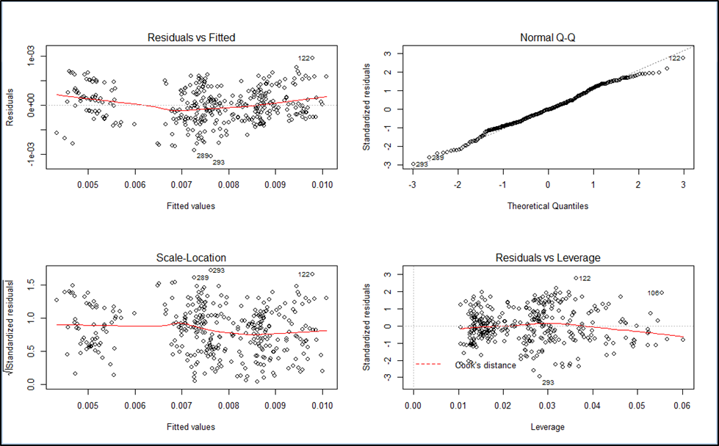
Final Model

Slide 9
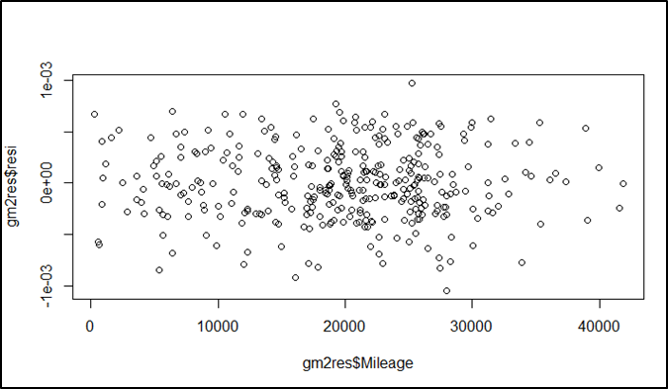
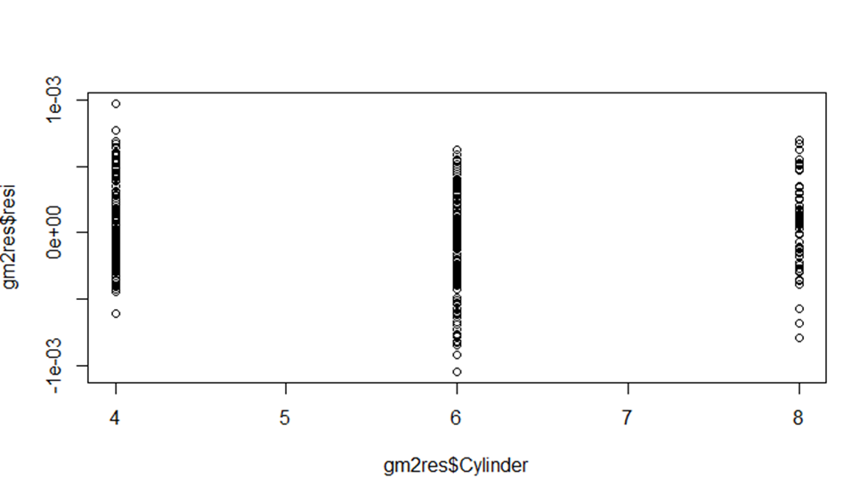
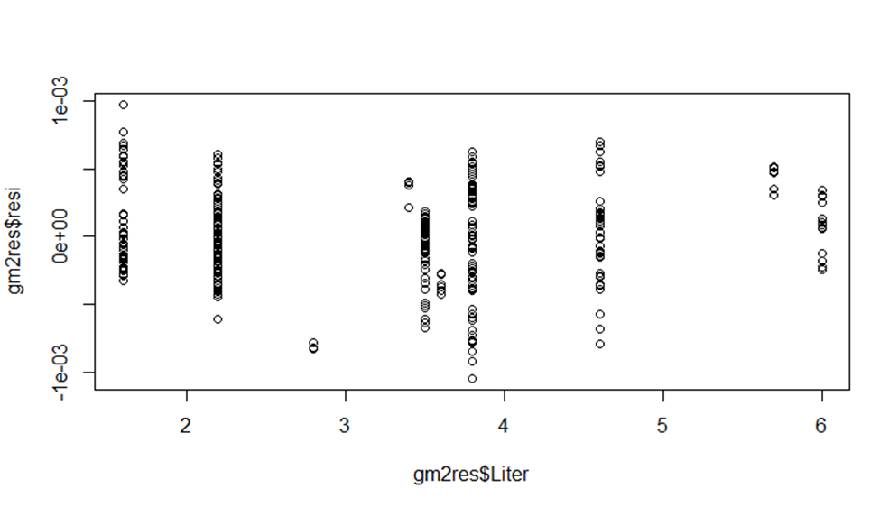
Fitted Vs Residual Plot

Slide 10
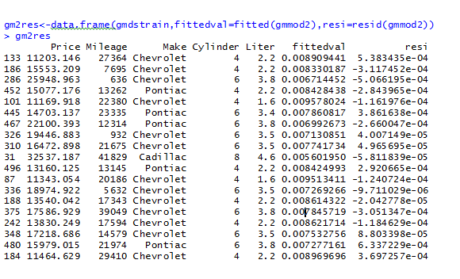
Fitted Value

