Slide 1
Project – Create a Linear Regression Model for DVD sales data set
Chandani W

Slide 2
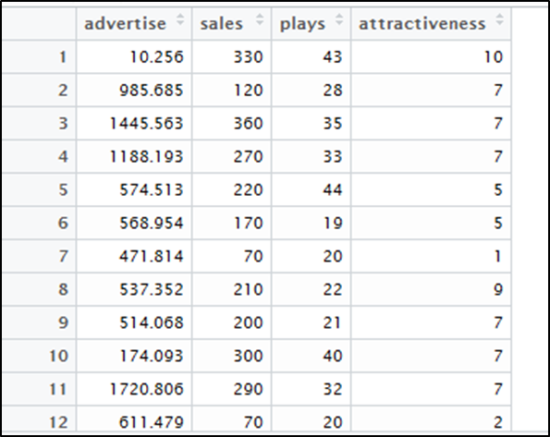
Dataset
Using attractiveness as CATEGORICAL VARIABLE:
d1$attractiveness <- as.factor(d1$attractiveness)

Slide 3
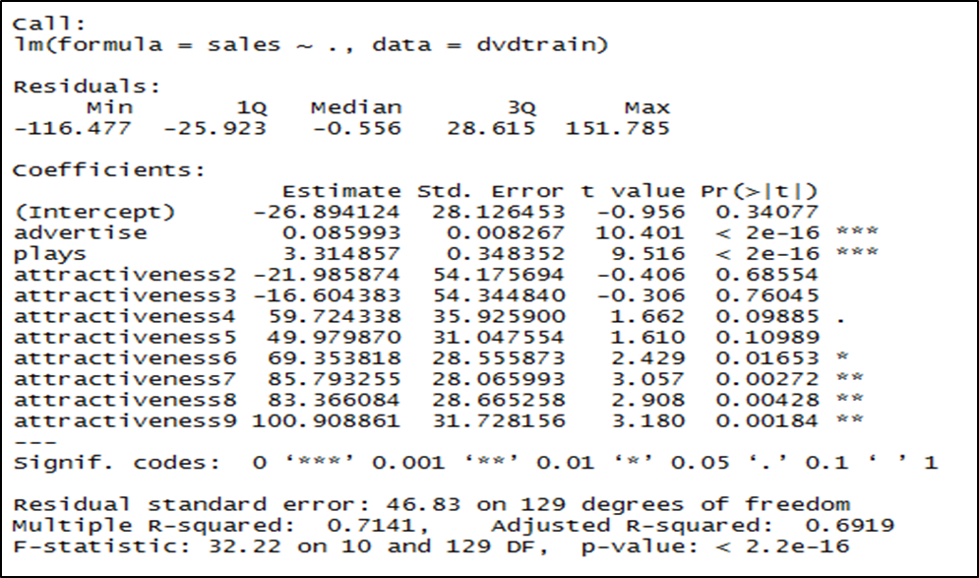
Linear model
Summary(dmod)

Slide 4
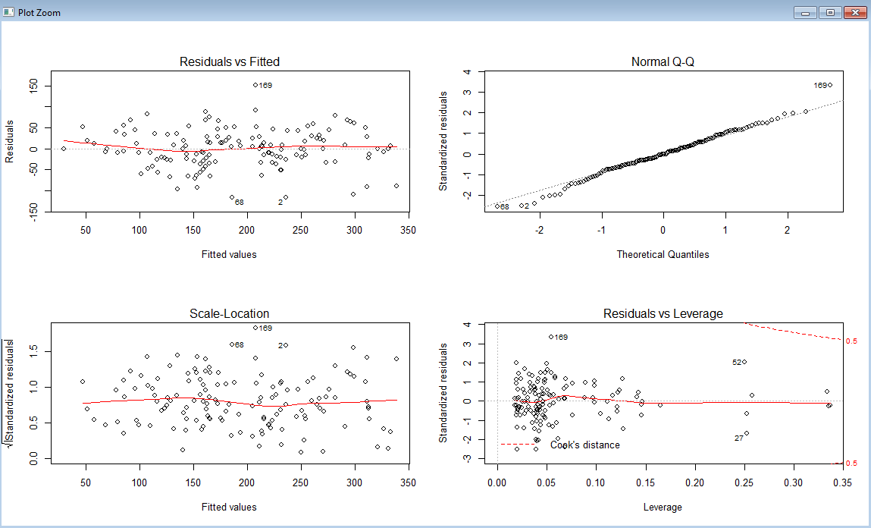
Plot
No heteroscedasticity Found and Data is normally distributed by looking at the Q-Q plot.
Hence not transforming the Data.

Slide 5
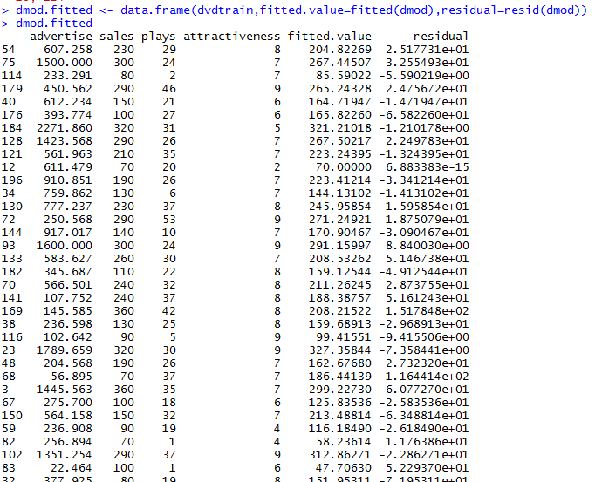
Fitted Value

Slide 6
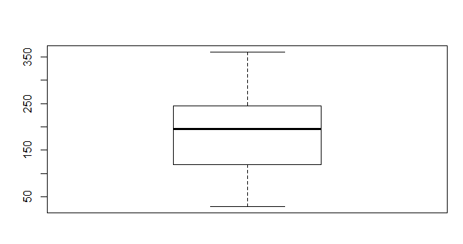
Outliers
No Outliers found.

Slide 7
Correlation

