Slide 1







Slide 2
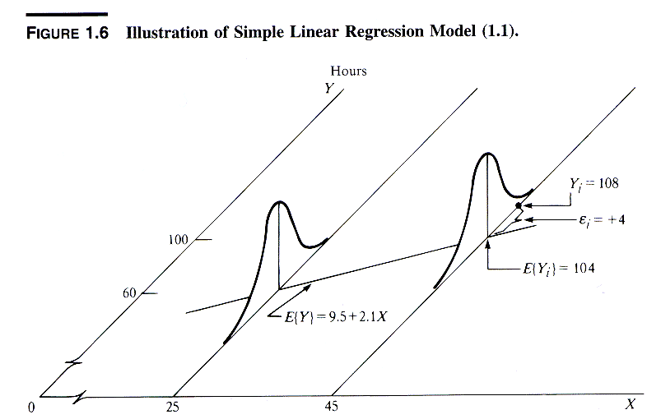


Assumptions
Targeted Learning

Slide 3
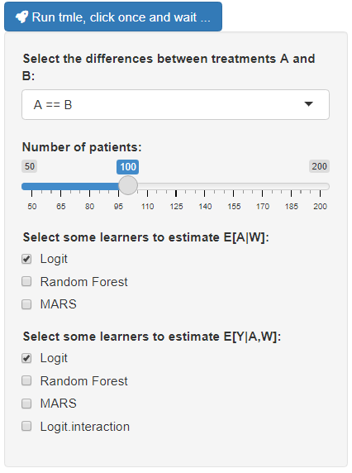






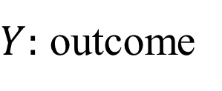


A > B
$$vs$$
$$T_{B}=0$$
$T_{A}=$1
$$P\left[T|W\right]$$
$W:$ covariables
$$P\left[Y|T,W\right]$$
$Y:$ outcome

Slide 4
https://github.com/dasalazarb/tmleShiny

