Slide 1

Say Hello to Highcharter 👋
Vasili Fokaidis, Biostatistician I

Slide 2

What is Highcharter?
Highcharter is the R-wrapper for the Highcharts library in Javascript
It produces highly customizable and versatile plots that can be altered in real-time by the viewer

Slide 3
Why use Highcharter over things like ggplot/matplotlib/seaborn/plotly
Many of these libraries lack the interactivity that can help produce actionable insights for analysis
Plotly is nice! But Highcharter has very easy implementation and valuable features that I will demo later on in this talk

Slide 4
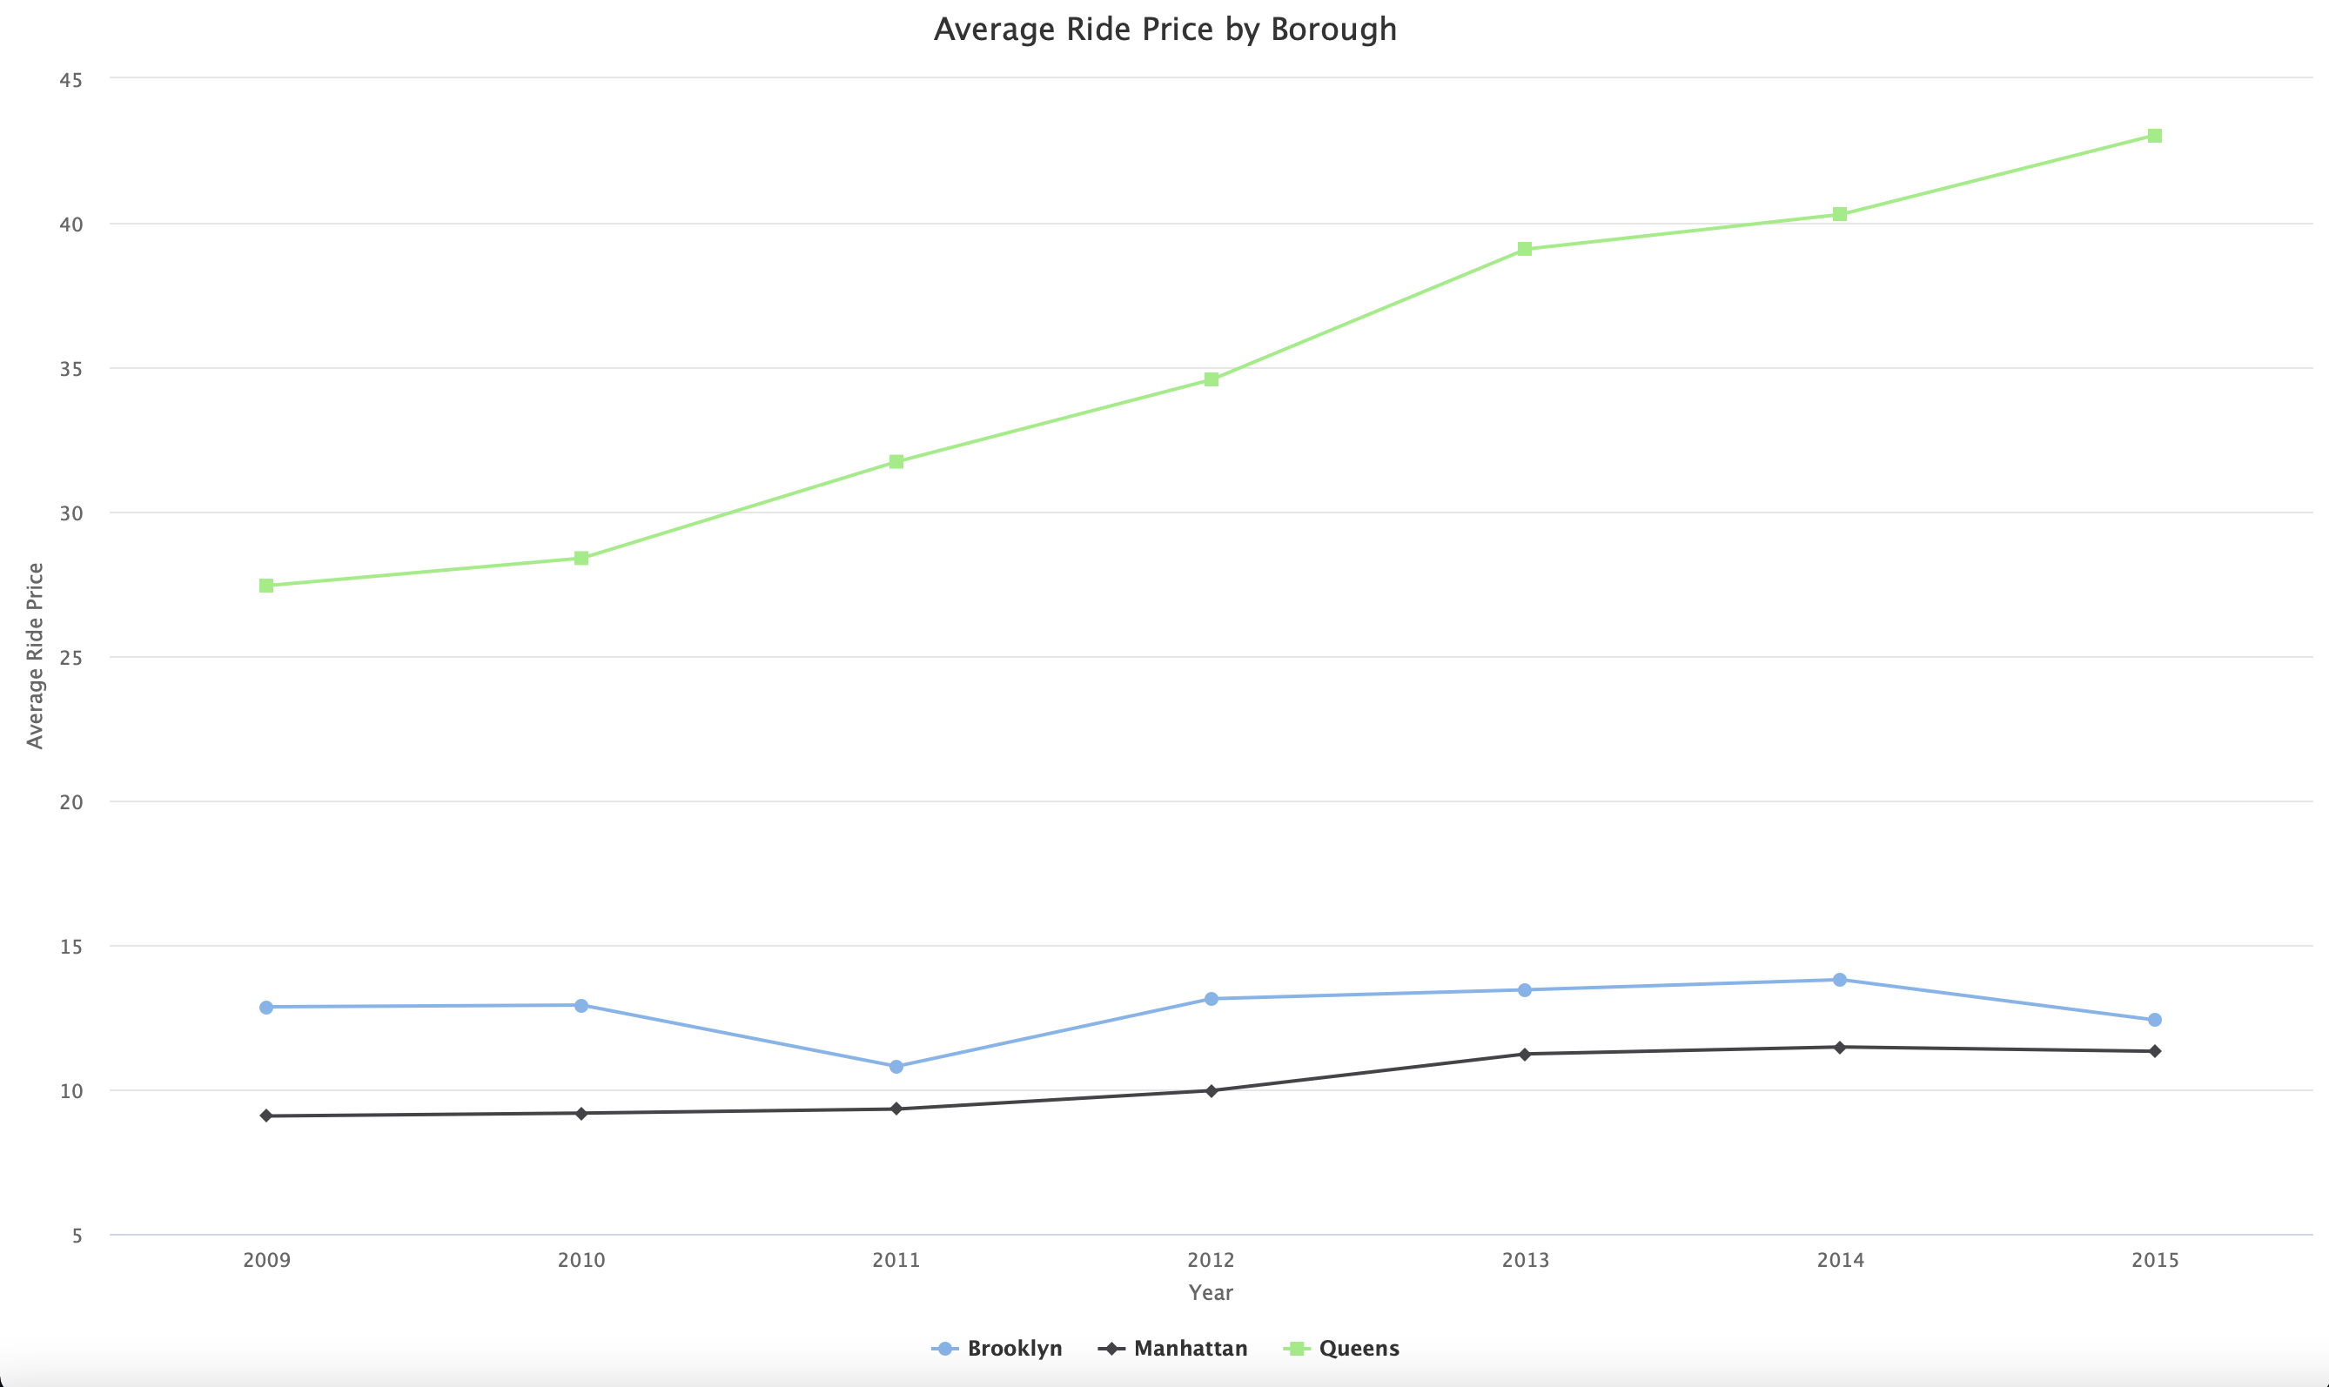
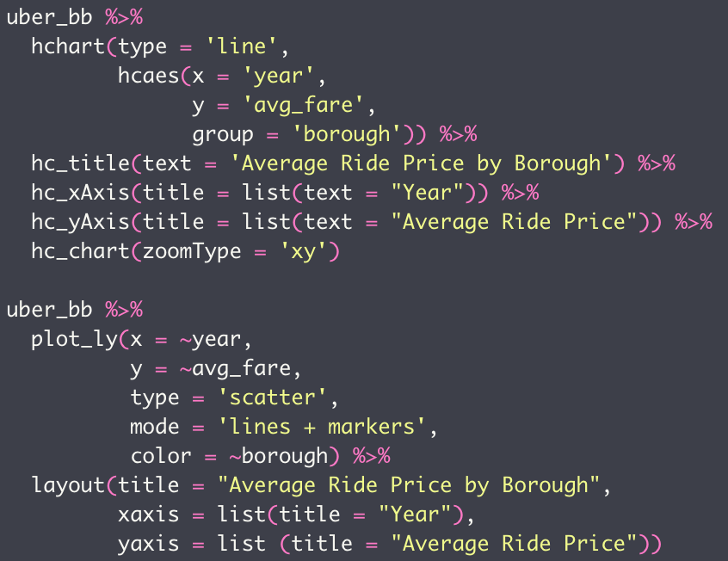
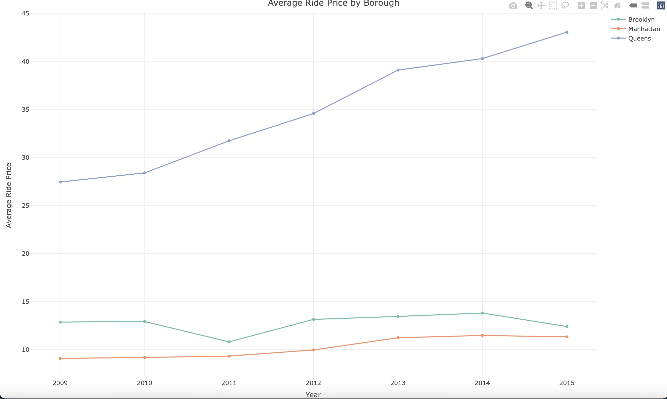
Highcharter vs Plotly (looks pretty similar, right?)

Slide 5
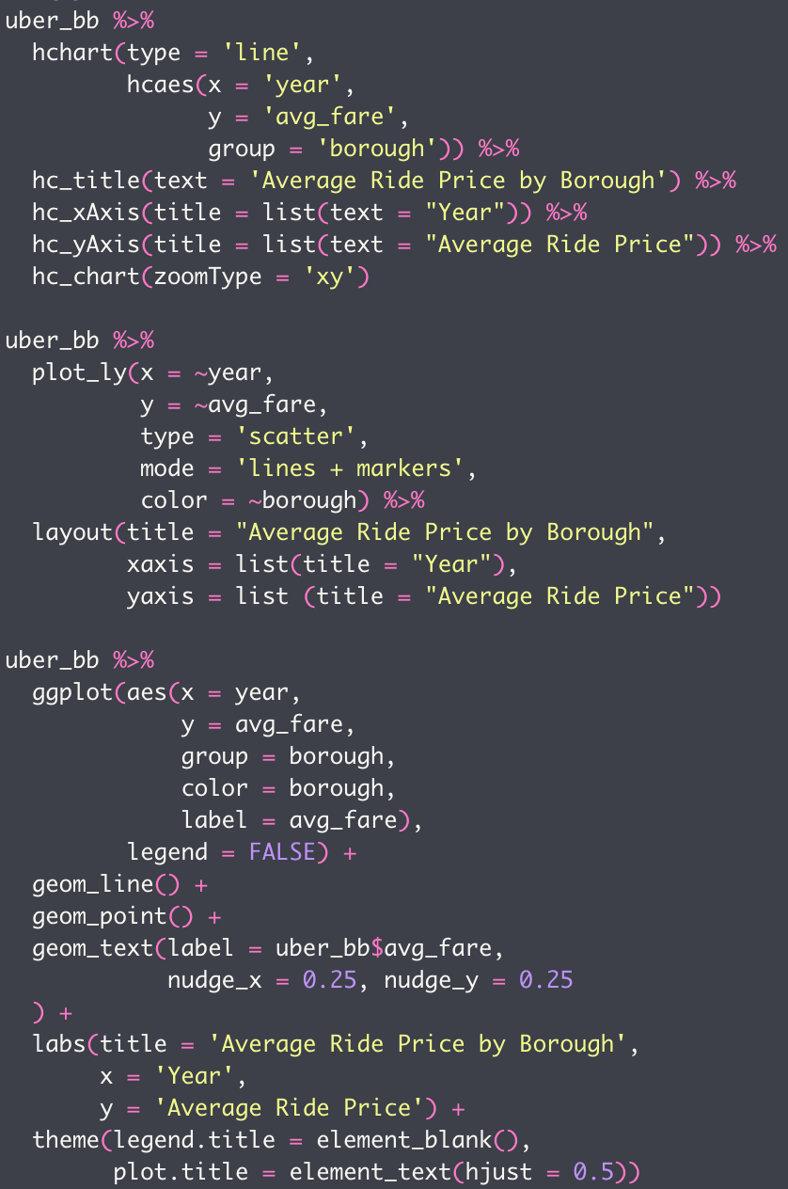
Highcharter vs Plotly vs ggplot2
Highcharter
😊
Plotly
🙂
ggplot2…
😐

Slide 6
Live demo with NYC Uber data!

