Slide 1
Plots in SAS
Boxplot, Lollipop graph, Scatterplot, Survival plot
-SGPLOT, GCHART, SGPANEL, LIFETEST
Xiaoyue Ma
Research Biostatistician II
Weill Cornell Medicine
Division of Biostatistics and Epidemiology, Department of Healthcare Policy & Research 402 E. 67th Street / C2 – LA0001B, New York, NY 10065
T: (646) 962-8029
xim2008@med.cornell.edu
05.23.2019

Slide 2
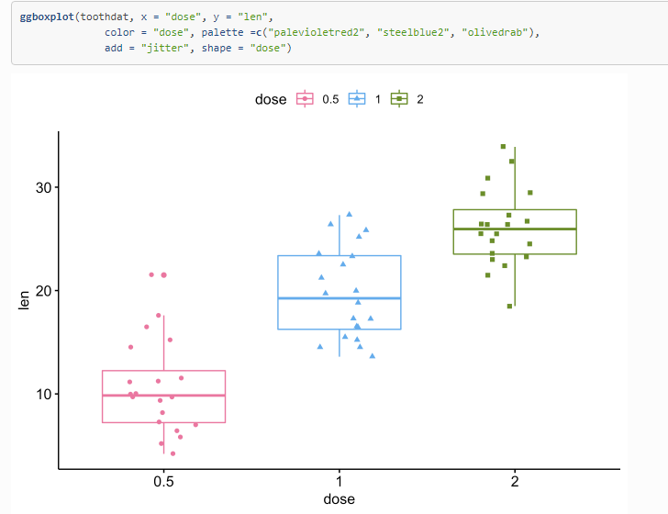
Boxplot

Slide 3
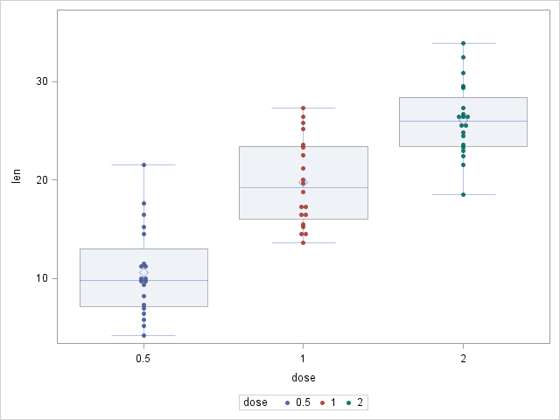
proc sgplot data=toothdat;
vbox len / category=dose boxwidth=0.8 transparency=0.7; *boxplot;
scatter x=dose y=len / jitter transparency=0.1
markerattrs=(symbol=CircleFilled size=5) group=dose; *scatterplot;
run;

Slide 4
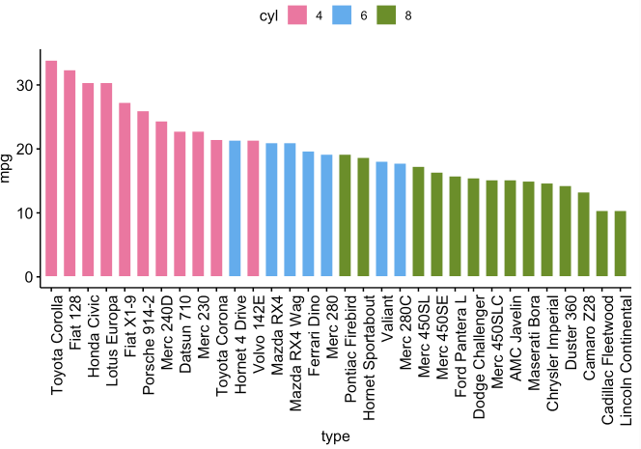
Bar graphs

Slide 5
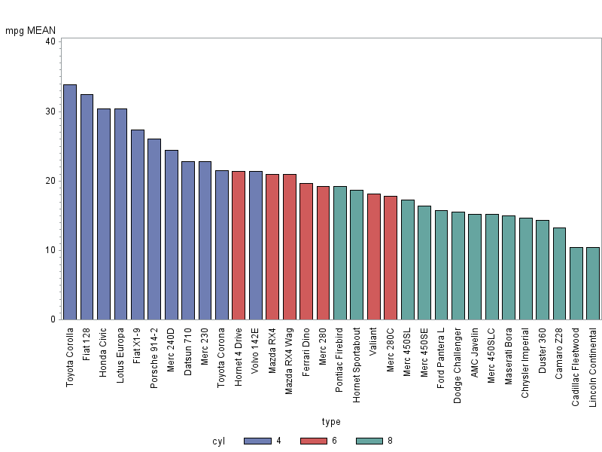
axis1 value=(a=90 width=0.5);
proc gchart data=mtdat2;
vbar type/type=mean sumvar=mpg descending subgroup=cyl maxis=axis1 space=1;
run;

Slide 6
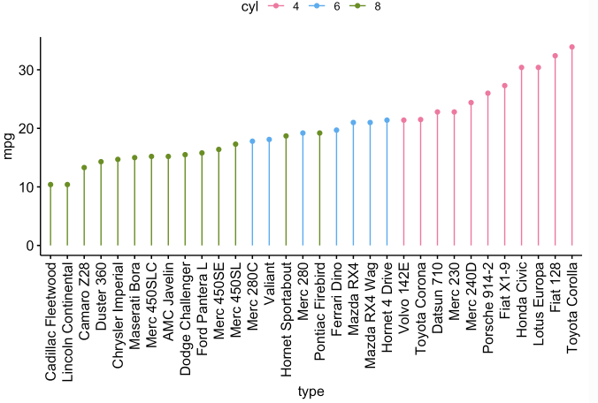
Lollipop graph

Slide 7
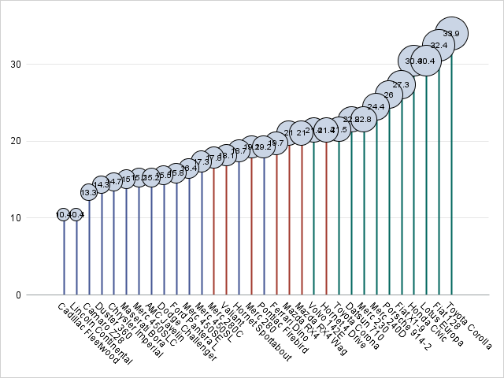
proc sort data=mtdat;
by mpg;
run;
proc sgplot data=mtdat noautolegend noborder;
needle x=type y=mpg / group=cyl lineattrs=(thickness=2) baselineattrs=(thickness=0);
bubble x=type y=mpg size=mpg/bradiusmin=8 datalabel datalabelpos=center;
xaxis display=(nolabel noticks);
yaxis offsetmin=0 display=(nolabel noticks noline) grid;
run;

Slide 8
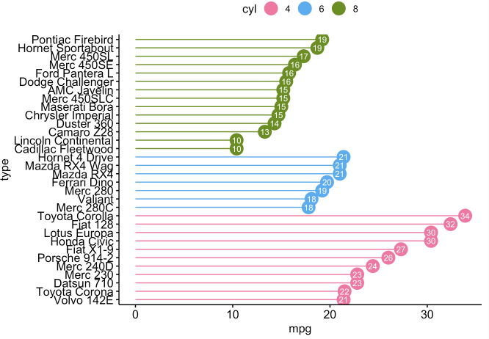
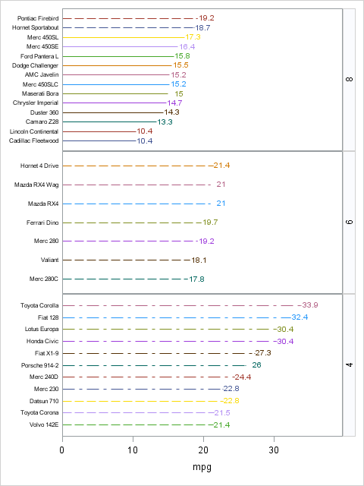
data test;
set test;
zero=0; run;
proc sgpanel data=test;
panelby cyl/ layout=rowlattice novarname uniscale=column sort=descending;
highlow y=type low=zero high=mpg / group=type;
scatter y=type x=mpg / group=type markerattrs=(symbol=circlefilled) markerchar=mpg;
colaxis offsetmin=0;
rowaxis display=(nolabel noticks) valueattrs=(size=6);
run;

Slide 9
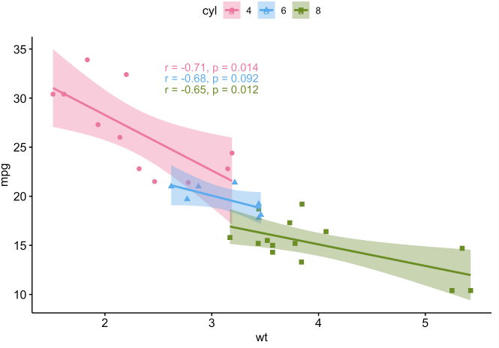
Scatterplot

Slide 10
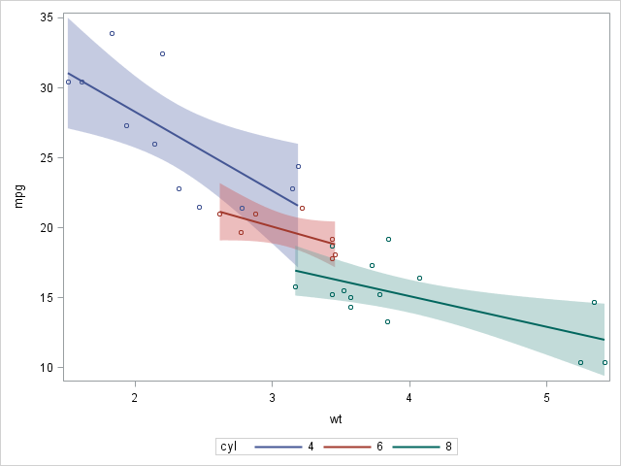
proc sgplot data=mtdat;
reg y=mpg x=wt /clm group=cyl clmtransparency=0.6 markerattrs=(size=5);
run;

Slide 11
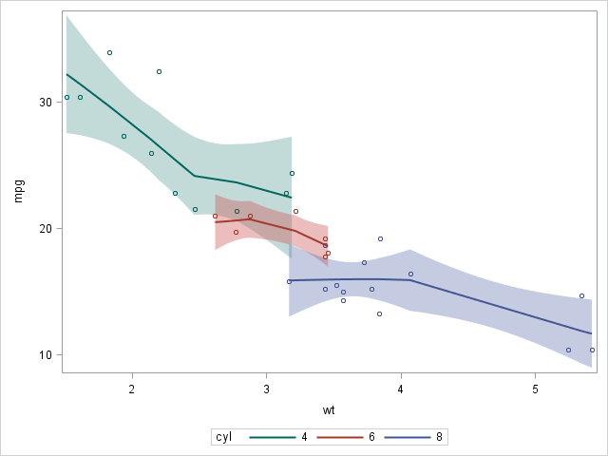
proc sgplot data=mtdat;
loess y=mpg x=wt /clm group=cyl degree=1 markerattrs=(size=5) CLMTRANSPARENCY=0.6;
run;

Slide 12
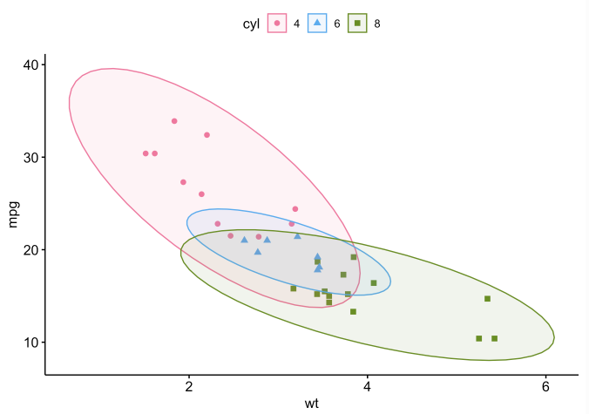
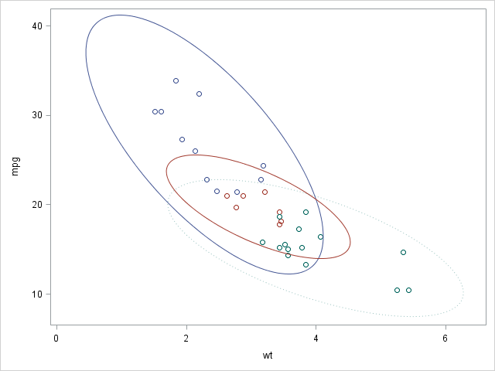
data test; set mtdat;
if cyl="4" then do; mpg_4=mpg; wt_4=wt; end;
if cyl="6" then do; mpg_6=mpg; wt_6=wt; end;
if cyl="8" then do; mpg_8=mpg; wt_8=wt; end; run;
proc sgplot data=test noautolegend;
scatter y=mpg x=wt /group=cyl jitter;
ellipse y=mpg_4 x=wt_4 ;
ellipse y=mpg_6 x=wt_6 ;
ellipse y=mpg_8 x=wt_8 /lineattrs=(pattern=dot) TRANSPARENCY=0.6;
run;

Slide 13
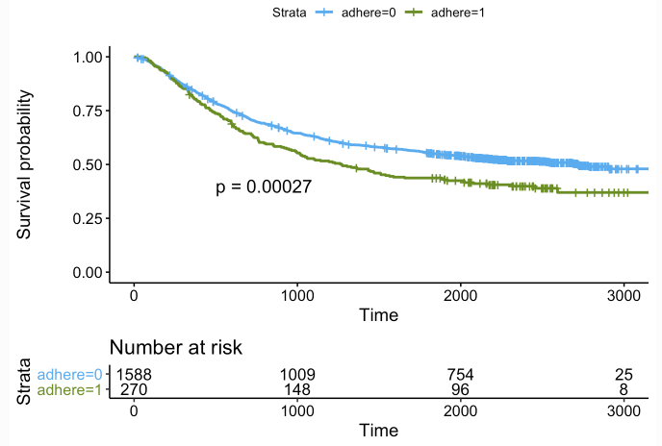
Survival plot

Slide 14
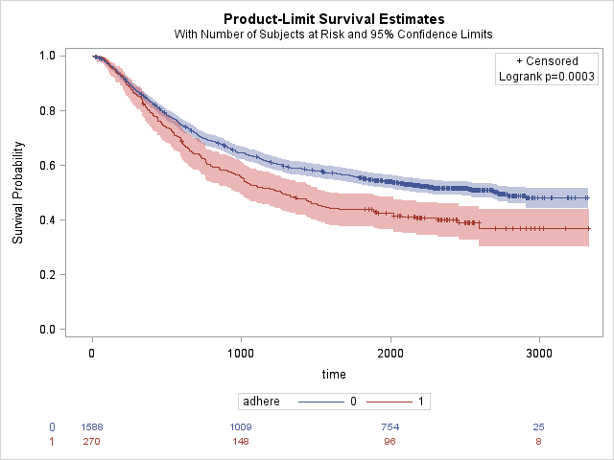
proc lifetest data=colon plot=survival(cl atrisk(outside) test);
time time*status(0); /*put the censor value in the bracket*/
strata adhere/ test=logrank;
run;

Slide 15
Reference:
R plot: https://wcm-computing-club.github.io/file_slides/201904_Cooley_Visualization_in_R.html#introduction
Violin plot: https://blogs.sas.com/content/graphicallyspeaking/2012/10/30/violin-plots/#prettyPhoto
Lollipop chart: https://blogs.sas.com/content/graphicallyspeaking/2017/07/24/lollipop-charts/#prettyPhoto
Ellipse: https://blogs.sas.com/content/iml/2014/07/21/add-prediction-ellipse.html

