Slide 1

An Intro to Regex in R
Alan Wu

Slide 2
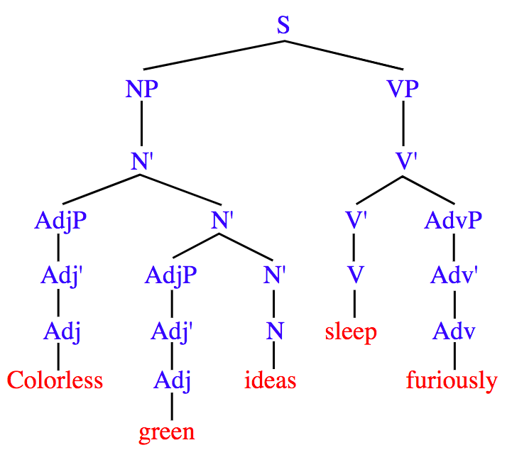
What is regex?
“Regular expression”
Sequence of characters that define a search pattern
^\(\d{3}\)\s\d{3}-\d{4}
(###) ###-####
“Regular” refers to a language being definable by certain regular rules
Notes:
Regex is short form for regular expression
What a regular expression is, is a sequence of characters that define a search pattern

Slide 3
What should I regex?
Strings
Notes:
The whole point of regex is for you to more easily characterize strings. Anything that is composed of characters, digits, or punctuation is the target of regex.

Slide 4

When should I use regex
Use for
Multiple, related conditions or nested if/else
Stringr/search functions
str_detect(), grepl(): Identify match to a pattern
str_extract(): extract match to a pattern
str_locate(): locate position of pattern
str_replace(), gsub(): replace a pattern
str_split(): split a string using a pattern
Don’t use it when something simpler will suffice
Notes:
Use should use regex when you have multiple conditions that are related or nested
What do I mean by related? Related mean that they are close variations of each other, like misspellings in a text or predictable variations like study ids between a certain number
Obviously if it’s a very straightforward if/then or contains/grepl use that

Slide 5
Why should I regex?
Flexible and structured
“Rename visit IDs with either between one and three spaces in their names”
“Instances of ‘Pred’, ‘Prad’, ‘Pren’...”
“Find all study IDs that start with a 9 and end with a 0”
Clearer and easier to understand (when done right)
Cleaner code
Easier to change/adapt
Reproducibility
Notes:
If you’ve ever had to search for obscure, yet predictable patterns, regex is what you want
The following are examples of times in just the last year that I’ve had very specific but predictable requests
If these ever were to require editting, it would be super easy to edit the regex without having to rewrite a bunch of new code
It’s easier to understand for YOU, because you can read it (and you should comment it), but it’s also easy to explain to someone what you’re doing instead of trying to decipher. This is because it reduces your code length and makes your script shorter to type and replicate
Like everything else there are times when it’s appropriate to use and that’s when it’s easier for you and your audience. Obviously you are your own audience 95% of the time, so you’re the best judge of that
Naturally because of this your code is easier to change and adapt

Slide 6
I’m sold. How do I regex?
Regex | Meaning | Example | Strings detected
^ | Start of a string | ^abc | abc, abcdefg, abc123
$ | End of a string | abc$ | abc, defgabc, 123abc
. | Any character | a.c | abc, acc, a1c
| | Alternation | apple|orange | apple, orange
{...} | Explicit quantifier | ab{2}c | abbc
[...] | Explicit character match | a[bB]c | abc, aBc
(...) | Expression grouping | (abc){2} | abcabc

Slide 7
I’m sold. How do I regex?
Regex | Meaning | Example | Strings detected
\ | Escape key for special characters | \$ | $32.50, pa$$word
\s | Any white-space | [bB]\s[cd] | B c, b d
\w | Any word | ([aeiou])\w+ | alien, elephant, igloo
\d | Any digit | (study_id)\d+ | study_id5, study_id1
\S, \W, \D | The converse of the previous three | (study_id)\D+ | study_idA, study_idf

Slide 8
Looking ahead
More advanced tactics include:
Lookarounds: (?<= … )
“Bradley Cooper” vs. “Cooper Hewitt”
Conditionals: (? (A)B|C)
If A is true, match with B; else match with C
Omitting: s\Kt
Text matched by left of \K is omitted, so only the first “t” in “streets” would be captured

Slide 9
I’m sold. How do I regex?
Regex | Meaning | Example | Strings detected
[a-z] or [:lower:] | Lowercase letters | [^ABZ[:lower:]] | A, B, C, D, c, d
[:upper:] | Uppercase letters | [ABZ[:upper:]] | A, B
[a-zA-Z] or [:alpha:] | Letters | [a-zA-Z]\w+ | Alabama, alabama
[:digit:] | Digits | a[[:digit:]]b | a0b, a1b, a2b
[:alnum:] | Alphanumeric | [[:alnum:]]\w+ | A1b2n, 2bdiC3D,
[:punct:] | punctuation | end[[:punct:]] | end., end,, end!

Slide 10
Let’s look at some code

