Slide 1
What We Learned at rstudio::conf(2020)
Alan Wu

Slide 2
Everything is online
What They Forgot to Teach You about R
https://rstudio-conf-2020.github.io/what-they-forgot/ (slides, exercises, structure)
https://rstats.wtf/ (pure content)
Conference talks
https://resources.rstudio.com/rstudio-conf-2020

Slide 3
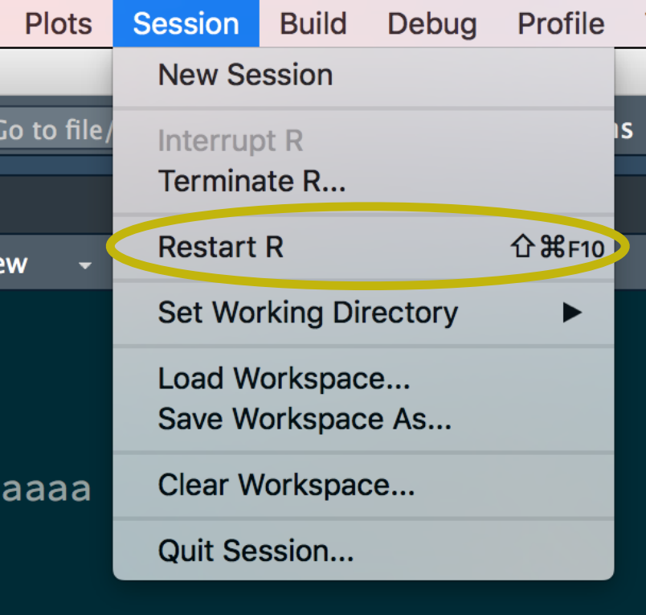
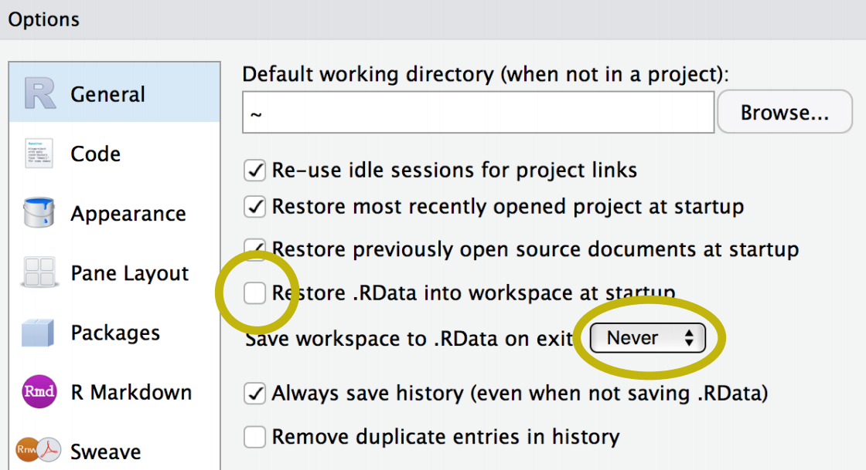
Adopt a project-oriented workflow
Help yourself compartmentalize
Use Projects and the here() package
stable base
Restart R often

Slide 4
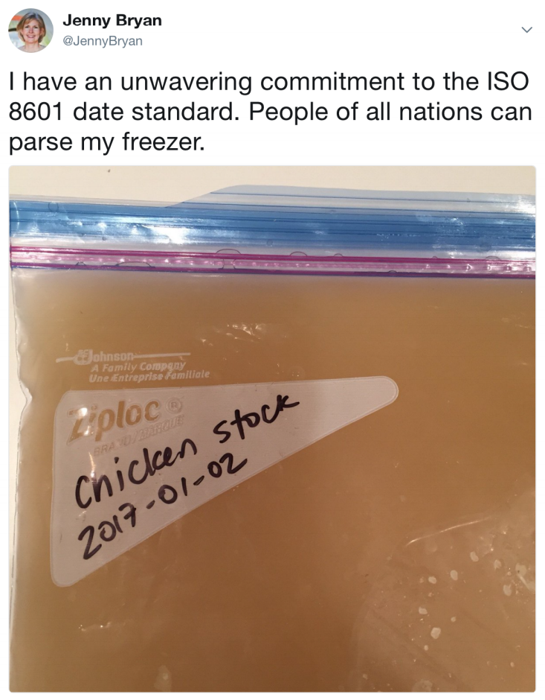
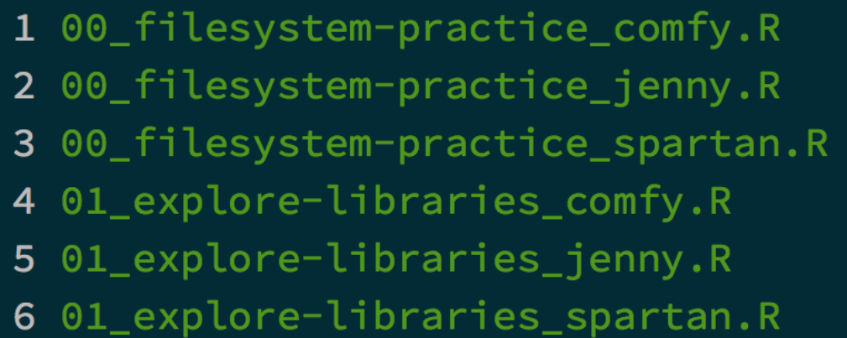
Be a friend to yourself and your machine
Machine readable names
Regex-friendly (avoid spaces, cases, punctuations)
Delimiters
Human readable names
Names contain info
Anticipates context
Play together nicely
Use numerics to sort (left pad with zeros for constant width)
ISO-8601 for dates (YYYY-MM-DD)
No excuses!
Easy to implement now
Payoff increases with time

Slide 5
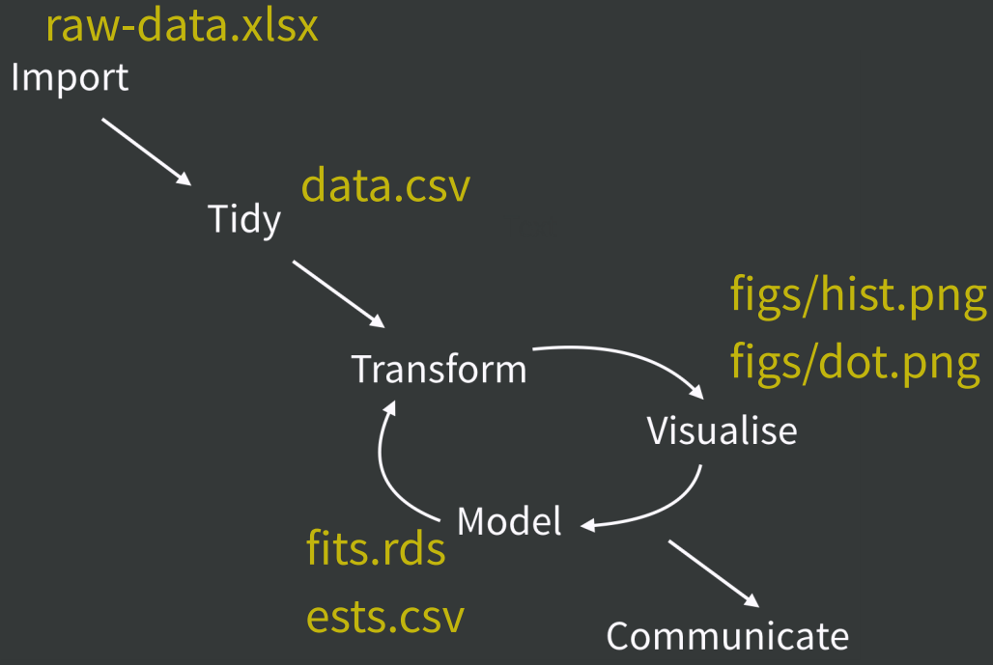
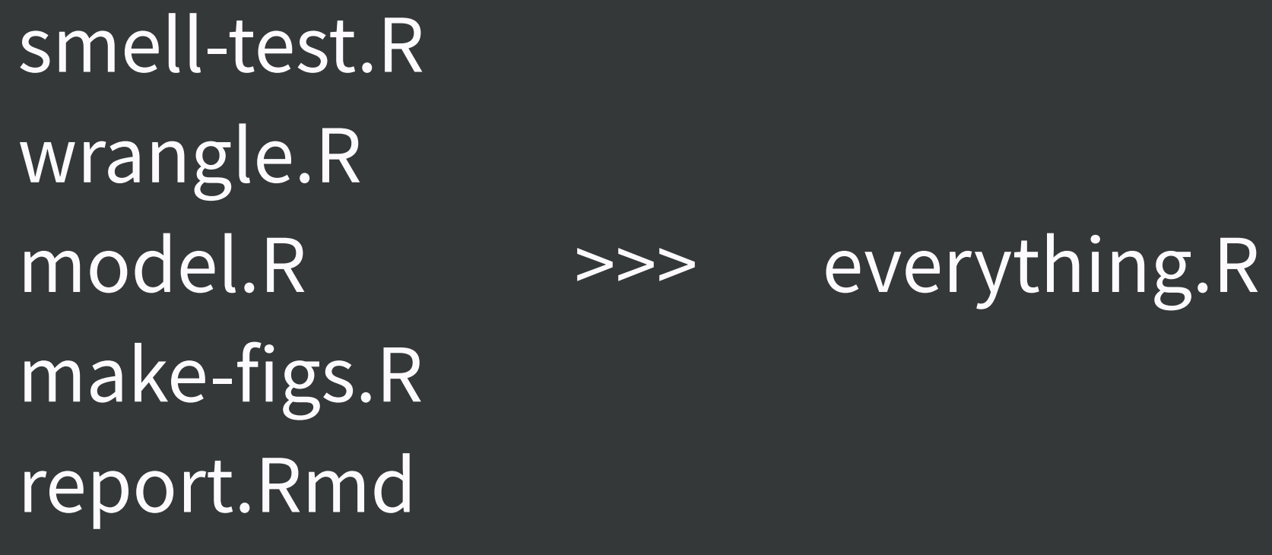
Break up monoliths
Long programs are opaque
Break logic and output into pieces
Helpful for future projects
Smaller chunks help with debugging and exporting

Slide 6
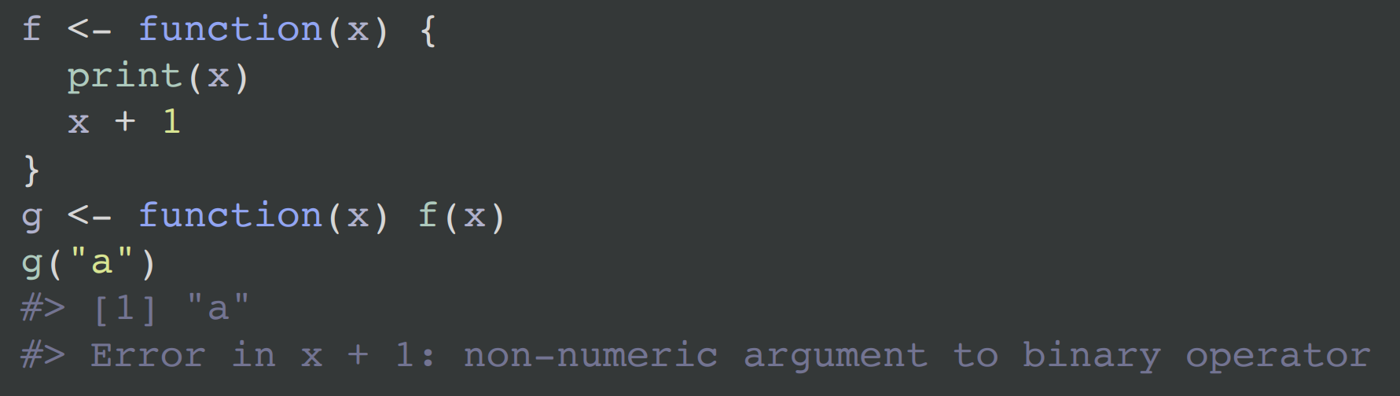
Debugging
Tips:
Google the exact error message
Keyword search community.rstudio.com
Stackoverflow - [r] tag
But given that we’ve tried that….
print()

Slide 7
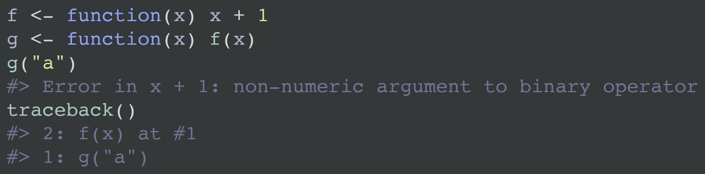
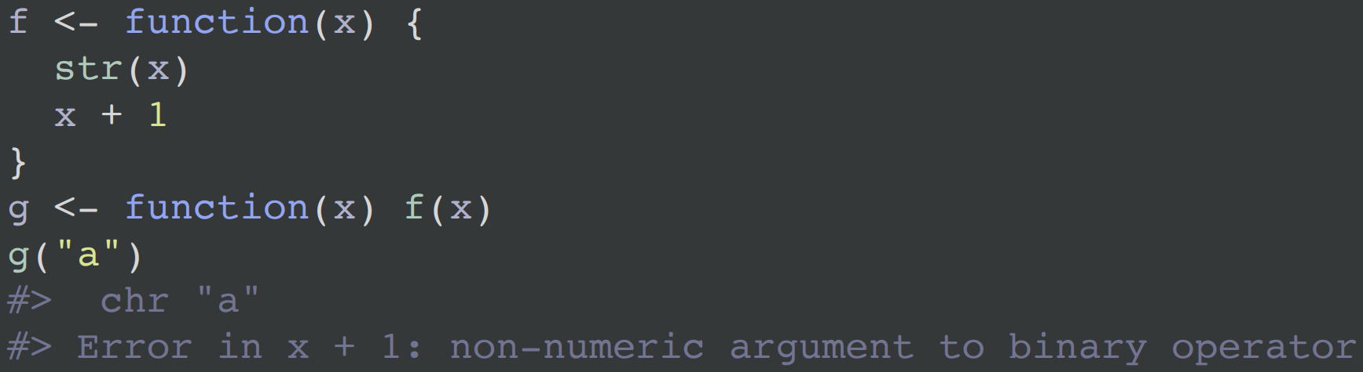
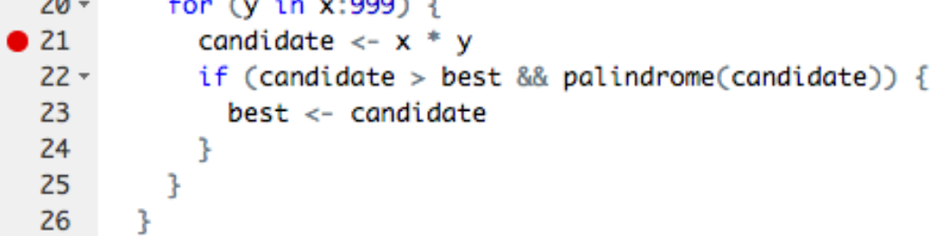
Debugging
More advanced techniques:
traceback()
str()
browser() or breakpoints
Step through functions
Use ls(), print(), and str() to understand what environment looks like

Slide 8
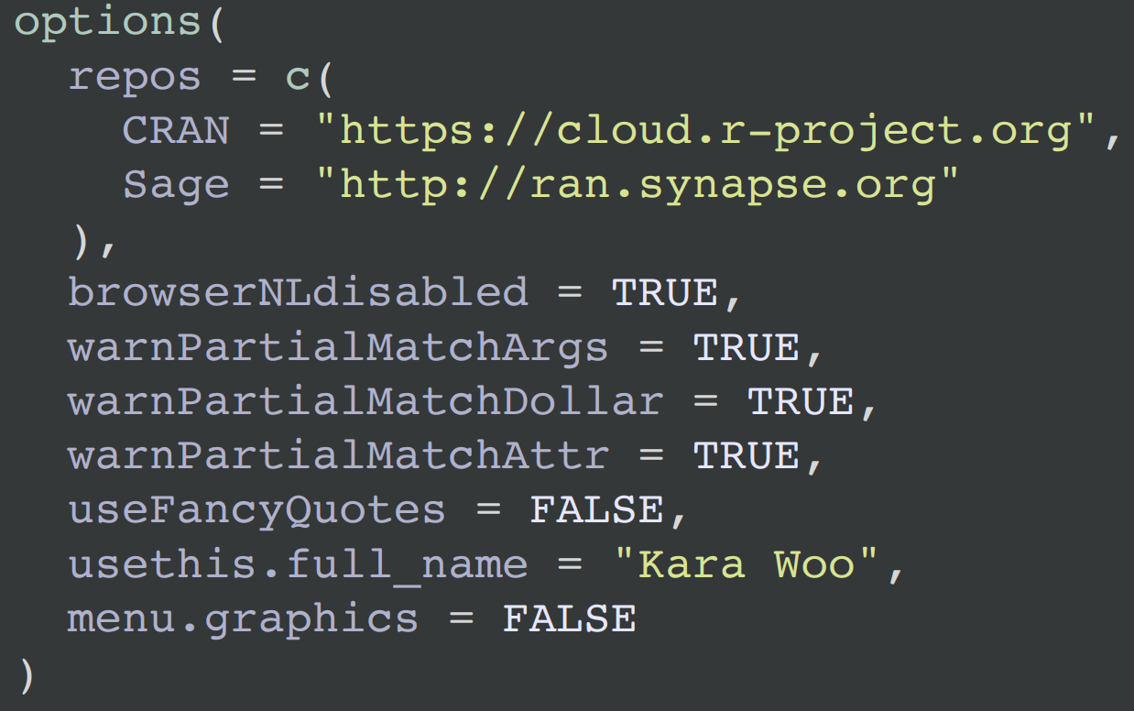
Customizing R
.Rprofile runs every session
Set default CRAN mirror
Write a welcome message
Customize R prompts
Options, screen width, numeric display*
Aliases/shortcuts for frequently used functions*
Be aware when sharing code
* with caution

Slide 9
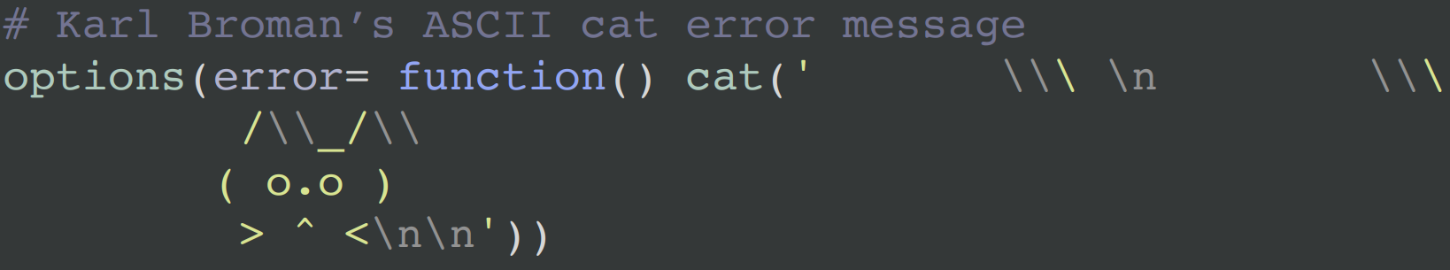
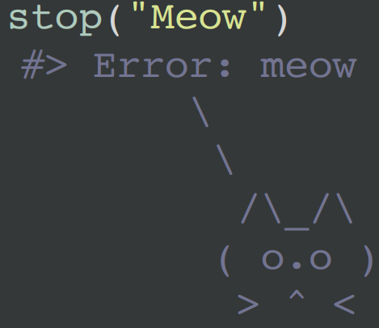
Customizing R

Slide 10
Thanks!
Credit to Kara Woo, Jenny Bryan, and Jim Hester
https://rstudio-conf-2020.github.io/what-they-forgot/

