Slide 2
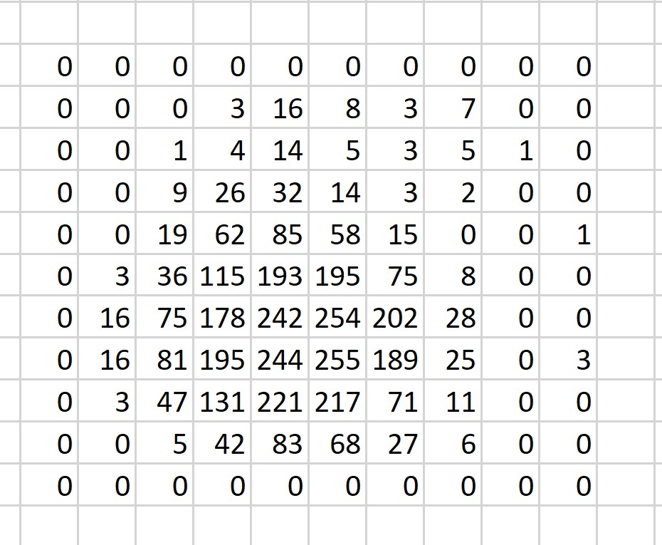
Slide Across Row Until Edge is Detected

Slide 3
Create a “Bar” going out to the end of the edge of the blob

Slide 4

Slide the bar down row

