Slide 1
This was a triumph. I'm making a note here: huge success. It's hard to overstate My satisfaction. Aperture Science. We do what we must Because we can. For the good of all of us. Except the ones who are dead. But there's no sense crying Over every mistake. You just keep on trying Till you run out of cake. And the Science gets done. And you make a neat gun. For the people who are Still alive. I'm not even angry. I'm being so sincere right now. Even though you broke my heart. And killed me. And tore me to pieces. And threw every piece into a fire. As they burned it hurt because I was so happy for you! Now these points of data Make a beautiful line. And we're out of beta. We're releasing on time. So I'm GLaD. I got burned. Think of all the things we learned For the people who are Still alive. Go ahead and leave me. I think I prefer to stay inside. Maybe you'll find someone else To help you. Maybe Black Mesa... THAT WAS A JOKE, HA HA, FAT CHANCE. Anyway this cake is great It's so delicious and moist Look at me still talking when there's science to do When I look out there It makes me GLaD I'm not you. I've experiments to run There is research to be done On the people who are Still alive. And believe me I am still alive I'm doing science and I'm still alive I feel FANTASTIC and I'm still alive While you're dying I'll be still alive And when you're dead I will be still alive Still alive Still alive.
Well here we are again It's always such a pleasure Remember when you tried to kill me twice?
Oh how we laughed and laughed Except I wasn't laughing Under the circumstances I've been shockingly nice
You want your freedom? Take it That's what I'm counting on I used to want you dead but Now I only want you gone
She was a lot like you (Maybe not quite as heavy) Now little Caroline is in here too
One day they woke me up So I could live forever It's such a shame the same will never happen to you
You've got your short sad life left That's what I'm counting on I'll let you get right to it Now I only want you gone
Goodbye my only friend Oh, did you think I meant you? That would be funny if it weren't so sad
Well you have been replaced I don't need anyone now When I delete you maybe I'll stop feeling so bad
Go make some new disaster That's what I'm counting on You're someone else's problem Now I only want you gone (×3)
APERTURE
L A B O R A T O R I E S

Slide 2
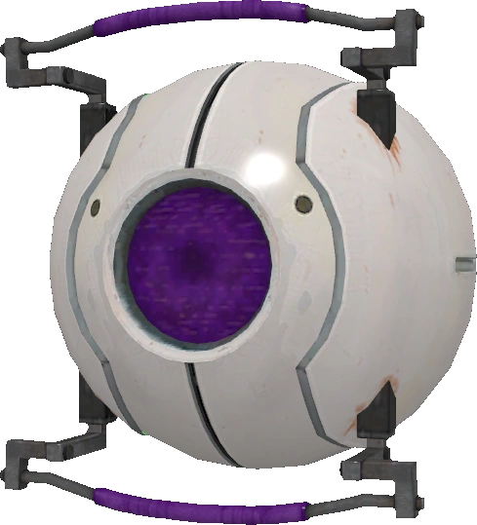
01
Introduction
Goals: Examine the relationships between taxation levels and housing code violations.
Tools:
Tableau
Data Visualization
RStudio
Wrangling and Cleaning
US Census Geocoder
Location Data Creation

Slide 3
02
Datasets
Real Property Tax 2024 : Data Montgomery
~345,000 Cases, 75 Variables
Housing Code Violations :Data Montgomery
~935,000 Cases, 24 Variables

Slide 4
03
Cleaning Summary
Tax Variables
Remove Commas and Currency Symbols
Outlier Filtering
Violation Tallying

Slide 5
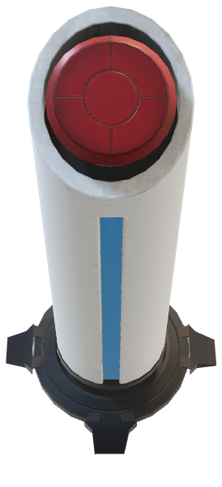

Slide 6
04
Reflection
Difficulties
Engineering Questions
Optimizing Visualizations
Rewarding
Learning PowerPoint
Better understanding Tableau
Recommendations
Take your own look around!

Slide 7
Thank You to:
For Your Education and Feedback:
Prof. Mais Alraee
Dr. Lori Perine
Dr. Rachel Saidi
Prof. Bonard Molina-Garcia
My Classmates
Special Thanks To:
Paul Hanscom
Lily Chang
Dr. Lomax Boyd
05
Thanks!

Slide 8
06
Q & A
APERTURE
L A B O R A T O R I E S

