Slide 1

Gain and Phase Analyzer
May 8, 2015
Notes:
Kaidi

Slide 2

Team
Chris Pavlina
Electrical Engineer, Team Lead
Harrison Owens
Computer Engineer
Ken Zach
Computer Engineer
Kyle Temkin
Faculty Advisor
Notes:
Kaidi

Slide 3
Agenda
Purpose
Requirements
Design
PCB
GUI
Schedule
Budget
Final Steps
Notes:
Kaidi

Slide 4
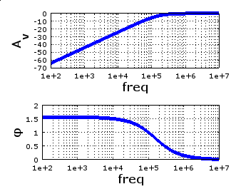
Purpose
Test the performance of filters, amplifiers
Generate Bode plot with
amplitude and phase
Notes:
Kaidi

Slide 5

Uses
Education
Testing, design, characterization of:
Signal filters
Signal amplifiers
Control systems
Notes:
Chris

Slide 6
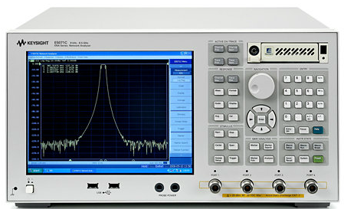
Why?
Current state of industry
  Large
  Expensive
  Learning curve
  Students can’t see how it works!
Our Goal
  Portable
  Cost around $200
  Easy to use for students and teachers
  Open source
Image: Keysight Technologies, “E5071C ENA Series Network Analyzer”
Notes:
Chris

Slide 7
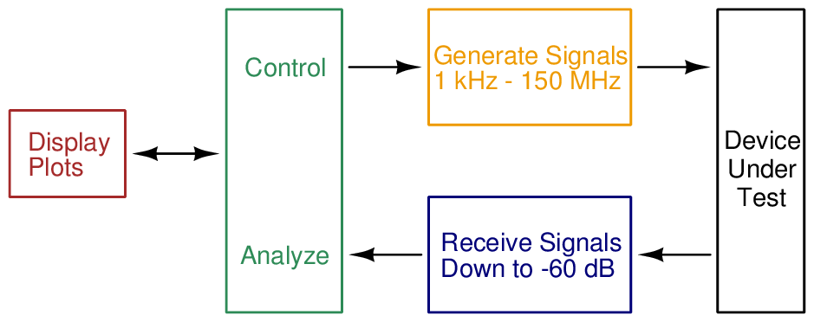
Requirements
Notes:
Chris

Slide 8
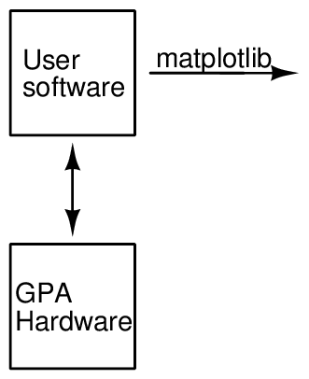
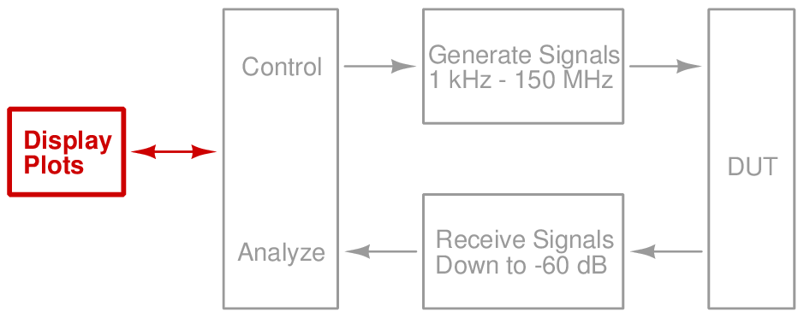
Design
Software
Notes:
Harrison

Slide 9
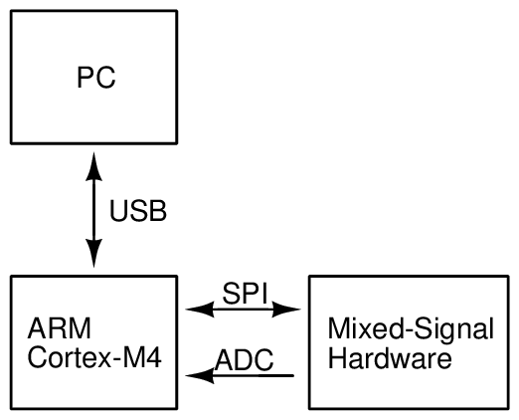
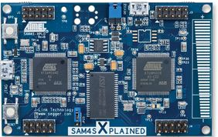
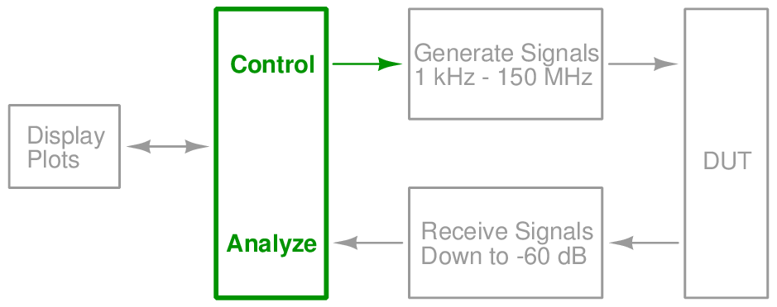
Design
Microcontroller
Notes:
Harrison

Slide 10
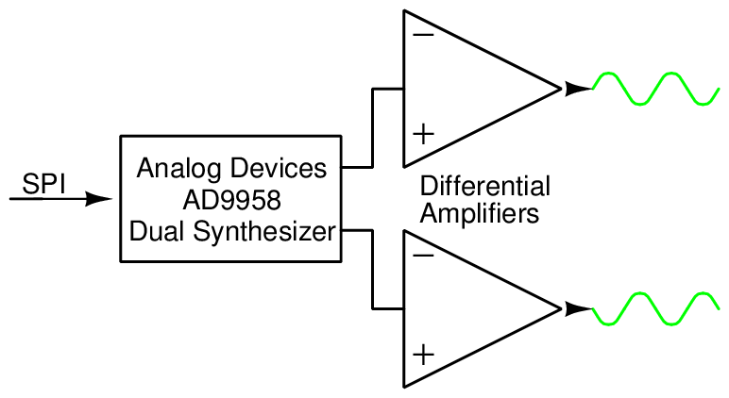
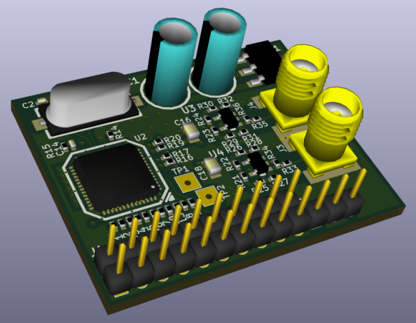
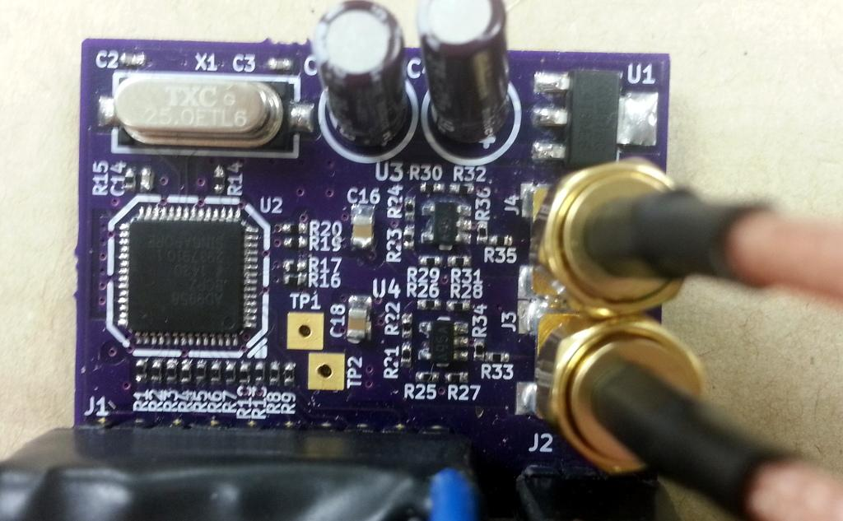
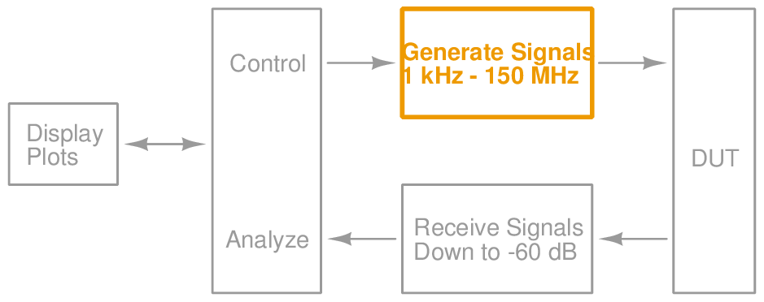
Design
Signal Generation
Notes:
Ken

Slide 11
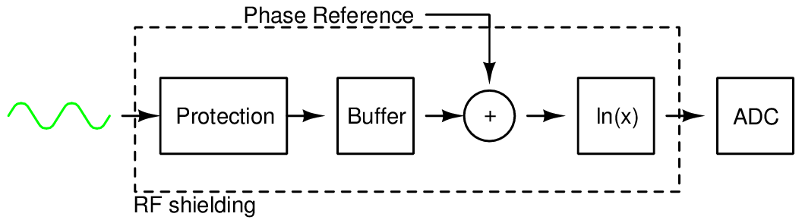
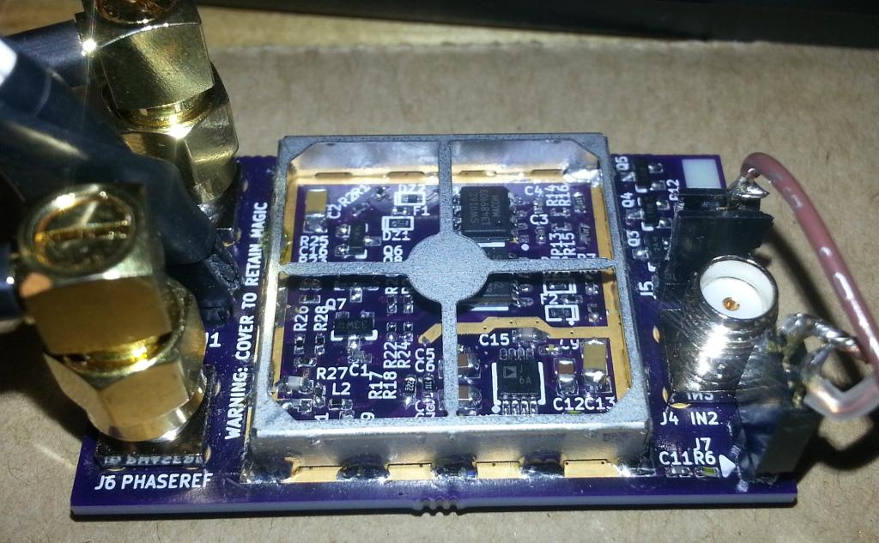
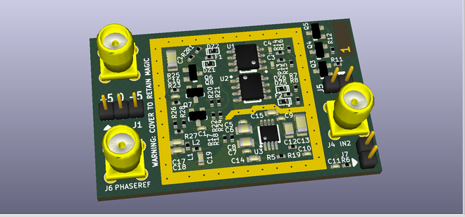
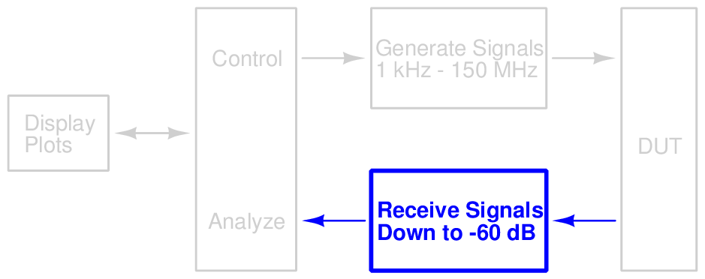
Design
Detection
Notes:
Chris

Slide 12
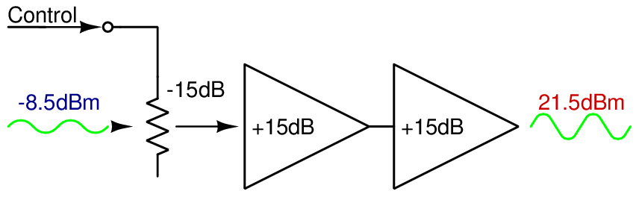
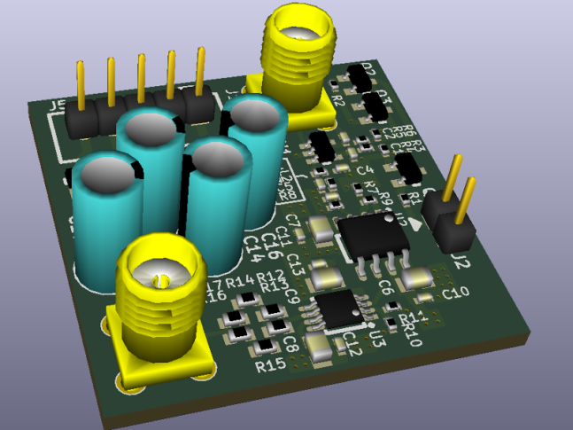
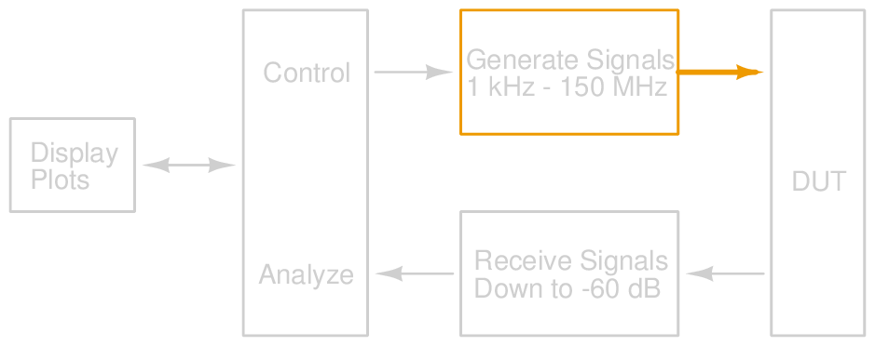
Design
Signal Output
Notes:
Ken

Slide 13
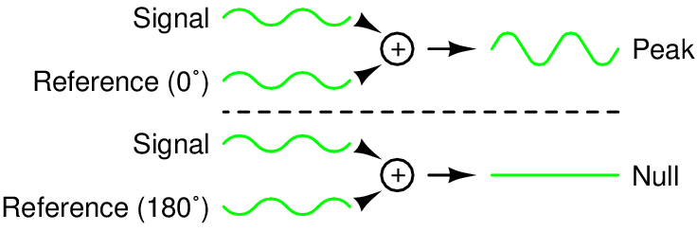
Design
Phase Detection
Notes:
Chris

Slide 14
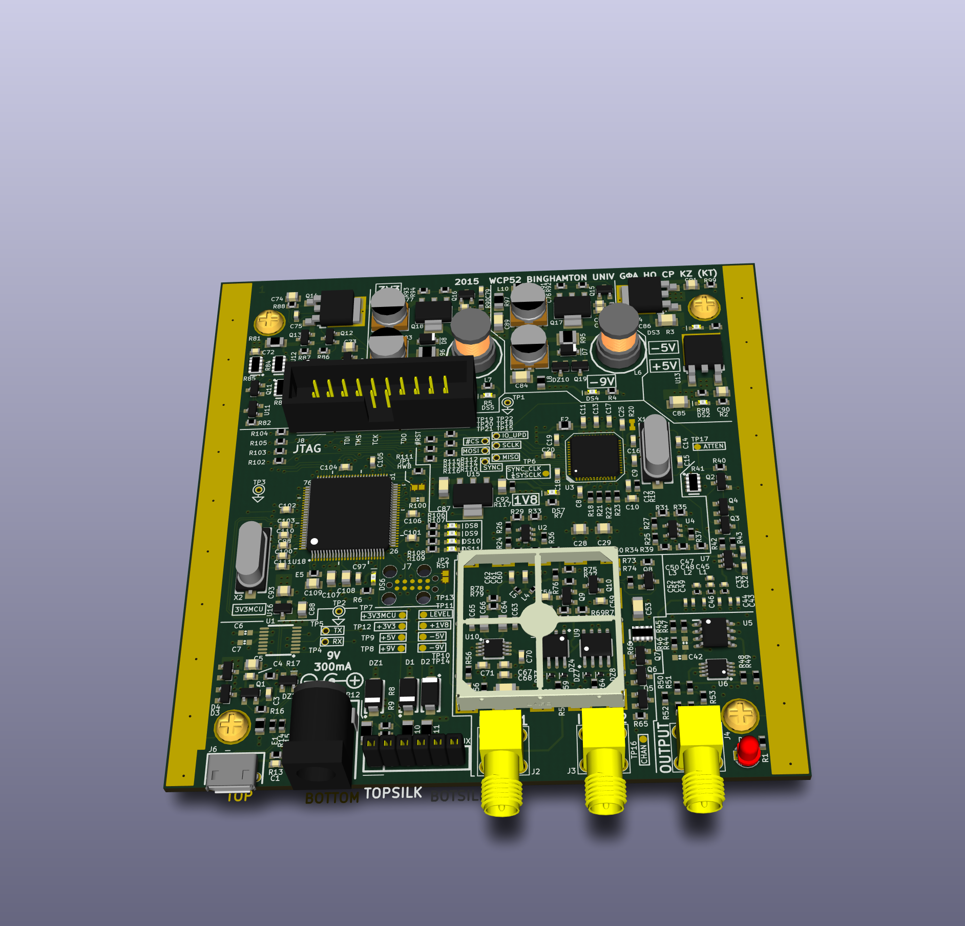
Design — PCB
Notes:
Harrison

Slide 15
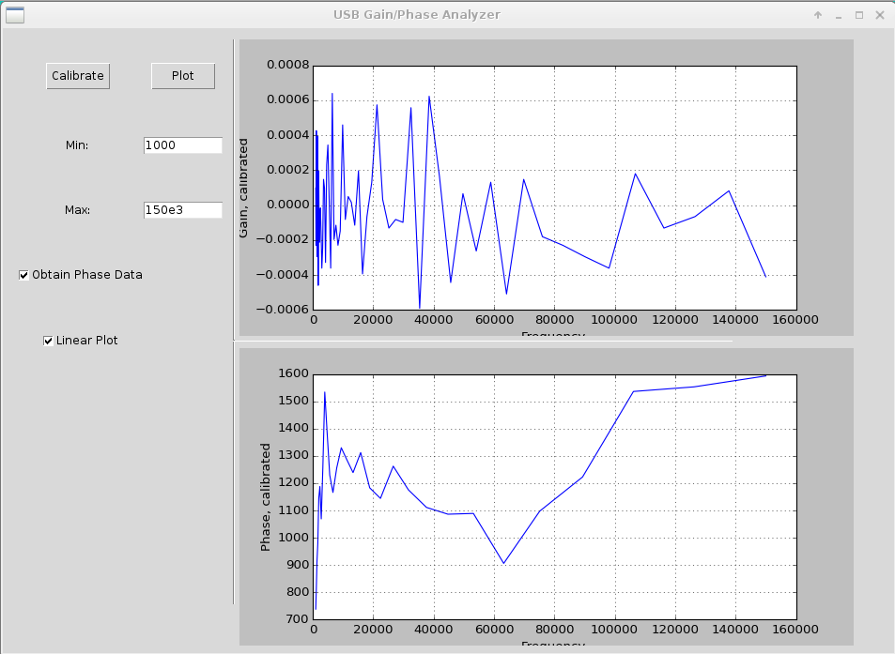
Design
GUI
Notes:
Harrison

Slide 16
Schedule
Item | Completed
Specification | October 17, 2014
Development plan | October 31, 2014
Prototypes built | December 5, 2014
Interim | December 5, 2014
Prototypes corrected | February 26, 2015
Final PCB layout | March 14, 2015
Alpha firmware completed | March 19, 2015
PCB assembled | April 8, 2015
PC software completed | April 30, 2015
Notes:
Harrison

Slide 17
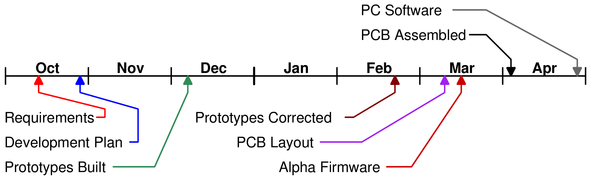
Timeline
Notes:
Harrison

Slide 18
Budget
Item | Expended | Actual | Estimated to Completion | Estimated at Completion
Synth. proto. | $60 | $60 | $0 | $60
Input proto. | $70 | $70 | $0 | $70
Amp proto. | $91 | $91 | $0 | $91
Final build | $210 | $210 | $0 | $210
Enclosure | $21 | $21 | $0 | $21
Total | $452 | $452 | $0 | $452
Notes:
Harrison

Slide 19
Future Plans
Board design is finalized and can be assembled by pick and place
Second revision may be necessary
    BOM cost can be lowered
        Software can be enchanced with more analysis functions be made more compatible with existing packages
Notes:
Ken

Slide 20
Conclusion
Product can capture Bode plots
Uses signal synthesizer, output amplifier, input frontend, ADC, and microcontroller
These have been prototyped and tested
Notes:
Kaidi

Slide 21
Demo

