Slide 1
WCP52 USB Gain/Phase Analyzer
Low-cost, open-source gain/phase analyzer
2014-10-31 0

Slide 2
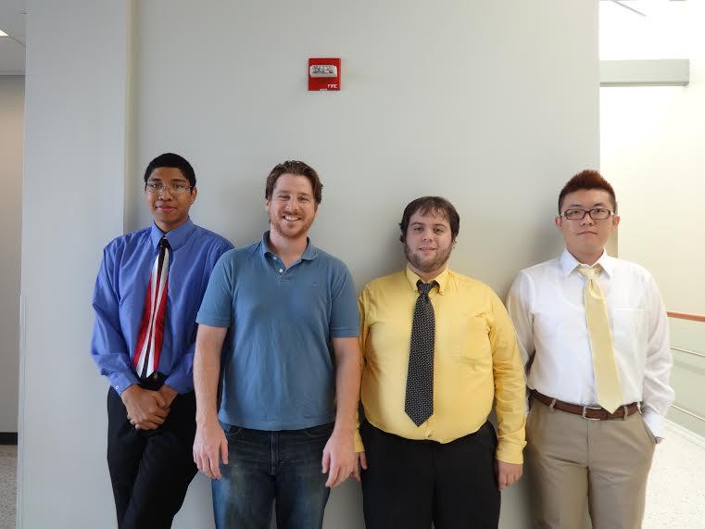
WCP52 USB Gain/Phase Analyzer
Key Personnel
Chris Pavlina- EE Student Team Lead
Kaidi Xu- EE Student
Kenneth Zachary- CoE Student
Harrison Owens- CoE Student
Prof. Kyle Temkin- Faculty Advisor
Prof. Maynard - Program Manager
[Pictured Left to Right: Harrison Owens,Kenneth Zachary,Chris Pavlina, Kaidi Xu]
2014-10-31 1

Slide 3
WCP52 USB Gain/Phase Analyzer
Executive Summary
We are creating a USB driven device that analyzes the frequency response of filters, amplifiers, and control systems and creates a corresponding Bode Plot of the analysis.
2014-10-31 2

Slide 4
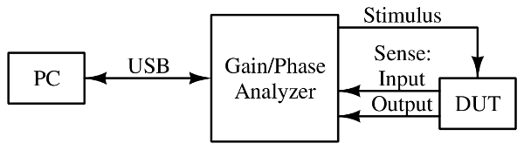
WCP52 USB Gain/Phase Analyzer
Context Diagram
2014-10-31 3

Slide 5
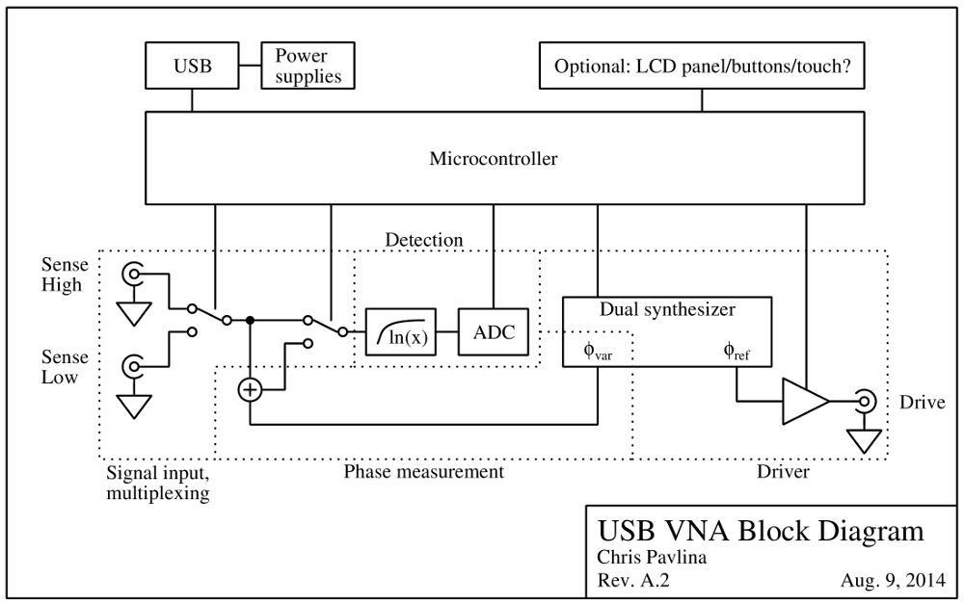
WCP52 USB Gain/Phase Analyzer
System Diagram
2014-10-31 3

Slide 6
WCP52 USB Gain/Phase Analyzer
Major Milestones Fall
100% Project Launch: 2012‐09‐21
100% Requirements Analysis / SRR: 2014‐10‐17
100% System Design / SDR: 2014‐10‐31
10% Architectural Design / PDR: 2014‐11‐14
0% Detailed Design / CDR: 2014‐12‐05
0% Interim Presentation: 2014‐12‐12
2014-10-31 4

Slide 7
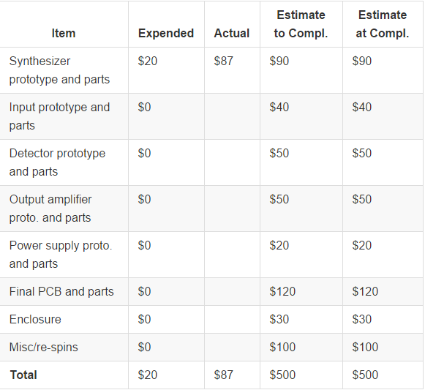
WCP52 USB Gain/Phase Analyzer
Project Finances: 500$
2014-10-31 5

Slide 8
WCP52 USB Gain/Phase Analyzer
Major Issues
Better understand how to interface with the ATSAM4S16C microcontroller
2014-10-31 6

