Slide 1
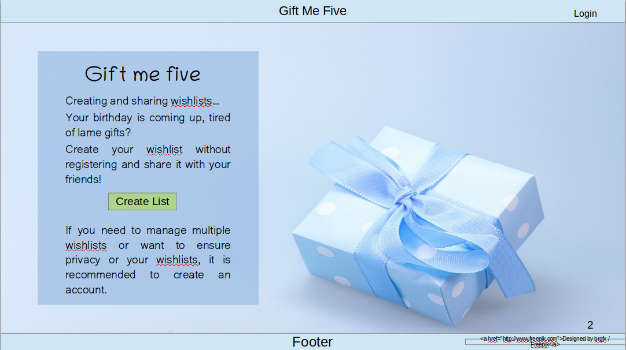
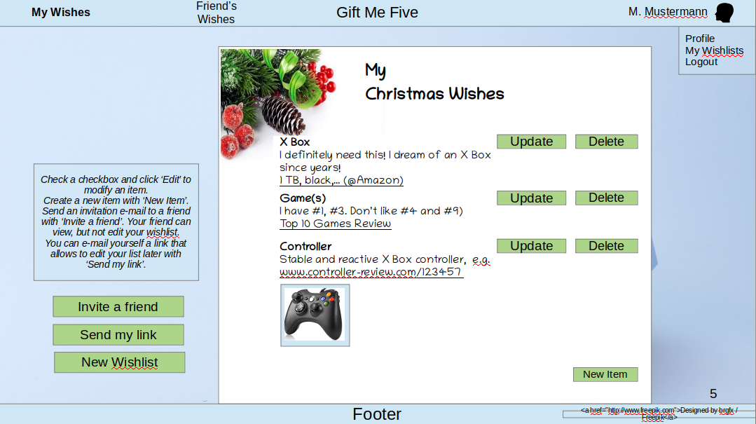
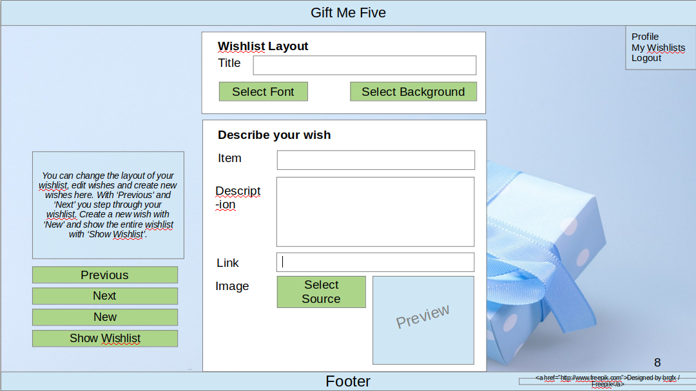
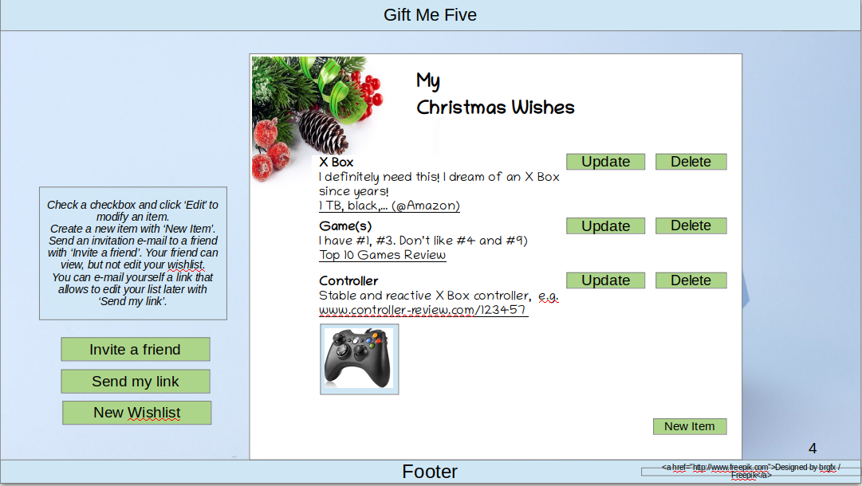
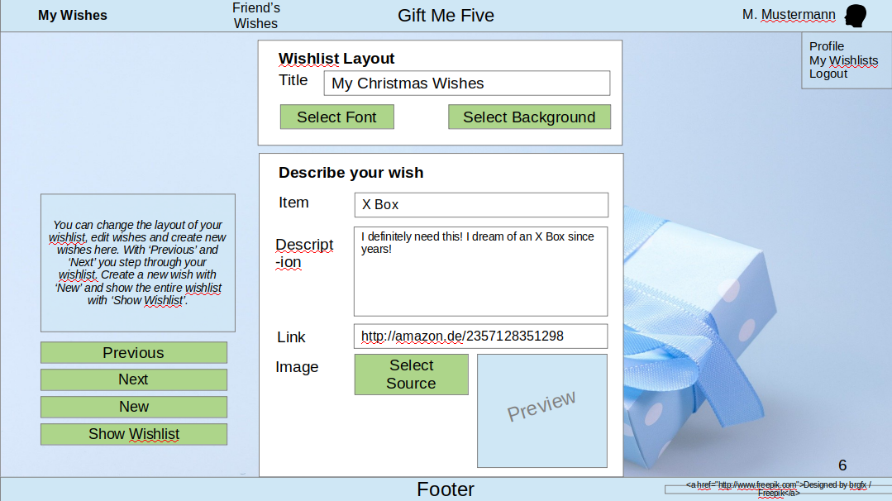
Gift Receiver usage pattern
Login, existing wishlist
Show existing wishlist
Login,no
existing wishlist
Update/
new wishlist
Create wishlist
without login
Show wishlist
Wishlist with unique url
for future access
Create/modify wishlist
Create new wishlist

Slide 2
Start Page
Users can create lists, store and retrieve them under a unique URL without login.
Some functionality only available with login (e.g. selection of items by givers).
Gift Me Five
Login
Creating and sharing wishlists…
Your birthday is coming up, tired of lame gifts?
Create your wishlist without registering and share it with your friends!
If you need to manage multiple wishlists or want to ensure privacy or your wishlists, it is recommended to create an account.
Gift me five
Create List
Footer
<a href="http://www.freepik.com">Designed by brgfx / Freepik</a>

Slide 3
Login popup (The login field appears as popup when user clicks on “Login”
Gift Me Five
Login
Username:
Password:
Creating and sharing wishlists…
Your birthday is coming up, tired of lame gifts?
Create your wishlist without registering and share it with your friends!
If you need to manage multiple wishlists or want to ensure privacy or your wishlists, it is recommended to create an account.
Gift me five
Forgot Pwd
Log in
Create List
Footer
<a href="http://www.freepik.com">Designed by brgfx / Freepik</a>

Slide 4


View own wishlist with unique url
(Without logging in) By using the appropriate URL, users will see the status of their wishlist. If they create multiple lists, users need to keep track of the different URLs of their wishlists. If the user clicks on ‘New Wishlist’, he will not be able to access the old wishlist without the URL! (Therefore a warning should be given where the url is displayed for copying)
Gift Me Five
My
Christmas Wishes
X Box
I definitely need this! I dream of an X Box since years!
1 TB, black,… (@Amazon)
Game(s)
I have #1, #3. Don’t like #4 and #9)
Top 10 Games Review
Controller
Stable and reactive X Box controller, e.g.
www.controller-review.com/123457
Update
Delete
Check a checkbox and click ‘Edit’ to modify an item.
Create a new item with ‘New Item’.
Send an invitation e-mail to a friend with ‘Invite a friend’. Your friend can view, but not edit your wishlist.
You can e-mail yourself a link that allows to edit your list later with ‘Send my link’.
Update
Delete
Update
Delete
Invite a friend
Send my link
New Wishlist
New Item
Footer
<a href="http://www.freepik.com">Designed by brgfx / Freepik</a>

Slide 5

Own wishlist
(With Login) After Login, users will see their latest edited wishlist. The wishlist is better protected because there is no public URL. Users can see their own wishlist collection (‘My Wishlists’) and also access the wishlists of friends they have registered for (‘Friend’s Wishes’)
Gift Me Five
My Wishes
Friend’s Wishes
M. Mustermann
Profile
My Wishlists
Logout
My
Christmas Wishes
X Box
I definitely need this! I dream of an X Box since years!
1 TB, black,… (@Amazon)
Game(s)
I have #1, #3. Don’t like #4 and #9)
Top 10 Games Review
Controller
Stable and reactive X Box controller, e.g.
www.controller-review.com/123457
Update
Delete
Check a checkbox and click ‘Edit’ to modify an item.
Create a new item with ‘New Item’.
Send an invitation e-mail to a friend with ‘Invite a friend’. Your friend can view, but not edit your wishlist.
You can e-mail yourself a link that allows to edit your list later with ‘Send my link’.
Update
Delete
Update
Delete
Invite a friend
Send my link
New Wishlist
New Item
Footer
<a href="http://www.freepik.com">Designed by brgfx / Freepik</a>

Slide 6
Edit wishlist
This page opens when the user selects ‘Update’ or ‘New Item’ on the wishlist page. With ‘New Item’, fields are not pre-filled. The header appears as shown when the user is looged in; if not same header as p.2. Otherwise no difference in layout between logged in / not logged in. Updates are saved on every click of ‘Previous’,…, ’Show Wishlist’.
Gift Me Five
My Wishes
Friend’s Wishes
M. Mustermann
Profile
My Wishlists
Logout
Wishlist Layout
Title
My Christmas Wishes
Select Font
Select Background
Describe your wish
You can change the layout of your wishlist, edit wishes and create new wishes here. With ‘Previous’ and ‘Next’ you step through your wishlist. Create a new wish with ‘New’ and show the entire wishlist with ‘Show Wishlist’.
Item
X Box
Descript-ion
I definitely need this! I dream of an X Box since years!
Link
http://amazon.de/2357128351298
Previous
Image
Select Source
Next
New
Preview
Show Wishlist
Footer
<a href="http://www.freepik.com">Designed by brgfx / Freepik</a>

Slide 7
Create new wishlist without login
This page opens when the user selects ‘Create List’ on the landing page. Updates are saved on every click of ‘Previous’,…, ’Show Wishlist’. When the user clicks on “New”, the unique url of the current list should be displayed in a pop up window for the user to confirm before the new list is started.
Gift Me Five
Profile
My Wishlists
Logout
Wishlist Layout
Title
Select Font
Select Background
Describe your wish
You can change the layout of your wishlist, edit wishes and create new wishes here. With ‘Previous’ and ‘Next’ you step through your wishlist. Create a new wish with ‘New’ and show the entire wishlist with ‘Show Wishlist’.
Item
Descript-ion
Link
Previous
Image
Select Source
Next
New
Preview
Show Wishlist
Footer
<a href="http://www.freepik.com">Designed by brgfx / Freepik</a>

Slide 8





Select background
This page opens when the user selects ‘Select Background’ on the Edit wishlist page. The header appears as shown when the user is looged in; if not same header as p.2. Otherwise no difference in layout between logged in / not logged in.
Gift Me Five
My Wishes
Friend’s Wishes
M. Mustermann
Profile
My Wishlists
Logout
Select your background
Tick the background you like and click on ‘Select’
√
Select
Footer
<a href="http://www.freepik.com">Designed by brgfx / Freepik</a>

Slide 9
Friend’s Wishes Page
(Without Login) The user creating the wishlist can generate a URL he can send to his friends that just allows to view the wishlist. Nothing can be edited or modified.
Gift Me Five
My
Christmas Wishes
X Box
I definitely need this! I dream of an X Box since years!
1 TB, black,… (@Amazon)
Game(s)
I have #1, #3. Don’t like #4 and #9)
Top 10 Games Review
Controller
Stable and reactive X Box controller, e.g.
www.controller-review.com/123457
Footer
<a href="http://www.freepik.com">Designed by brgfx / Freepik</a>

Slide 10
Friend’s Wishes Page
(With Login) After Login, users will see their latest viewed wishlist. They are able to select another wishlist they are registered for and to select a wish they plan to give as a gift. Such item can’t be selected by other users any more. The wisher can’t see which items have been selected already.
Gift Me Five
My Wishes
Friend’s Wishes
M. Mustermann
My Friend’s Wishes
- Birthday
- Jon’s Work
Anniversary
- Jenny’s Silver
Wedding
- Ben’s Xmas
My
Christmas Wishes
√
X Box
I definitely need this! I dream of an X Box since years!
1 TB, black,… (@Amazon)
Game(s)
I have #1, #3. Don’t like #4 and #9)
Top 10 Games Review
Controller
Stable and reactive X Box controller, e.g.
www.controller-review.com/123457
Check a checkbox and click ‘Select’ to reserve an item you want to give to your friend. Items displayed in gray font have already been selected by other people!
Select
Footer
<a href="http://www.freepik.com">Designed by brgfx / Freepik</a>

