Slide 1
Topics
Installing and using vmware server
Booting up a linux environment (live CD or VM)
Linux command line
Perl command line basics
Commonly needed tools
Commonly needed knowledge
CPU registers, memory, and the stack
Writing and compiling C programs
What is an overflow?
Objdump
Reading Assembly
Function calls and stack usage

Slide 2
vmware
Plain and simple...you're going to need it
Even if you already run linux on your desktop, you'll need it to run game images and other OS's provided during games.
  BSD is a common game OS.
  It's best run in a VM.
  Have a BSD VM ready to go before any game starts. It'll save time.
Besides, do you really want to run the binaries some other hacker gives you on your desktop with all of your personal files/data/passwords/etc?
Vmware server is free (workstation and others cost $)
  http://www.vmware.com/download
Virtualbox is also free.

Slide 3
Booting up a live CD or VM
Grab VM from http://vm1.wcsc.usf.edu/WCSC-Ubuntu904.tar.gz
  username/passwd: wcsc/wcsc_b00tc@mp!
    Has sudo access for root
  Log back in as your new user
Grab copy of Live CD from Chris/Joe
  Live CD is Ubuntu 9.04 Desktop with some useful packages added
  Initial username/passwd: wcsc/wcsc_b00tc@mp!
  Root password: wcsc_b00tc@mp!
  You can grab the iso from:
    http://vm1.wcsc.usf.edu/wcsc.iso

Slide 4
Useful software
Here are the list of packages we added to the default Ubuntu VM/LiveCD
irssi – IRC client
nmap – port scanning tool
ruby – ruby scripting language
irb
rubygems
wireshark – packet capture
vim-full – add-ons for vi
nasm – x86 assembler
unrar – rar extraction utility
upx-ucl – upx packer/unpacker
g++ - compiler
steghide – stenography tools
Metasploit
libimage-exiftool-perl – exif viewer
ghex – hex editor
Atlas' Utility Belt – handy utilities
scalpel – file dissector
audacity – audio editor
ptfinder - windows memory dump analyzer
pmodump.pl - windows memory dump analyzer
rotix – rot13 tool
libxmlrpc-c3-dev - xmlrpc command line util
john – john the ripper
mysql-client – mysql client (duh)
binutils – lots of binary utilities
enabled core dumps (/etc/security/limits.conf)
disabled stack randomizaton (/proc/sys/kernel/randomize_va_space)

Slide 5
Linux command line
http://fosswire.com/post/2007/8/unixlinux-command-cheat-sheet/

Slide 6
Perl one-liners
perl -e 'print “hello world”'
  Prints hello world (with no newline)
  Don't forget about the ending '
perl -e 'print “A”x100'
  Prints A 100 times
perl -e 'print “A”x100 . ”B”x100'
  Prints A 100 times, followed by B 100 times
  Note the spaces around the “.”
perl -e 'print “\x57\x58\x59\x5A”
  Prints “WXYZ” (the ascii equivalents of the hex values)

Slide 7
ASCII tables
You are going to need ASCII tables
  Memorize them
    At lest the basics
      \x20: space
      \x30-39: 0-9
      \x41: A
      \x61: a
      \x0a: \n (newline)
      \x20-\x7f: printable range
  or, know where to find them
    man ascii
    asciitable.com

Slide 8
Commonly needed tools
strings
exiftool
gimp
scalpel
ghex
audacity
objdump (later)
gdb (later)

Slide 9
Processors
There are lots of different processors (CPUs) out there
Each has its own set of instructions, registers, etc
Some examples are:
  x86
  x86_64
  IA-64
  sparc
  Motorola 6800/68000
  PowerPC
We're going to concentrate on x86.

Slide 10
CPU Registers
x86 processors have these registers (plus a bunch more)
  EAX – Accumulator
  ECX – Counter
  EDX – Data
  EBX – Base
  ESP – Stack Pointer
  EBP – Base Pointer
  ESI – Source Index
  EDI – Destination Index
  EIP – Instruction Pointer

Slide 11
Registers
With the exception of ESP, EBP, and EIP, all of the other registers are used for generally anything you want.
All are 4-byte registers
EAX, ECX, EDX, EBX can be accessed as 4-byte, 2-byte, or 1-byte registers
  EAX – 4-byte value
  AX – 2-byte value (lower 16 bits of EAX)
  AL – 1-byte value (lower 8 bits of AX)
  AH – 1-byte value (upper 8 bits of AX)
31
0
EAX
AX
AH
AL

Slide 12
EIP Register
EIP always points to the NEXT instruction to be executed by the CPU
  Technically it points to the memory address of the next instruction
So, if you can change EIP, you can change what the CPU will do next

Slide 13
Memory
Programs need memory to...
  hold the instructions which are to be executed
  store temporary information (variables)
  etc
A program's memory is divided into segments:
  text (aka code) – this contains the instructions to be executed
  data – initialized global variables
  bss – uninitialized variables
  heap – used for programmer allocated memory (malloc calls)
  stack – used for local function variables and parameter passing
You'll see even more segments than these in most programs, but these are the basic ones

Slide 14
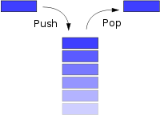
Stack
Functions need memory to store local variables and to pass parameters
  The stack can be used for these purposes
The stack is a LIFO data structure
Push and Pop operations are used to
  push a new item onto the 'top' of the stack
  pop an item off of the top of the stack
Typically the stack grows towards lower addresses
Lower addresses
Higher addresses

Slide 15
Stack management
You always have to remember the top address of the stack
  Otherwise you don't know where to push new data or pop existing data
The register ESP points to the top item on the stack
Pushing decrements ESP and then places the new item in that memory location
Popping copies the current item pointed to by ESP and then increments ESP
Push Operation:
esp-=4;
*esp = new_word
Pop Operation:
top_word = *esp;
esp+=4;

Slide 16
Writing and Compiling C Programs
If you've never written a C program, you're going to now...
C programs start off as a text file with C language instructions
They must be compiled into binaries which can then be run
  gcc (gnu C compiler) is used for this
At a minimum, you must run
  gcc -o <output filename> <input filename>
But, today we'll be enabling debug symbols and changing the stack boundary for easier debugging/reading
  gcc -g -mpreferred-stack-boundary=2 -o <output file> <input file>
int main(void) {
int i;
i = i+1;
}

Slide 17
Handy gcc options
-g
  Enable debugging symbols
-mpreferred-stack-boundary=2
  Use 'old' function prolog which makes overflow exploits easier
-mno-accumulate-outgoing-args
  Use 'push' instead of 'mov esp' operations for parameter passing (easier to read)
-fno-stack-protector
  Disable stack protection to make buffer overflow exploits easier
  Don't forget to disable stack randomization in the kernel

Slide 18
Feeding Perl to other programs
As standard input
  perl -e 'print “A”x1000' | ./vuln_prog
As a command line argument
  ./vuln_prog `perl -e 'print “A”x1000'`
  Back-ticks say “run perl, take whatever it produces, and use that as the first argument to vuln_prog”
Be careful. Spaces in perl's output make multiple arguments to vuln_prog
  ./vuln_prog `perl -e 'print “A”x5 . “ “ . “B”x5
    Is equivalent to providing two arguments to vuln_prog
    ./vuln_prog AAAAA BBBBB
  ./vuln_prog `perl -e 'print “A”x5 . “\x20” . “B”x5
    What will this do?

Slide 19
What is an overflow?
An overflow occurs anytime you write more to a memory location than it is capable of containing
For example, if you have an 80-byte buffer, and you write 100 bytes to it, those 20 bytes 'overflow' the end of the buffer
The problem is what else is in memory after that 80-byte buffer?
  It could be other variables or 'control' values that influence the operation of the program

Slide 20
Example overflow
~wcsc/Desktop/binaries/gera/stack1.c
int main() {
int cookie;
char buf[80];
printf("buf: %08x cookie: %08x\n", &buf, &cookie);
gets(buf);:
printf(“cookie: %08x\n”, cookie); // added for clarity
if (cookie == 0x41424344)
printf("you win!\n");
}
% gcc -mpreferred-stack-boundary=2 -mno-accumulate-outgoing-args -fno-stack-protector
-g -o stack1 stack1.c
% perl -e 'print “A”x10' | ./stack1

Slide 21
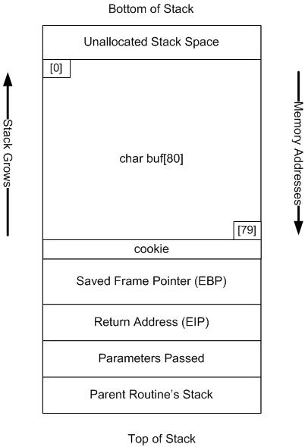
Day in the life of a stack

Slide 22
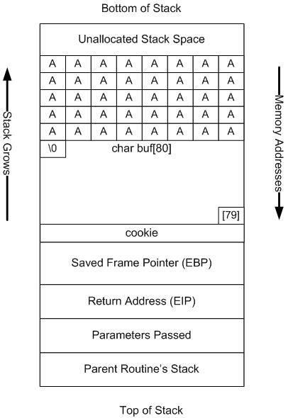
Day in the life of a stack

Slide 23
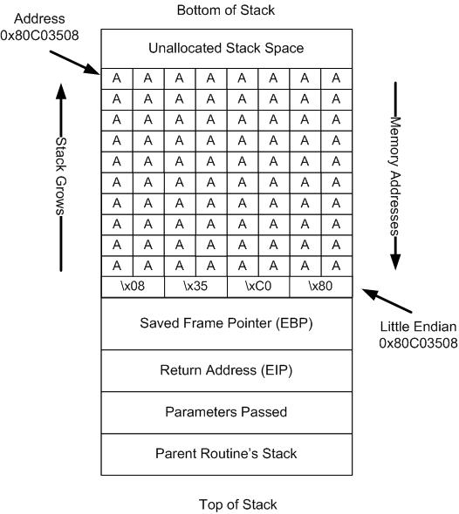
Day in the life of a stack

Slide 24
Objdump
Once you've successfully compiled a C program and have a runnable binary, there are tools called decompilers and disassemblers to partially reverse that process
  Hence the name binary reverse engineering
On linux, the binary file format is ELF (Executable and Linkable Format)
The objdump tool can read this format, extract the various segments, and disassemble the text section
The resulting disassembled text section will show you the assembly-level instructions which resulted from your C program
Objdump has a LOT of command line options
  These are the recommended ones
    objdump -DfhprRtTxlSs -M intel
  This will turn on just about everything objdump can do
    Bash aliases are your friend here

Slide 25
Intel vs AT&T Assembly Formats
From Wikipedia...
x86 assembly language has two main syntax branches: Intel syntax, originally used for documentation of the x86 platform, and AT&T syntax.[1] Intel syntax is dominant in the Windows world. In the Unix/Linux world, both are used because GCC only supported AT&T-syntax in former times. Here is a summarized list of the main differences between Intel syntax and AT&T syntax:
In AT&T syntax, the source comes before the destination, in the opposite style from Intel syntax[1]. Intel syntax follows that of many program statements ("a=5" is "mov eax, 5").
In AT&T syntax, the mnemonics are suffixed with a letter indicating the size of the operands (e.g. "q" for qword, "l" for dword, "w" for word, and "b" for byte)[1]. In Intel syntax, this is derived from the register that is used.
In AT&T syntax, immediate values must be prefixed with a "$", and registers must be prefixed with a "%"[1]
In AT&T syntax, effective addresses use the general syntax DISP(BASE,INDEX,SCALE), whereas in Intel syntax, effective addresses use variables, and need to be in square brackets; additionally, size keywords like 'byte', 'word' or 'dword' have to be used.[1] For example, the following are equivalent:
  In AT&T syntax: movl mem_location(%ebx,%ecx,4), %eax
  In Intel syntax: mov eax, dword [ebx + ecx*4 + mem_location]

Slide 26
Intel vs AT&T Assembly Formats
int main(int argc, char **argv) {
int i;
i = i+1;
}
instr <dst>, <src>
instr <src>, <dst>
Main():
INTEL: AT&T:
8048394: 55 push ebp push %ebp
8048395: 89 e5 mov ebp,esp mov %esp,%ebp
8048397: 83 ec 08 sub esp,0x8 sub $0x8,%esp
804839a: 83 45 fc 01 add DWORD PTR [ebp-0x4],0x1 addl $0x1,-0x4(%ebp)
804839e: c9 leave leave
804839f: c3 ret ret
We're going to stick with Intel format from here on out.

Slide 27
Reading Assembly
% cat asm1.c
int main(void) {
int i;
i = 0;
i++;
i--;
}
% gcc -g -mpreferred-stack-boundary=2 -o asm1 asm1.c
% objdump -DfhprRtTxlSs -M intel asm1 | grep -A 20 “main()”
main():
/home/joe/asm1.c:1
int main(void) {
8048394: 55 push ebp
8048395: 89 e5 mov ebp,esp
8048397: 83 ec 08 sub esp,0x8
/home/joe/asm1.c:3
int i;
i = 0;
804839a: c7 45 fc 00 00 00 00 mov DWORD PTR [ebp-0x4],0x0
/home/joe/asm1.c:4
i++;
80483a1: 83 45 fc 01 add DWORD PTR [ebp-0x4],0x1
/home/joe/asm1.c:5
i--;
80483a5: 83 6d fc 01 sub DWORD PTR [ebp-0x4],0x1
/home/joe/asm1.c:6
}
80483a9: c9 leave
80483aa: c3 ret

Slide 28
Assembly mnemonics
In doing binary reverse engineering, you're going to be looking at assembly for long periods of time
The more you do this, the more fluent you become in x86 assembly
But, for those times where you just don't recognize an instruction, here are the manuals:
  http://www.intel.com/products/processor/manuals/
Also, for the LiveCD/VM users, there's a x86-help.sh file on your desktop which opens a Windows .hlp file that has a reference to many of the x86 instructions

Slide 29
Parameter passing
Calling conventions describe how parameters are passed when functions are called and how the stack is used for this
cdecl is the calling convention for C on x86
Prior to the function call, parameters are pushed onto the stack in reverse (right to left) order
Note: example compiled with -mno-accumulate-outgoing-args
int foo(int j, int k) {
j++;
}
int main(void) {
int i = 0;
int z = 1;
foo(i, z);
}
/home/joe/t.c:5
int i = 0;
80483b1: c7 45 f8 00 00 00 00 mov DWORD PTR [ebp-0x8],0x0
/home/joe/t.c:6
int z = 1;
80483b8: c7 45 f4 01 00 00 00 mov DWORD PTR [ebp-0xc],0x1
/home/joe/t.c:7
foo(i, z);
80483bf: ff 75 f4 push DWORD PTR [ebp-0xc]
80483c2: ff 75 f8 push DWORD PTR [ebp-0x8]
80483c5: e8 ca ff ff ff call 8048394 <foo>
Stack just before the call
ESP
0 (i)
1 (z)

Slide 30
Function Calls and Stack Management
Understanding memory/stack management across function calls is critical to understanding program flow in assembly
int foo(int j, int k) {
j++;
}
int main(void) {
int i = 0;
int z = 1;
foo(i,z);
}
foo():
8048394: 55 push ebp
8048395: 89 e5 mov ebp,esp
8048397: 83 ec 04 sub esp,0x4
804839a: 83 45 08 01 add DWORD PTR [ebp+0x8],0x1
804839e: c9 leave
804839f: c3 ret
080483a0 <main>:
main():
80483a0: 55 push ebp
80483a1: 89 e5 mov ebp,esp
80483a3: 83 ec 0c sub esp,0xc
80483a6: c7 45 f8 00 00 00 00 mov DWORD PTR [ebp-0x8],0x0
80483ad: c7 45 fc 01 00 00 00 mov DWORD PTR [ebp-0x4],0x1
80483b4: ff 75 fc push DWORD PTR [ebp-0x4]
80483b7: ff 75 f8 push DWORD PTR [ebp-0x8]
80483ba: e8 d5 ff ff ff call 8048394 <foo>
80483bf: 83 c4 08 add esp,0x8
80483c2: c9 leave
80483c3: c3 ret

Slide 31
Function Calls and Stack Management
int main() {
foo(i,z); 80483b4: push DWORD PTR [ebp-0x4]
80483b7: push DWORD PTR [ebp-0x8]
80483ba: call 8048394 <foo>
80483bf: add esp,0x8
}
int foo(int j, int k) { 8048394: push ebp
8048395: mov ebp,esp
8048397: sub esp,0x4
j++; 804839a: add DWORD PTR [ebp+0x8],0x1
} 804839e: leave
804839f: ret
Stack
EIP: 80483b4
other
ESP
i
0
z
1
EBP

Slide 32
Function Calls and Stack Management
int main() {
foo(i,z); 80483b4: push DWORD PTR [ebp-0x4]
80483b7: push DWORD PTR [ebp-0x8]
80483ba: call 8048394 <foo>
80483bf: add esp,0x8
}
int foo(int j, int k) { 8048394: push ebp
8048395: mov ebp,esp
8048397: sub esp,0x4
j++; 804839a: add DWORD PTR [ebp+0x8],0x1
} 804839e: leave
804839f: ret
Stack
EIP: 80483b7
1
ESP
other
i
0
z
1
EBP

Slide 33
Function Calls and Stack Management
int main() {
foo(i,z); 80483b4: push DWORD PTR [ebp-0x4]
80483b7: push DWORD PTR [ebp-0x8]
80483ba: call 8048394 <foo>
80483bf: add esp,0x8
}
int foo(int j, int k) { 8048394: push ebp
8048395: mov ebp,esp
8048397: sub esp,0x4
j++; 804839a: add DWORD PTR [ebp+0x8],0x1
} 804839e: leave
804839f: ret
Stack
EIP: 80483ba
0
ESP
1
other
i
0
z
1
EBP

Slide 34
Function Calls and Stack Management
int main() {
foo(i,z); 80483b4: push DWORD PTR [ebp-0x4]
80483b7: push DWORD PTR [ebp-0x8]
80483ba: call 8048394 <foo>
80483bf: add esp,0x8
}
int foo(int j, int k) { 8048394: push ebp
8048395: mov ebp,esp
8048397: sub esp,0x4
j++; 804839a: add DWORD PTR [ebp+0x8],0x1
} 804839e: leave
804839f: ret
Stack
EIP: 8048394
80483bf
ESP
0
call is equivalent to:
push eip
jmp <addr>
1
other
i
0
z
1
EBP

Slide 35
Function Calls and Stack Management
int main() {
foo(i,z); 80483b4: push DWORD PTR [ebp-0x4]
80483b7: push DWORD PTR [ebp-0x8]
80483ba: call 8048394 <foo>
80483bf: add esp,0x8
}
int foo(int j, int k) { 8048394: push ebp
8048395: mov ebp,esp
8048397: sub esp,0x4
j++; 804839a: add DWORD PTR [ebp+0x8],0x1
} 804839e: leave
804839f: ret
Stack
EIP: 8048395
old EBP
ESP
80483bf
0
1
other
i
0
z
1
EBP

Slide 36
Function Calls and Stack Management
int main() {
foo(i,z); 80483b4: push DWORD PTR [ebp-0x4]
80483b7: push DWORD PTR [ebp-0x8]
80483ba: call 8048394 <foo>
80483bf: add esp,0x8
}
int foo(int j, int k) { 8048394: push ebp
8048395: mov ebp,esp
8048397: sub esp,0x4
j++; 804839a: add DWORD PTR [ebp+0x8],0x1
} 804839e: leave
804839f: ret
Stack
EIP: 8048397
old EBP
ESP, EBP
80483bf
0
1
other
i
0
z
1

Slide 37
Function Calls and Stack Management
int main() {
foo(i,z); 80483b4: push DWORD PTR [ebp-0x4]
80483b7: push DWORD PTR [ebp-0x8]
80483ba: call 8048394 <foo>
80483bf: add esp,0x8
}
int foo(int j, int k) { 8048394: push ebp
8048395: mov ebp,esp
8048397: sub esp,0x4
j++; 804839a: add DWORD PTR [ebp+0x8],0x1
} 804839e: leave
804839f: ret
Stack
EIP: 804839a
ESP
old EBP
EBP
80483bf
0
1
other
i
0
z
1

Slide 38
Function Calls and Stack Management
int main() {
foo(i,z); 80483b4: push DWORD PTR [ebp-0x4]
80483b7: push DWORD PTR [ebp-0x8]
80483ba: call 8048394 <foo>
80483bf: add esp,0x8
}
int foo(int j, int k) { 8048394: push ebp
8048395: mov ebp,esp
8048397: sub esp,0x4
j++; 804839a: add DWORD PTR [ebp+0x8],0x1
} 804839e: leave
804839f: ret
Stack
EIP: 804839e
ESP
old EBP
EBP
80483bf
1
1
other
i
0
z
1

Slide 39
Function Calls and Stack Management
int main() {
foo(i,z); 80483b4: push DWORD PTR [ebp-0x4]
80483b7: push DWORD PTR [ebp-0x8]
80483ba: call 8048394 <foo>
80483bf: add esp,0x8
}
int foo(int j, int k) { 8048394: push ebp
8048395: mov ebp,esp
8048397: sub esp,0x4
j++; 804839a: add DWORD PTR [ebp+0x8],0x1
} 804839e: leave
804839f: ret
Stack
EIP: 804839f
old EBP
EBP, ESP
leave is equivalent to:
mov esp, ebp
pop ebp
80483bf
1
1
other
i
0
z
1

Slide 40
Function Calls and Stack Management
int main() {
foo(i,z); 80483b4: push DWORD PTR [ebp-0x4]
80483b7: push DWORD PTR [ebp-0x8]
80483ba: call 8048394 <foo>
80483bf: add esp,0x8
}
int foo(int j, int k) { 8048394: push ebp
8048395: mov ebp,esp
8048397: sub esp,0x4
j++; 804839a: add DWORD PTR [ebp+0x8],0x1
} 804839e: leave
804839f: ret
Stack
EIP: 804839f
old EBP
leave is equivalent to:
mov esp, ebp
pop ebp
80483bf
ESP
1
1
other
i
0
z
1
EBP

Slide 41
Function Calls and Stack Management
int main() {
foo(i,z); 80483b4: push DWORD PTR [ebp-0x4]
80483b7: push DWORD PTR [ebp-0x8]
80483ba: call 8048394 <foo>
80483bf: add esp,0x8
}
int foo(int j, int k) { 8048394: push ebp
8048395: mov ebp,esp
8048397: sub esp,0x4
j++; 804839a: add DWORD PTR [ebp+0x8],0x1
} 804839e: leave
804839f: ret
Stack
EIP: 80483bf
old EBP
ret is equivalent to:
pop eip
80483bf
1
ESP
1
other
i
0
z
1
EBP

Slide 42
Function Calls and Stack Management
int main() {
foo(i,z); 80483b4: push DWORD PTR [ebp-0x4]
80483b7: push DWORD PTR [ebp-0x8]
80483ba: call 8048394 <foo>
80483bf: add esp,0x8
}
int foo(int j, int k) { 8048394: push ebp
8048395: mov ebp,esp
8048397: sub esp,0x4
j++; 804839a: add DWORD PTR [ebp+0x8],0x1
} 804839e: leave
804839f: ret
Stack
EIP: 80483c3
old EBP
80483bf
1
1
other
ESP
i
0
z
1
EBP

