Slide 1

MileStone 2 Review Meeting
AI-Powered Educational Speech Synthesis Software
Team 15
2253333 王沫涵
2250695 奥泉瑞
2252088 孙少杰
2253724 林昊洋

Slide 2
PART .01
Project Overview

Slide 3

PART.01
The project aims to develop an intelligent platform that utilizes voice synthesis and cloning technologies to enhance the quality and accessibility of education. Leveraging advancements in artificial intelligence, the system will generate natural-sounding speech from text or voice samples, with the ability to replicate specific voices (such as teachers’ voices) and support multi-language output including Mandarin and English.

Slide 4
PART .02
Workflow
Update

Slide 5
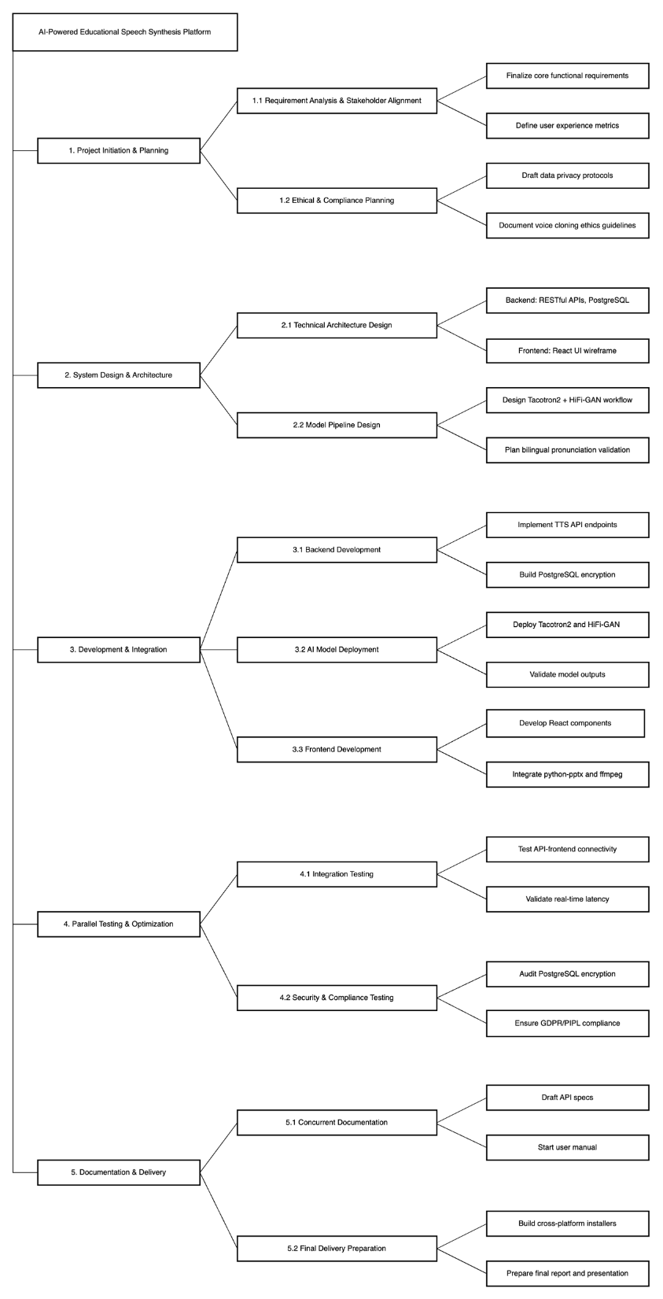
PART.03
Updated WBS

Slide 6
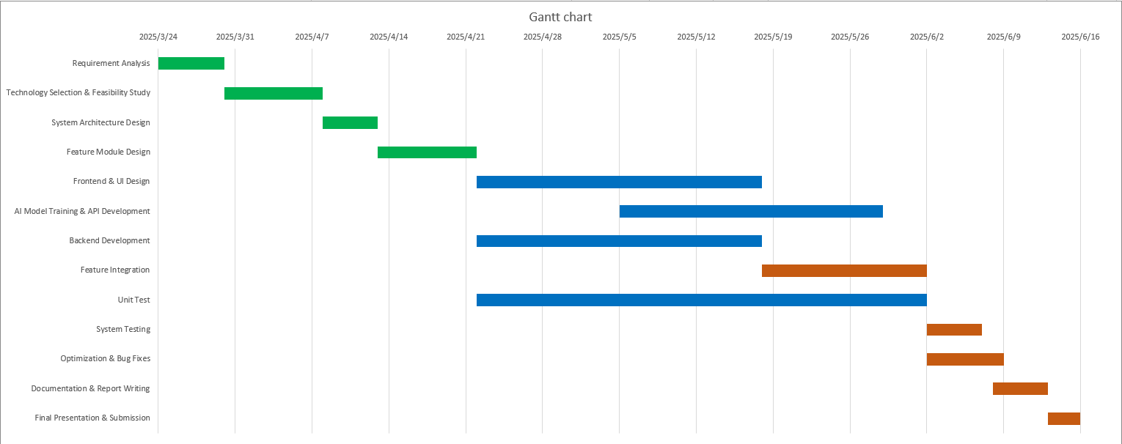
PART.03
Updated Gantt Chart

Slide 7
PART .03
Code Review

Slide 8
PART.03
Technology Stack
Backend: Flask (Python Web Framework)
Frontend: HTML + JavaScript
Core Libraries: pyttsx3 (Text-to-Speech), python-pptx (PPT Parsing)
Data Storage: Local File System (JSON Files)
System Architecture
Frontend-Backend Separation: Frontend interacts with backend via APIs
Data Flow: User uploads audio/text → Backend processing → Audio generation → Frontend display/download

Slide 9
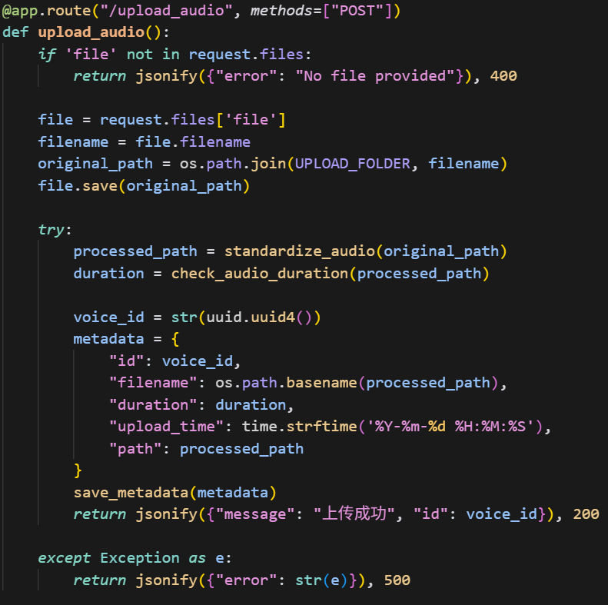
PART.03
Module One: Upload Teacher Voice Sample
API: /upload_audio (POST)
Functionality: Upload audio file, standardize processing, save metadata

Slide 10
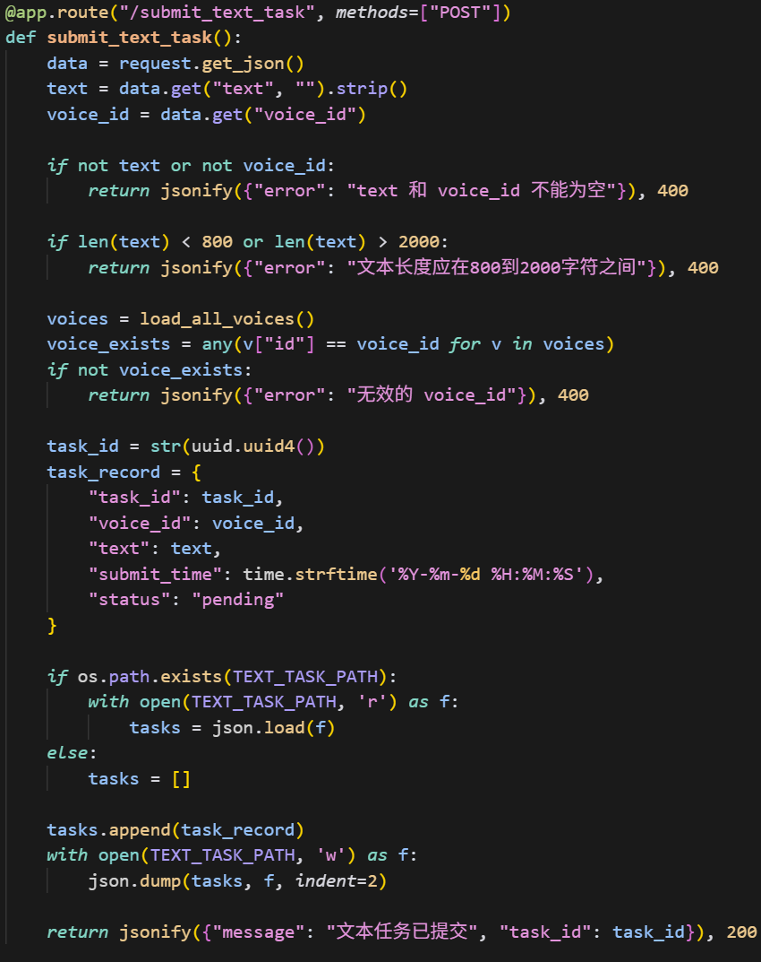
PART.03
Module Two: Submit Teaching Text Task
API: /submit_text_task (POST)
Functionality: Input text (800~2000 characters), select voice sample, generate task

Slide 11
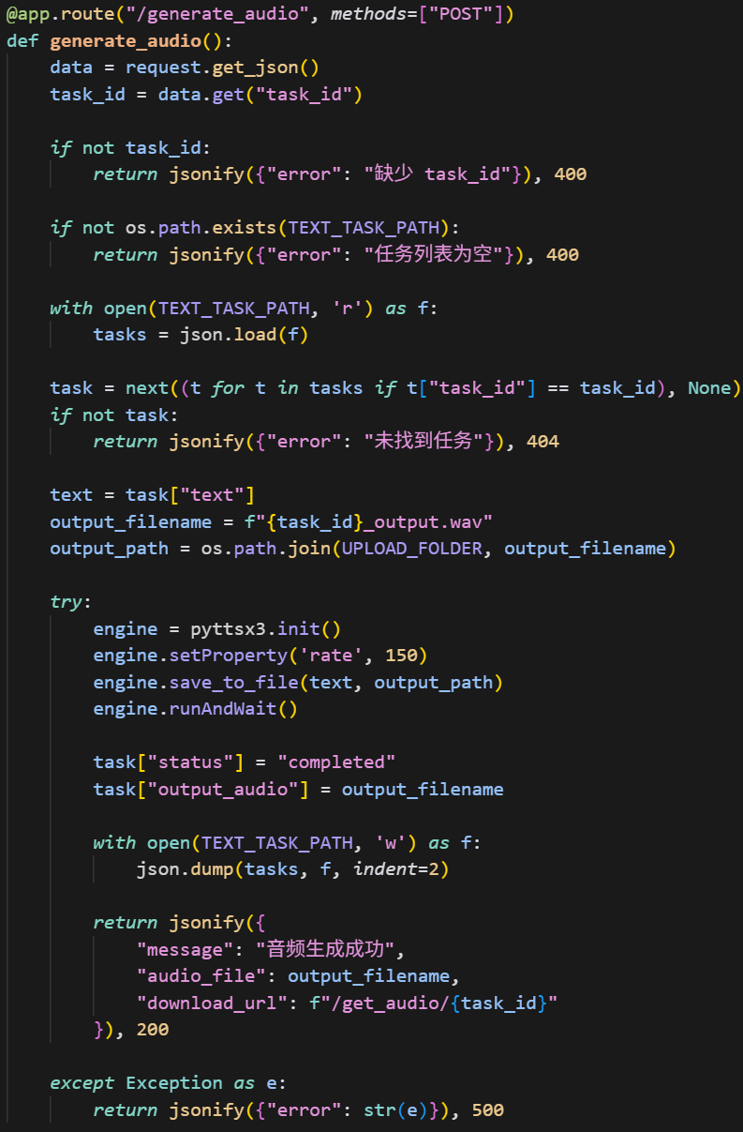
PART.03
Module Three: Synthesize Audio
API: /generate_audio (POST), /get_audio/<task_id> (GET)
Functionality: Call pyttsx3 to generate audio, support online playback/download

Slide 12
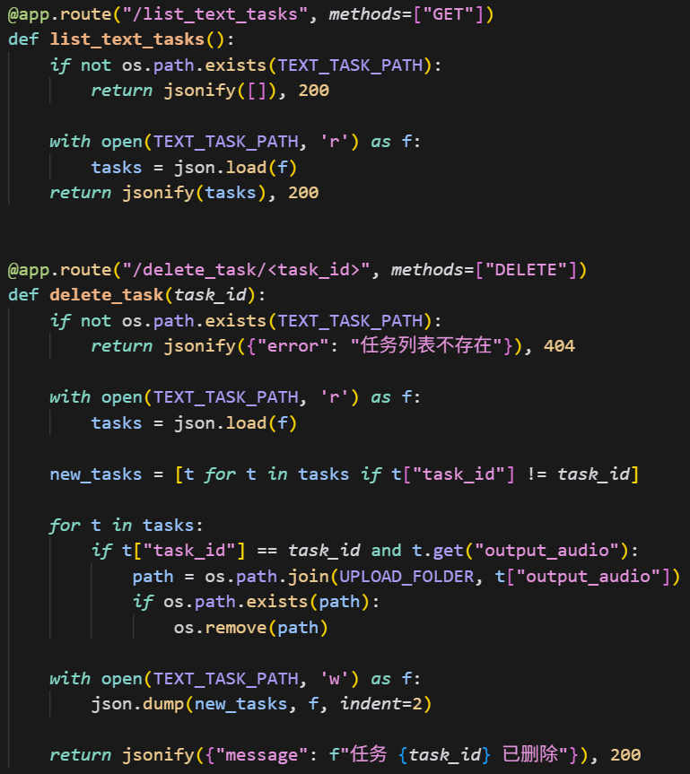
PART.03
Module Four: Historical Task Management
API: /list_text_tasks (GET), /delete_task/<task_id> (DELETE)
Functionality: View task status, delete tasks

Slide 13
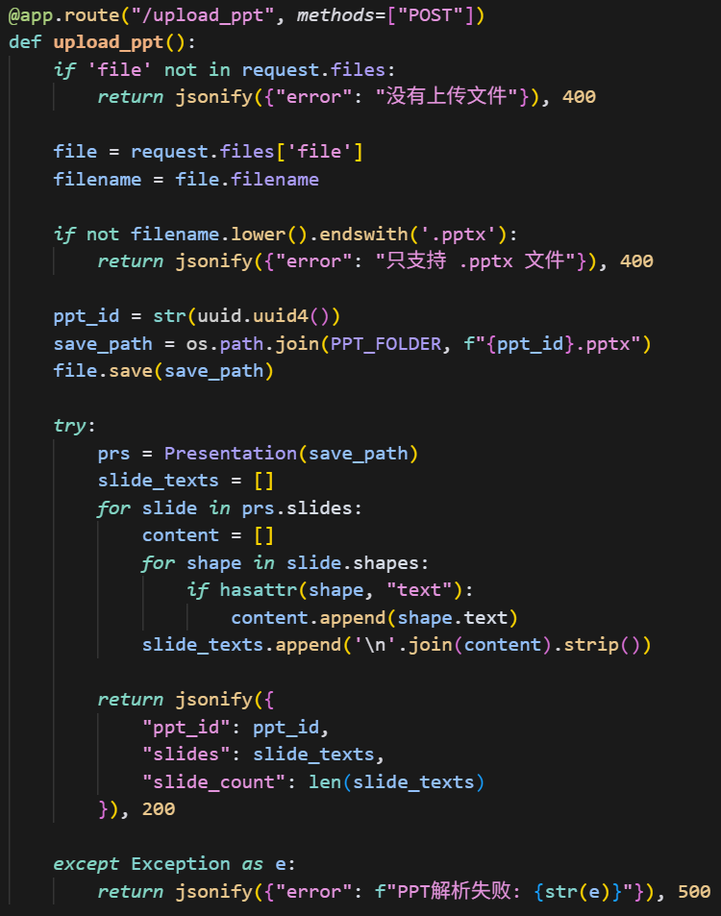
PART.03
Module Five: PPT Upload and Text Extraction
API: /upload_ppt (POST)
Functionality: Upload PPT, extract text from each slide

Slide 14
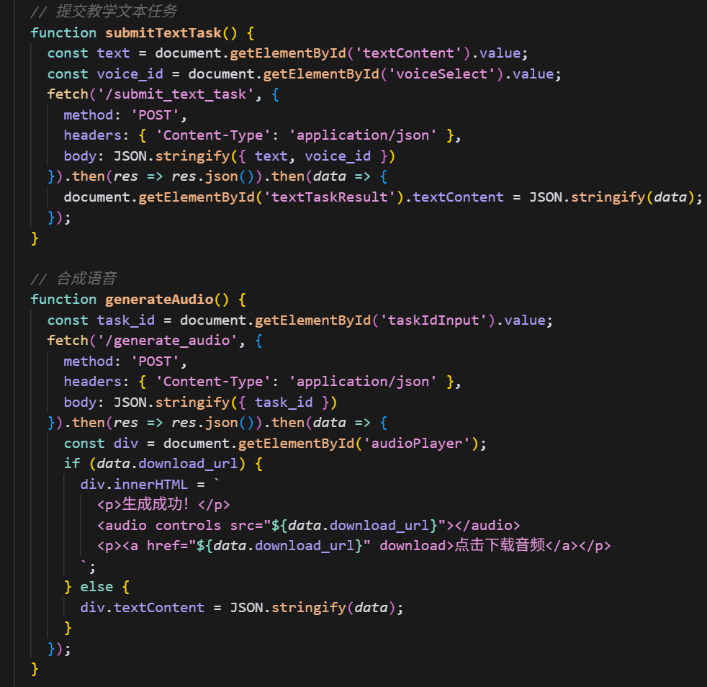
PART.03
Frontend Interaction
Main Features:
Upload audio/PPT files
Submit text tasks
Generate/play audio
Manage historical tasks

Slide 15
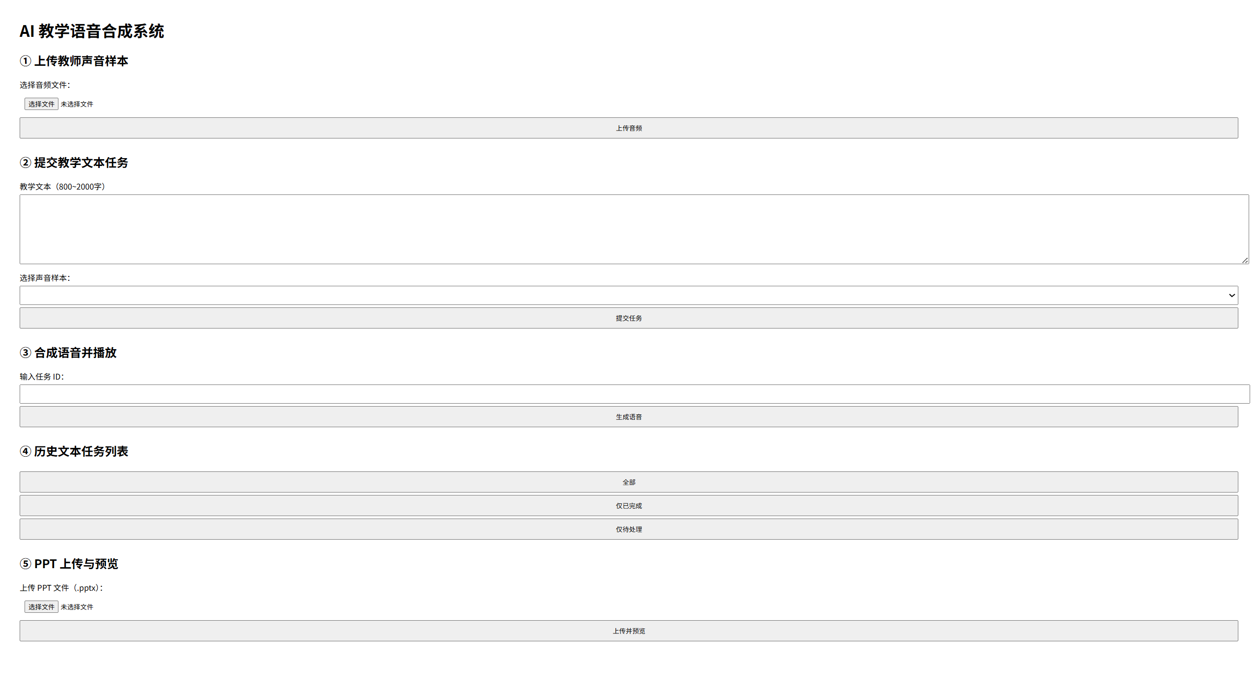
PART.03
Frontend Interaction

Slide 16
PART .04
Future Plan

Slide 17
PART.04
1. Finalize Backend & Frontend Development
- Complete remaining feature integrations.
- Ensure API stability and performance.
- Finalize UI/UX adjustments.
2. Testing Phase
- Conduct thorough unit testing for all modules.
- Perform end-to-end system testing.
- Fix critical bugs and optimize performance.
3. Documentation & Finalization
- Complete technical and user documentation.
- Prepare final reports and presentation materials.
4. Project Submission
- Deliver the finalized system.
- Present results and submit all deliverables.

