Slide 1
Bioinformatics Formats and Analysis Cheat Sheet

Slide 2
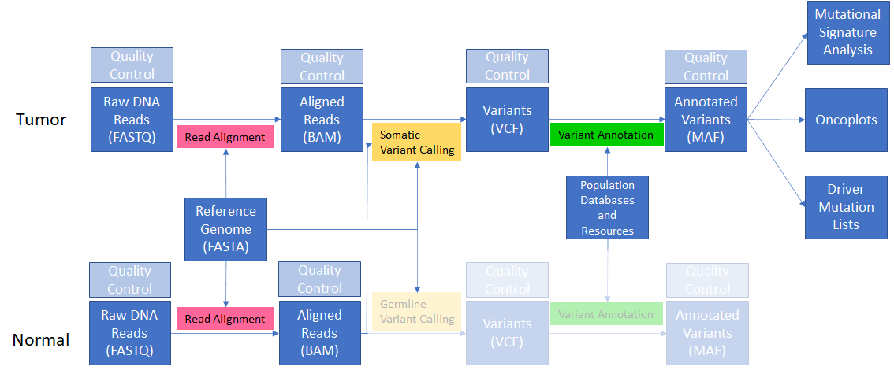
Bioinformatic Pipeline for a Somatic Study
Notes:
Remember from yesterday that we can’t do much with our raw FASTQ reads - we need to align them to the genome to have a meaningful understanding of what the genome of our tumor and normal actually look like.

Slide 3
Alignment
FASTQ
FASTA
BAM

Slide 4
Variant Calling
BAM
FASTA
VCF

Slide 5
Annotation
Database
VCF
Database
MAF
Database

Slide 6
Mutational Signatures
VCF
Reference
Mutational Signatures
Or
MAF

