Slide 1
De novo assembly Dr. David Bibby, Genomics and Clinical Virology, 15th June 2023

Slide 2
Overview
What is de novo assembly?
How does it differ from reference mapping?
When might it be used?
How does it work?
Pitfalls & difficulties with virus data
Outputs

Slide 3
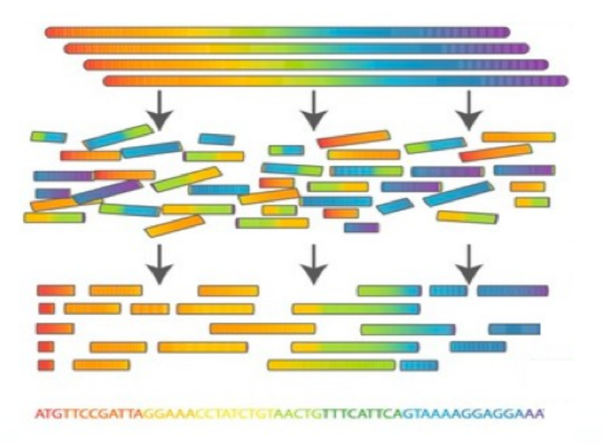
What is de novo assembly?
Basic definition:
“The process of reconstructing sample sequence(s) without any guide reference(s)”
De novo: “from the beginning”
Sample sequences
Sequencing reads
Assembly
Sequence!
Commins et al. Bio. Proc. Online (2009) 11(1)

Slide 4
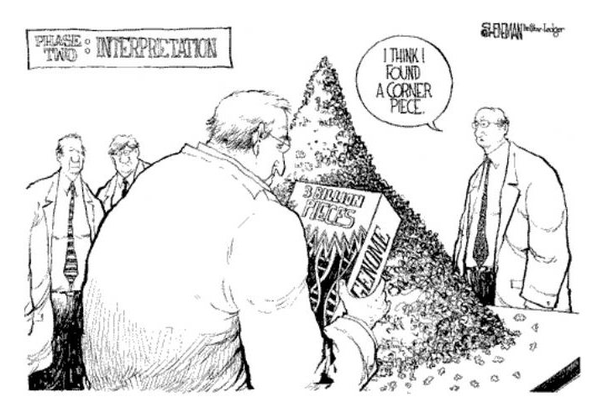
What is de novo assembly?
“Trying to solve a huge jigsaw puzzle where you don’t have the picture”
But there are also a number of additional confounding issues:
All the pieces are blank
Some are missing
Some are damaged
Many are duplicates
None are edges
Some belong to other puzzles

Slide 5
When might it be used?
So why not use a reference?
No suitable references for this virus
Poorly studied
Hard to sequence
Unreliable sequence data
Highly divergent species (e.g. many RNA viruses)
Target not specified
Metagenomic analysis
Syndromic testing
Unknown aetiological agent of disease

Slide 6
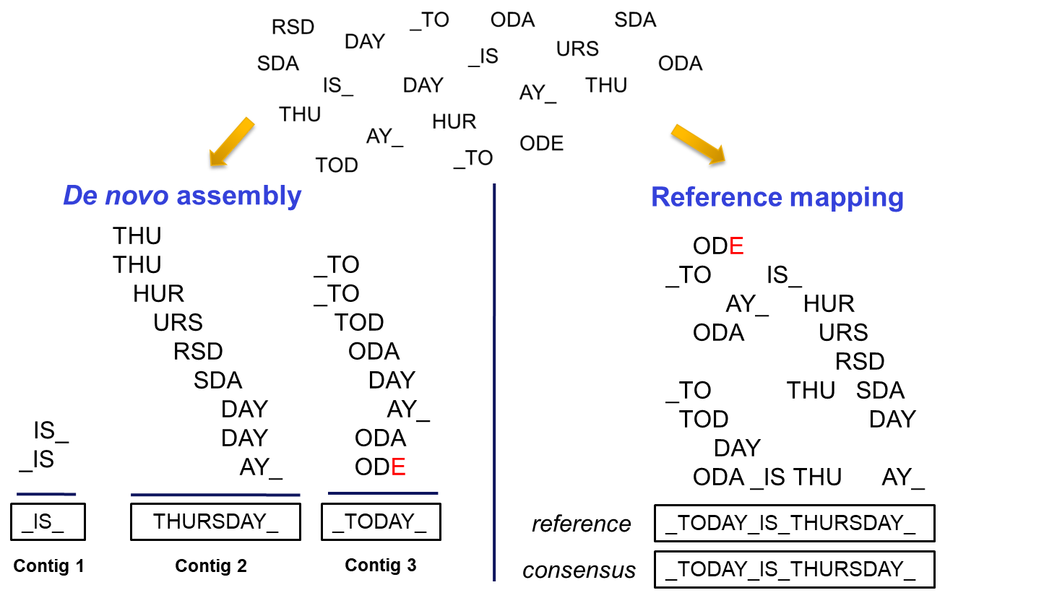
How does it work?

Slide 7
How does it work?
Principles
Find overlaps between reads
Build a graph of overlaps
Correct errors
Traverse graph
Deliver contigs
Methods
Greedy Approach
Overlap-Consensus-Layout
De Bruijn graphs
Other (e.g. VICUNA)

Slide 8
How does it work – Greedy Approach?
Iterate through pairs of reads
If an overlap exists, merge the two reads into one
Overlap detection criteria can be parameterized
Repeat until no further overlaps are possible
Slow Inaccurate Easily confounded by repeats

Slide 9
How does it work – Overlap-Layout-Consensus?
Find all overlaps between reads
Again, overlap detection criteria can be parameterized
Create a graph of all overlaps
Traverse graph to find an unambiguous path
“Hamiltonian path” (each vertex only once)
Arachne
PCAP
Newbler
Celera Assembler

Slide 10
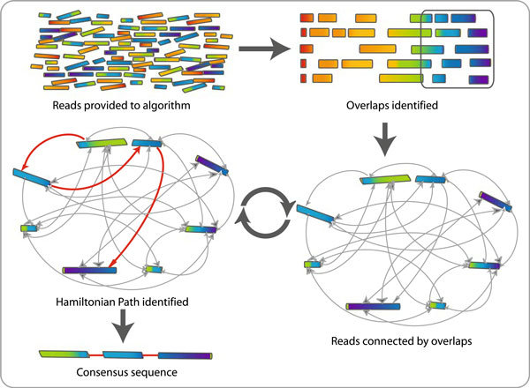
How does it work – Overlap-Layout-Consensus?
Commins et al. Bio. Proc. Online (2009) 11(1)

Slide 11
How does it work – De Bruijn graphs?
Derive kmers from sequence reads
Subsequences of length k
Create overlap graph using [k-1]mers
Traverse graph to reconstruct likely sequence
“Eulerian path” (each edge only once)
More memory-efficient than OLC
ABySS
SOAPdenovo
Trinity
Ben Langmead, Johns Hopkins
“De Bruijn Graph assembly” pdf

Slide 12
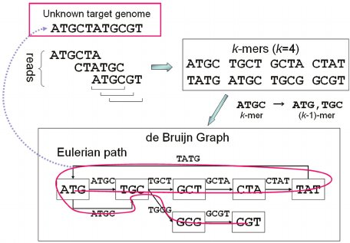
How does it work – De Bruijn graphs?
Namiki et al. Nuc. Acids. Res. (2012) 40:e155

Slide 13
Viral data - challenges
High levels of variation in the data set
Errors from sequencing
Errors from RT-PCR
Coverage variation from library prep
Variable quantities of off-target sequence data
High levels of variation in the source virus sample
Continuous quasispecies variation at the nucleotide level
Length polymorphisms
“High polyploidy”

Slide 14
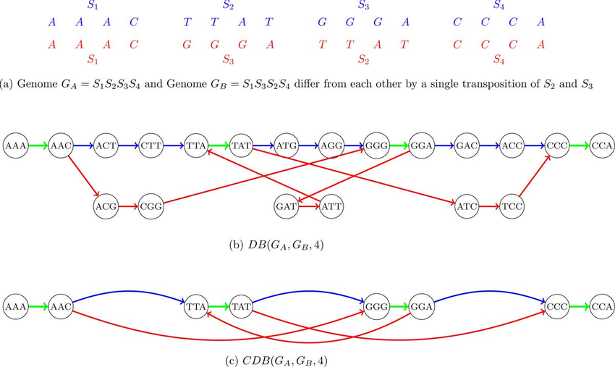
Viral data - challenges
OLC & De Bruijn graphs have many “bubbles” & “branches”
Whilst these can be simplified, they can be impossible to resolve

Slide 15
Viral data - challenges
Traditional assemblers often generate multiple contigs across a single region
Virus-specific assemblers try to allow for low-level nucleotide variation
Some tools use the variation to reconstruct haplotypes
Linking reads into longer structures
HaploClique, Savage
Velvet
IVA
SPAdes
VICUNA

Slide 16
Viral data - challenges
Ways to improve assemblies
Trim reads – QC
The termini comprise the overlaps; hence critical for good assembly
Often of poor quality
Errors may be statistically distinguishable from true variation
Reduce volume of duplicate information
Many near-identical reads can confound even the best assemblers
Reduce redundant reads through normalisation (see practical)
Eliminate off-target reads
Contaminating host/bacterial reads etc.
Can be mis-incorporated into graphs and hence contigs
Run a mapping against e.g. human/mouse and retain unmapped reads

Slide 17
De novo outputs
Contigs
Continuous stretches of sequence containing only A, C, G, or T without gaps.
These can be interrogated for similarity to known targets or used as reference sequences for mapping
Scaffolds
Created by joining contigs together using additional information regarding the relative position and orientation of the contigs with reference to a genome
The contigs within a scaffold are separated by gaps, which are denoted by a variable number of ‘N’ letters.
In viral genomes, these can represent repeat regions, or unresolved areas of structural uncertainty

Slide 18
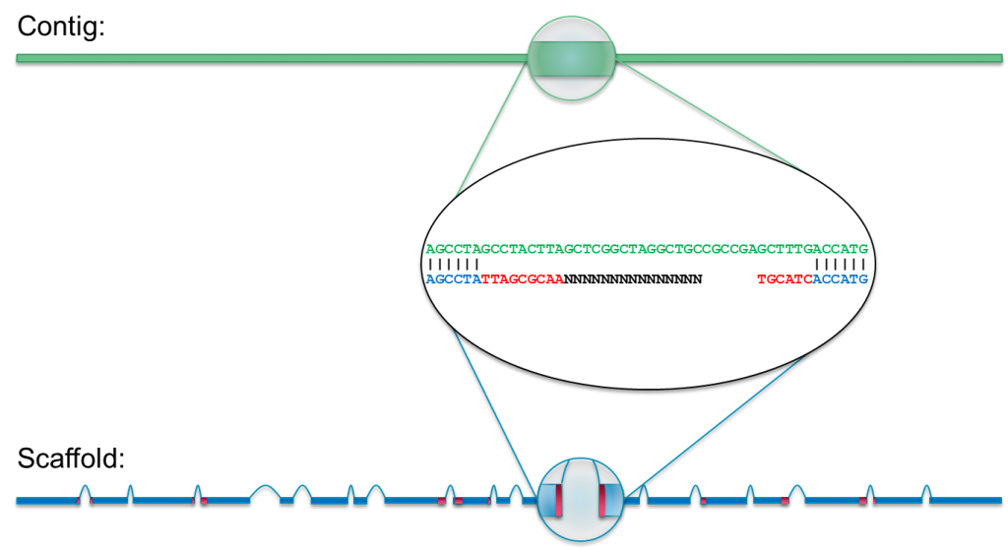
De novo outputs
PacBio: ow.ly/fAUJ304re2V

Slide 19
Practical
Three parts
IVA, QUAST, SPAdes & BLAST
Comparing ‘raw’ and ‘clean’ data
Normalising data
Command prompt
Written prompt:~$ in the documentation, lines following this are to be typed
Results files
If time is running short, type
prompt:~$ unzip results.zip
and the output files will magically appear for you to look at

