Slide 1
Please wait to view these slides until after the in-person session, unless you need them for accessibility reasons etc.

Slide 2
Introduction to Metagenomics for Clinical Virology
Sarah Buddle
UCL Great Ormond Street Institute of Child Health
Session developed by Dr Cristina Venturini

Slide 3
Session structure
11:00-12:00: Introduction to metagenomics
12:00-13:00: Metagenomics bioinformatics practical

Slide 4
What is metagenomics?
What clinical questions can we answer with metagenomics?
What are the advantages and disadvantages of metagenomics over other techniques you might use to answer those questions?

Slide 5
What is metagenomics?
Sequencing all the genetic material in a sample
Not targeting to one or a small number of organisms
In context of viruses, sequencing DNA and RNA

Slide 6
2. What clinical questions can we answer with metagenomics?
What pathogens are there?
What is causing the disease?
What is the composition of the microbial community?
Surveillance: Are there any novel strains or species?
What are the genome sequences of the viruses?
Antiviral resistance
Tracking of outbreaks

Slide 7
3. What are the advantages and disadvantages of metagenomics over other techniques you might use to answer those questions?
Advantages
No prior assumptions – good for new or unusual organisms
Sequence information
Disadvantages
Contamination
Expensive and time consuming
Lots of infrastructure required
Training requirements
Can be less sensitive than PCR/large inputs required

Slide 8
Protocol
What are the key steps in a metagenomics protocol?
What is the purpose of each step?
Sequencing
Sample collection
QC
Host removal
Assembly
Library prep
Classification
DNA/RNA extraction
Host removal
Viral sequence analysis
Reporting

Slide 9
Protocol
Sample collection
QC
DNA/RNA extraction
Host removal
Host removal
Library prep
Sequencing

Slide 10
Host removal: alignment
Sequencing reads
Human genome
Preliminary round with a quick classifier also an option

Slide 11
Protocol
Sample collection
QC
DNA/RNA extraction
Host removal
Host removal
Assembly (optional)
Library prep
Sequencing

Slide 12
Assembly
Reads
Reads
Contigs
Contigs
Assemblies

Slide 13
Protocol
Sample collection
QC
DNA/RNA extraction
Host removal
Host removal
Assembly (optional)
Library prep
Classification
Sequencing

Slide 14
Classification
Classification is deciding which species (or other taxonomic group) a read corresponds to
Reads are classified by comparison to a reference databases containing known genome sequences
Challenge: some parts of DNA are similar in different organisms

Slide 15
Classification tools
Alignment-based
E.g. BLAST, DIAMOND
K-mer-based
E.g. Kraken2, Centrifuge
Marker gene-based
E.g. mOTU, MetaPhlAn
Nucleotide-based
E.g. BLASTN
Protein-based
E.g. DIAMOND, Kaiju

Slide 16
Protocol
Sample collection
QC
DNA/RNA extraction
Host removal
Host removal
Assembly (optional)
Library prep
Classification
Sequencing
Viral sequence analysis
Reporting

Slide 17
Classification
What factors should we consider when choosing:
1: a classifier
2: sequences to include in your database

Slide 18
Classification
How should we choose a classifier?
Sensitivity and specificity
Suitability for type of sequencing and microbe
Time and computational resource requirements
Ease of use

Slide 19
Classification
How should we choose a database?
What organisms to include
Nucleotide vs protein (protein good for more divergent viruses but can give more false positives)
Prebuilt vs custom

Slide 20
How can we reduce/deal with contamination?
Sterile environment in lab
Negative controls
Database choice
Quality control and thresholds
Just because an organism is present in the sample doesn’t mean it’s causing the disease!

Slide 21
Practical: Metagenomics for diagnosis
Background:
We'll be analysing a clinical specimen from a 41-year-old patient who reported fever, chest tightness, cough, pain and weakness, and was admitted to hospital 6 days after the onset of the disease. The patient with no history of hepatitis, tuberculosis or diabetes. Preliminary investigations excluded the presence of influenza virus, Chlamydia pneumoniae and Mycoplasma pneumoniae and this was confirmed by PCR. Other common respiratory pathogens, including human adenoviruses, also tested negative. To investigate other possible infectious causes of disease, bronchoalveolar lavage fluid (BALF) was collected and deep metatranscriptomic sequencing was performed.
Task:
You need to analyse the data to determine the cause of the disease and determine what treatment options may be available.

Slide 22
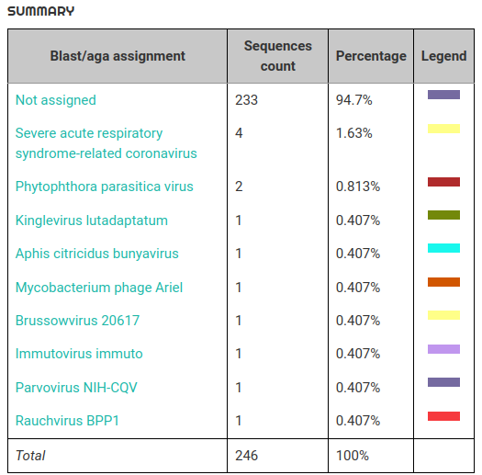
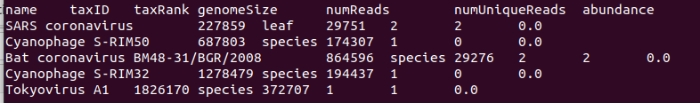
Practical: Metagenomics for diagnosis

Slide 23




Choosing bioinformatics protocols for metagenomics
The protocol shown in the practical is probably not the best one for your research or clinical question!
Some other tools: a non-exhaustive list
nf-core is a set of community-curated best practice bioinformatics pipelines built in Nextflow.
Taxprofiler Includes Kraken2/Bracken, DIAMOND, Centrifuge etc
Online, cloud-based, user-friendly tool
Illumina Dragen Metagenomics / Nanopore EPI2ME labs wf-metagenomics
Illumina and Nanopore’s tools. Simple to run and can be automated.
Check benchmarking papers for lots of other options!

