Slide 1

Genomic & Epidemiological Surveillance of Bacterial Pathogens
6-11 July 2025
Module 4: Mapping and Phylogeny
Bacterial population structure and sequence clustering
Mat Beale

Slide 2
Outline
Introduction to Population Structure
Applications and Approaches
Algorithms
Original Slide Credit: Gerry Tonkin-Hill, University of Melbourne

Slide 3
1. Population structure

Slide 4
What do we mean by population structure?
Systematic differences in alleles and/or gene frequencies between subpopulations
Random allele distribution between groups

Slide 5
What do we mean by population structure?
Systematic differences in alleles and/or gene frequencies between subpopulations
VS
Random allele distribution between groups
Non-Random allele distribution between groups

Slide 6
What do we mean by population structure?
Systematic differences in alleles and/or gene frequencies between subpopulations
VS
This population is ‘structured’
Random allele distribution between groups
Non-Random allele distribution between groups

Slide 7
What causes it?
physical separation
migration
bottlenecks
expansions
selection
random chance

Slide 8
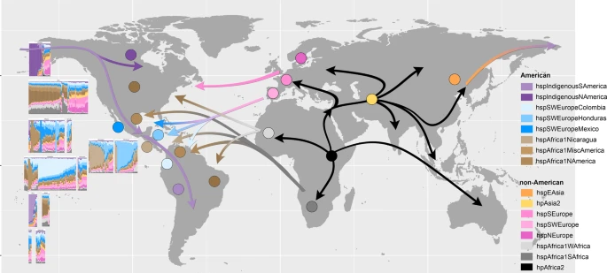
Physical separation - Helicobacter pylori
Muñoz-Ramirez, Z. Y. et al. A 500-year tale of co-evolution, adaptation, and virulence: Helicobacter pylori in the Americas. ISME J. 15, 78–92 (2021)

Slide 9
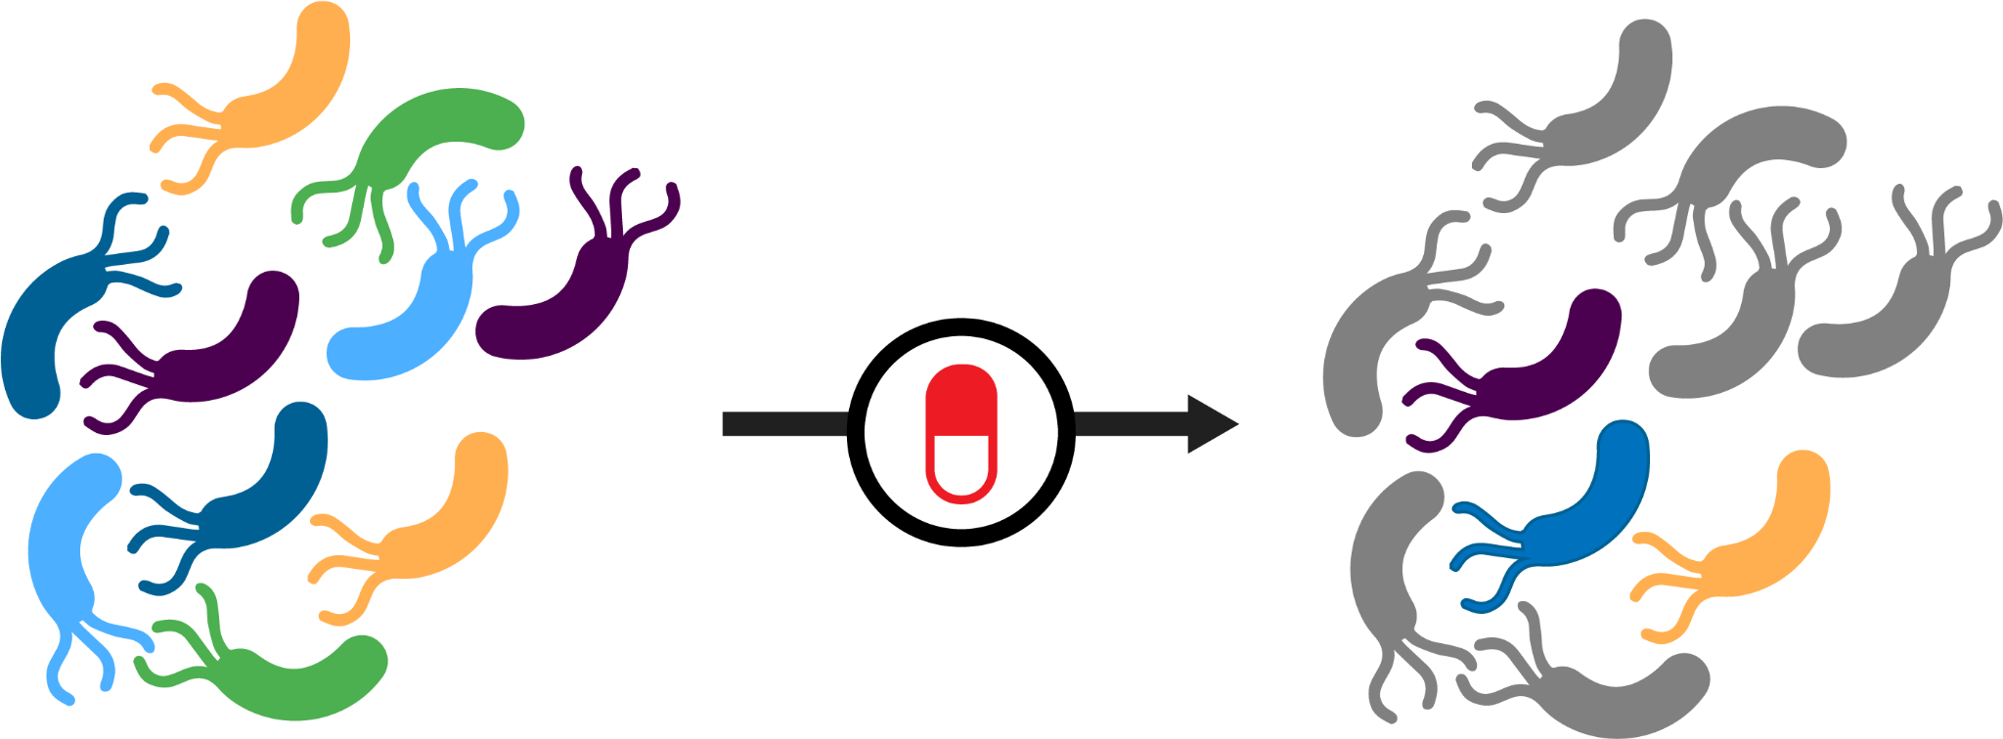
Selection induced structure

Slide 10
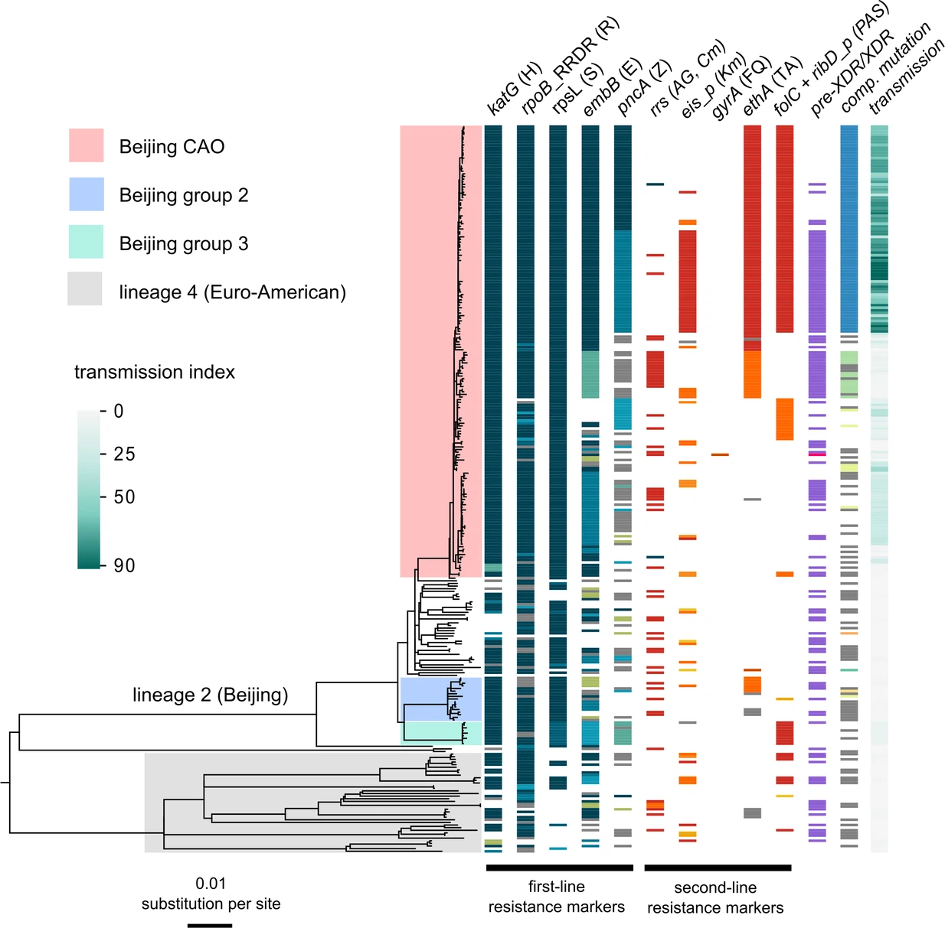
Selection induced structure - M. tuberculosis
Multi-drug resistant
Merker, M. et al. Compensatory evolution drives multidrug-resistant tuberculosis in Central Asia. Elife 7, (2018)

Slide 11

Differences in population size
VS

Slide 12
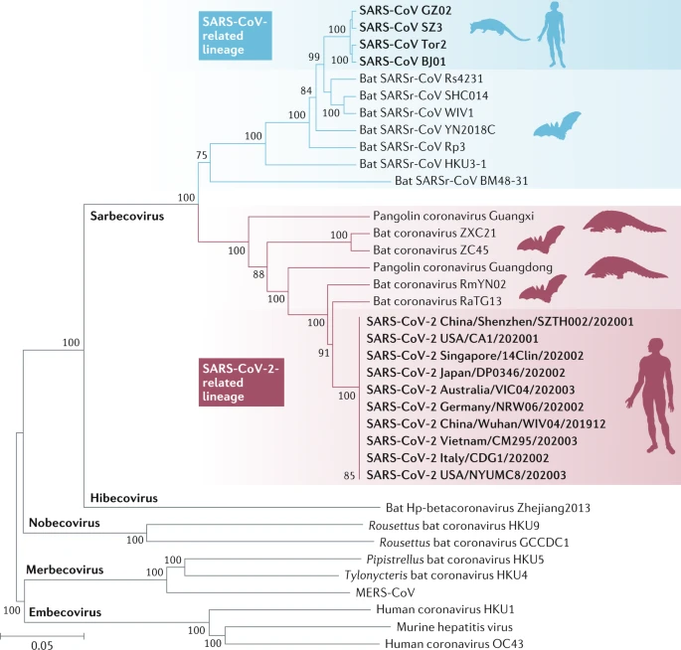
Differences in population size
Expansion of certain lineages
May be due to increased cases
Can also be due to oversampling due to interest (e.g. human pathogens v.s. animal pathogens)
Hu, B., Guo, H., Zhou, P. & Shi, Z.-L. Characteristics of SARS-CoV-2 and COVID-19. Nat. Rev. Microbiol. 19, 141–154 (2021)

Slide 13


Sampling Bias
VS

Slide 14
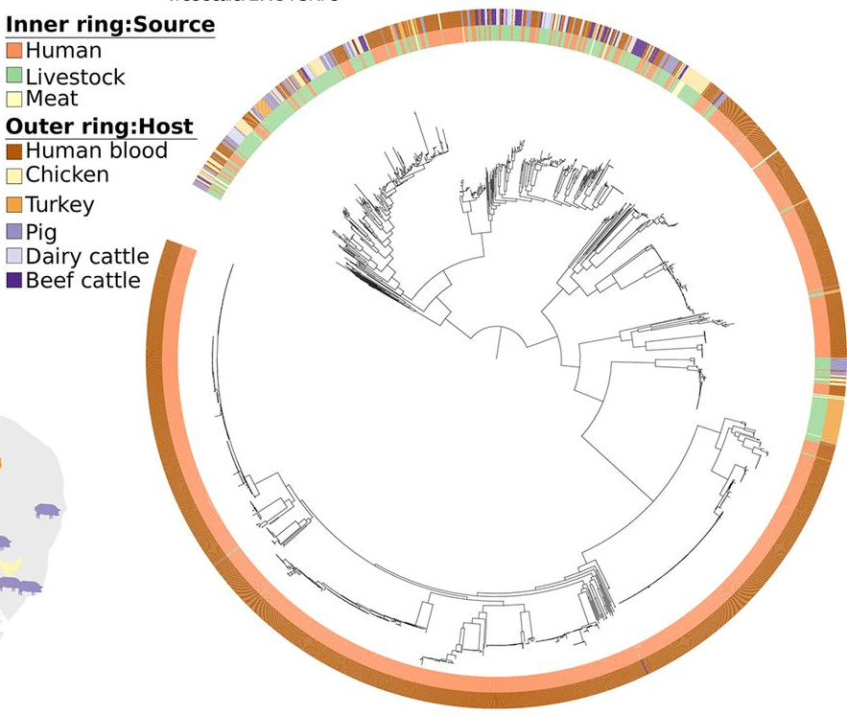
Sampling Bias - Escherichia coli
Lineages that appear strongly associated with a particular group (e.g. humans)
How well sampled was the other group (i.e. animals)?
Ludden, C. et al. One Health Genomic Surveillance of Escherichia coli Demonstrates Distinct Lineages and Mobile Genetic Elements in Isolates from Humans versus Livestock. MBio 10, (2019)

Slide 15
Why does population structure matter?
Population dynamics and selection
Transmission Inference
Genome Wide Association Studies
Predicting phenotypes from genotypes (machine learning)

Slide 16
Algorithms and Approaches
…for defining and describing Population Structure

Slide 17
2.1 Multilocus Sequence Typing
(MLST)

Slide 18
Multi-Locus Sequence Typing
Uses a reference database of housekeeping gene fragments to assign sequence ‘types’
Gene 1
Gene 2
Gene 3
Gene 4
Gene 5
Strain A
Strain B
Strain C

Slide 19
Multi-Locus Sequence Typing
Gene 1
Gene 2
Gene 3
Gene 4
Gene 5
Strain A
Strain B
Strain C
Query
Strain B
With MLST, genomes form part of a cluster if they are ‘identical’ over the defined regions/genes/loci

Slide 20
Core Gene Multi-Locus Sequence Typing (cgMLST)
Extends MLST to cover a much larger proportion of the core genome
Strain A
Strain B
Strain C
With MLST, genomes form part of a cluster if they are ‘identical’ over the defined regions/genes/loci

Slide 21
Core Gene Multi-Locus Sequence Typing (cgMLST)
Provides finer scale resolution
Strain B.1
MLST
Strain B.2
Strain B.1
cgMLST
Strain B.2

Slide 22
What if we don’t have a suitable database?
MLST is not so good for:
Identifying novel clusters
Controlling for population structure
Analysing outbreaks

Slide 23
2.2 Model based clustering

Slide 24
Model based clustering
population C
population A
population B
Statistical models allow genomes to be clustered, despite not being identical – finds the most likely groupings.

Slide 25

Model based clustering
population A
Allocate genomes to populations
population B
population C
Statistical models allow genomes to be clustered, despite not being identical – finds the most likely groupings.

Slide 26
Bayesian Hierarchical Clusters (hierBAPS, rHierBAPS, fastbaps)
Assumes each genome comes from a single population (bucket)
Merges the closest two genomes if it increases the likelihood of the model

Slide 27
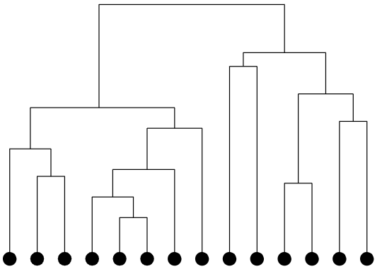
Bayesian Hierarchical Clusters (hierBAPS, rHierBAPS, fastbaps)
Clustering threshold may not be consistent across lineages
Simply reflects the best fit to the model
Support for population split
Genomes

Slide 28
Similar algorithms
STRUCTURE (Pritchard et al., 2000)
Snapclust (Beugin et al., 2018)
DAPC (Jombart et al., 2010)
BAPS (Corander et al., 2008)

Slide 29
2.3 Clustering the accessory genome

Slide 30
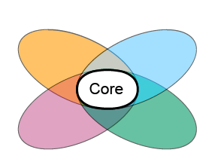
Beyond the core genome...
Accessory

Slide 31
PopPUNK (Population Profiling Using Nucleotide Kmers)
Incorporates both Core + Accessory data by using ‘k-mers’

Slide 32
PopPUNK (Population Profiling Using Nucleotide Kmers)
Original sequence
AGTTGAGTTG
AGTTGA
GTTGAG
TTGAGT
6-mers
TGAGTT
GAGTTG

Slide 33
PopPUNK (Population Profiling Using Nucleotide Kmers)
Genome A
Genome B
AGTTGAGT
GTTGAGTT
AGTTGA
GTTGAG
GTTGAG
TTGAGT
TTGAGT
TGAGTT
Intersection = 2
GTTGAG
TTGAGT

Slide 34
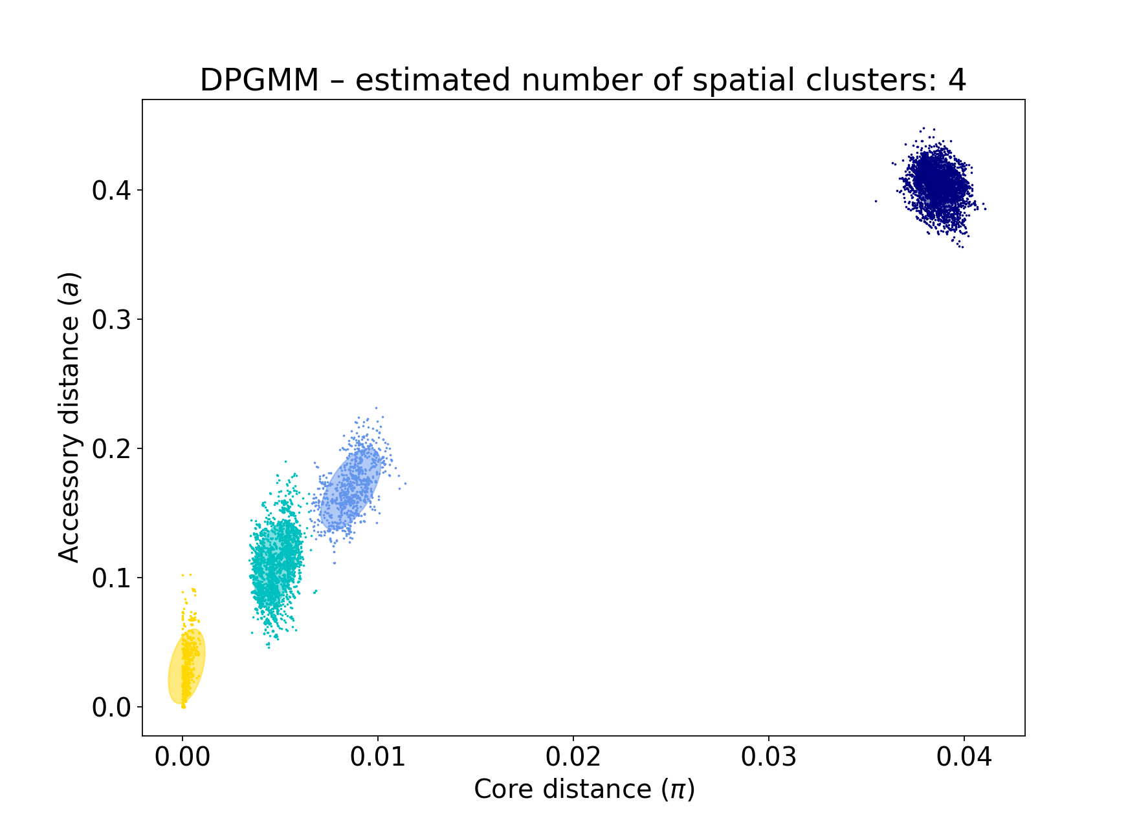
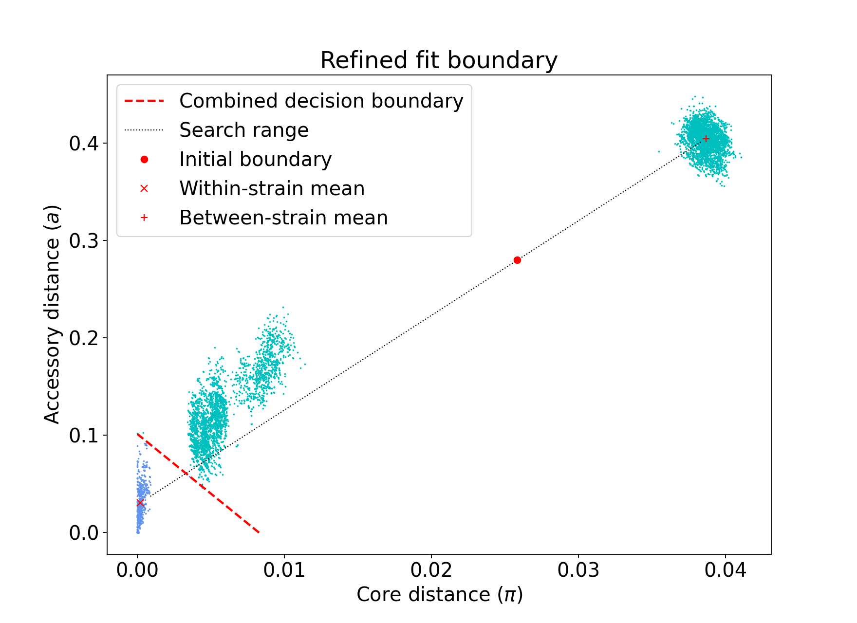
PopPUNK (Population Profiling Using Nucleotide Kmers)
Lees, J. A. et al. Fast and flexible bacterial genomic epidemiology with PopPUNK. Genome Res. 29, 304–316 (2019)

Slide 35
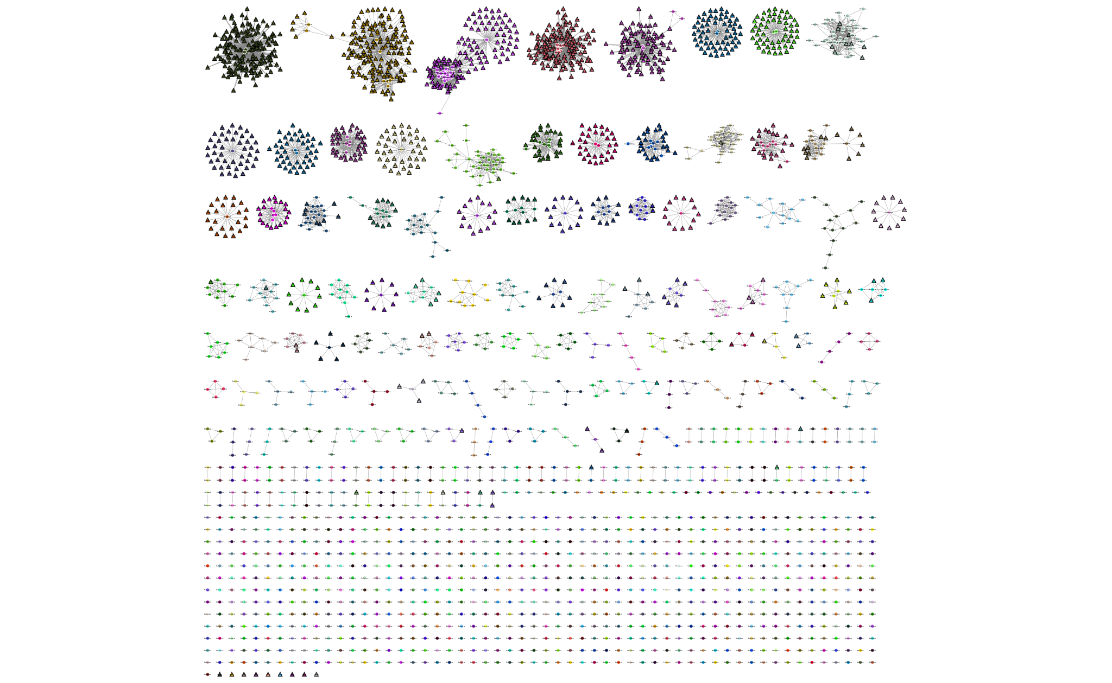
PopPUNK (Population Profiling Using Nucleotide Kmers)
Very fast to run
Can provide a persistent nomenclature (unlike BAPS)
Lees, J. A. et al. Fast and flexible bacterial genomic epidemiology with PopPUNK. Genome Res. 29, 304–316 (2019)

Slide 36
2.4 Transmission clustering

Slide 37
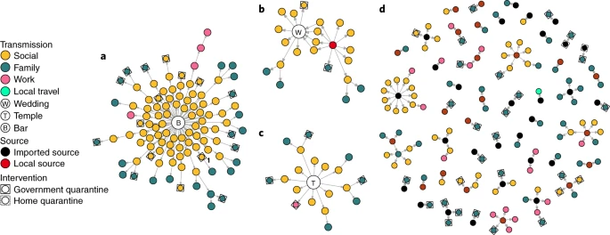
Transmission Clustering
Clustering very closely related genomes to infer transmission
Adam, D. C. et al. Clustering and superspreading potential of SARS-CoV-2 infections in Hong Kong. Nat. Med. 26, 1714–1719 (2020)

Slide 38
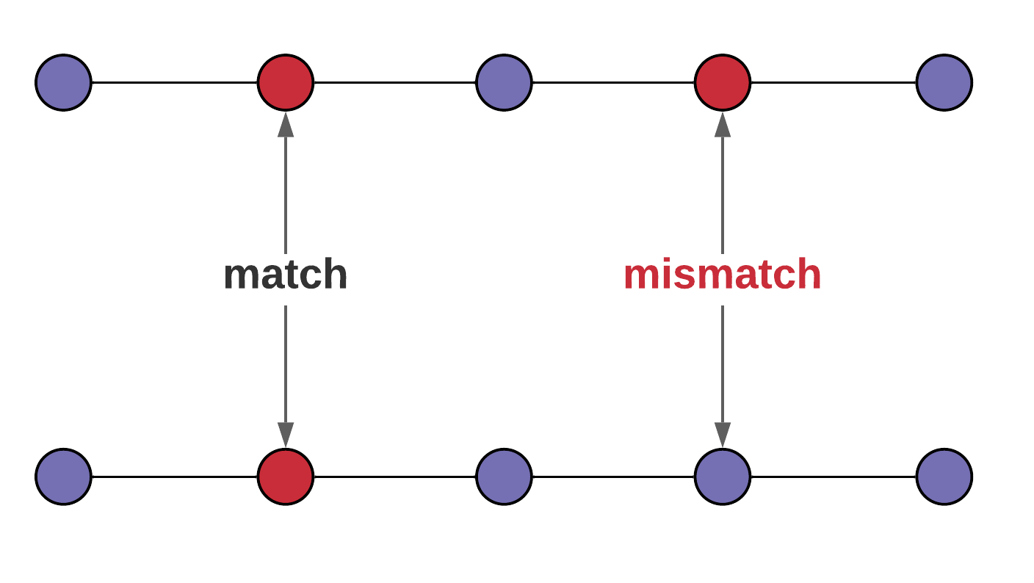
SNP Distance
Plausible transmission if SNP distance < Threshold

Slide 39
Single linkage hierarchical clustering
SNP distance
SNP threshold
Genomes
Plausible transmission if SNP distance < Threshold

Slide 40
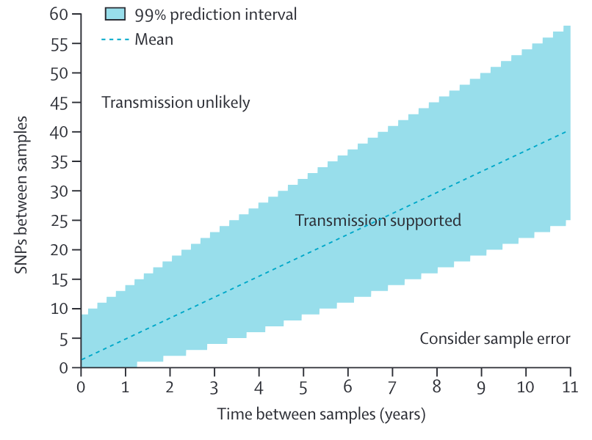
Single linkage clusters accounting for temporal variation
De Silva et al (2016) Lancet Infect Dis 11): 1295–1303 https://doi.org/10.1016/S1473-3099(16)30157-8

Slide 41
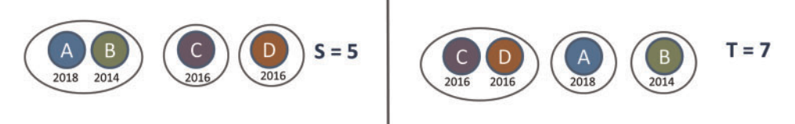
Transcluster
SNP approach
Accounts for:
Genetic distance
Accounts for:
Genetic distance
Sampling dates
Evolutionary rate
Transmission generation time
Transcluster
Stimson, J. et al. Beyond the SNP Threshold: Identifying Outbreak Clusters Using Inferred Transmissions. Mol. Biol. Evol. 36, 587–603 (2019)

Slide 42
3. Summary

Slide 43
Sequence Clustering Methods
Database based (MLST)
Statistical Model based (fastBAPS, STRUCTURE, Snapclust)
Accessory genome (PopPUNK)
Transmission (Single linkage, Transcluster)

Slide 44
Use cases
Important in understanding:
Selection
Migration
Transmission
Impact of interventions
Also used in:
GWAS
Control for sampling bias
Phenotype prediction

Slide 45
Thank you

