Slide 1

Genomic & Epidemiological Surveillance of Bacterial Pathogens
6-11 July 2025
Module 5: Genome Assembly & Annotation
Methods for de novo assembly of bacterial genomes
Mat Beale

Slide 2
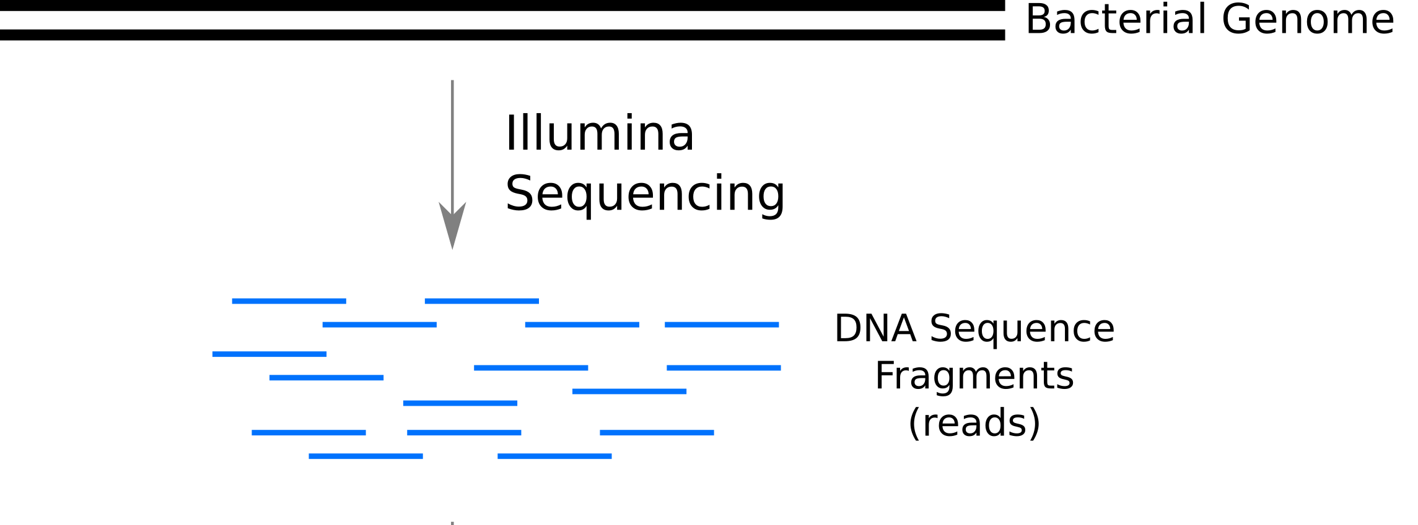
So you’ve sequenced a genome…
(fastq)
What next?

Slide 3
Map to Reference
De novo Assembly

Slide 4
Map to Reference
De novo Assembly

Slide 5
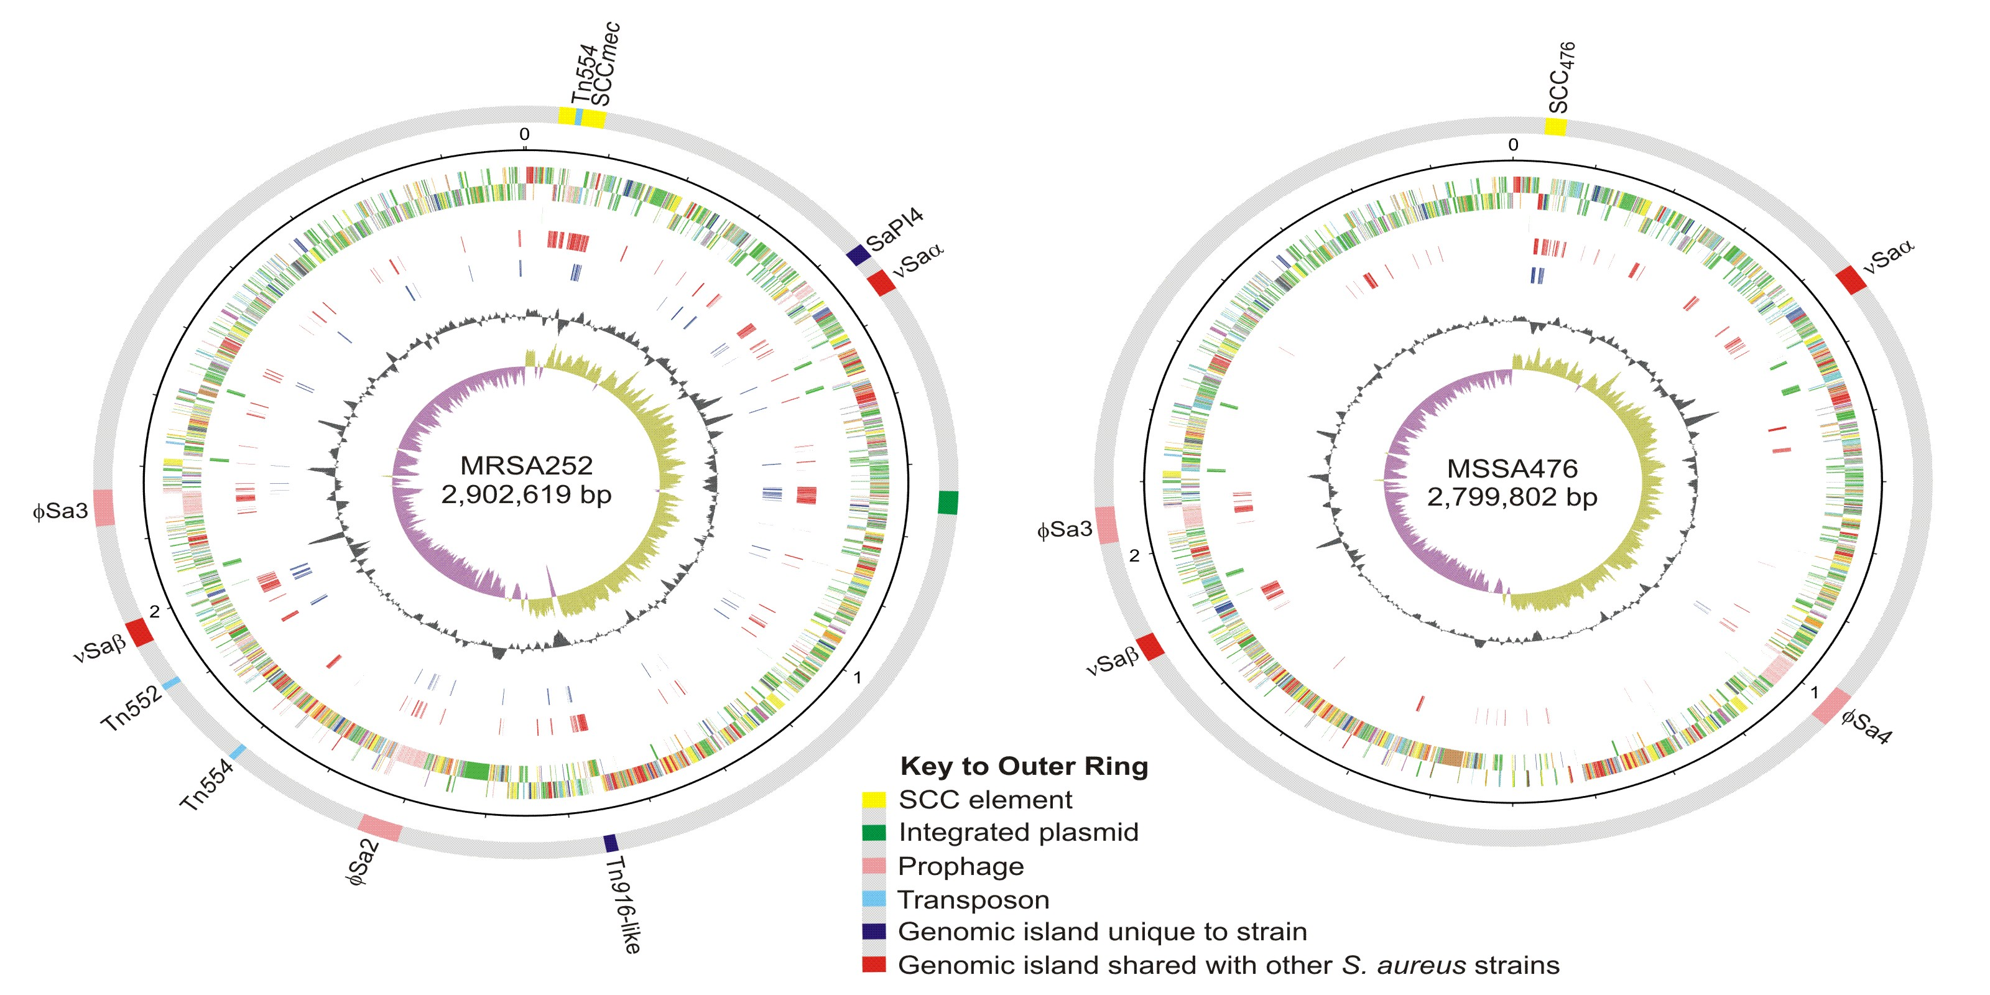
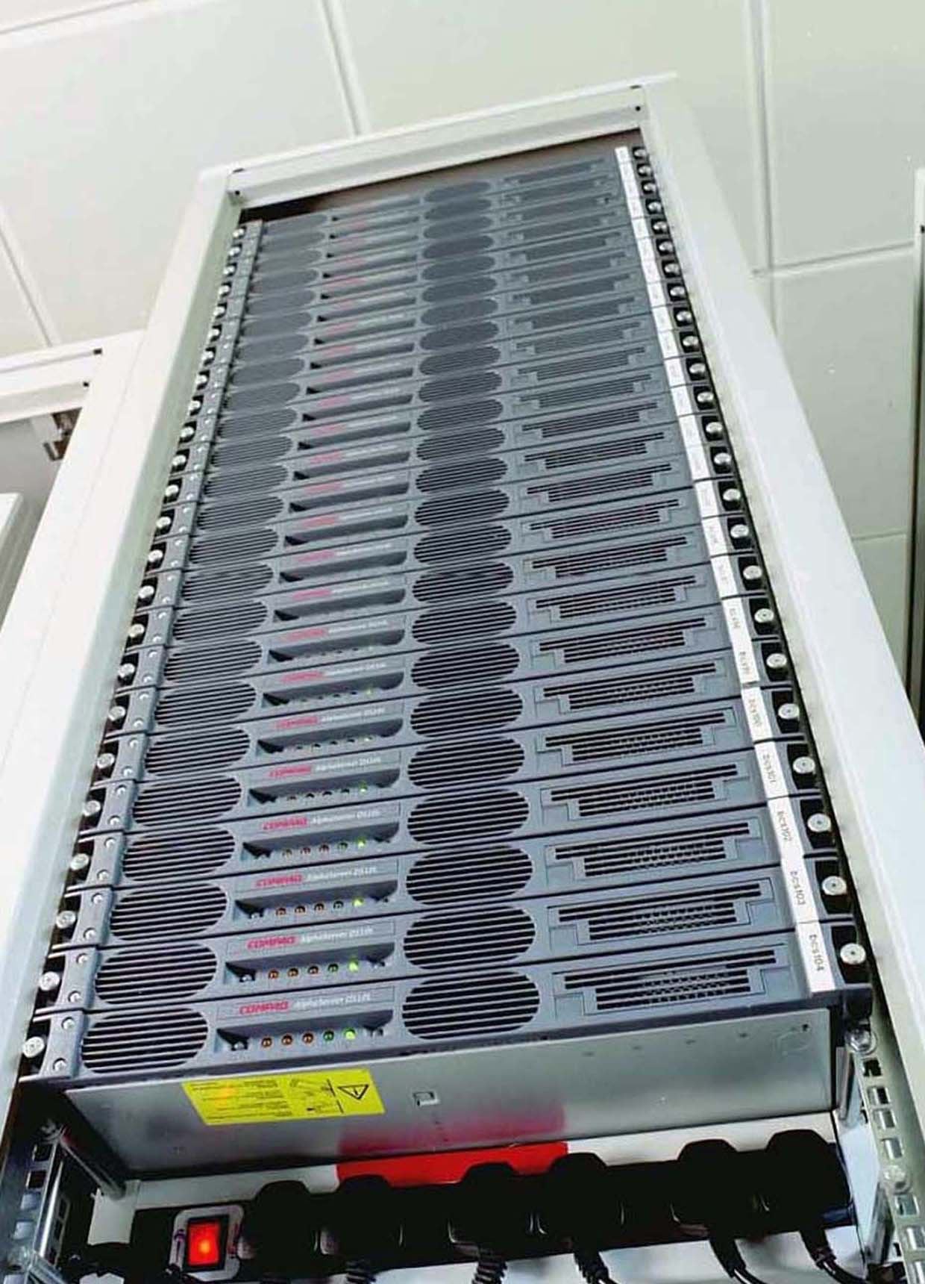
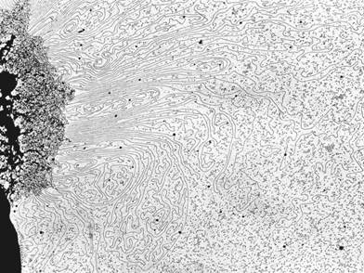
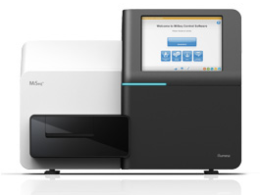
General principle of genome sequencing and bioinformatics
@HS2_07083:1:1104:4586:144649#23/1
ATTCGAACATTGTAAACACTCATGCTTCGGACCAAACTCATGGTGATGTTATGAAATTTGATTGCTCGCATCGTG
+
ECFI/JHJIFJLKMIKJJMLJINIGNLILJKMNKMJLKKJJHKKKKNJLKKLDFLJLKLJQNJKLNJJLKLHNI:
@HS2_07083:1:1101:11238:36254#23/1
TACAATATAACAAAATCCTTTTTATAACGCAAGTTCATTTTATACTACTGCTCAATTTTTTTACTTTTATCGATT
+
CBFHHIKJKKJLKMLIJNMLIINKHPKJLMKMNJMJJLKJGKMKKFNJLKKHNMLOJKLNMKKMLNHJLKMOHNG
@HS2_07083:1:2107:12192:120503#23/1
AATCCTTTTTATAACGCAAGTTCATTTTATACTACTGCTCAATTTTTTTACTTTTATCGATTAAAGATAGAAATA
+
C?EDGGHJKK@GHMLIJJADNE>@GPKKGIKIJGMMJGJKHDKKIKNHLFKILMLILKIIMKKJLE8AEKGHJII
@HS2_07083:1:1207:4799:54850#23/1
AATATAACAAAATCCTTTTTATAACGCAAGTTCATTTTATACTACTGCTCAATTTTTTTACTTTTATCGATTAAA
+
DBDFHKKJKKJLKMLIJJMLIINOLKKILKKMNKJKKJJKNJKKOKNJLKMHHMLLJKLIMKJMLMMJLDDHMJG
@HS2_07083:1:2107:7949:96311#23/1
AAGTATGTATAAGAACTGTATAAGGTATTCAAACATTGTAAACACTCATGCTTCGGACCAAACTCATGGTGATGT
+
DNA sequencing
Bioinformatics
Complete genomic DNA
Fastq sequencing reads
Assembled and annotated genome sequence

Slide 6
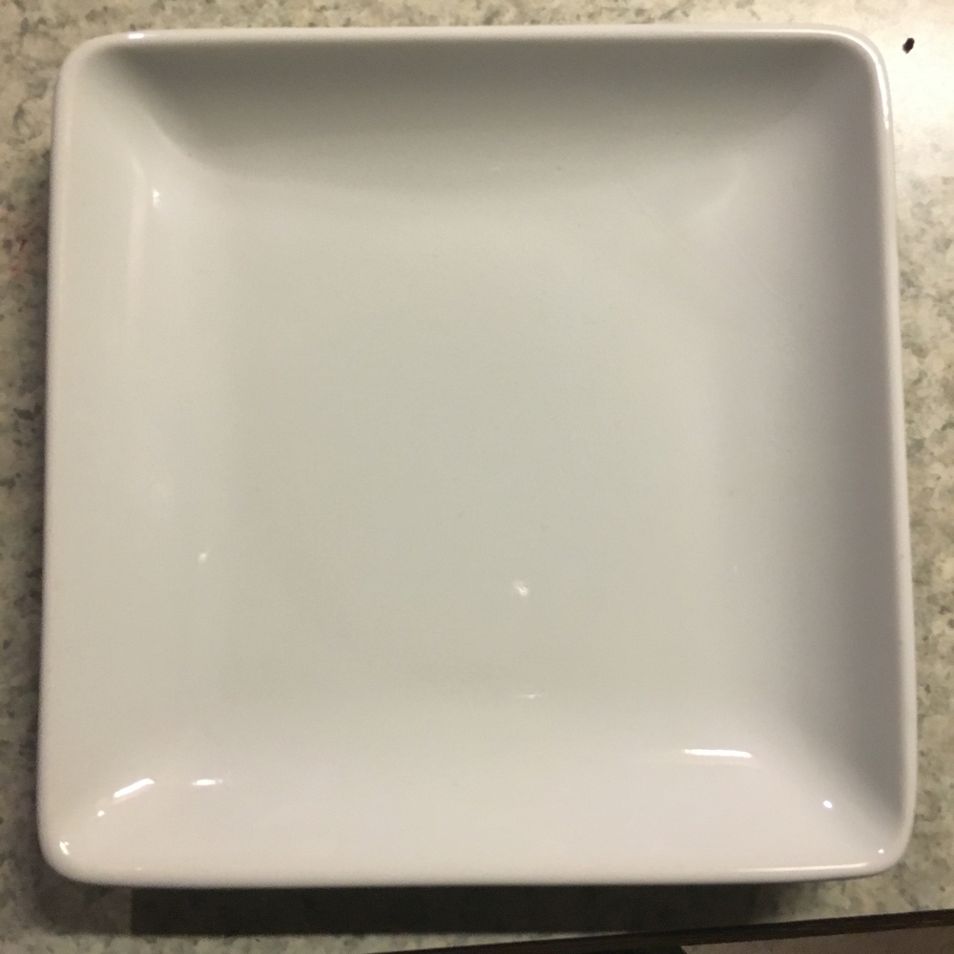
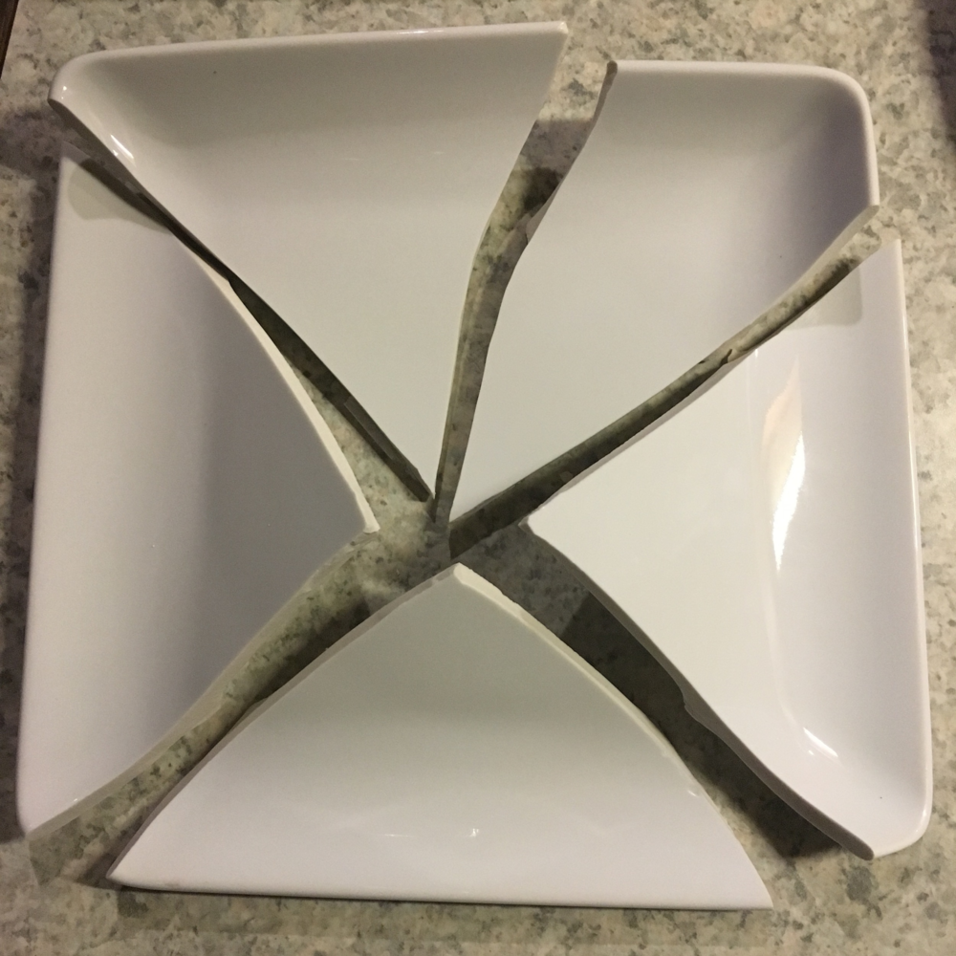
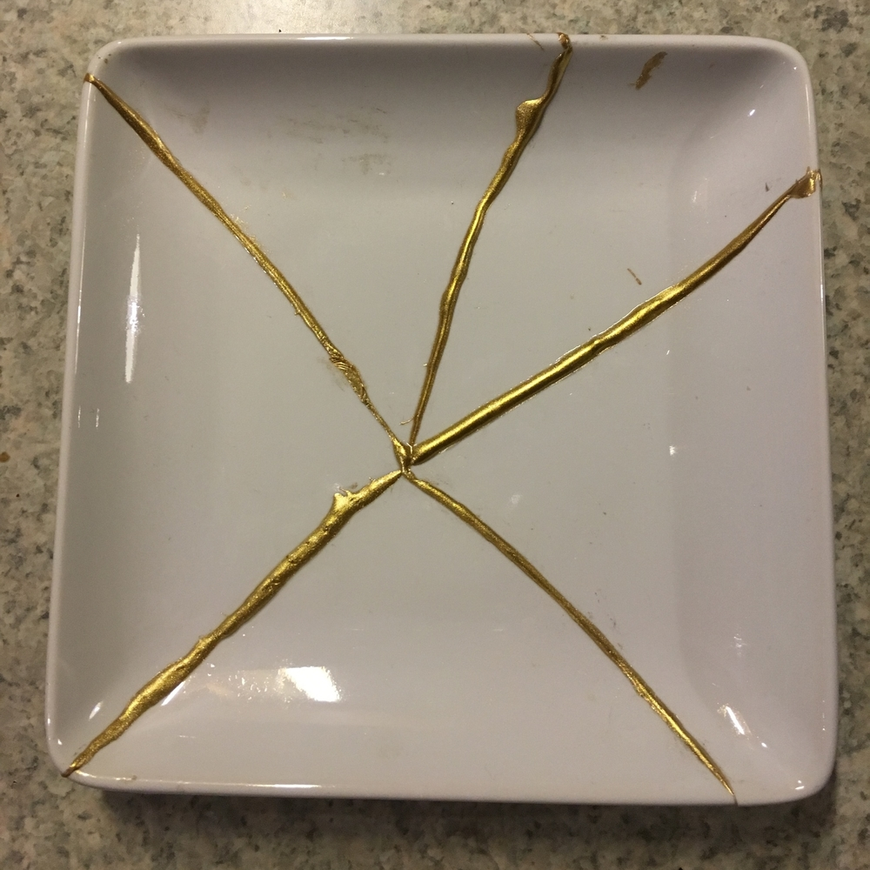
Kintsugi: about making the brokenness beautiful
@HS2_07083:1:1104:4586:144649#23/1
ATTCGAACATTGTAAACACTCATGCTTCGGACCAAACTCATGGTGATGTTATGAAATTTGATTGCTCGCATCGTG
+
ECFI/JHJIFJLKMIKJJMLJINIGNLILJKMNKMJLKKJJHKKKKNJLKKLDFLJLKLJQNJKLNJJLKLHNI:
@HS2_07083:1:1101:11238:36254#23/1
TACAATATAACAAAATCCTTTTTATAACGCAAGTTCATTTTATACTACTGCTCAATTTTTTTACTTTTATCGATT
+
CBFHHIKJKKJLKMLIJNMLIINKHPKJLMKMNJMJJLKJGKMKKFNJLKKHNMLOJKLNMKKMLNHJLKMOHNG
@HS2_07083:1:2107:12192:120503#23/1
AATCCTTTTTATAACGCAAGTTCATTTTATACTACTGCTCAATTTTTTTACTTTTATCGATTAAAGATAGAAATA
+
C?EDGGHJKK@GHMLIJJADNE>@GPKKGIKIJGMMJGJKHDKKIKNHLFKILMLILKIIMKKJLE8AEKGHJII
@HS2_07083:1:1207:4799:54850#23/1
AATATAACAAAATCCTTTTTATAACGCAAGTTCATTTTATACTACTGCTCAATTTTTTTACTTTTATCGATTAAA
+
DBDFHKKJKKJLKMLIJJMLIINOLKKILKKMNKJKKJJKNJKKOKNJLKMHHMLLJKLIMKJMLMMJLDDHMJG
@HS2_07083:1:2107:7949:96311#23/1
AAGTATGTATAAGAACTGTATAAGGTATTCAAACATTGTAAACACTCATGCTTCGGACCAAACTCATGGTGATGT
+

Slide 7
Module 5 – about making the brokenness beautiful
@HS2_07083:1:1104:4586:144649#23/1
ATTCGAACATTGTAAACACTCATGCTTCGGACCAAACTCATGGTGATGTTATGAAATTTGATTGCTCGCATCGTG
+
ECFI/JHJIFJLKMIKJJMLJINIGNLILJKMNKMJLKKJJHKKKKNJLKKLDFLJLKLJQNJKLNJJLKLHNI:
@HS2_07083:1:1101:11238:36254#23/1
TACAATATAACAAAATCCTTTTTATAACGCAAGTTCATTTTATACTACTGCTCAATTTTTTTACTTTTATCGATT
+
CBFHHIKJKKJLKMLIJNMLIINKHPKJLMKMNJMJJLKJGKMKKFNJLKKHNMLOJKLNMKKMLNHJLKMOHNG
@HS2_07083:1:2107:12192:120503#23/1
AATCCTTTTTATAACGCAAGTTCATTTTATACTACTGCTCAATTTTTTTACTTTTATCGATTAAAGATAGAAATA
+
C?EDGGHJKK@GHMLIJJADNE>@GPKKGIKIJGMMJGJKHDKKIKNHLFKILMLILKIIMKKJLE8AEKGHJII
@HS2_07083:1:1207:4799:54850#23/1
AATATAACAAAATCCTTTTTATAACGCAAGTTCATTTTATACTACTGCTCAATTTTTTTACTTTTATCGATTAAA
+
DBDFHKKJKKJLKMLIJJMLIINOLKKILKKMNKJKKJJKNJKKOKNJLKMHHMLLJKLIMKJMLMMJLDDHMJG
@HS2_07083:1:2107:7949:96311#23/1
AAGTATGTATAAGAACTGTATAAGGTATTCAAACATTGTAAACACTCATGCTTCGGACCAAACTCATGGTGATGT
+
CB?FIJFJICJEKMLIJPMGJELIL:IIL=KMIJMKKLJJHKMGLKNJLNGEHMLKJKINJLMCLI3JLKJHJFG
@HS2_07083:1:2202:11713:80294#23/1
TTATAACGCAAGTTCATTTTATACTACTGCTCAATTTTTTTACTTTTATCGATTAAAGATAGAAATACACGATGC
+
CBDFHIAJIKJLHMGJJNMGJJLOKJKJLIKJIHMMOKKKNHMKKCNJLKKLNMLOLKLLQLKMLFMJLKJHKJ@
@HS2_07083:1:2104:18154:101072#23/1
ATATAACAAAATCCTTTTTATAACGCAAGTTCATTTTATACTACTGCTCAATTTTTTTACTTTTATCGATTAAAG
+
8C-FIKJJKKJLKMLKJNMLJLJKHKKILFKMNKHKOJKKNJHKKKNJLKMLLMHOLKIJMLMMLHMJIKMMHIG
@HS2_07083:1:1102:3900:138412#23/1
TACTACTGCTCAATTTTTTTACTTTTATCGATTAAAGATAGAAATACACGATGCGAGCAATCAAATTTCATAACA
+
CBEJIKJJKKILKMLKJNMLILNOINLKLKKMNHMKLGFJHKJKLGNJLKMKNGDKJKLJENKMLNFJLKMOMJI
@HS2_07083:1:1208:11026:132224#23/1
AAAACAGCTTGGGAAATAATTTATAAAGTATGTATAAGAACTGTATAAGGTATTCAAACATTGTAAACACTCATG

Slide 8
Assembly
Generating contiguous sequences that represent genome of an isolate
De novo assembly
Using the information from the reads to stitch together the contigs
Reference based assembly
Use a reference sequence to help inform the relative position reads and stitch together the contigs

Slide 9
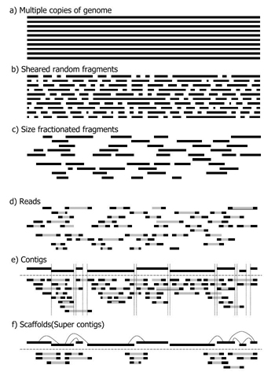


de novo Assembly
Reads
Find overlaps
Contigs

Slide 10
Assemblers produce 2 main outputs
Contigs file (fasta format)
Assembly graph (gfa format)
When a genome assembly is 100% complete, we have one contig per chromosome/plasmid and there's no real need for the graph.
BUT
Most short-read assemblies are not complete, and a graph can describe an incomplete assembly much better than contigs alone.

Slide 11
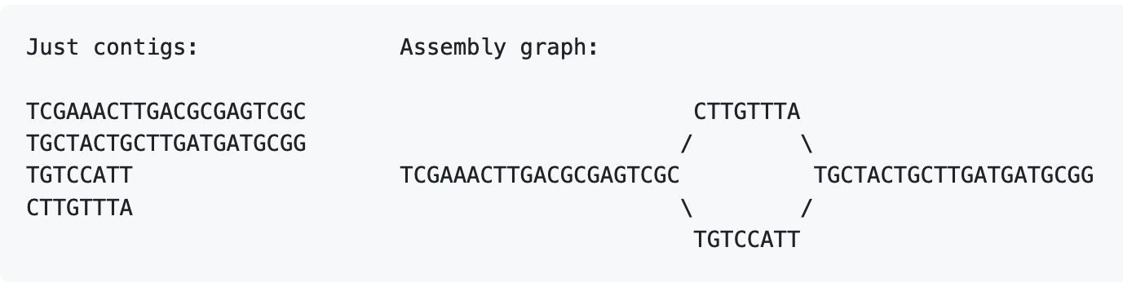
Assembly Graphs
A data structure where contigs aren't disconnected sequences, but can have connections to each other
3
1
2
3
4
1
2
4

Slide 12
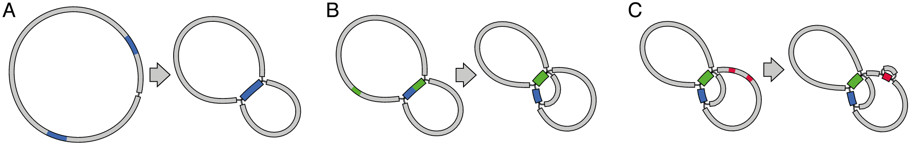
Why short reads don’t assemble well
Short reads cannot usually provide a complete assembly because:
The genome contains repeats (same sequence occurring 2 or more times)
When a repeat is longer than the reads (or longer than the insert size), it forms a single contig in the assembly graph with multiple connections in and multiple connections out.
Increasing repeats

Slide 13
To produce complete (or near complete) genomes, we need to resolve repeats

Slide 14
Methods for assembling genomes
Short Read Only
Long Read Only
Hybrid Assembly
Short Read First
Long Read First
Velvet
SPAdes
Unicycler
Shovill
Miniasm
Unicycler
Canu
Flye
Dragonflye
Raven
Unicycler
SPAdes + bridge
Miniasm/Flye/Canu + polish

Slide 15
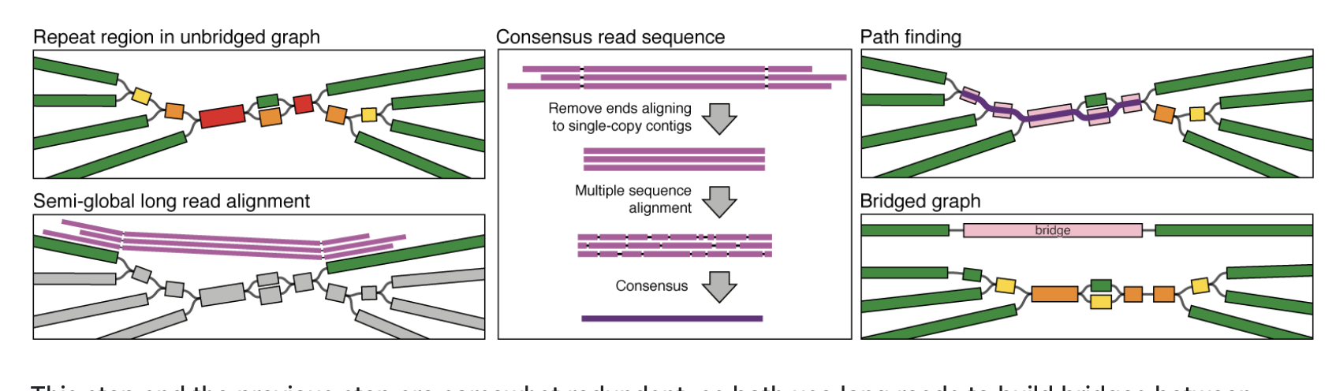
Hybrid Approaches
Short read first (Unicycler hybrid)
SPAdes assembly using short reads
Attempt to ‘bridge’ contig breaks using long reads

Slide 16
Hybrid Approaches
Short read first (Unicycler hybrid)
Advantages
Accurate short read assemblies improved by long reads
Works well when long-read data is poor/low coverage
Disadvantages
Can only bridge regions already identified in SPAdes assembly graph
Cannot resolve structural errors from SPAdes assembly

Slide 17
Hybrid Approaches
Long read first
Construct a long-read assembly
Use short reads to ‘polish’ the assembly (improve accuracy)
Advantages
Very contiguous assemblies
Great for resolving plasmids
Polishing with short read data improves accuracy and reduces sequencing artefacts
Disadvantages
Higher error rate in long-read data can lead to small errors
Low coverage/quality long-read data can lead to poor recovery of low copy number plasmids
Size selection during library prep can lead to loss of small plasmids in long read data

Slide 18
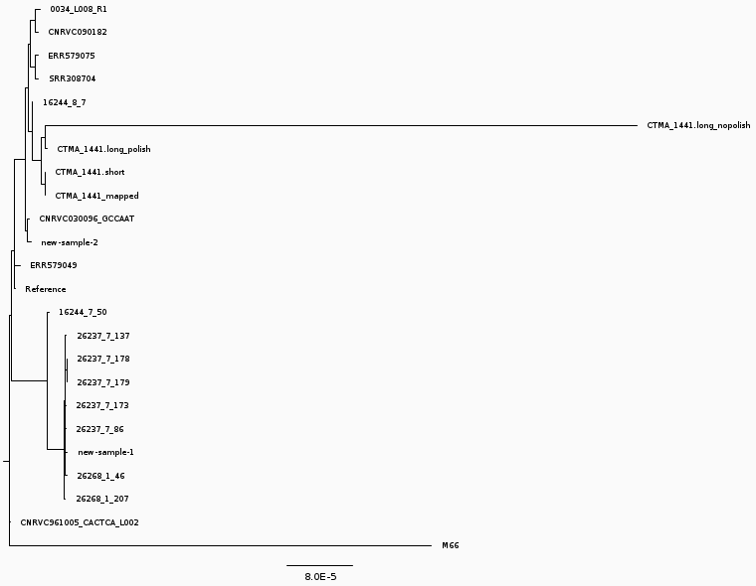
Example from Mapping exercise

Slide 19
Long Read only approaches
As long-read technologies become
More accurate
Produce better depth
Hybrid assembly will become less necessary
Can produce ‘perfect’ bacterial assemblies with just long-reads
Still more expensive to do high quality long-read sequencing at scale

Slide 20
Assembly Method Comparison Exercise
We are going to compare these different types of approaches as a group. We will:
Compare assembly approaches
Short-read only
Long-read only
Hybrid (short-read first & long-read first)
Compare the effect of long-read depth
Evaluate different assemblies using standard quality metrics (Quast)

