Slide 1
Module 6: Genetic variation
Helminth Bioinformatics
Khon Kaen University, 2023
Notes:
- this morning we will start to learn some basic UNIX skills, excited?
- how many used UNIX/command line before?
anyone that hasn’t used UNIX before don’t panic when see the UNIX prompt, all exercises this morning are step by step and all commands are provided
anyone who has used UNIX, be patient, exercises are short and in the later we will introduce more advanced UNIX concepts

Slide 2
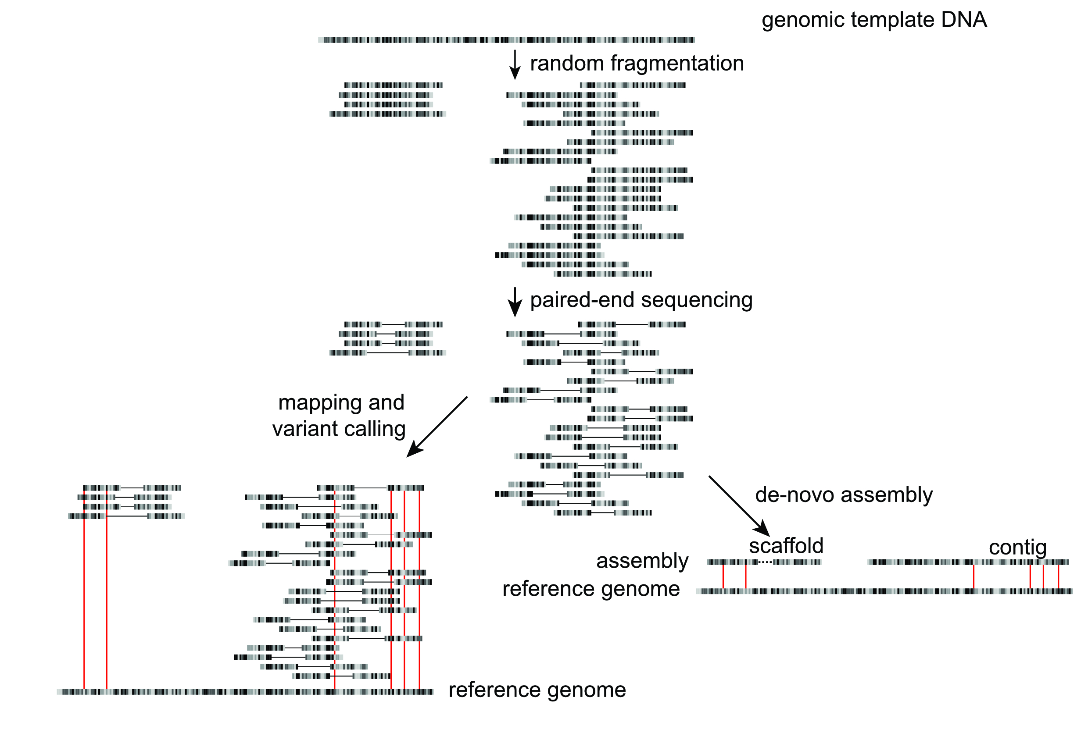
Using high-throughput sequencing to analyse genetic variation
Sample / library preparation
Sequencing
Informatics

Slide 3
Mapping short reads to a reference
@IL24_5151:3:1:1553:916#9/1
NAAACTACTTACACCCACTCAGGACACCAGGGACATCATTGCTGACGCCACGGCCTCACAGTGCTGAGCTGATGAT
+
$705291596=>>>>>=>=>=>==>>===>535:6=>=>>>=>==5:;318656:===991/1,-0,0015204.1
@IL24_5151:3:1:2173:904#9/1
NTTTTAACCGTACTTTCACCAGGATTATCGCAGGCGGATTCCTGGTGATTAATTTCAAAAAATAGCGTTTAATCCA
+
$948883999>==>>>>=>>=>>9>>>==>===>=>==>>:;:::===>=55:88>==>9:0;;:===>>==>>>5
@IL24_5151:3:1:2948:912#9/1
NCCACCAGACACTGTCCGCAACCCCGGTAAGGGGCCAACGTTAGAACATCAAACATTAAAGGGTGGTATTTCAAGG
+
>reference sequence
ATTGAACGCTGGCGGCAGGCCTAACACATGCAAGTCGAGCGGCAGCGGGAAGTAGTTT
TACTTTGCCGGCGAGCGGCGGACGGGTGAGTAATGTCTGGGAAACTGCCTGATGGAGG
GATAACTACTGGAAACGGTAGCTAATACCGCATGACCTCGTAAGAGCAAAGTGGGGGAC
TTCGGGCCTCACGCCATCGGATGTGCCCAGATGGGATTAGCTAGTAGGTGGGGTAATGG
TCACCTAGGCGACGATCCCTAGCTGGTCTGAGAGGATGACCAGCCACACTGGAACTGAG
CACGGTCCAGACTCCTACGGGAGGCAGCAGTGGGGAATATTGCACAATGGGCGCAAGC
GATGCAGCCATGCCGCGTGTGTGAAGAAGGCCTTCGGGTTGTAAAGCACTTTCAGCGAG
AGGAAGGCAGTCGTGTTAATAGCACGATTGATTGACGTTACTCGCAGAAGAAGCACCGGC

Slide 4
Types of genetic variation we might be interested
Our genome sequencing will aim to detect:
Single Nucleotide Polymorphisms (SNPs)
Small insertions and deletions (indels)
Other types of variation exist, but may need specialised technologies
Copy Number Variants (CNVs) between different samples
Large structural variants (multiple genes to whole chromosomes)
Variants that impact gene expression
Note: As sequences diverge from the reference, mapping becomes progressively less effective

Slide 5
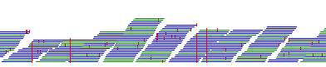
Common workflows and analyses
Identifying SNPs in your sample relative to a reference

Slide 6
Common workflows and analyses
Phylogenetics
Call SNPS and create pseudogenomes *
Paired-end sequence reads in FASTQ file *
Extract variable sites
and convert format
Map against reference *
*do for each isolate
Construct and interpret phylogeny
Create a sequence alignment

Slide 7
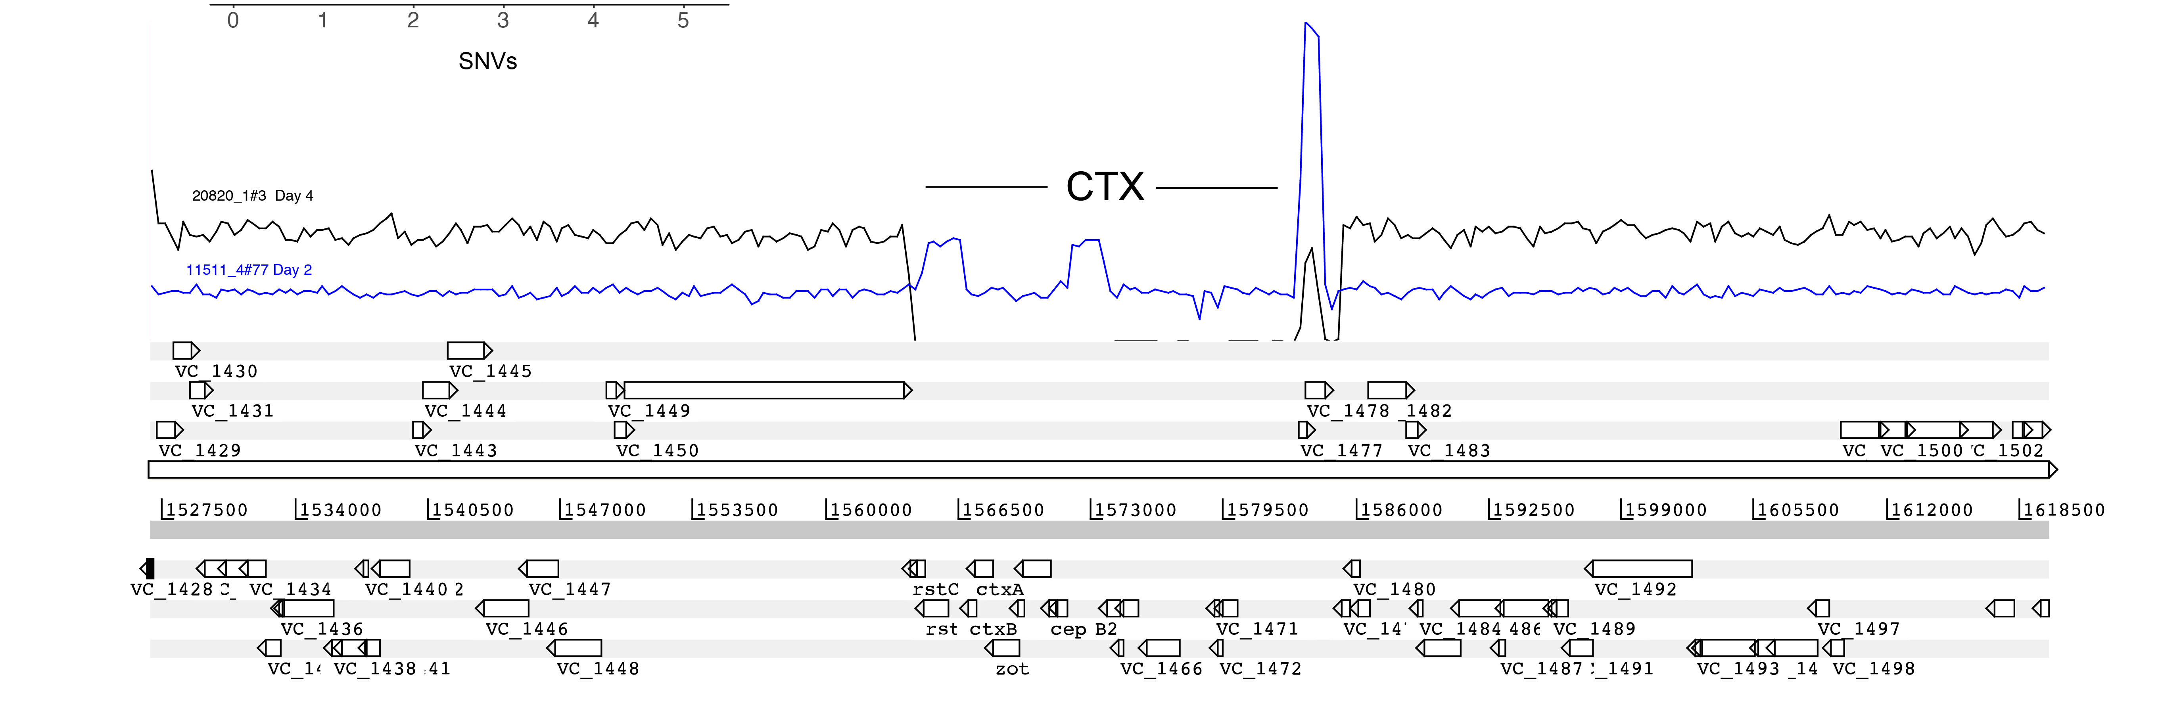
Common workflows and analyses
Gene presence or absence based on differences in sequencing coverage

Slide 8
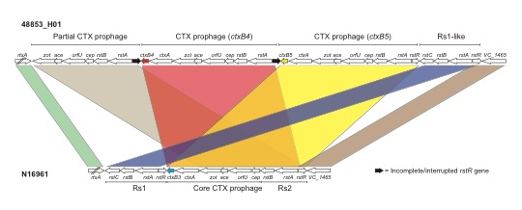
Common workflows and analyses
Copy number variation

Slide 9
Your task for today
Analysing the global diversity of the gastrointestinal nematode Haemonchus contortus
parasite found worldwide in wild and domesticated ruminants
Adult worms inhabit the abomasum, and feed on blood
Drug resistance is common (very high frequency in some regions), including all major classes of anthelmintics

Slide 10
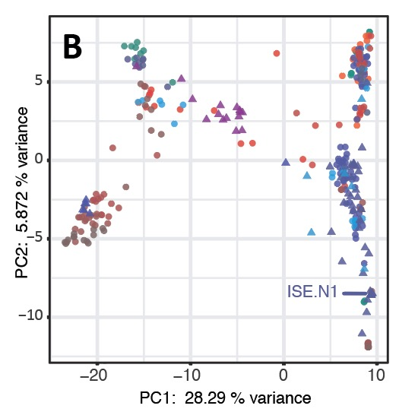
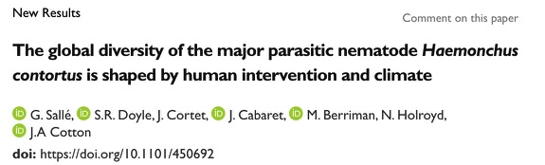
Your task for today
Analysing the global diversity of the gastrointestinal nematode Haemonchus contortus

Slide 11
Starting to use and understand a bioinformatics workflow

Slide 12
Aims of this module
Map high throughout sequencing reads to a reference genome
Illumina reads from 176 samples from parasite mitochondrial genomes
Bioinformatically identify and visualise genetic variation in your samples
SNP calling using the command line and visualise using Artemis
Analyses patterns of genetic diversity, and using associated metadata, uncover biological insights in your species
Using R, generate PCA plots, phylogenetic trees, and sampling maps with data

