Slide 1

Course website
https://wcscourses.github.io/HelminthBioinformatics_2023

Slide 2
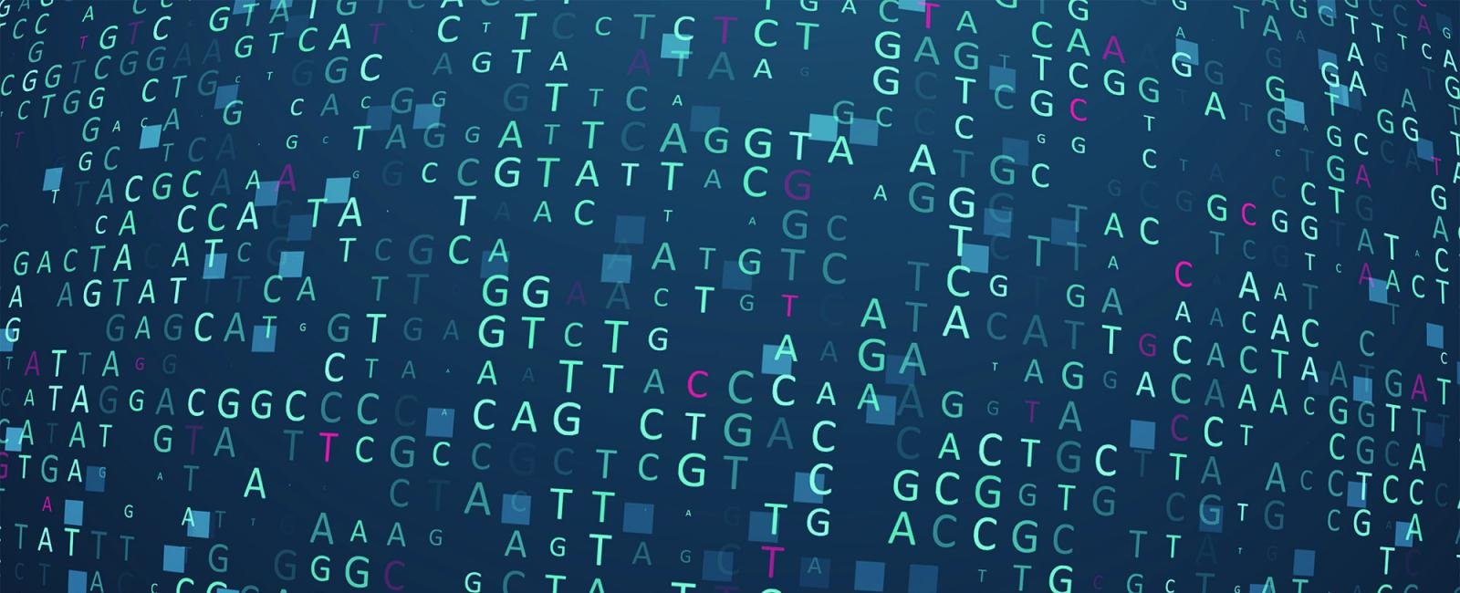


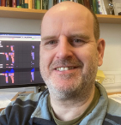


Prof. Matthew Berriman PI
School of Infection & Immunity,
College of Medical,Veterinary & Life Sciences,
University of Glasgow, UK
Part 1
parasite-help@wormbase.org
Dionysis Grigoriadis Bioinformatician
EMBL's European Bioinformatics Institute (EMBL-EBI), UK
Helminth Bioinformatics – Asia 2023
21-27 May 2023
KKU, Thailand

Slide 3
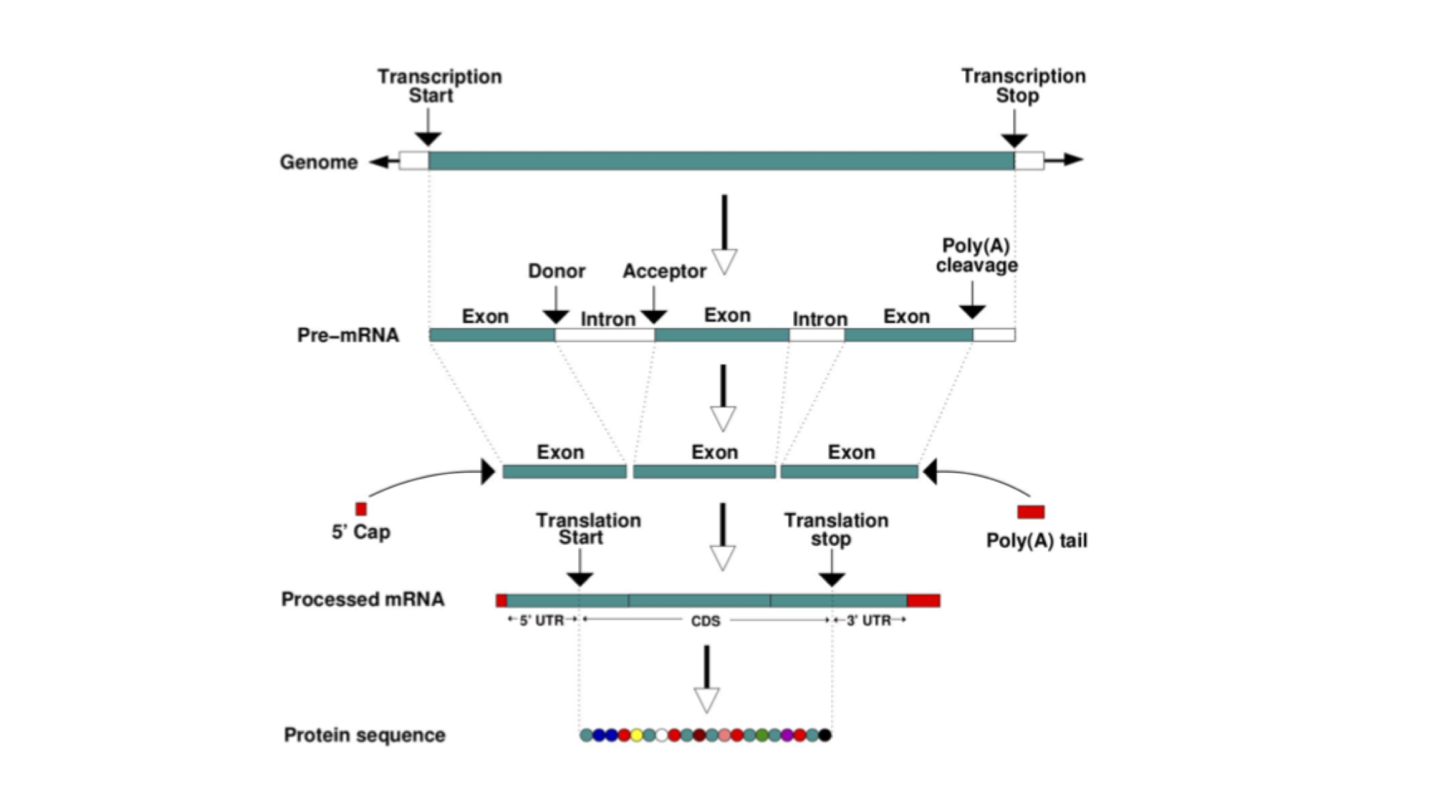
Genes: the basics
A gene is a unit of the genome, a DNA sequence, that is transcribed into an RNA molecule, or a transcript.
A gene can have multiple transcripts!
Notes:
This figure represents the steps that are needed to transform information encoded in the DNA into a polypeptide and eventually a functional protein. The starting information is encoded in the genome. A gene encodes, among other things, the transcription start and transcription end. These are the nucleotides from where an RNA copy of the DNA will be generated. UTRs. This is the gene’s transcript + multiple transcripts This copy is the pre-mRNA which is formed by exons and introns. Maturation of the mRNA molecule happens as it is transcribed and involves the splicing (removal) of introns with the concomitant joining of exons, addition of a CAP at the 5’ end and a polyadenylation tail (many As - AAAAAAA) at the 3’end. A processed mRNA will be the template for the translation of the mRNA message into a protein by the ribosome.

Slide 4
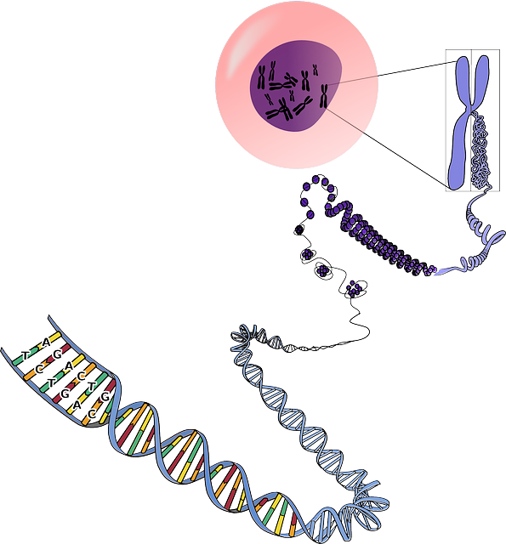

Genome
A genome is an organism’s complete set of genetic material.
Although every individual’s genome is unique
Notes:
A genome is an organism’s complete set of genetic material. Although every individual's genome is unique, the genomes of individuals of the same species will be very similar. It is useful to have a representative genome sequence for each species, and this is referred to as a reference genome.
In the cell, genomes are organised into chromosomes. In practice, current DNA sequencing methods are unable to read the DNA sequence of a whole chromosome without errors. We therefore use the technique of sequencing shorter segments of chromosomes, and do it in such a way that the segments overlap and can be pieced together like a jigsaw puzzle. This process is referred to as genome assembly. For now, we will focus on what genome assemblies look like, and how they are represented in genome databases.
The diagram below shows the structure of a typical assembly. It has 3 layers: the contigs are stretches of contiguous DNA sequence without gaps. The scaffolds are ordered sets of contigs separated by gaps of estimated length. In order to make scaffolds from contigs, techniques such as optical mapping and Hi-C are used. Finally, the chromosome is an ordered set of scaffolds separated by gaps on unknown length. To make the chromosome sequence from the scaffold, techniques such linkage mapping and FISH are used.
Sometimes, there is insufficient (or no) data to reliably place a scaffold into a specific position on a chromosome. In the figure above, this is true of the scaffold on the right. The assembly above therefore comprises 2 toplevel sequences: 1 chromosome, and one unplaced scaffold.

Slide 5
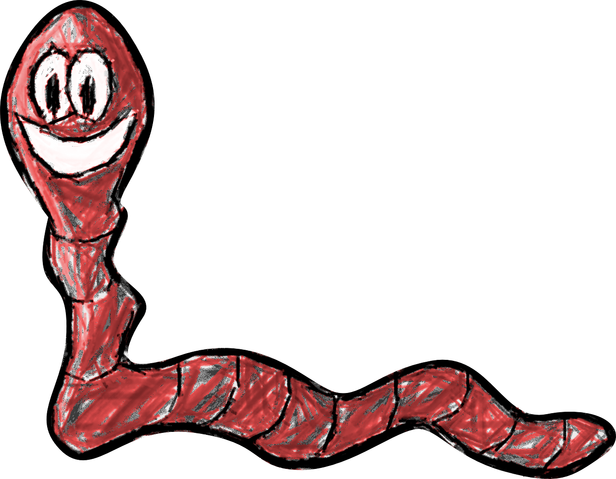



Genome
A genome is an organism’s complete set of genetic material.
The genomes of individuals of the same species will be very similar!
Notes:
A genome is an organism’s complete set of genetic material. Although every individual's genome is unique, the genomes of individuals of the same species will be very similar. It is useful to have a representative genome sequence for each species, and this is referred to as a reference genome.
In the cell, genomes are organised into chromosomes. In practice, current DNA sequencing methods are unable to read the DNA sequence of a whole chromosome without errors. We therefore use the technique of sequencing shorter segments of chromosomes, and do it in such a way that the segments overlap and can be pieced together like a jigsaw puzzle. This process is referred to as genome assembly. For now, we will focus on what genome assemblies look like, and how they are represented in genome databases.
The diagram below shows the structure of a typical assembly. It has 3 layers: the contigs are stretches of contiguous DNA sequence without gaps. The scaffolds are ordered sets of contigs separated by gaps of estimated length. In order to make scaffolds from contigs, techniques such as optical mapping and Hi-C are used. Finally, the chromosome is an ordered set of scaffolds separated by gaps on unknown length. To make the chromosome sequence from the scaffold, techniques such linkage mapping and FISH are used.
Sometimes, there is insufficient (or no) data to reliably place a scaffold into a specific position on a chromosome. In the figure above, this is true of the scaffold on the right. The assembly above therefore comprises 2 toplevel sequences: 1 chromosome, and one unplaced scaffold.

Slide 6

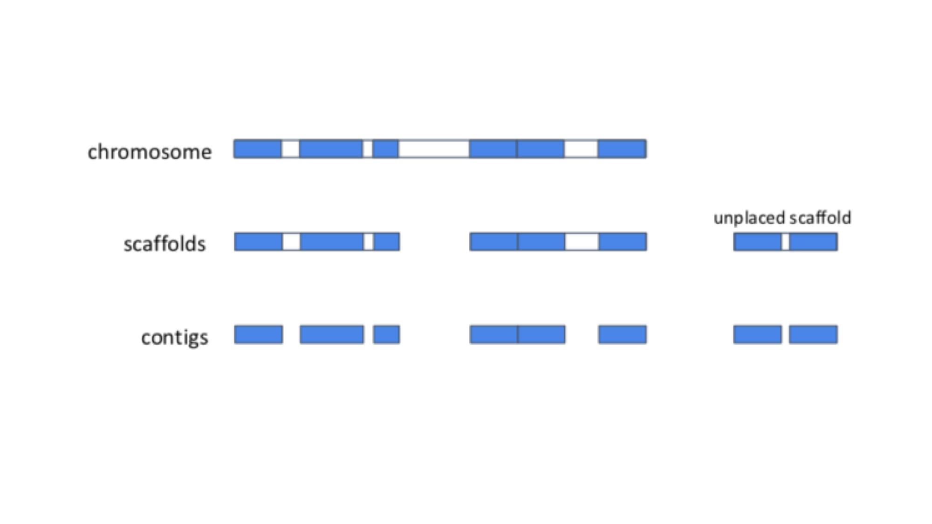
Genome
A genome is an organism’s complete set of genetic material.
It is useful to have a representative genome sequence for each species:
Reference genome
DNA Sequencing
Genome assembly
The genomes of individuals of the same species will be very similar!
We use the technique of sequencing shorter segments of chromosomes and piece them together like puzzle!
Notes:
A genome is an organism’s complete set of genetic material. Although every individual's genome is unique, the genomes of individuals of the same species will be very similar. It is useful to have a representative genome sequence for each species, and this is referred to as a reference genome.
In the cell, genomes are organised into chromosomes. In practice, current DNA sequencing methods are unable to read the DNA sequence of a whole chromosome without errors. We therefore use the technique of sequencing shorter segments of chromosomes, and do it in such a way that the segments overlap and can be pieced together like a jigsaw puzzle. This process is referred to as genome assembly. For now, we will focus on what genome assemblies look like, and how they are represented in genome databases.
The diagram below shows the structure of a typical assembly. It has 3 layers: the contigs are stretches of contiguous DNA sequence without gaps. The scaffolds are ordered sets of contigs separated by gaps of estimated length. In order to make scaffolds from contigs, techniques such as optical mapping and Hi-C are used. Finally, the chromosome is an ordered set of scaffolds separated by gaps on unknown length. To make the chromosome sequence from the scaffold, techniques such linkage mapping and FISH are used.
Sometimes, there is insufficient (or no) data to reliably place a scaffold into a specific position on a chromosome. In the figure above, this is true of the scaffold on the right. The assembly above therefore comprises 2 toplevel sequences: 1 chromosome, and one unplaced scaffold.

Slide 7
Genome
A genome is an organism’s complete set of genetic material.
It is useful to have a representative genome sequence for each species:
Reference genome
DNA Sequencing
Genome assembly
The genomes of individuals of the same species will be very similar!
We use the technique of sequencing shorter segments of chromosomes and piece them together like puzzle!
Notes:
A genome is an organism’s complete set of genetic material. Although every individual's genome is unique, the genomes of individuals of the same species will be very similar. It is useful to have a representative genome sequence for each species, and this is referred to as a reference genome.
In the cell, genomes are organised into chromosomes. In practice, current DNA sequencing methods are unable to read the DNA sequence of a whole chromosome without errors. We therefore use the technique of sequencing shorter segments of chromosomes, and do it in such a way that the segments overlap and can be pieced together like a jigsaw puzzle. This process is referred to as genome assembly. For now, we will focus on what genome assemblies look like, and how they are represented in genome databases.
The diagram below shows the structure of a typical assembly. It has 3 layers: the contigs are stretches of contiguous DNA sequence without gaps. The scaffolds are ordered sets of contigs separated by gaps of estimated length. In order to make scaffolds from contigs, techniques such as optical mapping and Hi-C are used. Finally, the chromosome is an ordered set of scaffolds separated by gaps on unknown length. To make the chromosome sequence from the scaffold, techniques such linkage mapping and FISH are used.
Sometimes, there is insufficient (or no) data to reliably place a scaffold into a specific position on a chromosome. In the figure above, this is true of the scaffold on the right. The assembly above therefore comprises 2 toplevel sequences: 1 chromosome, and one unplaced scaffold.

Slide 8
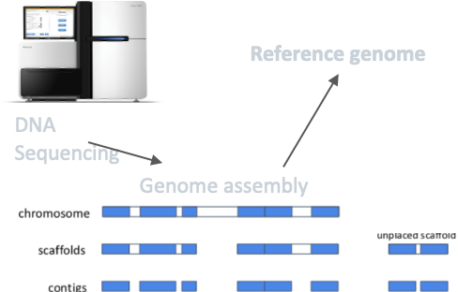
Genome
Notes:
A genome is an organism’s complete set of genetic material. Although every individual's genome is unique, the genomes of individuals of the same species will be very similar. It is useful to have a representative genome sequence for each species, and this is referred to as a reference genome.
In the cell, genomes are organised into chromosomes. In practice, current DNA sequencing methods are unable to read the DNA sequence of a whole chromosome without errors. We therefore use the technique of sequencing shorter segments of chromosomes, and do it in such a way that the segments overlap and can be pieced together like a jigsaw puzzle. This process is referred to as genome assembly. For now, we will focus on what genome assemblies look like, and how they are represented in genome databases.
The diagram below shows the structure of a typical assembly. It has 3 layers: the contigs are stretches of contiguous DNA sequence without gaps. The scaffolds are ordered sets of contigs separated by gaps of estimated length. In order to make scaffolds from contigs, techniques such as optical mapping and Hi-C are used. Finally, the chromosome is an ordered set of scaffolds separated by gaps on unknown length. To make the chromosome sequence from the scaffold, techniques such linkage mapping and FISH are used.
Sometimes, there is insufficient (or no) data to reliably place a scaffold into a specific position on a chromosome. In the figure above, this is true of the scaffold on the right. The assembly above therefore comprises 2 toplevel sequences: 1 chromosome, and one unplaced scaffold.

Slide 9
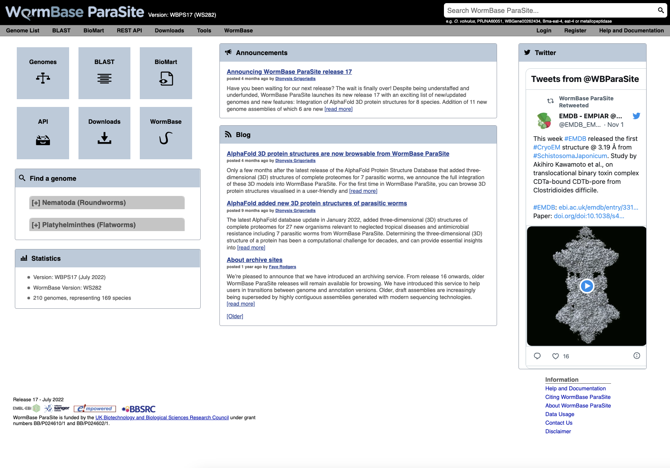

We’re adding value to the genomes!
Processing
Compara
Repeat Modeler
BUSCO score calculation
DNA features
RNA features
Analysis descriptions
Xrefs
GPAD load
Core statistics
Protein features
FIle dumps
BioMart
Gene expression studies
Jbrowse
AlphaFold
And then we make them accessible to you!
Genomes
EBI ensembl’s Web Team – Tuan Le

Slide 10

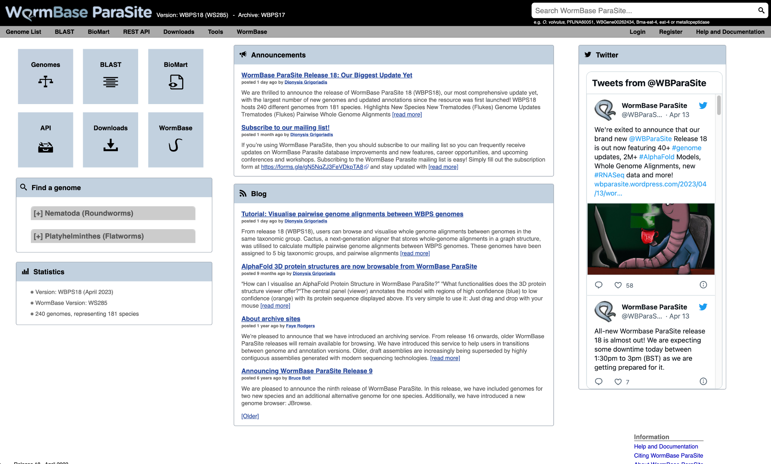
in 2023
parasite.wormbase.org

Slide 11
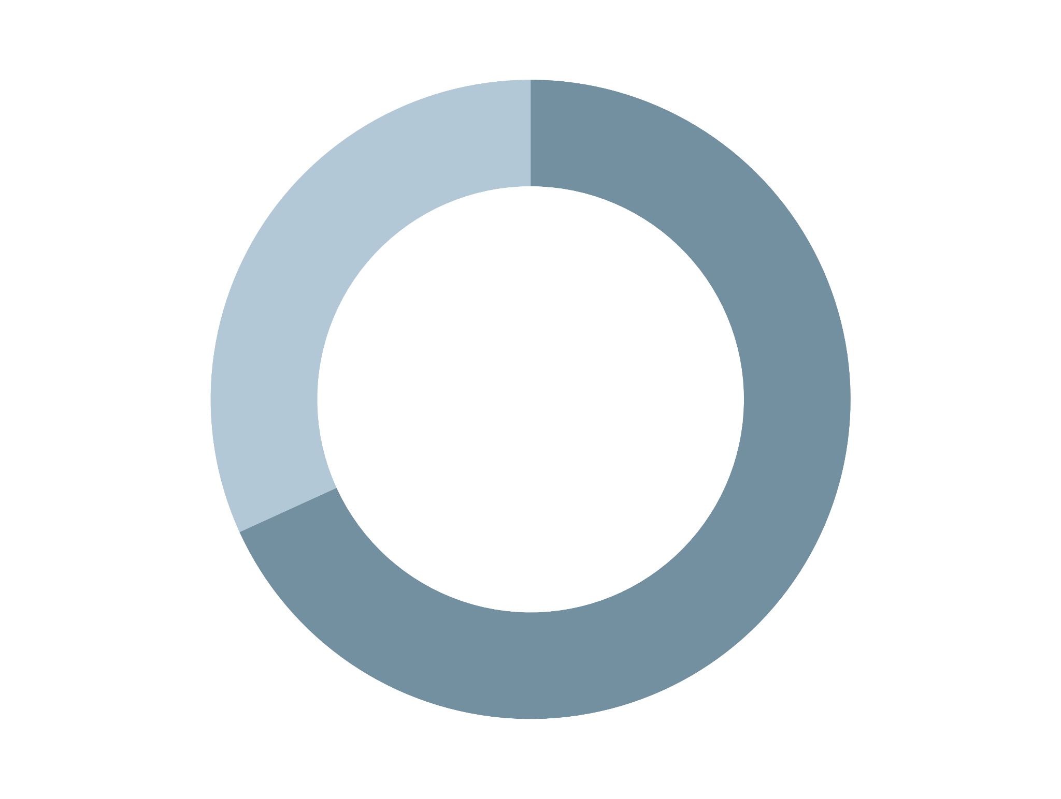
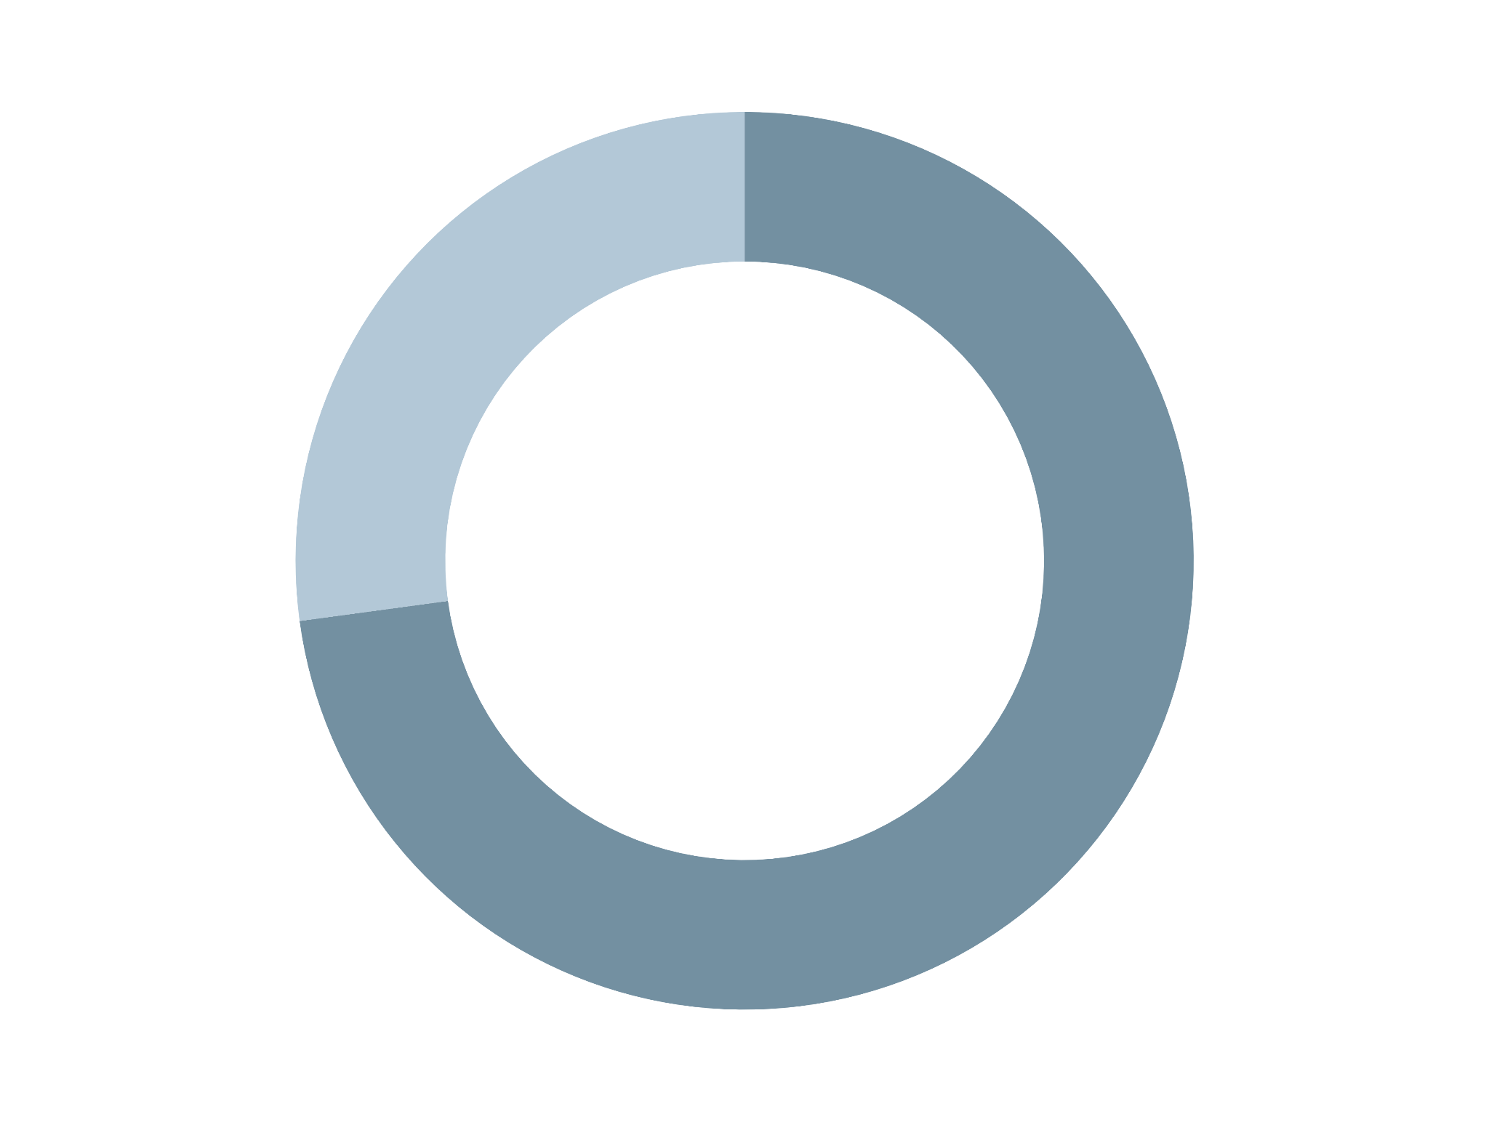
in 2023
Release
Species
Genomes
18
181
240
Platyhelminthes
Free Living
Nematodes
Parasites
63
57
135
153
parasite.wormbase.org
Annual Users
Page Views
Twitter Followers
Top Accessing Countries
17,000
350,000
1,903
1. USA, 2. China, 3. UK, 4. Germany, 5. India

Slide 12
Course website
https://wcscourses.github.io/HelminthBioinformatics_2023

Slide 13
Module 1 – WormBase ParaSite 1
Overview and aims
Browsing genomes
Browsing gene/transcript pages
Querying WormBase ParaSite with BioMart

Slide 14
Genome Statistics
Contiguity describes how many scaffolds a genome is represented by: in a perfectly contiguous reference genome, the number of scaffolds would be equal to the number of chromosomes.
N50: If all of the scaffolds of the assembly were lined up in order of longest to shortest, the N50 length is the length of the scaffold at the midpoint. The higher, the better!
Completeness: BUSCO is a method of assessing genome completeness based on the principle that some genes are so highly conserved across eukaryotic species that they should be present in any genome assembly, in single copy.
A higher percentage of single BUSCO genes, indicates a higher quality assembly.
BUSCO ASSEMBLY, assesses the assembly quality of a genome by predicting a gene-set ab initio using AUGUSTUS.
BUSCO ANNOTATION, on the other hand, is running at the protein level, assessing not only the assembly quality of a genome but also the quality of its annotation.

Slide 15
How to submit a genome to WormBase ParaSite?
1. Submit your genome to an INSDC Sequence database (ENA, NCBI or DDBJ)
Reference genome
Genome assembly
2. Contact WormBase ParaSite once submitted
3. Send us the gene model annotation file in GFF3 file format
parasite-help@wormbase.org

Slide 16
What is a gene?

Slide 17
What is a gene?
Gene page

Slide 18
What is a gene?
Gene page
Transcript page

Slide 19
What does the encoded protein do?

Slide 20
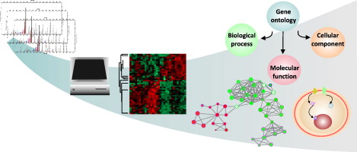
Functional Annotation
Gene Ontology
Gene ontology is a formal representation of knowledge about a gene with respect to three aspects:
Molecular Function
Cellular Component
Biological Process
Notes:
A fast way to find out about the function of a gene’s product is to see which Gene Ontology (GO) terms have been associated with it.
Gene ontology is a formal representation of knowledge about a gene with respect to three aspects: Molecular Function, Cellular Component and Biological Process. Cellular Component GO terms describe where a protein is localised (in the membrane, extracellular, in the nucleus etc). Molecular Function GO terms describe the biochemical activity of the protein. Biological Process GO terms describe the pathways and broader processes that the protein contributes to.

Slide 21
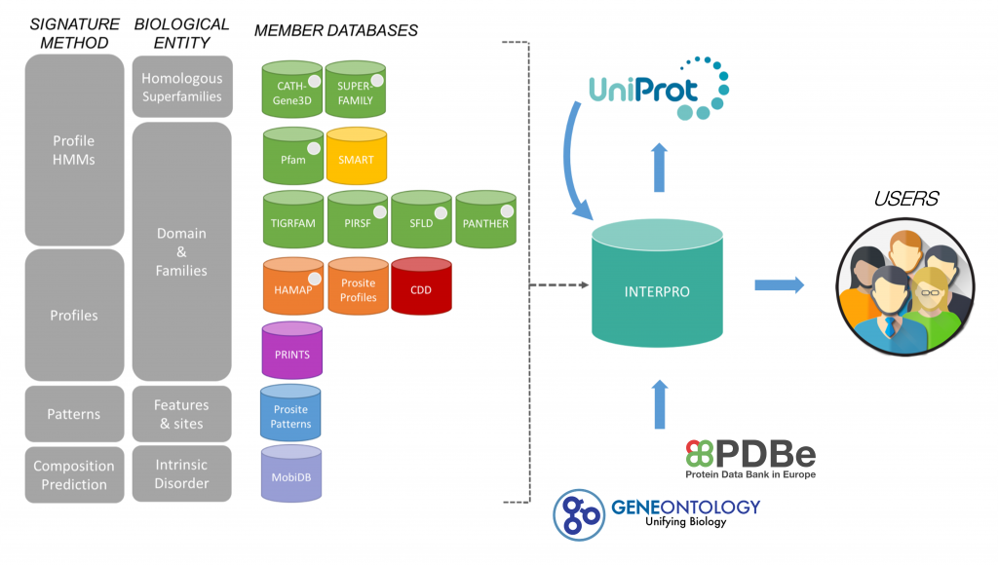
Functional Annotation
Protein domains and features
Usually, by knowing what domains and features exist in a protein, you can create a better understanding of its function!
InterPro
“a resource that provides functional analysis of protein sequences by classifying them into families and predicting the presence of domains and important sites..”
Notes:
How we do go from a string of amino acids to predicting what this protein might do in the cell? This is where another type of database comes in: protein family databases. For the vast majority of predicted protein sequences, nobody will have done experiments to test what its function is. However, we can use the principle of homology to take proteins that are well-studied in one experimental system and infer that proteins of similar sequence in other organisms are likely to have similar structure, and therefore similar function. In reality, protein sequences are analysed in terms of domains: these are subsequences of a protein that have a defined tertiary structure or sequence motif, conferring a defined function. A protein can consist of several domains. When comparing proteins between organisms, often the region encoding a protein domain is highly conserved whilst the bit that connects different domains together is more divergent.
A well known example of a protein domain database is Pfam. Pfam uses multiple sequence alignments of the known proteins with a certain domain to capture a representative model (a profile Hidden Markov Model) of that domain. Other protein domain databases, that might use slightly different methods to define domains, are: CATH, CDD, HAMAP, MobiDB Lite, Panther, PIRSF, PRINTS, Prosite, SFLD, SMART, SUPERFAMILY and TIGRfams. Luckily for us, all of these databases are united under the InterPro consortium.

Slide 22
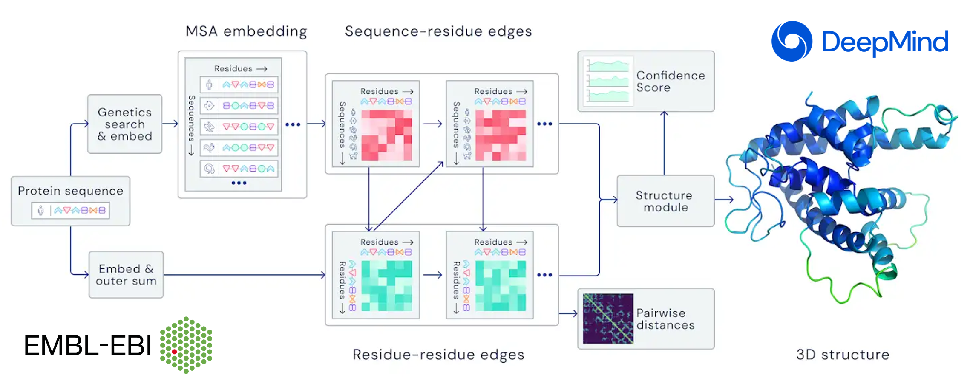


3D Protein Structure
Proteins are 3D molecules, and their 3D structure play a huge role on their function!
Knowledge of protein's 3D structure is a huge hint for understanding how the protein works
AlphaFold
https://alphafold.ebi.ac.uk/
Artificial Intelligence (AI) system
Computational prediction of protein structures with unprecedented accuracy and speed.
parasite-help@wormbase.org
@WBParaSite
Notes:
Knowledge of protein's 3D structure is a huge hint for understanding how the protein works, and use that information for different purposes; control or modify protein's function, predict what molecules bind to that protein and understand various biological interactions, assist drug discovery or even design our own proteins.
Protein structure prediction is the inference of the three-dimensional structure of a protein from its amino acid sequence—that is, the prediction of its secondary and tertiary structure from primary structure.
Predicting the 3D structure of proteins is one of the fundamental grand challenges in biology. By solving this challenge, we can dramatically deepen our understanding of human health, disease, and our environment, especially within areas like drug design and sustainability.
AlphaFold, the state-of-the-art AI system developed by DeepMind, is able to computationally predict protein structures with unprecedented accuracy and speed. Working in partnership with EMBL’s European Bioinformatics Institute (EMBL-EBI), we’ve released over 200 million protein structure predictions by AlphaFold that are freely and openly available to the global scientific community. Included are nearly all catalogued proteins known to science – with the potential to increase humanity’s understanding of biology by orders of magnitude.

Slide 23
Applications of AlphaFold 3D protein models
You can download the 3D protein structure from the AlphaFold resource and use it to perform your desired analysis.
Online tools that can be used with the downloaded structures from AlphaFold:
SwissDock, a web service to predict the molecular interactions that may occur between a target protein and a small molecule. It is used alongside S3DB, a database of manually curated target and ligand structures, inspired by the Ligand-Protein Database.
Zhang group Online-serivces portal
Docking simulations (https://zhanggroup.org/EDock/) against different ligands.
Protein structure alignment with another protein (https://zhanggroup.org/TM-align/).

Slide 24
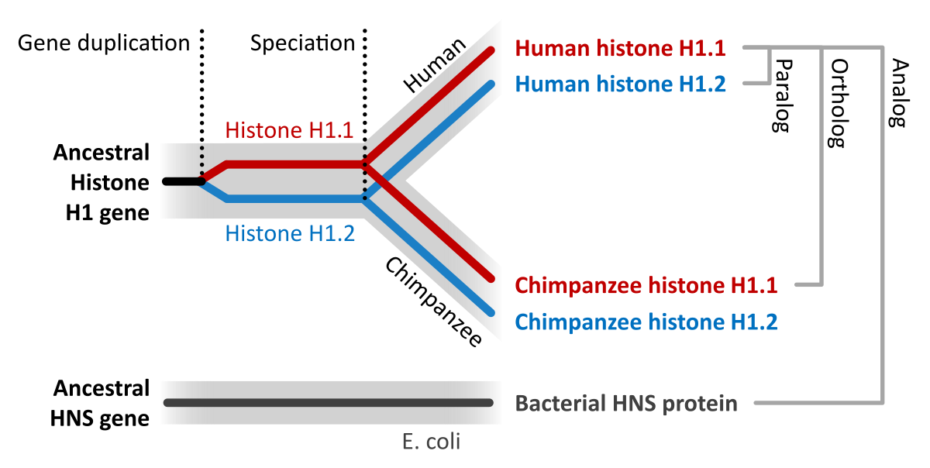
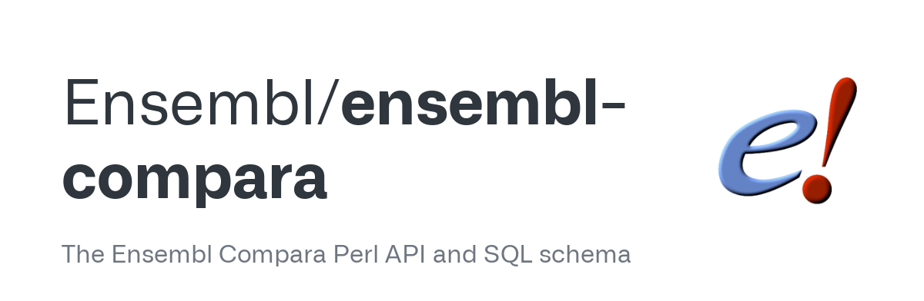
Comparative Genomics
Another approach to understand what a gene does is comparing its sequence to other genes, both within the same genome, and across different genomes.
Orthologues and Paralogues
Why would researchers want to find orthologues in other species for their gene of interest?
Functional Annotation! If the function of this gene in S. mansoni is not known, you can check the function of its orthologues genes in other species like C. elegans or other Schistosomes. Many times you will find that orthologous genes function will be similar to this of your gene of interest.
Notes:
Another approach to understanding what a gene does is comparing its sequence to other genes, both within the same genome, and across different genomes.
This analysis is called Comparative Genomics
Wait! What orthologues and paralogues are? Read here and/or here to find more!
In a nutshell Orthologues: Genes which evolved from a common ancestral gene by speciation that usually have retained a similar function in different species. Paralogues: Paralogs are homologous genes that arise from gene duplication events. Their common ancestry and replicated sequence often leads to similar structure and function in related pathways and protein complexes.
Why would researchers want to find orthologues in other species for their gene of interest? Function Annotation! If the function of this gene in S. mansoni is not known, you can check the function of its orthologues genes in other species like C. elegans or other Schistosomas. Many times you will find that orthologous genes function will be similar to this of your gene of interest.

Slide 25
Multiple Querying
Extract information from WormBase ParaSite for multiple entries
Biological research is becoming more and more high-throughput. Users want to be able to extract information simultaneously for multiple gene/transcript/proteins.
How to do that?
BioMart tool
Easy-to-use web-based tool that allows extraction of data without any programming knowledge or understanding of the underlying database structure.
Notes:
So far we have seen how you can manually browse WormBase ParaSite by searching for genes and then navigating to their gene/transcript/protein pages. However, in many cases you might have to automatically extract information from WormBase ParaSite for multiple entries. Or simply you might need to extract information about your favourite genome's features that fullfil some criteria. WormBase ParaSite's BioMart enables you to perform multiple queries like that as it is an easy-to-use web-based tool that allows extraction of data without any programming knowledge or understanding of the underlying database structure.
Back to our paper, following population genomic analyses, researchers identified a list of genomic regions as being under strong selection in Mayuge where we expect selection for survival following praziquantel treatment to be strongest!

Slide 26



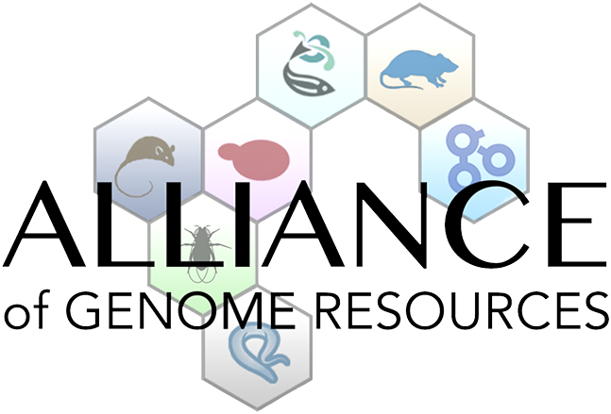

Prof. Matthew Berriman PI
School of Infection & Immunity,
College of Medical,Veterinary & Life Sciences,
University of Glasgow
Dr. Sarah Dyer PI
EMBL's European Bioinformatics Institute (EMBL-EBI)
Dionysios Grigoriadis Bioinformatician
EMBL's European Bioinformatics Institute (EMBL-EBI)
Tuan Le Web Developer
EMBL's European Bioinformatics Institute (EMBL-EBI)
parasite-help@wormbase.org

Slide 27
Course website
https://wcscourses.github.io/HelminthBioinformatics_2023

Slide 28
Prof. Matthew Berriman PI
School of Infection & Immunity,
College of Medical,Veterinary & Life Sciences,
University of Glasgow, UK
Part 1
parasite-help@wormbase.org
Dionysis Grigoriadis Bioinformatician
EMBL's European Bioinformatics Institute (EMBL-EBI), UK
Helminth Bioinformatics – Asia 2023
21-27 May 2023
KKU, Thailand

Slide 29
Genes: the basics
A gene is a unit of the genome, a DNA sequence, that is transcribed into an RNA molecule, or a transcript.
A gene can have multiple transcripts!
Notes:
This figure represents the steps that are needed to transform information encoded in the DNA into a polypeptide and eventually a functional protein. The starting information is encoded in the genome. A gene encodes, among other things, the transcription start and transcription end. These are the nucleotides from where an RNA copy of the DNA will be generated. UTRs. This is the gene’s transcript + multiple transcripts This copy is the pre-mRNA which is formed by exons and introns. Maturation of the mRNA molecule happens as it is transcribed and involves the splicing (removal) of introns with the concomitant joining of exons, addition of a CAP at the 5’ end and a polyadenylation tail (many As - AAAAAAA) at the 3’end. A processed mRNA will be the template for the translation of the mRNA message into a protein by the ribosome.

Slide 30
Genome
A genome is an organism’s complete set of genetic material.
Although every individual’s genome is unique
Notes:
A genome is an organism’s complete set of genetic material. Although every individual's genome is unique, the genomes of individuals of the same species will be very similar. It is useful to have a representative genome sequence for each species, and this is referred to as a reference genome.
In the cell, genomes are organised into chromosomes. In practice, current DNA sequencing methods are unable to read the DNA sequence of a whole chromosome without errors. We therefore use the technique of sequencing shorter segments of chromosomes, and do it in such a way that the segments overlap and can be pieced together like a jigsaw puzzle. This process is referred to as genome assembly. For now, we will focus on what genome assemblies look like, and how they are represented in genome databases.
The diagram below shows the structure of a typical assembly. It has 3 layers: the contigs are stretches of contiguous DNA sequence without gaps. The scaffolds are ordered sets of contigs separated by gaps of estimated length. In order to make scaffolds from contigs, techniques such as optical mapping and Hi-C are used. Finally, the chromosome is an ordered set of scaffolds separated by gaps on unknown length. To make the chromosome sequence from the scaffold, techniques such linkage mapping and FISH are used.
Sometimes, there is insufficient (or no) data to reliably place a scaffold into a specific position on a chromosome. In the figure above, this is true of the scaffold on the right. The assembly above therefore comprises 2 toplevel sequences: 1 chromosome, and one unplaced scaffold.

Slide 31
Genome
A genome is an organism’s complete set of genetic material.
The genomes of individuals of the same species will be very similar!
Notes:
A genome is an organism’s complete set of genetic material. Although every individual's genome is unique, the genomes of individuals of the same species will be very similar. It is useful to have a representative genome sequence for each species, and this is referred to as a reference genome.
In the cell, genomes are organised into chromosomes. In practice, current DNA sequencing methods are unable to read the DNA sequence of a whole chromosome without errors. We therefore use the technique of sequencing shorter segments of chromosomes, and do it in such a way that the segments overlap and can be pieced together like a jigsaw puzzle. This process is referred to as genome assembly. For now, we will focus on what genome assemblies look like, and how they are represented in genome databases.
The diagram below shows the structure of a typical assembly. It has 3 layers: the contigs are stretches of contiguous DNA sequence without gaps. The scaffolds are ordered sets of contigs separated by gaps of estimated length. In order to make scaffolds from contigs, techniques such as optical mapping and Hi-C are used. Finally, the chromosome is an ordered set of scaffolds separated by gaps on unknown length. To make the chromosome sequence from the scaffold, techniques such linkage mapping and FISH are used.
Sometimes, there is insufficient (or no) data to reliably place a scaffold into a specific position on a chromosome. In the figure above, this is true of the scaffold on the right. The assembly above therefore comprises 2 toplevel sequences: 1 chromosome, and one unplaced scaffold.

Slide 32
Genome
A genome is an organism’s complete set of genetic material.
It is useful to have a representative genome sequence for each species:
Reference genome
DNA Sequencing
Genome assembly
The genomes of individuals of the same species will be very similar!
We use the technique of sequencing shorter segments of chromosomes and piece them together like puzzle!
Notes:
A genome is an organism’s complete set of genetic material. Although every individual's genome is unique, the genomes of individuals of the same species will be very similar. It is useful to have a representative genome sequence for each species, and this is referred to as a reference genome.
In the cell, genomes are organised into chromosomes. In practice, current DNA sequencing methods are unable to read the DNA sequence of a whole chromosome without errors. We therefore use the technique of sequencing shorter segments of chromosomes, and do it in such a way that the segments overlap and can be pieced together like a jigsaw puzzle. This process is referred to as genome assembly. For now, we will focus on what genome assemblies look like, and how they are represented in genome databases.
The diagram below shows the structure of a typical assembly. It has 3 layers: the contigs are stretches of contiguous DNA sequence without gaps. The scaffolds are ordered sets of contigs separated by gaps of estimated length. In order to make scaffolds from contigs, techniques such as optical mapping and Hi-C are used. Finally, the chromosome is an ordered set of scaffolds separated by gaps on unknown length. To make the chromosome sequence from the scaffold, techniques such linkage mapping and FISH are used.
Sometimes, there is insufficient (or no) data to reliably place a scaffold into a specific position on a chromosome. In the figure above, this is true of the scaffold on the right. The assembly above therefore comprises 2 toplevel sequences: 1 chromosome, and one unplaced scaffold.

Slide 33
Genome
A genome is an organism’s complete set of genetic material.
It is useful to have a representative genome sequence for each species:
Reference genome
DNA Sequencing
Genome assembly
The genomes of individuals of the same species will be very similar!
We use the technique of sequencing shorter segments of chromosomes and piece them together like puzzle!
Notes:
A genome is an organism’s complete set of genetic material. Although every individual's genome is unique, the genomes of individuals of the same species will be very similar. It is useful to have a representative genome sequence for each species, and this is referred to as a reference genome.
In the cell, genomes are organised into chromosomes. In practice, current DNA sequencing methods are unable to read the DNA sequence of a whole chromosome without errors. We therefore use the technique of sequencing shorter segments of chromosomes, and do it in such a way that the segments overlap and can be pieced together like a jigsaw puzzle. This process is referred to as genome assembly. For now, we will focus on what genome assemblies look like, and how they are represented in genome databases.
The diagram below shows the structure of a typical assembly. It has 3 layers: the contigs are stretches of contiguous DNA sequence without gaps. The scaffolds are ordered sets of contigs separated by gaps of estimated length. In order to make scaffolds from contigs, techniques such as optical mapping and Hi-C are used. Finally, the chromosome is an ordered set of scaffolds separated by gaps on unknown length. To make the chromosome sequence from the scaffold, techniques such linkage mapping and FISH are used.
Sometimes, there is insufficient (or no) data to reliably place a scaffold into a specific position on a chromosome. In the figure above, this is true of the scaffold on the right. The assembly above therefore comprises 2 toplevel sequences: 1 chromosome, and one unplaced scaffold.

Slide 34
Genome
Notes:
A genome is an organism’s complete set of genetic material. Although every individual's genome is unique, the genomes of individuals of the same species will be very similar. It is useful to have a representative genome sequence for each species, and this is referred to as a reference genome.
In the cell, genomes are organised into chromosomes. In practice, current DNA sequencing methods are unable to read the DNA sequence of a whole chromosome without errors. We therefore use the technique of sequencing shorter segments of chromosomes, and do it in such a way that the segments overlap and can be pieced together like a jigsaw puzzle. This process is referred to as genome assembly. For now, we will focus on what genome assemblies look like, and how they are represented in genome databases.
The diagram below shows the structure of a typical assembly. It has 3 layers: the contigs are stretches of contiguous DNA sequence without gaps. The scaffolds are ordered sets of contigs separated by gaps of estimated length. In order to make scaffolds from contigs, techniques such as optical mapping and Hi-C are used. Finally, the chromosome is an ordered set of scaffolds separated by gaps on unknown length. To make the chromosome sequence from the scaffold, techniques such linkage mapping and FISH are used.
Sometimes, there is insufficient (or no) data to reliably place a scaffold into a specific position on a chromosome. In the figure above, this is true of the scaffold on the right. The assembly above therefore comprises 2 toplevel sequences: 1 chromosome, and one unplaced scaffold.

Slide 35
We’re adding value to the genomes!
Processing
Compara
Repeat Modeler
BUSCO score calculation
DNA features
RNA features
Analysis descriptions
Xrefs
GPAD load
Core statistics
Protein features
FIle dumps
BioMart
Gene expression studies
Jbrowse
AlphaFold
And then we make them accessible to you!
Genomes
EBI ensembl’s Web Team – Tuan Le

Slide 36
in 2023
parasite.wormbase.org

Slide 37
in 2023
Release
Species
Genomes
18
181
240
Platyhelminthes
Free Living
Nematodes
Parasites
63
57
135
153
parasite.wormbase.org
Annual Users
Page Views
Twitter Followers
Top Accessing Countries
17,000
350,000
1,903
1. USA, 2. China, 3. UK, 4. Germany, 5. India

Slide 38
Course website
https://wcscourses.github.io/HelminthBioinformatics_2023

Slide 39
Module 1 – WormBase ParaSite 1
Overview and aims
Browsing genomes
Browsing gene/transcript pages
Querying WormBase ParaSite with BioMart

Slide 40
Genome Statistics
Contiguity describes how many scaffolds a genome is represented by: in a perfectly contiguous reference genome, the number of scaffolds would be equal to the number of chromosomes.
N50: If all of the scaffolds of the assembly were lined up in order of longest to shortest, the N50 length is the length of the scaffold at the midpoint. The higher, the better!
Completeness: BUSCO is a method of assessing genome completeness based on the principle that some genes are so highly conserved across eukaryotic species that they should be present in any genome assembly, in single copy.
A higher percentage of single BUSCO genes, indicates a higher quality assembly.
BUSCO ASSEMBLY, assesses the assembly quality of a genome by predicting a gene-set ab initio using AUGUSTUS.
BUSCO ANNOTATION, on the other hand, is running at the protein level, assessing not only the assembly quality of a genome but also the quality of its annotation.

Slide 41
How to submit a genome to WormBase ParaSite?
1. Submit your genome to an INSDC Sequence database (ENA, NCBI or DDBJ)
Reference genome
Genome assembly
2. Contact WormBase ParaSite once submitted
3. Send us the gene model annotation file in GFF3 file format
parasite-help@wormbase.org

Slide 42
What is a gene?

Slide 43
What is a gene?
Gene page

Slide 44
What is a gene?
Gene page
Transcript page

Slide 45
What does the encoded protein do?

Slide 46
Functional Annotation
Gene Ontology
Gene ontology is a formal representation of knowledge about a gene with respect to three aspects:
Molecular Function
Cellular Component
Biological Process
Notes:
A fast way to find out about the function of a gene’s product is to see which Gene Ontology (GO) terms have been associated with it.
Gene ontology is a formal representation of knowledge about a gene with respect to three aspects: Molecular Function, Cellular Component and Biological Process. Cellular Component GO terms describe where a protein is localised (in the membrane, extracellular, in the nucleus etc). Molecular Function GO terms describe the biochemical activity of the protein. Biological Process GO terms describe the pathways and broader processes that the protein contributes to.

Slide 47
Functional Annotation
Protein domains and features
Usually, by knowing what domains and features exist in a protein, you can create a better understanding of its function!
InterPro
“a resource that provides functional analysis of protein sequences by classifying them into families and predicting the presence of domains and important sites..”
Notes:
How we do go from a string of amino acids to predicting what this protein might do in the cell? This is where another type of database comes in: protein family databases. For the vast majority of predicted protein sequences, nobody will have done experiments to test what its function is. However, we can use the principle of homology to take proteins that are well-studied in one experimental system and infer that proteins of similar sequence in other organisms are likely to have similar structure, and therefore similar function. In reality, protein sequences are analysed in terms of domains: these are subsequences of a protein that have a defined tertiary structure or sequence motif, conferring a defined function. A protein can consist of several domains. When comparing proteins between organisms, often the region encoding a protein domain is highly conserved whilst the bit that connects different domains together is more divergent.
A well known example of a protein domain database is Pfam. Pfam uses multiple sequence alignments of the known proteins with a certain domain to capture a representative model (a profile Hidden Markov Model) of that domain. Other protein domain databases, that might use slightly different methods to define domains, are: CATH, CDD, HAMAP, MobiDB Lite, Panther, PIRSF, PRINTS, Prosite, SFLD, SMART, SUPERFAMILY and TIGRfams. Luckily for us, all of these databases are united under the InterPro consortium.

Slide 48
3D Protein Structure
Proteins are 3D molecules, and their 3D structure play a huge role on their function!
Knowledge of protein's 3D structure is a huge hint for understanding how the protein works
AlphaFold
https://alphafold.ebi.ac.uk/
Artificial Intelligence (AI) system
Computational prediction of protein structures with unprecedented accuracy and speed.
parasite-help@wormbase.org
@WBParaSite
Notes:
Knowledge of protein's 3D structure is a huge hint for understanding how the protein works, and use that information for different purposes; control or modify protein's function, predict what molecules bind to that protein and understand various biological interactions, assist drug discovery or even design our own proteins.
Protein structure prediction is the inference of the three-dimensional structure of a protein from its amino acid sequence—that is, the prediction of its secondary and tertiary structure from primary structure.
Predicting the 3D structure of proteins is one of the fundamental grand challenges in biology. By solving this challenge, we can dramatically deepen our understanding of human health, disease, and our environment, especially within areas like drug design and sustainability.
AlphaFold, the state-of-the-art AI system developed by DeepMind, is able to computationally predict protein structures with unprecedented accuracy and speed. Working in partnership with EMBL’s European Bioinformatics Institute (EMBL-EBI), we’ve released over 200 million protein structure predictions by AlphaFold that are freely and openly available to the global scientific community. Included are nearly all catalogued proteins known to science – with the potential to increase humanity’s understanding of biology by orders of magnitude.

Slide 49
Applications of AlphaFold 3D protein models
You can download the 3D protein structure from the AlphaFold resource and use it to perform your desired analysis.
Online tools that can be used with the downloaded structures from AlphaFold:
SwissDock, a web service to predict the molecular interactions that may occur between a target protein and a small molecule. It is used alongside S3DB, a database of manually curated target and ligand structures, inspired by the Ligand-Protein Database.
Zhang group Online-serivces portal
Docking simulations (https://zhanggroup.org/EDock/) against different ligands.
Protein structure alignment with another protein (https://zhanggroup.org/TM-align/).

Slide 50
Comparative Genomics
Another approach to understand what a gene does is comparing its sequence to other genes, both within the same genome, and across different genomes.
Orthologues and Paralogues
Why would researchers want to find orthologues in other species for their gene of interest?
Functional Annotation! If the function of this gene in S. mansoni is not known, you can check the function of its orthologues genes in other species like C. elegans or other Schistosomes. Many times you will find that orthologous genes function will be similar to this of your gene of interest.
Notes:
Another approach to understanding what a gene does is comparing its sequence to other genes, both within the same genome, and across different genomes.
This analysis is called Comparative Genomics
Wait! What orthologues and paralogues are? Read here and/or here to find more!
In a nutshell Orthologues: Genes which evolved from a common ancestral gene by speciation that usually have retained a similar function in different species. Paralogues: Paralogs are homologous genes that arise from gene duplication events. Their common ancestry and replicated sequence often leads to similar structure and function in related pathways and protein complexes.
Why would researchers want to find orthologues in other species for their gene of interest? Function Annotation! If the function of this gene in S. mansoni is not known, you can check the function of its orthologues genes in other species like C. elegans or other Schistosomas. Many times you will find that orthologous genes function will be similar to this of your gene of interest.

Slide 51
Multiple Querying
Extract information from WormBase ParaSite for multiple entries
Biological research is becoming more and more high-throughput. Users want to be able to extract information simultaneously for multiple gene/transcript/proteins.
How to do that?
BioMart tool
Easy-to-use web-based tool that allows extraction of data without any programming knowledge or understanding of the underlying database structure.
Notes:
So far we have seen how you can manually browse WormBase ParaSite by searching for genes and then navigating to their gene/transcript/protein pages. However, in many cases you might have to automatically extract information from WormBase ParaSite for multiple entries. Or simply you might need to extract information about your favourite genome's features that fullfil some criteria. WormBase ParaSite's BioMart enables you to perform multiple queries like that as it is an easy-to-use web-based tool that allows extraction of data without any programming knowledge or understanding of the underlying database structure.
Back to our paper, following population genomic analyses, researchers identified a list of genomic regions as being under strong selection in Mayuge where we expect selection for survival following praziquantel treatment to be strongest!

Slide 52
Prof. Matthew Berriman PI
School of Infection & Immunity,
College of Medical,Veterinary & Life Sciences,
University of Glasgow
Dr. Sarah Dyer PI
EMBL's European Bioinformatics Institute (EMBL-EBI)
Dionysios Grigoriadis Bioinformatician
EMBL's European Bioinformatics Institute (EMBL-EBI)
Tuan Le Web Developer
EMBL's European Bioinformatics Institute (EMBL-EBI)
parasite-help@wormbase.org

