Slide 1
Why is there variation between genomes?

Slide 2
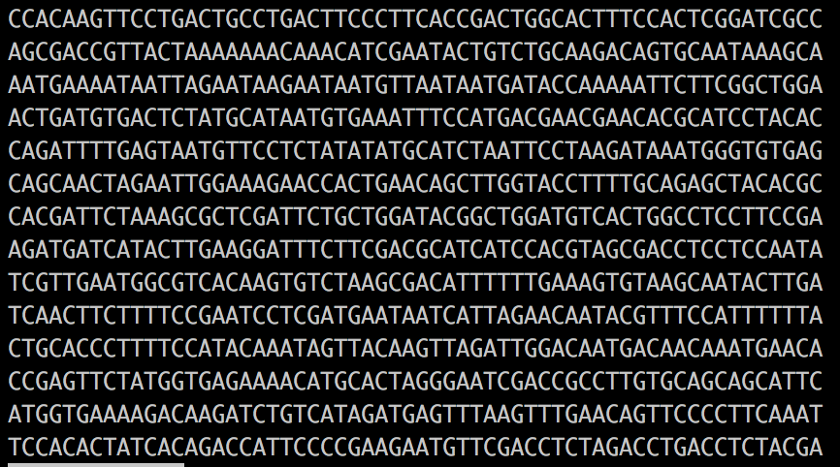
Coding genome biology: from in situ to in silico

Slide 3
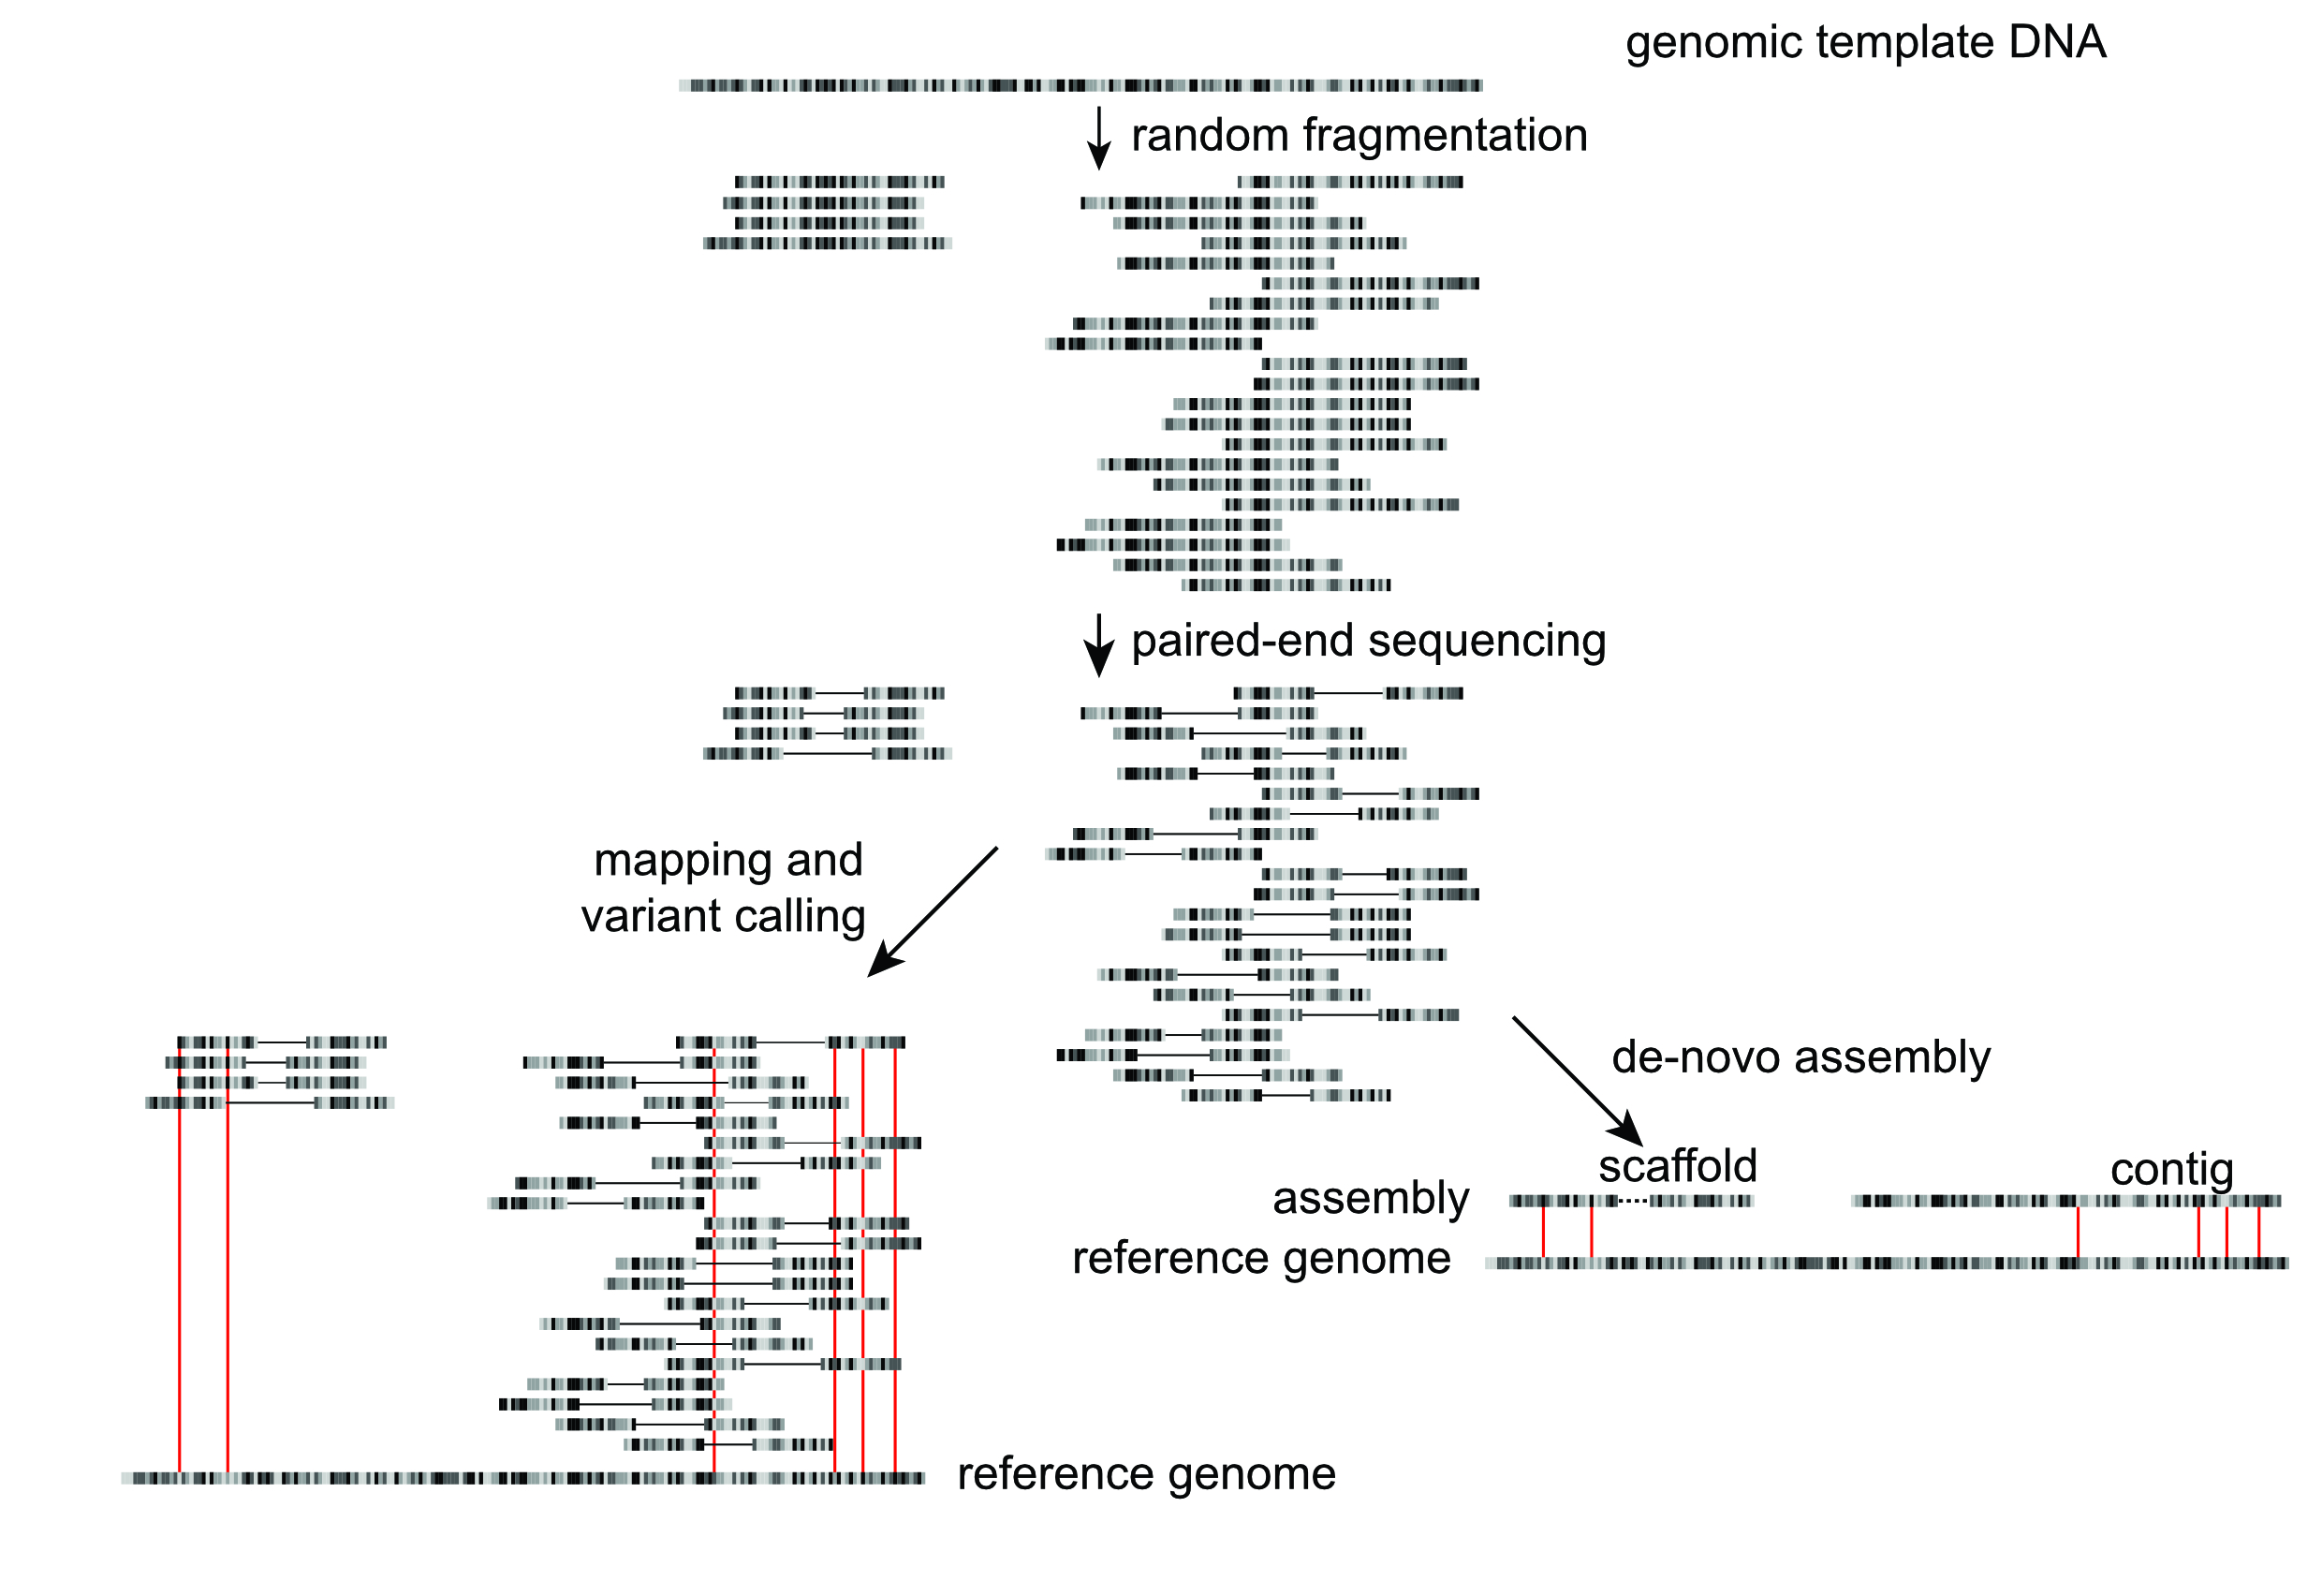
Basic genomics workflow
Sample / library preparation
Sequencing
Informatics

Slide 4
Tools of the trade: DNA sequencers
Sanger Sequencing: ABi
High Throughput Sequencing: Illumina
Long read sequencing: Pacbio & Nanopore
Read lengths: 100-300 bp
Insert lengths: ave 300-500 bp
Read lengths: 5-10 kb
- Pacbio: up to 60 kb
- Nanopore: up to 1Mb
Read length:500-1000 bp

Slide 5
Not all genomes are created equally
Genome: biologically
“the haploid set of chromosomes in a gamete or microorganism, or in each cell of a multicellular organism”
“the complete set of genes or genetic material present in a cell or organism”

Slide 6
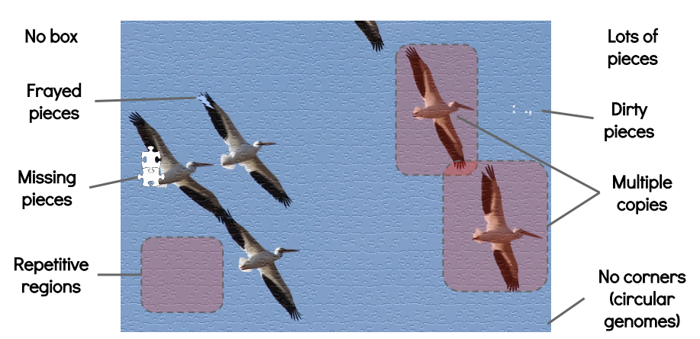
Not all genomes are created equally
Genome: bioinformatically
Best guess, but often:
highly fragmented
misassembled to some degree
Haplotypic
contaminated
duplicated or missing
Chromosome-scale
genomes
HARD
Draft genomes
“manageable”(?)
Time, money, expertise
Adapted from Torsten Seemann presentation: “De novo genome assembly”
https://www.slideshare.net/torstenseemann/de-novo-genome-assembly-tseemann-imb-winter-school-2016-brisbane-au-4-july-2016

Slide 7

Not all genomes are created equally
https://doi.org/10.1016/j.pt.2022.06.002

Slide 8
Assembly contiguity in a bit more detail
N50: a measure of "contiguity". The minimum sequence length for which 50% of the genome is in sequences at least this length
50%
Genome
1000 bp
Contigs /
scaffolds
300
200
100
50
40
20
20
N50 = contig length of contig that contains 50% of genome in sequences this length or larger = 40 bp
N50(n) = the number of contigs containing N50 contig or larger sequences = 5

Slide 9
There are many challenges faced to achieve high quality assemblies
Sampling
Difficult to obtain sufficient, quality material
Heavily reliant on archival samples
Environmentally accessible samples: juvenile, resistant, and contaminated
Sequencing
Helminths are often very small - difficult to get sufficient DNA from individuals
Pooling individuals is often required
Assembly & Analysis
High genetic diversity even in individuals, let alone populations (or pools)
Not "big" genomes, but complicated due to within and between sample diversity

