Slide 1
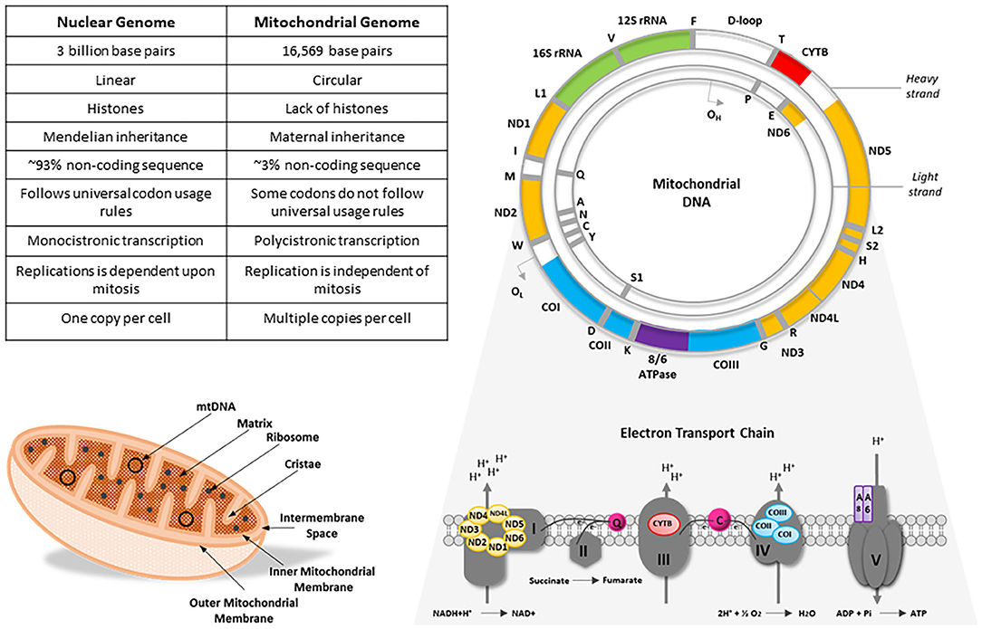
The mitochondrial genome
Is a circular, double-stranded DNA molecule within mitochondria.
It contains 37 genes that encode crucial for the oxidative phosphorylation :
13 proteins
22 tRNAs
2 rRNAs
Mito genes lacks intronic regions
Jones et al. 2021
doi: /10.3389/fgene.2021.698825

Slide 2
Why to study the mitochondrial genome?
The selection of genetic markers is essential for the diagnosis of infections and taxa differentiation and phylogenetic analysis of worms
This is often challenging because of the taxonomic resolution these may show
Mitochondrial genes are widely used to determine lower taxonomic levels (i.e. identification to genus and species-level) and resolve species-level phylogenies because of their high degree of sequence variation
Cox1 gene is recommended because of the high interspecies resolution and the large number of sequences available in databases.

Slide 3
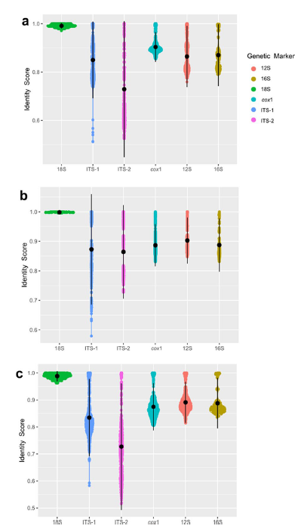
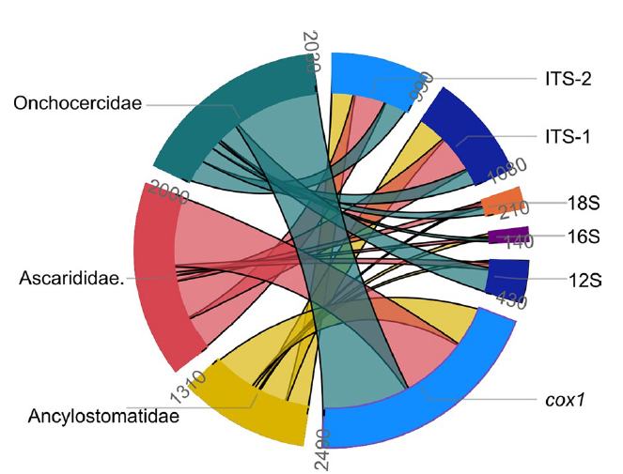
Cox1 gene is recommended because of the high interspecies resolution and the large number of sequences available in databases.
Mejias‑Alpizar et al 2024.
doi:/10.1186/s13071-023-06113-4

Slide 4
To get the sequence of COX1 and other mito genes we need to annotate our mitogenomes assemblies.

Slide 5
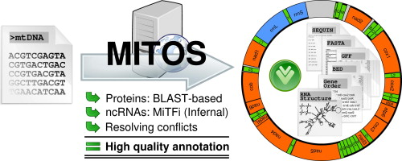
To get the sequence of COX1 and other mito genes we need to annotate our mitogenomes assemblies.
Bernt et al. 2012
doi: /10.1016/j.ympev.2012.08.023

Slide 6
Protein homology search
The annotation is a BLASTX-based similarity search using as queries the amino acid sequences of previously annotated orthologs.
The initial prediction are improved: for example, the BLAST alignments are often inaccurate at their ends. MITOS thus scans the vicinity of each prediction for the presence of in-frame start and stop codons.
Non-coding RNA annotation
MITOS employs covariance models capturing the similarity of primary sequence as well as secondary structure for the identification of tRNA and rRNA coding genes

Slide 7
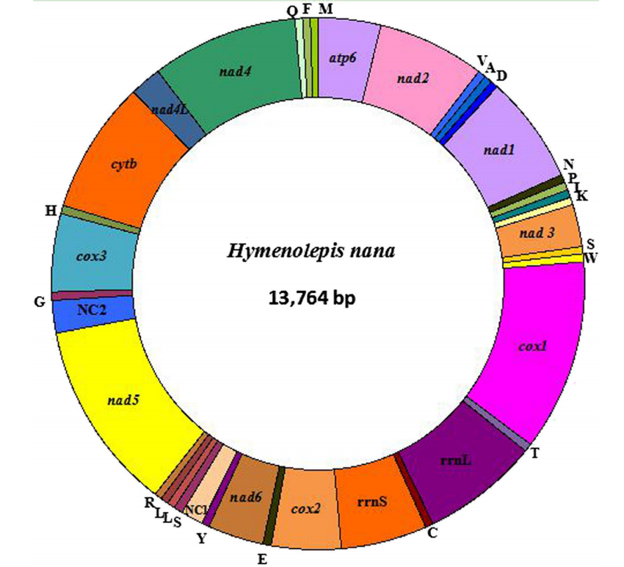
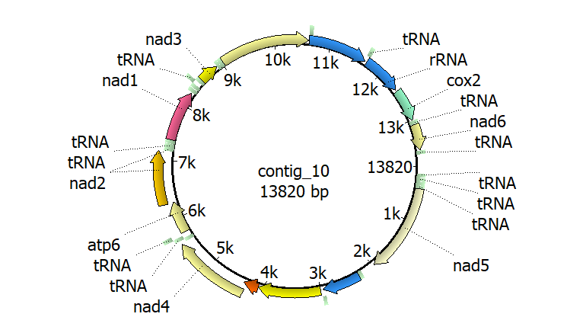
Cheng et al. 2015
doi: 10.1007/s00436-015-4862-8

Slide 8
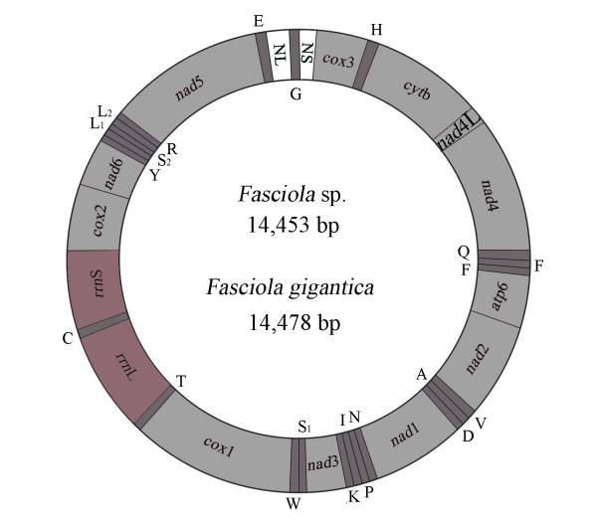

Liu et al. 2014
doi: 10.1186/1756-3305-7-150

