Slide 1
Introduction to Linux
Helminth Bioinformatics
Montevideo, Uruguay
May 2025

Slide 2
Welcome to the exciting world of
computational biology…..

Slide 3
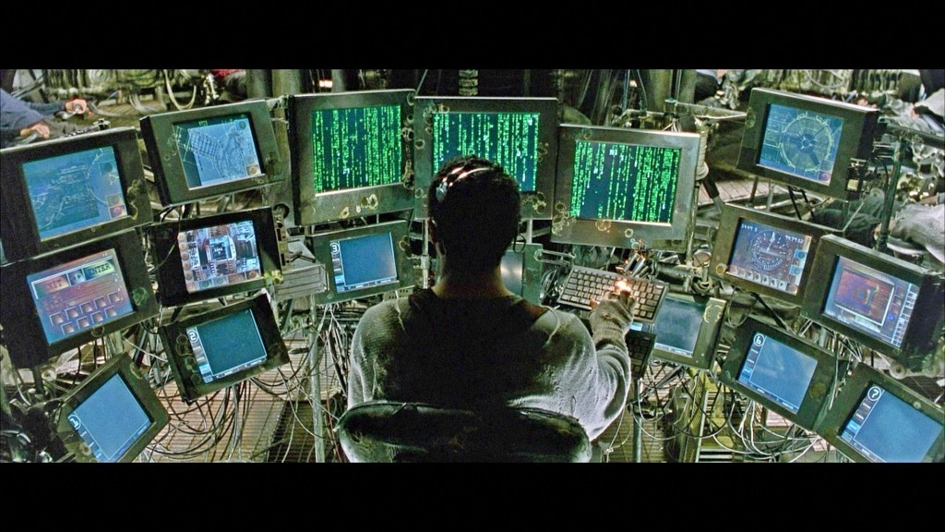

Slide 4
What is Unix?
Standard operating system (alternative to MS Windows, Mac OS)
Provides a different way for you to interact with the computer
Many ‘flavours’ of Unix, including Linux
Originally created to provide a free UNIX-like OS for PCs

Slide 5
Why use Unix?
Powerful, robust and stable operating system
Essential for handling “big data” - output of lots of biological research exists in large text files
Powerful and flexible commands for processing large text files
Enables reproducible research via use of scripts and pipelines
Widely used in scientific community - much is open access and easily sharable

Slide 6
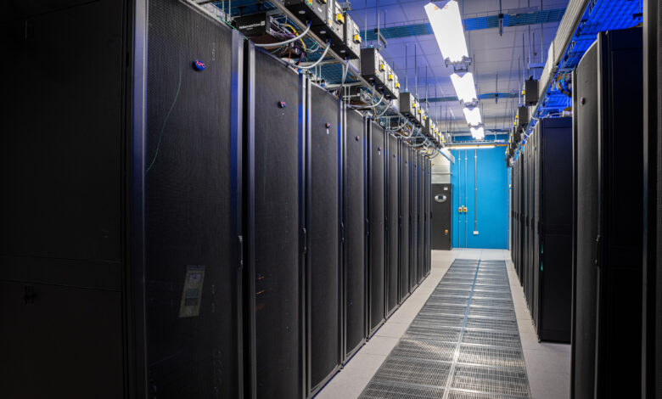
High performance computing

Slide 7
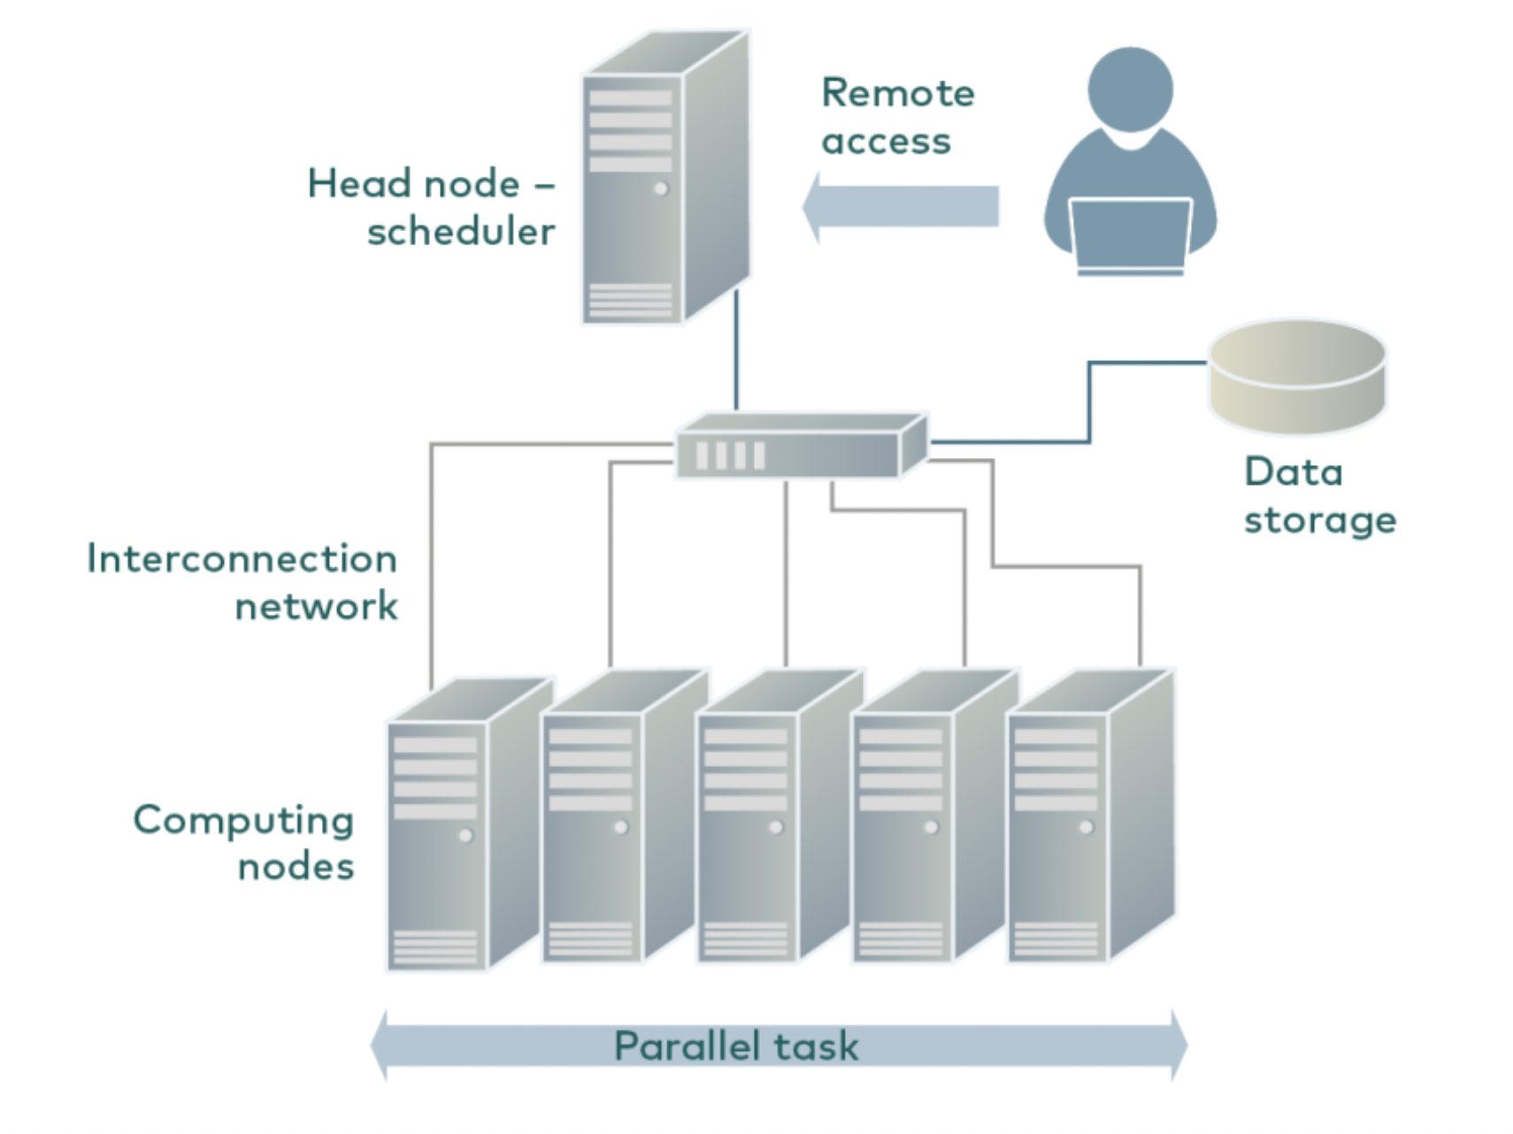
High performance computing
Your own computer has limited capacity
HPC allows you to access far greater processing capacity
You work can be split across multiple computers

Slide 8
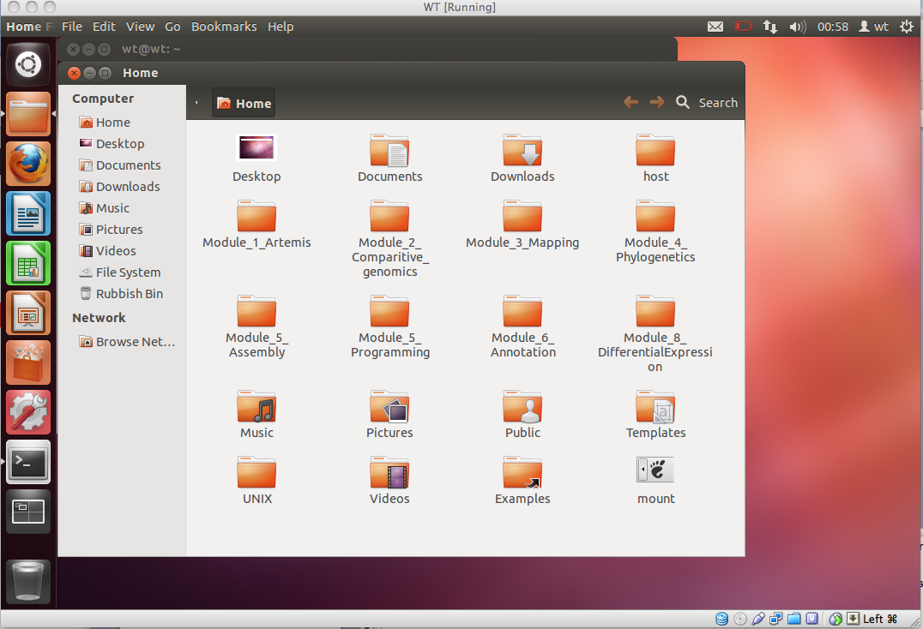
Navigating the Linux Virtual Machine (VM)
It should look pretty familiar

Slide 9
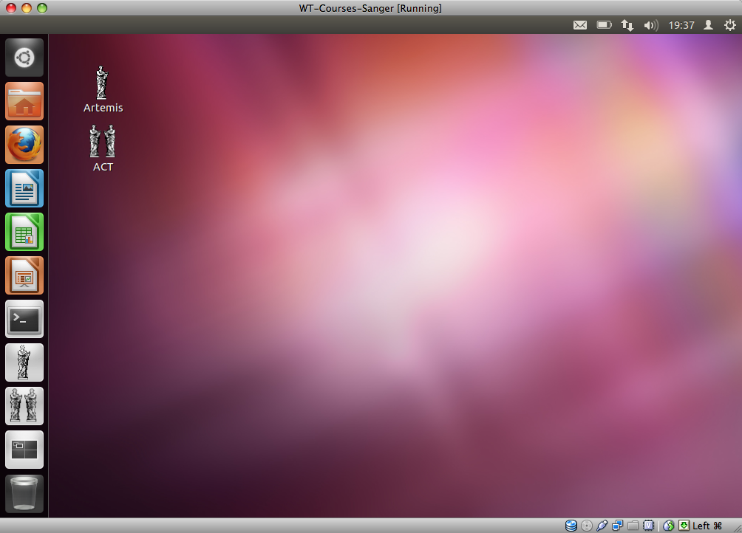
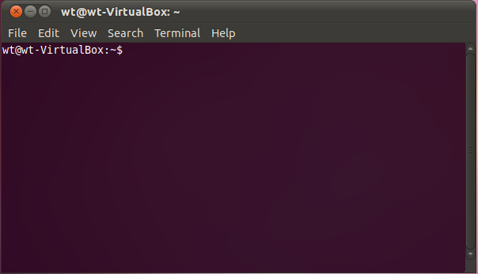
Navigating the Terminal and command line
This might be new for some of you
We use the terminal to write “commands” to interact and manipulate data
UNIX prompt

Slide 10
Some basic commands
Command
What it does
Commands can be very simple
They can also be very complex
Once they start being coming complex, we would usually write a “script” to link multiple commands into a pipeline
ls
List the contents of the current directory
cd
Changes a directory
mv
Moves a file
cp
Copies a file
rm
Remove a file
less
Displays the contents of a file
head
Displays the first ten lines of a file
tail
Displays the last ten lines of a file
cat
Concatenate files together
pwd
Print working directory
mkdir
Make a new directory

Slide 11
Tips and tricks
Unix is “case sensitive”
You need to put spaces in between commands and values passed to the command
Unix cannot read your mind - if you make a spelling mistake, it will not understand you
Error messages are really informative - make sure you read and try to understand them
Keep organised! File names, directories, commands
The “tab” key is your friend - “make tab-it a hab-it”

Slide 12
Today
introduce you to some tools and ways to interact with data on the command line
learn to navigate directories, manipulate data, and write scripts

Slide 13
Today
Some of you may have experience already, which is great! Do explore - there is something to learn here for everyone
For others, this will be a whole new world (hopefully, an enjoyable one!)
Learning to using unix is like learning any new language - it takes time, patience, and practice. Take your time, and ask questions if needed.

Slide 14
questions?

