Slide 1
R and Rstudio
Helminth Bioinformatics
Montevideo, Uruguay

Slide 2
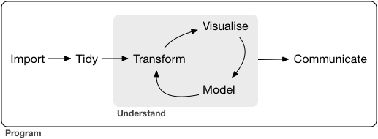
What is R?
R is a programming language, primarily for statistical analyses and data visualisation.

Slide 3
Why use R?
It is easy to use and has excellent graphics capabilities
It has a lot of statistical methods that can be used in straightforward manner
It is open source and free
It is supported by a large user network
It can be run in windows, linux, and mac

Slide 4
R packages
R consists of core and additional packages
They are collections of R functions, data, and compiled code
Some of the core packages are old and less intutitive to use
Well-defined format that ensures easy installation, a basic standard of documentation, and enhances portability and reliability
# install
install.packages(“tidyverse”)
#after it’s installed, you can initiate by using library
library(tidyverse)

Slide 5
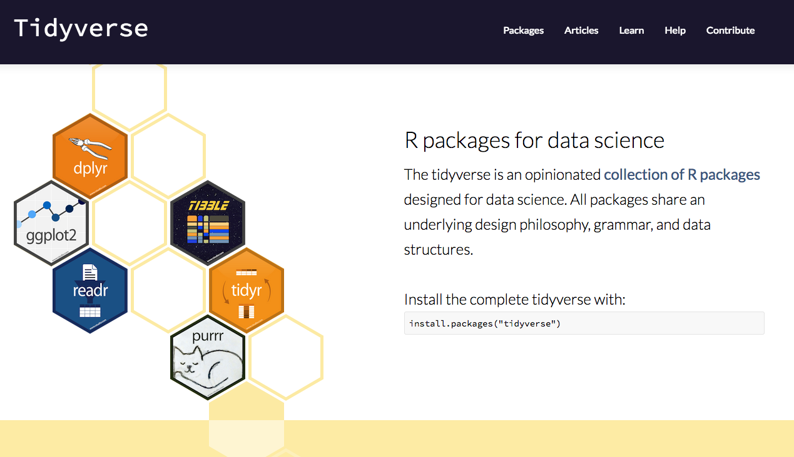
Tidyverse

Slide 6
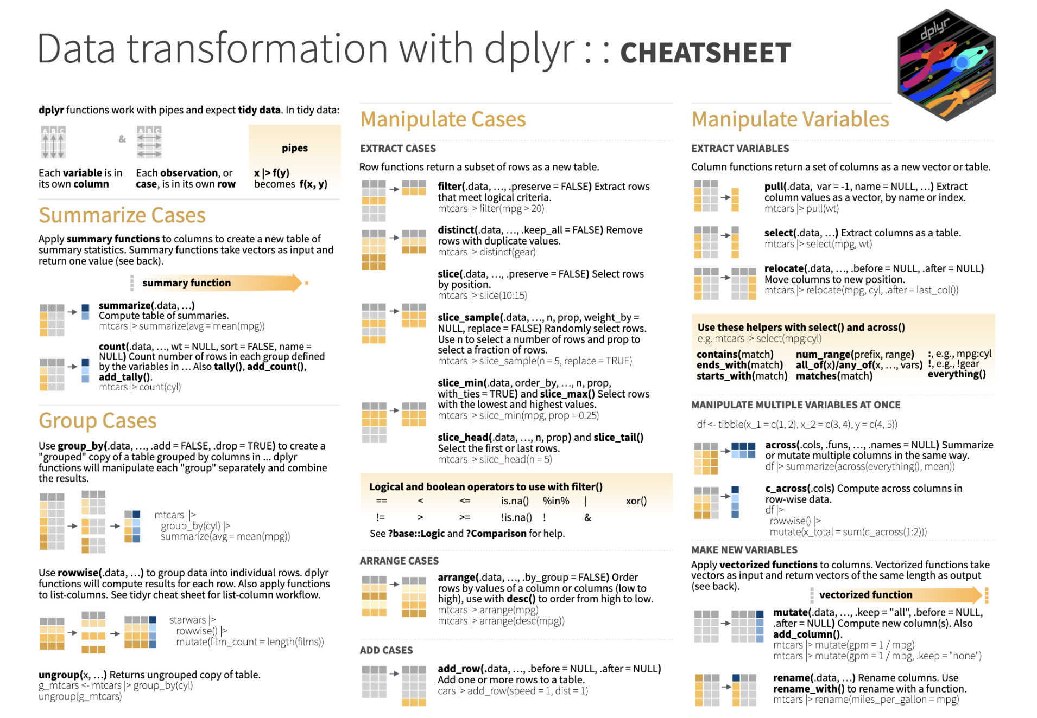
Tidyverse

Slide 7
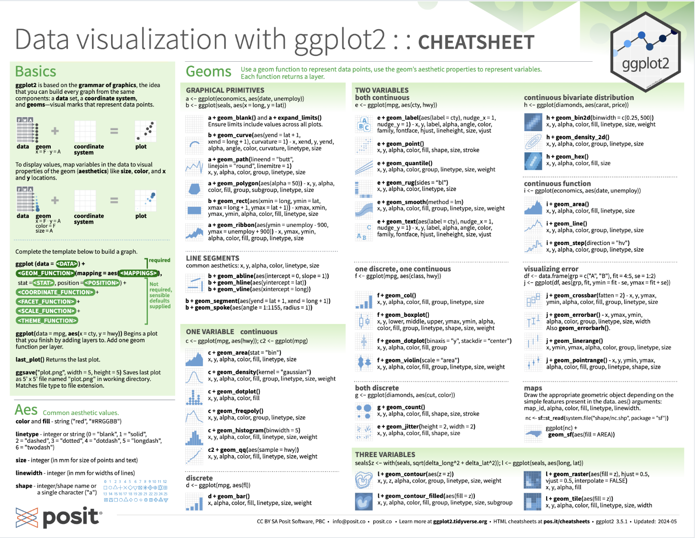
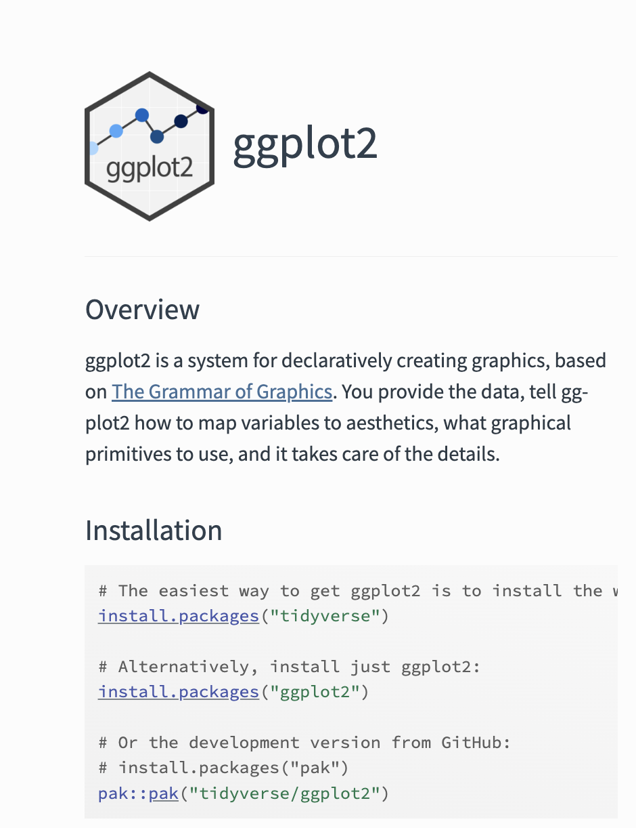
ggplot2

Slide 8
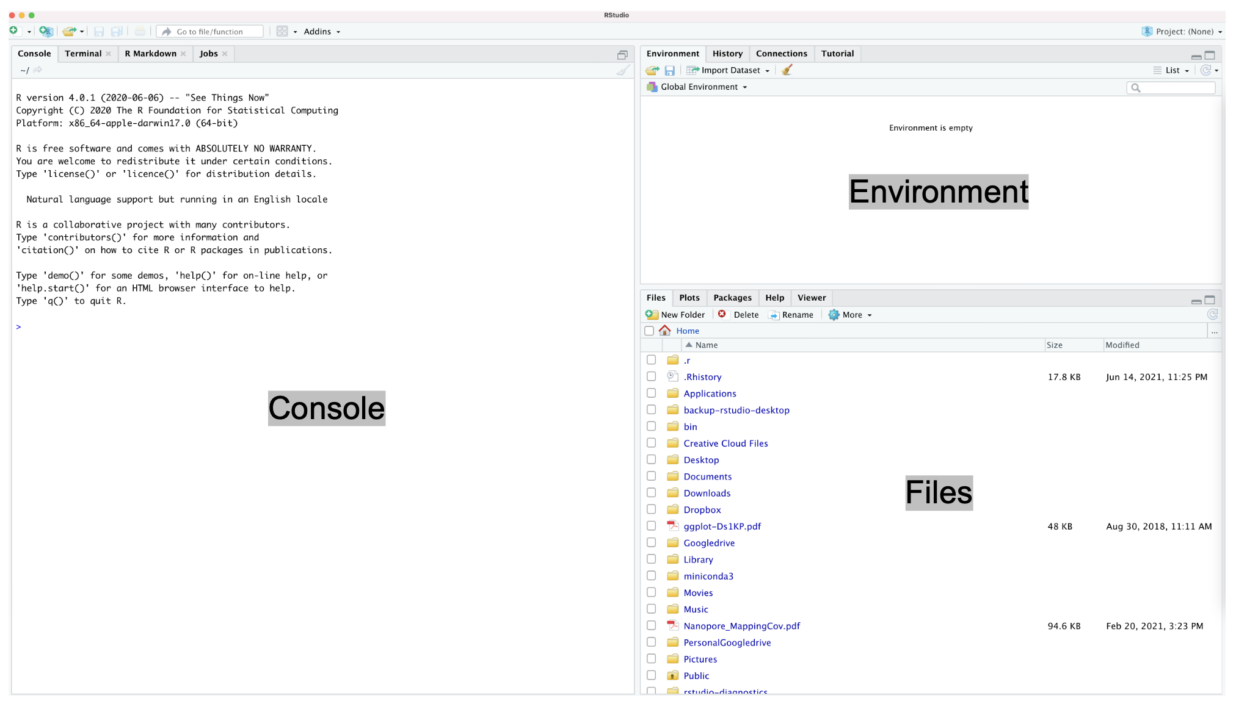
Rstudio interface

Slide 9
Today
In this module, we are going to explore:
Basics of R
importing / exporting data
manipulating / tidying data
visualising data

Slide 10
questions?

