Slide 1
computational resources and tools
Dr. Segun Fatumo
Associate Professor
London School of Hygiene and Tropical Medicine.

Slide 2
Outline
Overview of GWAS
Hardware computational requirement
Tools & Resources

Slide 3
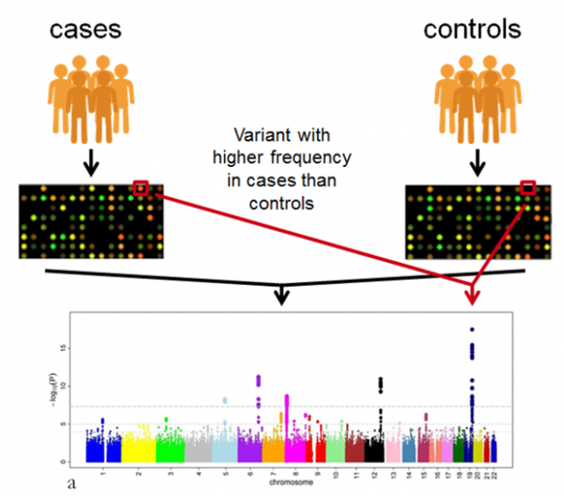
Overview of GWAS
Phenotype
Gene
(genetic variation in million)
Phenotype
Disease (Diabetes, covid-19, etc )
Trait (Height, Weight, BMI, etc)
Lifestyle (Smoking, Alcohol, Diet, etc)
others (Annual Salary, intelligence, etc )
Notes:
Typically cases and control for a disease
The individuals in the study are genotype on a commercial array (eg Infinium Asian Screening Array).
Specialized tool eg Genome Studio can be for genotyping analysis of the microarray data.
Genome Studio has many modules including a module (Region Report) that can generate PLINK file.

Slide 4

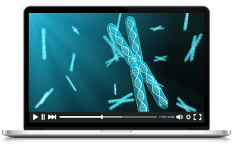
Hardware requirements
Given:
Data: 10K samples from Asian individuals, 2Million chip array (2M SNPs)
Computer: 8GB RAM, 250 GB, quad-core

Slide 5
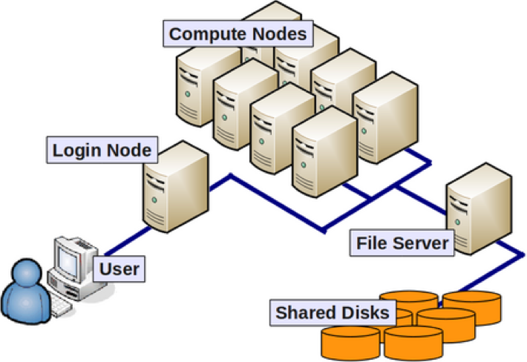
Hardware requirements
GWAS requires complex computing requirements.
Easier to move data from one cluster to another
Access to share tools & software

Slide 6
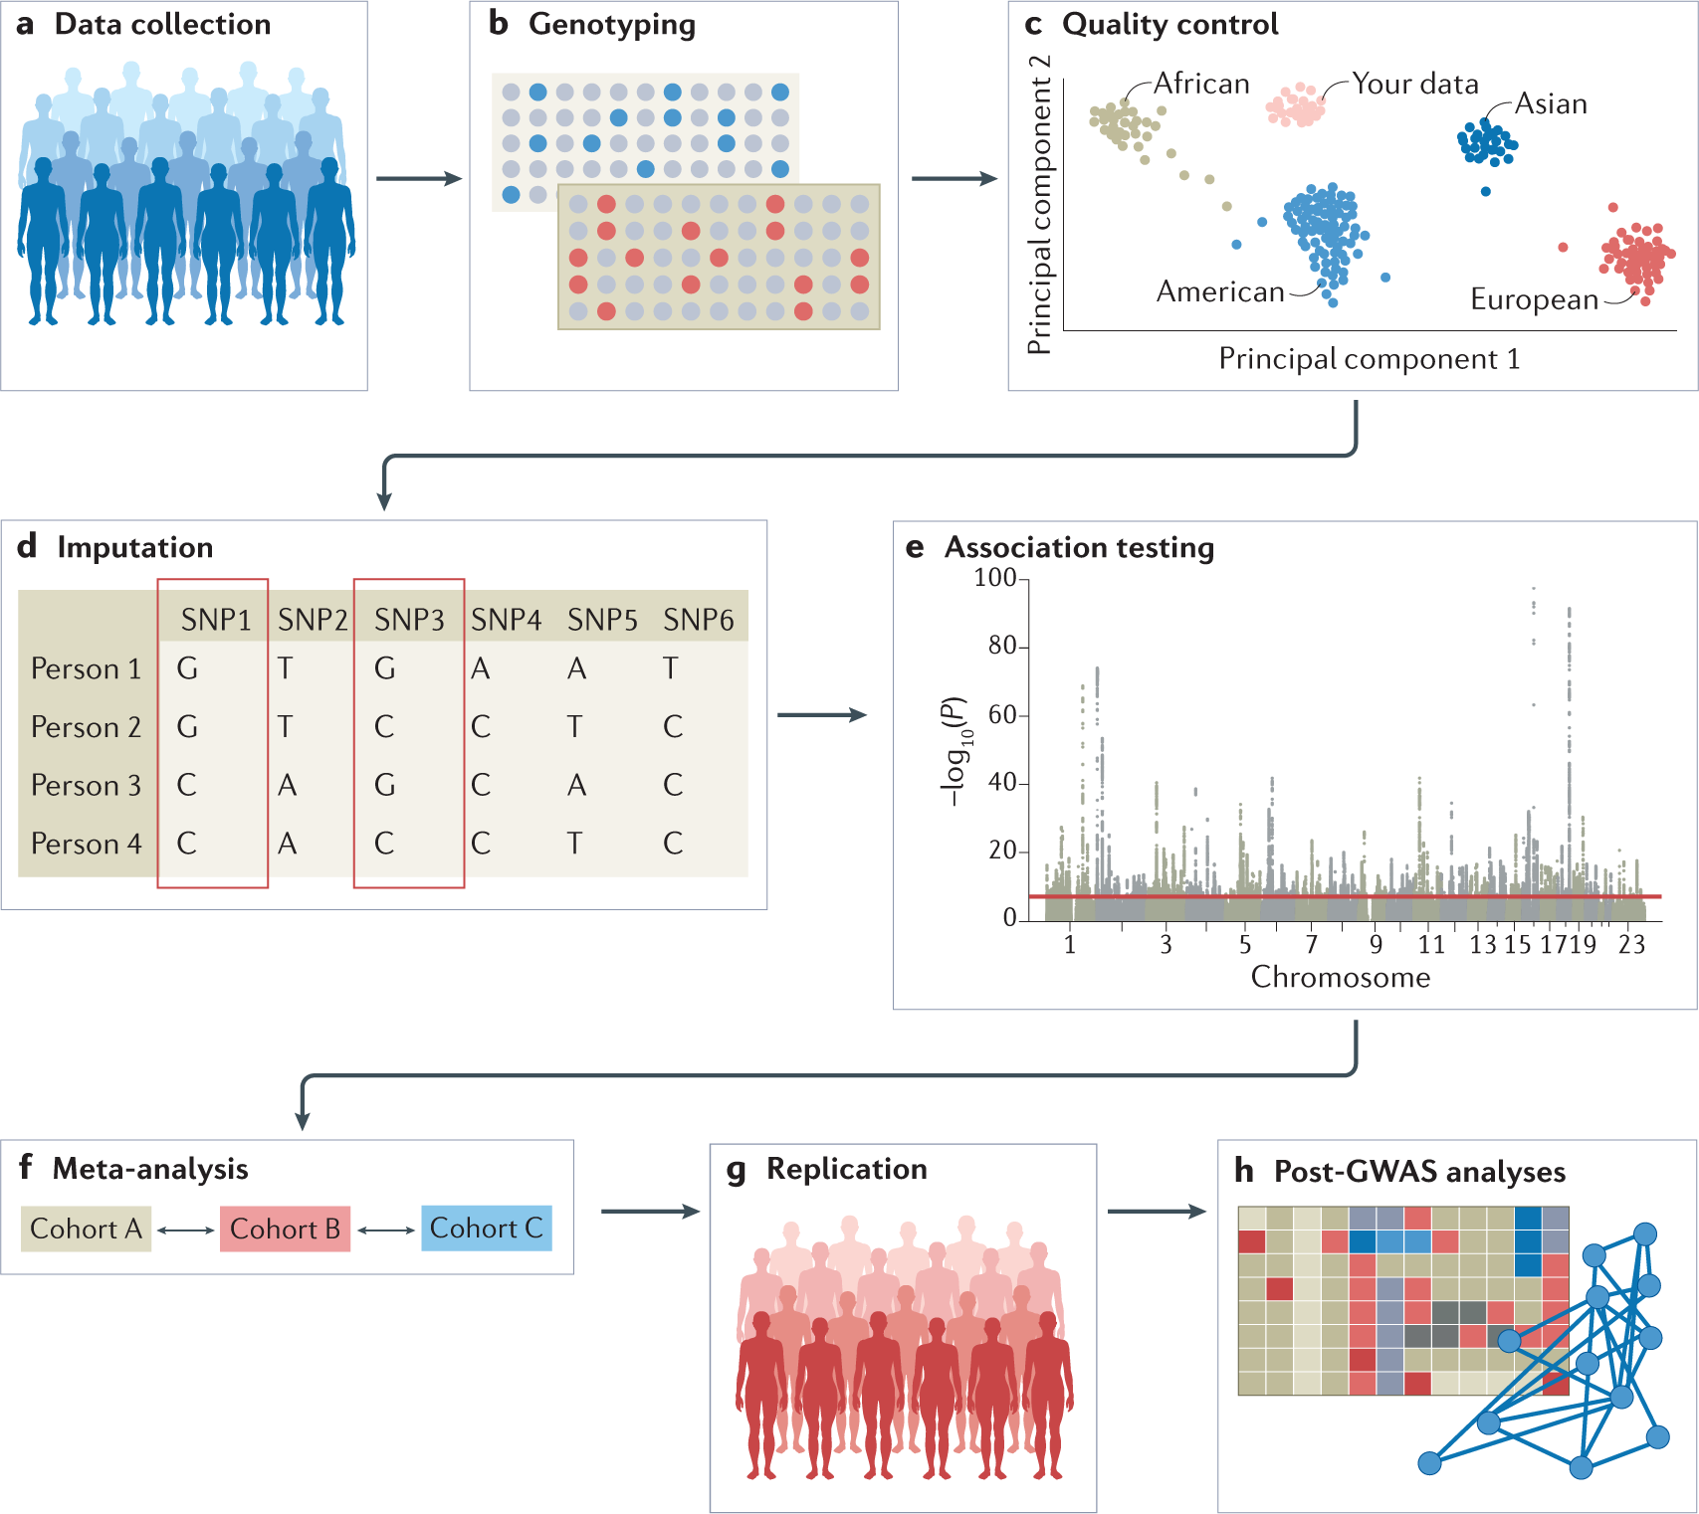
Nature Reviews Methods Primers (Nat Rev Methods Primers) ISSN 2662-8449 (online)

Slide 7

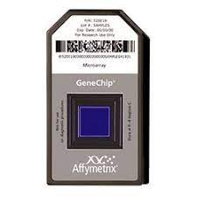
Unix (Bash, AWK, Sed, Grep, etc)
Tools
Genome Studio
genCall
zCall
Tools
PLINK
RICOPILI
EigenSoft
R
Tools
Impute2
BEAGLE
MIS, TIS, SIS*
Tools
PLINK
BOLT-LMM
GEMMA
REGENIE
Tools
METAL
Metasoft
GWAMA
MANTRA
Tools
FINEMAP
CAVIAR
BFMAP
SuSiE
Tools
Plink
PRSice
Ldpred
PRScs
Sample Collection
Genotyping Array
Genotype
Calling
Quality Control
Genotype Imputation
Association Analysis (GWAS)
Replication & Meta-analysis
In-silico Fine-mapping
Polygenic Risk score
Variant Annotation
VEP
ANNOVAR
FUMA
Gene-set Analysis & Enrichment
MAGMA
DEPICT
LDSC
*MIS: Michigan Imputation Server
*TIS: TOPMed Imputation Server
*SIS: Sanger Imputation Server

Slide 8
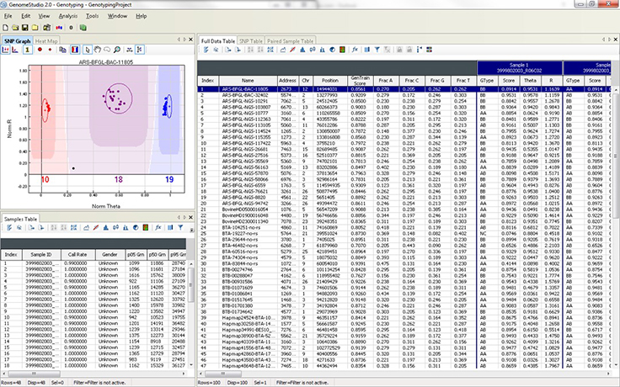
Unix (Bash, AWK, Sed, Grep, etc)
Tools
Genome Studio
genCall
zCall
Tools
PLINK
RICOPILI
EigenSoft
R
Tools
Impute2
BEAGLE
MIS, TIS, SIS*
Tools
PLINK
BOLT-LMM
GEMMA
REGENIE
Tools
METAL
Metasoft
GWAMA
MANTRA
Tools
FINEMAP
CAVIAR
BFMAP
SuSiE
Tools
Plink
PRSice
Ldpred
PRScs
Sample Collection
Genotyping Array
Genotype
Calling
Quality Control
Genotype Imputation
Association Analysis (GWAS)
Replication & Meta-analysis
In-silico Fine-mapping
Polygenic Risk score
The graphical display of genotypes with data points color coded for the call (red = AA, purple = AB, blue = BB).
Genotypes are called for each sample (dot) by their signal intensity and Allele Frequency relative to cluster positions (dark shading) for a given SNP marker.

Slide 9
Unix (Bash, AWK, Sed, Grep, etc)
Tools
Genome Studio
genCall
zCall
Tools
PLINK
RICOPILI
EigenSoft
R
Tools
Impute2
BEAGLE
MIS, TIS, SIS*
Tools
PLINK
BOLT-LMM
GEMMA
REGENIE
Tools
METAL
Metasoft
GWAMA
MANTRA
Tools
FINEMAP
CAVIAR
BFMAP
SuSiE
Tools
Plink
PRSice
Ldpred
PRScs
Sample Collection
Genotyping Array
Genotype
Calling
Quality Control
Genotype Imputation
Association Analysis (GWAS)
Replication & Meta-analysis
In-silico Fine-mapping
Polygenic Risk score
Tuesday 14 June | Day 2
 | SNPs and Sample Quality control - Clara/Kosta
https://www.cog-genomics.org/plink/1.9/index
https://www.cog-genomics.org/plink/2.0/index

Slide 10
Unix (Bash, AWK, Sed, Grep, etc)
Tools
Genome Studio
genCall
zCall
Tools
PLINK
RICOPILI
EigenSoft
R
Tools
Impute2
BEAGLE
MIS, TIS, SIS*
Tools
PLINK
BOLT-LMM
GEMMA
REGENIE
Tools
METAL
Metasoft
GWAMA
MANTRA
Tools
FINEMAP
CAVIAR
BFMAP
SuSiE
Tools
Plink
PRSice
Ldpred
PRScs
Sample Collection
Genotyping Array
Genotype
Calling
Quality Control
Genotype Imputation
Association Analysis (GWAS)
Replication & Meta-analysis
In-silico Fine-mapping
Polygenic Risk score
Wednesday 15 June | Day 3
 | Imputation -tools panels, online resources- Clara, Sathiya, Ananyo & Dhriti

Slide 11
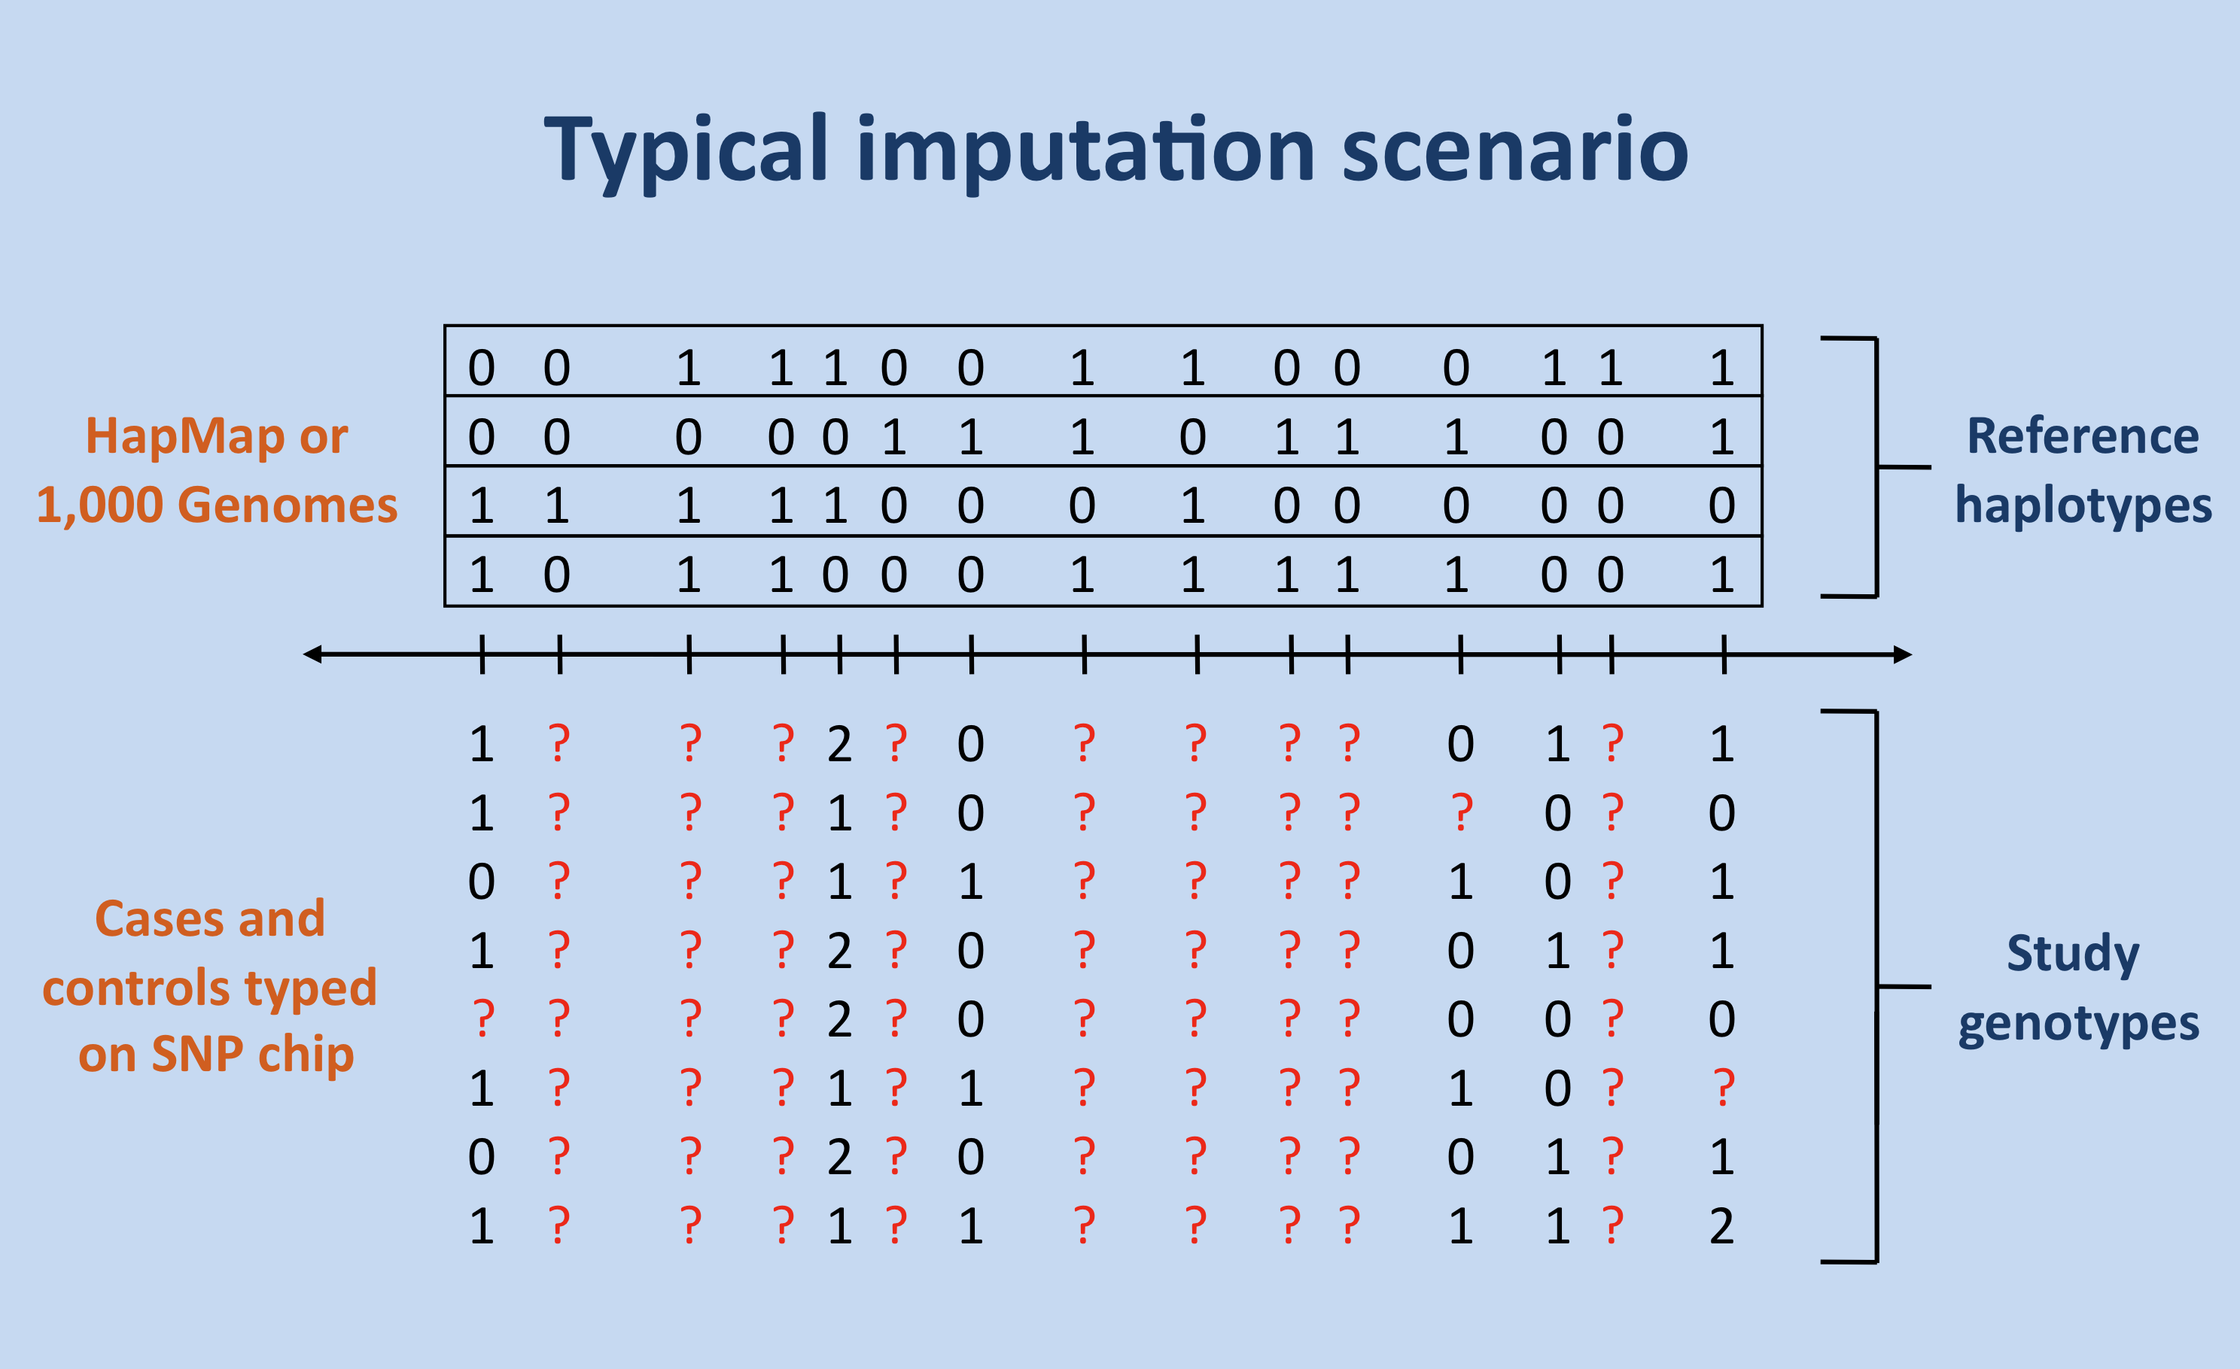
IMPUTE2 is a computer program for phasing observed genotypes and imputing missing genotypes.
IMPUTE2: https://mathgen.stats.ox.ac.uk/impute/impute_v2.html

Slide 12
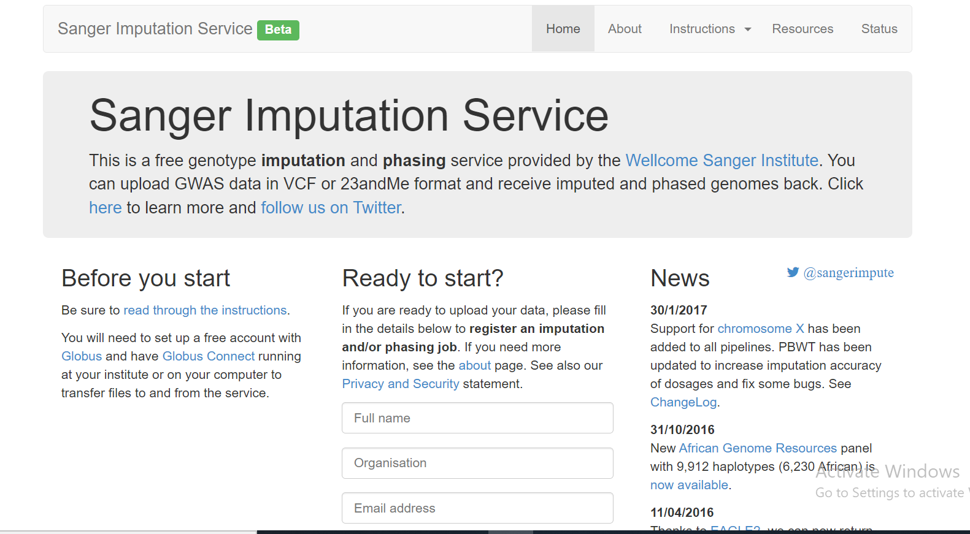
https://imputationserver.sph.umich.edu/index.html#!
https://imputation.biodatacatalyst.nhlbi.nih.gov/#!
https://imputation.sanger.ac.uk/

Slide 13
Unix (Bash, AWK, Sed, Grep, etc)
Tools
Genome Studio
genCall
zCall
Tools
PLINK
RICOPILI
EigenSoft
R
Tools
Impute2
BEAGLE
MIS, TIS, SIS*
Tools
PLINK
BOLT-LMM
GEMMA
REGENIE
Tools
METAL
Metasoft
GWAMA
MANTRA
Tools
FINEMAP
CAVIAR
BFMAP
SuSiE
Tools
Plink
PRSice
Ldpred
PRScs
Sample Collection
Genotyping Array
Genotype
Calling
Quality Control
Genotype Imputation
Association Analysis (GWAS)
Replication & Meta-analysis
In-silico Fine-mapping
Polygenic Risk score
Tuesday 14 June | Day 2
 | Variant -level association analysis: Pak, Clara, Segun
BOLT-LMM Manual: https://alkesgroup.broadinstitute.org/BOLT-LMM/BOLT-LMM_manual.html

Slide 14
Unix (Bash, AWK, Sed, Grep, etc)
Tools
Genome Studio
genCall
zCall
Tools
PLINK
RICOPILI
EigenSoft
R
Tools
Impute2
BEAGLE
MIS, TIS, SIS*
Tools
PLINK
BOLT-LMM
GEMMA
REGENIE
Tools
METAL
Metasoft
GWAMA
MANTRA
Tools
FINEMAP
CAVIAR
BFMAP
SuSiE
Tools
Plink
PRSice
Ldpred
PRScs
Sample Collection
Genotyping Array
Genotype
Calling
Quality Control
Genotype Imputation
Association Analysis (GWAS)
Replication & Meta-analysis
In-silico Fine-mapping
Polygenic Risk score
Wednesday 15 June | Day 3
 | Replication and Meta-analysis: Tinashe, Kostas, Clara, Ananyo
METAL: http://csg.sph.umich.edu/abecasis/Metal/download/

Slide 15
Unix (Bash, AWK, Sed, Grep, etc)
Tools
Genome Studio
genCall
zCall
Tools
PLINK
RICOPILI
EigenSoft
R
Tools
Impute2
BEAGLE
MIS, TIS, SIS*
Tools
PLINK
BOLT-LMM
GEMMA
REGENIE
Tools
METAL
Metasoft
GWAMA
MANTRA
Tools
FINEMAP
CAVIAR
BFMAP
SuSiE
Tools
Plink
PRSice
Ldpred
PRScs
Sample Collection
Genotyping Array
Genotype
Calling
Quality Control
Genotype Imputation
Association Analysis (GWAS)
Replication & Meta-analysis
In-silico Fine-mapping
Polygenic Risk score
Thursday 16 June | Day 4
 | Insilico Finemapping: Ananyo, Dhriti
FineMap: http://www.christianbenner.com/

Slide 16
Unix (Bash, AWK, Sed, Grep, etc)
Tools
Genome Studio
genCall
zCall
Tools
PLINK
RICOPILI
EigenSoft
R
Tools
Impute2
BEAGLE
MIS, TIS, SIS*
Tools
PLINK
BOLT-LMM
GEMMA
REGENIE
Tools
METAL
Metasoft
GWAMA
MANTRA
Tools
FINEMAP
CAVIAR
BFMAP
SuSiE
Tools
Plink
PRSice
Ldpred
PRScs
Sample Collection
Genotyping Array
Genotype
Calling
Quality Control
Genotype Imputation
Association Analysis (GWAS)
Replication & Meta-analysis
In-silico Fine-mapping
Polygenic Risk score
Thursday 16 June | Day 4
 | Polygenic Risk Scores: Tinashe, Segun, Ananyo
PRScise-2: https://www.prsice.info/

Slide 17
Important tool/skills across all stages of analyses - Bash Scripting, AWK, Sed, Grep, etc
Unix (Bash, AWK, Sed, Grep, etc)
Tools
Genome Studio
genCall
zCall
Tools
PLINK
RICOPILI
EigenSoft
R
Tools
Impute2
BEAGLE
MIS, TIS, SIS*
Tools
PLINK
BOLT-LMM
GEMMA
REGENIE
Tools
METAL
Metasoft
GWAMA
MANTRA
Tools
FINEMAP
CAVIAR
BFMAP
SuSiE
Tools
Plink
PRSice
Ldpred
PRScs
Sample Collection
Genotyping Array
Genotype
Calling
Quality Control
Genotype Imputation
Association Analysis (GWAS)
Replication & Meta-analysis
In-silico Fine-mapping
Polygenic Risk score

Slide 18
“LIFE-SAVING” UNIX COMMANDS
ls, rm, cd, mv, cp (scp), wc, mkdir, wget
cat, head, tail, less, more, echo, > , |
passwd, su , date, man, chmod,
find, diff, sort, cut, uniq, grep
gzip, unzip, bzip2
Awk, sed, join and paste
Expected to know these commands
Now – Self Practical Exercise (Refresher)

Slide 19
MAP file - Example
AWK is a “must” - HIGHLY helpful to manipulate GWAS data
Example of a MAP file of the standard PLINK format:
21 | rs11511647 | 0 | 26765
X | rs3883674 | 0 | 32380
X | rs12218882 | 0 | 48172
9 | rs10904045 | 0 | 48426
9 | rs10751931 | 0 | 49949
8 | rs11252127 | 0 | 52087
10 | rs12775203 | 0 | 52277
8 | rs12255619 | 0 | 52481

Slide 20
PED file - Example
Example of a PED file of the standard PLINK format:
FAM1 | NA06985 | 0 | 0 | 1 | 1 | A | T | T | T | G | G | C | C | A | T | T | T | G | G | C | C
FAM1 | NA06991 | 0 | 0 | 1 | 1 | C | T | T | T | G | G | C | C | C | T | T | T | G | G | C | C
0 | NA06993 | 0 | 0 | 1 | 1 | C | T | T | T | G | G | C | T | C | T | T | T | G | G | C | T
0 | NA06994 | 0 | 0 | 1 | 1 | C | T | T | T | G | G | C | C | C | T | T | T | G | G | C | C
0 | NA07000 | 0 | 0 | 2 | 1 | C | T | T | T | G | G | C | T | C | T | T | T | G | G | C | T
0 | NA07019 | 0 | 0 | 1 | 1 | C | T | T | T | G | G | C | C | C | T | T | T | G | G | C | C
0 | NA07022 | 0 | 0 | 2 | 1 | C | T | T | T | G | G | 0 | 0 | C | T | T | T | G | G | 0 | 0
0 | NA07029 | 0 | 0 | 1 | 1 | C | T | T | T | G | G | C | C | C | T | T | T | G | G | C | C
FAM2 | NA07056 | 0 | 0 | 0 | 2 | C | T | T | T | A | G | C | T | C | T | T | T | A | G | C | T
FAM2 | NA07345 | 0 | 0 | 1 | 1 | C | T | T | T | G | G | C | C | C | T | T | T | G | G | C | C

Slide 21
Refresher on Basic AWK commands
CLICK ON THE LINK BELOW AND RUN THROUGH
Launch an Interactive Terminal, then practice
AWK
https://www.digitalocean.com/community/tutorials/how-to-use-the-awk-language-to-manipulate-text-in-linux
SED
https://www.digitalocean.com/community/tutorials/the-basics-of-using-the-sed-stream-editor-to-manipulate-text-in-linux

Slide 22
Thank you

