Slide 1
Pathogen Genomics – working with pathogen genomes
Adam Reid
Wellcome Sanger Institute
LSHTM Pathogen Genomics 2020

Slide 2
Summary
What is the point of a genome sequence?
Genome sequencing technologies
Sequence data files
Viewing genomes

Slide 3
Why do genome sequencing?
Reference for molecular biology
Tropheryma whipplei causes the potentially fatal Whipple’s disease. Could not easily be grown. Genome revealed it had lost genes involved in producing amino acids.
Identify all the genes that determine the function of the organism
Neisseria meningitidis, a major cause of meningitis. The first vaccine for a particular form of meningitis for identified by looking for candidates in its genome.
Rickettsia prowazekii is the cause of epidemic typhus, which killed millions in the early 20th century. It cannot reproduce outside of these cells. It was found to have just over 800 genes.
Examine evolution by comparative genomics
Track spread of pathogens
Identify antimicrobial/drug resistance genes and drug targets
Mtb researchers made bacteria resistant to a new drug. Genome sequencing identified the gene involved in resistance.
Basis for other omics technologies – RNA-seq, ChIP-seq, Methylome etc.

Slide 4
Why do genome sequencing? - Video of Wellcome Sanger Institute researchers

Slide 5
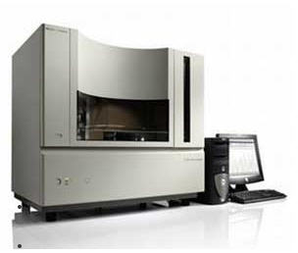
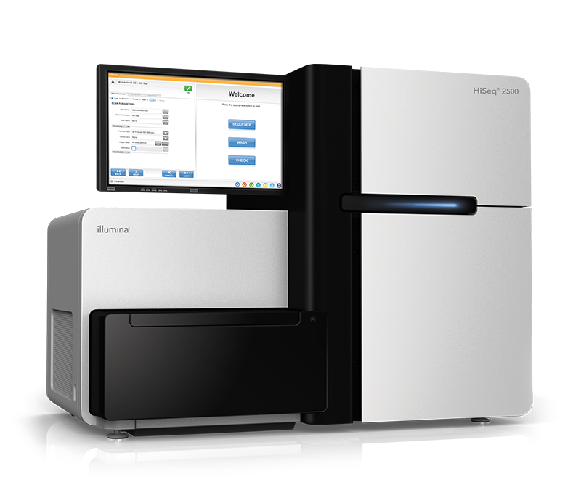
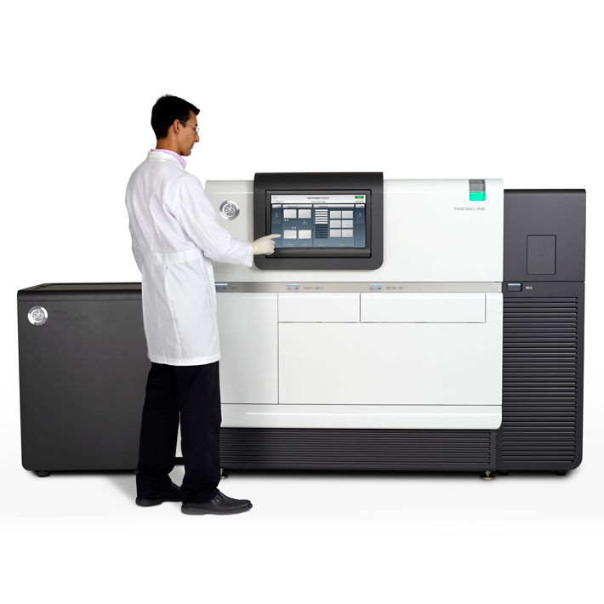
Technology overview
Sanger sequencing produces ~500bp reads
Pros: Highly accurate
Cons: Expensive, laborious
Uses: High quality reference genomes
Illumina’s sequencing-by-synthesis 75-250bp
Pros: cheap, lots of reads (e.g. 500 million per run)
Cons: short reads
Uses: Resequencing, draft genomes, RNA-seq
Pacific Biosciences Single-Molecule Real Time (SMRT) reads of 5000bp-40000bp
Pros: long reads
Cons: Fewer reads than Illumina - ~1 million, low accuracy
Uses: Reference genomes

Slide 6
Genome sequencing technologies – Interview with Mike Quail

Slide 7
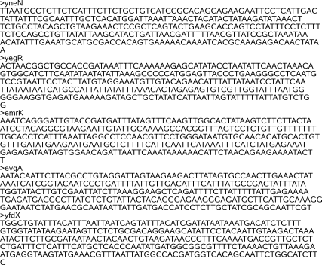
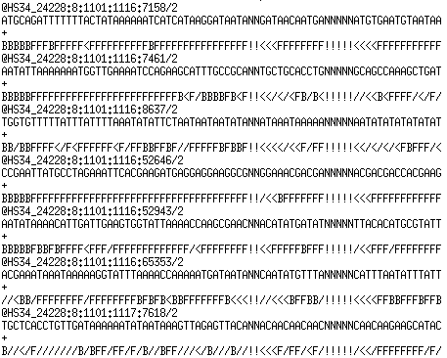
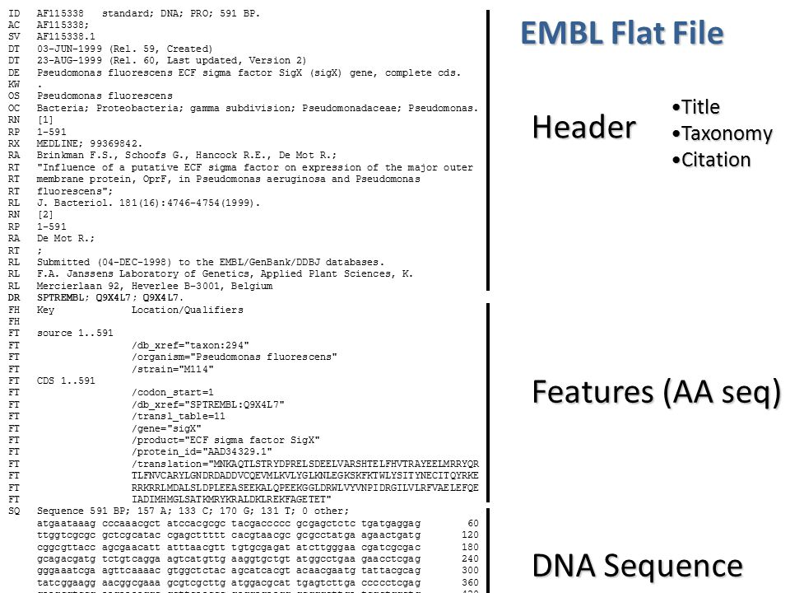
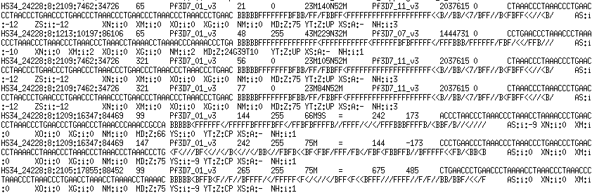
Sequence data
Fasta
Fastq
EMBL
SAM/BAM

Slide 8
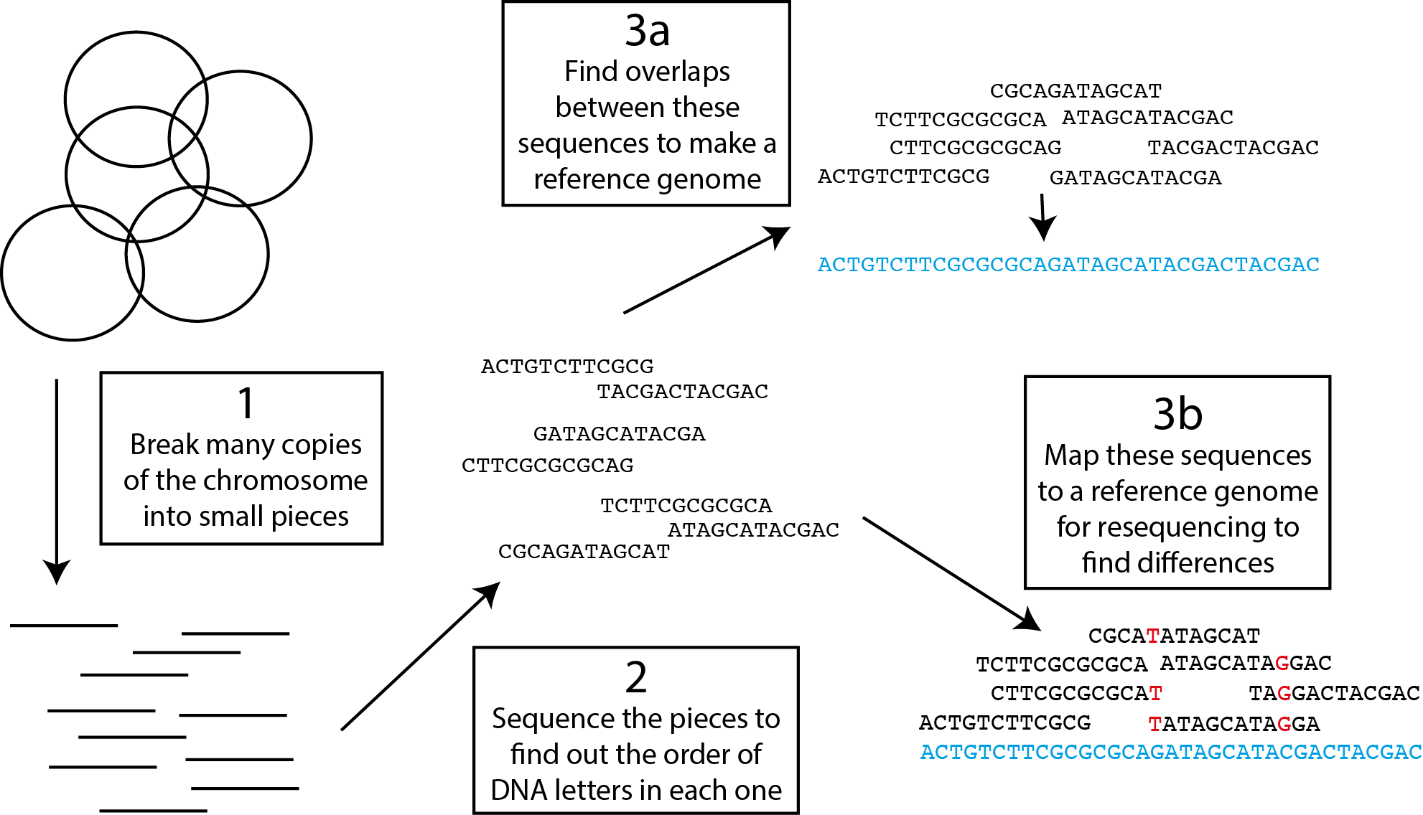
What do we do with these data?
Annotation (find the genes)
Look for interesting differences
Build a tree

Slide 9
Doing bioinformatics
Has anyone here done any bioinformatics?
How are we going to do our bioinformatics?
Virtual machine with Linux
Artemis for viewing genomes
Various command line tools for mapping, assembling etc.
Web-based applications

Slide 10
What will we do today?
Get familiar with the Virtual Machine
Use Artemis to get intimate with genomes (morning)
Map Illumina genome sequencing data to understand differences between closely related bacteria (afternoon)

