Slide 1

Introduction to R Lesson 2

Slide 2

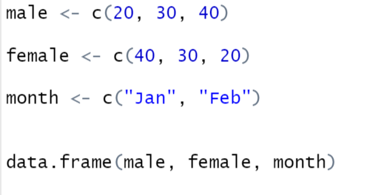
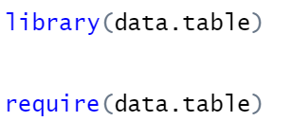
Recap
✘
✔️
✔️
✔️
✔️
✔️
✔️
✘
✘

Slide 3



Understanding your dataset

Slide 4
Questions we can answer?
The number of samples collected in each year? [hint: table]
The number of samples in each serogroup?
The number of samples in each genogroup?
The number of samples in each genogroup in samples collected in Nigeria [hint: filter & table]

Slide 5
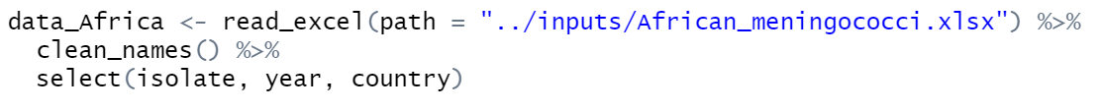
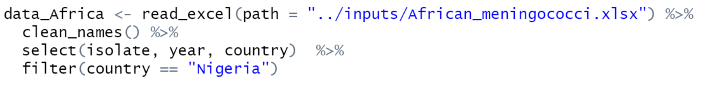
Too many variables?
Pipe command: “%>%”

Slide 6
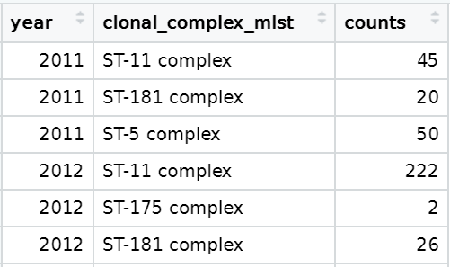
More complex questions we can answer
**The clonal complexes identified in each year?**

Slide 7
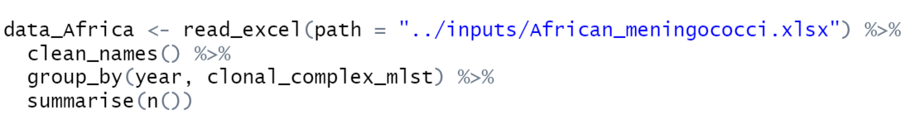
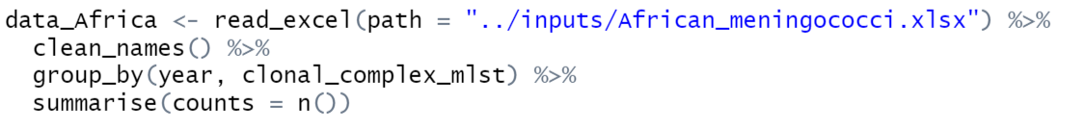
Functions: group_by & summarise

Slide 8
More questions we can answer
The clonal complexes identified in each genogroup? [hint: group_by and summarise]
The clonal complexes identified by country in each year? [hint: group_by and summarise]
*Add the proportions of each?*

Slide 9
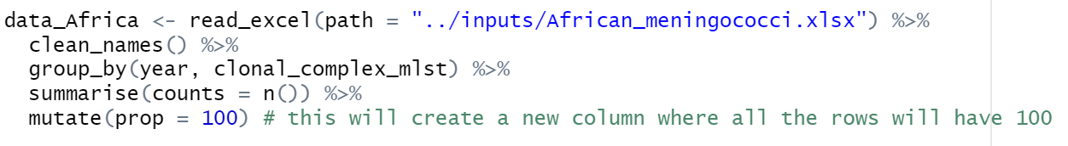
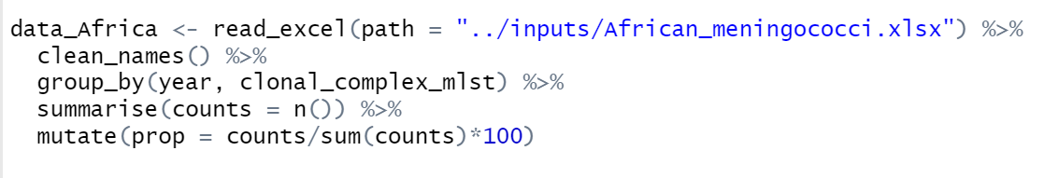
Function: ‘mutate’

Slide 10
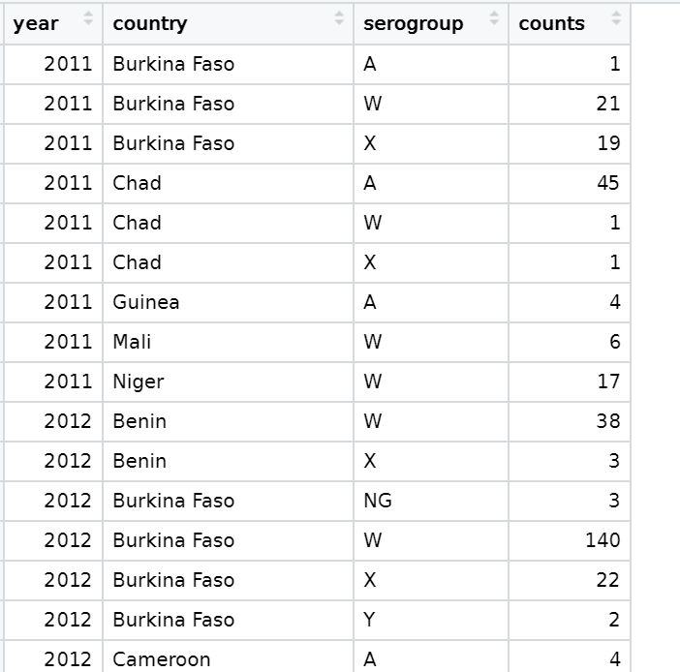
Visualization sometimes better than long tables

Slide 11
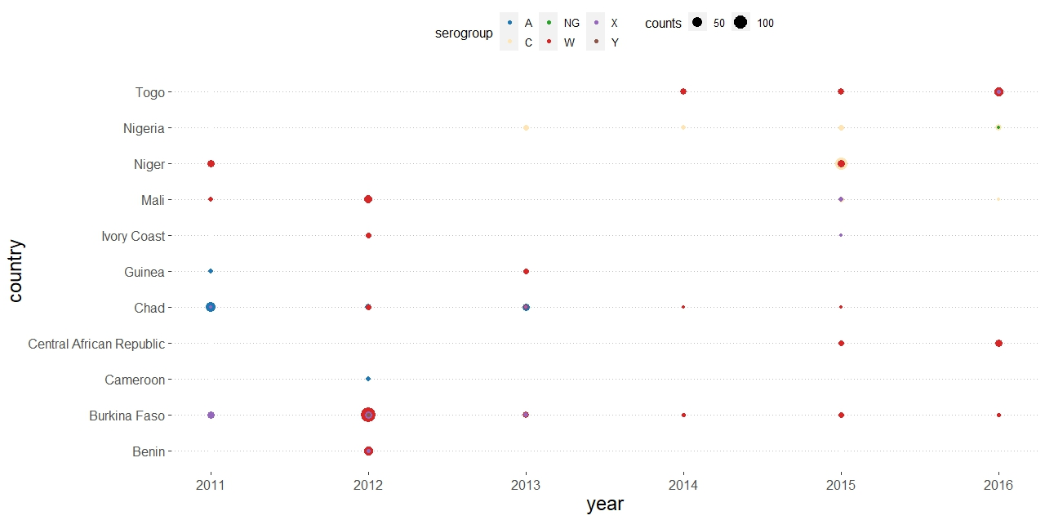

Slide 12
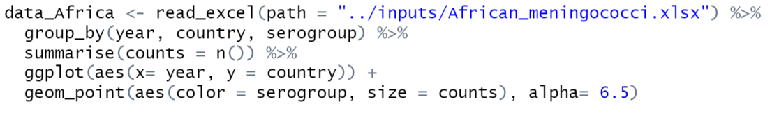
Functions: ggplot

