Slide 1


Module 2.1: Introduction to UNIX
Presented by:
Carla Daniela Robles Espinoza
Laboratorio Internacional de Investigación sobre el Genoma Humano
Universidad Nacional Autónoma de México
@daniela_oaks
drobles@liigh.unam.mx
Based on slides by:
Jacqueline Keane
Next Generation Sequencing Bioinformatics Course
22-27 January 2023 - Santiago - Chile
FACULTAD DE
CIENCIAS BIOLOGICAS
PONTIFICIA UNIVERSIDAD CATÓLICA DE CHILE
Notes:
Hello everyone, very exciting to start the first practical session for this course, so the first thing you need to know is that you can find the material for this module in your VM, which you should have already tried
We will spend 15 minutes on this presentation, from 9:30 to 9"45 am here. Then we will go to the breakout rooms, where you will be divided in groups of 4 with one instructor each, this way you can work on these exercises at your own pace, and please if you get stuck or get any questions, please ask the instructor! And of course, discuss the exercises with the rest of the students and the instructors. At the end of the session, we will tell you where to find the solutions, and in the same way each instructor will provide the solutions for their session.
We will have a break in an hour and a half to have lunch, and then we will return to continue from where you stopped before lunch.
Any questions you have during the session, please raise your hand in Zoom, which will be noted by Caro who is one of our course assistants or please ask in Slack

Slide 2
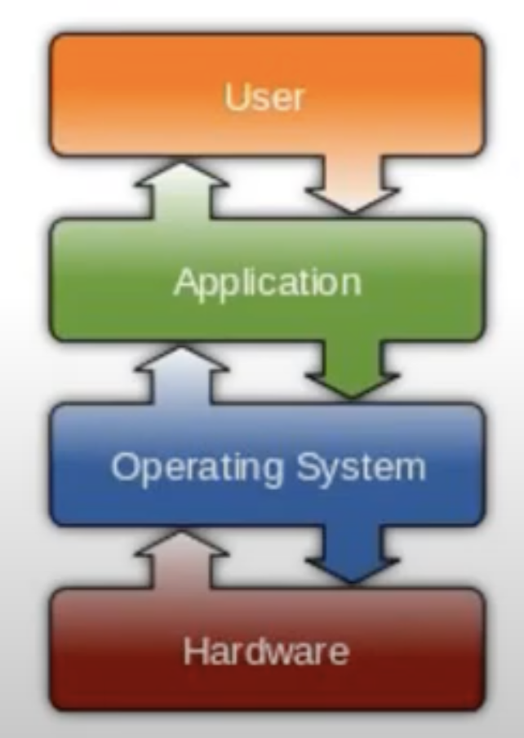
Virtual machine
Operating system: Software that supports the computer’s basic functions
Manages computer hardware (screen, mouse, keyboard)
Provides tools for managing files, running software
Provides a way via software applications to interact with the computer
Examples
Windows
OS X
Unix
Linux
Notes:
Very brief introduction to the virtual machine, as we will be using it during this course, and you should have already tested it

Slide 3
Virtual machine (VM)
VM is a computer environment that can be run on any computer
OS, data, software applications
Allows you to run one OS (Linux) on another OS (Windows)
Created a VM for this course
Linux OS
Data for practicals
Bioinformatics software (bwa, samtools, vcftools, etc)
Continue using it on your own machine
Take the course again!
Run bioinformatic analyses
Notes:
Think of a VM as a computer environment that can be run on any other computer system
Has its own operating system, it has all the data and programs that you will need during the week
Which means that you can take the course again, as many times as you like, and also use it to run bioinformatic analyses
Do you all know how to use your VM for the exercises? Please tell us either by raising your hand or in the Slack

Slide 4
Unix
What is Unix?
Standard operating system (alternative to MS Windows, Mac OS)
Provides a way for you to interact with the computer
Many ‘flavours’ of Unix, using Linux
Originally created to provide a free UNIX-like OS for PCs
Why use Unix?
Output of lots of biological research exists in large text files
Very suitable for working with such files
Powerful and flexible commands for processing large text files
Save you time
Widely used in scientific community
Powerful, robust and stable operating system
Notes:
If you haven’t used it before, don’t worry, we will go from the very basic operations and we will progress to more advanced concepts. For those that have used unix before, please be patient, and well, I am sure you will be able to do the exercises fast.
You will hopefully learn new things that will save loads of time, things that perhaps you used to do in Excel

Slide 5
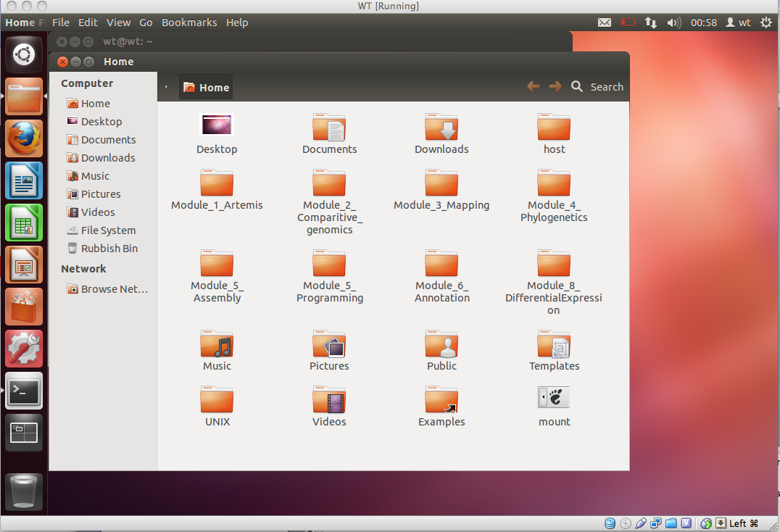
Using Unix
Notes:
How do you use the UNIX operating system?
Just like any other operating system, have a graphical user interface, click on icons to launch programs, explore files and folders on disk using a file manager

Slide 6
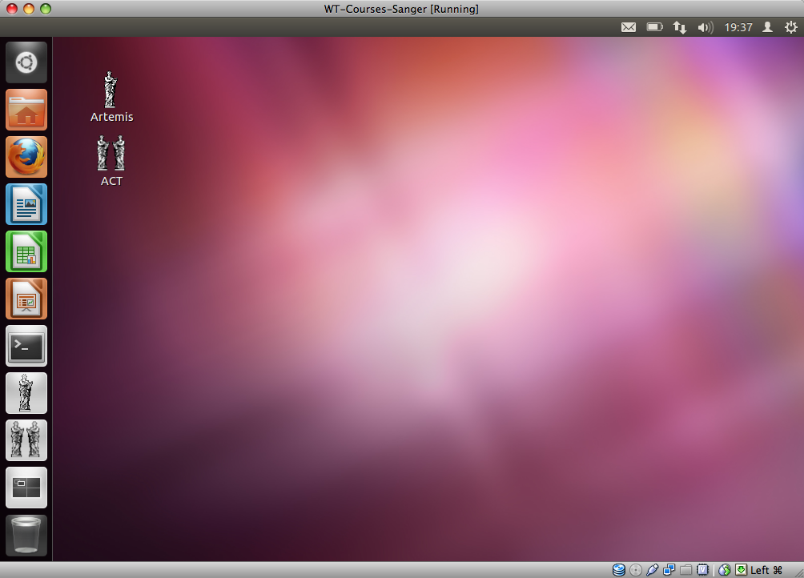
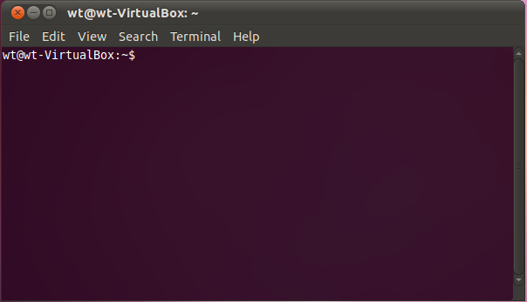
Terminals and Commandline
UNIX prompt
Notes:
However another really cool feature about UNIX is the ability to interact and provide instructions to the computer using a series of text based commands
The commands/instructions are provided to the computer in a terminal window on the commandline
Very powerful as it allows you to carry out certain tasks very quickly that otherwise may take be time consuming if using the file manager e.g. moving or deleting hundreds of files

Slide 7
Unix Commands
Command
What it does
ls
List the contents of the current directory
cd
Changes a directory
mv
Moves a file
cp
Copies a file
rm
Remove a file
less
Displays the contents of a file
head
Displays the first ten lines of a file
tail
Displays the last ten lines of a file
cat
Concatenate files together
pwd
Print working directory
mkdir
Make a new directory
Notes:
Some of the basic commands, you will be using these during the week
Mention the terseness/how short they are of the commands, they will save you time

Slide 8
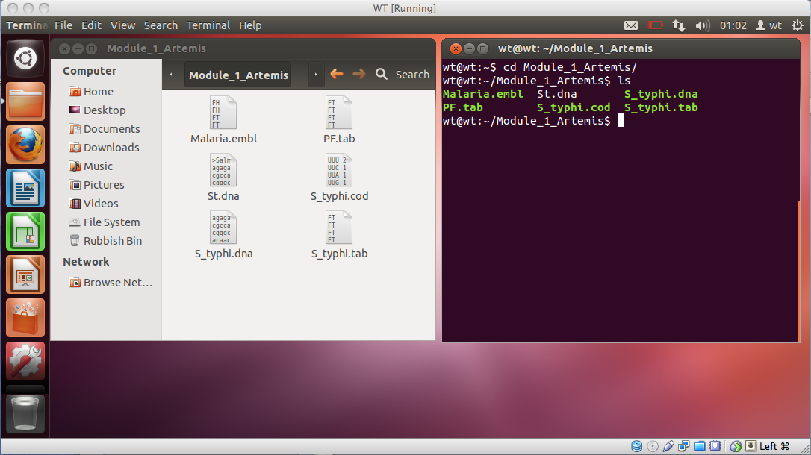
ls command
Notes:
This command will allow you to see the contents of a directory
If you want to use it with a graphical interface you would open the directory and see the contents, as you are seeing in the left window here, whereas in the command line you will just type ls inside the directory, or ls and the directory path, to see a list of its contents

Slide 9
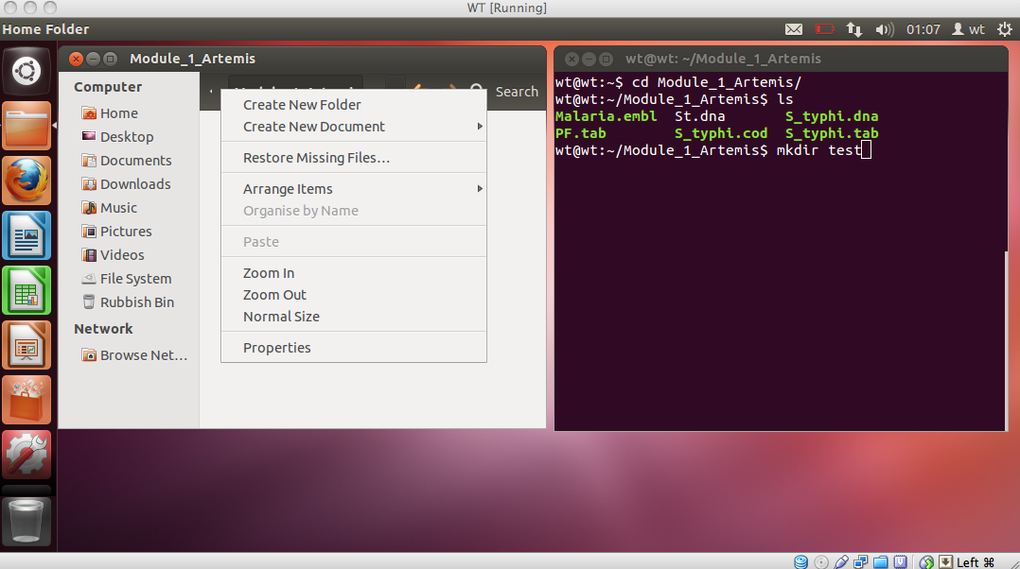
mkdir command
Notes:
If you want to create a new file or folder
On the left you see the traditional way to do that, but you can also do it with the command line, you would write mkdir, a space,a nd the name of the directory you want to create

Slide 10
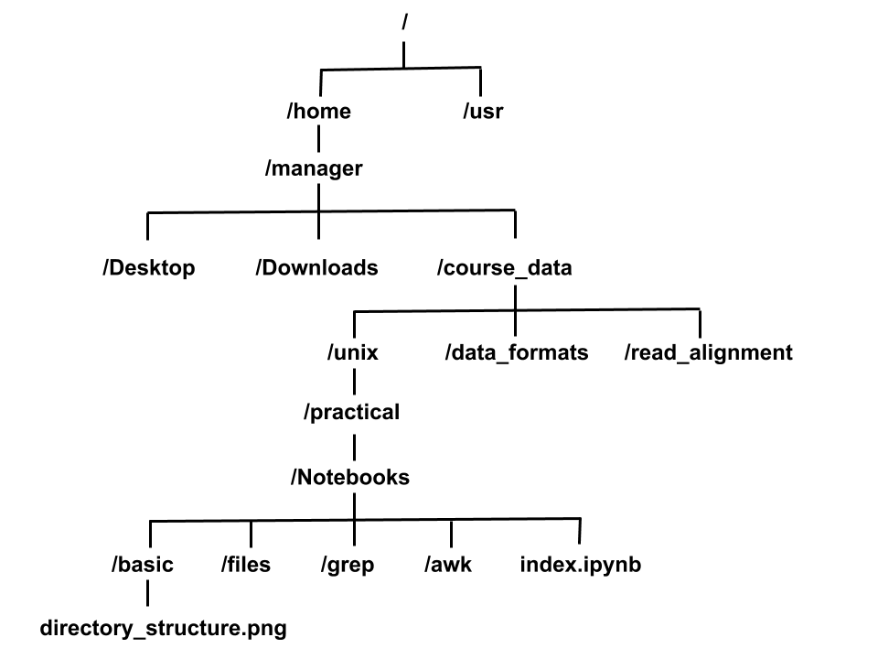
Directory Structure
root directory
/home/manager/course_data/unix/practical/Notebooks/index.ipynb
Notes:
Shows a typical directory structure in UNIX, a directory is equivalent to folder in Windows
Your files are organised in a hierarchy, directories can have subdirectories and so on
Very useful for organising your work – organise files for different projects into different directories to keep them separate
The most top level directory in the hierarchy is called the root directory and is denoted by a forward slash
You can type ls, and see what is in the directory where you are
The full location or path of a specific files given by listing it’s location from the root directory

Slide 11
Unix Tips & Tricks
Unix is case sensitive
Typing LS is NOT the same as typing ls
You need to put spaces between
a command
the values passed to the command
mkdir new_dir will create a new directory
mkdirnew_dir will just give an error!
Unix is not psychic! If you misspell the name of command or a file it will not understand you
Notes:
Don’t worry if this seems confusing at the time, we have plenty of exercises
When learning UNIX some common mistakes we see happen over and over
Forgetting that UNIX is case sensitive, to add spaces and mis-spelling commands/file names
-Some of this may not make sense until you start looking at examplesread through the module which gives a bit more background to UNIX and make a start on the exercises – as always if you have any questions on UNIX please feel free to ask any of us

Slide 12
Exercise time!
Open your VM
Open a terminal window.
Go to course_data/unix
cd course_data/unix/
Open the exercises, which are in Github or in:
/home/manager/course_data/unix/practical/unix.pdf
e.g.
firefox /home/manager/course_data/unix/practical/unix.pdf
Follow the instructions!

Slide 13
Exercise time!
Solutions (inside course_data/unix/practical):
course_data/unix/practical/.unix_solutions.pdf

