Slide 1
References
References
Abbot, J. C. et al. (2005) Bioinformatics 21(18) 3665-3666. WebACT – an online companion for the Artemis Comparison Tool.
Allen JE & Salzberg SL (2005). Bioinformatics 21: 3596-3603. JIGSAW: integration of
multiple sources of evidence for gene prediction.
Alexa A. et al. (2006) Bioinformatics 22: 1600-1607. Improved scoring of functional groups from gene expression data by decorrelating GO graph structure.
Anders S & Huber W (2010) Genome Biol 11: R106. Differential expression analysis for sequence count data.
Anders S. HTSeq: Analysing high-throughput sequencing data with Python. 2010.
Software. [http://www-huber.embl.de/users/anders/HTSeq/]
Assefa, S. et al. (2009) Bioinformatics 25 (15) 1968-9. ABACAS: algorithm-based automatic contiguation of assembled sequences.
Berriman, M., and K. Rutherford (2003) Brief Bioinform 4 (2) 124-132. Viewing and annotating sequence data with Artemis.
Bozdech Z. et al. (2003) PLOS Biol 1: E5.The transcriptome of the intraerythrocytic developmental cycle of Plasmodium falciparum.
Carver T. J. et al. (2010) Bioinformatics (doi:10.1093/bioinformatics/btq010)
BamView: Viewing mapped read alignment data in the context of the reference sequence.
Carver T. J. et al. (2005) Bioinformatics 21: 3422-3. ACT: the Artemis Comparison Tool.
Conesa A, et al. (2005) Bioinformatics 21: 3674-3676. Blast2GO: a universal tool for annotation, visualization and analysis in functional genomics research.

Slide 2
References
Delcher AL. et al. (1999) Nucleic Acids Res 27: 4636-4641. Improved microbial gene identification with GLIMMER.
Gardner et al. (2002). Nature 419(6906):498-511. Genome sequence of the human malaria parasite Plasmodium falciparum.
Grant GR, et al. (2011) Bioinformatics 27: 2518-2528. Comparative analysis of RNA-Seq alignment algorithms and the RNA-Seq unified mapper (RUM).
Hacker, J. et al. (1997) Mol Microbiol 23: 1089-97. Pathogenicity islands of virulent bacteria: structure, function and impact on microbial evolution.
Haas BJ, et al. (2008). Genome Biol 9: R7. Automated eukaryotic gene structure annotation using EVidenceModeler and the Program to Assemble Spliced Alignments.
Hardcastle TJ & Kelly KA (2010). BMC Bioinformatics 11: 422. baySeq: empirical Bayesian methods for identifying differential expression in sequence count data
Kozarewa, I., Z. Ning, et al. (2009). Nature Met 6(4): 291-295. Amplification-free Illumina sequencing-library preparation facilitates improved mapping and assembly of (G+C)-biased genomes.
Langmead et al. (2009). Genome Biol 10:R25. Ultrafast and memory-efficient alignment of short DNA sequences to the human genome.
Li et al. (2008a). Genome Res 18:1851-8. Mapping short DNA sequencing reads and calling variants using mapping quality scores.
Li et al. (2008b). Bioinformatics 24(5):713-714. SOAP: short oligonucleotide alignment program.
Li et al. (2009). Bioinformatics, 25:1754-60. Fast and accurate short read alignment with Burrows-Wheeler Transform.
Majoros et al. (2003) Nucleic Acids Res 31 (13) 3601-3604. GlimmerM, Exonomy and Unveil: three ab initio eukaryotic genefinders.
Mortazavi et al. (2008). Nature Met 5: 621 – 628. Mapping and quantifying mammalian transcriptomes by RNA-Seq.
Ning et al. (2001). Genome Res 10:1725-9. SSAHA: a fast search method for large DNA databases.

Slide 3
Otto et al. (2010) Mol Microbiol Apr;76(1):12-24. New insights into the blood stage transcriptome of Plasmodium falciparum using RNA-Seq.
Otto, T. D., G. P. Dillon, et al. (2011). Nucleic Acids Res 39(9): e57. RATT: Rapid Annotation Transfer Tool.
Otto, T. D., M. Sanders, et al. (2010). Bioinformatics 26(14): 1704-1707. Iterative Correction of Reference Nucleotides (iCORN) using second generation sequencing technology.
Parkhill, J. (2002) Method Microbiol 33: 1-26. Annotation of microbial genomes.
Robinson MD, et al. (2010) Bioinformatics 26: 139-140.edgeR: a Bioconductor package for differential expression analysis of digital gene expression data.
Rutherford et al. (2000) Bioinformatics 16 (10) 944-945. Artemis: sequence visualization and annotation.
Simpson, J. T., K. Wong, et al. (2009). Genome Res 19(6): 1117-1123. ABySS: a parallel assembler for short read sequence data.
Stephens et al. (1998). Science 282(5389): 754 – 759. Genome sequence of an obligate intracellular pathogen of humans: Chlamydia trachomatis.
Tsai, I. J., T. D. Otto, et al. (2010). Genome Biol 11(4): R41. Improving draft assemblies by iterative mapping and assembly of short reads to eliminate gaps.
Trapnell et al. (2009). Bioinformatics 25(9):1105-1111. TopHat: discovering splice junctions with RNA-Seq.
Wang et al. (2009). Nat Rev Genet 10(1):57-63. RNA-Seq: A revolutionary tool for transcriptomics.
Zerbino, D. R. and E. Birney (2008). Genome Res 18(5): 821-829. Velvet: algorithms for de novo short read assembly using de Bruijn graphs.

Slide 4
Appendices
Appendices
Appendix I: Course Virtual Machine (VM) Quick Start Guide
Appendix III: ACT comparison files
Appendix IV: Feature Keys and Qualifiers – a brief explanation of what they are and a sample of the ones we use.
Appendix V: Generating ACT comparison files using BLAST
Appendix VIII: Prokaryotic Protein Classification Scheme used within the PSU
Appendix IX: List of colour codes
Appendix XI: Splice site information

Slide 5
Appendices
Appendix I: Course Virtual Machine (VM) Quick Start Guide
Using a VM enables us to encapsulate the course data and software in such a way that you can still make use of them when you return to your own laboratory.
To use the VM on the USB stick provided, you will first need to download VirtualBox (http://www.virtualbox.org/). This software is required to run the VM on your machine, it is free and available for windows, MacOSX and linux,
For a detailed description of VirtualBox and the installation see the on-line manual (http://www.virtualbox.org/manual/).
Download and Install VirtualBox
Download VirtualBox for the type of workstation you are using (e.g. Windows) from http://www.virtualbox.org/wiki/Downloads.
Double click on the executable file (Windows). The installation welcome dialog opens and allows you to choose where to install VirtualBox to, and which components to install. Depending on your Windows configuration, you may see warnings about "unsigned drivers" or similar. Please select "Continue" on these warnings; otherwise VirtualBox might not function correctly after installation.
Launch the VirtualBox software from the desktop shortcut or from the program menu.
Setting up the VM
VirtualBox needs to be pointed at the VDI (This is the file that is on the memory stick used during the course) file as follows:
Insert the USB memory stick provided. This contains a Virtual Disk Image (VDI) file.
Create a new virtual machine by selecting ‘New’ from the options at the top. Then fill the boxes in as shown below:
In the first window enter:
Name: Artemis
Operating System: Linux
Version: Ubuntu

Slide 6
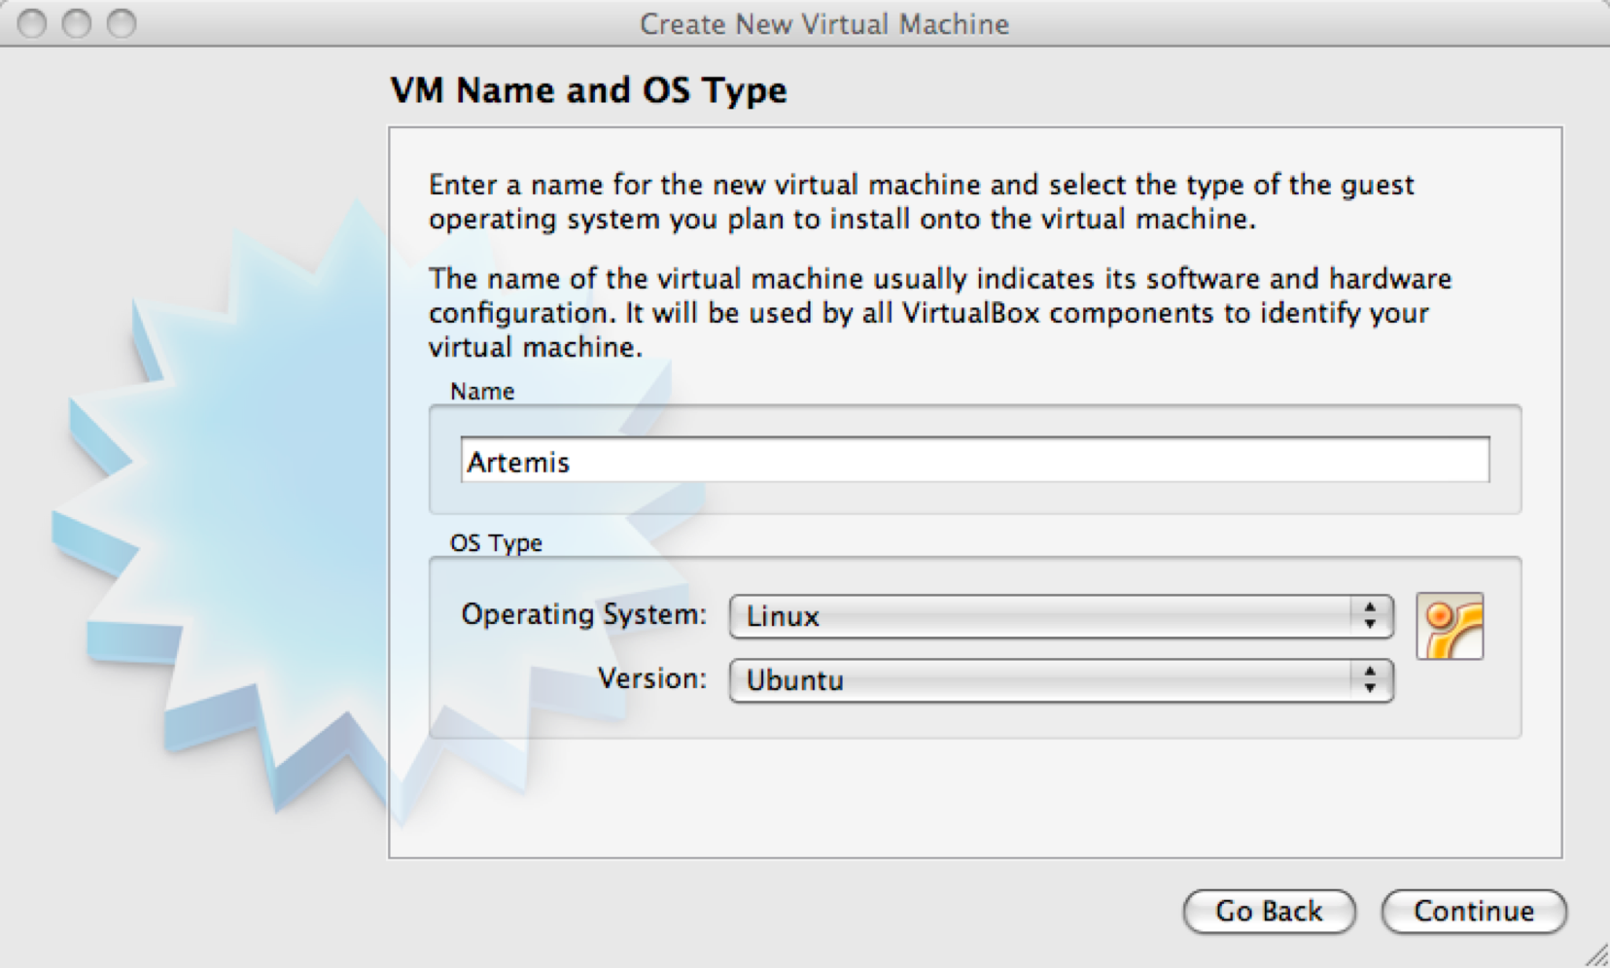
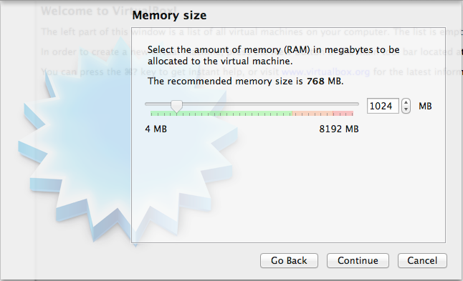
Appendices
Click ‘Continue’
In the next window set the memory to at least 1GB (as shown), but 2GB (2048 MB) will give you better performance. You can use more but no more than half the amount of memory on your PC.
Click ‘Continue’.

Slide 7
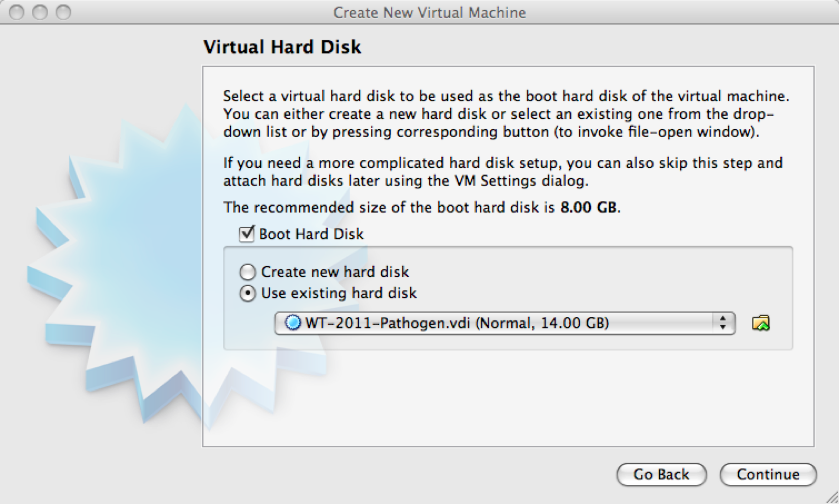
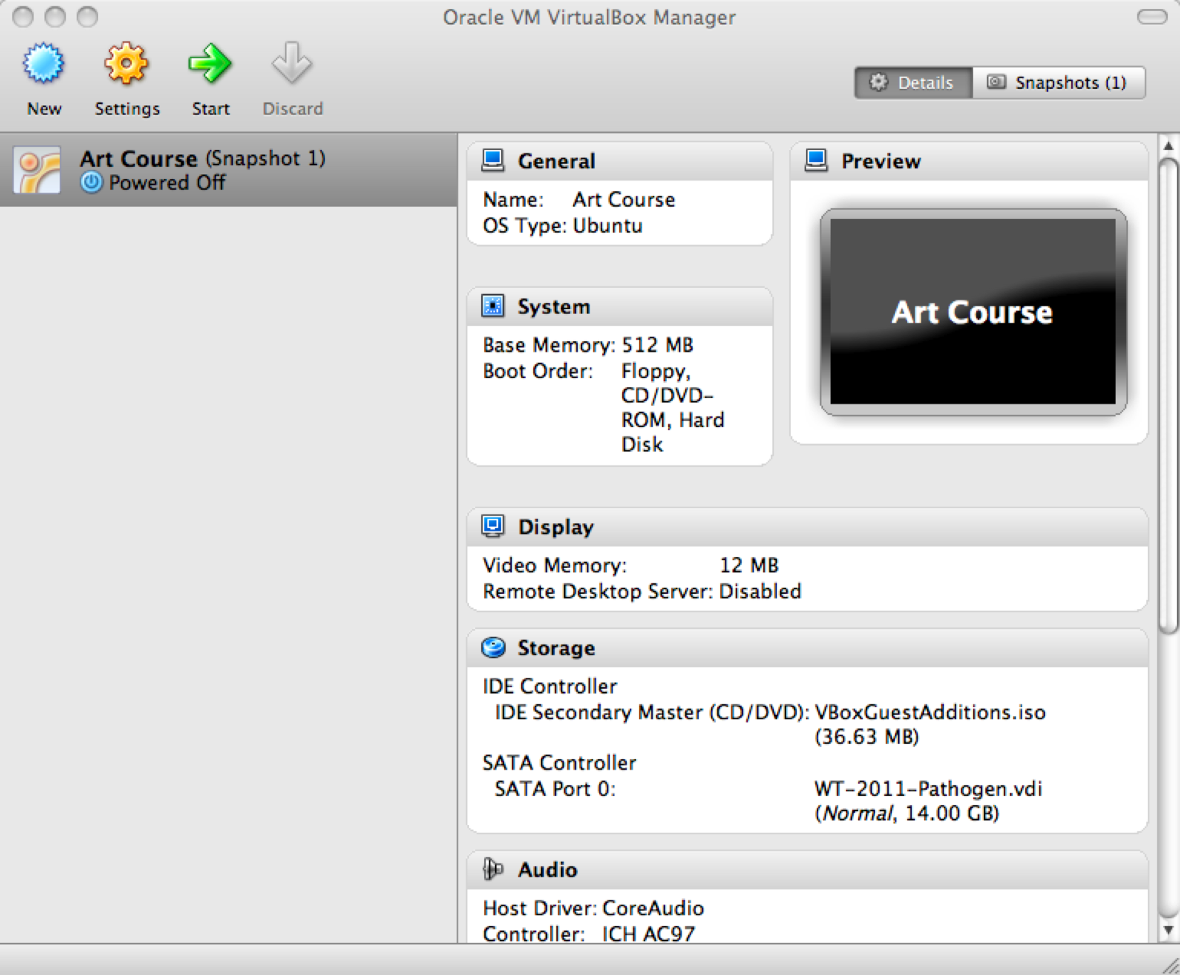
Appendices
In the next window select ‘Use existing hard disk’ and from the folder icon on the right hand side navigate to the memory USB stick and select the VDI file located on the memory stick
Click ‘Continue’.
There will now be an ‘Artemis’ (powered off) button in the left hand side of VirtualBox.

Slide 8
Appendices
Double click on this new Artemis course power button to start the VM. It will then log you into the Ubuntu desktop.
Setting up a Shared Folder
This allows you to share a folder between the VM and your workstation. This means you can put files that you want to share between the operating systems in this folder.
Create a directory to share called ‘VMshare’ on your machine. With the VM shutdown select the ‘Artemis’ button in VirtualBox and click ‘Settings’ in the top menu bar. Go to ‘Shared Folders’ and select the ‘+’ button on the right. In the ‘Folder Path’ select ‘Other’ and navigate to and select the ‘VMshare’ folder that you have created. Then click on ‘OK’.
When the ‘Artemis’ VM is next started double click on the ‘mount’ icon in your home folder. This will open a window that you need to type the password into:
wt
It will show the contents of this folder in the /home/wt/host directory in Ubuntu.
A note on memory usage:
Some computing processes are very memory hungry. Should you find that your computer processes are killed without a clear reason, one aspect to check is the amount of memory allocated to the VM. The 1024MB you have allocated using this tutorial has been check and should be enough. Nonetheless, the amount of memory allocated to the VM can be changed at any time.

Slide 9
Appendices
Appendix III: ACT comparison files
ACT supports three different comparison file formats:
1) BLAST version 2.2.2 output: The blastall command must be run with
the -m 8 flag which generates one line of information per HSP.
2) MegaBLAST output: ACT can also read the output of MegaBLAST,
which is part of the NCBI blast distribution.
3) MSPcrunch output: MSPcrunch is program for UNIX and GNU/Linux
systems which can post-process BLAST version 1 output into an
easier to read format. ACT can only read MSPcrunch output with
the -d flag.
Here is an example of an ACT readable comparison file generated by MSPcrunch -d.
1399 97.00 940 2539 sequence1.dna 1 1596 AF140550.seq
1033 93.00 9041 10501 sequence1.dna 9420 10880 AF140550.seq
828 95.00 6823 7890 sequence1.dna 7211 8276 AF140550.seq
773 94.00 2837 3841 sequence1.dna 2338 3342 AF140550.seq
The columns have the following meanings (in order): score, percent
identity, match start in the query sequence, match end in the query
sequence, query sequence name, subject sequence start, subject sequence
end, subject sequence name.
The columns should be separated by single spaces.

Slide 10
Appendices
Appendix IV: Feature Keys and Qualifiers – a brief explanation of what they are and a sample of the ones we use.
1 – Feature Keys: They describe features with DNA coordinates and once marked, they all appear in the Artemis main window. The ones we use are:
CDS: Marks the extent of the coding sequence.
RBS: Ribosomal binding site
misc_feature: Miscellaneous feature in the DNA
rRNA: Ribosomal RNA
repeat_region
repeat_unit
stem_loop
tRNA: Transfer RNA
2 – Qualifiers: They describe features in relation to their coordinates. Once marked they appear in the lower part of the Artemis window. They describe the feature whose coordinates appear in the ‘location’ part of the editing window. The ones we commonly use for annotation at the Sanger Institute are:
/class: Classification scheme we use “in-house” developed from Monica Riley’s MultiFun assignments (see Appendix VI).
/colour: Also used in-house in order to differentiate between different types of genes and other features.
/gene: Descriptive gene a name, eg. ilvE, argA etc.
/label: Allows you to label a gene/feature in the main view panel.
/note: This qualifier allows for the inclusion of free text. This could be a description of the evidence supporting the functional prediction or other notable features/information which cannot be described using other qualifiers.
/product: The assigned possible function for the protein goes here.
/pseudo: Matches in different frames to consecutive segments of the same protein in the databases can be linked or joined as one and edited in one window. They are marked as pseudogenes. They are normally not functional and are considered to have been mutated.
/locus_tag : Systematic gene number, eg SAS1670, Sty2412 etc.
The list of keys and qualifiers accepted by EMBL in sequence/annotation submission files are list at the following web page:
http://www3.ebi.ac.uk/Services/WebFeat/

Slide 11
Appendices
Appendix V: Generating ACT comparison files using BLAST
The following pages demonstrate how you can generate your own comparison files for ACT from a stand-alone version of the BLAST software. In Appendix X the NCBI BLAST distribution was downloading onto a PC with Windows XP. The exercises in this module are based on the Linux version of the BLAST software. Although the operating systems are different, the command lines used to run the programs are the same. One of the main differences between the two operating systems is that in Windows the BLAST program command line is run in the DOS Command Prompt window, whereas in Linux it is run from a Xterminal window.
In the exercises below you are going to download two small sequences (plasmids), and for two large sequences (whole genomes). You are then going generate files containing DNA sequences in FASTA format for these sequences, which will then be compared using two different programs from the NCBI BLAST distribution to generate ACT comparison files.
Exercise 1
In this exercise you are going to download two plasmid sequences in EMBL format from the EBI genomes web page. You are then going to use Artemis to write out the DNA sequences of both plasmids in FASTA format. These two FASTA format sequences will then be compared using the blastall program from the NCBI BLAST distribution. Using blastall you can run BLASTN to identify regions of DNA-DNA similarity and write out a ACT readable comparison file. If required, blastall can also used to run other flavours of BLAST with the appropriate input files (i.e. DNA files for TBLASTX, protein files for BLASTP, and protein and DNA for BLASTX). For the purposed of generating ACT comparison files BLASTN and TBLASTX are appropriate.
In this example two relative small sequences have been chosen (<500 kb). BLAST running on a relatively modern stand alone machine can easily deal with required computations, and thus the comparison file should be produced in a matter of seconds. However as the size of the compared sequences increases the time taken to produce the output will dramatically increase. Therefore for very large sequences (several Mb) it will be impractical to run them using blastall. In Exercise 2 you will use megablast, another program in the NCBI BLAST distribution, which is useful for comparing large sequence that are very similar.
The plasmids chosen for this comparison are the multiple drug resistance incH1 plasmid pHCM1 from the sequenced strain of Salmonella typhi CT18 originally isolated in 1993, and R27, another incH1 plasmid first isolated from S. typhi in the 1960s.

Slide 12
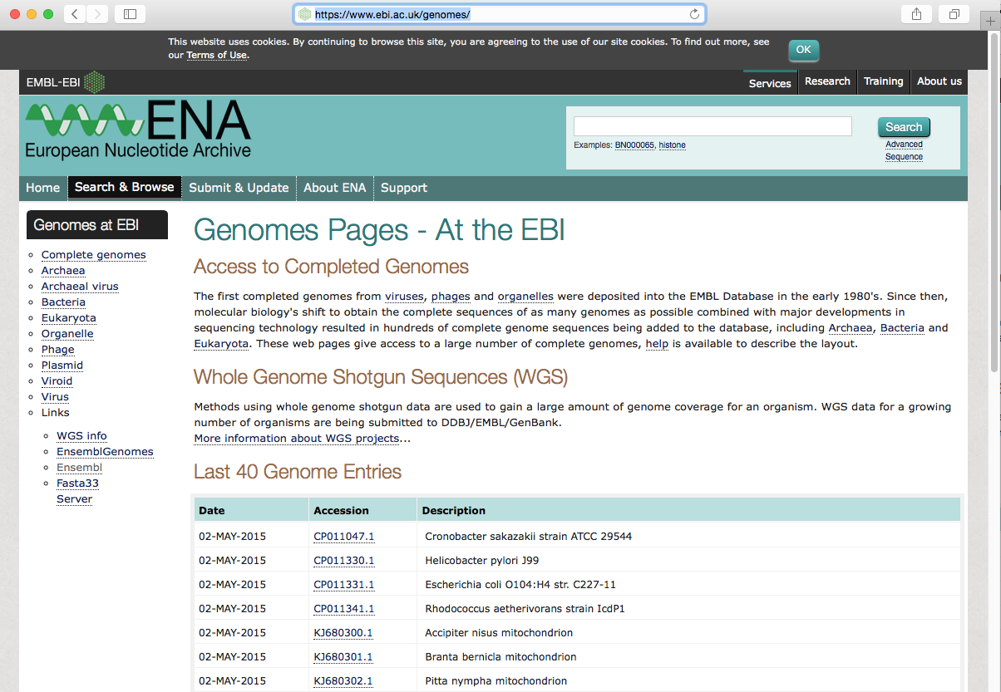
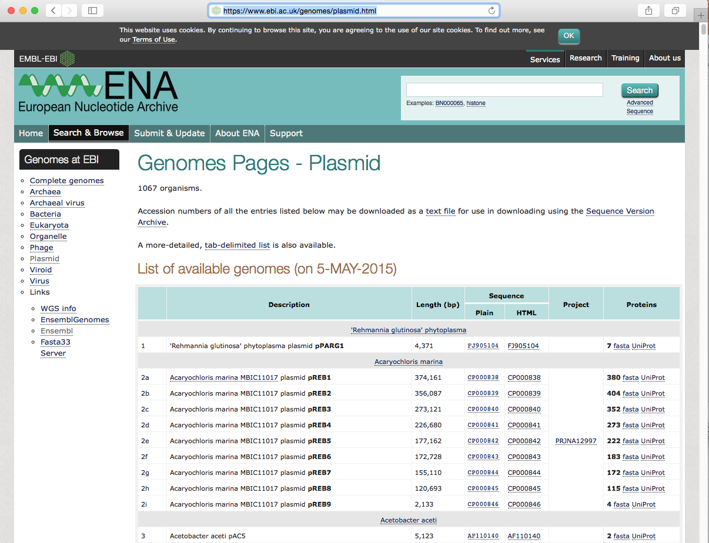
Appendices
Downloading the S. typhi plasmid sequences
Go to the EBI genomes web page (http://www.ebi.ac.uk/genomes)
Click on the Plasmid hyperlink
Scroll down the page to the Salmonella plasmids

Slide 13
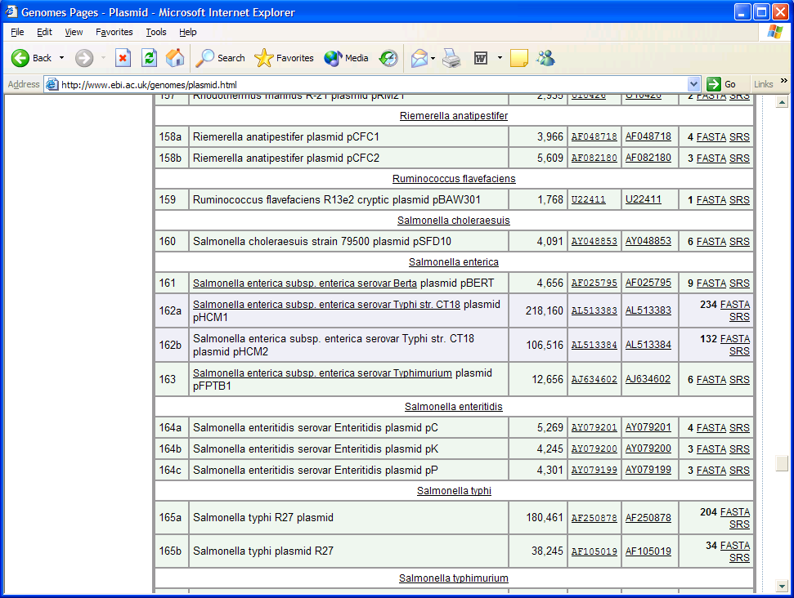
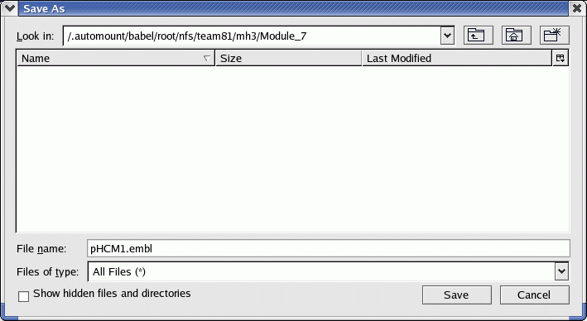
Appendices
Press the Shift key and left Click on the accession number hyperlink for pHCM1 (AL513383) in the Plain Sequence column
Save the EMBL sequence in a suitable directory.
For example: BLAST_Appendix
BLAST_Appendix
Save the file as pHCM1.embl
Repeat for the Salmonella typhi R27 plasmid (AF250878). Be careful when choosing the plasmid to download as there is also a Salmonella typhi plasmid R27 entry (AF105019 ), the one that you want is the larger of the two, 180,461 kb as opposed to 38,245 kb – make sure the accession number is correct. Save as R27.embl.

Slide 14
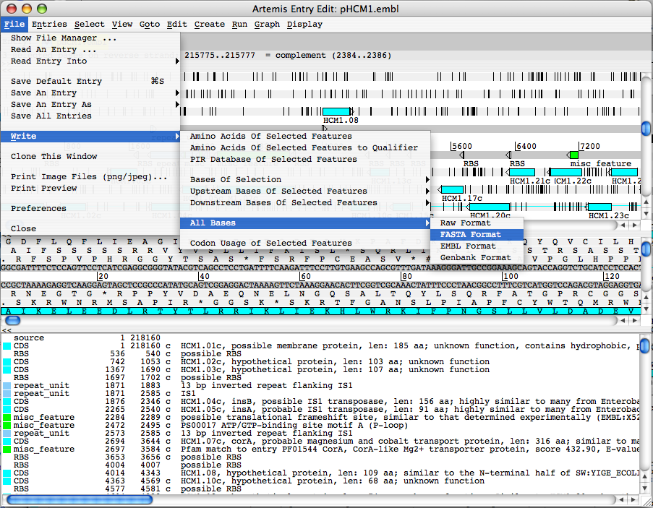
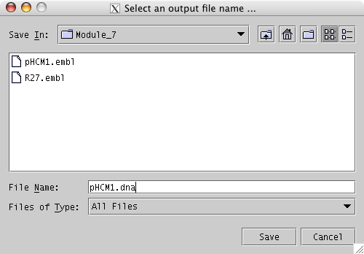
Appendices
In order to run BLASTN you require two DNA sequences in FASTA format. The pHCM1 and R27 sequences previously downloaded from the EBI are EMBL format files, i.e. they contain protein coding information and the DNA sequence. In order to generate the DNA files in FASTA format, Artemis can be used as follows.
Load up the plasmid EMBL files in Artemis (each plasmid requires a separate Artemis window), select Write, All Bases, FASTA format.
BLAST_Appendix
Save the DNA sequence in the BLAST_Appendix directory
Save as pHCM1.dna
Also do this for R27.embl

Slide 15
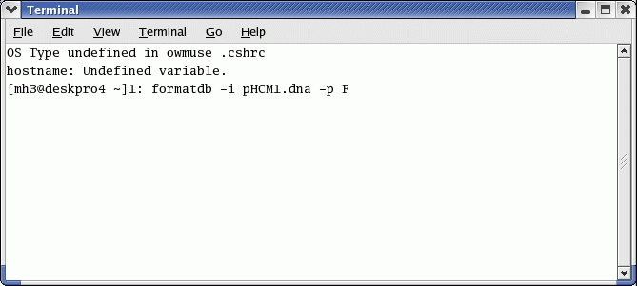
Appendices
Running Blast
There are several programs in the BLAST package that can be used for generating sequence comparison files. For a detailed description of the uses and options see the appropriate README file in the BLAST software directory (see Appendix X).
In order to generate comparison files that can be read into ACT you can use the blastall program running either BLASTN (DNA-DNA comparison) or TBLASTX (translated DNA-translated DNA comparison) protocols.
As an example you will run a BLASTN comparison on two relatively small sequences; the pHCM1 and R27 plasmids from S. typhi. In principle any DNA sequences in FASTA format can be used, although size becomes and issue when dealing with sequences such whole genomes of several Mb (see Exercise 2 in this module). When obtaining nucleotide sequences from databases such as EMBL using a server such as SRS (http://srs.ebi.ac.uk), it is possible to specify that the sequences are in FASTA format.
To run the BLAST software you will need an Xterminal window like the one below. If you do not already have one opened, you can open a new window by clicking on the Xterminal icon on the menu bar at the bottom of your screen.
$:
Make sure you are in the appropriate directory (in this example it is BLAST_Appendix.) You should now see both the new FASTA files for the pHCM1 and R27 sequences in the BLAST_Appendix directory as well as their respective EMBL format files.
(Hint: You can use the pwd command to check the present working directory, the cd command to change directories, and the ls command will list the contents of the present working directory).
When comparing sequences in BLAST, one sequence is designated as a database sequence, and the other the query sequence. Before you run BLAST you have to format one of the sequences so that BLAST recognises it as a database sequence. formatdb is a program that does this and comes as part of the NCBI BLAST distribution.

Slide 16
Appendices
You will treat pHCM1.dna as the database sequence and R27.dna as the query sequence
At the Command Prompt type:
formatdb –i pHCM1.dna –p F
Press Return
formatdb is the database format program
$:
formatdb –i pHCM1.dna –p F
–p designates the sequence type: DNA is F (protein would be T)
–i designates the input sequence: pHCM1.dna
Now you can run the BLAST on the two plasmid sequences. The program that you are going to use is blastall. In addition to the standard command line inputs we have to add an additional flag (-m 8) to the command line so that the BLAST output can be read by ACT. This specifies that the output of BLAST is in one line per entry format (see appendix II).
At the Command Prompt type:
blastall –p blastn –m 8 –d pHCM1.dna –i R27.dna –o pHCM1_vs_R27
Press Return
tblastx could be substituted here if a translated DNA-translated DNA comparison was required
–o designates the output file: pHCM1_vs_R27
$:
blastall –p blastn –m 8 –d pHCM1.dna –i R27.dna –o pHCM1_vs_R27
blastall is the BLAST program
–p designates the flavour of BLAST: blastn (in this instance a DNA-DNA comparison)
–m 8 designates the ACT readable output
–d designates the database sequence: pHCM1.dna
–i designates the query sequence: R27.dna

Slide 17
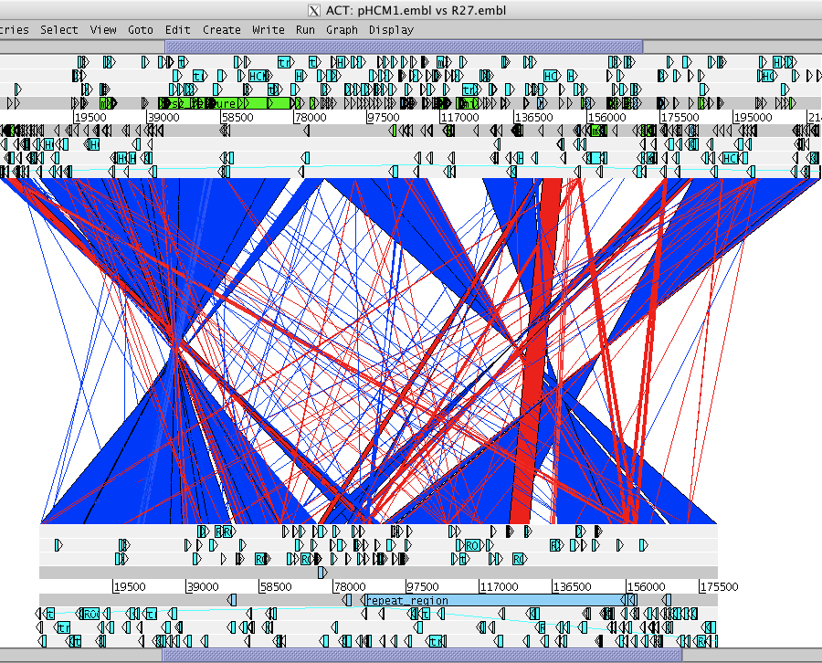
Appendices
The pHCM1_vs_R27 comparison file can now be read into ACT along with the pHCM1.embl and R27.embl (or pHCM1.dna and R27.dna) sequence files.
The result of the BLASTN comparison shows that there are regions of DNA shared between the plasmids; pHCM1 shares 169 kb of DNA at greater than 99% sequence identity with R27. Much of the additional DNA in the pHCM1 plasmid appears to have been inserted relative to R27 and encodes functions associated with drug resistance. What antibiotic resistance genes can you find in the pHCM1 plasmid that are not found in R27?
The two plasmids were isolated more than 20 years apart. The comparison suggests that there have been several independent acquisition events that are responsible for the multiple drug resistance seen in the more modern S. typhi plasmid.

Slide 18
Appendices
Exercise 2
In the previous exercise you used BLASTN to generate a comparison file for two relatively small sequences (>500,000 kb). In the next exercise we are going to use another program from NCBI BLAST distribution, megablast, that can be used for nucleotide sequence alignment searches, i.e. DNA-DNA comparisons. If you are comparing large sequences such as whole genomes of several Mb, the blastall program is not suitable. The BLAST algorithms will struggle with large DNA sequences and therefore the processing time to generate a comparison file will increase dramatically.
megablast uses a different algorithm to BLAST which is not as stringent which therefore makes the program faster. This means that it is possible to generate comparison files for genome sequences in a matter of seconds rather than minutes and hours.
There are some drawbacks to using this program. Firstly, only DNA-DNA alignments (BLASTN) can be performed using megablast, rather than translated DNA-DNA alignments (TBLASTX) as can be using blastall. Secondly as the algorithm used is not as stringent, megablast is suited to comparing sequences with high levels of similarity such as genomes from the same or very closely related species.
In this exercise you are going to download two Staphylococcus aureus genome sequences from the EBI genomes web page and use Artemis to write out the FASTA format DNA sequences for both as before in Exercise 1. These two FASTA format sequences will then be compared using megablast to identify regions of DNA-DNA similarity and write out an ACT readable comparison file.
The genomes that have been chosen for this comparison are from a hospital-acquired methicillin resistant S. aureus (MRSA) strain N315 (BA000018), and a community-acquired MRSA strain MW2 (BA000033).

Slide 19
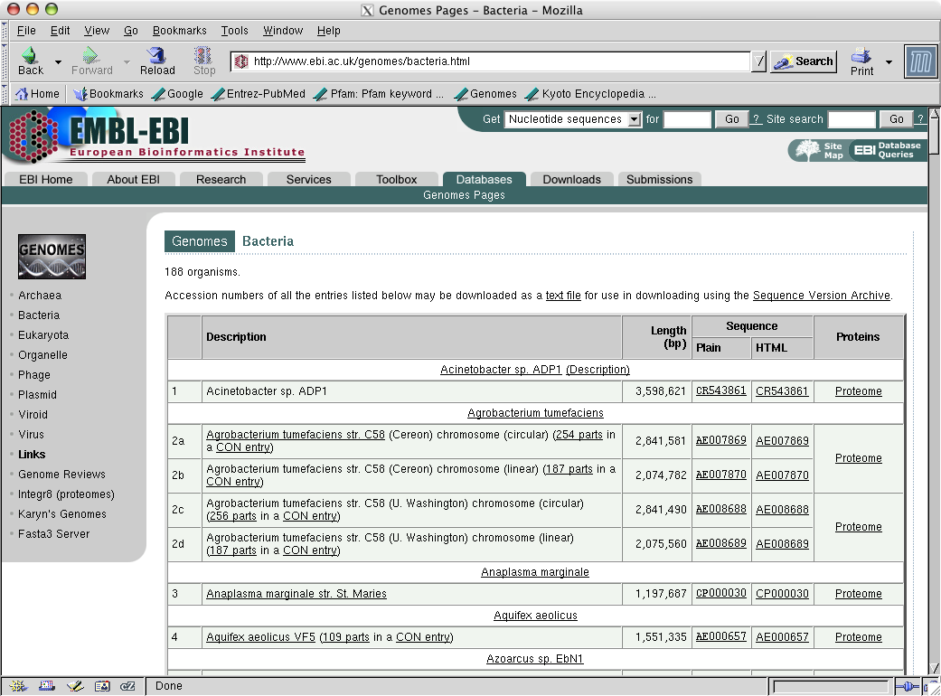
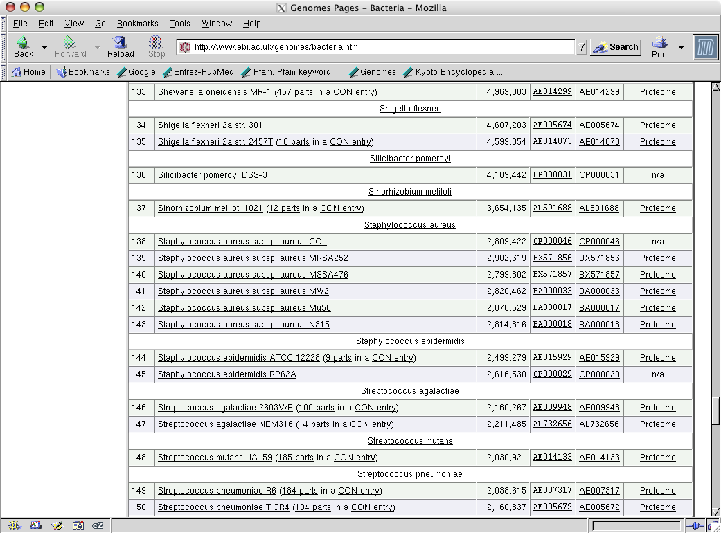
Appendices
Downloading the S. aureus genomic sequences
Go to the EBI genomes web page (http://www.ebi.ac.uk/genomes) as before in Exercise 2, and click on the Bacteria hyperlink
Scroll down the page to the Staphylococcus aureus genomes
Press the Shift key and left Click on the S. aureus N315 accession number hyperlink (BA000018) in the Plain Sequence column

Slide 20
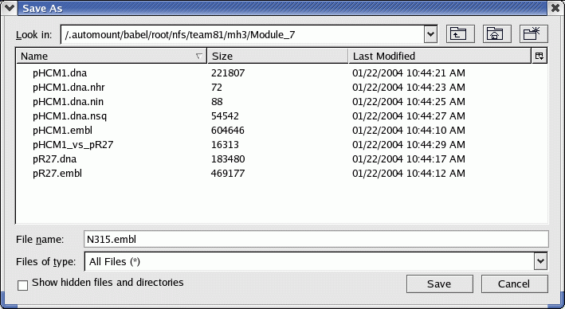
Appendices
Save the EMBL sequence in a suitable directory.
For example: BLAST_Appendix
BLAST_Appendix
Save the file as N315.embl
Repeat for the S. aureus MW2 genome (BA000033). Be careful when choosing the genome to download as there is another S. aureus genome entry for strain Mu50 (BA000017). Save as MW2.embl.
Generate DNA files in FASTA format using Artemis for both the genome sequences as previously done in exercise 1.
(Hint: In Artemis (each genome requires a separate Artemis window), select Write, Write All Bases, FASTA format).
Save the DNA sequences as N315.dna and MW2.dna for the respective genomes.
Running Blast
In the previous exercise you used the blastall program to run BLASTN on two plasmid sequences. As the genome sequences are larger (~2.8 Mb) you are going to run megablast, another program from the NCBI BLAST distribution that can generate comparison files in a format that ACT can read (see Appendix II). For a detailed description of the uses and options in megablast see the megablast README file in the BLAST software directory (Appendix X).
As before you will run the program from the command line in an Xterminal window.
Like BLAST, megablast requires that one sequence is designated as a database sequence and the other the query sequence. Therefore one of the sequences has to be formatted so that Blast recognises it as a database sequence. This can be done as before using formatdb.

Slide 21
Appendices
We will treat N315.dna as the database sequence and MW2.dna as the query sequence
At the Command Prompt type:
formatdb –i N315.dna –p F
Press Return
$:
formatdb –i N315.dna –p F
–i designates the input sequence: N315.dna
–p designates the sequence type: DNA is F (protein would be T)
Now we can run the megablast on the two MRSA genome sequences. The default output format is one line per entry that ACT can read, therefore there is no need to add an additional flag (i.e. -m 8) to the command line (see appendix II).
At the Command Prompt type:
megablast –d N315.dna –i MW2.dna –o N315_vs_MW2
Press Return
megablast is the program
–o designates the output file: N315_vs_MW2
$:
megablast –d N315.dna –i MW2.dna –o N315_vs_MW2
–d designates the database sequence: N315.dna
–i designates the query sequence: MW2.dna

Slide 22
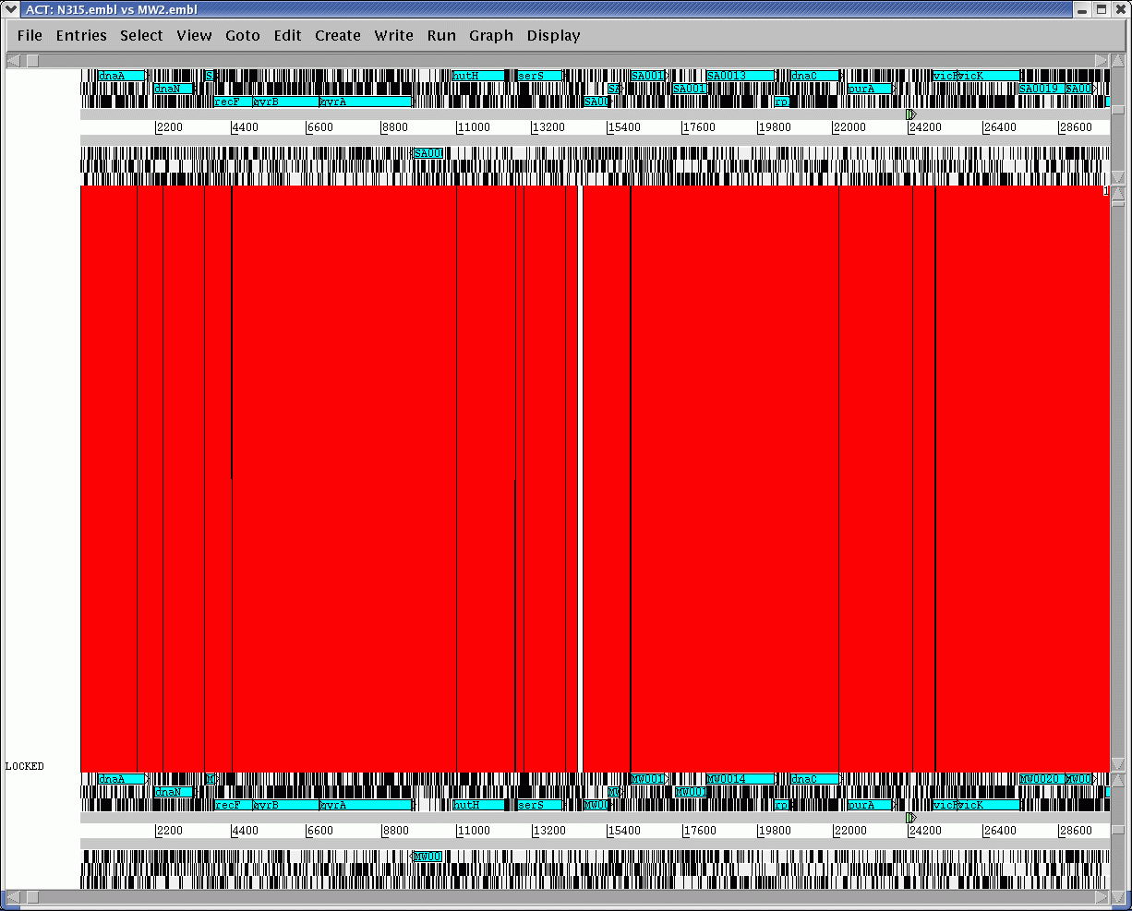
Appendices
The N315_vs_MW2 comparison file can now be read into ACT along with the N315.embl and MW2.embl (or N315.dna and MW2.dna) sequence files.
A comparison of the N315 and MW2 genomes in ACT using the megablast comparison reveals a high level of synteny (conserved gene order). This is perhaps not unsurprising as both genomes belong to strains of the same species. Using results of comparisons like these it is possible to identify genomic differences that may contribute to the biology of the bacteria and also investigate mechanisms of evolution.
Both N315 and MW2 are MRSA, however N315 is associated with disease in hospitals, and MW2 causes disease in the community and is more invasive.
Scroll rightward in both genomes to find the first large region of difference. Examine the annotation for the genes in these regions. What are the encoded functions associated with these regions? What significance does this have for the evolution of methicillin resistance in these two S. aureus strains from clinically distinct origins?

Slide 23
Appendices
Appendix VIII: Prokaryotic Protein Classification Scheme used within the PSU
This scheme was adapted for Sanger in-house use from the Monica Rileys protein classification
(http://genprotec.mbl.edu/files/Multifun.html).
More classes can be added depending on the microorganism that is being annotated (e.g secondary metabolites,
sigma factors (ECF or non-ECF), etc).
0.0.0 Unknown function, no known homologs
0.0.1 Conserved in Escherichia coli
0.0.2 Conserved in organism other than Escherichia coli
1.0.0 Cell processes
1.1.1 Chemotaxis and mobility
1.2.1 Chromosome replication
1.3.1 Chaperones
1.4.0 Protection responses
1.4.1 Cell killing
1.4.2 Detoxification
1.4.3 Drug/analog sensitivity
1.4.4 Radiation sensitivity
1.5.0 Transport/binding proteins
1.5.1 Amino acids and amines
1.5.2 Cations
1.5.3 Carbohydrates, organic acids and alcohols
1.5.4 Anions
1.5.5 Other
1.6.0 Adaptation
1.6.1 Adaptations, atypical conditions
1.6.2 Osmotic adaptation
1.6.3 Fe storage
1.7.1 Cell division
2.0.0 Macromolecule metabolism
2.1.0 Macromolecule degradation
2.1.1 Degradation of DNA 2.1.3 Degradation of polysaccharides
2.1.2 Degradation of RNA 2.1.4 Degradation of proteins, peptides, glycoproteins
2.2.0 Macromolecule synthesis, modification
2.2.01 Amino acyl tRNA synthesis; tRNA modification 2.2.07 Phospholipids
2.2.02 Basic proteins - synthesis, modification 2.2.08 Polysaccharides - (cytoplasmic)
2.2.03 DNA - replication, repair, restriction./modification 2.2.09 Protein modification
2.2.04 Glycoprotein 2.2.10 Proteins - translation and modification
2.2.05 Lipopolysaccharide 2.2.11 RNA synthesis, modif., DNA transcrip.
2.2.06 Lipoprotein 2.2.12 tRNA
3.0.0 Metabolism of small molecules
3.1.0 Amino acid biosynthesis
3.1.01 Alanine 3.1.08 Glutamine 3.1.15 Phenylalanine
3.1.02 Arginine 3.1.09 Glycine 3.1.16 Proline
3.1.03 Asparagine 3.1.10 Histidine 3.1.17 Serine
3.1.04 Aspartate 3.1.11 Isoleucine 3.1.18 Threonine
3.1.05 Chorismate 3.1.12 Leucine 3.1.19 Tryptophan
3.1.06 Cysteine 3.1.13 Lysine 3.1.20 Tyrosine
3.1.07 Glutamate 3.1.14 Methionine 3.1.21 Valine

Slide 24
Appendices
Appendix VIII (cont):
3.2.0 Biosynthesis of cofactors, carriers
3.2.01 Acyl carrier protein (ACP) 3.2.09 Molybdopterin
3.2.02 Biotin 3.2.10 Pantothenate
3.2.03 Cobalamin 3.2.11 Pyridine nucleotide
3.2.04 Enterochelin 3.2.12 Pyridoxine
3.2.05 Folic acid 3.2.13 Riboflavin
3.2.06 Heme, porphyrin 3.2.14 Thiamin
3.2.07 Lipoate 3.2.15 Thioredoxin, glutaredoxin, glutathione
3.2.08 Menaquinone, ubiquinone 3.2.16 biotin carboxyl carrier protein (BCCP)
3.3.0 Central intermediary metabolism
3.3.01 2'-Deoxyribonucleotide metabolism 3.3.11 Nucleotide interconversions
3.3.02 Amino sugars 3.3.12 Oligosaccharides
3.3.03 Entner-Douderoff 3.3.13 Phosphorus compounds
3.3.04 Gluconeogenesis 3.3.14 Polyamine biosynthesis
3.3.05 Glyoxylate bypass 3.3.15 Pool, multipurpose conversions of intermed. metab.
3.3.06 Incorporation metal ions 3.3.16 S-adenosyl methionine
3.3.07 Misc. glucose metabolism 3.3.17 Salvage of nucleosides and nucleotides
3.3.08 Misc. glycerol metabolism 3.3.18 Sugar-nucleotide biosynthesis, conversions
3.3.09 Non-oxidative branch, pentose pathway 3.3.19 Sulfur metabolism
3.3.10 Nucleotide hydrolysis 3.3.20 Amino acids
3.3.21 other
3.4.0 Degradation of small molecules
3.4.1 Amines 3.4.4 Fatty acids
3.4.2 Amino acids 3.4.5 Other
3.4.3 Carbon compounds 3.4.0 ATP-proton motive force
3.5.0 Energy metabolism, carbon
3.5.1 Aerobic respiration 3.5.5 Glycolysis
3.5.2 Anaerobic respiration 3.5.6 Oxidative branch, pentose pathway
3.5.3 Electron transport 3.5.7 Pyruvate dehydrogenase
3.5.4 Fermentation 3.5.8 TCA cycle
3.6.0 Fatty acid biosynthesis
3.6.1 Fatty acid and phosphatidic acid biosynthesis
3.7.0 Nucleotide biosynthesis
3.7.1 Purine ribonucleotide biosynthesis 3.7.2 Pyrimidine ribonucleotide biosynthesis
4.0.0 Cell envelop
4.1.0 Periplasmic/exported/lipoproteins 4.1.3 Outer membrane constituents
4.1.1 Inner membrane 4.1.4 Surface polysaccharides & antigens
4.1.2 Murein sacculus, peptidoglycan 4.1.5 Surface structures
4.2.0 Ribosome constituents
4.2.1 Ribosomal and stable RNAs 4.2.3 Ribosomes - maturation and modification
4.2.2 Ribosomal proteins - synthesis, modification
5.0.0 Extrachromosomal
5.1.0 Laterally acquired elements
5.1.1 Colicin-related functions 5.1.3 Plasmid-related functions
5.1.2 Phage-related functions and prophages 5.1.4 Transposon-related functions
5.1.5 Pathogenicity island-related function
6.0.0 Global functions
6.1.1 Global regulatory functions
7.0.0 Not classified (included putative assignments)

Slide 25
Appendices
Appendix IX: List of colour codes
0 (white) - Pathogenicity/Adaptation/Chaperones
1 (dark grey) - energy metabolism (glycolysis, electron transport etc.)
2 (red) - Information transfer (transcription/translation + DNA/RNA modification)
3 (dark green) - Surface (IM, OM, secreted, surface structures
4 (dark blue) - Stable RNA
5 (Sky blue) - Degradation of large molecules
6 (dark pink) - Degradation of small molecules
7 (yellow) - Central/intermediary/miscellaneous metabolism
8 (light green) - Unknown
9 (light blue) - Regulators
10 (orange) - Conserved hypo
11 (brown) - Pseudogenes and partial genes (remnants)
12 (light pink) - Phage/IS elements
13 (light grey) - Some misc. information e.g. Prosite, but no function
Appendix X: List of degenerate nucleotide value/IUB Base Codes.
R = A or G
S = G or C
B = C, G or T
Y = C or T
W = A or T
D = A, G or T
K = G or T
N = A, C, G or T
H = A, C or T
M = A or C
V = A, C or G

Slide 26
Appendices
Appendix XI: Splice site information
Gene No. Exon Intron Exon Size (bp)
41-3 1 GAA|GTACACA..CCTTCTTTTTCCATATTTAG|CAA 152
2 AAT|GTTAAAA...TTTTTTTTTTTAAACTTAG|CCG 208
3 GAG|GTAAGAA...ATTCATTATATATTTATAG|GGA 86
4 TCG|GTATGGA...TTTTGAAATACTTCCTCAG|TTA 152
5 ACT|GTAATAT..TTTTTTTTTTTATTTCCTAG|ATG 112
6 CAG|GTAAATA..ATAATGACATTTTGATACAG|ATT 120
7 AAT|GTACATT..TTATTTTTATTTATTTATAG|AAA 81
8 TAG|GTATTTG..ATATTTTTTACTTATGATAG|TTA 96
RhopH3 1 AGG|GTAATAT..TTTATTTTATTTTTTTTTTA|TTT 150
2 GGA|GTAAGAG..TTTTTATTATTTTATTGTAG|TCC 442
3 GGA|GTAAGAG..TTTTTATTATTTTATTGTAG|TCC 199
4 CAG|GTAYGCT..TTTAATTTTTTTTTCCTTCA|TCA 160
5 AAA|GTAAGAA..TATTTTTTTACAATTTTTAG|TTC 206
6 AAG|GTAAAAG..TTTTTTTTTTTTTGTTTCAG|TTT 142
RNA pol III 1 CAG|GTACATA..TTTTTTTTTTTTTTTTTTAG|GTG 158
2 CAA|GTAATTA..TATATTTTATTTTTTCTTAG|GTT 113
3 TAC|GTTAGTT..TTTTTTTTTTTTTTTTTTAG|TGG 169
4 ATT|GTAAGTT..TATTTTTTTTTTTTTTTTAG|TGA 112
SERA 1 TGT|GTAAGAA..TTGTCATTATTTTTTTTTAG|GTG 158
2 AAA|GTATAAA..TTTATTTATTTTTTTTTTAG|ATA 175
3 CAG|GTAAATA..TTTTAATTTTTTTGTTTTAG|AAA 129
SERP H 1 CTG|GTTTGTC..CATATATTTCTTTATTTTAG|ATA 345
2 AGA|GTAAAAA..TTTCTTATATTTTCTTTTAG|GTG 92
3 CTG|GTTTGTC..CATATATTTCTTTATTTTAG|ATA 116
Ag15 1 ATG|GTAAGAG..TATTTTTGATACCTTTATAG|AGT 214
2 AAA|GTAATTA..CAATCATATTAACACAAAAG|ATG 280
PfGPx 1 GAG|GTATACA..TTATTATTCCCTTGCTTTAG|ATC 208
2 TCG|GTTAGTA..TATTTATCATTTTTTTCCAG|ATG 168
Calmodulin 1 GAA|GTAAATC..TTTTTTATTTTTCTCATTAG|CTA 480
PfPK1 1 TAG|GTGTGTT..TCATTACATTTTTACCTTAG|GAT 101
MESA 1 TTA|GTAAGTT..CGTAATATATTTTTTTTTAG|GAT 122
Aldolase 1 ATG|GTAAGAA..TATTTTTATATTTTTTTTAG|GCT 452
KAHRP 1 AAC|GTAAGTT..TTATTTTTTTTTTCATATAG|TGC 430
GBPH2 1 TTG|GTATGCC..TTTGTATTATTTAATTTTAG|AAT 157
GBP 1 TTG|GTATG....TGTGTATTGTTTATTTTTAG|AAT 179
FIRA 1 TGT|GTAAGGA..TTTTTATATTTTTTCTTTAG|CGA 175
GARP 1 AAG|GTAACAA..TATATGTATTTTTTTTTTAG|TGC 214
Donor motif
Acceptor motif
The splice acceptor and donor sequences for several P. falciparum genes: adapted from Coppel and Black(1998). In "Malaria:Parasite Biology, Pathogenesis and Protection", I.W. Sherman (ed.); ASM Press; Washington DC; pp185-202

