Slide 1
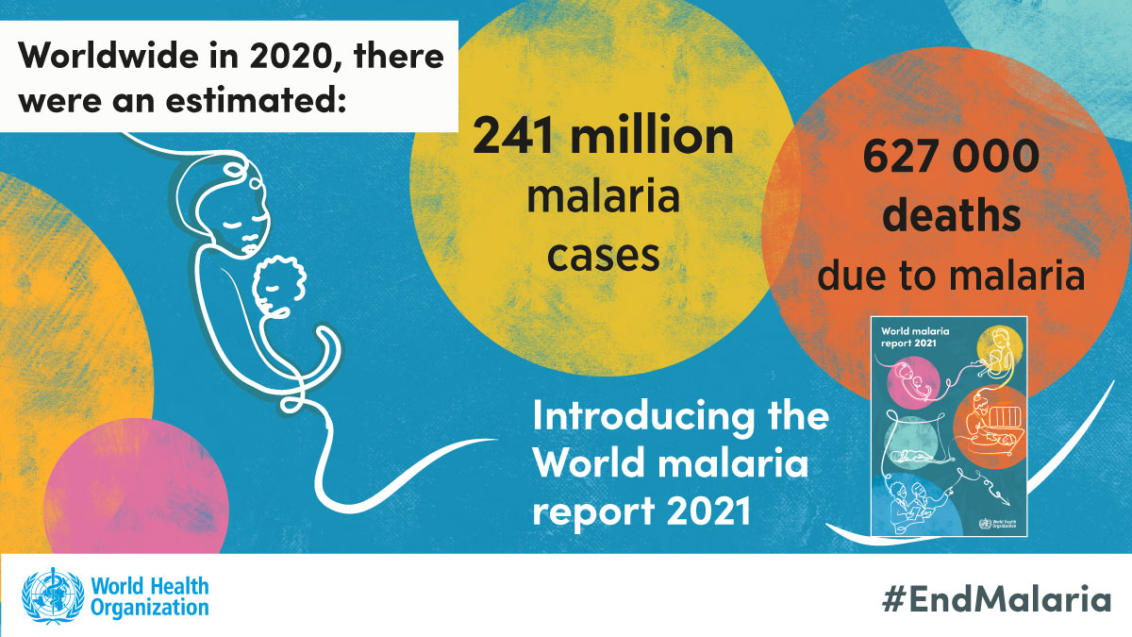
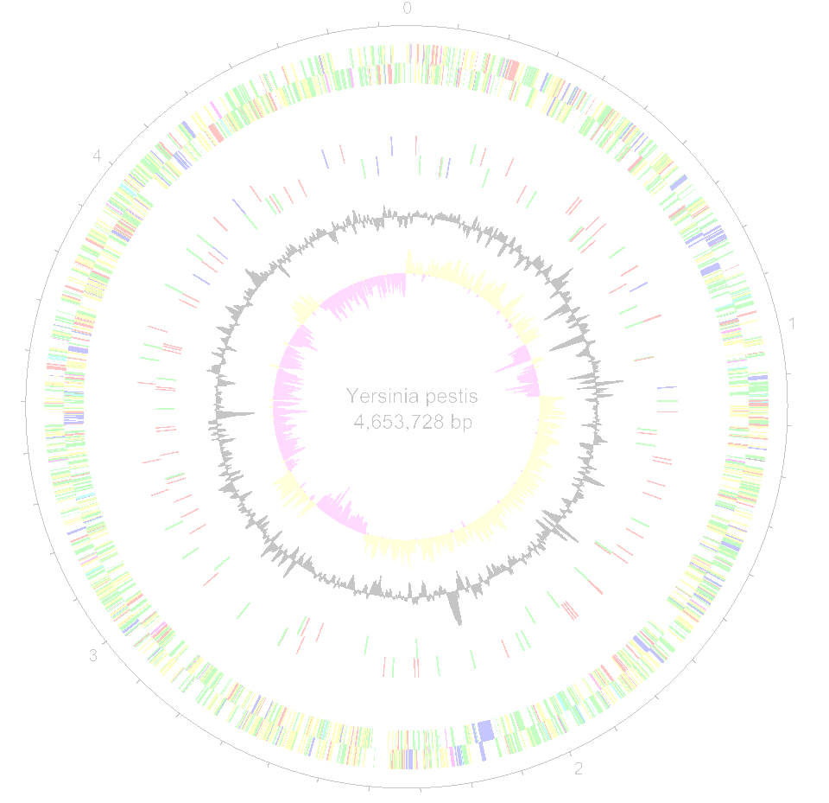
Working with Pathogen Genomes
Task 1 –Sexual development of malaria parasites
Notes:
1
Insert HIV tree with scale.

Slide 2
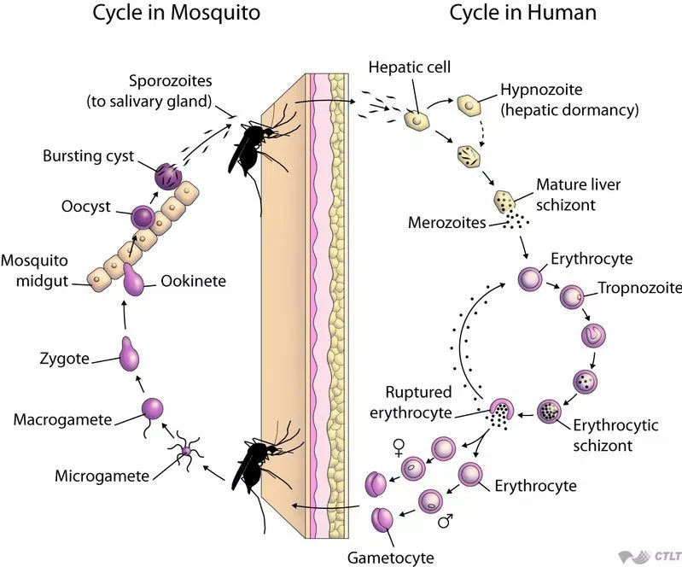
Plasmodium spp have a very complex life cycle.
P.berghgei is a rodent model of malaria
On continuous culture the parasite lost the capacity of producing gametocytes
Notes:
Malaria, are one of the major health problems globally
Plasmodium species have a very complex life cycle, with sexual stages produced in mammalian hosts.
P.Berghgei is a rodent model of malaria.
On continuous culture by erythrocyte passage the infective parasite los the

Slide 3
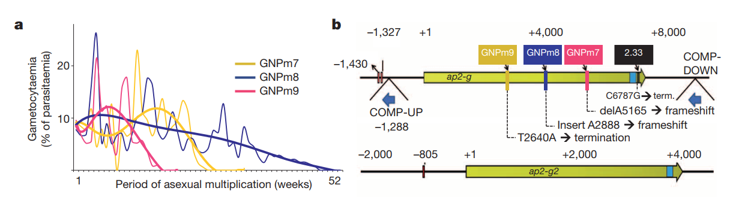
Sexual stage can be shut down
Gametocyte non-producer (GNPs) strains can be obtained over time in the lab
SEXUAL IMPAIRED LINES CAN GIVE CLUES TO SEXUAL DIFFERENTIATION
Notes:
Growth of the trasmisible strain on the lab through serial passages end up with strains that cannot produce gametocytes
Sexually impaired lines can give clues to sexual differentiation
By looking at mutations on 3 different GNP strains, they found that they all share mutations on a particular gene encoding for a TF.

Slide 4
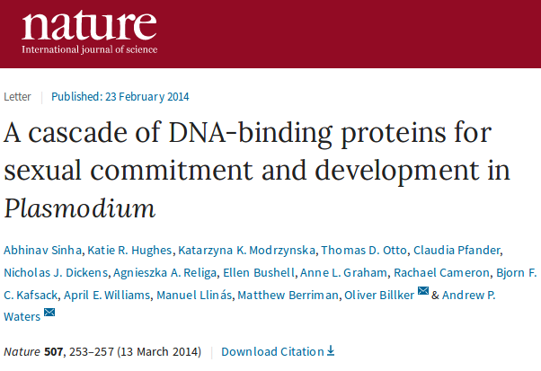
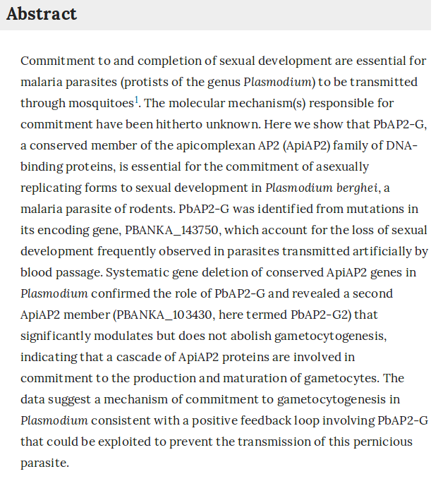

Slide 5
RNAseq data for ap2-g knock-out mutants
what kind of genes are differentially expressed in the KO mutants?
Map RNAseq data to reference genome
Call differentially expressed genes
Confirm the knock-out of the AP2-G gene in the mutant samples
6 samples so it might be a good chance to put your scripting skills in practice
How many up-regulated genes were found?
How many down-regulated?
Perform Gene Onthology enrichment analysis (R script provided)

Slide 6


Slide 7
For differential expression analysis:
echo “target_id description” > tmp
cat tmp PbANKA_v3.desc > tmp2
mv tmp2 PbANKA_v3.desc
Modify your kallisto folders to match the sample ids in your sleuth.R script
sample_id <- c("WT1", "WT2", "WT3","MUT1","MUT2","MUT3")

Slide 8
For GO_enrichment:
cut -f1,3,4,12 kallisto.results | awk ‘{if ($2<0.01 && $3>0) print $1}’ | sed -i “s/\.1//” > up_WT.list
sudo R
source("https://bioconductor.org/biocLite.R")
BiocInstaller::biocLite("IRanges")
q()
Rscript GO_enrichment.R

