Slide 1
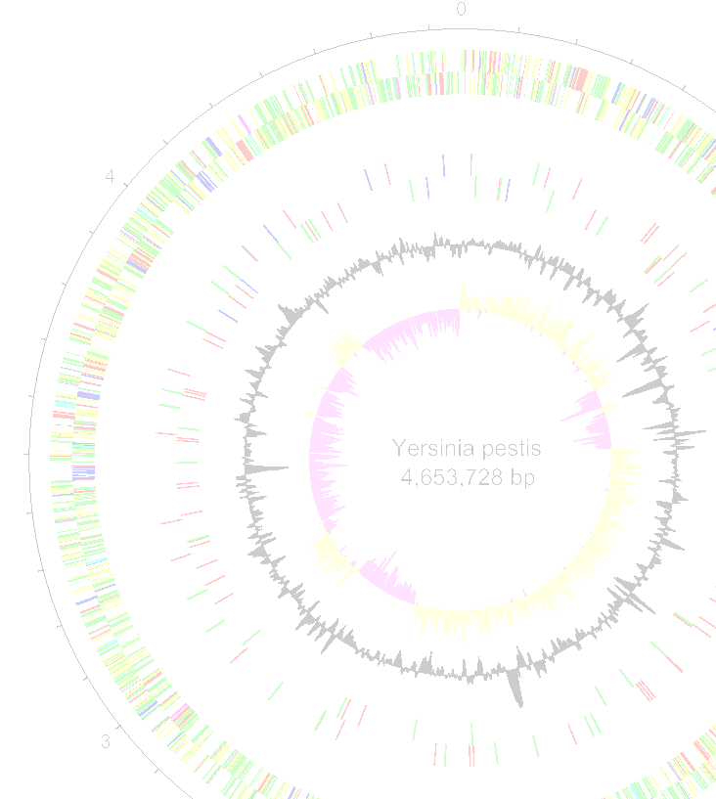
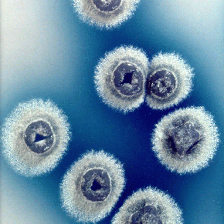




Wellcome Trust Workshop
Working with Pathogen Genomes
Comparative Genomics Seminar (ACT)
Rodrigo Quiroga rquiroga@unc.edu.ar
Fernán Agüero fernan@iib.unsam.edu.ar

Slide 2
Comparative Genomics
Analyses of complete (or large parts of) genomes from within and/or between species
Identification of similarities and differences between organisms can tell us about:
Core functions
Evolutionary history
Adaptation (for ex. Infectivity and virulence, alternative metabolic pathways, etc. )

Slide 3
Why is comparative genomics useful?
Large scale conservation over long and diverging evolutionary histories suggests functional restrictions
Lack of conservation over short evolutionary histories may indicate adaptive evolution
Helps identify regulatory, coding and non-coding sequences
Transfer knowledge built analyzing one genome to another, novel genome (species, lineage, strain, etc)
Key in attempting to infer the genetics behind phenotypic differences such as pathogenesis, tissue tropism, drug resistance, etc.

Slide 4
Comparative Genomics
Whole genomes
Chromosomal structure & rearrangements
Gene gain & loss
Gene order & rearrangements
Pseudogenes
Coding and non-coding variation
Single nucleotides

Slide 5
Resources & tools
Many resources exist for undertaking comparative genomic analyses
Databases: Genbank, Ensemble, MBGD…
Datasets: Metagenomic data, curated data, refseq...
Dataset formats: fasta, GFF, VCF…
DNA similarity: BLAST, Mummer…
DNA composition: GC%, codon usage, kmer…
However, the output of these resources & tools is not easy to visualise / conceptualise, esp for large datasets / whole genomes

Slide 6
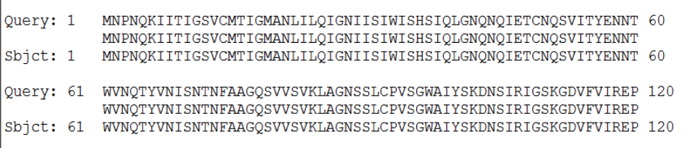
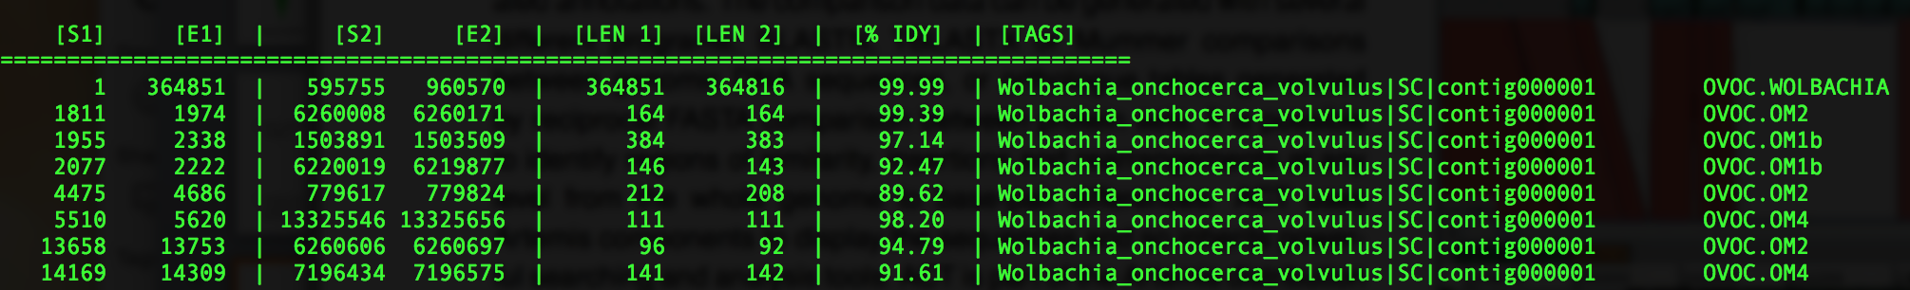
Output does not scale well
BLAST
nucmer

Slide 7
Artemis Comparison Tool (ACT)
Interactive tools to visualise and compare two or more sequences and their annotations
whole genomes > single genes
Based on, and builds upon, Artemis
Many of the functions learnt in Artemis are the same

Slide 8
Strengths and limitations
Strengths
Allows very easy and fast comparison of two or more genomic sequences
Great for initial exploratory analyses
Outstanding for comparing bacterial strains and/or plasmids
Weaknesses
Not great for dealing with very large sequences
Analyses of eukaryotic genomes can be much more complicated

Slide 9
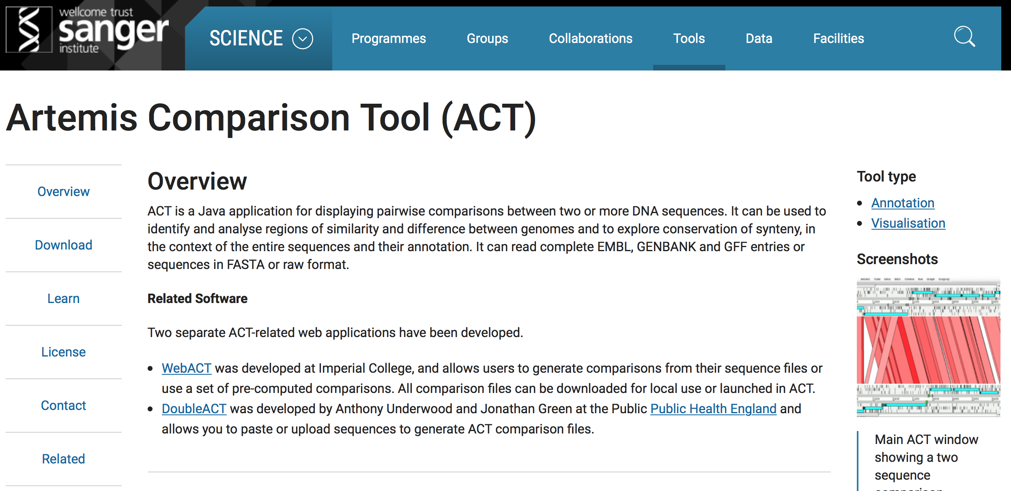
Where to find ACT?
Freely available (unix, mac, win)
- WEB: - WEB: http://www.sanger.ac.uk/science/tools/artemis-comparison-tool-act
MANUAL: ftp://ftp.sanger.ac.uk/pub/resources/software/act/act.pdf
PAPER: Carver et al. (2005) Bioinformatics. 21;16;3422-3

Slide 10
What do you need to run ACT?
The program
Local install (currently on your VM desktop) or on the web (as described in your manual)
Two or more files containing sequence information
Format: Fasta, EMBL, Genbank
Output from a comparative analysis of those sequence files
Format: BLAST, mummer, VCF
Optional: Additional metadata
Format: GFF, EMBL,

Slide 11
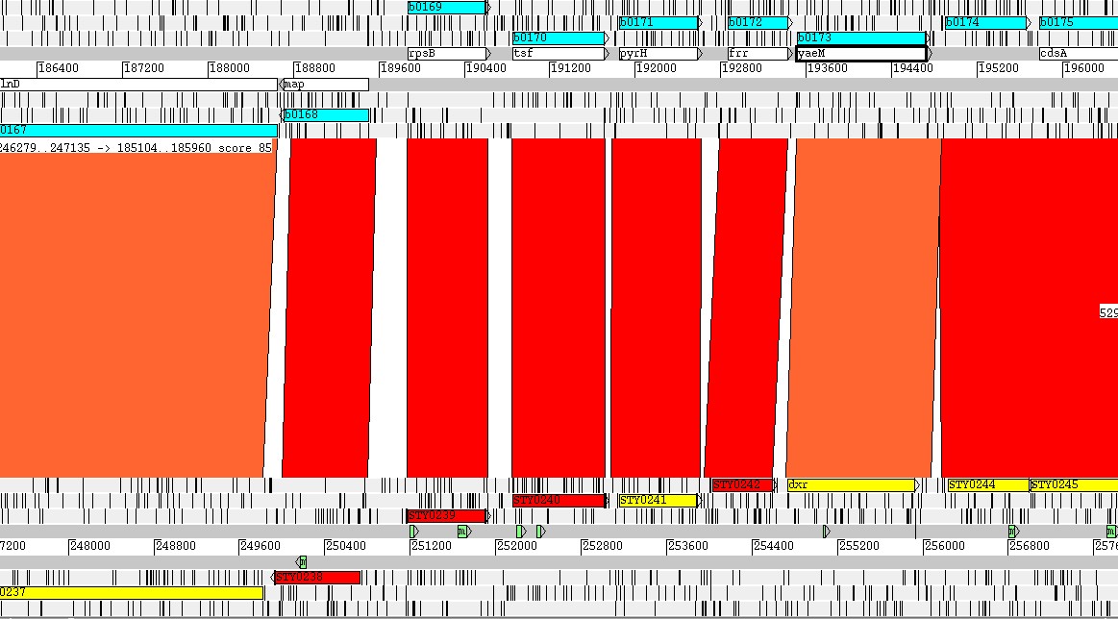
Basic setup of an ACT session
Stop codons
S1
bp
S2
6 RF
Coding sequence
Regions of homology

Slide 12
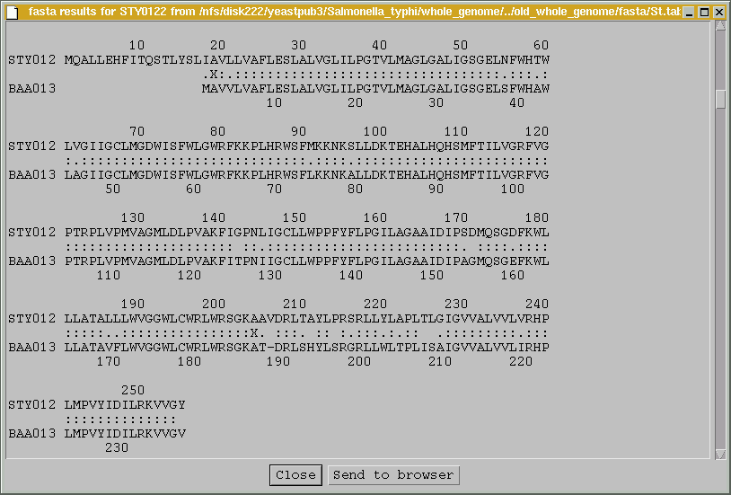
Visualising sequence similarity
MQALL…
…RHP
Region sharing similarity
(BLASTP)
MAVV…
…RHP

Slide 13
Mecanisms of genetic diversity
Gene gain/loss
Duplication, horizontal gene transfer, indels
Gene function modification
Loss of function (pseudogenes, gene fission )
Gain of function ( gene fusion, domain fusion, gene duplication)
Regulatory changes (differential expression, PTGS,etc.)
Coding Mutation accumulation (SNPs)

Slide 14
Visualising genome arrangements
Genome 1
Blast output
Genome 2
Genome 1
Blast output
Genome 2

Slide 15
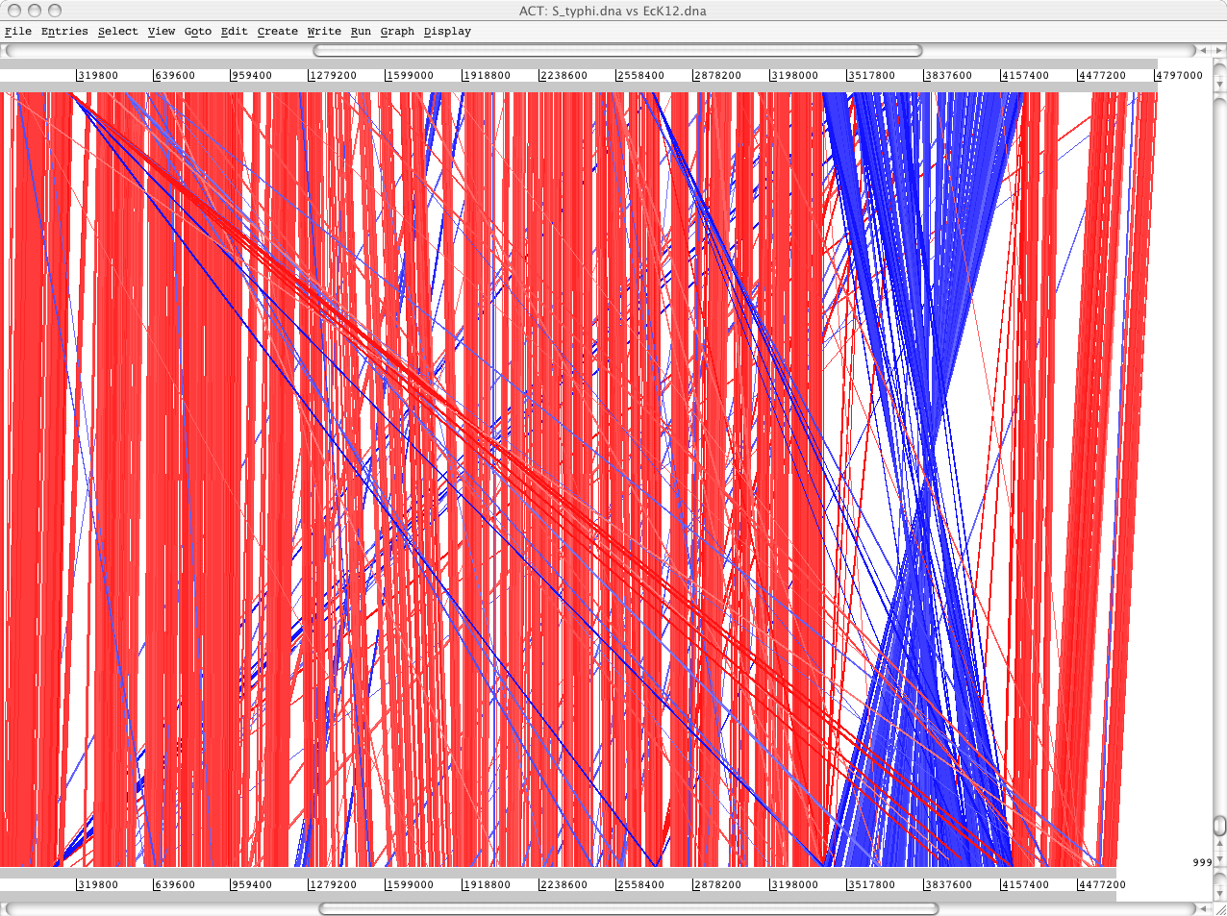
Visualising genome arrangements
S. typhi
BLASTN
DNA-DNA
matches
E. coli

Slide 16
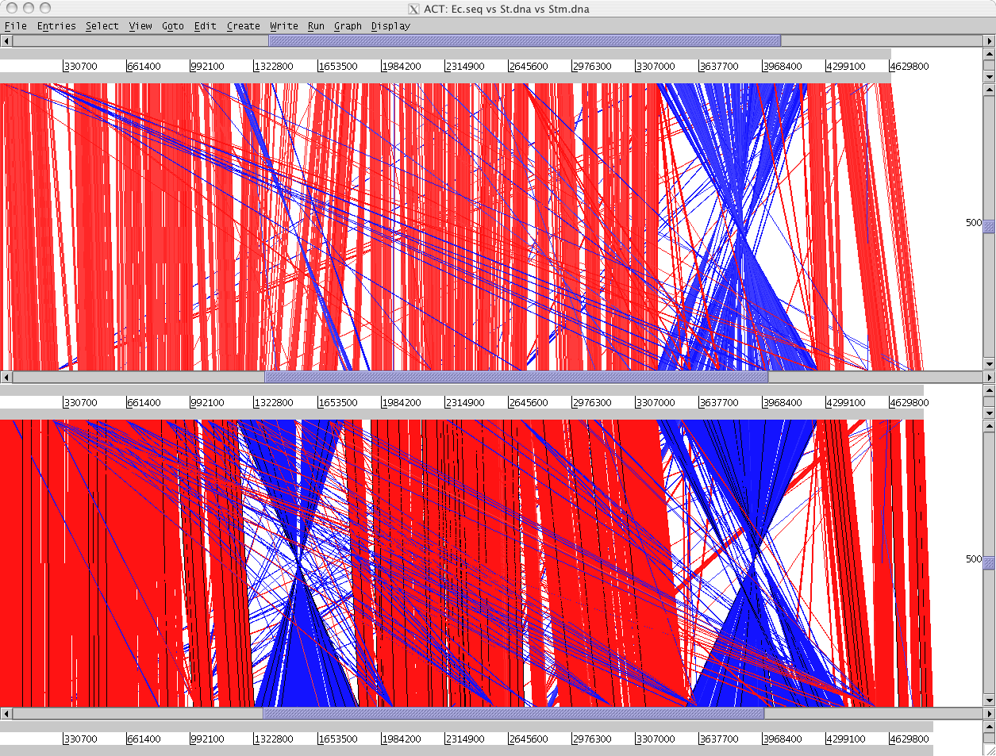
Visualising genome arrangements
E. coli
S. typhi
S. typhimurium

Slide 17
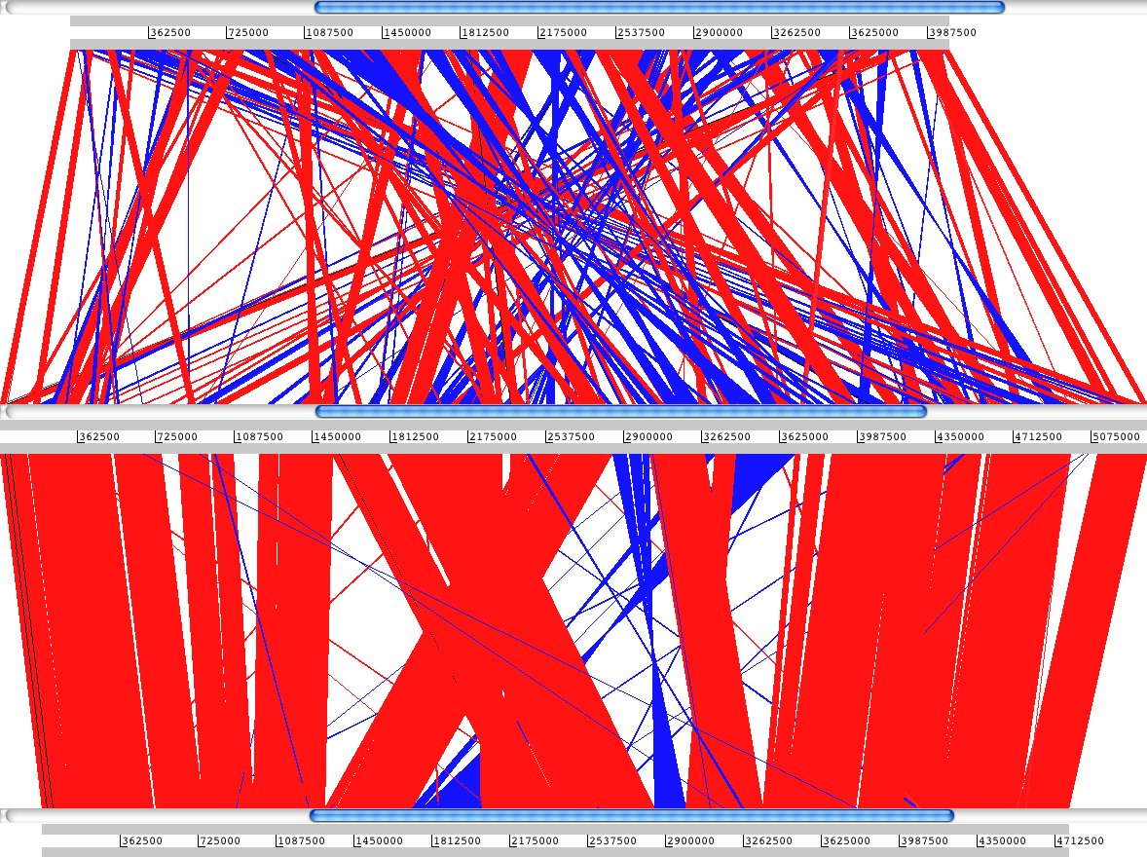
Chromosomal rearrangements in Bordetella
B. pertussis
B. bronchiseptica
B. parapertussis

Slide 18
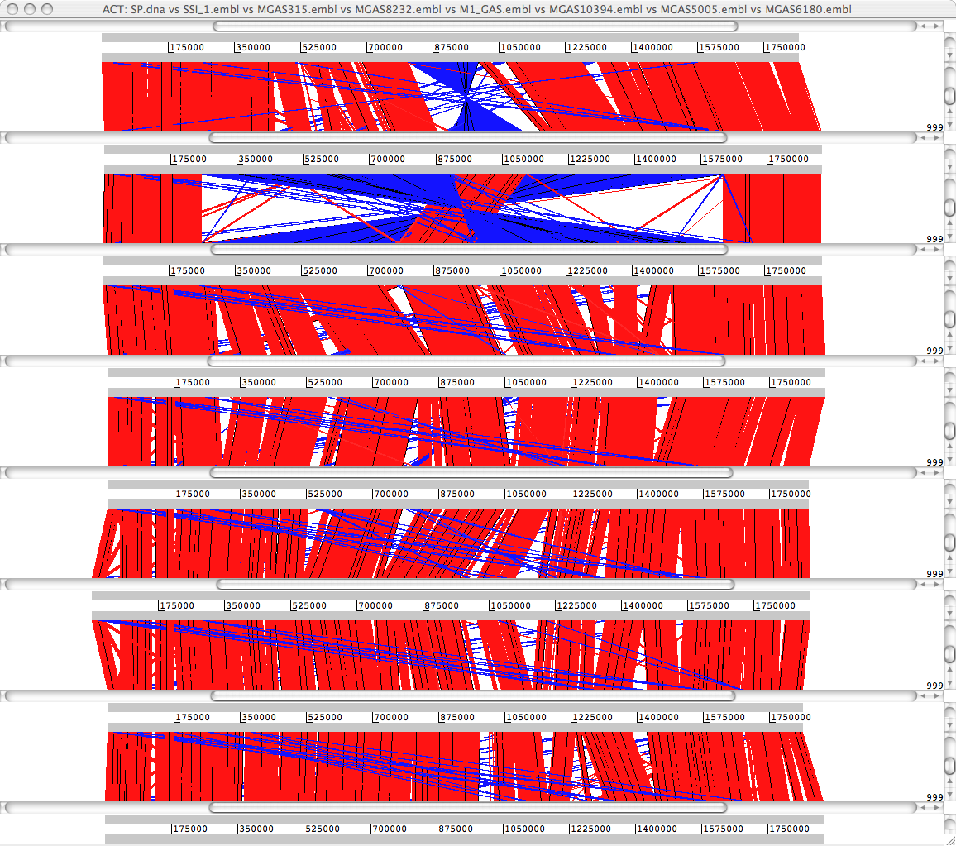
Comparison of strain diversity
Manfredo
SS_1
MGAS315
MGAS8232
M_1
MGAS10394
MGAS5005
MGAS6180
Streptococcus pyogenes comparison

Slide 19
Mechanisms of genetic diversity
Gene gain-loss
Duplication, horizontal gene transfer, indels
Gene function modification
Loss of function (pseudogenes, gene fission)
Gain of function (gene fusion)
Mutation accumulation (SNPs)

Slide 20
Visualising loss & gain
Example of an insertion or deletion

Slide 21
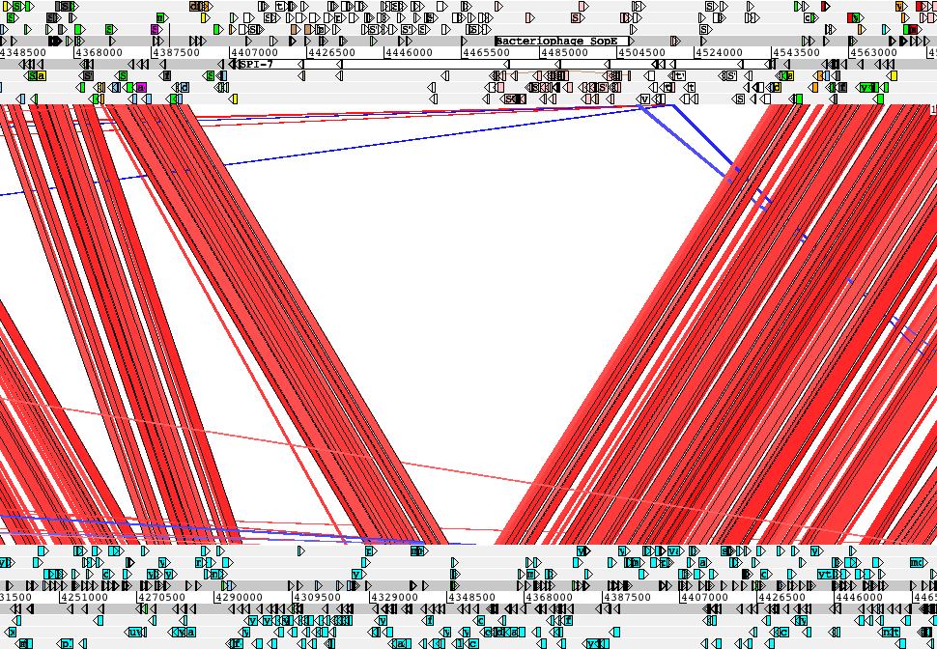
Visualising loss & gain
tRNA-Phe
type IV pilus
sopE
Vi antigen
S. typhi
E. coli

Slide 22
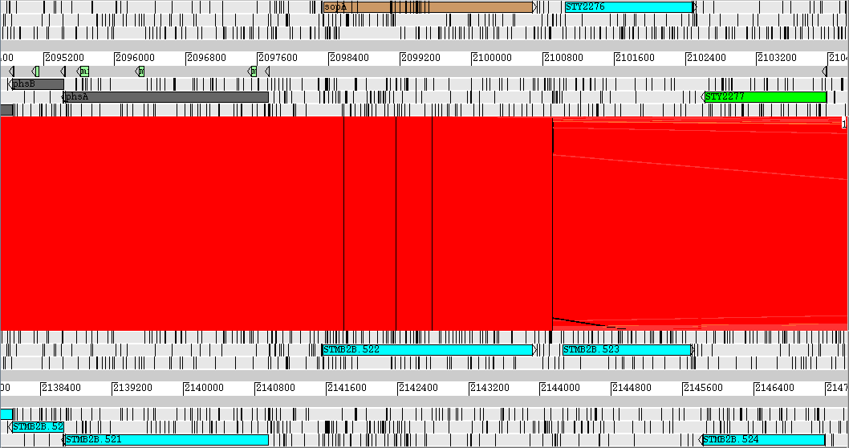
Loss of function: pseudogenes
secreted effector protein (type-III)

Slide 23
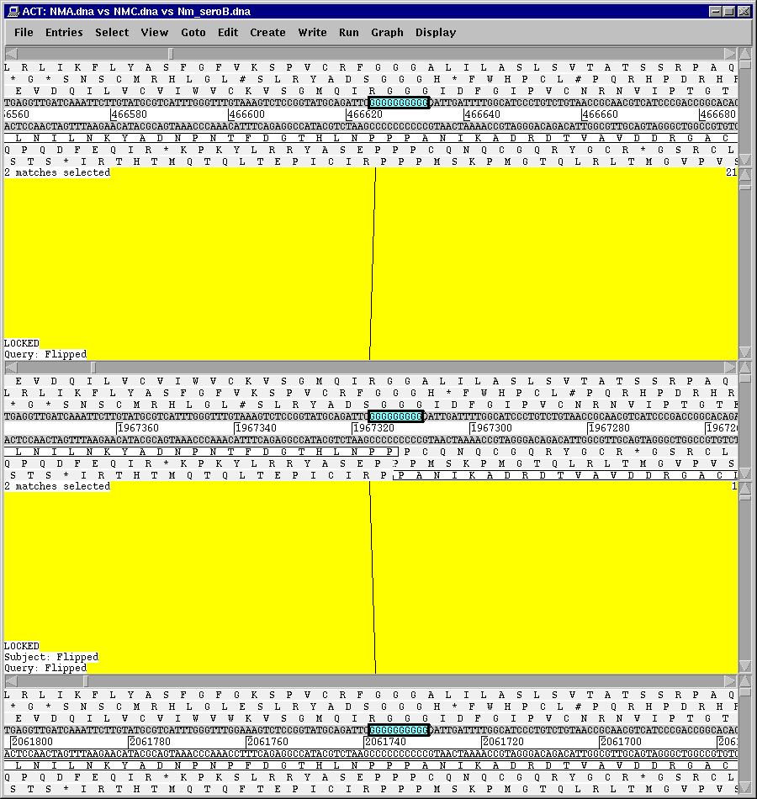
Change of function: phase variation
A
Neisseria meningitidis serogroups
C
B

Slide 24
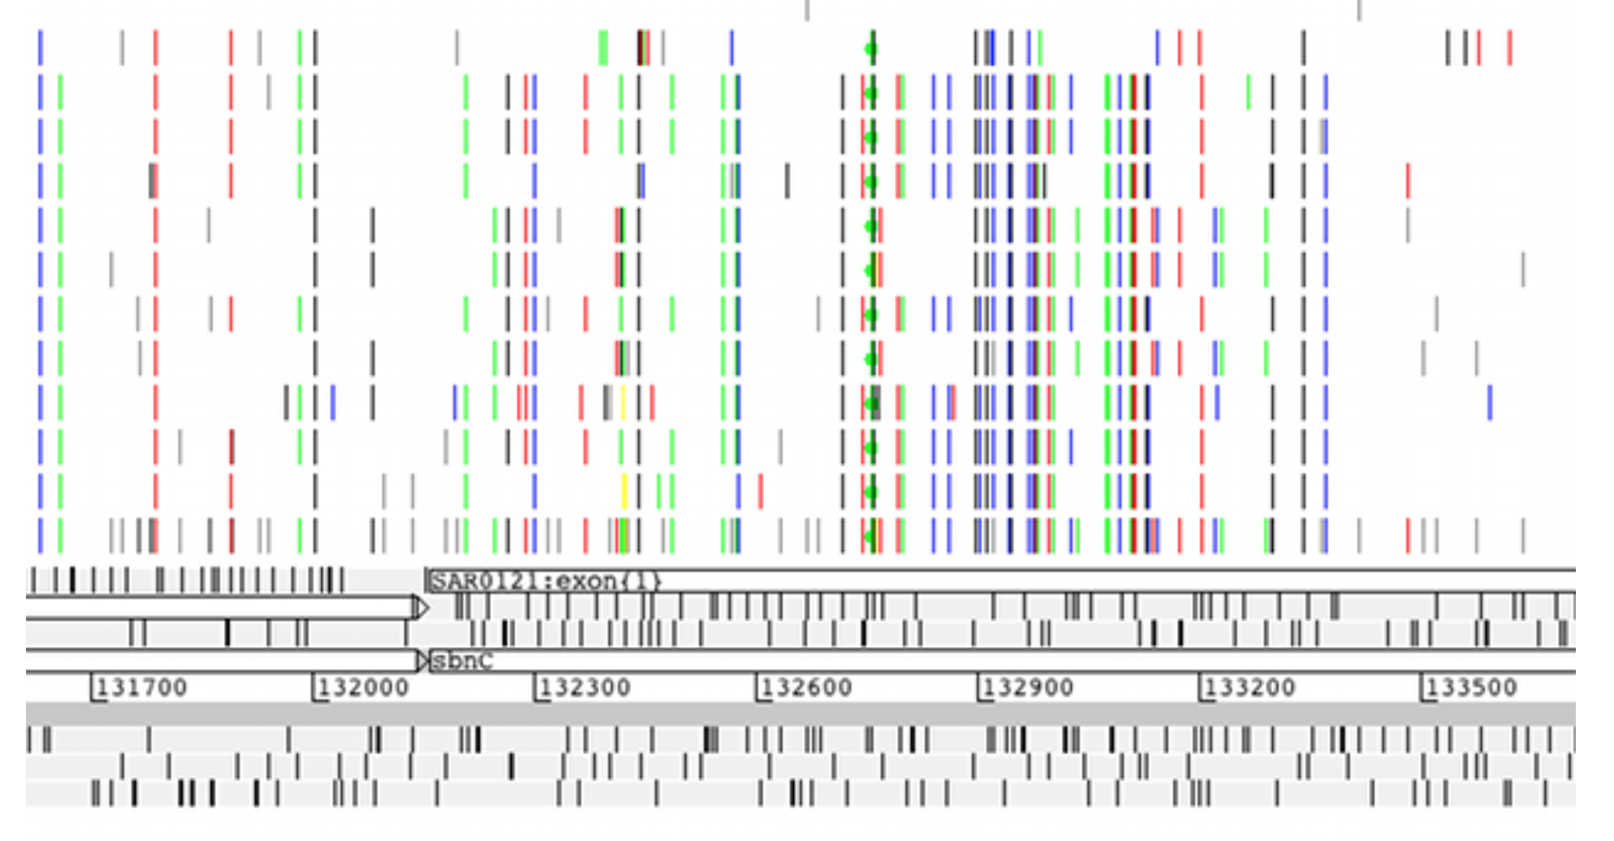
Genetic variation among populations
VCF input: row represents an individual, line represents a SNP

Slide 25
Aims of this module
Demonstrate some of the the basic functions of ACT
Enable you to perform basic comparative analyses

Slide 26
Tasks for today
Comparison of S. typhi and E. coli genomes
Gene order and annotation of P. falciparum and P. knowlesi
Synteny and gene conservation between T. brucei and Leishmania
Comparison of variation between Burkholderia mallei & Burkholderia pseudomallei using WebACT

