Slide 1


Module 1: File formats, QC and Data Processing
Presented by:
Eric Dawson¹ and Carla Daniela Robles Espinoza²
¹Bioinformatics Scientist (Genomics / AI) - Nvidia
²Laboratorio Internacional de Investigación sobre el Genoma Humano
Universidad Nacional Autónoma de México
Based on slides by:
Petr Danecek
@daniela_oaks
drobles@liigh.unam.mx
@erictdawson
eric.t.dawson@gmail.com
Cancer Genome Analysis
12 – 16 September 2022 – Virtual course
Notes:
If you have any questions at any time, please raise your hand, will be monitored by Caro, or ask in Slack

Slide 2
Data Formats
FASTA:
genomic sequences and their identifiers
FASTQ:
unaligned genomic sequences (sequencing reads), their identifiers, base qualities, and an optional comment
SAM/BAM:
Unaligned (uSAM / uBAM) or aligned reads
Text and binary formats
CRAM:
Better compression than BAM
VCF/BCF:
Flexible, descriptive variant call format
SNPs, indels, structural variations, and complex types with BND MAF:
Annotated germline or somatic variants
Sequencing Instrument
FASTQ
Sequence Alignment
BAM
Variant Calling
VCF/MAF
Analysis
BAM/VCF specifications maintained by the Global Alliance for Genomics and Health MAF documentation can be found in NCI's Genomic Data Commons
Notes:
Schematic pipeline that guides us through the data you will be using

Slide 3
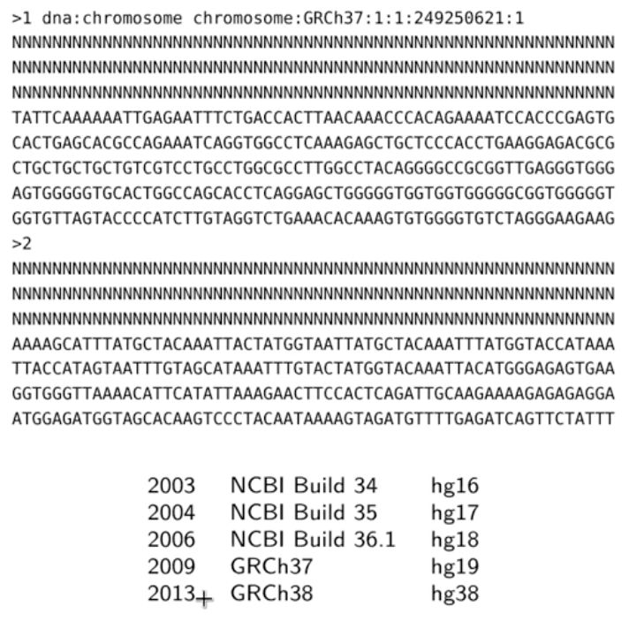
FASTA – reference genome
Notes:
FASTA reference genome, you saw this format before
Name of the sequence this larger than sign, followed by the name of the sequence
Then the sequence

Slide 4
FASTA – reference genome
Notes:
For some of you that work in humans, these are the different reference genomes that are available, here are different versions and years in which they were published. Last two still in use, you have to be very careful to check which one you will be using

Slide 5
FASTQ
Simple format for raw unaligned sequencing reads
Extension to the FASTA file format
Sequence and an associated per base quality score
@ERR007731.739 IL16_2979:6:1:9:1684/1 CTTGACGACTTGAAAAATGACGAAATCACTAAAAAACGTGAAAAATGAGAAATG
+
BBCBCBBBBBBBABBABBBBBBBABBBBBBBBBBBBBBABAAAABBBBB=@>B
@ERR007731.740 IL16_2979:6:1:9:1419/1 AAAAAAAAAGATGTCATCAGCACATCAGAAAAGAAGGCAACTTTAAAACTTTTC
+
BBABBBABABAABABABBABBBAAA>@B@BBAA@4AAA>.>BAA@779:AAA@A
Quality encoded in ASCII characters with decimal codes 33-126
ASCII code of “A” is 65, the corresponding quality is Q=65−33=32
Phred quality score: P = 10^{−Q/10}
perl -e ’printf "%d\n",ord("A")-33;’
Beware: multiple quality scores were in use!
Sanger, Solexa, Illumina 1.3+
Paired-end sequencing produces two FASTQ files
Notes:
Two different entries, highlighted in different colours
The first line, starting with an at sign, is the name of the sequence, followed by the actual sequence, like in the FASTA format, then a plus sign, which is a separator, and then the qualities of the bases
An important thing to remember is that if you have done paired end sequencing, the read pairs will have the same name, only the slash will change at the end. Usually you have two files, one with the forward sequences, and the other one with the reverse sequences
Base qualities – give us an idea of how accurate our sequencing was.

Slide 6
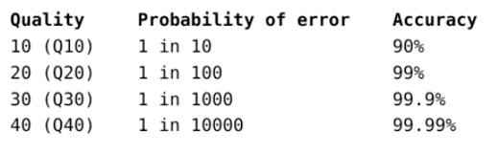
FASTQ
Simple format for raw unaligned sequencing reads
Extension to the FASTA file format
Sequence and an associated per base quality score
@ERR007731.739 IL16_2979:6:1:9:1684/1 CTTGACGACTTGAAAAATGACGAAATCACTAAAAAACGTGAAAAATGAGAAATG
+
BBCBCBBBBBBBABBABBBBBBBABBBBBBBBBBBBBBABAAAABBBBB=@>B
@ERR007731.740 IL16_2979:6:1:9:1419/1 AAAAAAAAAGATGTCATCAGCACATCAGAAAAGAAGGCAACTTTAAAACTTTTC
+
BBABBBABABAABABABBABBBAAA>@B@BBAA@4AAA>.>BAA@779:AAA@A
Quality encoded in ASCII characters with decimal codes 33-126
ASCII code of “A” is 65, the corresponding quality is Q=65−33=32
Phred quality score: P = 10^{−Q/10}
perl -e ’printf "%d\n",ord("A")-33;’
Beware: multiple quality scores were in use!
Sanger, Solexa, Illumina 1.3+
Paired-end sequencing produces two FASTQ files
Notes:
Base qualities – give us an idea of how accurate our sequencing was.

Slide 7
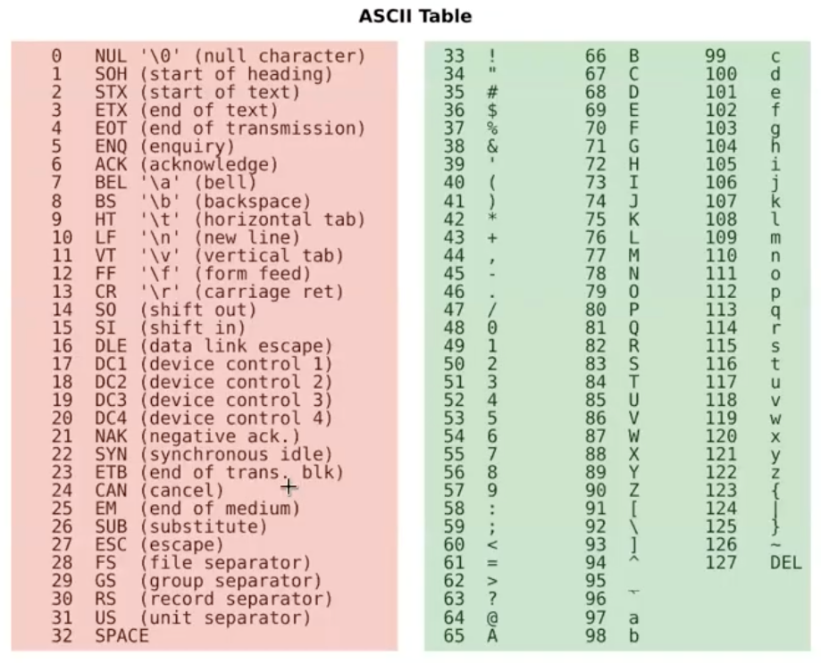
FASTQ
Simple format for raw unaligned sequencing reads
Extension to the FASTA file format
Sequence and an associated per base quality score
@ERR007731.739 IL16_2979:6:1:9:1684/1 CTTGACGACTTGAAAAATGACGAAATCACTAAAAAACGTGAAAAATGAGAAATG
+
BBCBCBBBBBBBABBABBBBBBBABBBBBBBBBBBBBBABAAAABBBBB=@>B
@ERR007731.740 IL16_2979:6:1:9:1419/1 AAAAAAAAAGATGTCATCAGCACATCAGAAAAGAAGGCAACTTTAAAACTTTTC
+
BBABBBABABAABABABBABBBAAA>@B@BBAA@4AAA>.>BAA@779:AAA@A
Quality encoded in ASCII characters with decimal codes 33-126
ASCII code of “A” is 65, the corresponding quality is Q=65−33=32
Phred quality score: P = 10^{−Q/10}
perl -e ’printf "%d\n",ord("A")-33;’
Beware: multiple quality scores were in use!
Sanger, Solexa, Illumina 1.3+
Paired-end sequencing produces two FASTQ files
Notes:
Base qualities – give us an idea of how accurate our sequencing was.
Phred scale, to represent this quality easily

Slide 8
FASTQ
Simple format for raw unaligned sequencing reads
Extension to the FASTA file format
Sequence and an associated per base quality score
@ERR007731.739 IL16_2979:6:1:9:1684/1 CTTGACGACTTGAAAAATGACGAAATCACTAAAAAACGTGAAAAATGAGAAATG
+
BBCBCBBBBBBBABBABBBBBBBABBBBBBBBBBBBBBABAAAABBBBB=@>B
@ERR007731.740 IL16_2979:6:1:9:1419/1 AAAAAAAAAGATGTCATCAGCACATCAGAAAAGAAGGCAACTTTAAAACTTTTC
+
BBABBBABABAABABABBABBBAAA>@B@BBAA@4AAA>.>BAA@779:AAA@A
Quality encoded in ASCII characters with decimal codes 33-126
ASCII code of “A” is 65, the corresponding quality is Q=65−33=32
Phred quality score: P = 10^{−Q/10}
perl -e ’printf "%d\n",ord("A")-33;’
Beware: multiple quality scores were in use!
Sanger, Solexa, Illumina 1.3+
Paired-end sequencing produces two FASTQ files
Notes:
Base qualities – give us an idea of how accurate our sequencing was.

Slide 9
SAM / BAM
Sequencing Instrument
SAM (Sequence Alignment/Map) format
Unified format for storing read alignments to a reference genome
Developed by the 1000 Genomes Project group (2009)
One record (a single DNA fragment alignment) per line describing alignment between fragment and reference
11 fixed columns + optional key:type:value tuples
FASTQ
Sequence Alignment
BAM
Chr1
Reference sequence
DNA sequence
40M 5D 30M 2I 28M
Ref-name
Position
CIGAR string
Orientation
Note that BAM can contain
unmapped reads
multiple alignments of the same read
supplementary (chimeric) reads
Notes:
First a header, then data rows
FASTQ plus more information
BAM/SAM equivalent

Slide 10
SAM
$ samtools view -h file.bam | less
@HD VN:1.0 GO:none SO:coordinate
@SQ SN:1
@SQ SN:2
@RG ID:1
LN:249250621 LN:243199373
UR:hs37d5.fa.gz AS:NCBI37 UR:hs37d5.fa.gz AS:NCBI37
M5:1b22b98cdeb4a9304cb5d48026a85128 SP:Human M5:a0d9851da00400dec1098a9255ac712e SP:Human
PL:ILLUMINA PU:13350_1 LB:13350_1 SM:13350_1 CN:SC
@PG ID:bwa PN:bwa VN:0.7.10-r806 CL:bwa mem hs37d5.fa.gz 13350_1_1.fq 13350_1_1.fq
1:2203:10256:56986 97 1 9998 0 106M45S = 10335
0 \
CCATAACCCTAACCCTAACCCTAACCATAGCCCTAACCCTAACCCTAACCCTAACCCT[...]CAAACCCACCCCCAAACCCAAAACCTCACCAC\ FFFFFJJJJJJJJFJJJJFJAJJJJJ-JJAAAJFJJFFJJF<FJJFFJJJJFJJJJFF[...]<---F-----A7-J-<J-A--77AF---J7-- \
MD:Z:1G24C2A76 PG:Z:MarkDuplicates RG:Z:1 NM:i:3 MQ:i:0 AS:i:94 XS:i:94
SAM fields
1 | QNAME | Query NAME of the read or the read pair
2 | FLAG | Bitwise FLAG (pairing, strand, mate strand, etc.)
3 | RNAME | Reference sequence NAME
4 | POS | 1-Based leftmost POSition of clipped alignment
5 | MAPQ | MAPping Quality (Phred-scaled)
6 | CIGAR | Extended CIGAR string (operations: MIDNSHPX=)
7 | MRNM | Mate Reference NaMe (’=’ if same as RNAME)
8 | MPOS | 1-Based leftmost Mate POSition
9 | ISIZE | Inferred Insert SIZE
10 | SEQ | Query SEQuence on the same strand as the reference
11 | QUAL | Query QUALity (ASCII-33=Phred base quality)
12- | OTHER | Optional fields
Notes:
-h includes the header

Slide 11
CIGAR string
Compact representation of sequence alignment
M
= X I D S H N P
alignment match or mismatch
sequence match
sequence mismatch
insertion to the reference
deletion from the reference
soft clipping (clipped sequences present in SEQ)
hard clipping (clipped sequences NOT present in SEQ)
skipped region from the reference
padding (silent deletion from padded reference)
Examples:
Ref: ACGTACGTACGTACGT Read: ACGT----ACGTACGA
Cigar: 4M 4D 8M
Ref: ACGT----ACGTACGT Read: ACGTACGTACGTACGT
Cigar: 4M 4I 8M
Ref: ACTCAGTG--GT
Read: ACGCA-TGCAGTtagacgt Cigar: 5M 1D 2M 2I 2M 7S
Notes:
Some aligners decompose M into = and X, sequence match in the number of bases
Soft clip – a portion of the read does not align. Hard clip is the same, except that the sequence is removed and you don’t see it in your file. Different programs will choose to do different thing. For example, some programs will hard clip reads with adapters, as the adapters are not part of your biological input, but others can choose to softclip normal reads to be able to come back at a later time
P – padding means for when you are aligning multiple sequences and therefore you want to express how the sequences align with respect to each other

Slide 12
Flags
Hex | Dec | Flag | Description
0x1 | 1 | PAIRED | paired-end (or multiple-segment) sequencing technology
0x2 | 2 | PROPER_PAIR | each segment properly aligned according to the aligner
0x4 | 4 | UNMAP | segment unmapped
0x8 | 8 | MUNMAP | next segment in the template unmapped
0x10 | 16 | REVERSE | SEQ is reverse complemented
0x20 | 32 | MREVERSE | SEQ of the next segment in the template is reversed
0x40 | 64 | READ1 | the first segment in the template
0x80 | 128 | READ2 | the last segment in the template
0x100 | 256 | SECONDARY | secondary alignment
0x200 | 512 | QCFAIL | not passing quality controls
0x400 | 1024 | DUP | PCR or optical duplicate
0x800 | 2048 | SUPPLEMENTARY | supplementary alignment
Bit operations made easy
python
0x1 | 0x2 | 0x20 | 0x80 .. 163
bin(163) .. 10100011
samtools flags
0xa3 163 PAIRED,PROPER_PAIR,MREVERSE,READ2
Notes:
Secondary – mapping to multiple sites
Supplementary – chimeric reads

Slide 13


Optional tags
Each lane has a unique RG tag that contains meta-data for the lane RG tags
Sample_A
Sample_B
Sample_C
Library prep
ID: SRR/ERR number
PL: Sequencing platform
PU: Run name
LB: Library name
PI: Insert fragment size
SM: Individual
CN: Sequencing center
Machine run
Machine run
Sample_A
Sample_A
Sample_B Sample_C
Sample_A
Sample_B
Sample_C Sample_C
Lane/Plex
BAM
BAM
BAM
Library merge
BAM BAM
Duplicates removal
BAM
BAM
Sample merge
BAM
Notes:
Finally, there is optional information. It allows you to record the history of the sequencing
Later, when you do variant calling, if you see anything weird, you can go back and reconstruct how you did the experiment

Slide 14
BAM
BAM (Binary Alignment/Map) format
Binary version of SAM
Developed for fast processing and random access
BGZF (Block GZIP) compression for indexing
Can store alignments from most mappers
Supports multiple sequencing technologies
Supports indexing for quick retrieval/viewing
Compact size (e.g. 112Gbp Illumina = 116GB disk space)
Reads can be grouped into logical groups e.g. lanes, libraries, samples
Widely supported by variant calling packages and viewers`
SAM/BAM tools
Several tools and programs for interacting with SAM/BAM files:
Samtools (Wellcome Sanger Institute)
Picard tools (Broad Institute)
Visualisation: IGV, Ensembl, UCSC
Key features
Notes:
Samtools, allows you to convert between SAM, BAM, CRAM
Sort and index files
Summary of the flags
Merge multiple files, remove duplicates
Picard also many functions, mark duplicates, convert SAM to Fastq, obtain more information

Slide 15
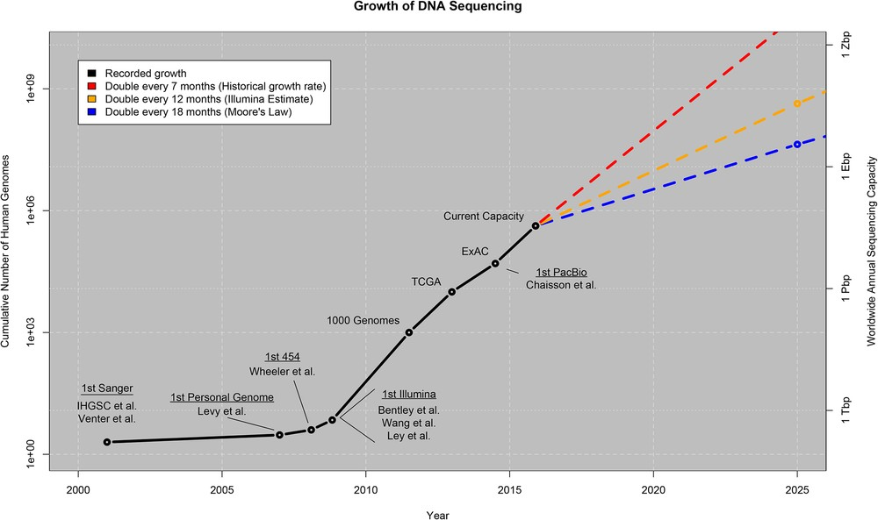
Reference-based Compression
BAM files are too large
~1.5-2 bytes per base pair
Increases in disk capacity are being far outstripped by sequencing technologies
Zachary D. Stephens, et al, Big Data: Astronomical or Genomical? DOI: 10.1371/journal.pbio.1002195
Notes:
BAM files are compact, but still quite large.
How much sequence has been produced and extrapolation into the future. Very steep increase, but the storage information is not developing that quickly. So what to do?

Slide 16
Reference-based Compression
BAM files are too large
~1.5-2 bytes per base pair
Increases in disk capacity are being far outstripped by sequencing technologies BAM stores all of the data
Every read base
Every base quality
Using a single conventional compression technique for all types of data
Reference sequence:
ACGTACGTACGTACGTACGTACGTACGTACGTAC
ACGTACGTACGTACGTACGTGC TACGTACGCACGTACGTGCGTA
CGTACGCACGTACGTACGTACG TACGTACGTACGTGCGTACGTA
CGCACGTACGTACGTACGTACG
TACGTGCGTACGTACGTAC
read 1:
read 2:
read 3:
read 4:
read 5:
read 6:

Slide 17
Reference-based Compression
BAM files are too large
~1.5-2 bytes per base pair
Increases in disk capacity are being far outstripped by sequencing technologies BAM stores all of the data
Every read base
Every base quality
Using a single conventional compression technique for all types of data
Reference sequence:
ACGTACGTACGTACGTACGTACGTACGTACGTAC
....................G. ........C........G....
......C............... .............G........
..C...................
.....G.............
read 1:
read 2:
read 3:
read 4:
read 5:
read 6:

Slide 18
CRAM
Three important concepts
Reference-based compression
Controlled loss of quality information
Different compression methods to suit the type of data, e.g. base qualities vs. metadata vs. extra tags
In lossless mode: 60% of BAM size
CRAM is now mature and used in production pipelines
Support for CRAM added to Samtools/HTSlib in 2014
Added in Picard/GATK in 2015
Header | SAM header | Container (1-100k reads) | .... | Container
Compression header | Slice | Slice (1-10k reads) | ... | Slice
Slice header | Core | External data | ... | External data
Chr, Pos, Len, Flags, MapQ,..
Bases
Quality
Names, ...

Slide 19
VCF: Variant Call Format
File format for storing generic variation data
Accommodate all types of variation: SNPs, short indels, large events
Multiple samples
Sequencing Instrument
FASTQ
Sequence Alignment
BAM
Variant Calling
VCF

Slide 20
VCF: Variant Call Format
File format for storing generic variation data
Accommodate all types of variation: SNPs, short indels, large events
Multiple samples
Sequencing Instrument
FASTQ
Sequence Alignment
BAM
Variant Calling
Columns
Chromosome and position
Variant ID
Quality of the call
Soft filtering (e.g., is the site low quality, low depth, etc)
Optional per-site information in the INFO column
Optional per-sample information in the FORMAT columns (one column per sample)
Optional tags: DP (sequencing depth), GQ (genotype quality)
VCF

Slide 21
VCF: Variant Call Format
File format for storing generic variation data
Accommodate all types of variation: SNPs, short indels, large events
Multiple samples
Sequencing Instrument
FASTQ
Sequence Alignment
BAM
Variant Calling
Genotypes (for diploid individuals)
Homozygous reference (e.g., A/A if the reference allele is A)
Homozygous alternative (e.g., G/G if the reference allele is A)
Heterozygous (e.g., C/T)
Allele numbering (for VCF notation):
Reference allele is 0, first alternative allele is 1, second is 2, etc
Homozygous reference (0/0)
Homozygous alternative (1/1, 2/2, etc.)
Heterozygous (0/1, 1/2, etc)
VCF

Slide 22
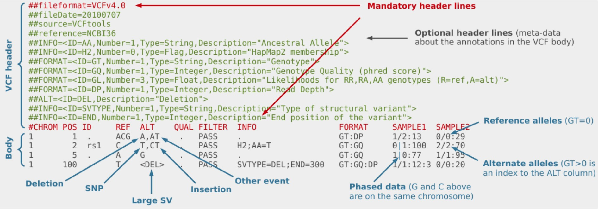
VCF: Variant Call Format
File format for storing generic variation data
Accommodate all types of variation: SNPs, short indels, large events
Multiple samples
Tab-delimited text, parsable by standard UNIX commands
Flexible and user-extensible
Compressed with BGZF (bgzip), indexed with TBI or CSI (tabix)
Sequencing Instrument
FASTQ
Sequence Alignment
BAM
Variant Calling
VCF

Slide 23
VCF: Variant Call Format
File format for storing generic variation data
Accommodate all types of variation: SNPs, short indels, large events
Multiple samples
Tab-delimited text, parsable by standard UNIX commands
Flexible and user-extensible
Compressed with BGZF (bgzip), indexed with TBI or CSI (tabix)
Some annotations important in tumour VCFs:
AF: Allelic fraction of alternate alleles in tumour sample
GERMQ: Phred-scaled quality that ALT alleles are not germline
PON: Site found in panel of normals
Sequencing Instrument
FASTQ
Sequence Alignment
BAM
Variant Calling
VCF

Slide 24
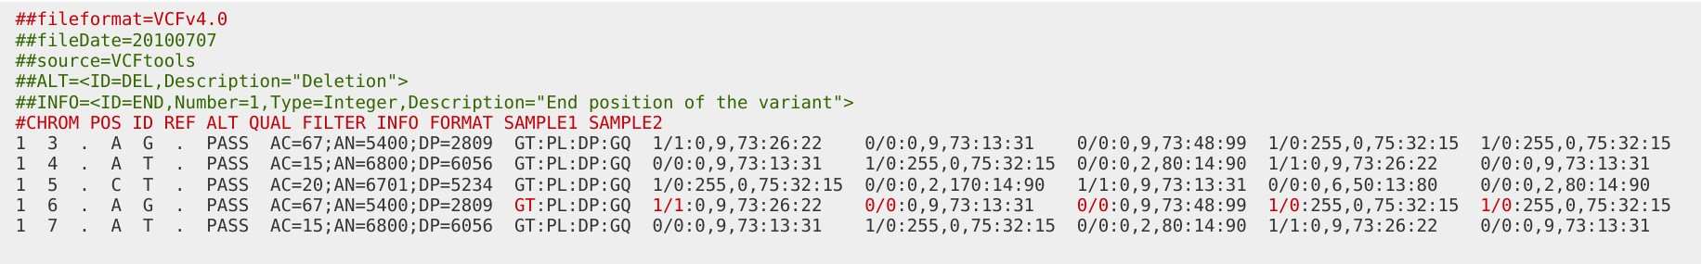
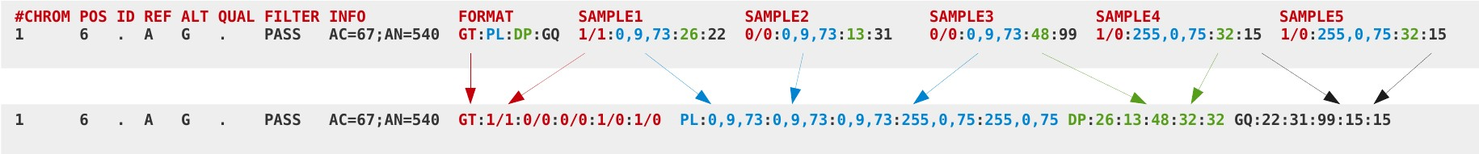
VCF / BCF
VCFs can be very big
compressed VCF with 3781 samples, human data:
54 GB for chromosome 1
680 GB whole genome
VCFs can be slow to parse
text conversion is slow
main bottleneck: FORMAT fields
BCF
binary representation of VCF
fields rearranged for fast access
Notes:
Text formats can be slow to parse. Imagine you want to query just one record, for example, getting just one genotype. So you need to parse all the line and it is slow. So there is a motivation to start a binary format. Immediate understanding by the computer, and rearranging the fields so you get this information in a single block

Slide 25
gVCF
Often it is not enough not know variant sites only
was a site dropped because of a reference call or because of missing data?
We need evidence for both variant and non-variant positions in the genome
gVCF
blocks of reference-only sites can be represented in a single record using the INFO/END tag
symbolic alleles <*> for incremental calling
raw, “callable” gVCF
calculate genotype likelihoods only once (an expensive step)
then call incrementally as more samples come in
#CHROM | POS | ID | REF | ALT | QUAL | FILTER | INFO | FORMAT | SAMPLE
19 | 9902 | . | G | <*> | . | . | END=9915;MinDP=0 | PL:DP | 0,0,0:0
19 | 9916 | . | C | <*> | . | . | END=9922;MinDP=5 | PL:DP | 0,15,137:5
19 | 9923 | . | G | <*> | . | . | END=9948;MinDP=10 | PL:DP | 0,30,214:10
19 | 9949 | . | G | A, <*> | . | . | DP=28 | PL:DP | 0,60,255,78,255,255:27
19 | 9950 | . | C | <*> | . | . | END=9958;MinDP=28 | PL:DP | 0,84,255:28
19 | 9959 | . | G | T, <*> | . | . | DP=34 | PL:DP | 0,82,255,99,255,255:34
19 | 9960 | . | C | <*> | . | . | END=9969;MinDP=34 | PL:DP | 0,102,255:34
Symbolic "unobserved" allele
Represents any other possible alternate allele
Genotype likelihoods
for CC, C*, **
A block of 10 sites with at least 34 reference reads
Notes:
VCF was conceived to represent variant sites only
A block of sites that have about the same coverage
Placeholder that allows us to represent a block of sequence where we have not seen any other allele but the reference allele

Slide 26
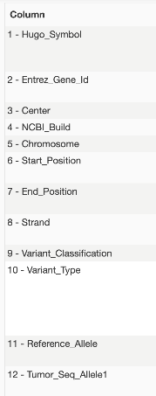
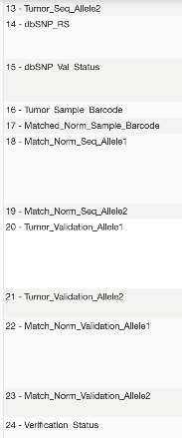
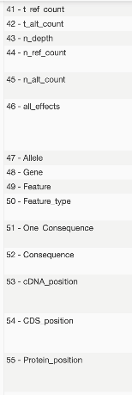
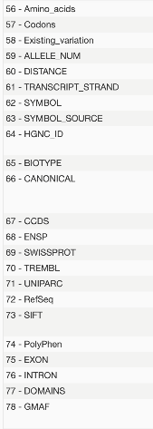
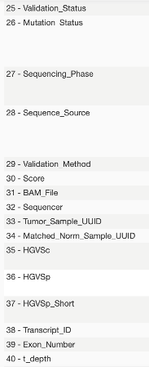
MAF
File format for storing aggregated variation data
Stands for “Mutation-Annotation Format” and is a tab-delimited text file containing aggregated information from somatic VCF files (NCI-GDC)
Variant calls alone don’t tell us the impact of a mutation - they must be annotated so we can assess whether they’re associated with disease.
It aggregates lots of information – up to120+ fields per mutation! You can review all these at:
https://docs.gdc.cancer.gov/Data/File_Formats/MAF_Format/
Sequencing Instrument
FASTQ
Sequence Alignment
BAM
Variant Calling
Annotation
MAF
Notes:
VCF was conceived to represent variant sites only
A block of sites that have about the same coverage
Variant calls alone don’t
Placeholder that allows us to represent a block of sequence where we have not seen any other allele but the reference allele

Slide 27
MAF
You can convert between VCF and MAF via vcf2maf tools!
perl vcf2maf.pl --input-vcf [vcf_file] --output-maf [maf_file] --vep-path /cm/shared/apps/vep/ensembl-vep-release-106.1/ --vep-data /mnt/Archives/vep/106/38/ --ref-fasta [fasta_file] --tumor-id [tumor] --normal-id [normal]
Sequencing Instrument
FASTQ
Sequence Alignment
BAM
Variant Calling
MAF
Notes:
VCF was conceived to represent variant sites only
A block of sites that have about the same coverage
Placeholder that allows us to represent a block of sequence where we have not seen any other allele but the reference allele

Slide 28

Global Alliance for Genomics and Health
International coalition dedicated to improving human health
Mission
establish a common framework to enable sharing of genomic and clinical data Working groups
clinical
regulatory and ethics
security
data
Data working group
beacon project .. test the willingness of international sites to share genetic data
BRCA challenge .. advance understanding of the genetic basis of breast and other cancers
matchmaker exchange .. locate data on rare phenotypes or genotypes
reference variation .. describe how genomes differ so researchers can assemble and interpret them
benchmarking .. develop variant calling benchmark toolkits for germline, cancer, and transcripts
file formats .. CRAM, SAM/BAM, VCF/BCF
File formats
http://samtools.github.io/hts-specs/

Slide 29
Quality Control
Biases in sequencing
Base calling accuracy
Read cycle vs. base content
GC vs. depth
Indel ratio
Biases in mapping
Genotype checking
Sample swaps
Contaminations

Slide 30
Read coverage
Read coverage / depth
Is every genomic position covered to a sufficient depth?
Average depth: number of reads / target size
Whole human genome: 3Gb
Human exome: 50Mb
Exomes
Be careful to distinguish between the total sequencing yield and on-target bases
Useful coverage:
15x OK for common germline variants
30x OK for most things
100-200x for low VAF variants in tumours

Slide 31
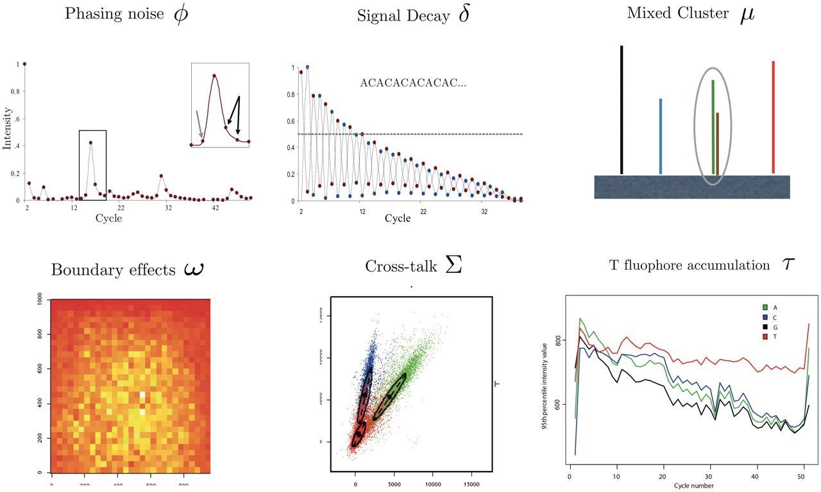
Base calling errors
Base-calling for next-generation sequencing platforms, doi: 10.1093/bib/bbq077
Notes:
Common error modes that you can see in your data
In Illumina sequencing these are the types of errors that can arise in your data
Signal decay: As you continue adding and washing up the chemicals there can be a decay of the signal
Some of the espectra of the fluorophores can overlap when imaged
You can detect these things and assign a low base quality

Slide 32
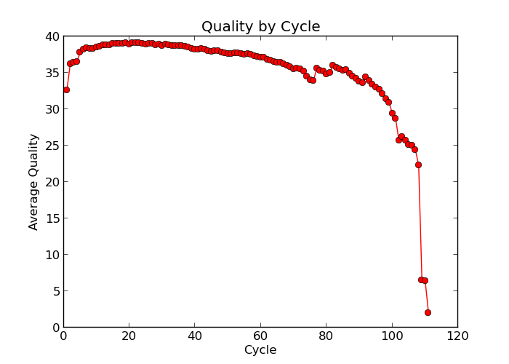
Base quality
Sequencing by synthesis: dephasing
growing sequences in a cluster gradually desynchronize
error rate increases with read length
Calculate the average quality at each position across all reads
Quality | Probability of error | Call Accuracy
10 (Q10) | 1 in 10 | 90%
20 (Q20) | 1 in 100 | 99%
30 (Q30) | 1 in 1000 | 99.9%
40 (Q40) | 1 in 10000 | 99.99%
Notes:
Take all the reads as they come from the sequencing machine. Base quality at the first base, average, graph

Slide 33
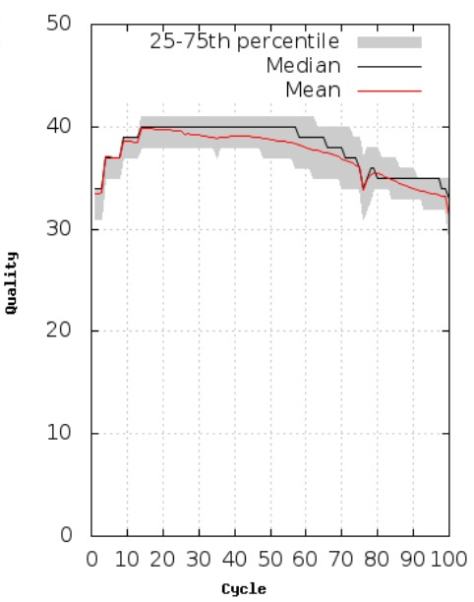
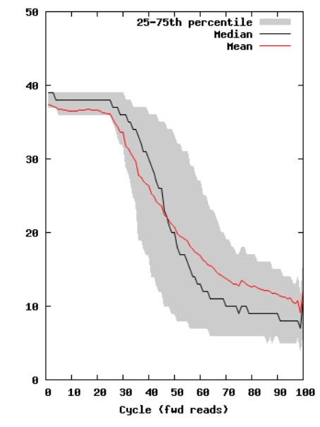
Base quality

Slide 34

Base quality

Slide 35
Library prep biases: PCR duplicates
Experiments start with small amounts of DNA
A PCR amplification step is necessary for Illumina sequencing: one molecule -> many identical molecules
Problem:
Additional PCR copy molecules are not informative
Solution:
Infer and mark PCR duplicates, discount in later analysis
Mark if reads and their mates start at the same position
Use Picard MarkDuplicates or samtools markdup
Typical duplication rates: Exomes 15-20%, Genomes < 5%

Slide 36
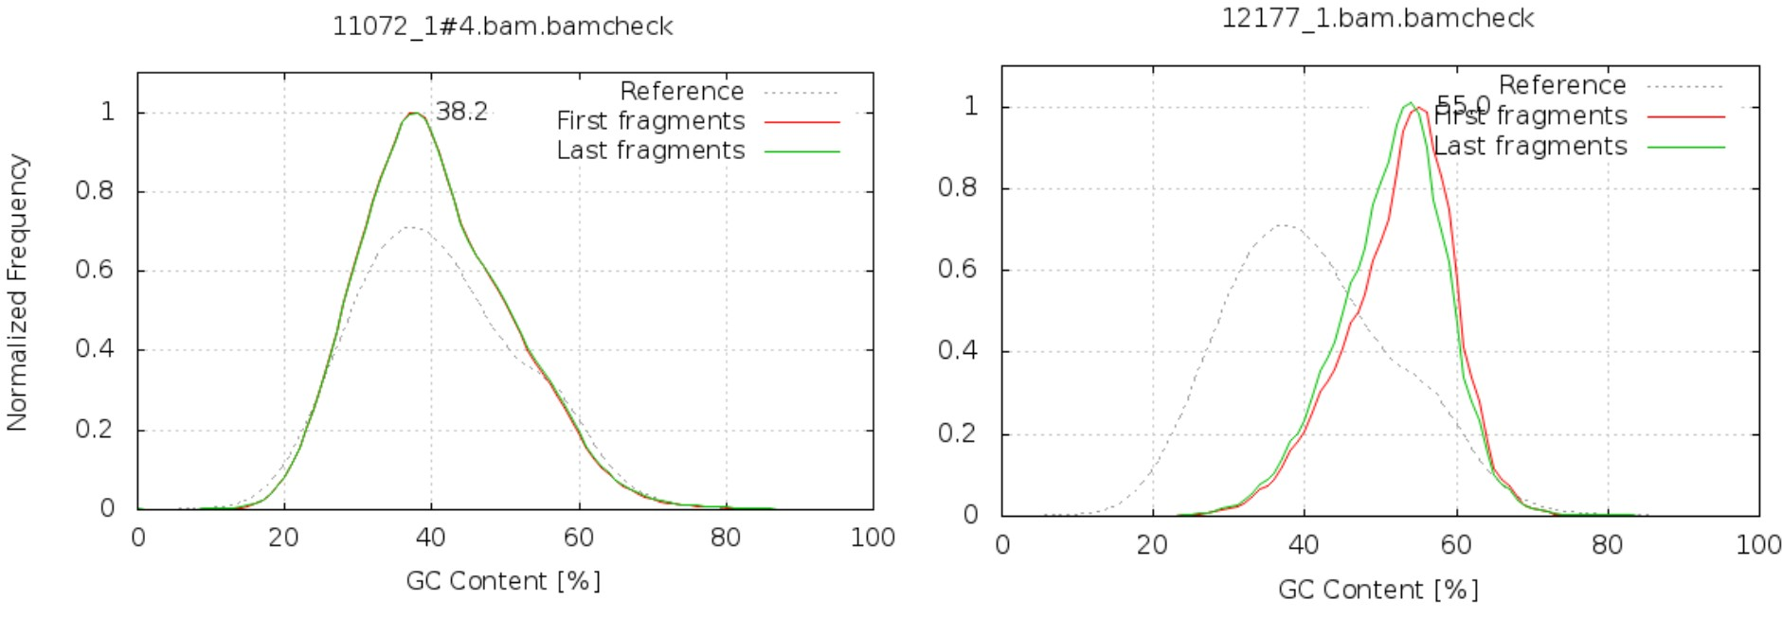
GC bias
GC- and AT-rich regions are more difficult to amplify
compare the GC content against the expected distribution (reference sequence)

Slide 37
GC bias
GC- and AT-rich regions are more difficult to amplify
compare the GC content against the expected distribution (reference sequence)
Notes:
Targeted sequencing where things may be different from the reference genome

Slide 38
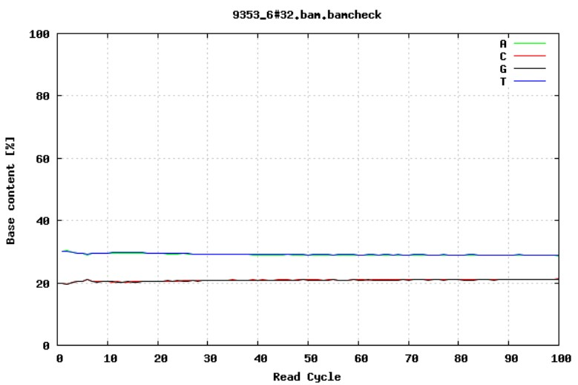
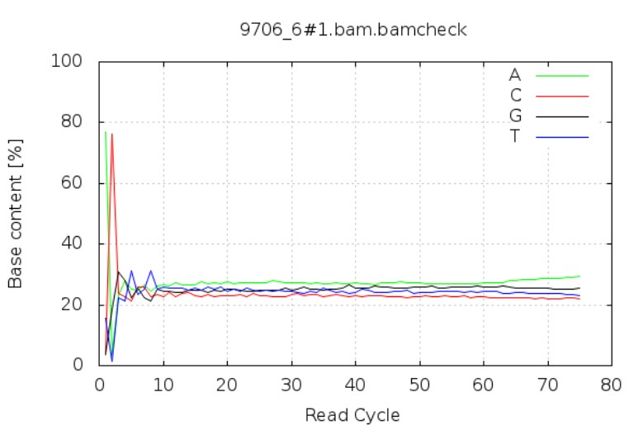
GC content by cycle
Was the adapter sequence trimmed?

Slide 39
GC content by cycle
Was the adapter sequence trimmed?

Slide 40
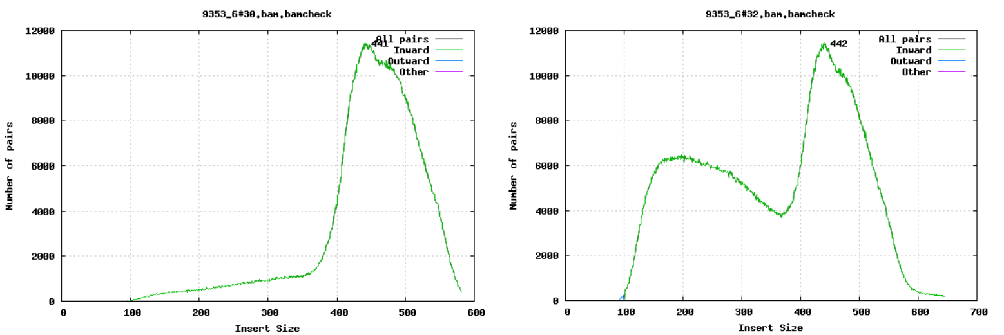
Fragment size
Paired-end sequencing: the size of DNA fragments matters
Notes:
Insert size includes the reads
Fragment size includes adapters

Slide 41
Fragment size
Paired-end sequencing: the size of DNA fragments matters

Slide 42
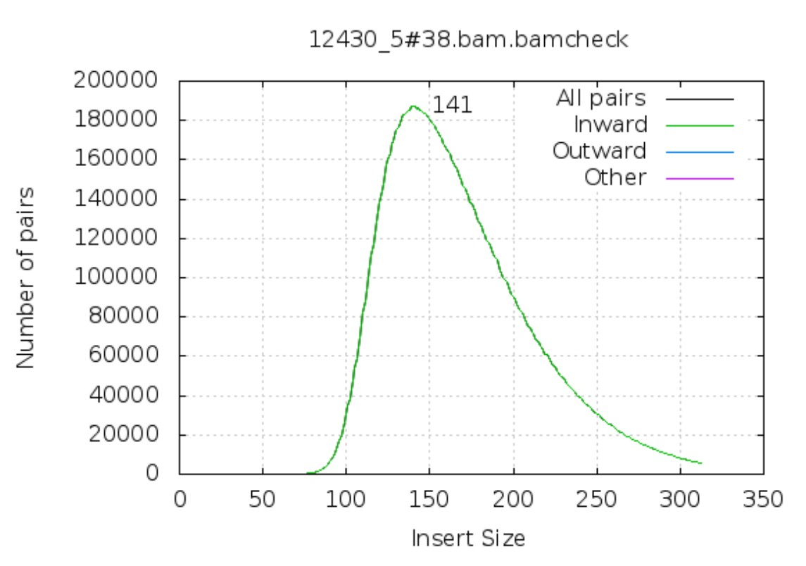
Quiz
This is 100bp paired-end sequencing. Can you spot any problems??

Slide 43
Quiz
This is 100bp paired-end sequencing. Can you spot any problems??
The insert size should be at least 200bp for the mates not to overlap.

Slide 44
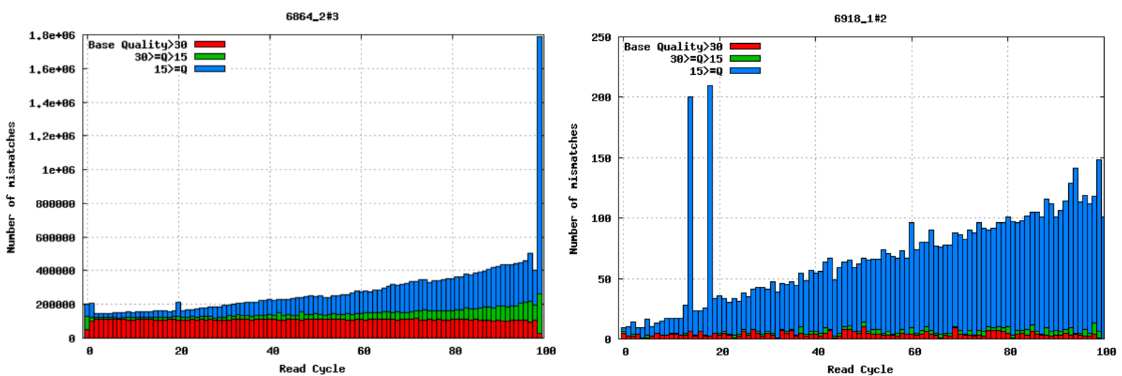
Mismatches per cycle
Mismatches in aligned reads (requires reference sequence)
detect cycle-specific errors
Base qualities are informative!
Notes:
Base qualities are informative
Take all reads, map them onto the genome, and ask, how many mismatches per position of the reads are there?
All mismatches in theory should be real variation, and should exist regardless of read quality. Variant callers take this into account

Slide 45
Mismatches per cycle
Mismatches in aligned reads (requires reference sequence)
detect cycle-specific errors
Base qualities are informative!
Notes:
Base qualities are informative
Take all reads, map them onto the genome, and ask, how many mismatches per position of the reads are there?
All mismatches in theory should be real variation, and should exist regardless of read quality. Variant callers take this into account
Mismtaches should be equally distributed in read position, which you can see in red

Slide 46
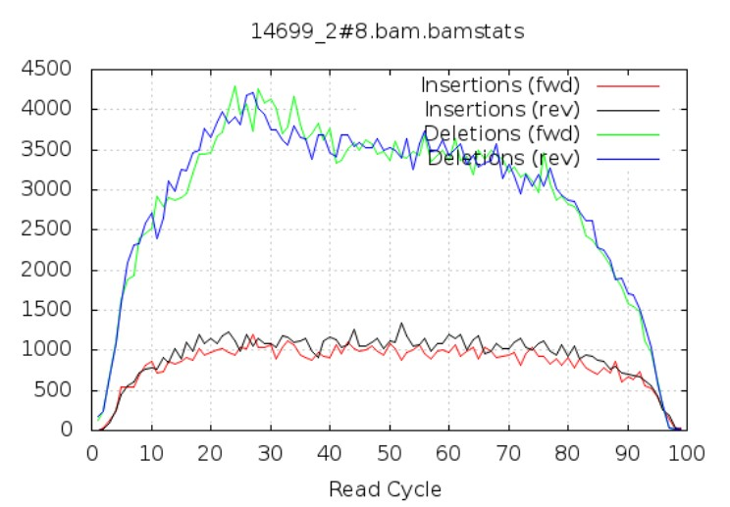
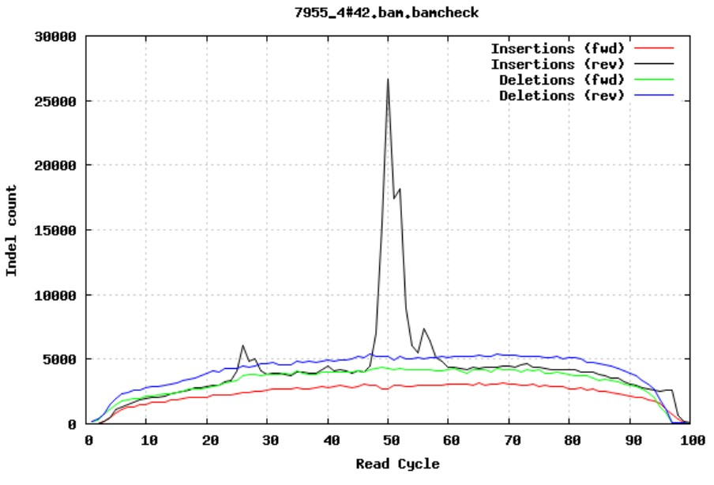
Insertions /Deletions per cycle
False indels
air bubbles in the flow cell can manifest as false indels
Notes:
Similar to he previous one, but we look at indels, how many indels do we detect by cycle?

Slide 47
Insertions /Deletions per cycle
False indels
air bubbles in the flow cell can manifest as false indels
Notes:
Similar to he previous one, but we look at indels, how many indels do we detect by cycle?
How can the spike happens? A proportion of the sequencing was affected by air bubbles in the flowcell, which prevents the reading of the sequencing, and it can read something else

Slide 48
Auto QC tests
A suggestion for human data:
Minimum number of mapped bases | 90%
Maximum error rate | 0.02%
Maximum number of duplicate reads | 5%
Minimum number of mapped reads which are properly paired | 80%
Maximum number of duplicated bases due to overlapping read pairs | 4%
Maximum in/del ratio | 0.82
Minimum in/del ratio | 0.68
Maximum indels per cycle, factor above median | 8
Minimum number of reads within 25% of the main peak | 80%
Read pairs within 25% of the main peak
Number of read pairs
1.25x
x Insert Size
Notes:
Some suggestions if you have a few lanes of sequencing lanes you can eyeball and see it’s ok – but if you have loads of data you need a program to decide for you

Slide 49
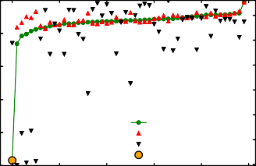
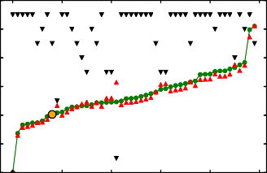
Detecting sample swaps
Check the identity against a known set of variants
_{1.0} 1e4 1e3 ₆ 1e2
40
2.45
5
0.8
38
Discordance
2.40
Number of sites
Discordance
Number of sites
0.6
4
36
2.35
2.30
3
34
0.4
2
Discordance (total) Discordance (avg per site) Number of sites
Tested sample
2.25
32
0.2
2.20
1
30
0.0
0
10
20 30
Sample ID
40
50
2.15
0
0
10
20 30
Sample ID
40
50
28
Notes:
Greatest source of errors can be sample swaps
In large sequencing projects you first will genotype all samples that come in, then sequence the data many months later, then you compare the expected genotypes and each sample should match to itself, otherwise, it indicates that there may be a sample swap.

Slide 50
Software
Software used to produce graphs in these slides
samtools stats and plot-bamstats
bcftools gtcheck
matplotlib

Slide 51
Exercise time!
Open your VM
Open a terminal window.
Go to the Module 1 folder:
cd /home/manager/Module_1
Open the exercises, which are in the GitHub
Data formats and QC
Follow the instructions!

Slide 52
Exercise time!
Solutions will be shared through Slack!

