Slide 1
Issue
The elderly are not always treated with the best care
In particular, if they are wheelchair-bound and are in one position for too long, they can develop pressure ulcers which are painful and expensive to treat

Slide 2
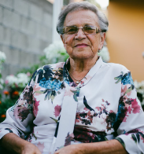

Common Story
June
Gertrude
Works a full time job
Primary caretaker for her mom
Promised her mom she would never put her in a nursing home
Worries about her mom at home alone when she is at work
82 years old
Lives at home with her daughter
Alzheimer's disease
Increasingly frail
Loss of mobility
Wheelchair bound

Slide 3


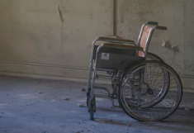
Common Story
June notices her mom getting more confused and can't get up anymore. Hires a care giver for during the day when no one else is around
However, it becomes clear the care giver is neglecting her mom. Within a few months, Gertrude develops a painful and dangerous pressure ulcer
Gertrude now requires frequent nurse visits, wound care clinic appointments, and requires a wound vac. When it doesn't heal, she is admitted to a nursing home

Slide 4
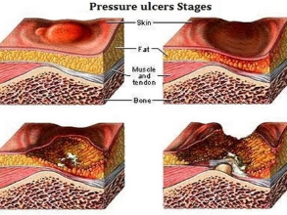
Pressure Ulcers
Injuries to skin and underlying tissue resulting from prolonged pressure on the skin

Slide 5
Pressure Ulcers
HARMFUL
60,000 deaths / year from pressure ulcers
2.5 million patients with pressure ulcers / year
Severe pain, infection, temporary or permanent disability
PREVENTABLE
1 in 10 Americans aged 60+ have experienced elder abuse
Pressure ulcers arise from passive neglect
Mobility and mental impairments increase risk
COSTLY
$9.1 to $11.6 billion / year in the US
$20,900 to $151,700 / pressure ulcer
17,000 lawsuits / year

Slide 6
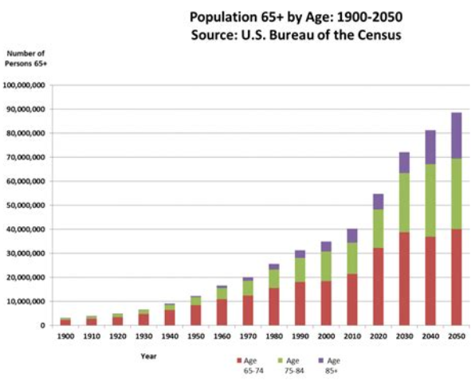
Trends
By 2050, one-fifth of the U.S. population will be age 65 or older
Per the US Census Bureau, in 2017 an estimated 22.6% of seniors 65+ faced ambulatory difficulty. Below is estimated % with ambulatory difficulty by age:
Population 65 years and over | 22.6%
Population 65 to 74 years | 15.5%
Population 75 years and over | 32.6%

Slide 7
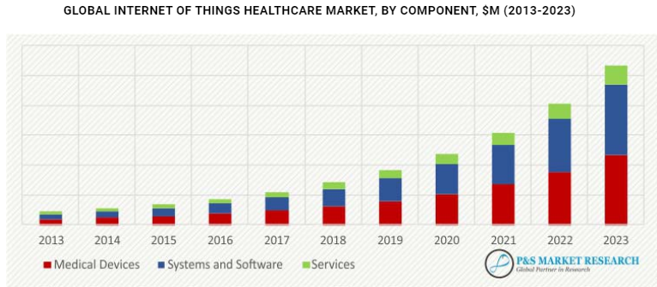
Trends
Global wheelchair and components market expected to reach $7.5B by 2026, a CAGR of 3.5% over 2016-2026
Increasing use of sensors, motor control software, wireless devices, and other technologies in wheelchairs
Global IoT healthcare market expected growth:

Slide 8
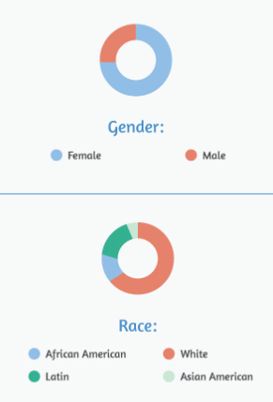
Family Caregivers
.
Family caregivers provide 90% of long-term care in the U.S.
~57% feel don’t have choice in performing provider or clinical tasks
Many do not have formal training
High risk for financial difficulties
Average age about 49 years old
17.7M Americans care for a family member with a significant impairment at age 65+

Slide 9
Our Solution
We have a solution that
can prevent pressure ulcers from occurring
relieves stress for families and family caregivers
helps save patients from a potential costly medical bill

Slide 10
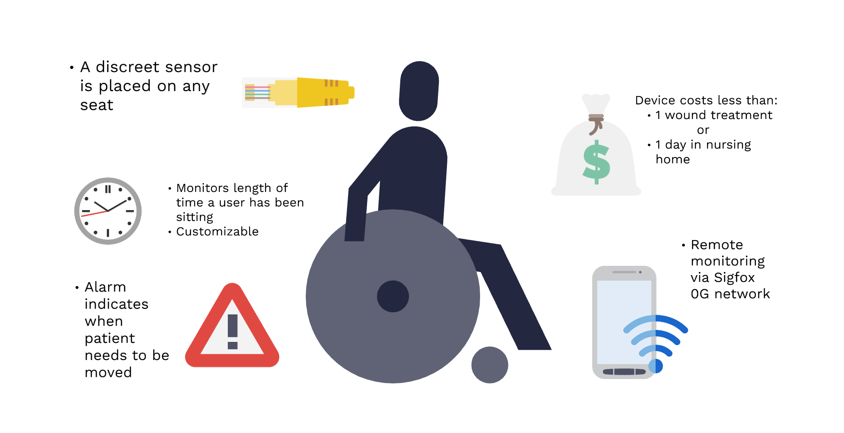

Slide 11
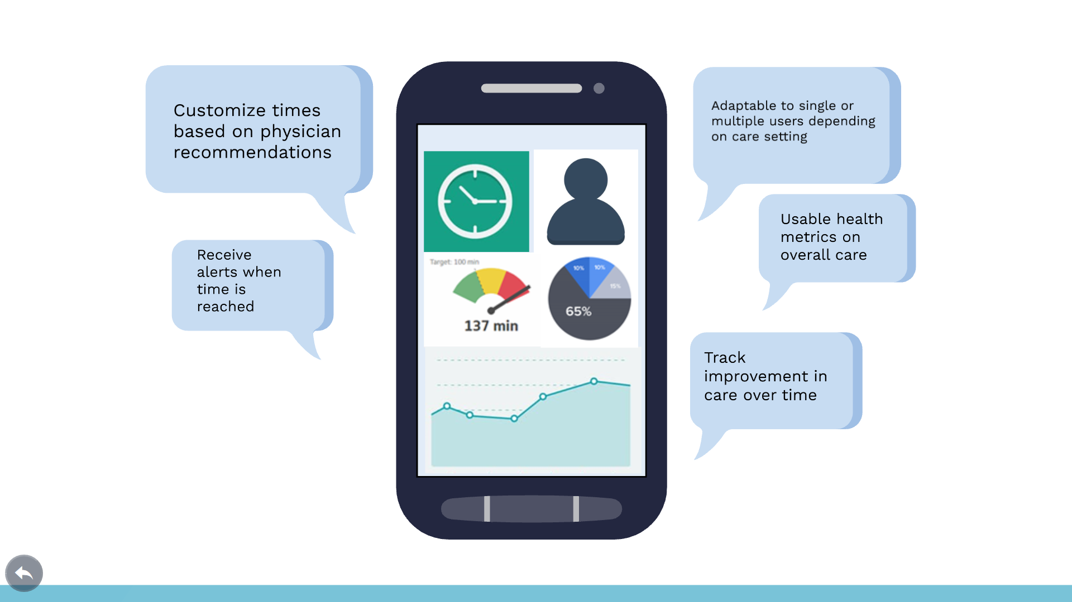
App Design

Slide 12

We are here to help give peace of mind to families and ensure our elders get the care they deserve
Rob Seaberg: searobea@gmail.com
Winnie Wu: wcwc789@gmail.com

